Slide 1
ERCOT Technology Working Group (TWG)
February 22, 2024

Slide 2
ERCOT TWG
WELCOME

Slide 3
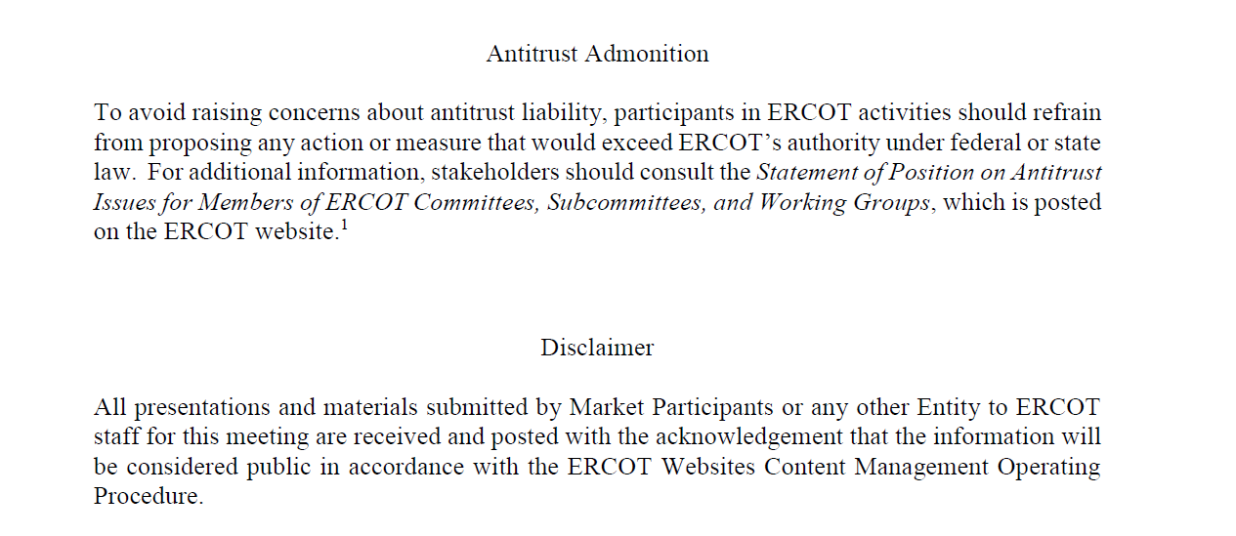
ERCOT TWG

Slide 4
ERCOT TWG Agenda
Item # | Item Description | Presenter
1 | Antitrust admonition | Sreenivas Badri
2 | TWG Charter Review | Sreenivas Badri/TWG
3 | Vice-Chair nomination/Selection | Sreenivas Badri
4 | Project Updates | Troy Anderson
5 | RTC+B Updates | Matt Mereness
6 | RTC+B - QSE Technical Survey | Sreenivas Badri
7 | NERC Update – EMSWG | Wei Qiu
8 | Public API Updates | Omar Soberanis
9 | Developer Portal Soft launch | Brandon Johnson
10 | Secure API Roadmap | Brian Brandaw
11 | NPRR1132 (Operating Temperature Limits) - RIOO changes | Ashwini Krishna/Stephen Solis
12 | NPRR1186 Update | Nitika Mago/Sreenivas Badri
13 | Other Projects/Initiatives update.
 | Mobile App redesign – Q2 2024 Release | Priyanka Parthasarathy
 | ERCOT MMS Migration to Linux | Katherine Li
 | NERC Project 2015-09 Update | Sreenivas Badri
14 | Future Topics of Interest | Sreenivas Badri
15 | Adjourn | Sreenivas Badri

Slide 5
ERCOT TWG – Charter Review
TWG draft charter is posted in TWG main page https://www.ercot.com/committees/other/twg
Review and provide the feedback

Slide 6
ERCOT TWG : Vice-Chair
Nomination/Selection

Slide 7
Project Updates
Project Updates – Troy Anderson

Slide 8
RTC+B Updates
RTC+B Updates – Matt Mereness

Slide 9
RTC+B – QSE Technical Survey
RTC+B – QSE Technical Survey – Sreenivas Badri

Slide 10
NERC EMSWG Update
NERC EMSWG Update – Wei Qiu

Slide 11
Public API Updates, Developer Portal, Secure API Roadmap
Public API Updates – Omar Soberanis
Developer Portal Soft launch – Brandon Johnson
Secure API Roadmap – Brian Brandaw

Slide 12
NPRR1132 (Operating Temperature Limits) - RIOO changes
NPRR1132 (Operating Temperature Limits) - RIOO changes – Ashwini Krishna/Stephen Solis

Slide 13
NPRR1186 Update
NPRR1186 Update – Nitika Mago/Sreenivas Badri

Slide 14
Other Projects/Initiatives Update
Mobile App redesign – Priyanka Parthasarathy
ERCOT MMS Migration to Linux – Katherine Li
NERC Project 2015-09 Update – Sreenivas Badri

Slide 15
ERCOT TWG – Open Forum
Future Topics of Interest
Topics and presentations from TWG members

Slide 16
ERCOT TWG
Thank You
You can reach me at
Sreenivas.Badri@ercot.com

