Slide 1
Public API GA Release
Presented by: Omar Soberanis
Date: 2/22/2024

Slide 2
ERCOT Public API Updates
Release Functionality
Important Notices
Release
Demo

Slide 3
Beta Release Functionality
Data Portal http://data.ercot.com | API Gateway http://api.ercot.com | API Explorer http://apiexplorer.ercot.com
List of Data Reports | Access to all data reports through the APIs | API documentation/specs
Near real-time current reports | API versioning | API testing
Historical report downloads | RESTFUL API using OpenAPI specification | Scripting suggestions
Report Search | Stateless client-server communication
Data Navigation | Secure – TLS encryption as data is transfer
 | Rate Limiting

Slide 4
GA Release Functionality
Data Portal https://data.ercot.com | API Gateway https://api.ercot.com | API Explorer http://apiexplorer.ercot.com | Developer Portal https://developer.ercot.com
Authentication | Token Authentication | Authentication | Open API Specifications
Data filter on real-time: Date time picker Data Type |  |  | Token Authentication Documentation
Sorting |  |  | Developer Forums
Data Downloads
More historical files

Slide 5
Important Notices
Reports
  There approximately 10 million archival public reports, most of the documents are now transferred.
  Near-real time reports were activated on December 11^{th.}
  Data filters are now in the Data Portal.
  Download features are now in the Data Portal.
  Defect: LMP has some performance issue.
Data Portal
  Authentication via Azure B2C
API Gateway/API Explorer
  Authentication via Azure B2C
Developer Portal
  Still in Beta, more information will be coming soon

Slide 6
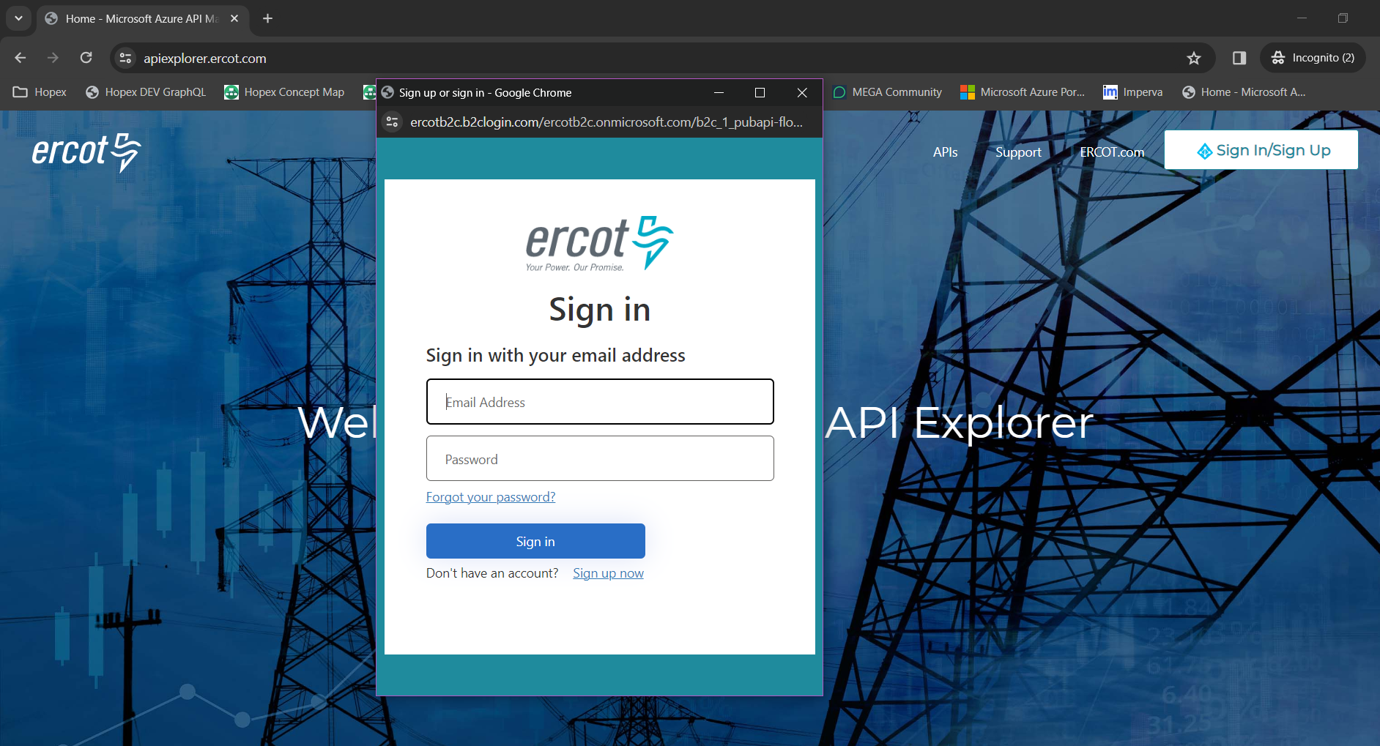
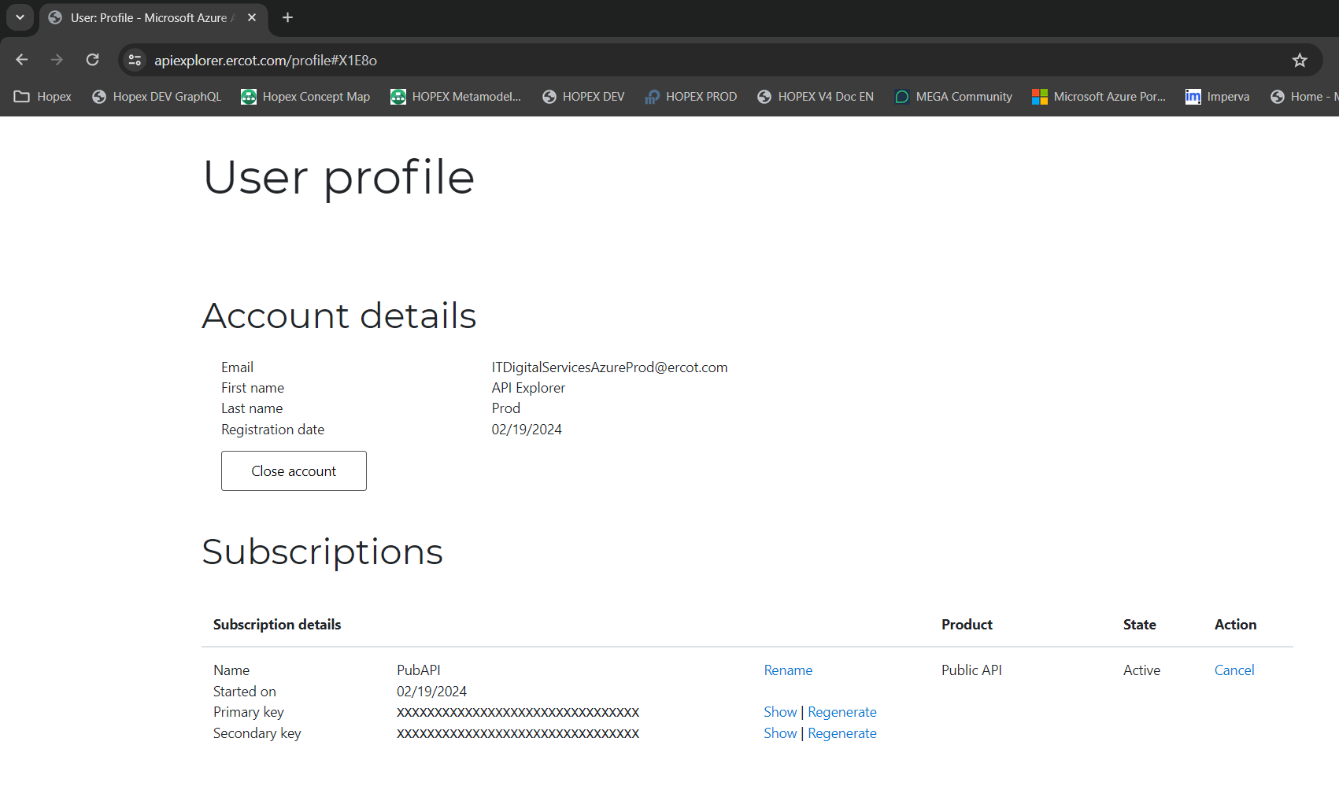
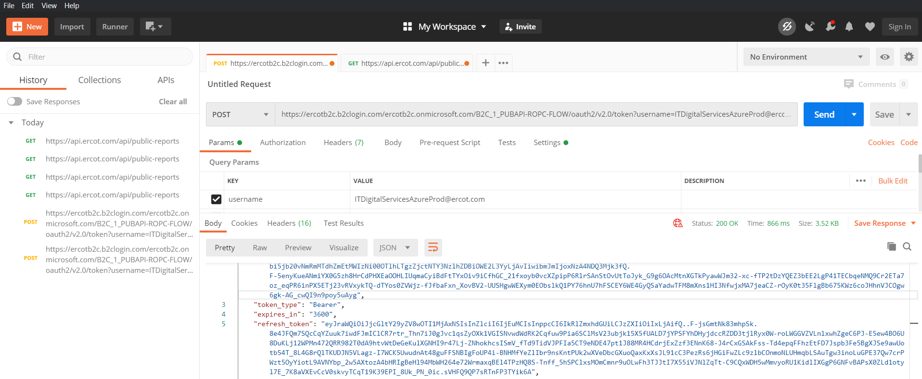
Demo

Slide 7

Q&A

