Slide 1
NPRR1132 (Operating Temperature Limits) - RIOO changes
Ashwini Krishna/Stephen Solis
February 22, 2024

Slide 2
NPRR1132 Operating Temperature Limits - RIOO
NPRR1132
Requires each Resource Entity to provide Resource-specific cold weather minimum temperature limits, hot weather maximum temperature limits, and alternate fuel capability information in its Resource Registration data.
RIOO Release Timelines
Hot and Cold Operating Temperature limits change is targeted to go live on 02/21/2024 (R2 release).
Alternate Fuel is targeted to go live with the ERCOT R3 release schedule (end of March 2024).
Expectations of RE Users
After the go live of NPRR1132, a Market notice will be sent out as a reminder on March 1st and September 1st every year for the Market participants to enter their seasonal data.
During their compliance period RE Users will need to create an RSCR in RIOO application to submit their seasonal data.

Slide 3
NPRR1132 Operating Temperature Limits - RIOO
RE Users can do interim updates of their seasonal data at any time of the year, Users are not required to submit their historical data until one hot/cold season is completed since the time of synchronization else Users are required to re-verify their data during the compliance period.
If there are NO changes to the seasonal data, User can just select the “All entered temperature values are unchanged” checkbox for each Unit in RIOO application and submit an RSCR.

Slide 4
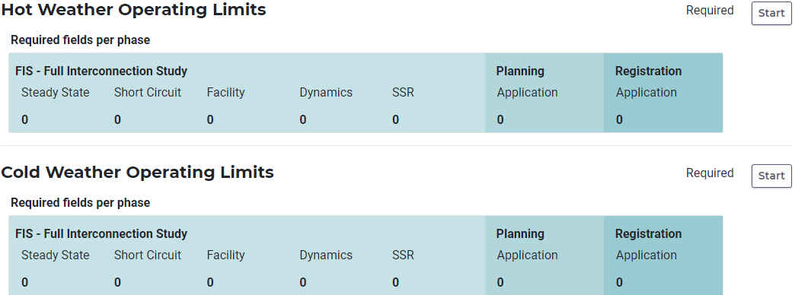
NPRR1132 Operating Temperature Limits - RIOO
Expectations of Users at the time of Interconnection
IE/RE user is required to enter hot and cold panels data only during the full registration phase.
Alternate fuel data is required during full registration phase as well but only for Conventional Gen and Combined Cycle projects.

Slide 5
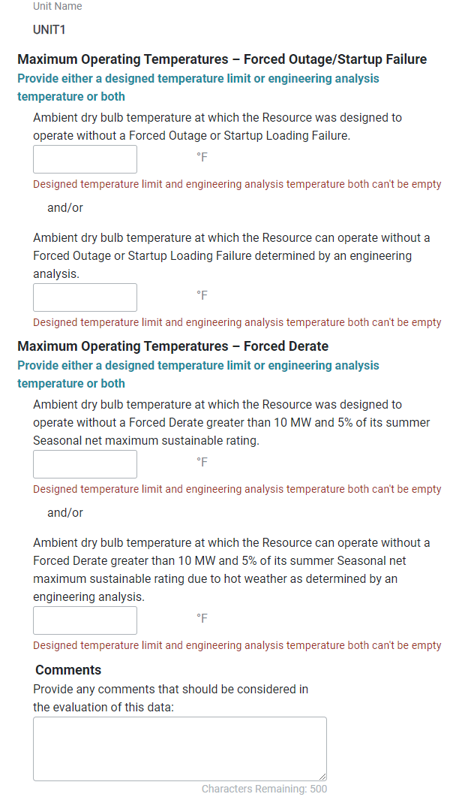
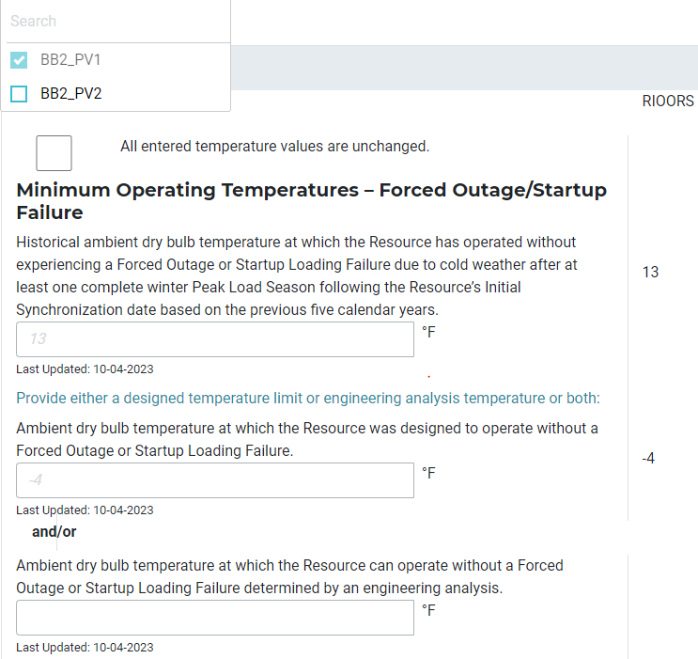
NPRR1132 Operating Temperature Limits - RIOO
RIOO Application Hot/Cold Operating Temperature Limits panels

