Slide 1
ERCOT Mobile App and Web Redesign
February 22, 2024

Slide 2
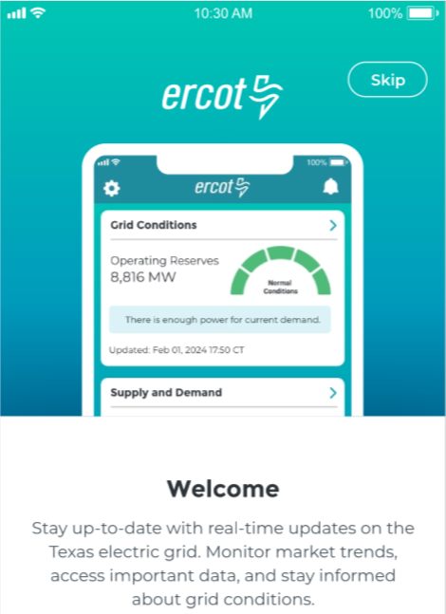
Mobile App and Website Redesign
Mobile App is projected to be in stores by Q2 2024.
Current version has been analyzed for multiple enhancements.
Goal is to provide clear and understandable alerts, grid condition data, and market information for various audiences.
Website redesign research is underway.
Track project status at ERCOT Mobile App & Website Redesign.
Please send feedback to userexperience@ercot.com.

