Slide 1
RTC+B Task Force
Update
Matt Mereness
RTCBTF
February 21, 2024

Slide 2
Outline
Brief Program update: RTC+B Program Update from Feb Board T&S
Reminder of RTCBTF Review Cycle (no change)
Review of Issues List
  Historical PUC direction on AS Demand Curves and AS Offer Caps
  Emergency Pricing approach (NPRR1216)
Today’s topics relate to Issues List:
  RTCBTF Issue 18 - AS Demand Curves
    (ERCOT to provide some initial analysis)
  RTCBTF Issue 10 - Draft Notice- QSE Technical Survey
    (ERCOT will discuss a market notice for technical engagement)
  RTCBTF Issue 17 - RUC Capacity Short
    (ERCOT will lead significant discussion of settlement calculations for RUC charges for QSE short positions)
Multiple requests to complete by 1pm today

Slide 3
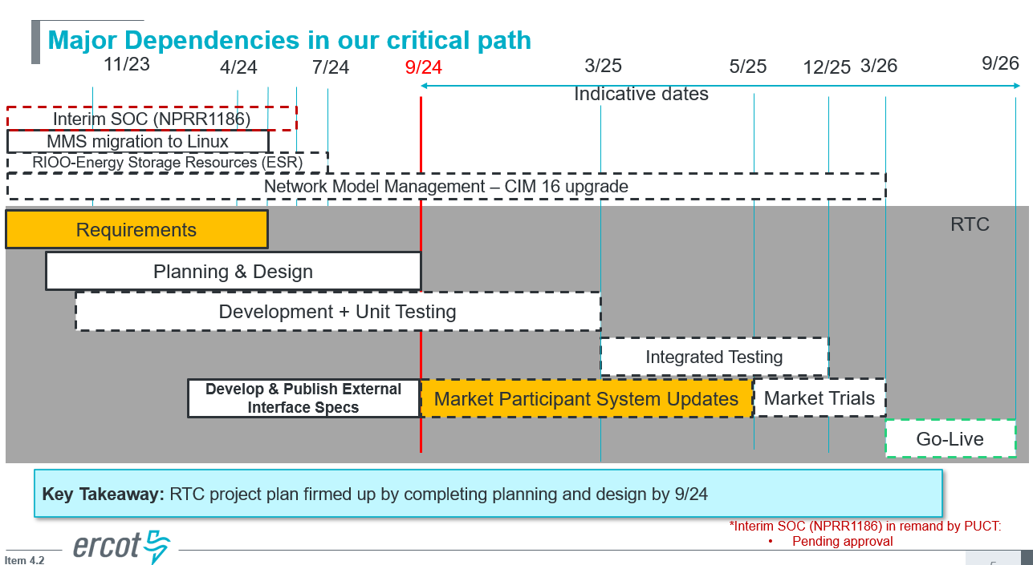
RTC+B Program Update
(excerpt from Feb Board T&S RTC Update)

Slide 4
Plans for Meetings and Review Cycles
Reminder of RTC+B Program Scope
  RTC Key Principles were approved to lay foundation of NPRR1007-1013
    Consolidated Key Principles: https://www.ercot.com/files/docs/2020/04/01/RTC_Key_Principle_Quick_Reference.docx
    Library of Key Principles: https://www.ercot.com/mktrules/puctDirectives/rtCoOptimization
  Battery Key Topic Concepts approved to lay foundation of NPRR1014
    https://www.ercot.com/mktrules/keypriorities/bes
  RTC State-of-Charge accounting in NPRR1204
Objective is to present concepts or issues that need to be resolved for an effective implementation.
  Coordinating timelines for interface requirements and testing,
  Providing the forum for any analysis or policy decisions (such as parameter values)
  Coordinating market readiness and cutover activities,
  Review draft Revision Requests or other artifacts necessary to successfully implement the program within the identified timeframes, and discussing other details as needed.
Lessons learned from RTCTF to avoid being delayed in decisions:
  Meeting #1: Initial concept presented by ERCOT staff
  Meeting #2: Comments and alternatives presented by MPs
  Meeting #3: RTCTF consensus achieved or escalated to TAC for a vote to decide the matter.

Slide 5
Current Issues List
As we review current issues list want to highlight:
  2019 PUCT Direction on certain types of items (AS Demand Curve, AS Offer Cap)
    https://interchange.puc.texas.gov/Documents/48540_60_1023555.PDF
    Changes to these areas of policy would be outside of this task force, where MPs could file a petition for a rulemaking or contested case.
  Discuss if/how to consider NPRR1216 Emergency Pricing at RTCBTF
Link to this month’s issues on today’s meeting page

Slide 6
Proceed with rest of meeting
Any questions before we start today’s topics?
  RTCBTF Issue 18 - AS Demand Curves
    (ERCOT to provide some initial analysis)
  RTCBTF Issue 10 - Draft Notice- QSE Technical Survey
    (ERCOT will discuss a market notice for technical engagement)
  RTCBTF Issue 17 - RUC Capacity Short
    (ERCOT will lead significant discussion of settlement calculations for RUC charges for QSE short positions)

