Slide 1
Credit Exposure Update
Market Credit Work Group
ERCOT Public
February 2024

Slide 2
Monthly Highlights December 2023 – January 2024
Market-wide average Total Potential Exposure (TPE) increased from $1.33 billion in December 2023 to $1.80 billion in January 2024.
  TPE increased due to both higher forward adjustment factors and real-time and day-ahead prices
    Discretionary Collateral is defined as Secured Collateral in excess of TPE,CRR Locked ACL and DAM Exposure
  Average Discretionary Collateral increased $4.13 billion in December 2023 to $5.57 billion in January 2024
ERCOT issued 71 collateral requests to 40 Counter-Parties due to futures prices increasing in anticipation of Winter Storm Heather. One trade-only entity defaulted on collateral requirements (no uplift to the market).

Slide 3
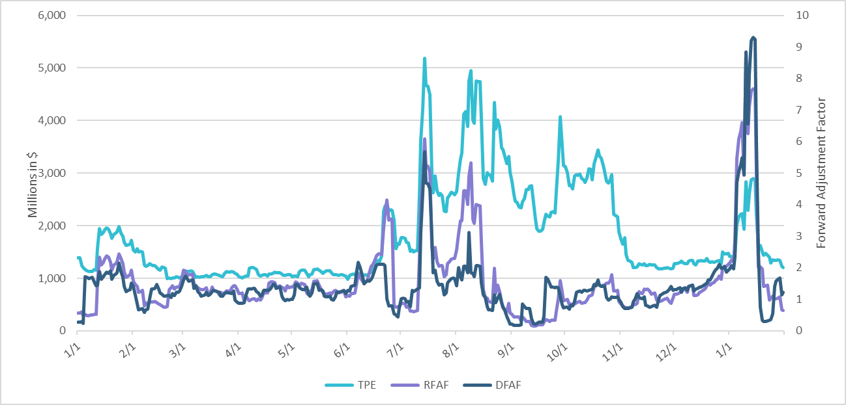
TPE and Forward Adjustment Factors January 2023 – January 2024
*TPE adjusted to exclude short pay entities eliminating data skew

Slide 4
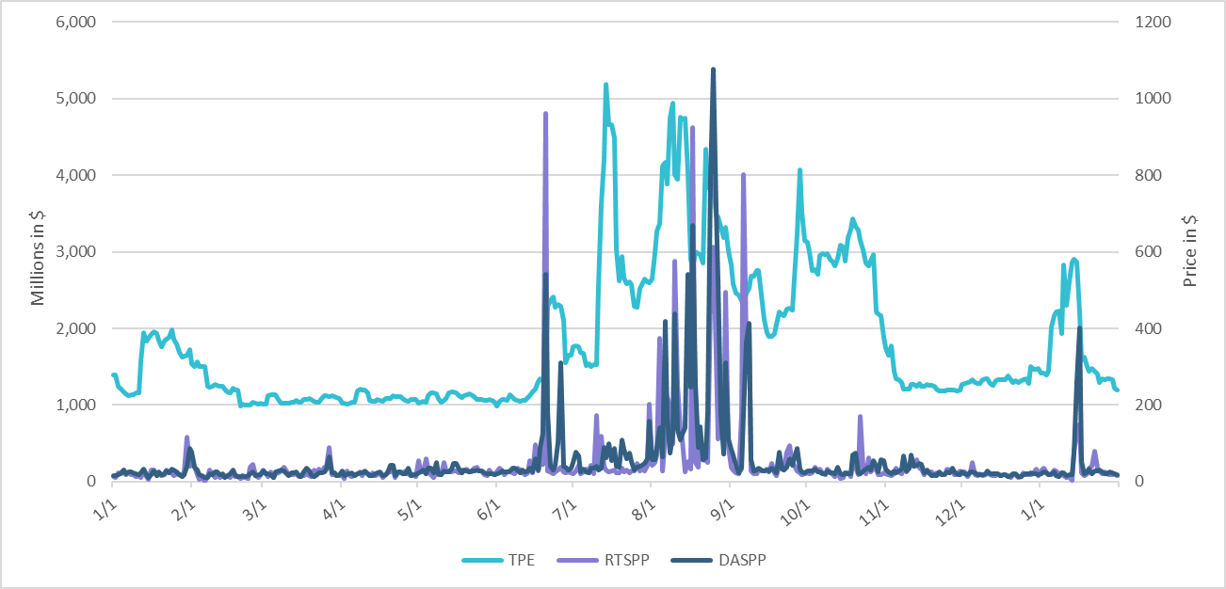
TPE/Real-Time & Day-Ahead Daily Average Settlement Point Prices for HB_NORTH January 2023 - January 2024
* TPE adjusted to exclude short pay entities eliminating data skew

Slide 5
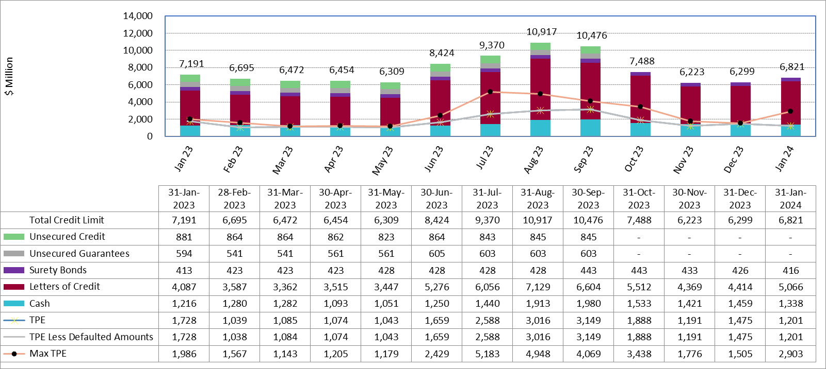
Available Credit by Type Compared to Total Potential Exposure (TPE)
Jan 2023 - Jan 2024
Numbers are as of month-end except for Max TPE
Max TPE is the highest TPE for the corresponding month
TPE less Defaulted Amounts: TPE – Short-Paid Invoices

Slide 6
Issuer Credit Limits vs Total LC Amounts Per Issuer
As of January 31, 2024
There are a total of 36 banks that have issued LCs.

Slide 7
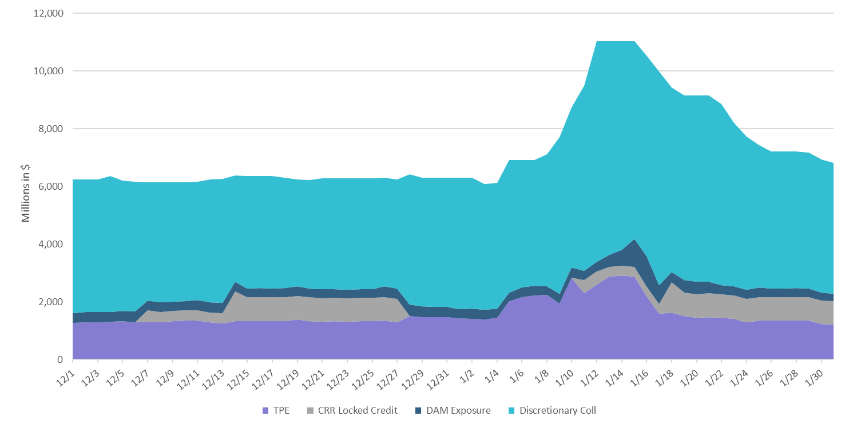
Discretionary Collateral December 2023 – January 2024
* Discretionary collateral doesn’t include Unsecured Credit Limit or parent guarantees
* TPE adjusted to exclude short pay entities eliminating data skew

Slide 8
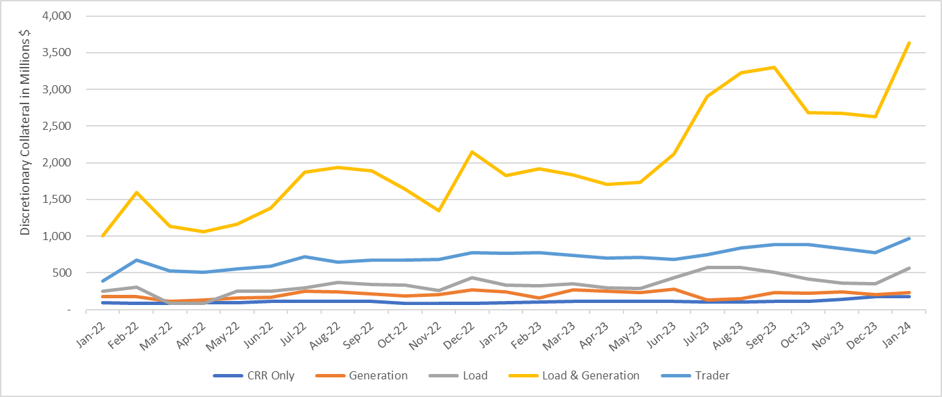
Discretionary Collateral by Market Segment January 2022 - January 2024
* Discretionary Collateral adjusted to exclude short pay amounts eliminating data skew

Slide 9
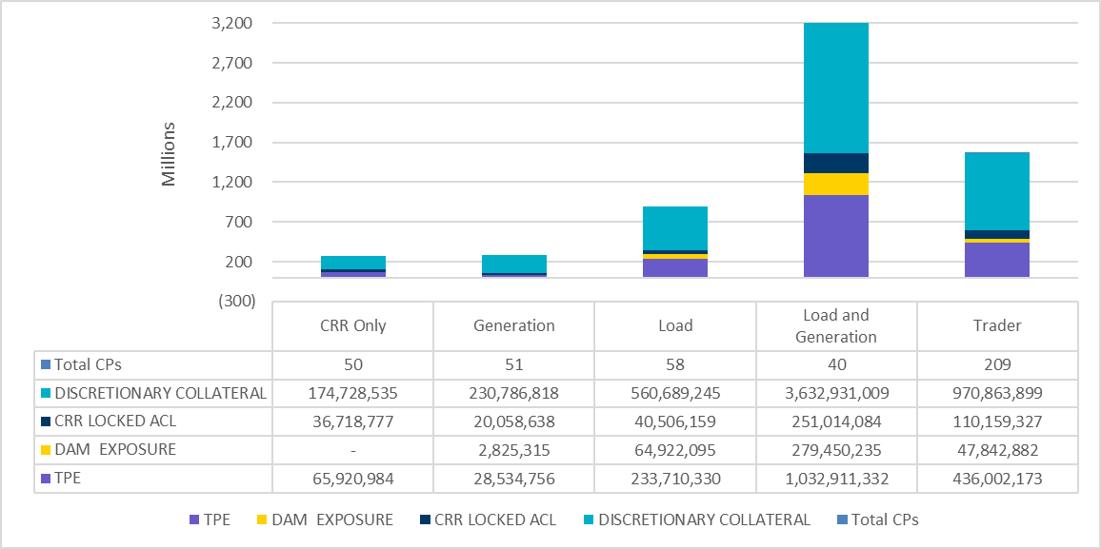
TPE and Discretionary Collateral by Market Segment - January 2024*
Load and Generation entities accounted for the largest portion of discretionary collateral
*Discretionary collateral doesn’t include Unsecured Credit Limit or parent guarantees
* TPE adjusted to exclude short pay amounts eliminating data skew

Slide 10
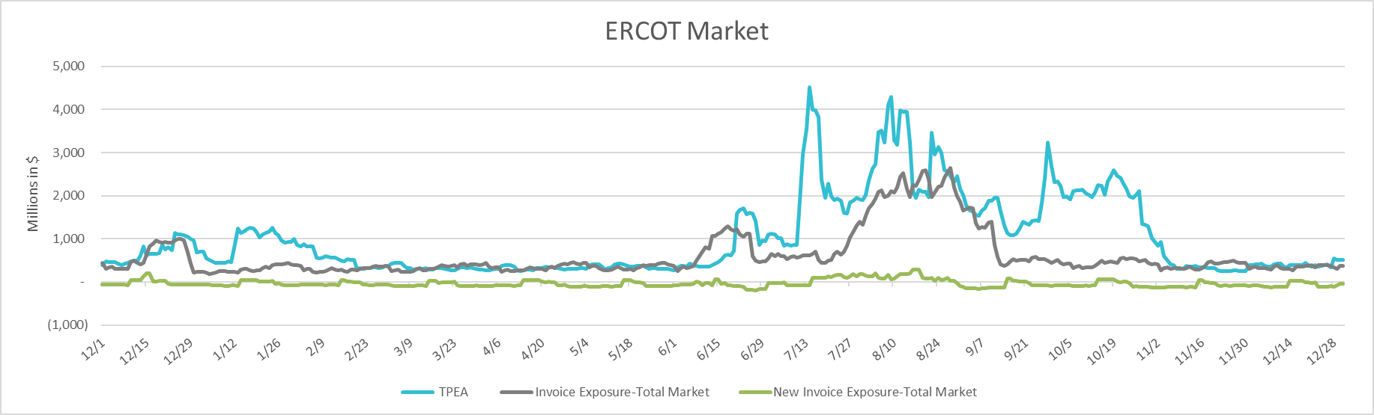
TPEA Coverage of Settlements December 2022 - December 2023
Invoice Exposure | Historical | Future
Existing Invoice Exposure | RTLCNS + UDAA | M1 Days (including current day) Forward Charge Invoice Amounts
New Invoice Exposure | 7 Days Back Net Invoice Amounts (Charges & Credits) | M1 Days (including current day) Forward Net Invoice Amounts (Charges & Credits); Excluding: 1) Securitization Invoices; 2) CRR Auction Invoices; and 3) Subchapter N Funds Distribution Invoice
TPEA closely approximates actual/invoice exposure
TPEA adjusted to exclude short pay entities eliminating data skew

Slide 11
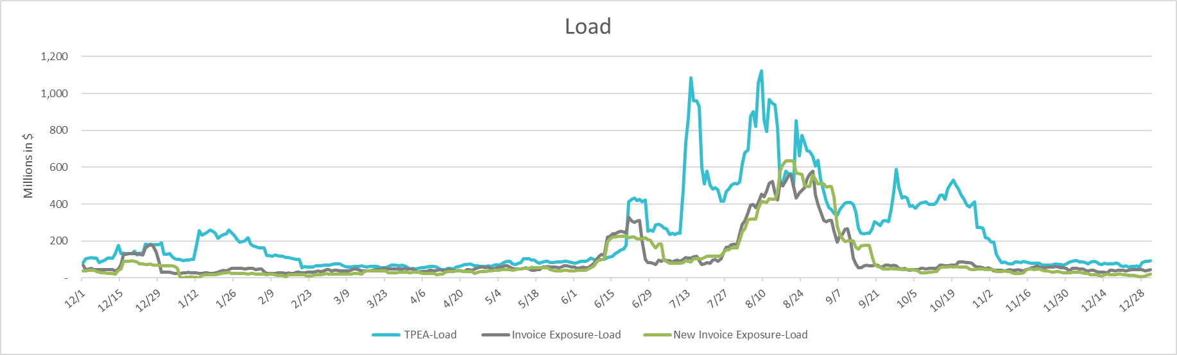
TPEA Coverage of Settlements December 2022 - December 2023
Invoice Exposure | Historical | Future
Existing Invoice Exposure | RTLCNS + UDAA | M1 Days (including current day) Forward Charge Invoice Amounts
New Invoice Exposure | 7 Days Back Net Invoice Amounts (Charges & Credits) | M1 Days (including current day) Forward Net Invoice Amounts (Charges & Credits); Excluding: 1) Securitization Invoices; 2) CRR Auction Invoices; 3) Subchapter N Funds Distribution Invoice
*TPEA exceeds invoice exposure
*TPEA adjusted to exclude short pay entities eliminating data skew

Slide 12
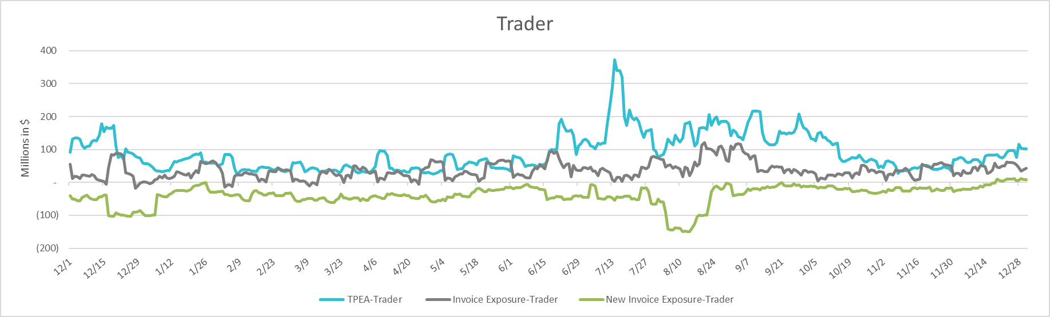
TPEA Coverage of Settlements December 2022 - December 2023
Invoice Exposure | Historical | Future
Existing Invoice Exposure | RTLCNS + UDAA | M1 Days (including current day) Forward Charge Invoice Amounts
New Invoice Exposure | 7 Days Back Net Invoice Amounts (Charges & Credits) | M1 Days (including current day) Forward Net Invoice Amounts (Charges & Credits); Excluding: 1) Securitization Invoices; 2) CRR Auction Invoices; 3) Subchapter N Funds Distribution Invoice
*TPEA generally exceeds invoice exposure

Slide 13
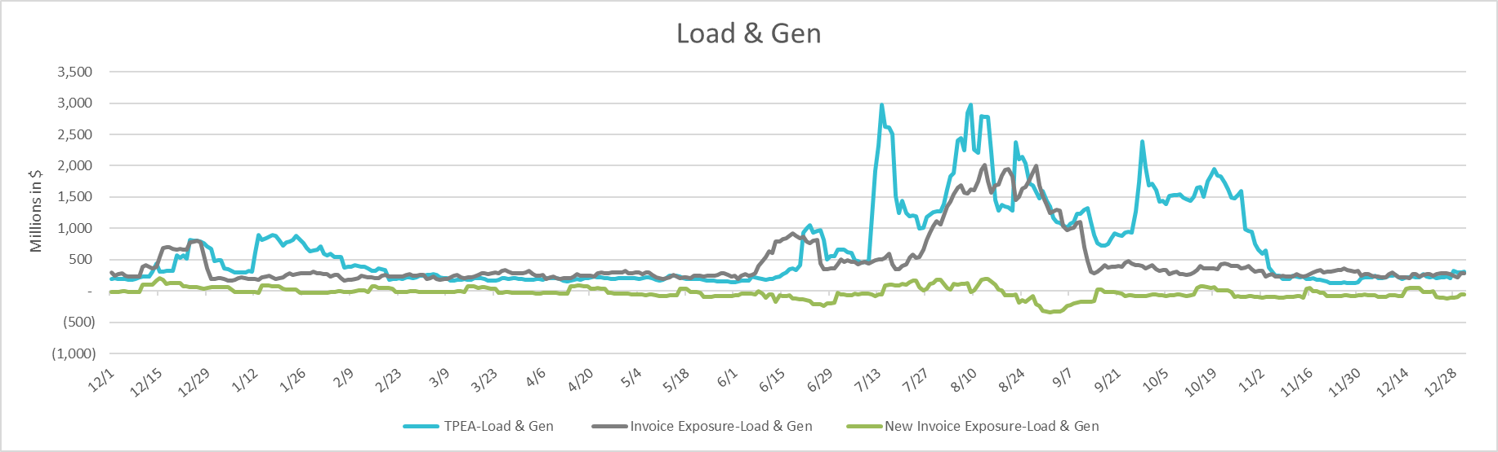
TPEA Coverage of Settlements December 2022 - December 2023
Invoice Exposure | Historical | Future
Existing Invoice Exposure | RTLCNS + UDAA | M1 Days (including current day) Forward Charge Invoice Amounts
New Invoice Exposure | 7 Days Back Net Invoice Amounts (Charges & Credits) | M1 Days (including current day) Forward Net Invoice Amounts (Charges & Credits); Excluding: 1) Securitization Invoices; 2) CRR Auction Invoices; 3) Subchapter N Funds Distribution Invoice
Invoice exposure generally exceeds TPEA
TPEA adjusted to exclude short pay entities eliminating data skew

Slide 14
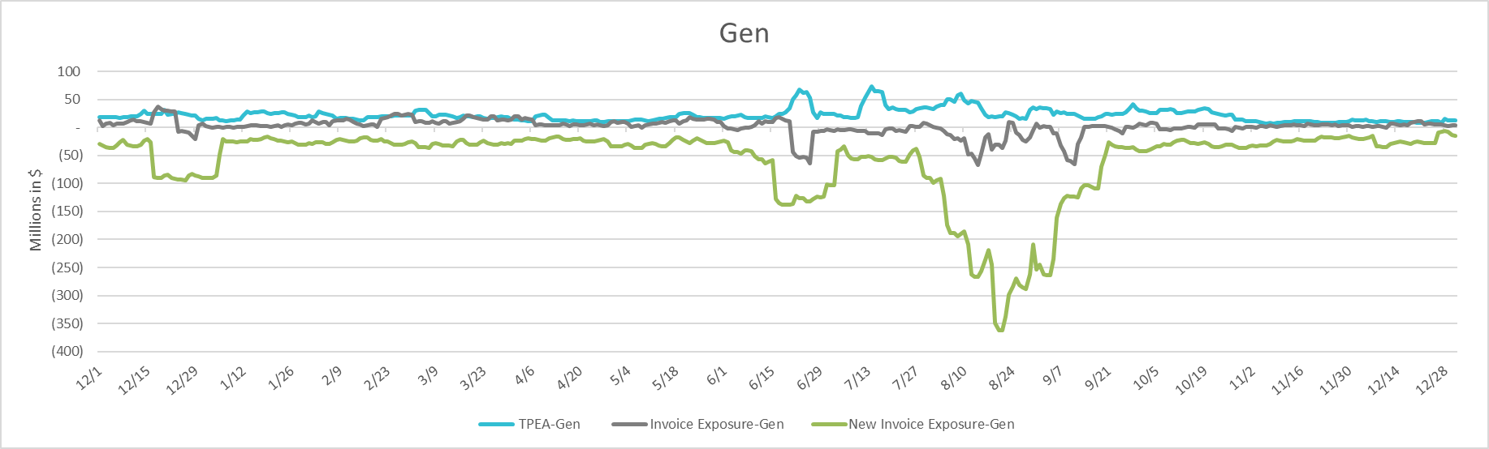
TPEA Coverage of Settlements December 2022 - December 2023
Invoice Exposure | Historical | Future
Existing Invoice Exposure | RTLCNS + UDAA | M1 Days (including current day) Forward Charge Invoice Amounts
New Invoice Exposure | 7 Days Back Net Invoice Amounts (Charges & Credits) | M1 Days (including current day) Forward Net Invoice Amounts (Charges & Credits); Excluding: 1) Securitization Invoices; 2) CRR Auction Invoices; 3) Subchapter N Funds Distribution Invoice
* TPEA generally exceeds Invoice exposure

Slide 15
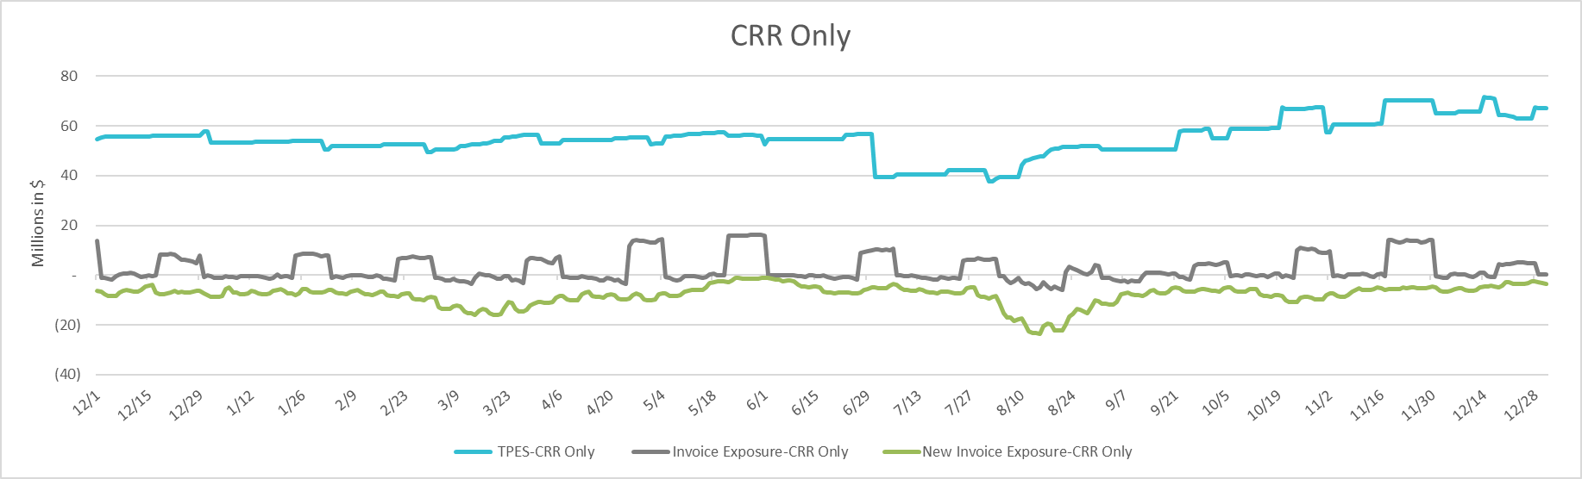
TPEA Coverage of Settlements December 2022 - December 2023
Invoice Exposure | Historical | Future
Existing Invoice Exposure | RTLCNS + UDAA | M1 Days (including current day) Forward Charge Invoice Amounts
New Invoice Exposure | 7 Days Back Net Invoice Amounts (Charges & Credits) | M1 Days (including current day) Forward Net Invoice Amounts (Charges & Credits); Excluding: 1) Securitization Invoices; 2) CRR Auction Invoices; 3) Subchapter N Funds Distribution Invoice
*TPES exceeds actual/invoice exposure

Slide 16
Questions

