Slide 1
EAL Change Proposals – Gap analysis
Sanchir Dashnyam
ERCOT Market Credit Manager
ERCOT Public
February 16, 2024

Slide 2
Invoice Exposures – Definitions
Invoice exposures – New
M1 days forward invoices + 7 days look back actual invoices
M1 days could range from 10 to 21 days depending on weekends/holidays, MP activity
Invoices exclude M&N securitization invoices, CRR auction invoices and miscellaneous invoices relating to $2B distributed to market for Sec N on 6/21/22
Data is for a period covering 1/1/2022 through 11/30/23
TPEA excludes Uri invoices and PUL uplift
TPEA – Invoice exposures = Gap
Negative gap is when invoice exposures exceed TPEA (less than -$10,000)
Positive gap is when TPEA exceeds invoice exposures (more than $10,000)

Slide 3
Current EAL Formula vs. Scenarios #1, #2 and #3
Current: EAL _{q} = Max [IEL during the first 40-day period only beginning on the date that the Counter-Party commences activity in ERCOT markets, RFAF * Max {RTLE during the previous lrq days}, RTLF] + DFAF * DALE + Max [RTLCNS, Max {URTA during the previous lrq days}] + OUT _{q} + ILE _{q}
Scenario #1: EAL t = Max [RFAF * Max { RTNLE during the previous lrt days}, FAF*RTNLF] + DFAF * DALE + Max [RTLCNS NLCD, Max {ULERTA during the previous lrq days}] + OUT t
NLE = Total net liability extrapolated (Last 14 days RTM Initial Statement Average + Last 14 days DAM Initial Statement Average based on RTM Initial OD)*M1. Use same RTM ODs for DAM as well
NLF = net liability forward = 1.5 * NLCD
NLCD = (7 most recent Operating days Real time estimates + 7 most recent DAM ODs day-ahead) if settled data is available use settled else estimates – no price cap
FAF = 21 future / most recent days 7 RTM Prices
ULE = unbilled liability extrapolated (Last 14 days RTM Initial Statement Average + Last 14 days DAM Initial Statement Average based on RTM Initial OD)*M2 - use same RTM ODs for DAM as well
Scenario #2: EAL q = Max [IEL during the first 40-day period only beginning on the date that the Counter-Party commences activity in ERCOT markets, Max{(RFAF * Max {RTLE) during the previous lrq days}, RTLF] + DFAF * DALE + Max [RTLCNS, Max {URTA during the previous lrq days}] + OUT q + ILE q
Scenario #3: EAL q = Max [IEL during the first 40-day period only beginning on the date that the Counter-Party commences activity in ERCOT markets, RFAF * Max {RTLE during the previous lrq days}, RTLF] + DFAF * DALE + Max [RTLCNS, Max {URTA during the previous lrq days}] + OUT q + ILE q
  Two RFAF’s: CP specific RFAF and Global RFAF
  CP specific RFAF = Projected Real-Time ICE Forward Average Price / Max RTLE date Historic Real-Time Settled Average Price
  Global RFAF is calculated based on existing methodology. Global RFAF is used in MCE calculations.

Slide 4
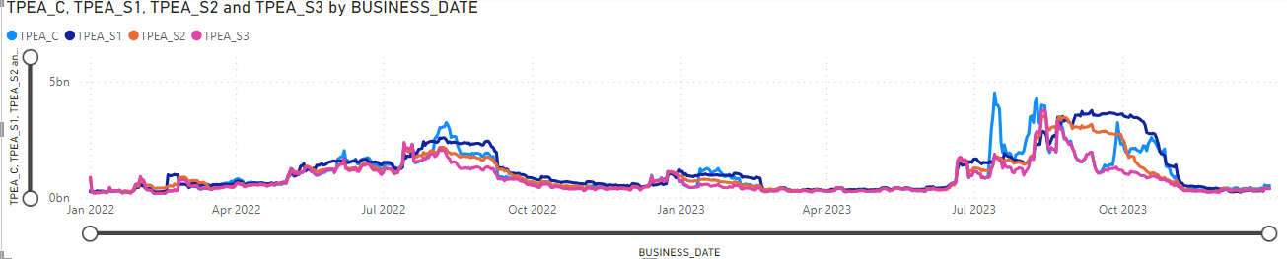
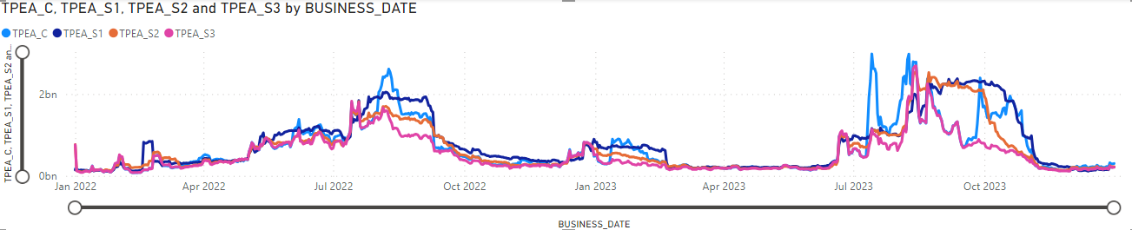
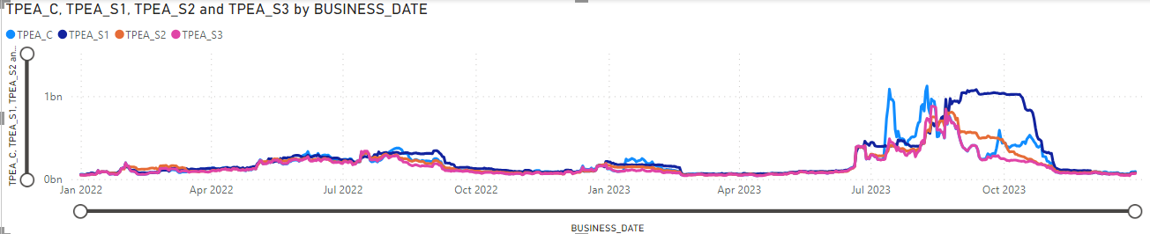
TPEA for Scenario#1,#2,#3 vs Current: Market, Load & Gen, Load

Slide 5
Negative and Positive Gaps: Market
Negative gaps – Scenario #1 lowers negative gaps the most while Scenario #3 increases negative gaps
Scenario #1 reduces negative gap occurrences by 25%, aggregate total negative gap amounts by 27% with the average negative gap amounts decreasing 2.5%.
Scenario #2 reduces negative gap occurrences by 4%, aggregate total negative gap amounts by 11% with the average negative gap amounts decreasing 8%.
Scenario #3 increases negative gap occurrences by 5.5%, aggregate total negative gap amounts by 17% with the average negative gap amount increasing by 11%.
Positive gaps – Scenario #3 will lower positive gaps the most while Scenario #1 will increase them
Scenario #1 increases positive gap occurrences by 1.4%, increases aggregate total positive gap amounts by 14% with the average positive gap amount increasing 12.3%.
Scenario #2 yields about the same positive gap occurrences as current, while decreases aggregate total positive gap amounts by 3.8% with the average positive gap amount decreasing by 4%.
Scenario #3 reduces positive gap occurrences by 0.5%, aggregate total positive gap amounts by 19% with the average positive gap amount decreasing 19%.
Scenario #1 increases cost to the market by 15% while Scenario #3 lowers the cost by 21% and Scenario #2 by 4%. Cost is estimated at 5% per annum, 365 days and is calculated on TPEA for each scenario.

Slide 6
Negative and Positive Gaps: Load & Gen, Load

Slide 7
Negative and Positive Gaps: Gen, Traders

Slide 8
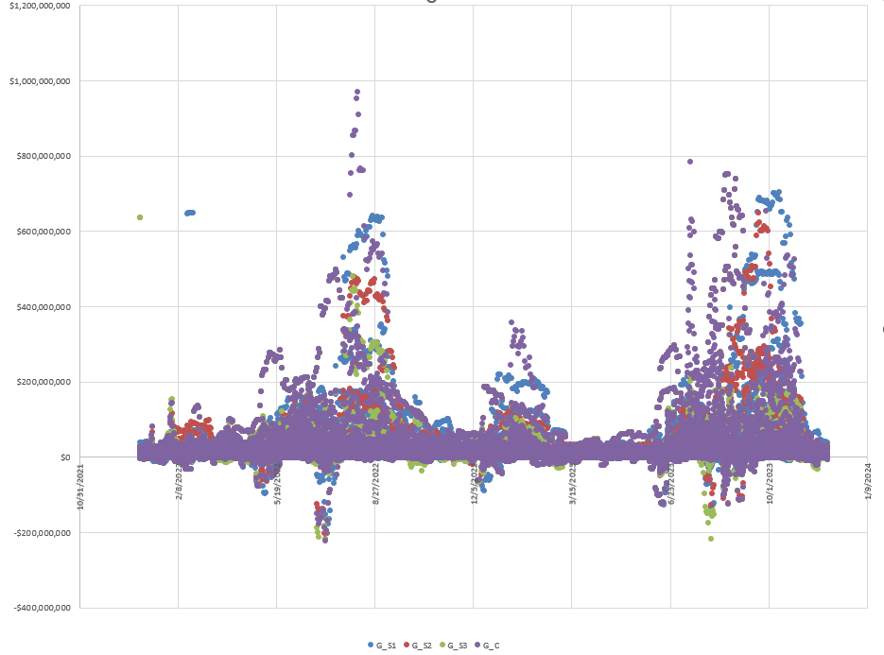
Market

Slide 9
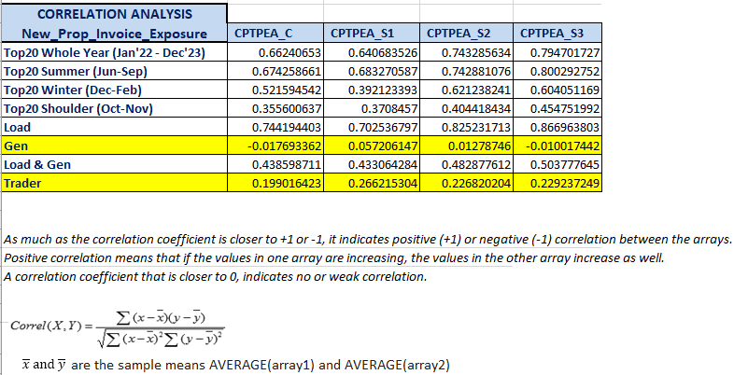
Correlation: Invoice Exposures vs Current, Scenario #1-3
Both scenarios appear to have higher correlation with invoice exposures compared to the existing methodology.
Scenario #3 appears to have the highest correlation with invoice exposures, though the marginal difference compared to Scenario #2 appears not that significant.
Scenario #2 lowers negative gaps while Scenario #3 increases negative gaps. Scenario #3 lowers the positive gaps the most.

Slide 10
Summary: Current vs Scenario #1, Scenario #2 and Scenario #3
Conclusion
Perceived overcollateralization – Scenario #2 lowers positive gaps while also lowering negative gaps. Specifically, Scenario #2 appears to better solve "double top" or "2nd top" TPEA behavior without bringing excessive amount of risk.
All scenarios struggle to solve the “timing lag” - negative gaps occurring (to a large extent) before the price spike. Coming into the high price environment, MCE is driving the TPE, both scenarios do not shorten the lag as compared to the existing TPE – the results are mostly the same. When RTLE is coming off of lower base, reflecting lower prices and/or overhedged positions as the price spike event happens the short position will be captured through RTLCNS first then through RTLE, but only after the fact.

