Slide 1
NPRR 1215 - Clarifications to the Day-Ahead Market (DAM) Energy-Only Offer Calculation
- An Example
February 16, 2024
Curry Holden
Day-Ahead Market Supervisor

Slide 2
Example Offer and Credit Values
Data Type | Value
TRADE_DATE | 6/6/2022
ENERGY_TYPE | OFFER
STL_PNT_NAME | HB_SOUTH
DELIVERY_HOUR | 9
NUM_PQ_POINTS | 1
PRICE1 | -10
QUANTITY1 | 180.4
e2 | 0
e3 | 1
a^{th} Percentile | 52.245
b^{th} Percentile | 50.9215
dp^{th} Percentile (incorrect) | 75.48375
dp^{th} Percentile (correct) | 8.708
Notes:
The incorrect percentile shown here is the 90th percentile of the furthest right column on the next slide.
The correct percentile shown here is the 90th percentile of the second-furthest right column on the next slide.

Slide 3
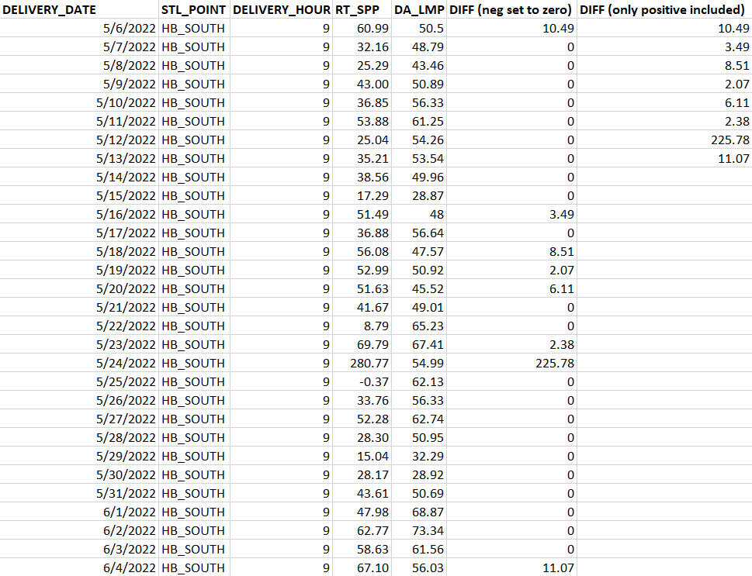
Example RT/DAM Differences

Slide 4
Exposure Calculation
The current language can be interpreted to mean that the dp^{th} percentile in the “incorrect” row is used.
In this example, the exposure calculated in the “incorrect” row is almost 9 times more than the “correct” row because the incorrect dp^{th} percentile is almost 9 times more than the value actually used.
The rows and columns marked “correct” in this document are how it is currently implemented and has been since nodal go-live.

Slide 5
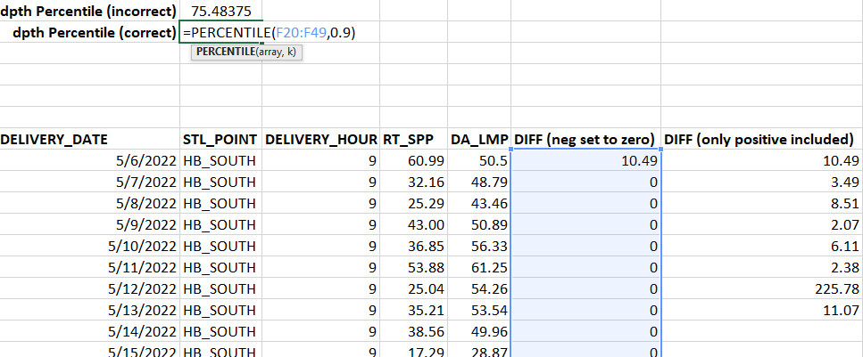
More details
For clarity I have included the formula used to calculate the correct and incorrect dp^{th} percentile on this slide and the next.

Slide 6
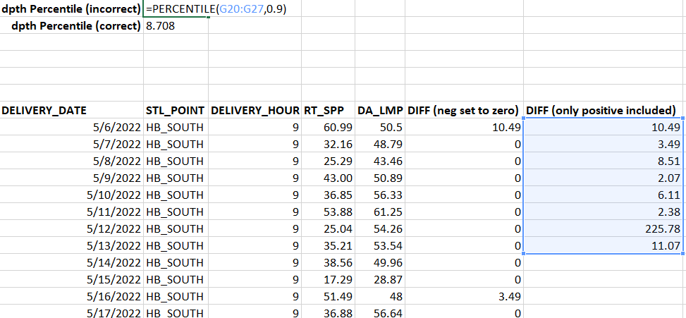
More details (cont’d)

