Slide 1
Monthly Review of Reliability Unit Commitment Market Impacts – January 2024
Wholesale Market Working Group
ERCOT Staff

Slide 2
RUC Resource-Hours
January 2024 | Total | Opt-Out | Non-Opt-Out
Instructed Resource-Hours
Total Count | 140 | 28 | 112
Effective Resource-Hours*
Total Count | 129 | 28 | 101
Average LSL | 99.6 | 118.8 | 94.3
Average LDL | 125.3 | 237 | 94.3
Average BP | 137.9 | 293.5 | 94.8
Average HSL | 267.7 | 419.8 | 225.6
* The difference between “Instructed” and “Effective” values is a result of Resources starting up, shutting down, receiving partial hour instructions, or otherwise not being dispatchable by SCED.

Slide 3
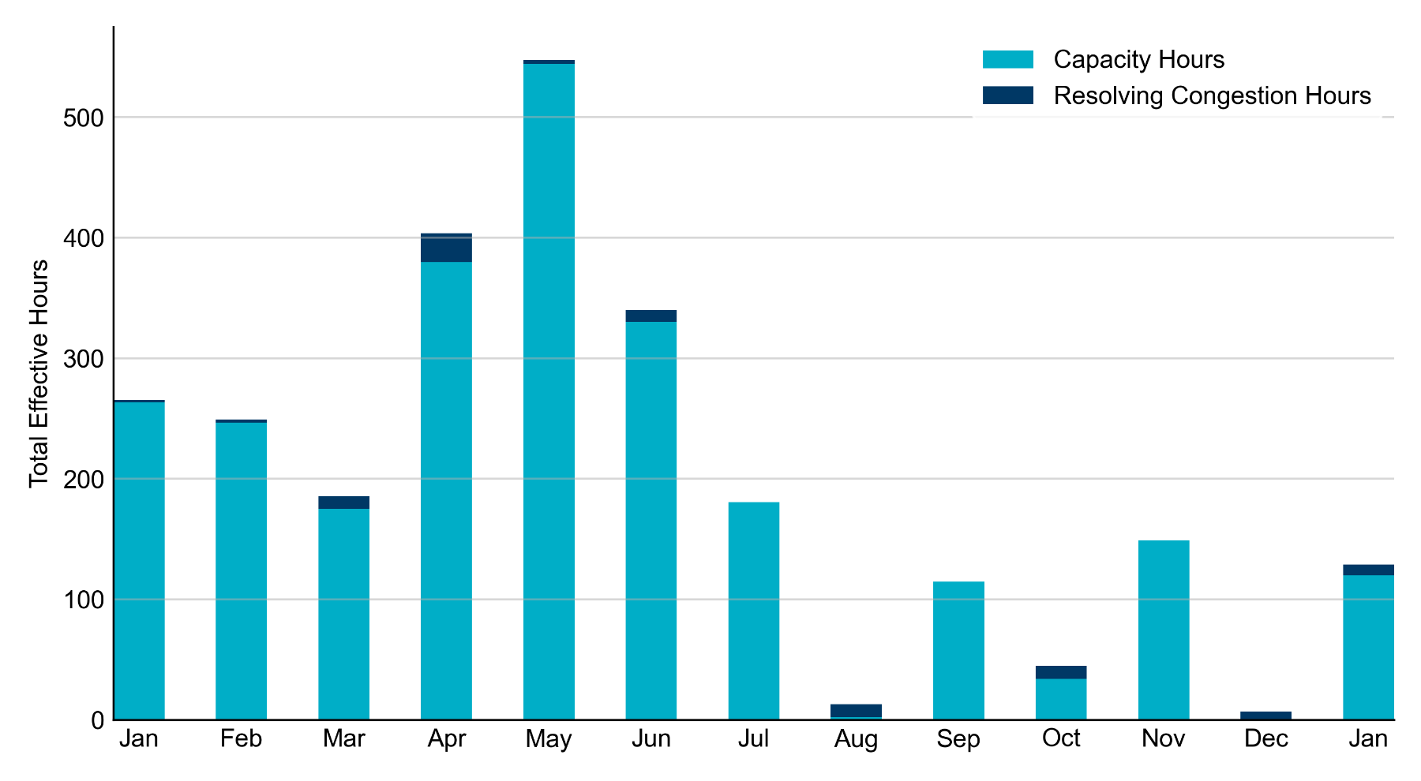
RUC Instruction Reasons: Last 13 Months RUC in January 2024 was primarily driven by concerns over capacity and transmission congestion.

Slide 4
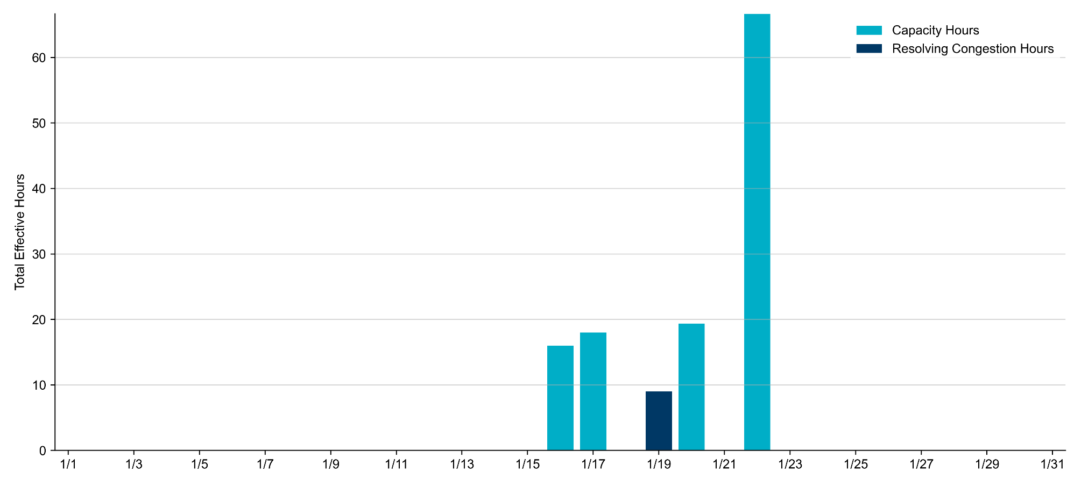
RUC Instruction Reasons in January 2024
129 effective RUC Resource-hours.
120 hours (93.03%) for capacity concerns.
9 hours (6.97%) for congestion concerns.

Slide 5
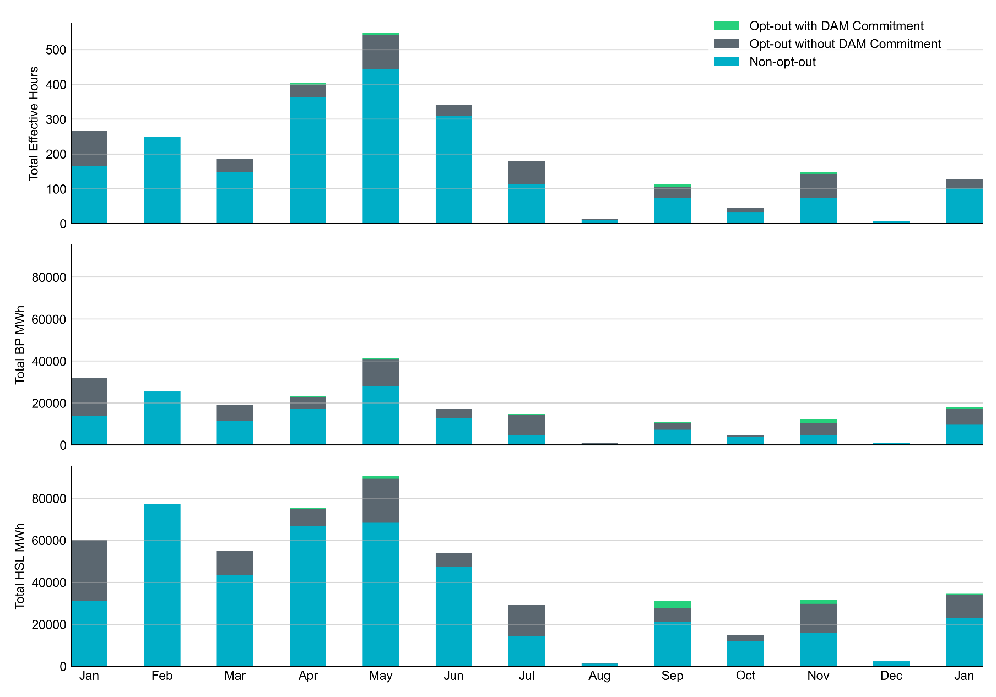
Non-opt-out and Opt-out Totals: Last 13 Months January 2024 had a total of 101 non-opt-out effective Resource-hours, which was 78.3% of the effective Resource-hours for the month, as there were 28 opt-out effective Resource-hours.

Slide 6
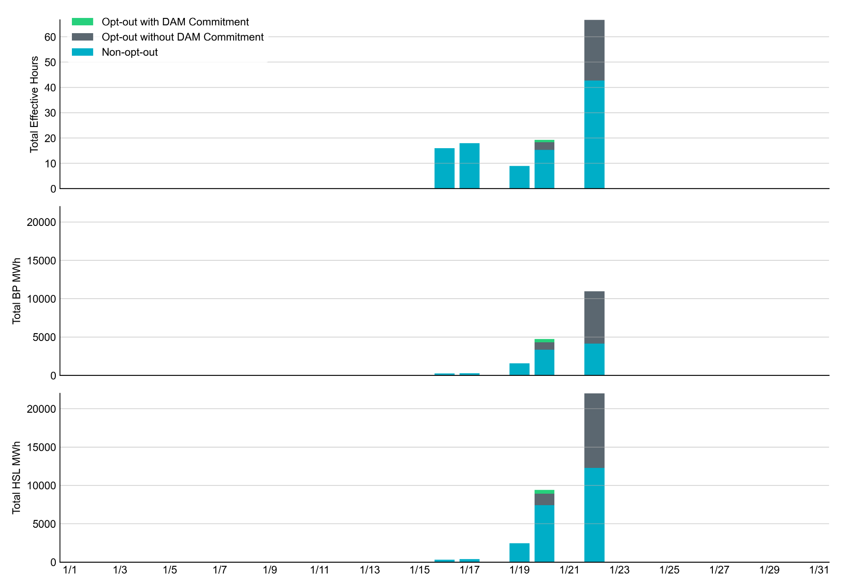
Non-opt-out and Opt-out Totals: January 2024

Slide 7
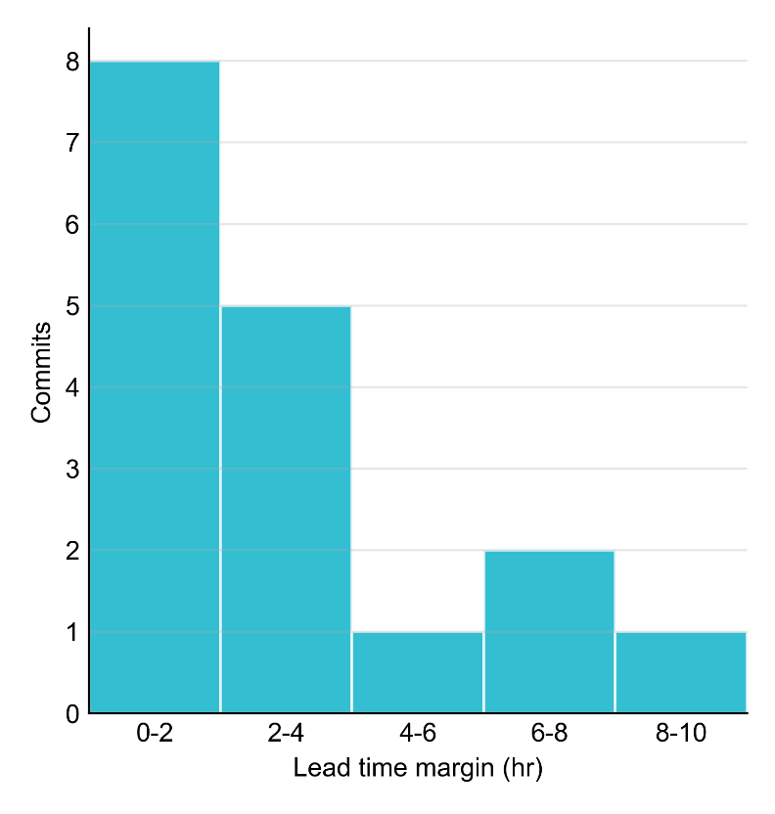
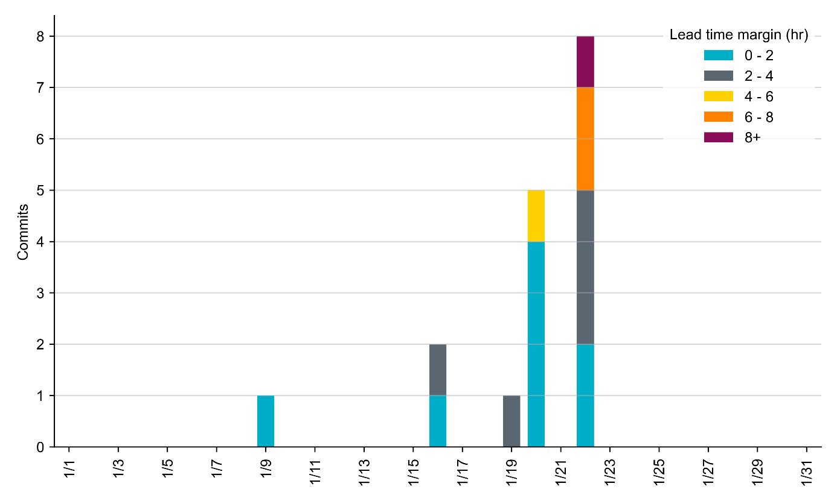
RUC Lead Time Margin: January 2024
Most RUC commit windows had lead time margin at or below 2 hours.
Lead time refers to the length of time between a RUC instruction and the start of the commitment window.
Lead time margin is the difference between lead time and the Resource’s startup time.
In cases where a Resource is committed for multiple back-to-back time blocks, lead time margin is calculated from the first instruction.
Notes:
The first bin is both-inclusive (i.e. [0, 2] ), while subsequent bins are left-inclusive (i.e. [2, 3), [3, 4), etc.).

Slide 8
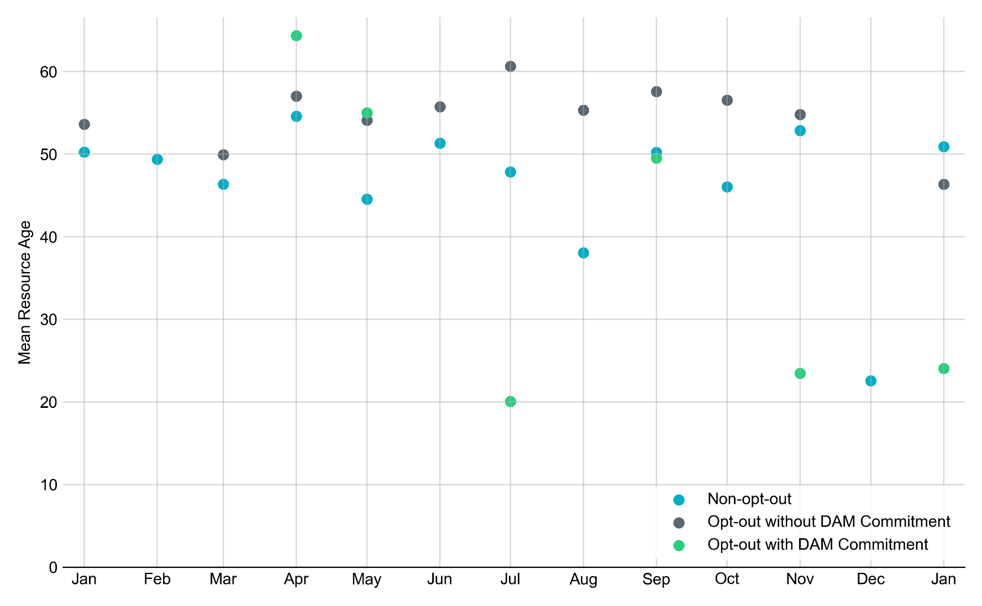
Average Resource Age: Last 13 Months In January 2024, the mean age of RUC-committed Resources was 50.9 years for Non-Opt-Out Resource-hours and 46.3 years for Opt-Out Resource-hours without DAM Commitments.
Note: For Resource configurations with multiple physical generators, the age of the oldest generator is used.

Slide 9
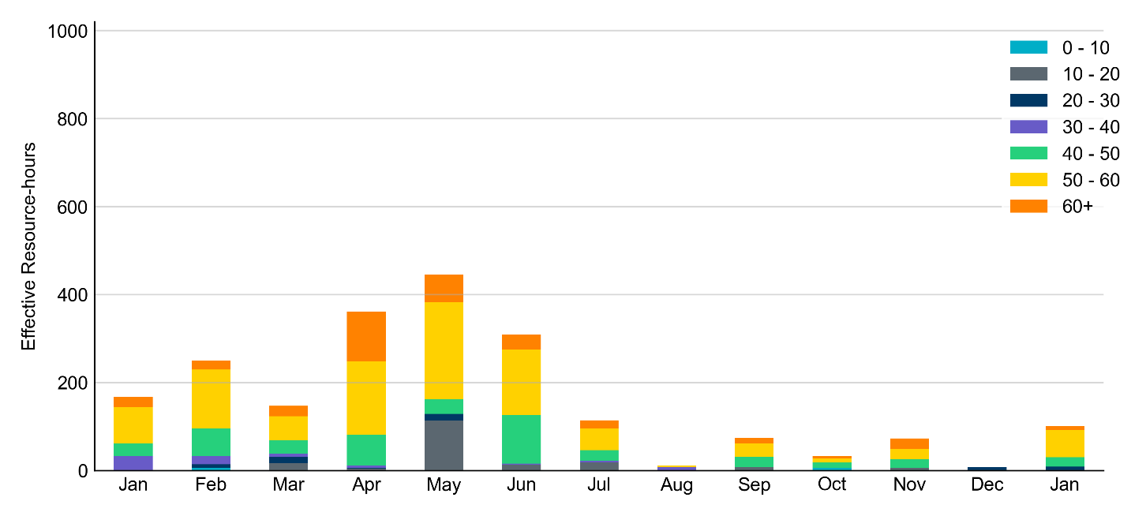
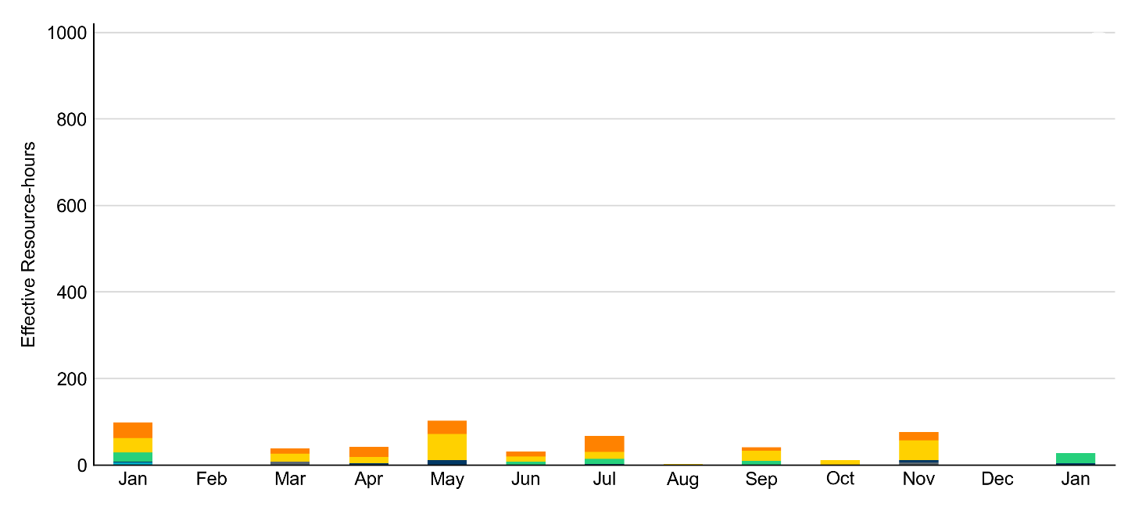
Age Category: Last 13 Months Most RUC-Committed Resources in January 2024 were older than 50 years.
Non-opt-out
Opt-out

Slide 10
RUC-Instructed Resource Dispatch above LDL
January 2024
There were 2.5 effective Resource-hours in which Resources that did not successfully opt out were dispatched above their LDL in January 2024.
Additionally, there were no Exceptional Fuel Cost submissions for any RUC-Committed Resources in January 2024.

Slide 11
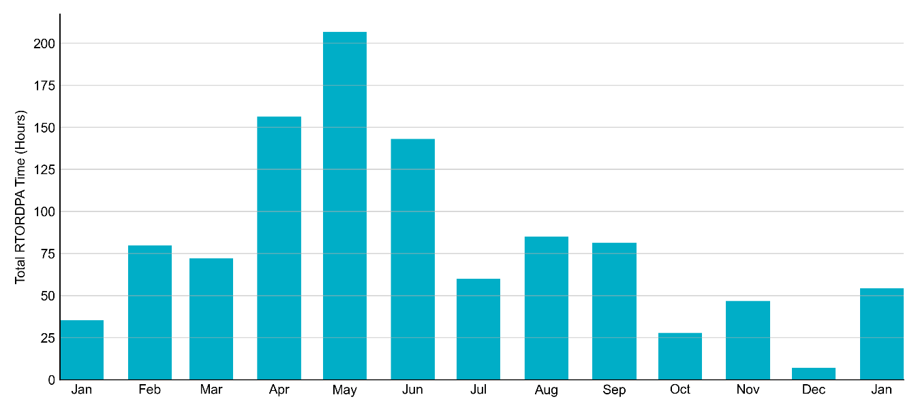
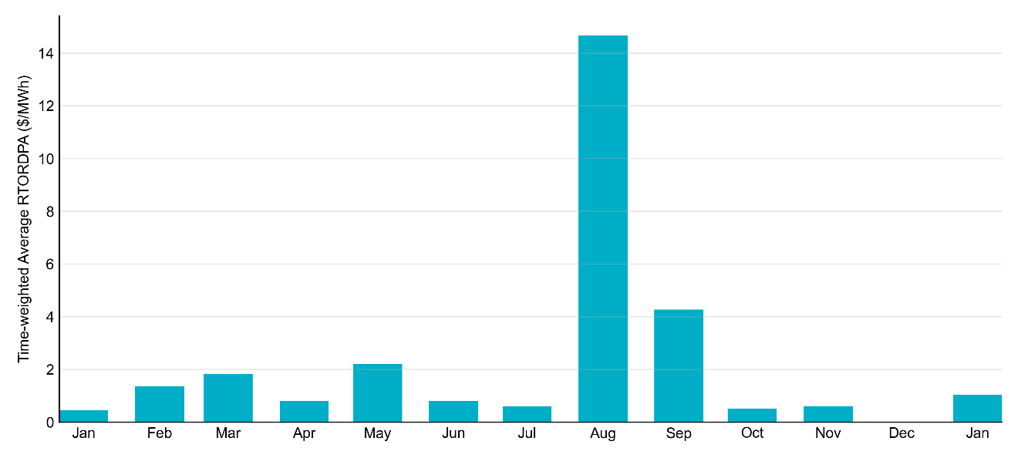
Reliability Deployment Price Adder: Last 13 Months January 2024 had a total of 54.25 RTORDPA hours with an average value of $1.03/MWh.
These graphs include all non-zero RTORDPA triggered by reliability action taken by ERCOT including RUC, Deployed Non-Controllable Load Resources, Deployed ERS, etc. The full list and detailed methodology can be found in protocol section 6.5.7.3.1, Determination of Real-Time Reliability Deployment Price Adders.

Slide 12
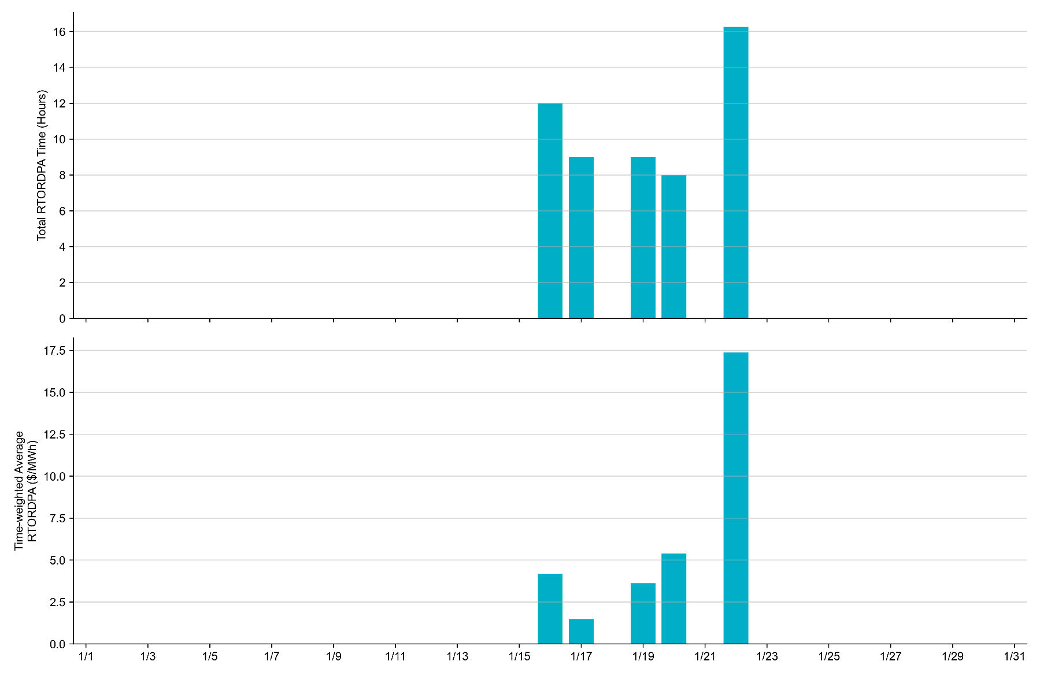
Reliability Deployment Price Adder: January 2024 OD 1/22 had the highest daily time-weighted average RTORDPA of $17.37/MWh.
These graphs include all non-zero RTORDPA triggered by reliability action taken by ERCOT including RUC, Deployed Non-Controllable Load Resources, Deployed ERS, etc. The full list and detailed methodology can be found in protocol section 6.5.7.3.1, Determination of Real-Time Reliability Deployment Price Adders.

Slide 13
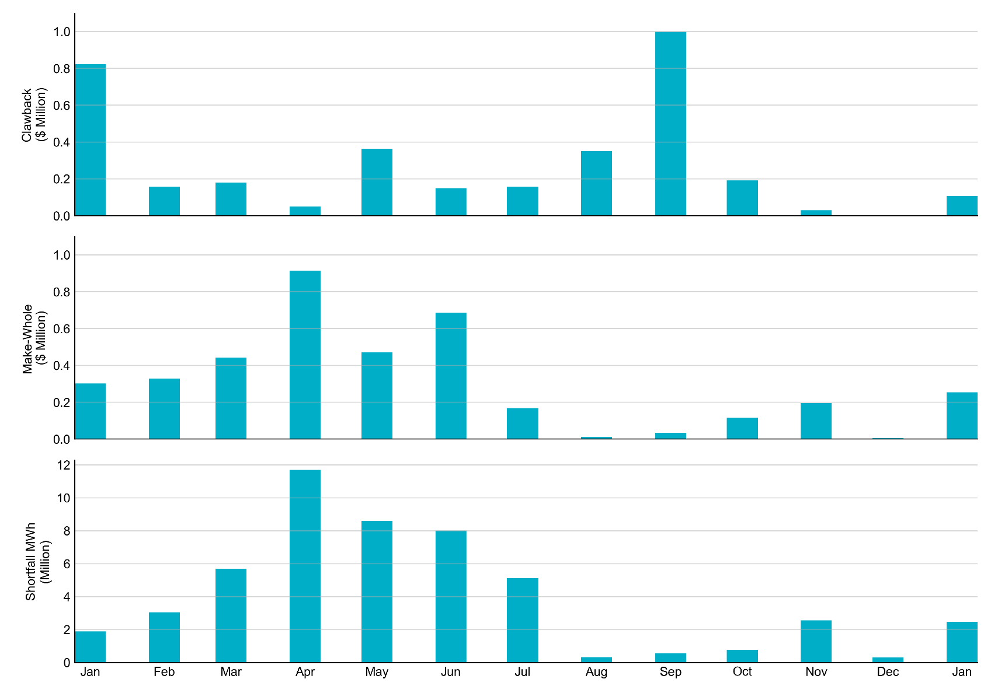
RUC Clawback, Make-Whole, and Shortfall For January 2024, the total Clawback charge was $0.12M. The total Make-Whole payment was $0.253M, which was almost entirely covered through capacity-short charges.
Of the $0.253 million in Make-Whole payments made in January 2024, the majority was collected through Capacity Short Charges.
Data as of February 8^{h}, 2024

Slide 14
RUC Make-Whole by Settlement Type
Month | Initial Settlement ($) | Final Settlement Change ($) | True-up Settlement Change ($) | Net as of February 8, 2024 ($)
Jan '23 | -141,639 | -59,381 | -100,426 | -301,446
Feb ‘23 | -295,131 | - | -31,972 | -327,103
Mar ‘23 | -343,491 | - | -97,889 | -441,379
Apr ‘23 | -687,506 | - | -226,976 | -914,482
May ‘23 | -426,974 | - | -43,426 | -470,400
Jun ‘23 | -600,652 | - | - | -600,652
Jul ‘23 | -161,994 | -4,996 | - | -166,990
Aug ‘23 | -12,090 | - | - | -12,090
Sep ‘23 | -35,168 | - | - | -35,168
Oct ‘23 | -72,477 | - | - | -72,477
Nov ‘23 | -194,731 | - | - | -194,731
Dec ‘23 | -5,316 | - | - | -5,316
Jan ‘24 | -253,468 | - | - | -253,468
Negative dollars represent a payment from ERCOT to a market participant
“-” indicates settlement has yet to be completed.

Slide 15
RUC Clawback by Settlement Type
Month | Initial Settlement ($) | Final Settlement Change ($) | True-up Settlement Change ($) | Net as of February 8, 2024 ($)
Jan '23 | 835,738 | -6,526 | -6,864 | 822,349
Feb ‘23 | 158,319 | - | -1,348 | 156,971
Mar ‘23 | 179,783 | - | - | 179,783
Apr ‘23 | 53,643 | - | -3,557 | 50,087
May ‘23 | 426,519 | - | -62,724 | 363,795
Jun ’23 | 149,347 | - | - | 149,347
Jul ‘23 | 218,907 | -60,841 | - | 158,066
Aug ‘23 | 352,002 | - | - | 352,002
Sep ‘23 | 997,843 | - | - | 997,843
Oct ‘23 | 190,721 | - | - | 190,721
Nov ‘23 | 29,684 | - | - | 29,684
Dec ‘23 | - | - | - | -
Jan ‘24 | 107,175 | - | - | 107,175
Negative dollars represent a payment from ERCOT to a market participant
“-” indicates settlement has yet to be completed.

