Slide 1
Ancillary Service Demand Curves
(ASDCs)
Market Analysis
RTCBTF
February 21, 2024
ERCOT Public

Slide 2
Introduction
One of the key issues for discussion at the RTC+B Task Force is a “Review of the AS Demand Curves in the context of current policy”.
Purpose of this presentation:
Review of AS Demand Curve concept under RTC
Explanation of approach and methodology
Illustration of results

Slide 3
Overview
Under RTC, the ORDC will not be used. Instead, scarcity pricing and the value of reserves are set by AS Demand Curves (ASDCs)
Sufficient remaining capacity and offers
Insufficient remaining capacity or offers
Value of the AS product in shortage

Slide 4
Overview
ASDCs will be based on the shape and pricing outcomes of the ORDC

Slide 5
RTC Key Principles KP1.1
The RTC Key Principles outline the methodology to calculate ASDCs and how it inherits the ORDC policy in place.
To reasonably reflect the current RTM pricing outcomes expected with the ORDC methodology changes being made starting in March, 2020, the following steps will be taken to develop a single aggregate ORDC for disaggregation into individual ASDCs:
For all Security-Constrained Economic Dispatch (SCED) intervals where the sum of RTOLCAP and RTOFFCAP is less than 10,000MW, use the historical RTOLCAP and RTOFFCAP values to calculate the composite LOLP and composite price with composite price defined as:
$$\left(0.5∗\left(1−pnorm\left(RTOLCAP−X, 0.5∗925, 0.707∗1213\right)\right)+0.5∗\left(1−pnorm\left(RTOLCAP+RTOFFCAP−X, 925, 1213\right)\right)\right)$$
$$∗\left(VOLL−min\left(System Lambda, 250\right)\right)$$
To account for lower reserve level areas where there are no historical observations, create a single point using the following assumptions:
RTOFFCAP = 0, RTOLCAP = 2,000MW
Set System Lambda equal to the average of system lambda, with the historical values capped at $250/MWh, during SCED timestamps with less than or equal to 4,000MW of total reserves
Using the results of (a) and (b) above, use regression methods to fit a curve to the average reserve pricing outcomes for the various MW reserve levels.

Slide 6
RTC Key Principles KP1.1
The RTC Key Principles outline the methodology to calculate ASDCs and how it inherits the ORDC policy in place.
ERCOT will design and implement parameters to represent the disaggregation of ASDCs so that potential future changes in values and distribution will not require system changes. The following steps will be taken to disaggregate the single aggregate ORDC into individual ASDCs:
Place Reg-Up requirement at the highest priced MWs on the aggregate ORDC;
Place Responsive Reserve Service (RRS) requirement at the highest priced open MWs on the aggregate ORDC;
Place ERCOT Contingency Reserve Service (ECRS) requirement at the highest priced open MWs on the aggregate ORDC;
Place Non-Spin requirement at the highest priced open MWs on the aggregate ORDC; and
Fill remaining MWs on the aggregate ORDC priced at >= $0.01 as Non-Spin.

Slide 7
Methodology Summary
The upcoming slides will provide a visualization for each step
Calculate “Composite Price” using historical ORDC data
Take the average Composite Price per bin of reserve levels
Use regression methods to fit a curve to the binned average data
Apply LOLP = 1 to reserve levels below minimum contingency level (MCL)
Assign ancillary services to the curve in the following order
REGUP (highest prices on the curve)
RRS
ECRS
NSPIN (lowest prices on the curve)

Slide 8
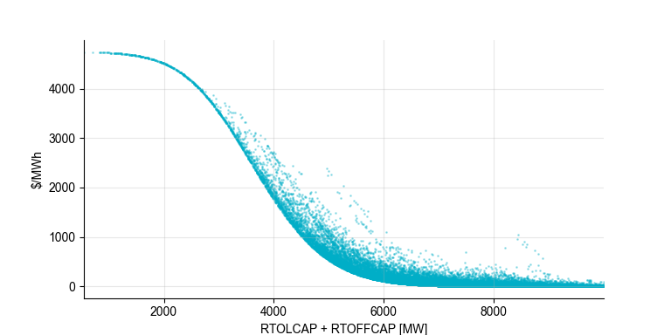
1) Calculate “Composite Price” Using ORDC Outcomes
Composite Price for each SCED interval between 01/01/2018 and 01/01/2024
Only considering reserve levels < 10,000 MW
Composite price
$$\left(0.5∗\left(1−pnorm\left(RTOLCAP−X, 0.5∗925, 0.707∗1213\right)\right)+0.5∗\left(1−pnorm\left(RTOLCAP+RTOFFCAP−X, 925, 1213\right)\right)\right)$$
$$∗\left(VOLL−min\left(System Lambda, 250\right)\right)$$

Slide 9
2) Take the average Composite Price per bin of reserves
Reserve levels were split into 50 equally sized bins (200 MW each)
Calculated the average price per bin

Slide 10
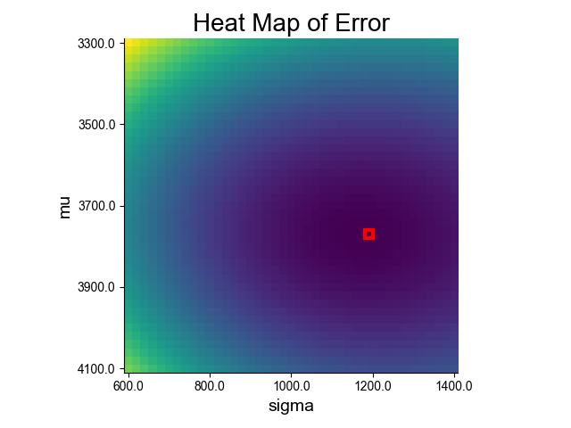
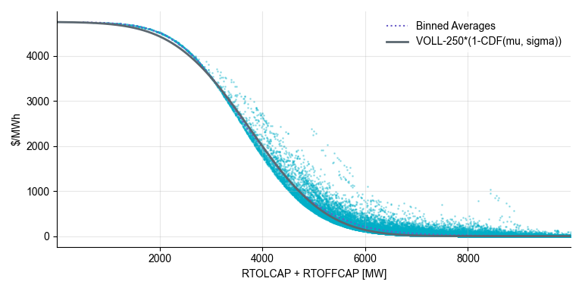
3) Use regression methods to fit curve to binned averages
Determine mu and sigma to best fit binned averages
Equation takes the form: (VOLL – 250) *(1-CDF(mu, sigma))
CDF is the cumulative distribution function of a normal distribution
Polynomial and LOESS curve fitting methods were considered, but results were not guaranteed to be monotonically decreasing.
Best fit: Mu = 3760, sigma = 1180

Slide 11
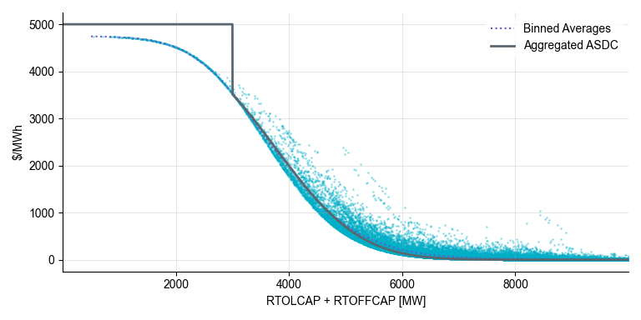
4) Apply LOLP = 1 to reserve levels < MCL
Mu = 3760, sigma = 1180

Slide 12
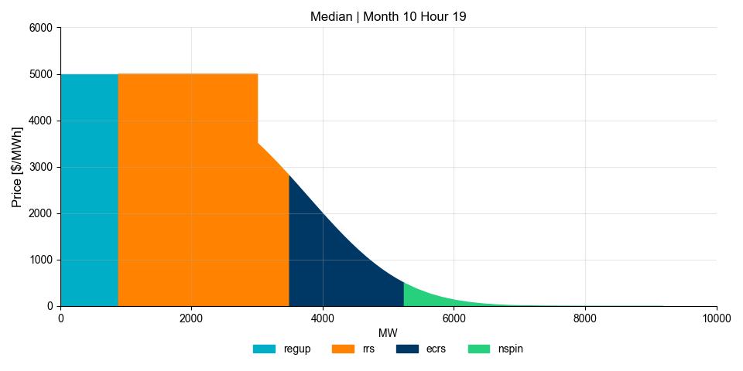
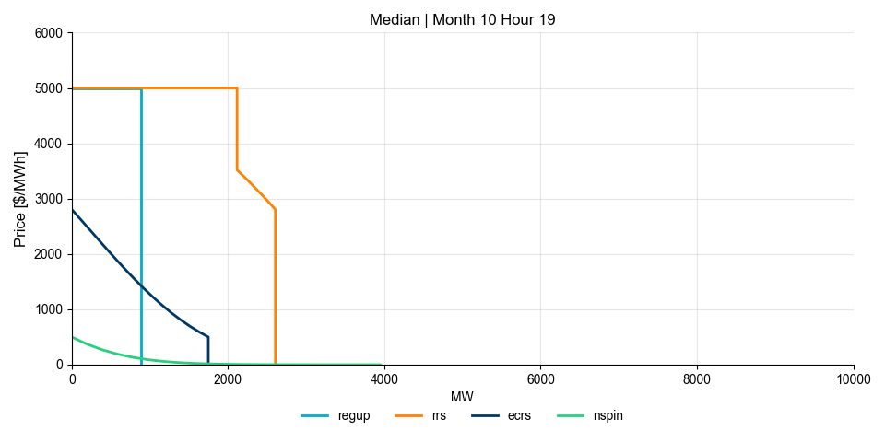
5) Assign AS to the curve
Assign ancillary services to the curve in descending order of price.
The example below uses the AS plan for October 2024 Hour 19
REGUP = 884 MW
RRS = 2606 MW
ECRS = 1748 MW
NSPIN = 2403 MW

Slide 13
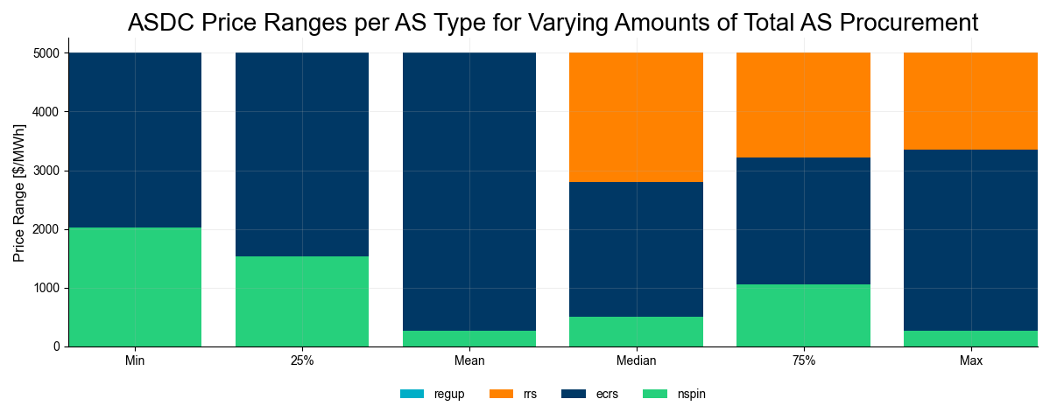
ASDCs – Varying levels of AS procurement
Calculated ASDC for varying levels of total AS procurement from 2024 AS plan
Case Name | Month | Hour | REGUP (MW) | RRS (MW) | ECRS (MW) | NSPIN (MW) | Total AS (MW) | REGUP Max Price ($/MWh) | RRS Max Price ($/MWh) | ECRS Max Price ($/MWh) | NSPIN Max Price ($/MWh)
Min | 9 | 3 | 220 | 2529 | 1226 | 1651 | 5626 | 5000 | 5000 | 5000 | 2032
25% | 6 | 24 | 134 | 2491 | 1673 | 2475 | 6773 | 5000 | 5000 | 5000 | 1540
Mean | 9 | 17 | 484 | 2300 | 2853 | 1926 | 7563 | 5000 | 5000 | 5000 | 265
Median | 10 | 19 | 884 | 2606 | 1748 | 2403 | 7641 | 5000 | 5000 | 2805 | 500
75% | 5 | 5 | 301 | 2916 | 1443 | 3564 | 8224 | 5000 | 5000 | 3217 | 1058
Max | 5 | 14 | 564 | 2560 | 2514 | 4482 | 10120 | 5000 | 5000 | 3349 | 265
If REGUP and RRS are not shown in the graph above, it means their price is at $5000/MWh for the full range of their ASDC

Slide 14
Appendix

Slide 15
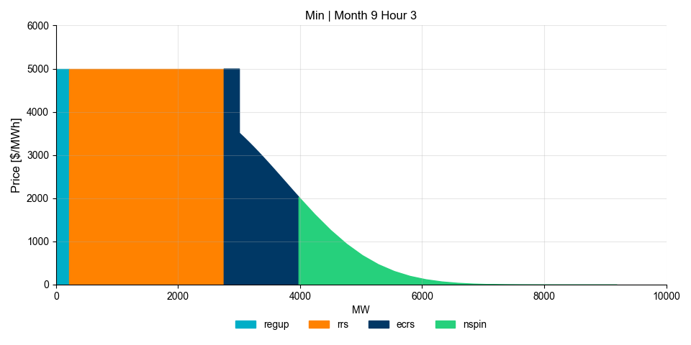
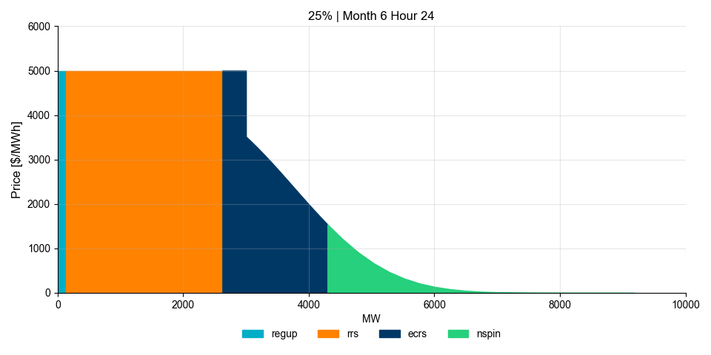
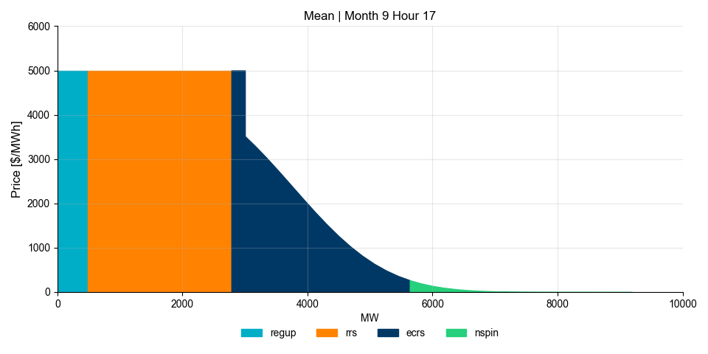
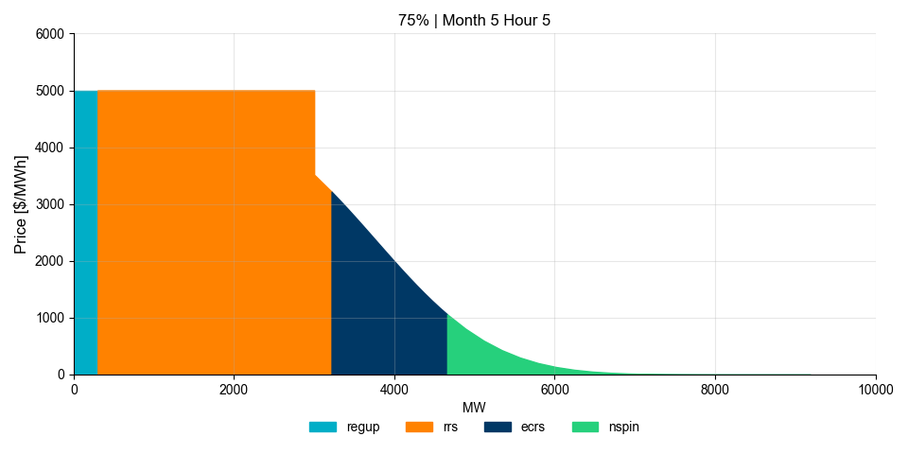
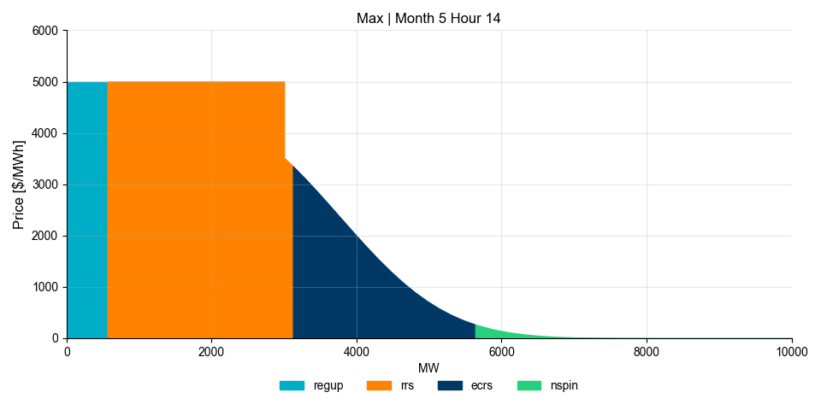
Appendix – ASDC, all cases

