Slide 1
ERCOT IBRTF: NERC and Other Industry Updates
Julia Matevosyan
Chief Engineer
ESIG
02/09/2024

Slide 2
Agenda
AEMO Voluntary Specification for Grid-forming Inverters: Core Requirements Test Framework
ENTSO-E RfG 2.0 (high level update)
ESIG Webinar: Measures to Address Stability Issues in Fingrid
ESIG Spring Workshop: Sessions relevant for IBRWG

Slide 3

AEMO: Voluntary Specification for Grid-forming
Inverters, May 2023
A preliminary document to provide guidance to stakeholders while the regulatory environment around GFM technology develops.
Specifies the ‘core’ and ‘additional’ technical capabilities and expected performance that power electronic devices should have to be categorized as GFM.
Considers all technology forms, not just GFM batteries
Inform future regulatory changes on technical requirements/standards, service specifications, and procurement processes
https://aemo.com.au/-/media/files/initiatives/primary-frequency-response/2023/gfm-voluntary-spec.pdf?la=en&hash=F8D999025BBC565E86F3B0E19E40A08E
Notes:
All technology forms: also includes wind and solar inverters, STATCOMS and HVDC converter stations and loads interfaced to the power system with controllable converters.

Slide 4
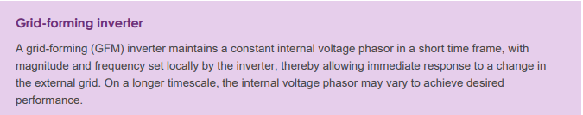
GFM Definition
‘Core’ capabilities of GFM inverters can be delivered with software and control changes.
To achieve ‘core’ capabilities GFM device is expected to have a small energy buffer by design or operation.
‘Additional’ capabilities require hardware or operational practices changes to provide larger energy buffer and overcurrent capability and are considered optional extensions to the ‘core’ capabilities.
Not all GFM inverters need to provide ‘additional’ capabilities, but these capabilities are valuable for secure operation of a power system with high share of IBRs.
https://aemo.com.au/-/media/files/initiatives/primary-frequency-response/2023/gfm-voluntary-spec.pdf?la=en&hash=F8D999025BBC565E86F3B0E19E40A08E
Notes:
.

Slide 5
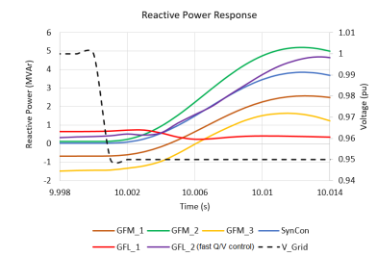
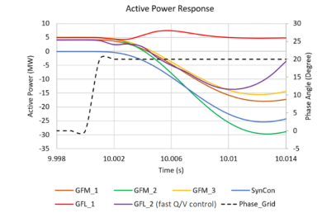
Response to Voltage Magnitude and Phase Angle Change
Nearly-instantaneous (< 5 ms) reactive response to an external voltage magnitude step, to oppose the change in voltage.
Nearly-instantaneous active power response to a voltage phase angle step, by injecting or absorbing power to oppose the change in phase angle.
The response when the inverter is at a limit, and in transition to and from a limit condition, must be smooth and stable.
The behavior at a limit should not be detrimental to stability and to harmonic performance (for example, clipping of current waveforms).
The conditions for these simulations have been chosen so that the devices do not encounter current limits. 5% voltage step top, 20 deg phase jump bottom
https://aemo.com.au/-/media/files/initiatives/primary-frequency-response/2023/gfm-voluntary-spec.pdf?la=en&hash=F8D999025BBC565E86F3B0E19E40A08E

Slide 6
Inertial Response
Inertial response from GFM inverters should be inherent (no calculation of frequency), providing a near-instantaneous active power response to a grid disturbance (e.g. load or generation trip)
If the inertia is configurable, it needs to be tuned based on network conditions and requirements (high inertia constant may increase power oscillations, particularly in strong systems).
https://aemo.com.au/-/media/files/initiatives/primary-frequency-response/2023/gfm-voluntary-spec.pdf?la=en&hash=F8D999025BBC565E86F3B0E19E40A08E
Notes:
AEMO has chosen to define ability to provide inertial response as a core capability without specifying the need to provide this capability across the inverter’s full operating range. In conjunction with this, the additional capability to maintain headroom or an energy buffer could be utilized to ensure a synthetic inertial response can be delivered across the desired operating range. This differs from some other international specifications, and not all GFM implementations currently have this capability. This capability is a function of the implementation algorithm, not requiring substantial modification, and therefore can be classed as core capability. However, it is recognized that for inverters to provide meaningful amounts of inertial response in both directions they would likely require a suitable energy buffer or adequate headroom

Slide 7
Other ‘Core’ Capability Requirements
Surviving Loss of Last Synchronous Machine (SM): operate stably in a grid without any other GFM inverters or SMs; remain stable for a transition from a grid with SMs to one without (and back); provide frequency and reactive support, unaffected by these transitions. All of that, provided the resultant state of the system is within the operating envelope of the GFM inverter.
Operate stably under a very low short circuit ratio, as defined by the system operator; provide system strength support to nearby GFL inverters during and after disturbances.
Provide positive damping for oscillations: following a disturbance GFM inverter output should be adequately damped; add damping to the system for the oscillatory phenomena:
SSCI (either between GFL inverters or GFL inverter and grid)
Rotor angle modes of oscillation inter-area modes of oscillation
Oscillations at harmonic frequencies which result from interactions of electrical and control resonances.
https://aemo.com.au/-/media/files/initiatives/primary-frequency-response/2023/gfm-voluntary-spec.pdf?la=en&hash=F8D999025BBC565E86F3B0E19E40A08E
Notes:
Rotor angle modes of oscillation damping: through the provision of damping power akin to that provided by synchronous machine damper windings. Where relevant, this should include damping for

Slide 8
‘Additional’ Capabilities
Next steps for this effort were:
Develop a test plan and metrics for each of the qualitative capabilities to quantify requirements and to demonstrate that a device meets the specs (started, to be published in 2024)
Develop methodology to account for contributions from GFM devices in planning studies (some contributions are dependent on the operating point)
Larger headroom and energy buffer
Current capability above continuous rating
Black start capability
Power quality improvement
https://aemo.com.au/-/media/files/initiatives/primary-frequency-response/2023/gfm-voluntary-spec.pdf?la=en&hash=F8D999025BBC565E86F3B0E19E40A08E

Slide 9
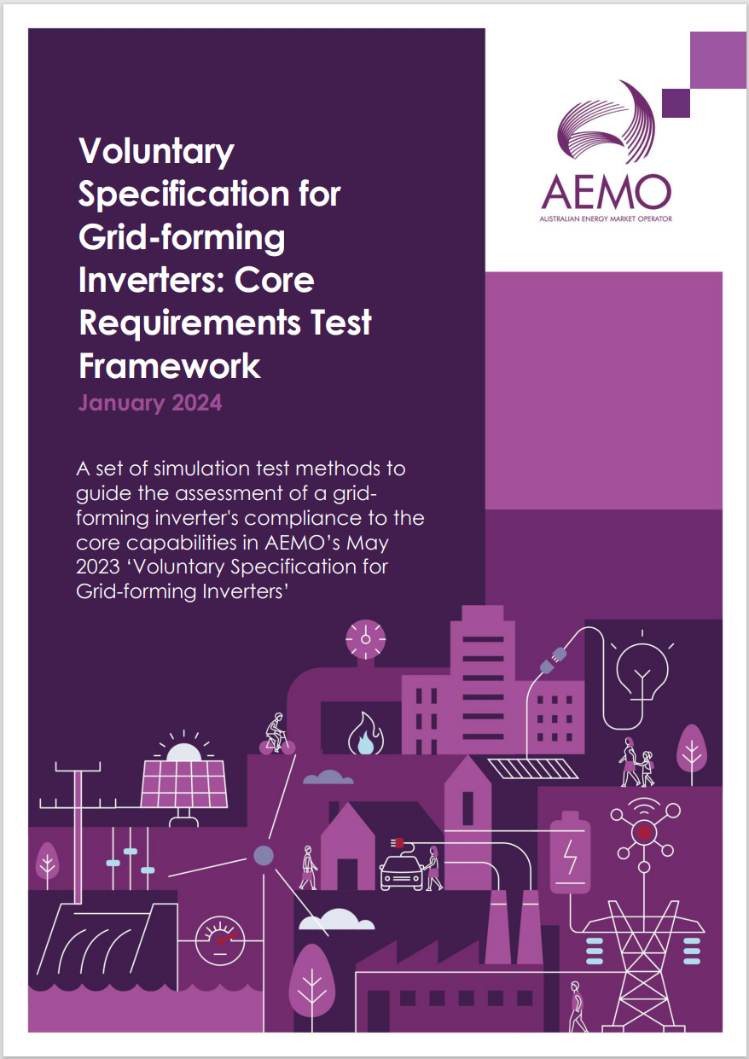
‘Core’ Requirements Test Framework
Purpose: Provide an informative framework for testing equipment and control modes in simulation,
to determine whether GFM IBR can meet the requirements of the “core” capabilities listed in the Voluntary Specification and thereby provide expected benefits.
The document accompanies the Voluntary Specification as a preliminary set of documents to provide guidance to stakeholders while the regulatory environment around grid-forming technology develops.
https://aemo.com.au/-/media/files/initiatives/engineering-framework/2023/grid-forming-inverters-jan-2024.pdf?la=en

Slide 10
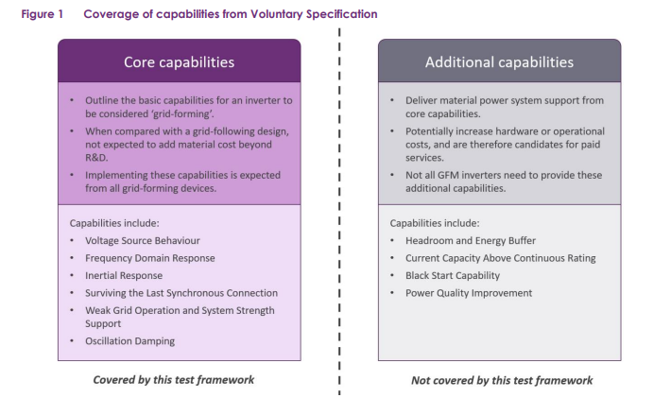
‘Core’ Requirements Test Framework
Scope: provides a minimal set of simulation to determine whether a GFM IBR meets the criteria set out as ‘core’ capabilities in the Voluntary Specification
Each test is presented with a reference to:
  The Voluntary Specification
  A described simulation testbench
  Testbench configuration
  Criteria for assessment.
The thresholds and bounds presented in the assessment criteria are based on engineering judgement rather than any specific regulatory requirements and are provided for guidance only at this time.
https://aemo.com.au/-/media/files/initiatives/engineering-framework/2023/grid-forming-inverters-jan-2024.pdf?la=en
Notes:
Balance between providing clear assessment criteria and the need to provide flexibility as GFM controls, and industry understanding of them, evolves.
Oscillation damping requirement is in sub-synchronous range.

Slide 11
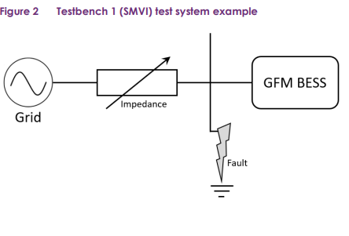
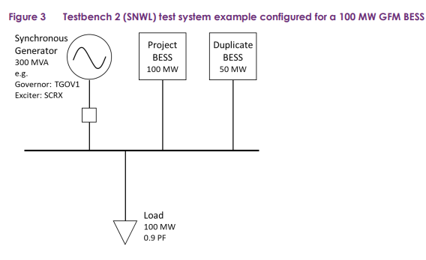
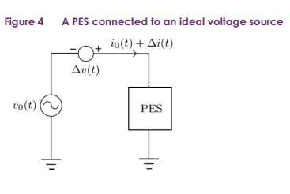
Core’ Requirements Test Framework
Test Loss of SG when:
  BESS discharging
  BESS charging
  BESS at limits
  Power balance
RoCoF up and down (4 Hz/s)
SCR ramp down with fault
Voltage angle step change (10-60 deg)
NERC. 2023 White Paper: Grid Forming Functional Specifications for BPS-Connected Battery Energy Storage Systems, September 2023 https://www.nerc.com/comm/RSTC_Reliability_Guidelines/White_Paper_GFM_Functional_Specification.pdf
Impedance Scan
As described in: S. Shah, et al, “A Testing Framework for Grid-Forming Resources.” 2023 IEEE Power & Energy Society General Meeting (PESGM), Orlando, FL, USA
Notes:
Loss of SG/Power Balance Test is very similar to other three Loss of SG Tests, except it is configured with zero power in and out of the synchronous machine, such that the GFM device and load is balanced. This test is more feasible for GFM devices with very little energy storage or active power margin than tests 1-3
RoCoF test (SCR=10, X/R=6GFM dispatch at 50%): Plant real and reactive power output should be well controlled. System frequency and voltage should not oscillate excessively or deviate from steady state levels for any significant amount of time. Voltage settles to a stable operating point when frequency is not ramping. Active power should settle according to its frequency droop and deadband settings when frequency is not ramping. d. Any oscillation shall be adequately damped in line with definition presented in the NER
SCR ramp down tests (SCR=20, X/R=6, GFM dispatch at 100%) is very similar to existing tests applied for connection assessment, with a key difference that in the existing DMAT test protocols the test is informational rather than “pass/fail”, and is allowed to trip at SCR = 1 or lower. This this test specifies that for GFM, stability of the resource down to the minimum level of 1.25 is required as a “pass” criterion. An SCR of 1.25 was selected as the lower limit as it is below the SCR stability threshold of typical GFL devices but is above power transfer limits. Testing an SCR drop to (or near) 1.0 is possible as an informative test but may require an active power dispatch reduction to respect power transfer limitations. A 6-cycle 2 phase-to-ground fault is applied with a minimum fault depth of 0.5pu just before each SCR transition. The SCR transition occurs at fault clearing time.
Phase Jump (SCR=3 X/R=6, GFM dispatch at 50%): Instantaneous active power output of the plant should quickly respond to oppose the angle change for each of the 10 degree voltage phase angle jumps, with a peak active power change of at least 0.2 pu on the rated active power base (e.g. a 100 MW rated plant should temporarily increase active power output from 50 MW to at least 70 MW when source voltage angle is decreased by 10 degrees, and should temporarily decrease active power from 50 to 30 MW or below when voltage source angle is increased by 10 degrees)
For each of the 10 degree voltage phase angle jumps, response time to 90% of initial change in instantaneous active power should occur within 15ms
Active power settles to pre-disturbance level shortly after all phase jumps.
If active power / current reaches limits for the 60 degree phase change, the plant should return to pre-event power levels in a stable manner.
Any oscillation shall be settled.
Any distortion observed in phase quantities should dissipate over time

Slide 12
Core’ Requirements Test Framework
The following assumptions are implicit in the proposed tests:
Model quality should be high (usable and accurate), and in accordance with AEMO requirements (such as Dynamic Model Acceptance Test Guideline)
It is assumed that the plant can meet existing requirements for GFL IBRs
  Fault ride through and recovery
  Voltage control
  Frequency control
  Stability
Any specific stability considerations for a given point of connection will need to be discussed as part of the connection process.

Slide 13
ENTSO-E to Include GFM Requirements into the Grid Code
ENTSO-E is the European association for the cooperation of transmission system operators (TSOs) for electricity.
In 2016 ENTSO-E approved Network Code (NC) on Requirements for Generators (RfG) – a harmonized minimum standard that all generators across Europe must respect to connect to the grid.
On 11/23/22, ENTSO-E held a web-meeting to present proposed amendments to the network code to include grid forming capability requirements for IBRs (including battery storage) to ensure stable operation at high penetration of non-synchronous generation.
The TSOs have developed proposal for legal text and submitted it to the regulator for consideration.

Slide 14
ENTSO-E to Include GFM Requirements into the Grid Code
At a high level the requirement is that within its current limits the IBR shall be capable of behaving as a voltage source behind an internal impedance at its POI during normal operation conditions and first instant after a grid disturbance (including voltage, frequency and phase angle disturbance).
During first instant following a grid disturbance and while within IBR equipment limits:
  Keep internal voltage amplitude and voltage phase angle unchanged during a voltage phase jump or voltage step (in positive and negative sequence) at a POI. The positive and the negative sequence current exchanged between the IBR and the grid shall flow naturally according to grid and inverter impedances.
  The relevant system operator shall specify a minimum time dependent current profile for which the grid forming capability of the IBR is required

Slide 15
ENTSO-E to Include GFM Requirements into the Grid Code
During the disturbance period (voltage magnitude, frequency and voltage phase angle disturbance) and after the first instant:
  The internal voltage magnitude and voltage phase angle of the IBR shall be adapted according to a predefined dynamic performance (as specified by the relevant TSO).
  IBR active and reactive current adjustments shall always respect IBR capability and current limits
  IBR shall be capable of stable and smooth transition when reaching its current limits without interruption, in a continuous manner and returning to the behavior as described by a minimum time dependent current profile as soon as the limitations are no longer active.
The required energy to deliver minimum GFM capability as described above shall be ensured through the whole active power operating range of IBR.

Slide 16
ENTSO-E to Include GFM Requirements into the Grid Code
In addition to the requirements listed above, larger IBRs (10s-100s MW range) are also required to be capable of smooth and stable transition towards and from island mode of system operation, without interruption, in a continuous manner performing the needed active and reactive power adjustments.
If specified by a relevant system operator the IBR shall be capable of limiting transient frequency deviations both in low and high frequency events. In this case the relevant TSO shall specify the contribution to inertia in their requirements.

Slide 17
ENTSO-E RfG 2.0, Current Draft as Approved by ACER
Unit size in Continental Europe (smaller synchronous area have lower values):
Type A <1 MW
Type B <50 MW
Type C <75 MW
Type D >75 MW
Grid forming is not a mandatory requirement. Decision is up to the member state and the TSOs.
If TSO requires GFM:
  Minimum of 3 years transition phase after RfG in place
  Roadmap to introduce GFM within 2 years after RfG in place
If TSO requires GFM:
  Within the plant’s current and energy limits, it shall be capable of behaving at the terminals of the individual unit(s) as a voltage source behind an internal impedance (Thevenin source), during normal operating conditions and upon inception of a disturbance (voltage, frequency and voltage phase angle). The Thevenin source is characterized by its internal voltage amplitude, voltage phase angle, frequency and internal impedance.”
  Type B+C additional requirements
    Inertia
    Limiting the transient frequency deviation under high and low frequency conditions
  Type D additional requirements
    Power oscillations damping (the term "grid forming" not mentioned)

Slide 18

REGISTER FOR WEBINAR

Slide 19

Topics relevant to ERCOT IBRWG:
Tutorial: Electromagnetic Transient Analysis Simulation Tools
Opening Plenary Session: Grid Forming Technology Applications
Session: Grid Forming Technology Developments
Session: System Oscillations
Register for the Workshop
Workshop Agenda

Slide 20
Julia Matevosyan
julia@esig.energy

