Slide 1
CRR Activity Calendar Update
Samantha Findley
CRR Market Operations
WMS
February 7, 2024

Slide 2
CRR activity calendar – overview
Protocol 7.5.1(4)(c) requires ERCOT to post an updated calendar no later than April 1 of each calendar year
Each calendar includes auction activity dates for the remainder of the current calendar year and for the two subsequent calendar years
The calendar must be approved by WMS prior to the annual posting
Calendar was shared with CMWG on January 29, 2024
No revisions were requested
Seeking final approval today from WMS

Slide 3
CRR activity calendar – general reminders
The model build process begins 3 weeks prior to the model posting date (get outages and Common Information Model snapshot)
Added a 3rd week at the beginning of 2023 due to changes to model build tools
We hold a monthly auction and a long-term auction every month of the year
Typical pattern is monthly auction bid window in the first half of the month followed by the long-term auction bid window the very next week (occasionally, there will be a one-week gap to avoid holidays)
Monthly auction results are posted one week after the bid window closes; long-term auction results are posted two weeks after the bid window closes
Since SCR816 was implemented in Dec 2023, auction credit is now released the same day results are posted.

Slide 4
CRR activity calendar – general reminders
There are two additional tabs on the calendar
“Calendar Protocol References” includes any specific protocol sections related to the selection of dates
“PCRRs” contains activity dates and protocol sections related to the annual PCRR allocation process

Slide 5
CRR activity calendar – description of changes
Current calendar goes through the 2026.MAR.Monthly.Auction
Draft dates cover CRR activities through the 2027.MAR.Monthly.Auction
Applied the same patterns to assign the dates as have been used for previous calendars to maintain Protocol requirements and consistency
PCRR-eligible NOIEs are encouraged to view the dates on the “PCRRs” tab of the calendar

Slide 6
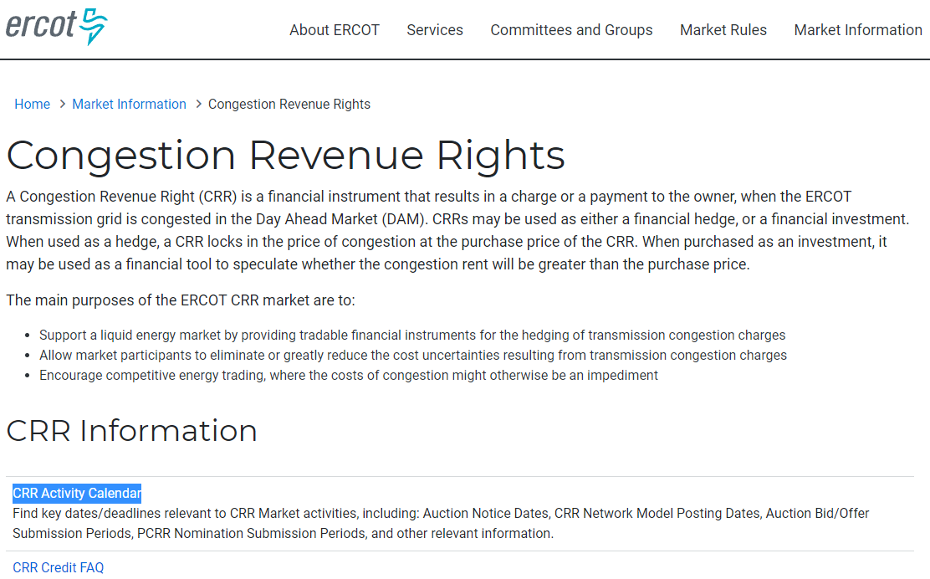
CRR activity calendar – next steps
ERCOT is seeking final approval today from WMS
Last chance to get WMS approval will be on March 6
Approved calendar will be posted on the CRR webpage by April 1

