Slide 1
TDTMS Update
RMS
February 6th, 2024

Slide 2
TDTMS
Update
ERCOT Updates –
Listserv Activity – interestingly TXANS listserv, for conservation and media announcements, jumped from 20,000 to 26,000 subscribers
SCR817 – testing is progressing well. MarkeTrak User’s Guide language is drafted for the two new subtypes (AMS vs LSE and Meter Cycle Change Requests). ERCOT currently working on the Inadvertent Gain revisions for the User’s Guide.
MIS API project update – released weekend of 12/9 – 12/10 and is reportedly functioning well. A couple of follow up issues reported, one being missing ‘key date’ requested for initiating transactions if the viewer is not the submitter. Corrections are expected for the 2/25 retail release as they are currently being tested.
Digital Certificates – ERCOT announced DCs will be moving to a multi-factor authentication (MFA) where researching alternatives will occur in 2024 with an implementation in 2025. Operations will continue as normal (renewals and new user requests).

Slide 3
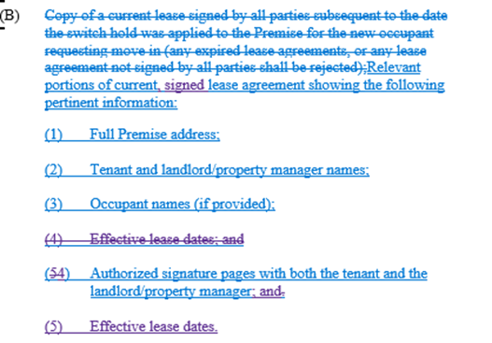
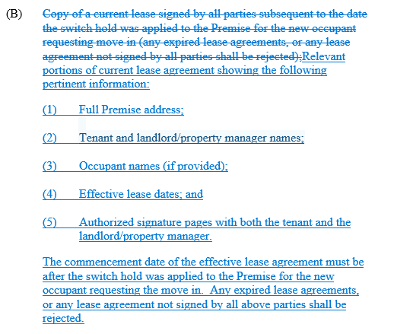
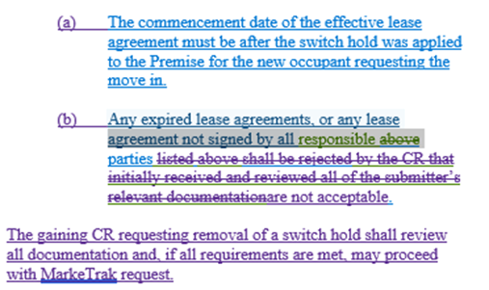
TDTMS
RMGRR177 – Switch Hold Removal Clarification – TDTMS comments
Switch Hold Removal –
“copy of lease” was clarified with the following language
TDTMS Comments

Slide 4
TDTMS
2023 Accomplishments
Performed the bi-annual reviews of the MarkeTrak Subtype Analysis volumes communicating observations to RMS.
Completed deeper dive of more common subtype analysis: volumes by REP, unexecutable reasons, timing for completion.
Reviewed monthly ERCOT IAG report noting observations and presenting findings to RMS.
Discussed at length the April NAESB outages impacting all market participants and the importance of timely market notices.
Supported ERCOT MIS API project.
Supported review of SCR817 - MarkeTrak Enhancements Aligning w/ TXSET 5.0 business requirements offering guidance on development.

Slide 5
TDTMS
2023 Accomplishments - continued
Discussed AMS Settlement extract timing as it related to LP&L availability of interval data to REPs.
Revised TDTMS EDM Implementation Guide – administrative updates and realignment with references to OBDs as opposed to duplicating information.
Discussion on ERCOT’s Digital Certificate initiative.
Various MarkeTrak scenario discussions for clarification:
Switch Hold Removal & documentation required thus resulting in a draft RMGRR
MVI vs SWI scenario – consequences of sending inappropriate transactions and use of IAG process as a resolution
Use of IAG process for identity theft
MarkeTrak Inadvertent Gain/Inadvertent Loss Analysis for 2022 MTs – deep dive on REP performance for each phase of the IAG process.

Slide 6
TDTMS
2024 Goals
Support Texas data transport improvement initiatives and continue joint efforts with other retail market working groups
Collaborate with the Retail Market Training Task Force for any operational education opportunities
Continued support of TXSET 5.0 IAG development requirements and implementation
Quarterly review of monthly ERCOT IAG report
Support/Monitor ERCOT’s development efforts and implementation of SCR 817 MarkeTrak Enhancements associated with TXSET v5.0
Perform biannual review of overall MarkeTrak subtype volumes for trends and the need for further performance analysis of various subtypes
Perform IAG & MT data analysis using established framework to identify metrics/trends for market participants and market performance using ERCOT provided data

Slide 7
TDTMS
2024 Goals - continued
Perform monthly review of the Retail Market Services and Market Data Transparency Service Level Agreements (SLAs), including Listserv performance, and work with ERCOT to evaluate and implement any potential changes, as needed
Review the quarterly ERCOT Retail Market Performance Measures, as needed
Support ERCOT resolution efforts in addressing each outage and/or degradation of service

Slide 8
TDTMS
Next Meeting – February 14th
DRAFT Agenda:
System Instances & MT Performance
Listserv
ERCOT Updates
MIS API update – update on ‘key dates’ populating
SCR817 Business Requirements
MarkeTrak Subtypes Volume Analysis - 2023
Review of User’s Guide drafts - 867 vs LSE, Meter Cycle Change requests, Inadvertent Gains
Data/Talking Points for Client Services on MarkeTrak analysis - update
Wednesday, February 14th - 9:30 AM WebEx only
RMBRR177 Switch Hold Removal Clarification, if necessary

