Slide 1
TEXAS SET UPDATE
RMS: February 6, 2024

Slide 2
Meeting
Elections
Kyle Patrick, Reliant, Chair
Sam Pak, Oncor, Vice Chair
Stephen Wilson, TXU, Vice Chair
Mobile Generation Update
RMGRR179, TDSP Temporary Emergency Electric Energy Facility (TEEEF) Deployment Transactional Processing

Slide 3
Goals
Continue to Update Texas SET procedures, Retail Market Guide and Protocols as directed by RMS
Support and Review Changes to the Texas Market Test Plan (TMTP)
Analyze Issues as they are presented to Texas SET
Monitor Flight Testing and Recommend Changes to Scripts as Needed
Review and Endorse Flight Testing Schedule Changes as Needed
Support the Business and Functional Requirements and Implementation of Texas SET 5.0
Monitor Mass Transition Preparedness Testing

Slide 4
Accomplishments
Monitored approval/implementation of NPRR 1095
Monitored approval/implementation of RMGRR 169
Recommended 24 Change Controls for 5.0
RMGRR172, Texas SET V5.0 Continuous Service Agreements Changes
RMGRR179, TDSP Temporary Emergency Electric Energy Facility (TEEEF) Deployment Transactional Processing

Slide 5
Accomplishments
Monitored successful completion of 2023 Flight Schedule
Collaborated with TDTMS to the develop an Inadvertent Gain/Loss transactional process solution for TEXAS SET 5.0.
Collaborated with LRITF on any issues surrounding the retail integration of Lubbock Power & Light
Supported Summer and Winter Preparedness Workshops
Monitored approval/implementation of NPRR 1095

Slide 6
LUBBOCK
TEXAS SET reaffirmed LPLs participation in Flight 0224 is limited to bank changes and third-party service providers.

Slide 7
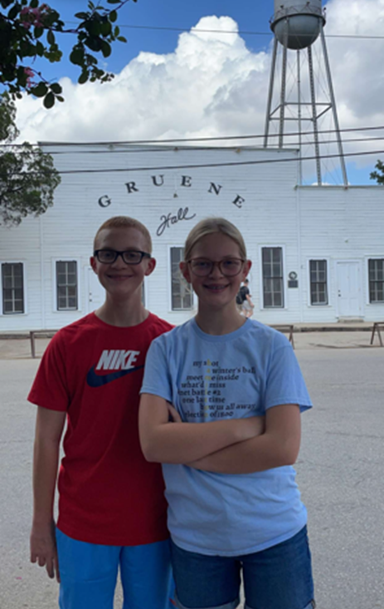
February
February 13, 2024 @ 9:30
Joint MCT/TEXAS SET
Change Control Call
WebEx Only

