Slide 1
Lubbock
Retail Integration Task Force – LRITF
February 6th, 2024
Chris Rowley Michael Winegeart Sheri Wiegand

Slide 2
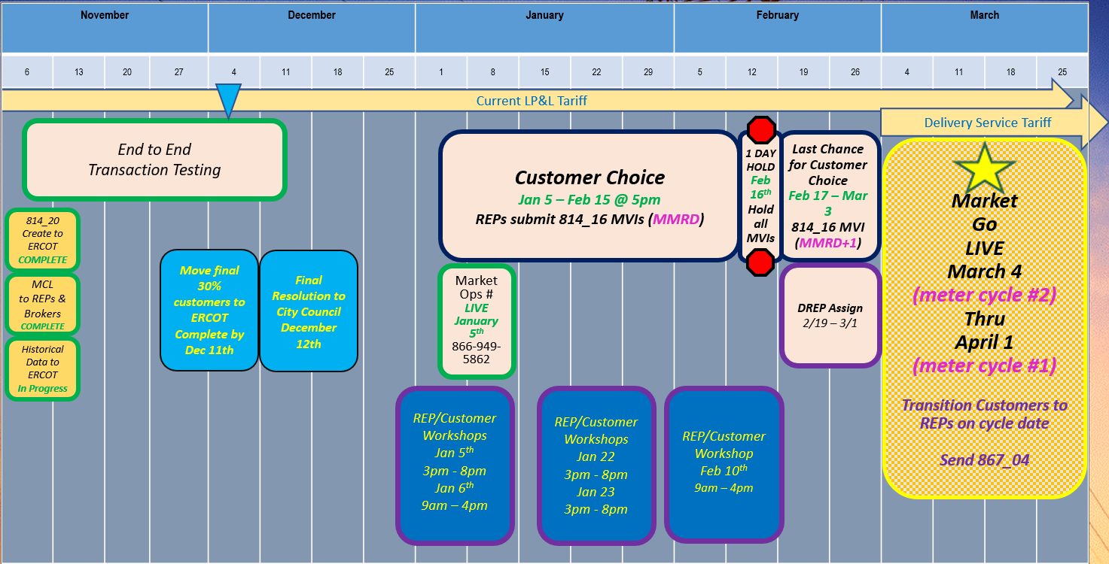
Final Transition Timeline

Slide 3
LRITF meetings
1/9/24
1/23/24
The Task Force reviewed the following:
Customer Choice Transaction Status – with the opening of the Customer Choice period, transaction totals have been presented: 1/9 ~5000 enrollments, 1/23 ~19,700 enrollments
Winter Storm Uri Securitization: LP&L, ERCOT, PUCT Staff, & REPs all agree on interpretation of legislation/dockets calling for exemptions of Lubbock residents from Uri securitizations (M and N). ERCOT filed declaratory order seeking PUC approval of interpretation.
Distribution Loss Factors: Lubbock revised DLFs to only three codes: one for secondary voltages, one for primary, and one for transmission voltages. Revised DLFs posted on ercot.com.
Duplicate Addresses: LP&L created multiple ESI IDs at the same address without utilizing a differentiator such as barn, well, A/C. LP&L created look-up tool for REP use only to align meter number with the respective ESI.
Various Updates: Shopping Fairs, zip codes, historical LP&L rates, transaction testing, historical usage requests, transitioning de-energized ESIs (clearance requests), right of rescission

Slide 4
Completed Action Items
Q&A
Transition to Competition
Q: Will inspections be required for the transitioning MVI transactions? A: Permits will not be required to ‘schedule’ the transitioning MVI transaction. Q: Will existing LP&L customers with multiple ESI IDs be assigned to the same DREP if necessary? A: YES, LP&L will attempt to group the same customer to the same DREP. Q: Will LP&L transition de-energized ESI IDs? If so, under what circumstances? How will the new REP be aware the premise is de-energized? A: LP&L will transition only active accounts. If a premise does not have an active account, a DREP will not be assigned and the ESI ID will be energized only when an MVI is submitted post-transition. De-energized ESI IDs with active accounts (ESI ID is de-energized for a clearance request) will transition to a REP of Choice or a DREP. Upon transition, LP&L will send a 650_04 to the REP of Record notifying of the de-energized status.

Slide 5
Completed Action Items
Q&A
TDSP Specific Activities
Q: Will historical usage information be available for transitioning customers? Will an LOA process be available and when? A: Monthly summary historical usage information will be available via the Mass Customer List (MCL) for entering REPs. Historical interval data will be available for REPs by emailing marketops@mylubbock.us with a signed copy of the approved LOA which is posted on the LP&L website. Brokers may also request monthly and interval data via the LOA process noted above. The LOA process may commence at the time the MCL is available for distribution (late April/early May). LOAs are required to be notarized. Out of state LOAs are accepted with a valid Commission ID. Modifications to the LOA will not be accepted. Upon effectuation of RMGRR176, the LOA found in Appendix B1/B2 may be utilized for LOA requests. LP&L has agreed to provide the following information when responding to a valid LOA: DLF code, load profile, LP&L Rate Class, LP&L Meter Read Cycle, and address. The data for the LOA responses are being pulled from existing systems prior to an ESI transitioning and will be found in the current format. Once an ESI transitions, the format of the data received will align with Section 9, Appendix B4. Q: What are the applicable LP&L zip codes? A: A full list of zip codes has been provided to ERCOT and are also posted on the main LRITF page. Zip + 4s will not be available. https://www.ercot.com/files/docs/2024/01/17/Lubbock-Zip-Codes-2024-01.xlsx Additional zip codes were added in December 2023.

Slide 6
Completed Action Items
Q&A
TDSP Specific Activities - continued
Q: What are the Call Center support lines for LP&L customers to contact for outage reporting? Call Center? REP Hotline? A: The following phone numbers should be utilized: LP&L outage line will remain the same as today 1-806-775-2509 New REP hotline number established (for REPs only) 1-866-949-5862 LP&L Call Center (for customers) 1-806-775-2509 LP&L has also developed a REP Contact list of resources which is posted on the main LRITF page. https://www.ercot.com/files/docs/2023/09/14/REP-Contact-Resources.docx The new REP hotline opened mid January, This line is to used for REPs only (no customers) as REPs will be required to provide their REP account number upon contact. Q: What are is the approximate number of solar customers in the Lubbock territory? How will these customers be billed for delivery charges? Will net metering continue for these customers? A: LP&L currently has ~1200 solar (PV) customers and growing. Current LP&L solar customers receive true net metering where energy costs reflect consumption – generation values. Upon transition, LP&L will adopt current TDSP practices of non-bypassable consumption charges. Any generation “credits” may be received from a customer’s REP of choice depending upon their product. LP&L delivery charges will include a monthly fixed charge. LP&L Delivery Charges will be billed under the residential rate classification. A list of all current Solar PV customers will be provided in the same format as the MCL. The TDSP Solar Matrix has been updated to include the operational procedures of LP&L and is posted on the main LRITF meeting page. https://www.ercot.com/files/docs/2023/09/14/Draft-REP-Solar-Questions-TDSP-Matrix_LPL-09082023.xlsx

Slide 7
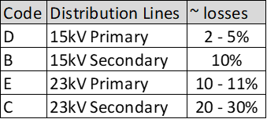
Completed Action Items
Q&A
TDSP Specific Activities - continued
Q: What are LP&L’s Distribution Loss Factors? A: Additional information is posted https://www.ercot.com/files/docs/2023/08/01/LPL-Distribution-Loss-Factor-and-Methodology.docx. DLFs will be applied the same as other TDUs: DL ADJUSTED LOAD = UNADJUSTED LOAD * (1/(1-DLF)) LP&L Distribution Loss Factors were calculated based on 70% of the load in ERCOT with remaining 30% in SPP and acknowledging some inefficient 23kV circuits. LP&L plans to review DLFs in Q2-3 2024 timeframe to update.at the end of 2023 when the final 30% of Lubbock’s load has moved to ERCOT. The revised DLFs will include one value for secondary voltage, one for primary voltage, and one for transmission. New codes will be provided early January 2024. The new DLF codes are expected to be: A – Primary voltage – F1 = 0.0322, F2 = 0.000302, F3 = 0.0254 B – Secondary voltage - F1 = 0.0361, F2 = 0.000926, F3 = 0.083277644 T – Transmission voltage (LP&L currently has no transmission level customers) LP&L does not plan to review any efficiencies gained with moving to ERCOT for at least a couple of months.

Slide 8
Completed Action Items
Q&A
TDSP Specific Activities - continued
Q: Has LP&L created multiple ESI IDs at the same address (duplicate addresses)? If so, how are REPs able to align the appropriate ESI ID with the premise? A: Yes, unfortunately, some ESI IDs were created under the same address without a differentiator such as barn, well, A/C, etc. LP&L has created an ESI look up tool to be used only by registered REPs /brokers which will align the meter number at the premise (found on customer’s current utility bill) with the assigned ESI ID. REPs may request the tool via marketops@mylubbock.us
LP&L Rates
Below is a summary of the approved non-discretionary rates:

Slide 9
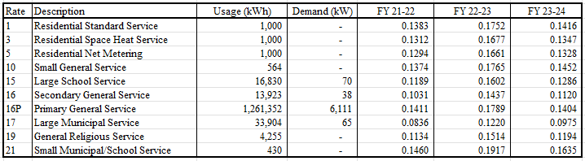
Completed Action Items
Q&A
LP&L Rates - continued
Q: What are LP&L’s historical ‘all in’ rates? A: The following ‘all in’ rates are posted on the main LRITF meeting page:

Slide 10
TIMELINE of Actions
Pro Forma Tariff
Access Agreement
POLR Process
Safety Net Process
Q4 2022
ERCOT Activities: SAC04s, Load Profiles
TSDP Activities: Critical Care, DLFs, Solar/DG, Switch Hold Files, BUSIDDRQ, Call Center, OGFLT, Weather Moratoriums, Proration
LP&L Rates
Customer Enrollment Process – Detailed Timeline
PUCT Complaint Process / Application of PUCT Rules
Transaction Timelines / TXSET Timelines
CSA Process
Q1 2023
Q2 2023
ESI IDs in TDSP Extract
RMG Chapter 8 Revisions
Historical Usage Requests
TDSP AMS Data Practices
Mass Customer Lists
Power to Choose website
Customer Forums/Town Halls
Flight Testing / Bank Testing
Q3 2023
CBCI files
Default REP Selection Process
DNP Blackout Period
Market Operations Group Established
Tampering Information Process
Smart Meter Texas
Q4 2023
March 2024
GO LIVE – Transition to Competition
Completed
Q3 2023
Q4 2023
Q1 2024
Q2 2024

Slide 11
Lritf meeting
2/6/2024 @ 1:00PM following RMS
AGENDA ITEMS:
Customer Choice –
  update on transaction counts / cadence of updates
  Issues/observations
  CSA counts
Shopping Fairs update
Winter Storm Uri Securitization Applicability Status
Sample 867 IDR payload
Historical Usage Requests - LOA
Updated Tariff
  Elimination of DG rates
  Discretionary PMVI
“All bills paid” apartments
Q&A document
Open Discussion

