Slide 1
Monthly Review of Reliability Unit Commitment Market Impacts – December 2023
Wholesale Market Working Group
ERCOT Staff

Slide 2
RUC Resource-Hours
December 2023 | Total | Opt-Out | Non-Opt-Out
Instructed Resource-Hours
Total Count | 7 | - | 7
Effective Resource-Hours*
Total Count | 7 | - | 7
Average LSL | 108.6 | - | 108.6
Average LDL | 109.8 | - | 109.8
Average BP | 109.8 | - | 109.8
Average HSL | 337.4 | - | 337.4
* The difference between “Instructed” and “Effective” values is a result of Resources starting up, shutting down, receiving partial hour instructions, or otherwise not being dispatchable by SCED.

Slide 3
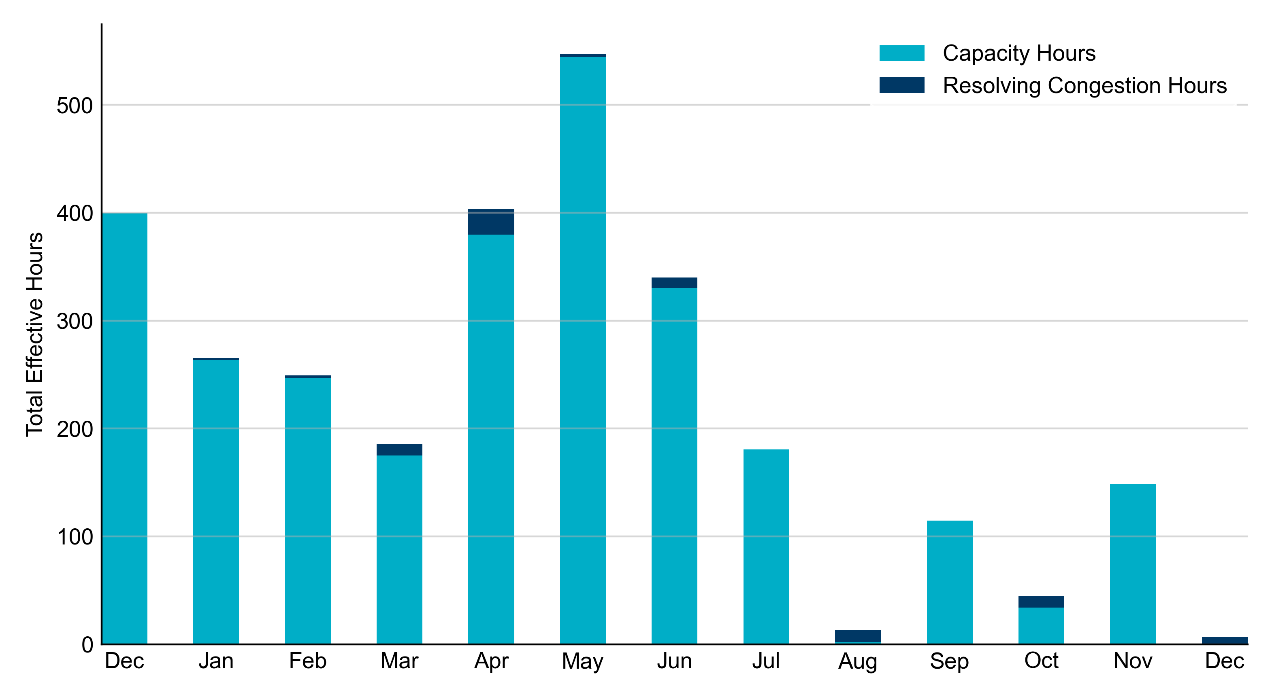
RUC Instruction Reasons: Last 13 Months RUC in December 2023 was primarily driven by concerns over transmission congestion.

Slide 4
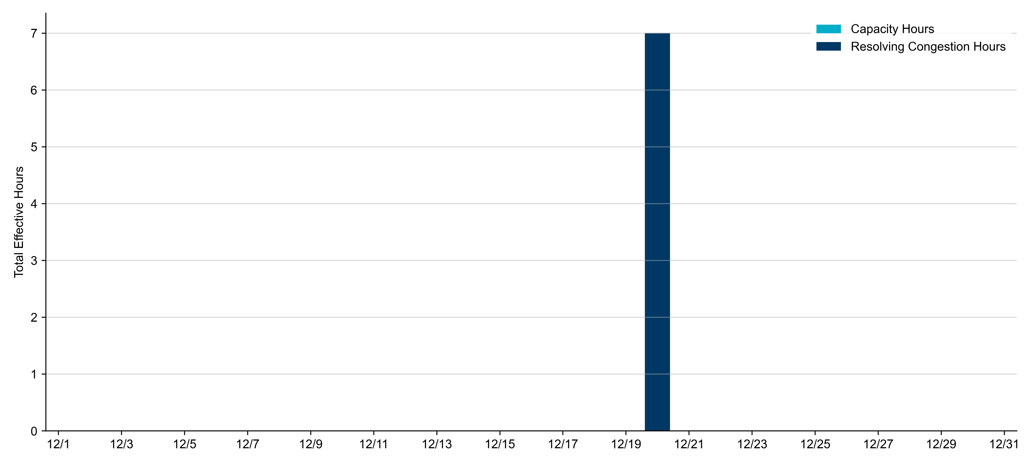
RUC Instruction Reasons in December 2023
7 effective RUC Resource-hours.
7 hours (100%) for congestion concerns.

Slide 5
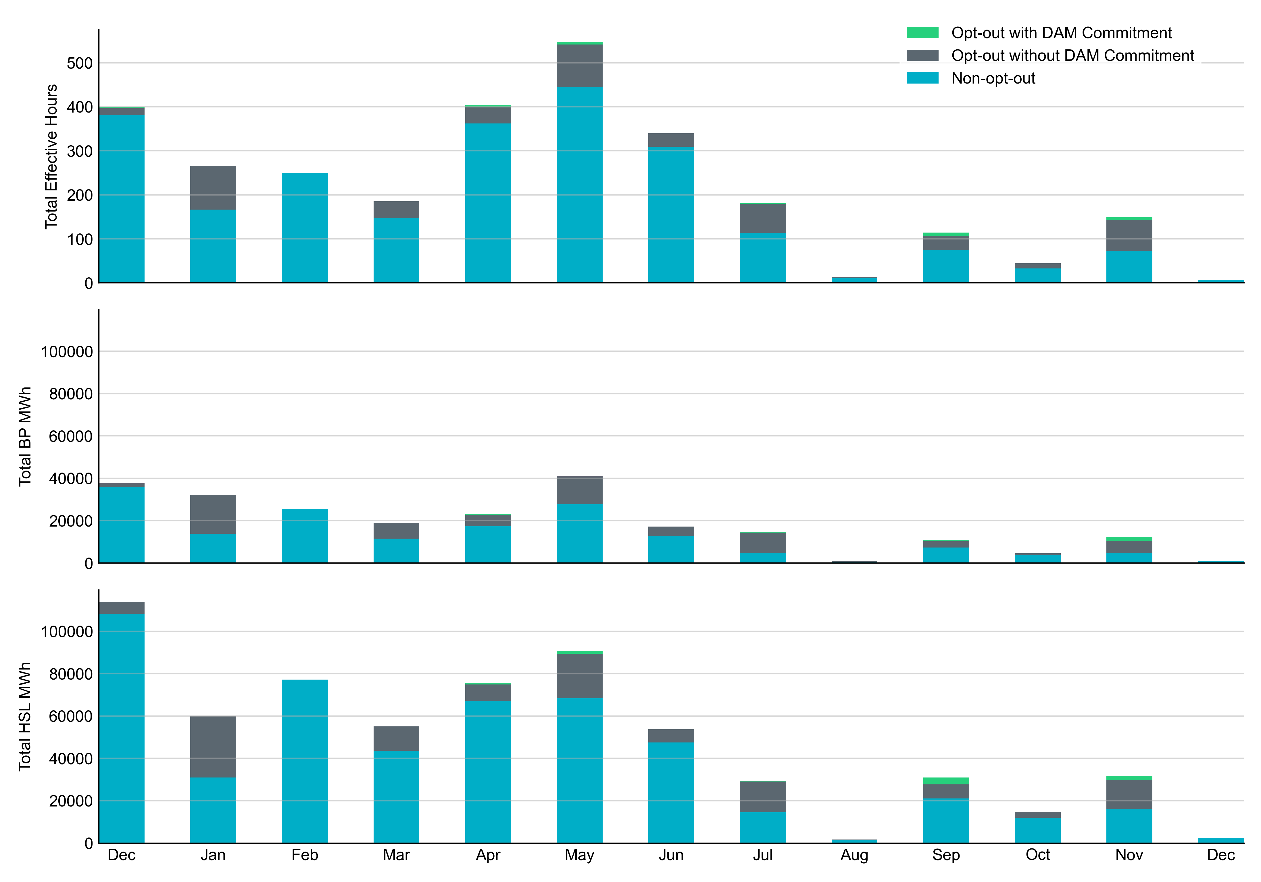
Non-opt-out and Opt-out Totals: Last 13 Months December 2023 had a total of 7 non-opt-out effective Resource-hours, which was 100% of the effective Resource-hours for the month, as there were 0 opt-out effective Resource-hours.

Slide 6
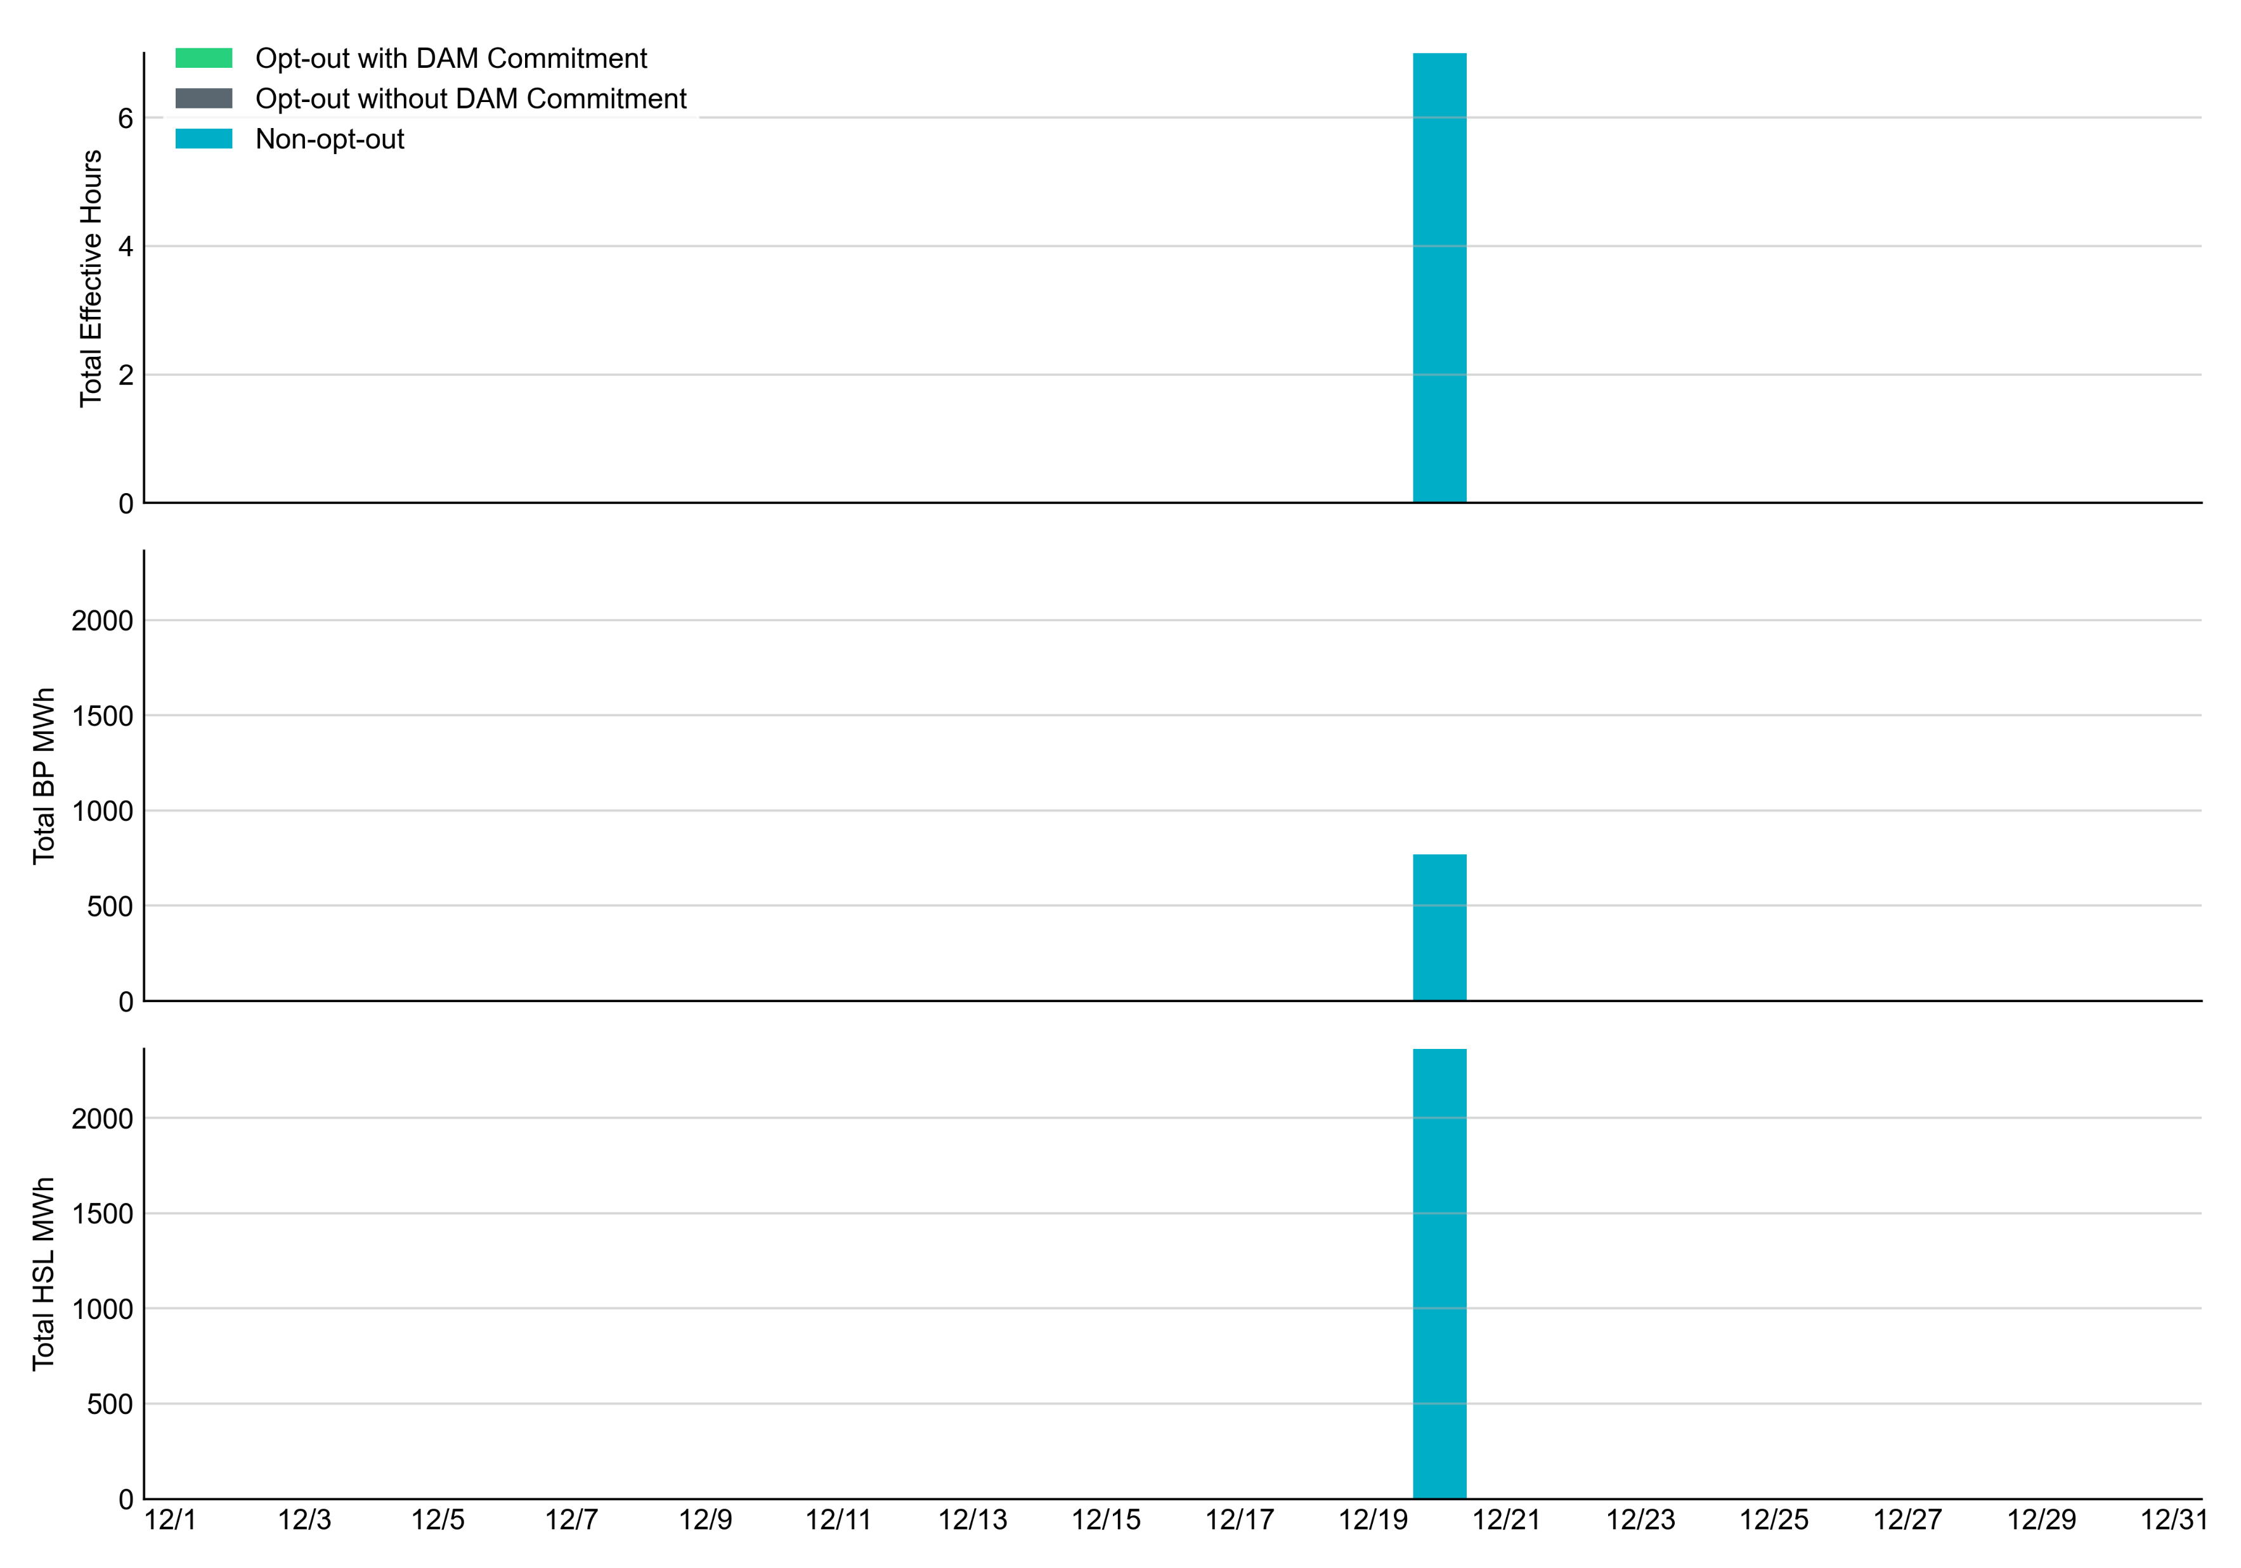
Non-opt-out and Opt-out Totals: December 2023

Slide 7
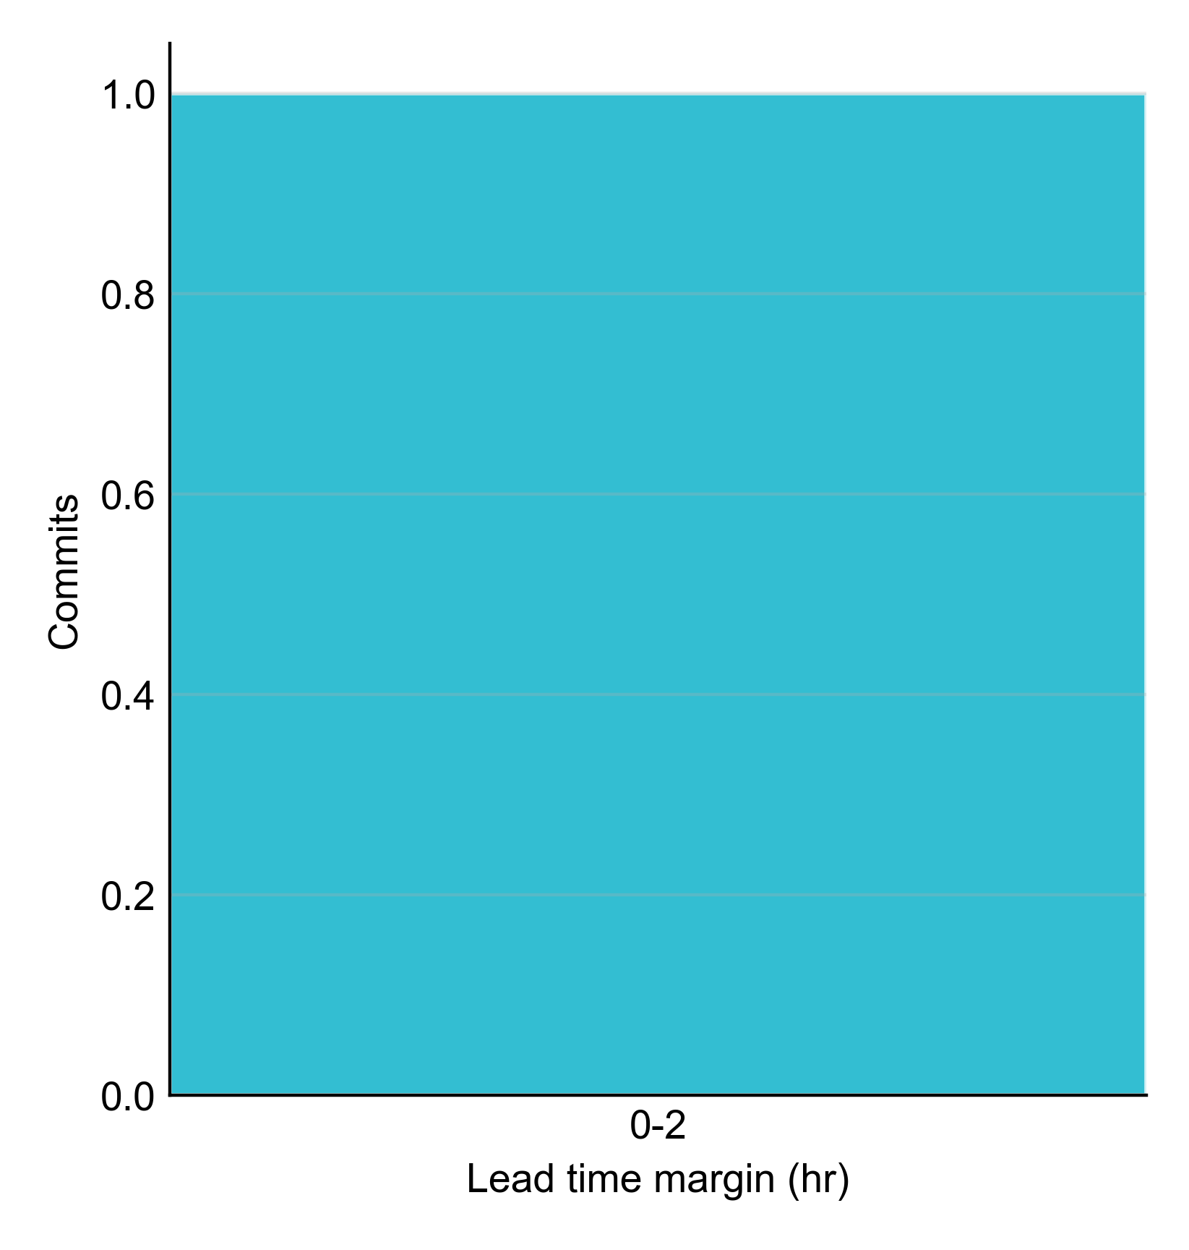
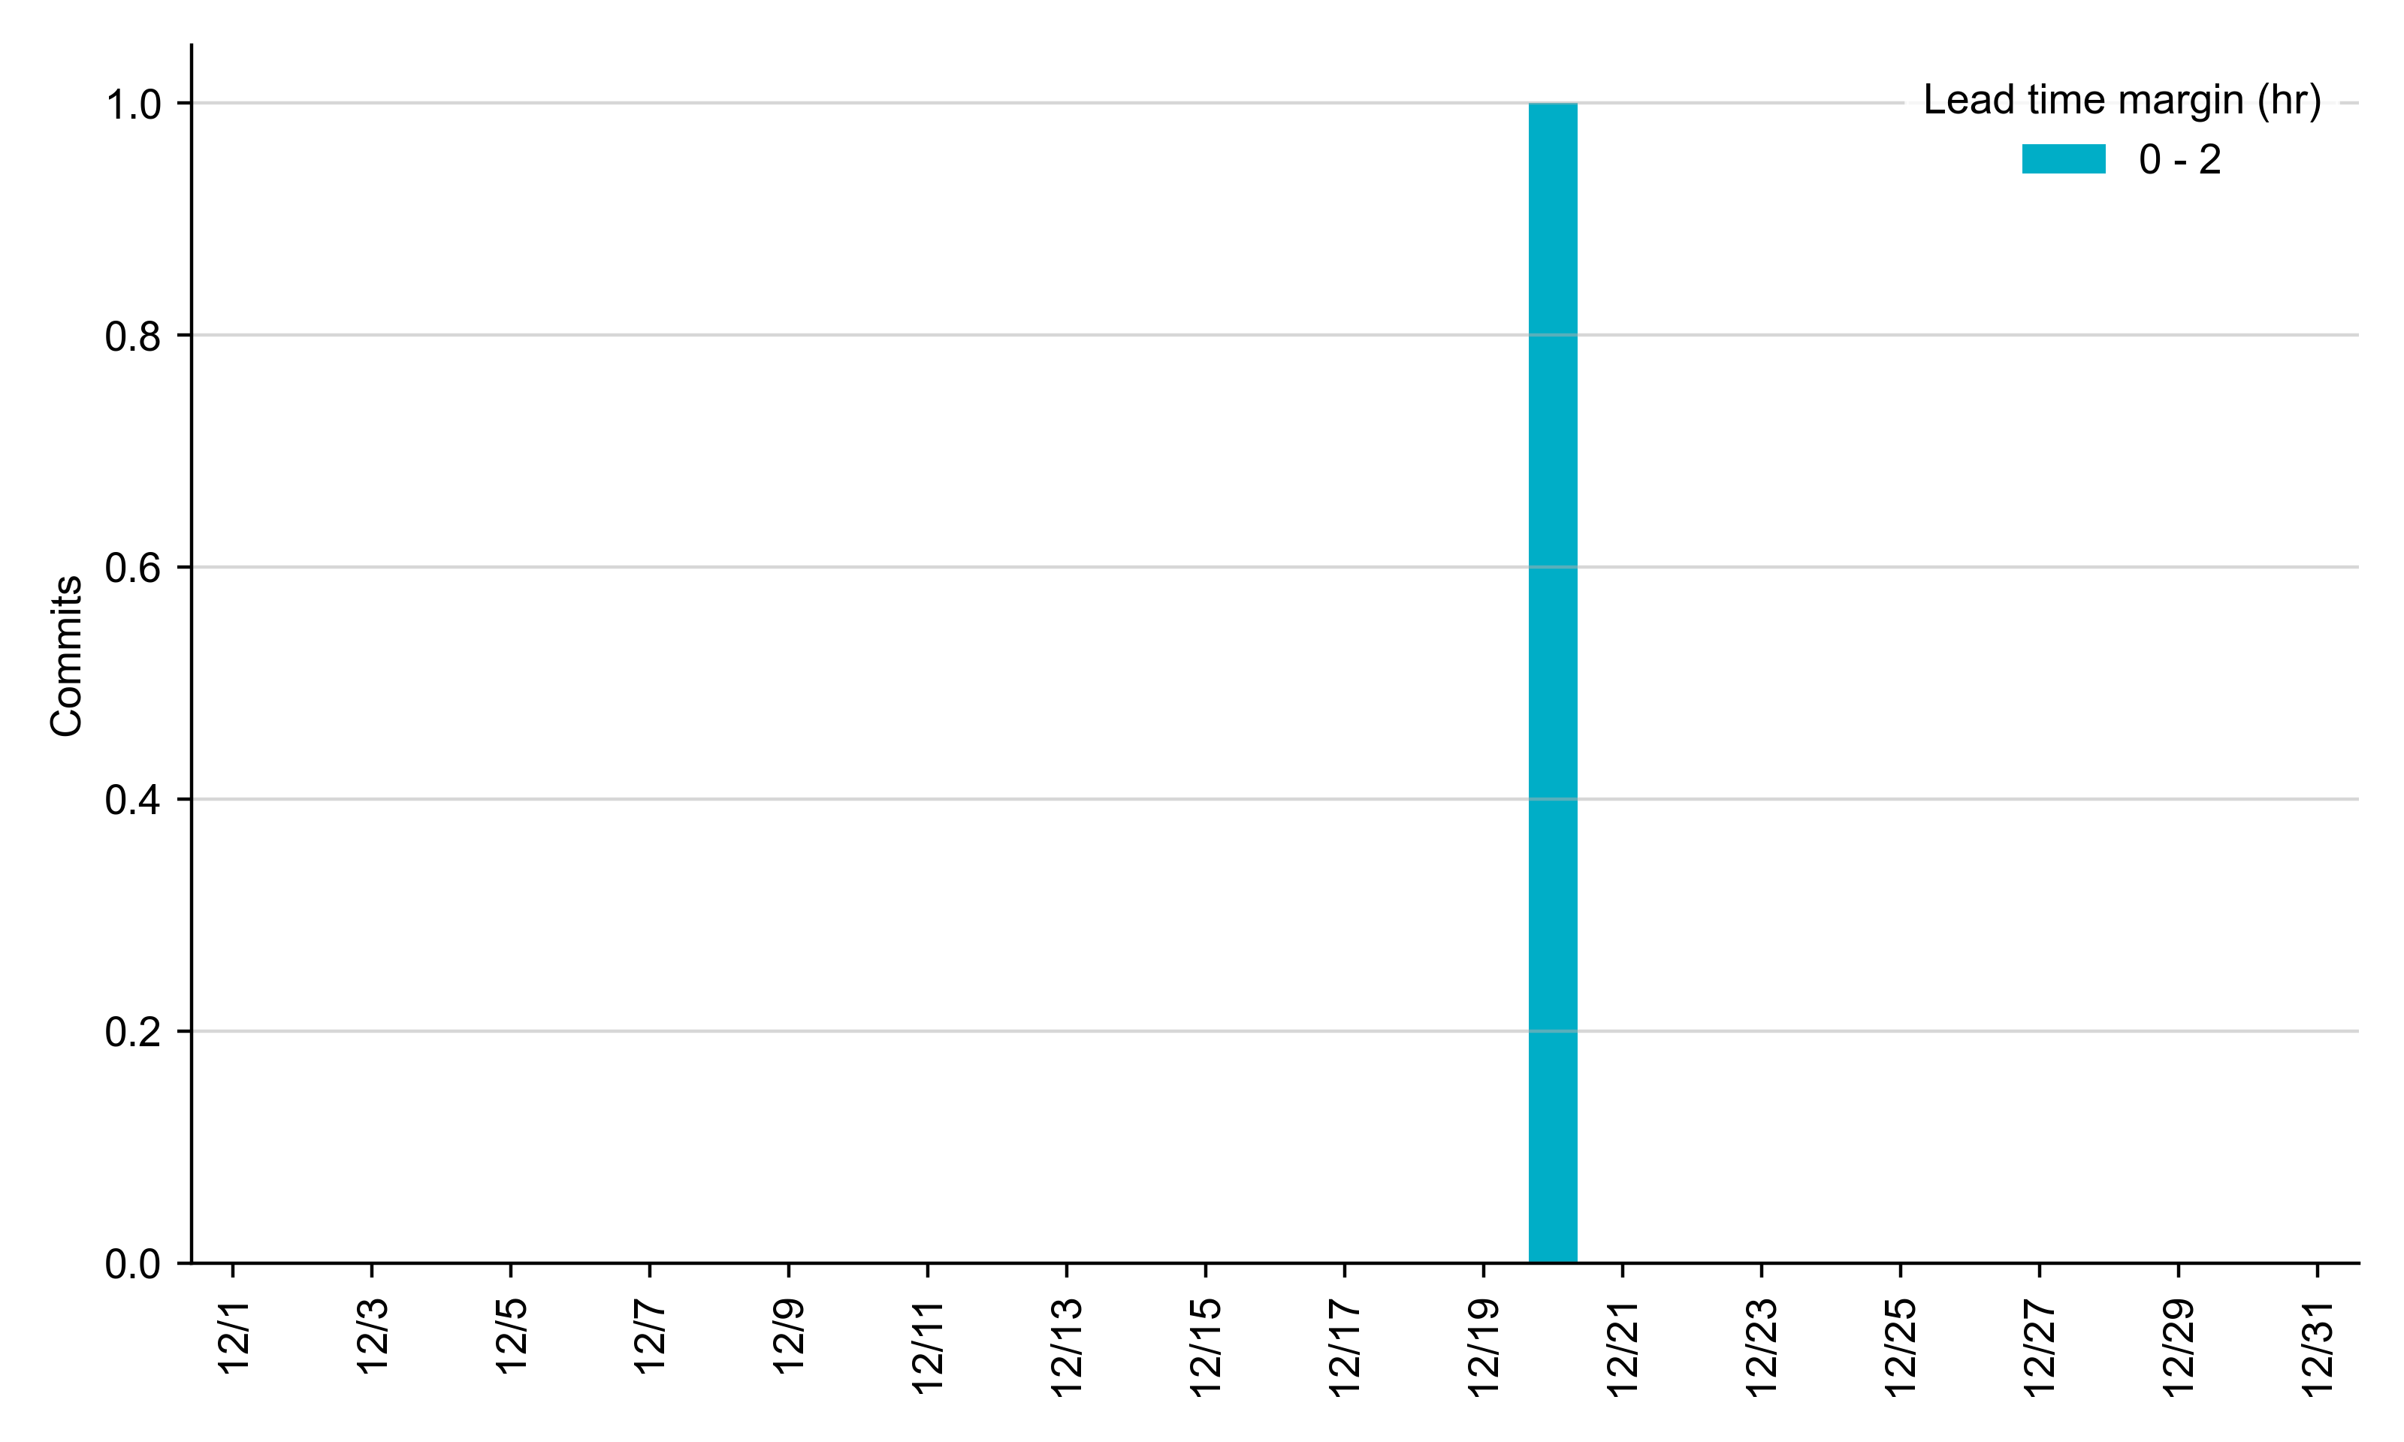
RUC Lead Time Margin: December 2023
The RUC commitment had a lead time margin of 1 hour.
Lead time refers to the length of time between a RUC instruction and the start of the commitment window.
Lead time margin is the difference between lead time and the Resource’s startup time.
In cases where a Resource is committed for multiple back-to-back time blocks, lead time margin is calculated from the first instruction.
Notes:
The first bin is both-inclusive (i.e. [0, 2] ), while subsequent bins are left-inclusive (i.e. [2, 3), [3, 4), etc.).

Slide 8
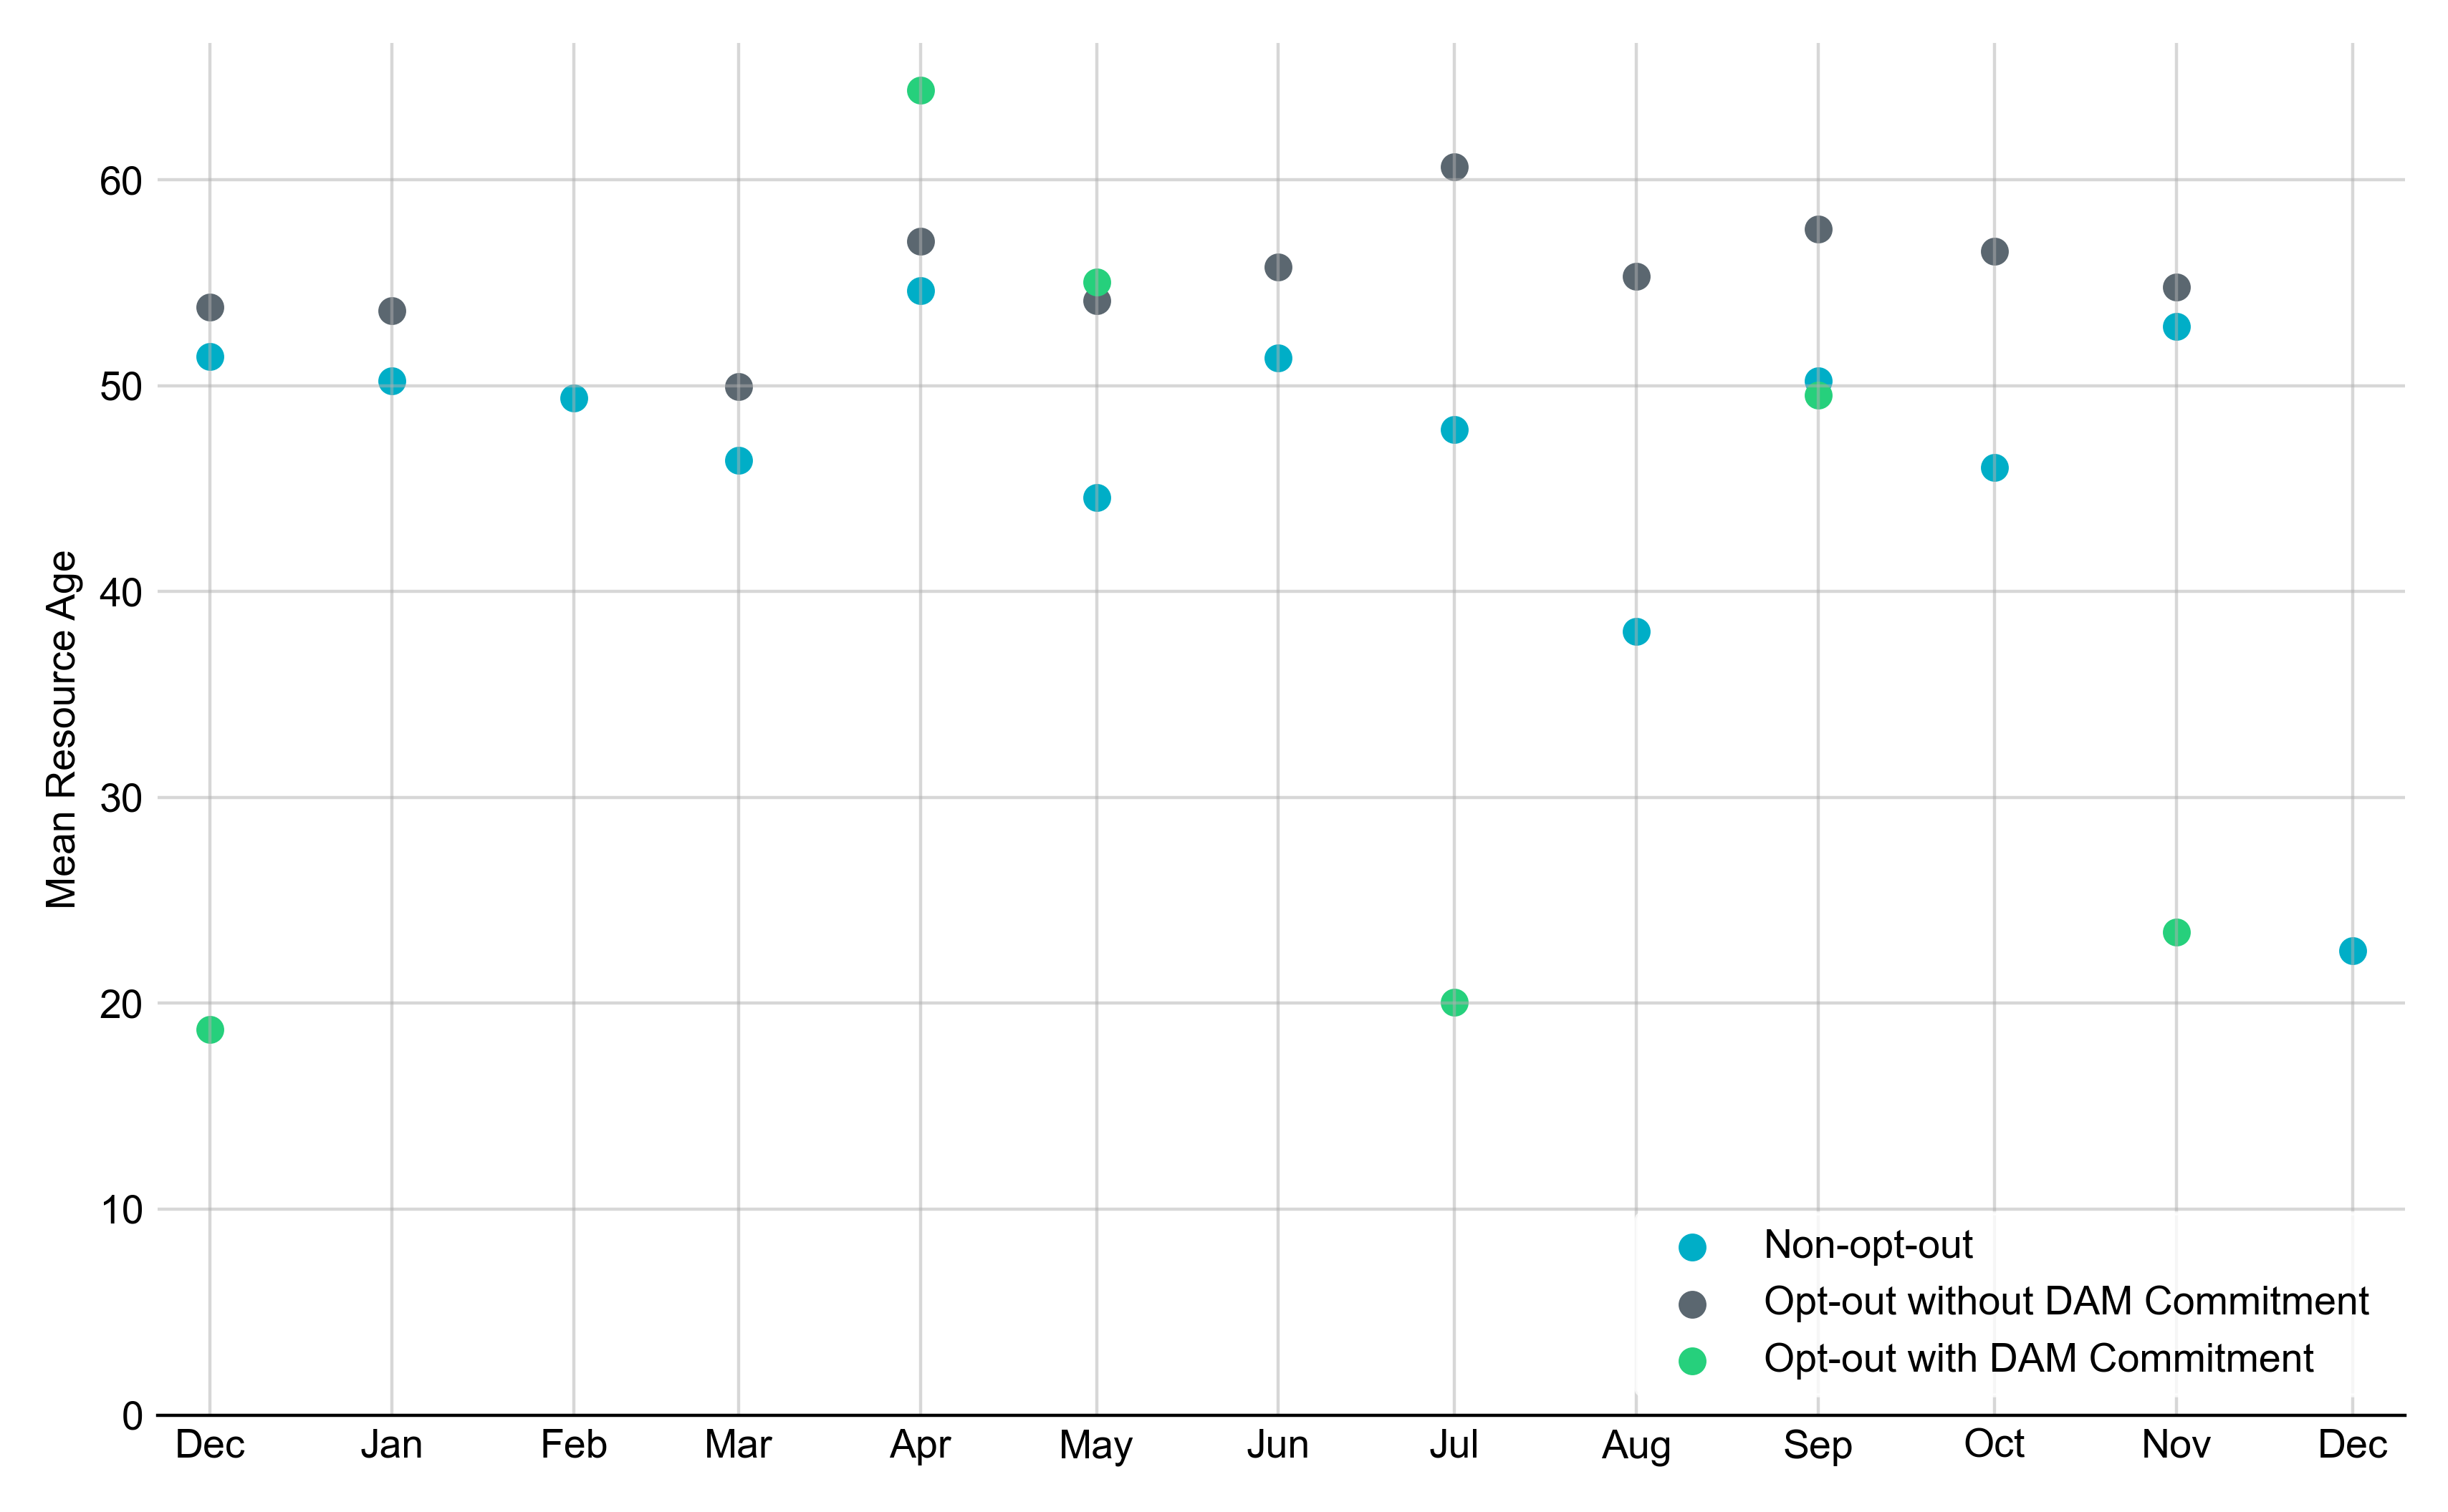
Average Resource Age: Last 13 Months In December 2023, the age of the RUC-committed Resource was 22.6 years.
Note: For Resource configurations with multiple physical generators, the age of the oldest generator is used.

Slide 9
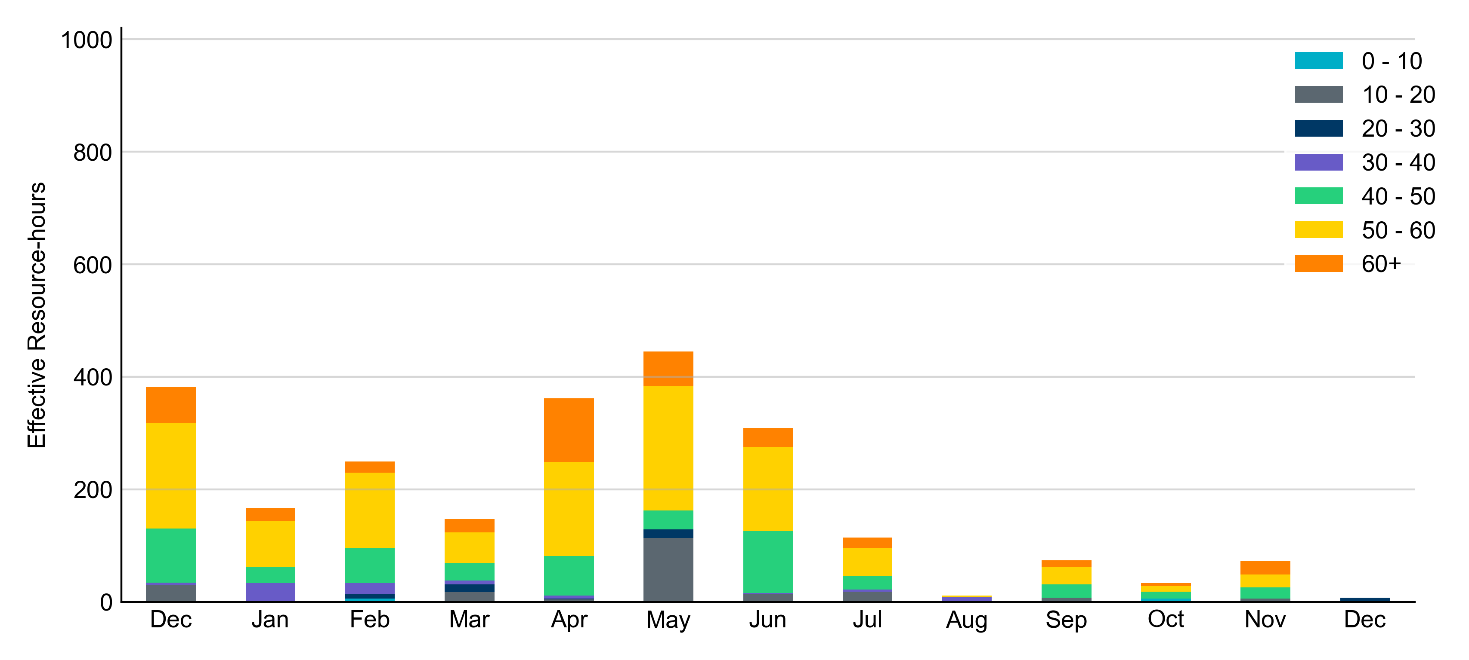
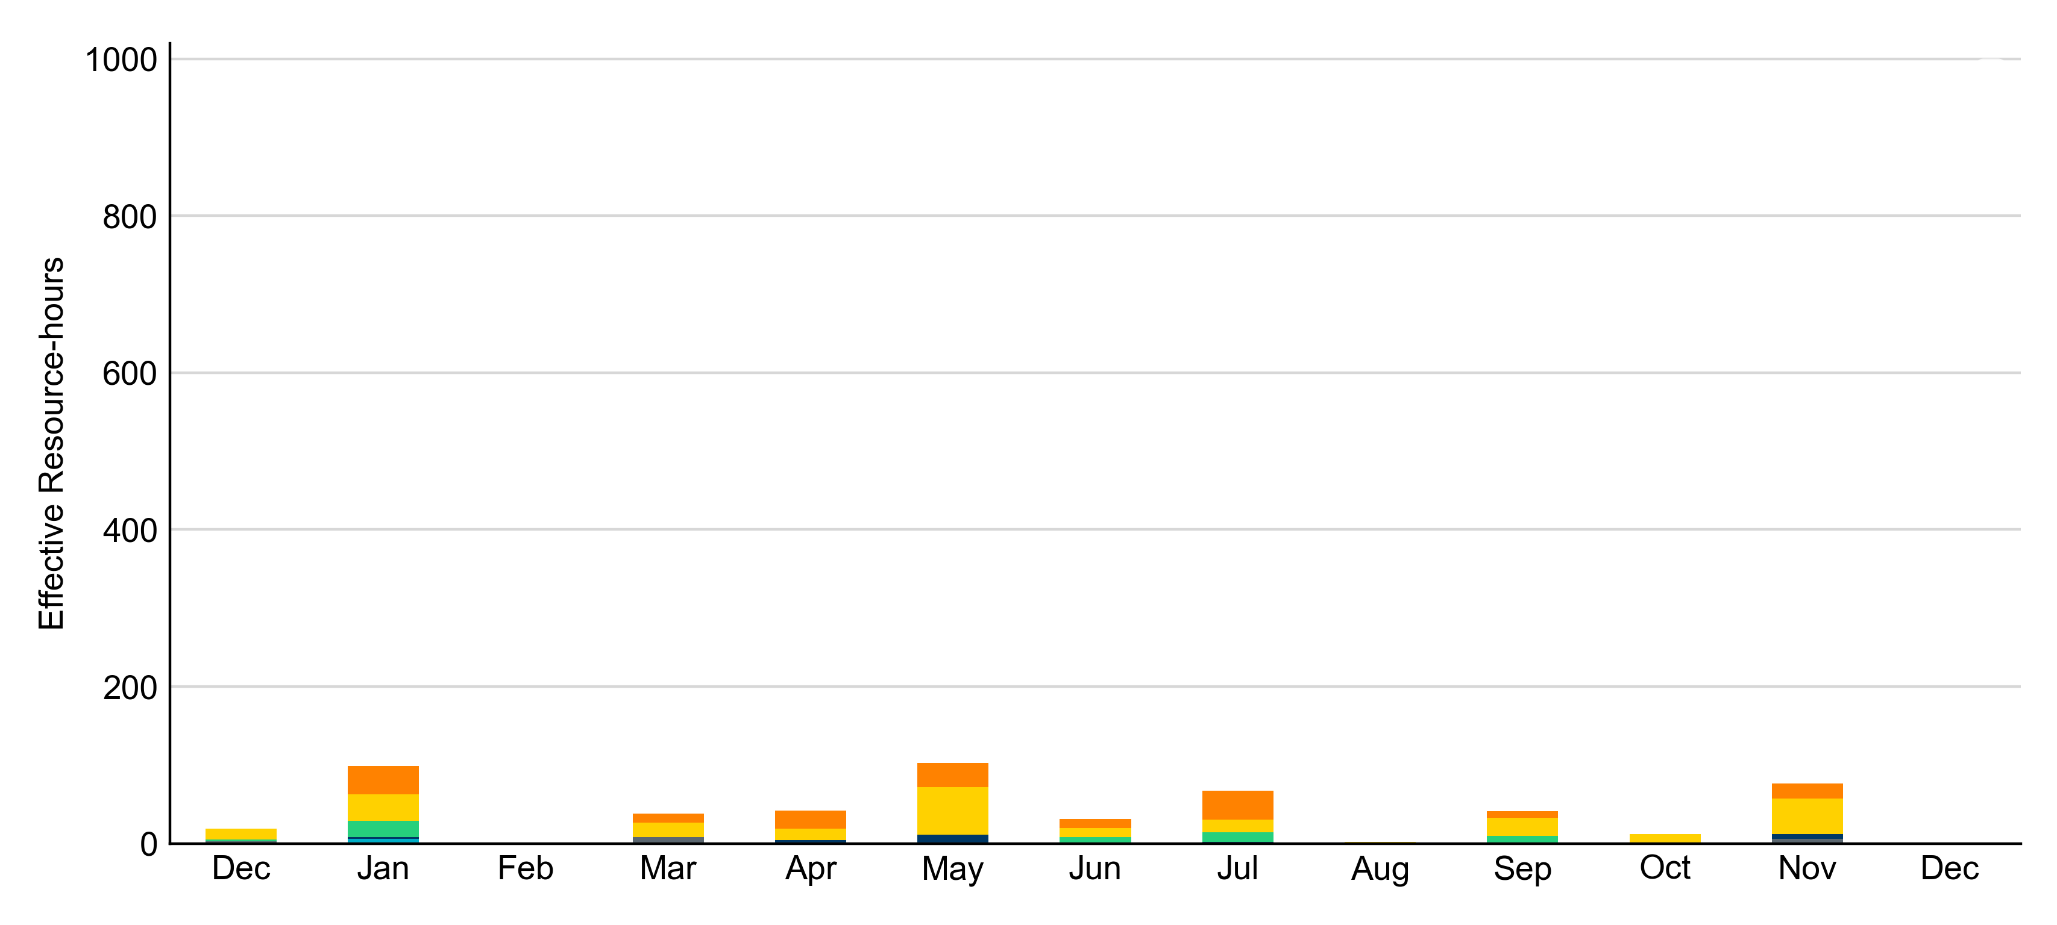
Age Category: Last 13 Months The RUC-committed Resource in December 2023 was 22.6 years old.
Non-opt-out
Opt-out

Slide 10
RUC-Instructed Resource Dispatch above LDL
December 2023
There were no effective Resource-hours in which Resources that did not successfully opt out were dispatched above their LDL in December 2023.
Additionally, there were no Exceptional Fuel Cost submissions for any RUC-Committed Resources in December 2023.

Slide 11
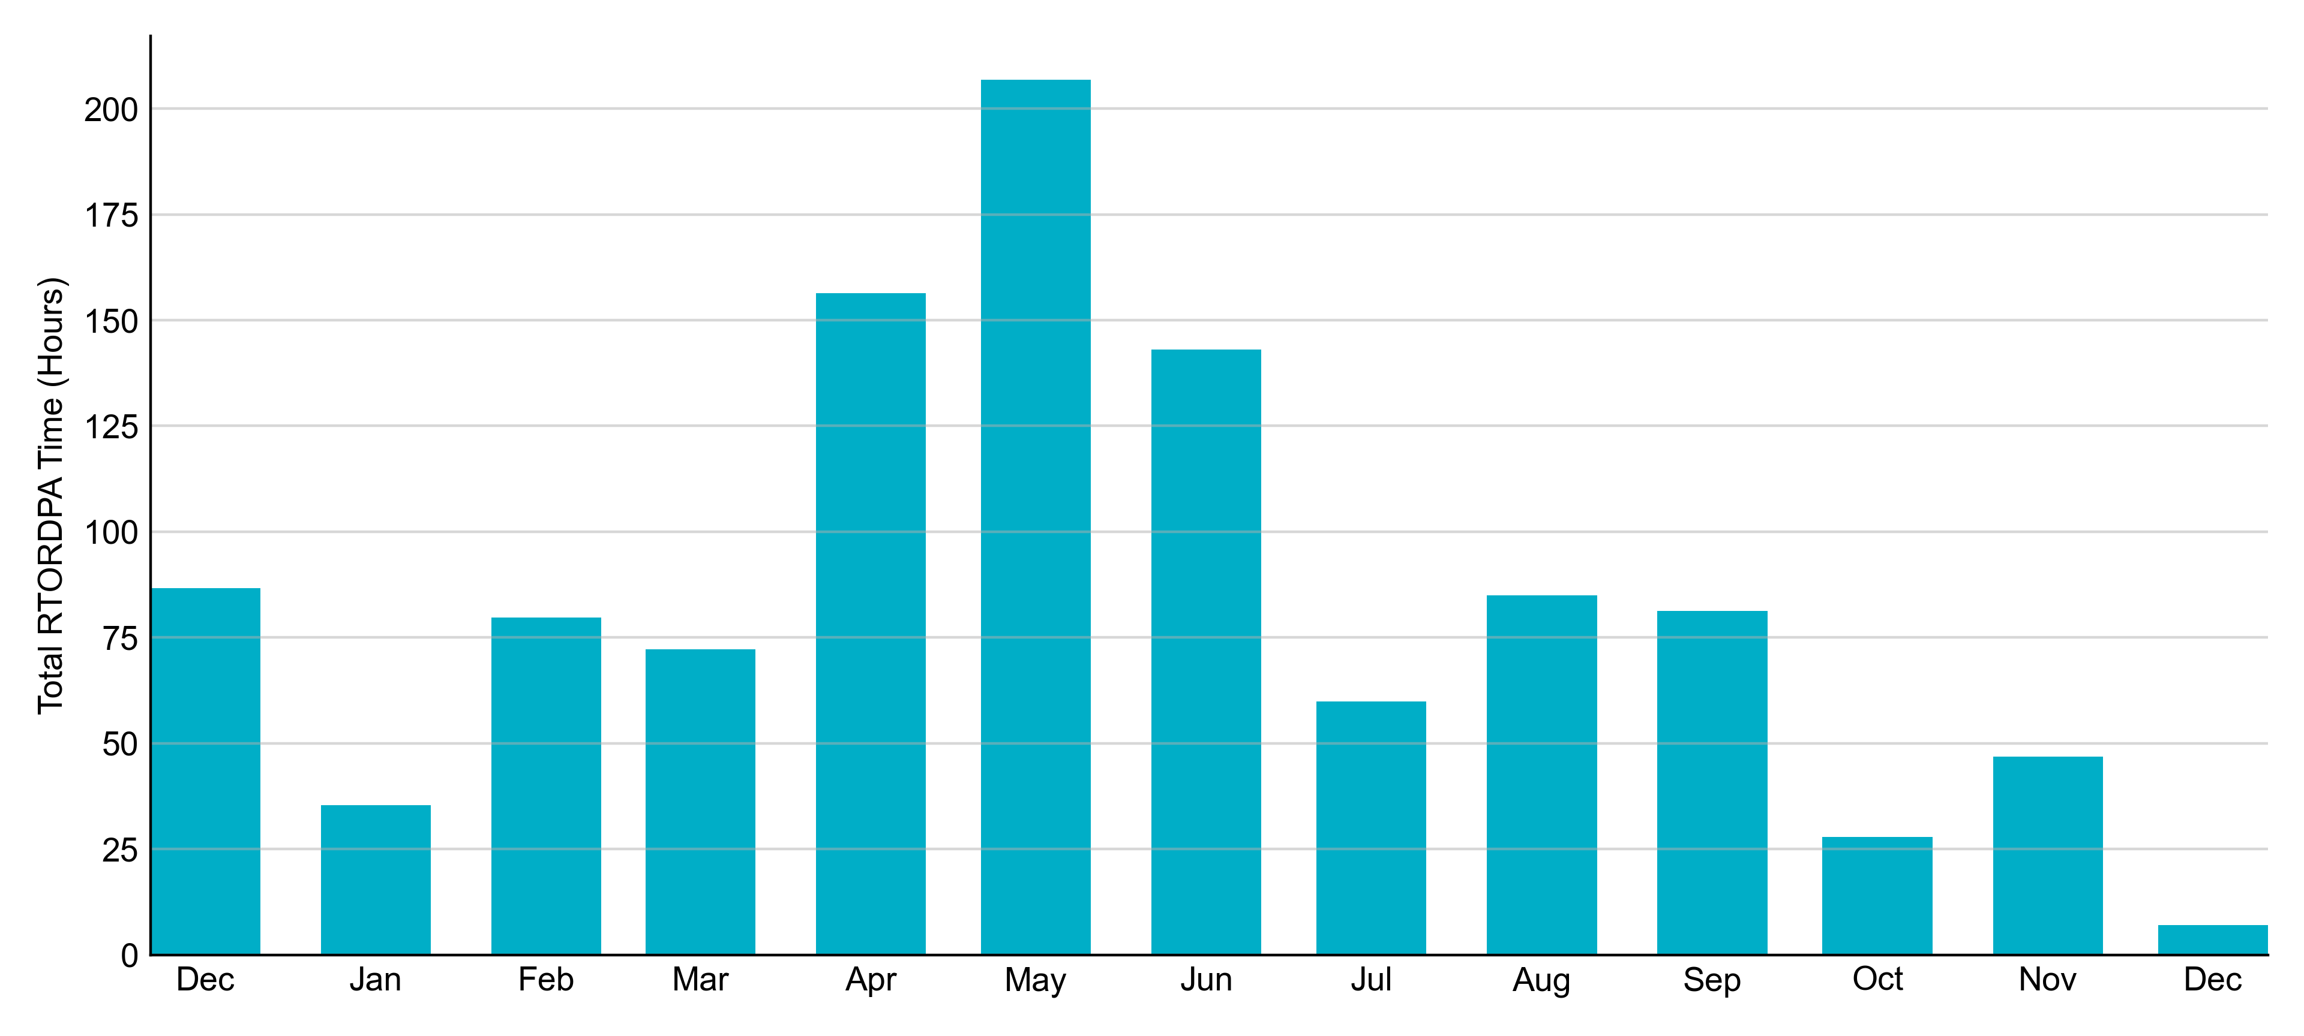
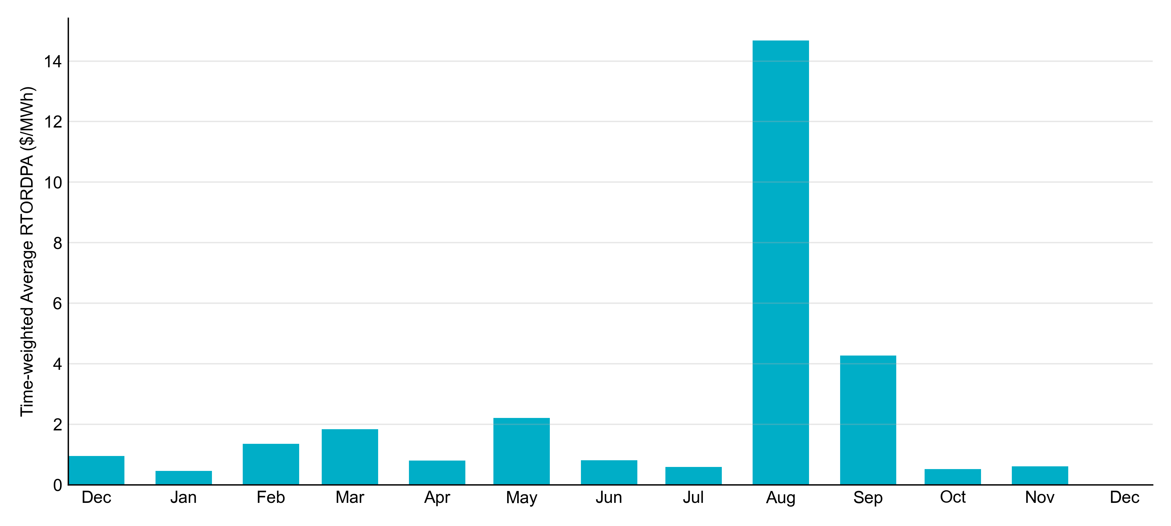
Reliability Deployment Price Adder: Last 13 Months December 2023 had a total of 7 RTORDPA hours with an average value of $0.01/MWh.
These graphs include all non-zero RTORDPA triggered by reliability action taken by ERCOT including RUC, Deployed Non-Controllable Load Resources, Deployed ERS, etc. The full list and detailed methodology can be found in protocol section 6.5.7.3.1, Determination of Real-Time Reliability Deployment Price Adders.

Slide 12
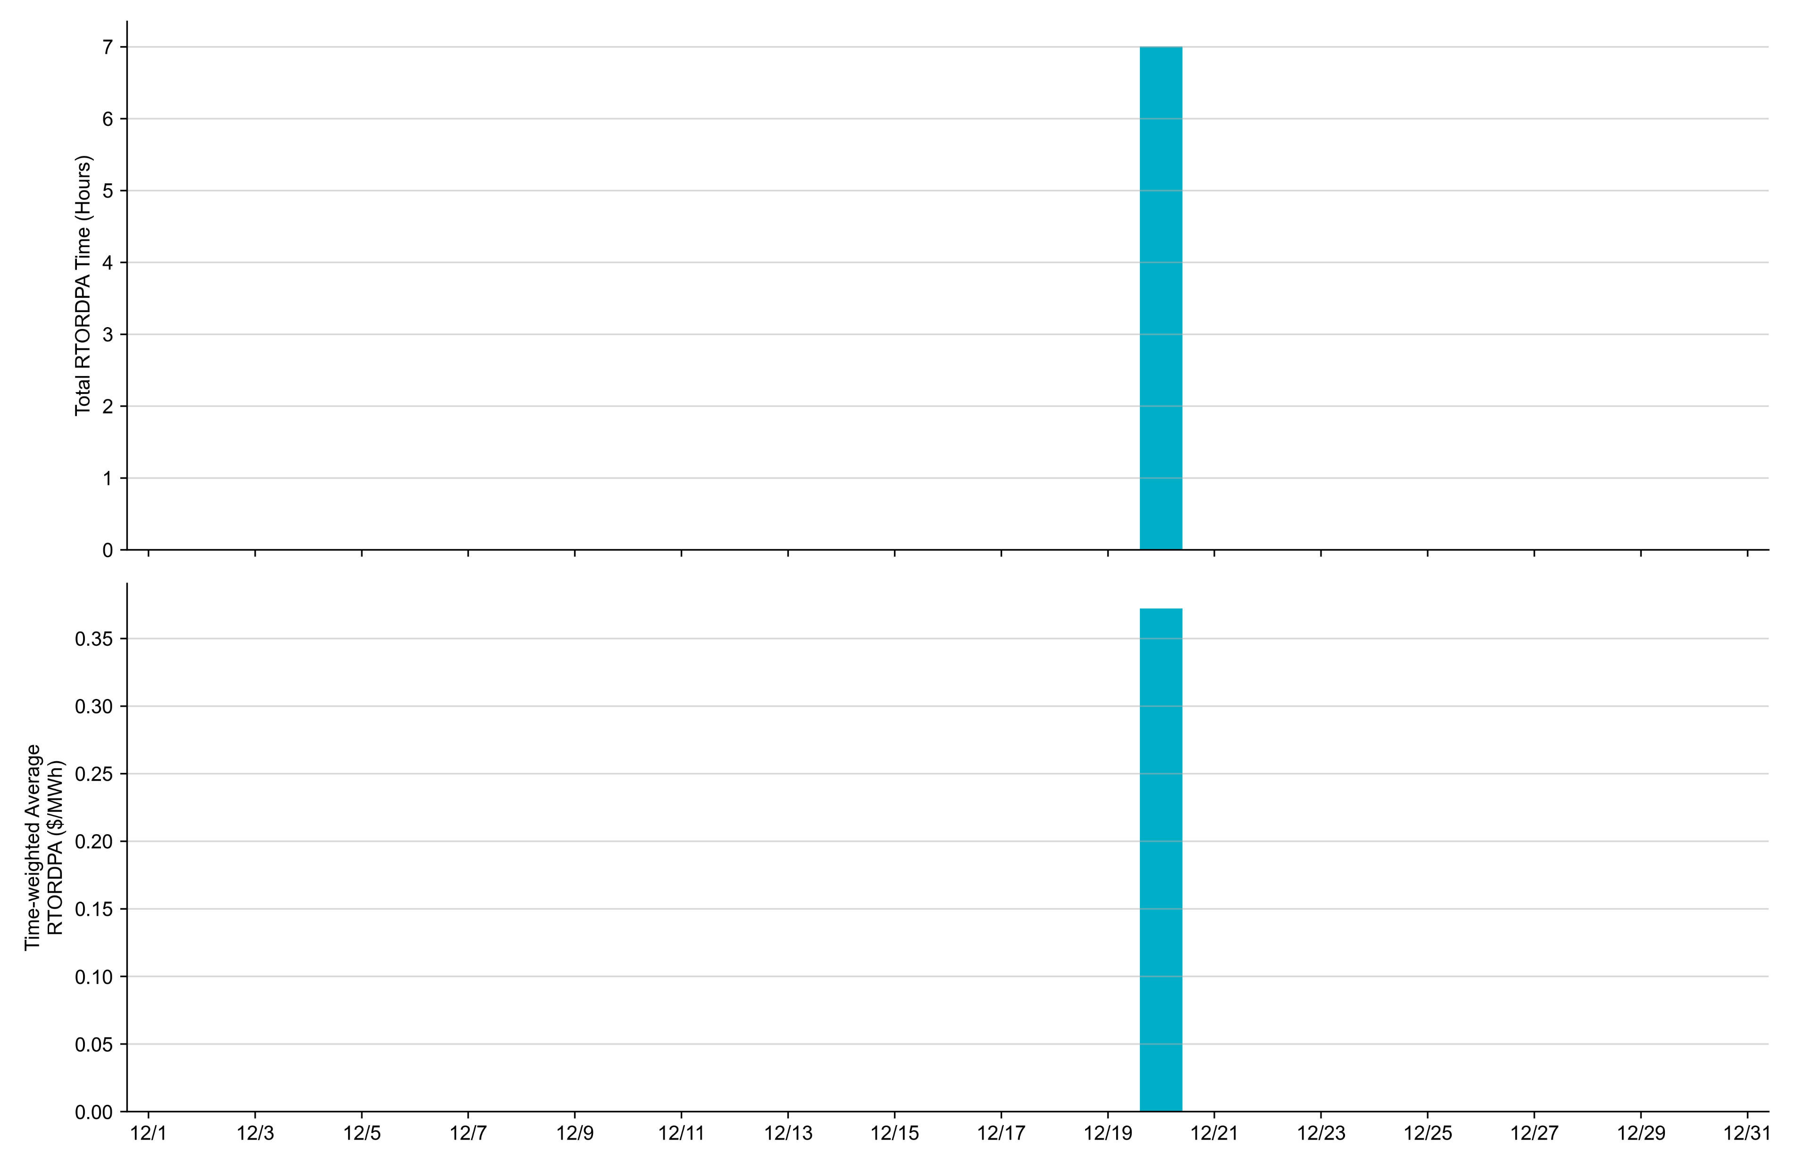
Reliability Deployment Price Adder: December 2023 OD 12/20 had a daily time-weighted average RTORDPA of $0.37/MWh, based on a total of 7 hours.
These graphs include all non-zero RTORDPA triggered by reliability action taken by ERCOT including RUC, Deployed Non-Controllable Load Resources, Deployed ERS, etc. The full list and detailed methodology can be found in protocol section 6.5.7.3.1, Determination of Real-Time Reliability Deployment Price Adders.

Slide 13
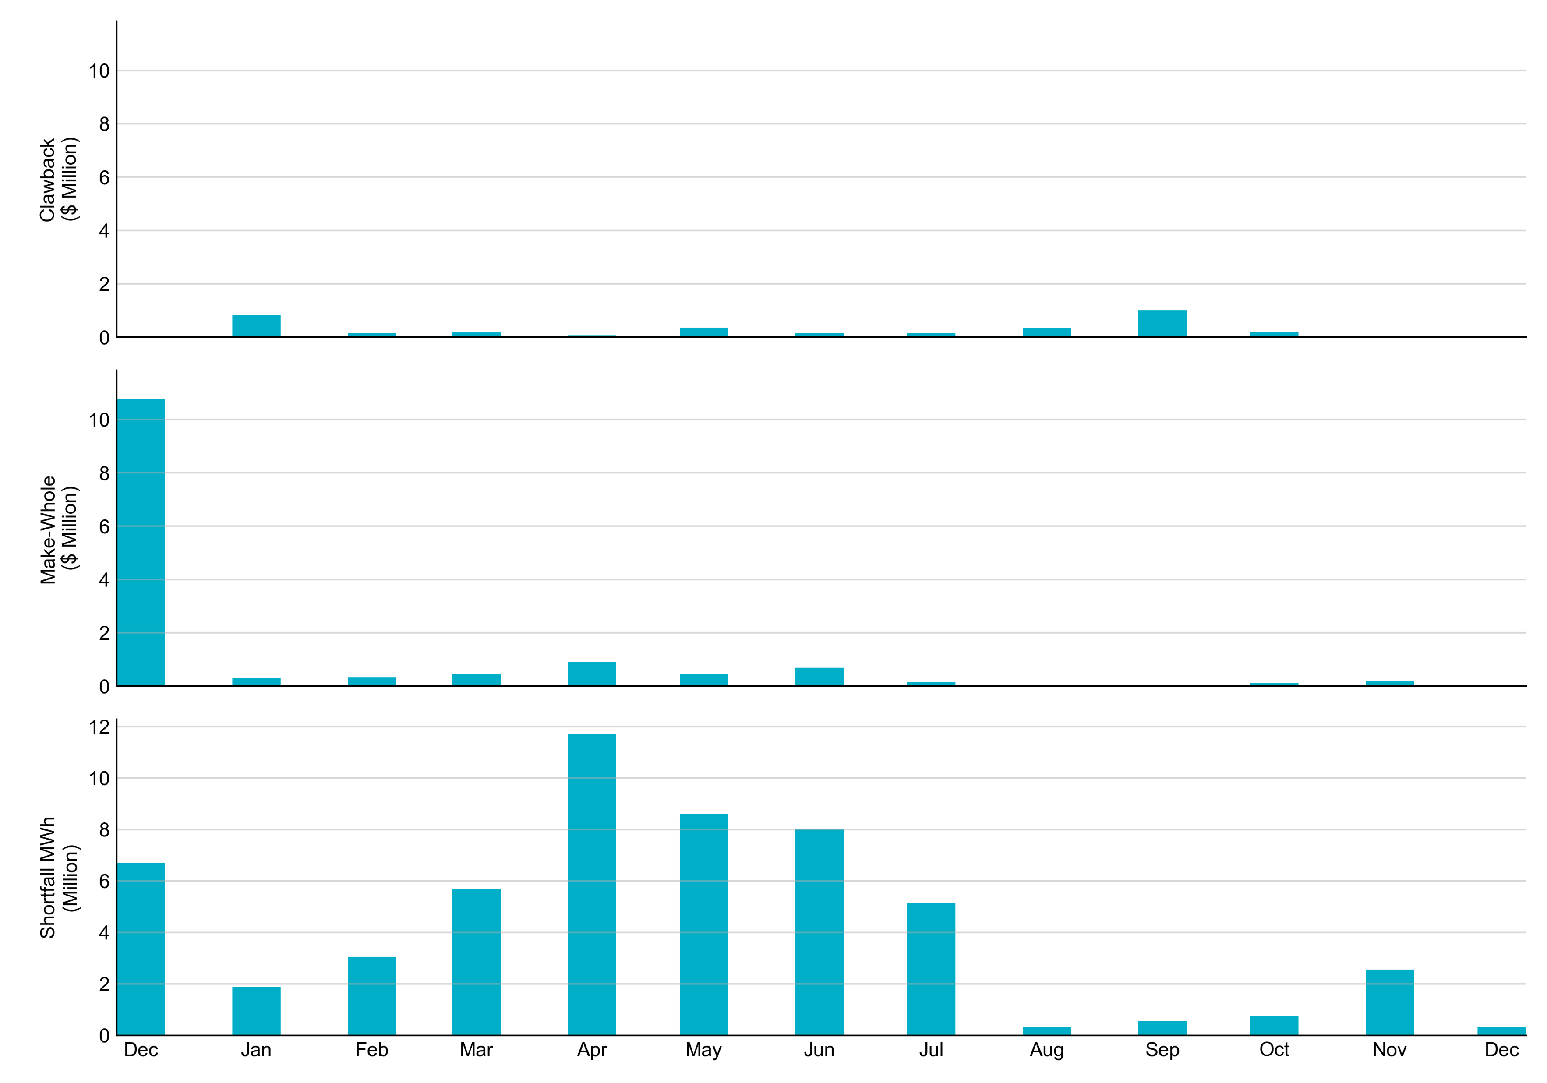
RUC Clawback, Make-Whole, and Shortfall For December 2023, the total Clawback charge was $0. The total Make-Whole payment was $0.005(M)
Of the $0.005 million in Make-Whole payments made in December 2023, the majority was collected through Capacity Short Charges.
Data as of January 8^{h}, 2024

Slide 14
RUC Make-Whole by Settlement Type
Month | Initial Settlement ($) | Final Settlement Change ($) | True-up Settlement Change ($) | Net as of January 8, 2024 ($)
Dec '22 | -1,479,207 | - | -9,288,953 | -10,768,159
Jan '23 | -141,639 | -59,381 | -100,426 | -301,446
Feb ‘23 | -295,131 | - | -31,972 | -327,103
Mar ‘23 | -343,491 | - | -97,889 | -441,379
Apr ‘23 | -687,506 | - | -226,976 | -914,482
May ‘23 | -426,974 | - | -43,426 | -470,400
Jun ‘23 | -600,652 | - | - | -600,652
Jul ‘23 | -161,994 | -4,996 | - | -166,990
Aug ‘23 | -12,090 | - | - | -12,090
Sep ‘23 | -35,168 | - | - | -35,168
Oct ‘23 | -72,477 | - | - | -72,477
Nov ‘23 | -194,731 | - | - | -194,731
Dec ‘23 | -5,316 | - | - | -5,316
Negative dollars represent a payment from ERCOT to a market participant
“-” indicates settlement has yet to be completed.

Slide 15
RUC Clawback by Settlement Type
Month | Initial Settlement ($) | Final Settlement Change ($) | True-up Settlement Change ($) | Net as of January 8, 2024 ($)
Dec '22 | 148,277 | - | -148,277 | 0
Jan '23 | 835,738 | -6,526 | -6,864 | 822,349
Feb ‘23 | 158,319 | - | -1,348 | 156,971
Mar ‘23 | 179,783 | - | - | 179,783
Apr ‘23 | 53,643 | - | -3,557 | 50,087
May ‘23 | 426,519 | - | -62,724 | 363,795
Jun ’23 | 149,347 | - | - | 149,347
Jul ‘23 | 218,907 | -60,841 | - | 158,066
Aug ‘23 | 352,002 | - | - | 352,002
Sep ‘23 | 997,843 | - | - | 997,843
Oct ‘23 | 190,721 | - | - | 190,721
Nov ‘23 | 29,684 | - | - | 29,684
Dec ‘23 | - | - | - | -
Negative dollars represent a payment from ERCOT to a market participant
“-” indicates settlement has yet to be completed.

