Slide 1
Unregistered Distributed Generation Report:
2023 Q4 Update
Resource Adequacy
2/7/2024

Slide 2
2023 Q4 Unregistered Distributed Generation Report
Totals may not match the sum of their columns/rows due to rounding
Notes:
Competitive vs. NOIE breakdown:
Competitive: 1,410.84 MW
NOIE: 1,100.64 MW
NOIE data is submitted through surveys. Competitive TDSP data is submitted through load profile codes.

Slide 3
2023 Q3 → Q4 Change
Solar >=50KW decrease due to data correction from NOIEs.
Totals may not match the sum of their columns/rows due to rounding

Slide 4
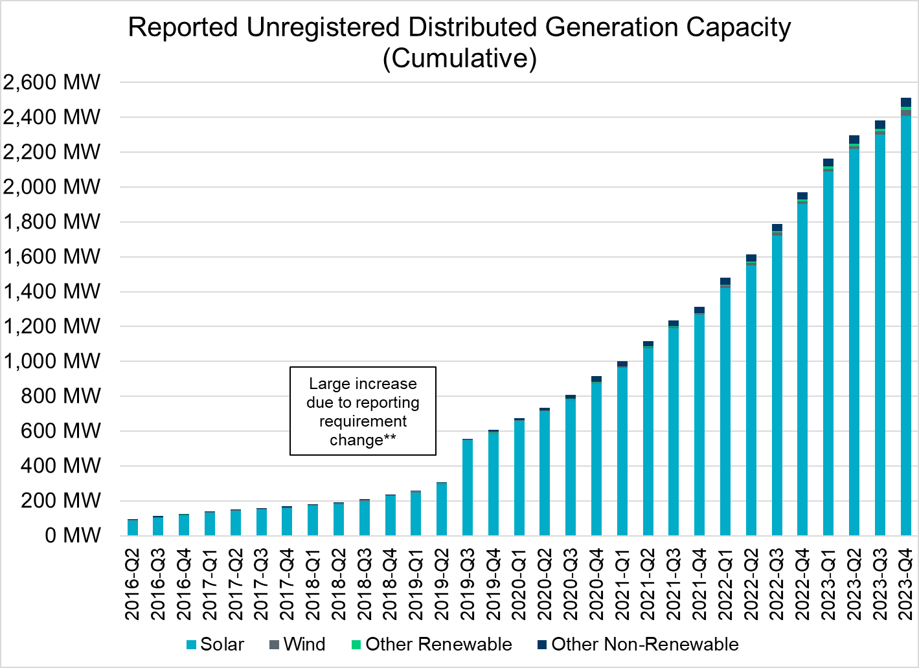
Unregistered DG Growth: 2016-Q2* to 2023-Q4
* 2016-Q2 was the first report published after implementation of report changes per NPRR794/COPMGR044
** 2019-Q3 was the first report published after implementation of report changes per NPRR891

