Slide 1
PDCWG Report to ROS
Chair: Kevin Bunch, EDF Trading North America
Vice Chair: Chad Mulholland, NRG
ROS
February 1st, 2024

Slide 2
Report Overview & Notes
Report Overview
Meeting Minutes
2024 Leadership PDCWG
ERCOT Analysis of Disturbances/Frequency Events
ERCOT Frequency Control Metrics and Regulation Reports
No TRE Report
ROS Open Action Items
BAL-001-TRE-2 FMEs and IMFR
0 FMEs in the month of December
Frequency Control Report

Slide 3
Frequency Measurable Events Performance

Slide 4
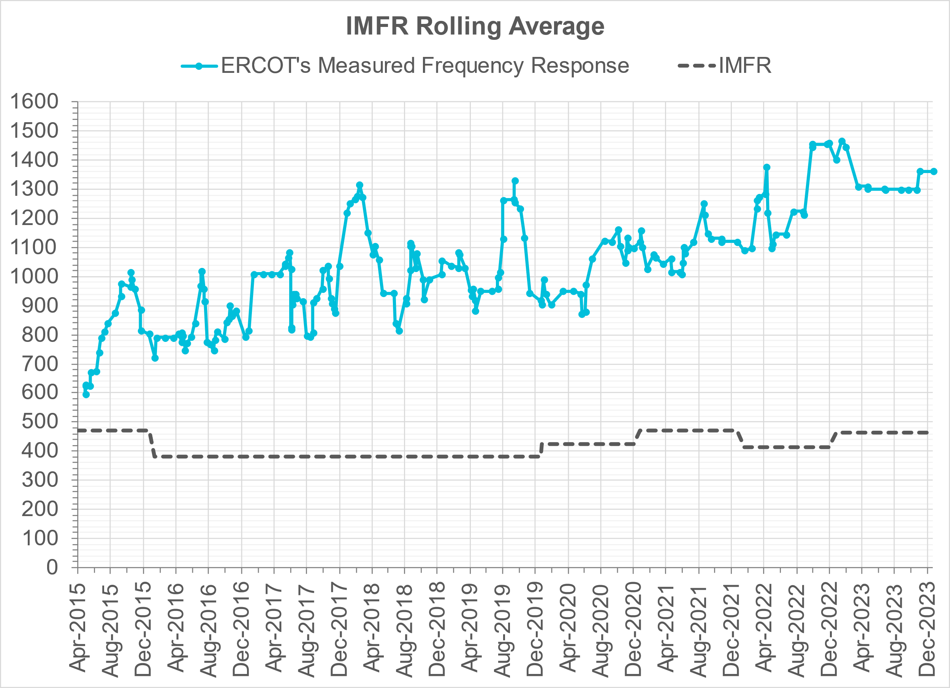
Interconnection Minimum Frequency Response (IMFR) Performance
IMFR Performance currently
1362.18 MW/0.1HZ
Frequency Response Obligation (FRO): 463 MW/0.1 Hz

Slide 5
Questions?

Slide 6
Frequency Control Report
December 2023

Slide 7
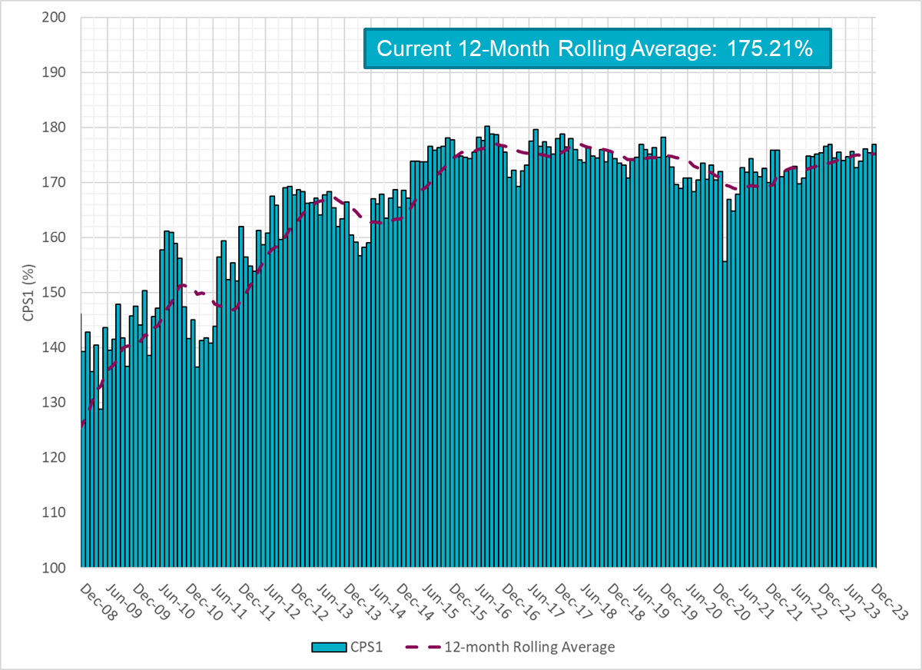
CPS1 Performance

Slide 8
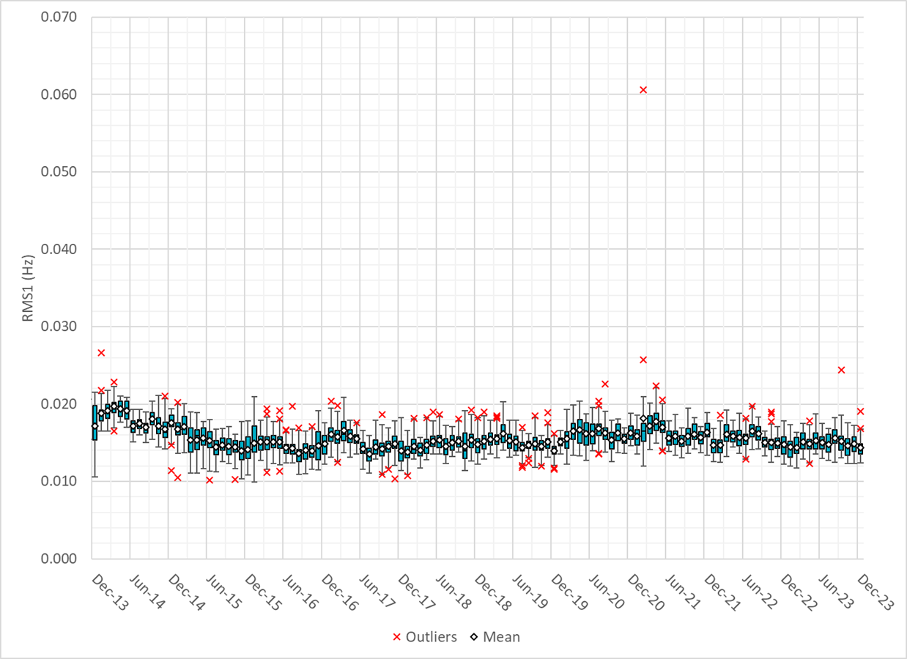
RMS1 Performance of ERCOT Frequency
Notes:
14.36 mHz on avg for December 2023

Slide 9
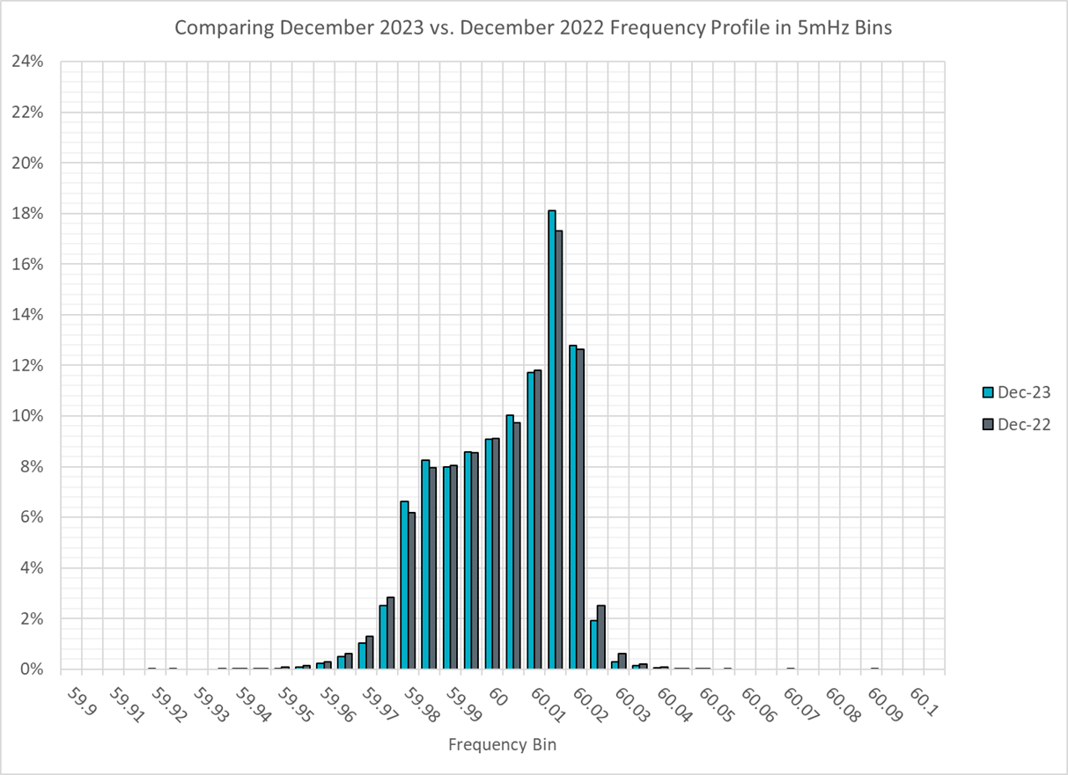
Frequency Profile Analysis

Slide 10
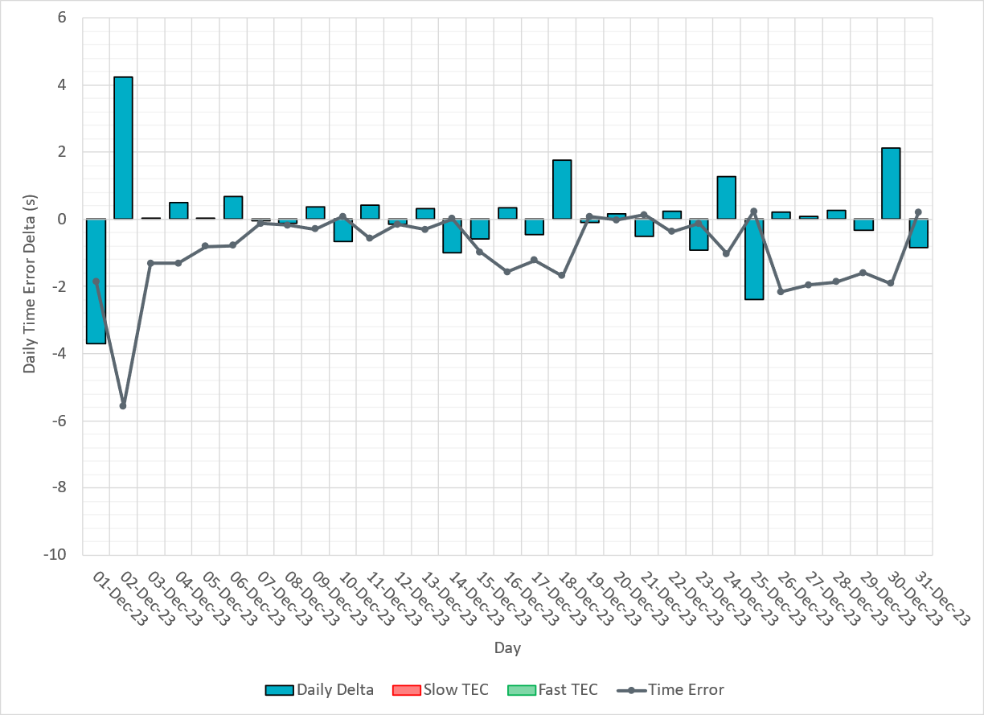
Time Error Corrections

Slide 11
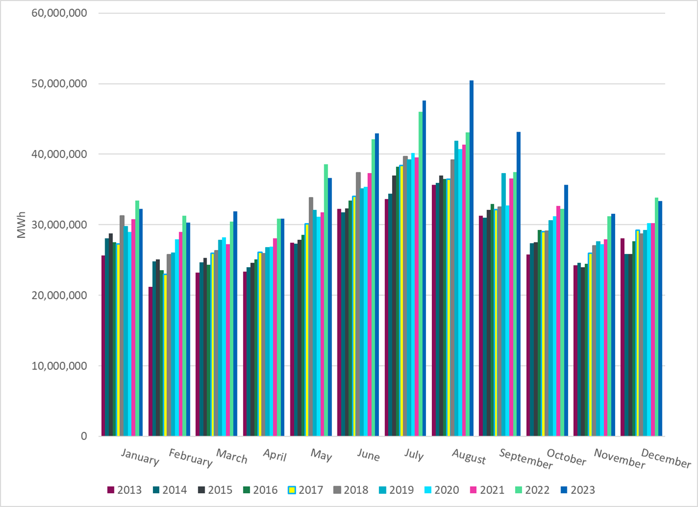
ERCOT Total Energy
Notes:
33,383,311 MWh

Slide 12
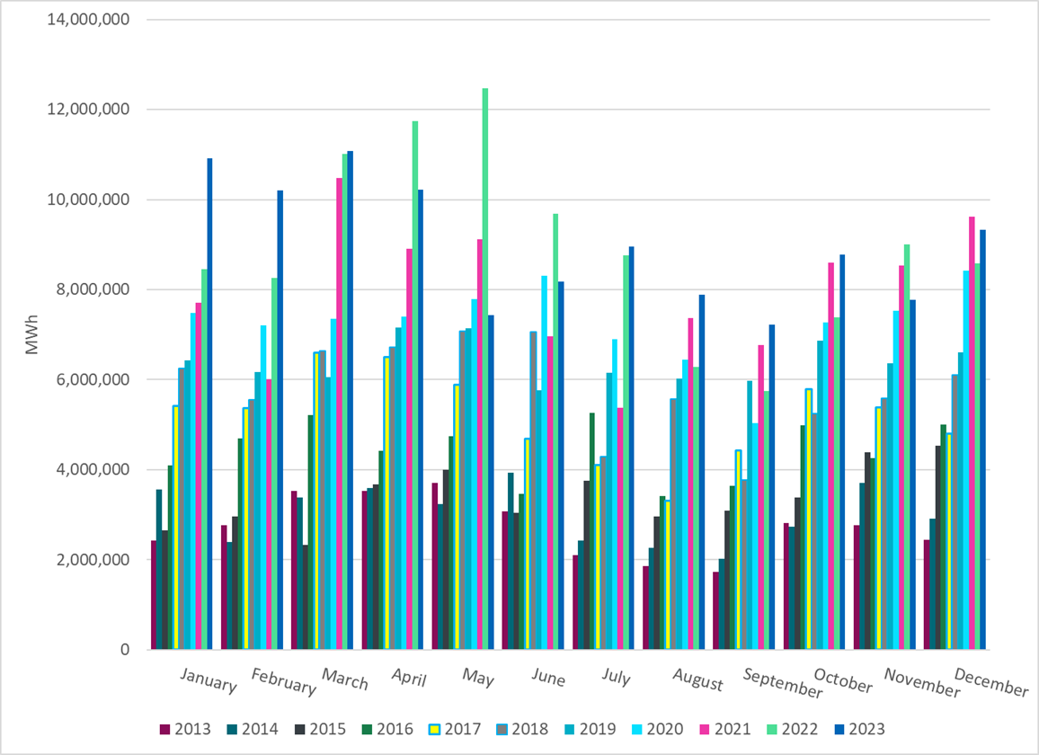
ERCOT Total Energy from Wind Generation
Notes:
9,330,245 MWH

Slide 13
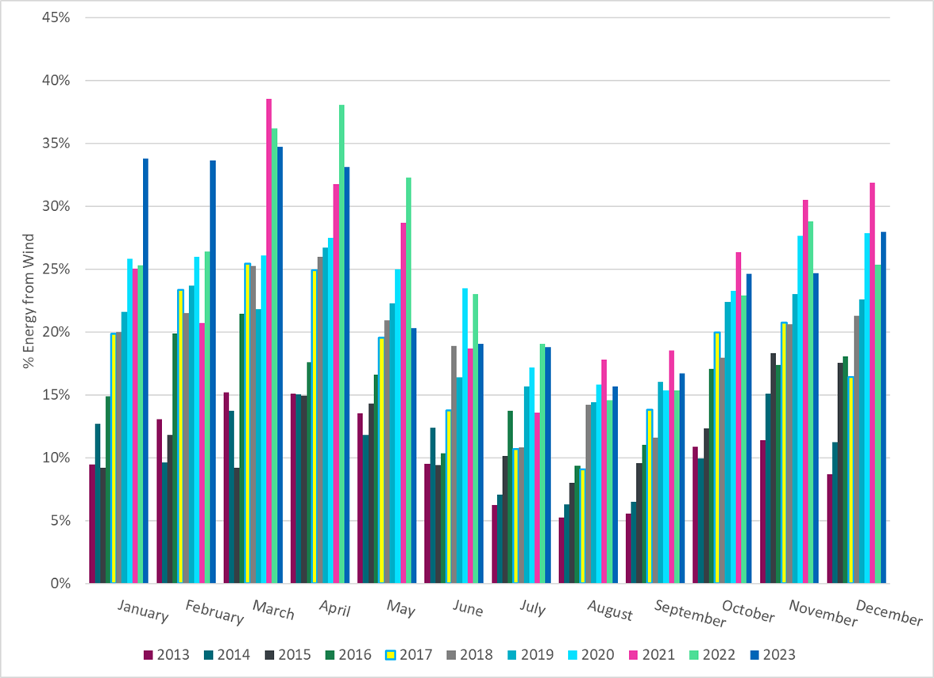
ERCOT % Energy from Wind Generation
Notes:
27.95% of total energy was provided by wind generation

Slide 14
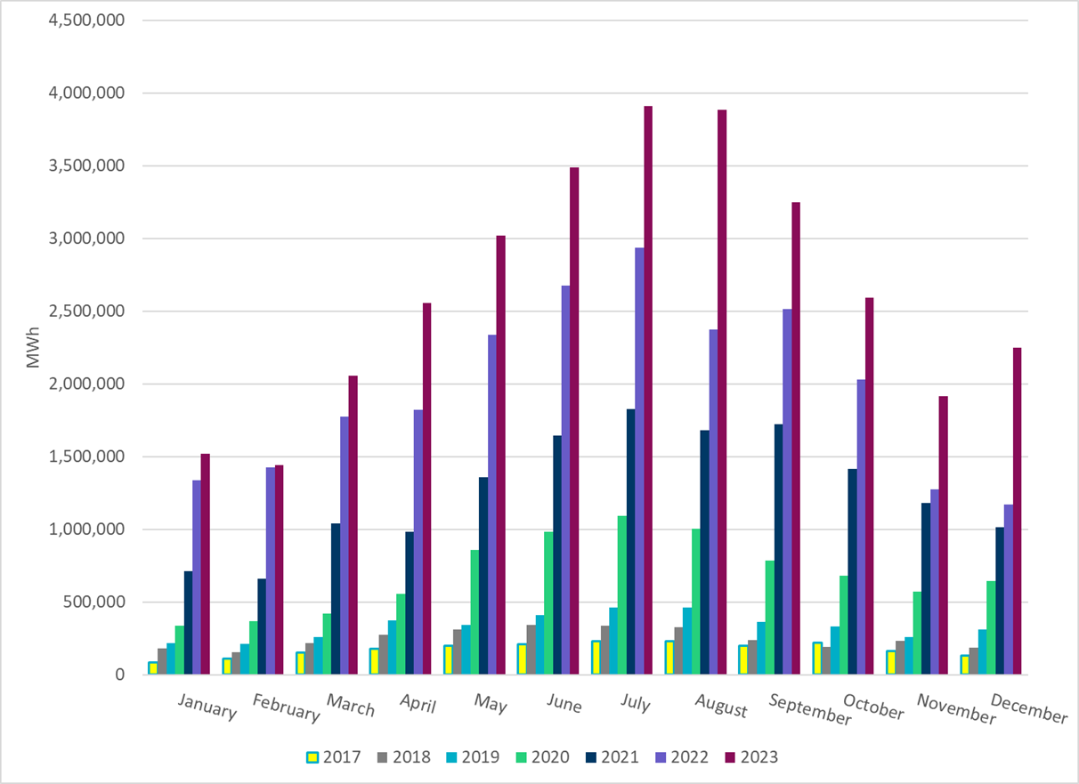
ERCOT Total Energy from Solar Generation
Notes:
2,246,189 MWh

Slide 15
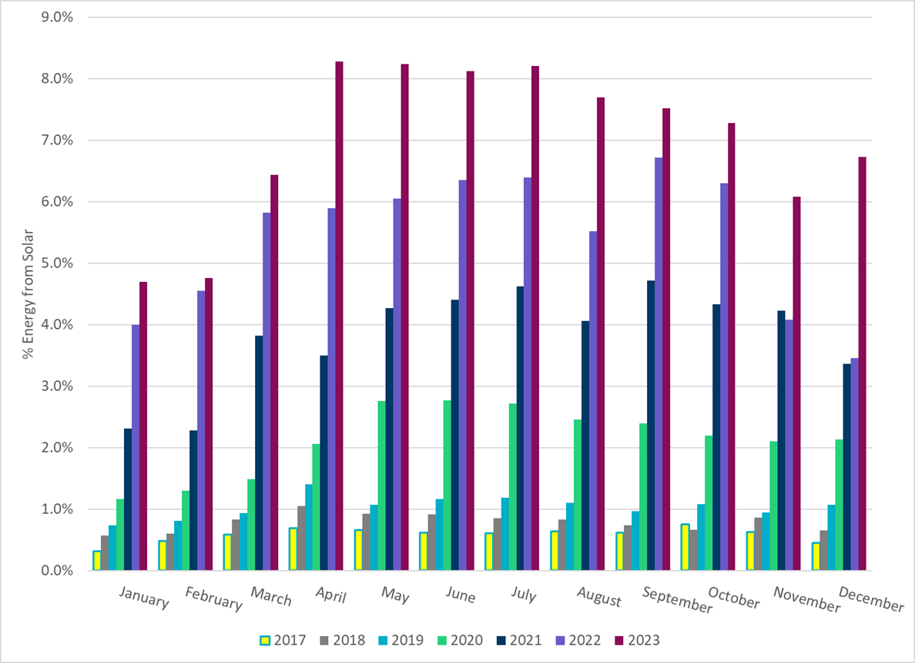
ERCOT % Energy from Solar Generation
Notes:
6.73% of total energy was provided by solar generation.

Slide 16
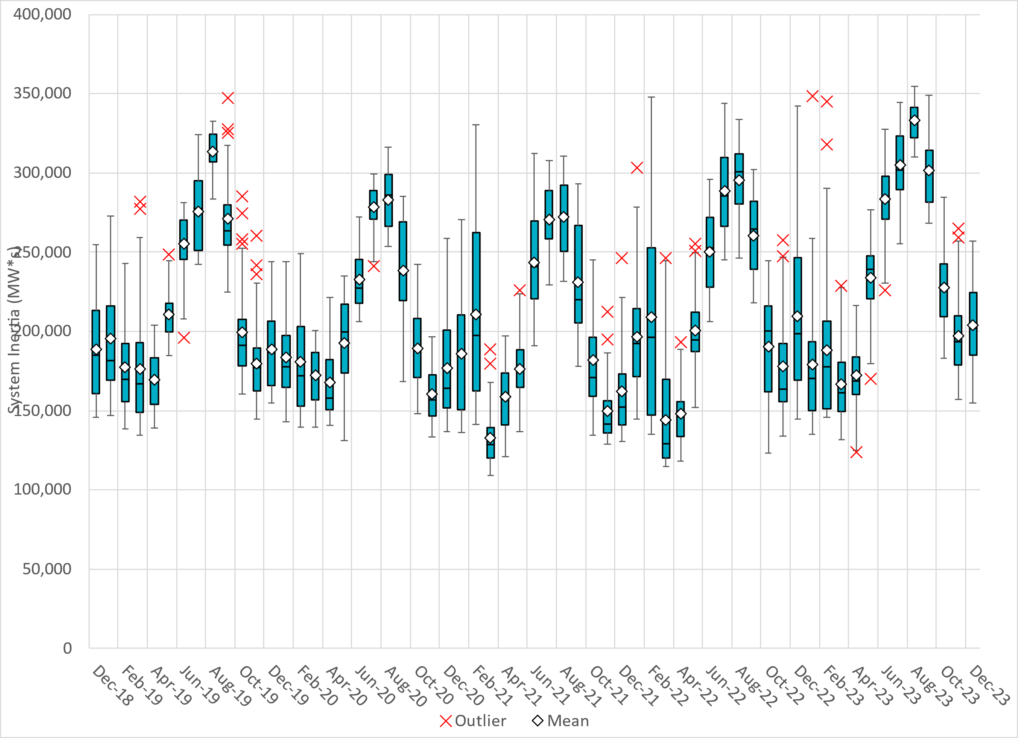
ERCOT Daily Minimum System Inertia
Notes:
Minimum Inertia = 154,946 MW*s on 12/08/2023
Previous Overall Minimum was 109,029 MW*s on 3/22/2021
Data:
Mean: 204,183 MW*s
Max: 257,095 MW*s on December 28th
Min: 154,946 MW*s on December 8th

Slide 17
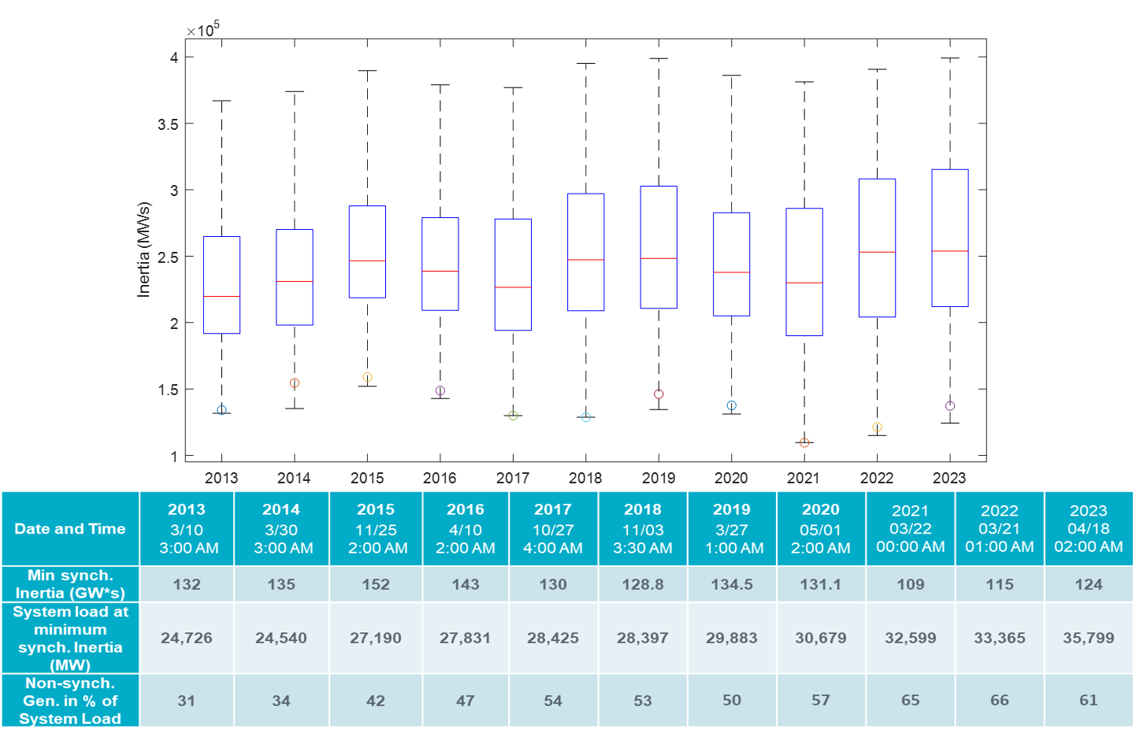
ERCOT Inertia Trend
Notes:
For each box, the central mark (red line) is the median, the edges of the box (in blue) are the 25th and 75th percentiles, the whiskers correspond to +/- 2.7 sigma (i.e., represent 99.3% coverage, assuming the data are normally distributed. The corresponding lowest inertia in each year is given in the table.
The circle on each boxplot is showing inertia during time when highest portion of load was served by wind/solar generation in that year.

