Slide 1
CRR Updates
Samantha Findley
CRR Market Operations
CMWG
January 29, 2024

Slide 2
Agenda
Change to collateral process effective January 26, 2024
KML file issue update
Draft – Annual CRR Activity Calendar update
Continuation of CRR auction transaction limits discussion

Slide 3
Change to collateral process; effective January 26, 2024
Collateral deposits for CRR auctions must be received by 3:00PM to be included in ACL for a CRR auction closing the same day
2024.MAR.Monthly.Auction will be the first auction affected by this change (bid and credit windows close 2/8/2024).
See M-A1221023-01 for additional details

Slide 4
KML file issue update
ERCOT will continue providing KML files as usual until the KML tool is updated (TBD).
Issue Recap: The tool that generates the KML files has not been updated to include new substations containing new RNs since Sept 2017.
273 RNs have been added to the model since Sept 2017.
107 of those are located within substations that existed prior to Sept 2017, so they are included in KML files.
166 RNs are located at new substations, and those substations are not captured by the KML generating tool.

Slide 5
CRR activity calendar – overview
Protocol 7.5.1(4)(c) requires ERCOT to post an updated calendar no later than April 1 of each calendar year
Each calendar includes auction activity dates for the remainder of the current calendar year and for the two subsequent calendar years
The calendar must be approved by WMS prior to the annual posting
Would like feedback today from CMWG on the draft calendar before seeking final approval from WMS on February 7

Slide 6
CRR activity calendar – general reminders
The model build process begins 3 weeks prior to the model posting date (get outages and Common Information Model snapshot)
Added a 3rd week at the beginning of 2023 due to changes to model build tools
We hold a monthly auction and a long-term auction every month of the year
Typical pattern is monthly auction bid window in the first half of the month followed by the long-term auction bid window the very next week (occasionally, there will be a one-week gap to avoid holidays)
Monthly auction results are posted one week after the bid window closes; long-term auction results are posted two weeks after the bid window closes
Since SCR816 was implemented in Dec 2023, monthly auction credit is now released the same day results are posted.

Slide 7
CRR activity calendar – general reminders
There are two additional tabs on the calendar
“Calendar Protocol References” includes any specific protocol sections related to the selection of dates
“PCRRs” contains activity dates and protocol sections related to the annual PCRR allocation process

Slide 8
CRR activity calendar – description of changes
Current calendar goes through the 2026.MAR.Monthly.Auction
Draft dates cover CRR activities through the 2027.MAR.Monthly.Auction
Applied the same patterns to assign the dates as have been used for previous calendars to maintain Protocol requirements and consistency
PCRR-eligible NOIEs are encouraged to view the dates on the “PCRRs” tab of the calendar

Slide 9
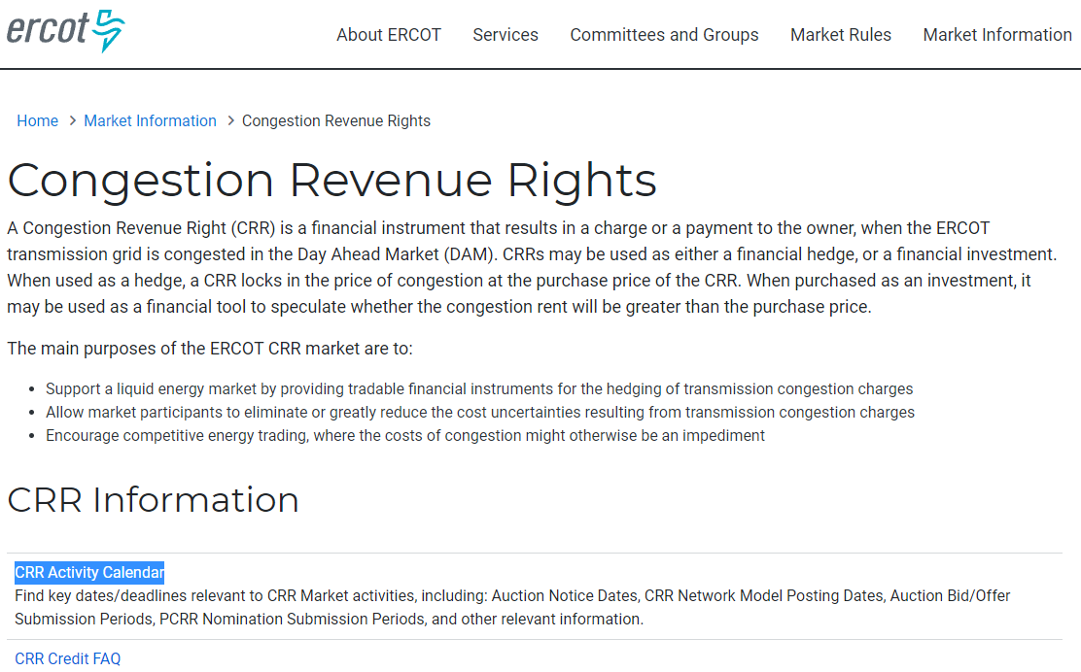
CRR activity calendar – next steps
Will take to WMS for final approval on February 7
Last chance to get WMS approval will be on March 6
Approved calendar will be posted on the CRR webpage by April 1

Slide 10
CRR auction transaction limits discussion recap
Problems:
Risk of transaction adjustment period
Increased submitted transactions and grouped baseload due to increases in CRRAHs and Settlement Points over time
Increasingly long run times for the optimizations especially for LTAS
Optimizing multi-month bids over 6 different network models
Exacerbated by 80%+ of submitted transactions being OPT bids

Slide 11
Possible options for avoiding a Transaction Adjustment Period (TAP) and alternative TAP process
Increase Minimum PTP Option Bid Price, currently $0.01 (NPRR but no system change needed)
Bid fee on uncleared bids (NPRR and system change)
Bid fee on only uncleared OPT bids (NPRR and system change)
Add a new Protocol definition for Participating CRRAH for TAPs to include only CRRAHs who submitted bids in initial bid window. Participating CRRAH currently defined as either owning baseload or whose CP submitted credit for the auction. (NPRR and system change)
This would decrease the number of CRRAHs eligible for TAP transactions by ~68 CRRAHs per auction, which results in ~500-700 more transactions per CRRAH
Enable TAPs as follows:
CRRAHs who did not submit bids in the initial bid window are not Participating CRRAH for TAPs and would have portfolios retracted at close of any TAP
First TAP allows 2500 bids per Participating CRRAH for TAPs
If first TAP exceeds the number of transactions that can be processed by the CRR system, second TAP with (available transactions / # Participating CRRAHs for TAPs)
(NPRR and system change)

Slide 12
Possible option for increasing total transactions for LTAS auctions
Optimize each month of the LTAS auctions individually (current process for monthly auctions)
Would require CRRAHs to submit bids to 6 separate auctions per LTAS
Would require CPs to submit credit to 6 separate auctions per LTAS
Would allow same number of transactions per month as the monthly auctions (6 x 400K = 2,400,000)
Large increase in transactions would need to be studied for array limits and other impacts.
Before implementation, old data would have to be trimmed from the database tables.

Slide 13
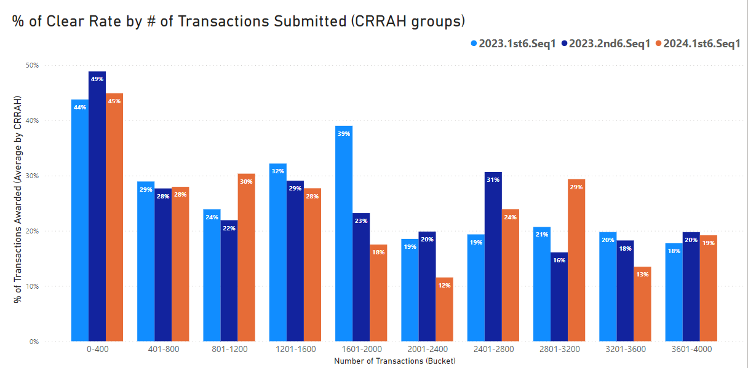
Transactions awarded/total transactions submitted by CRRAH groups

Slide 14
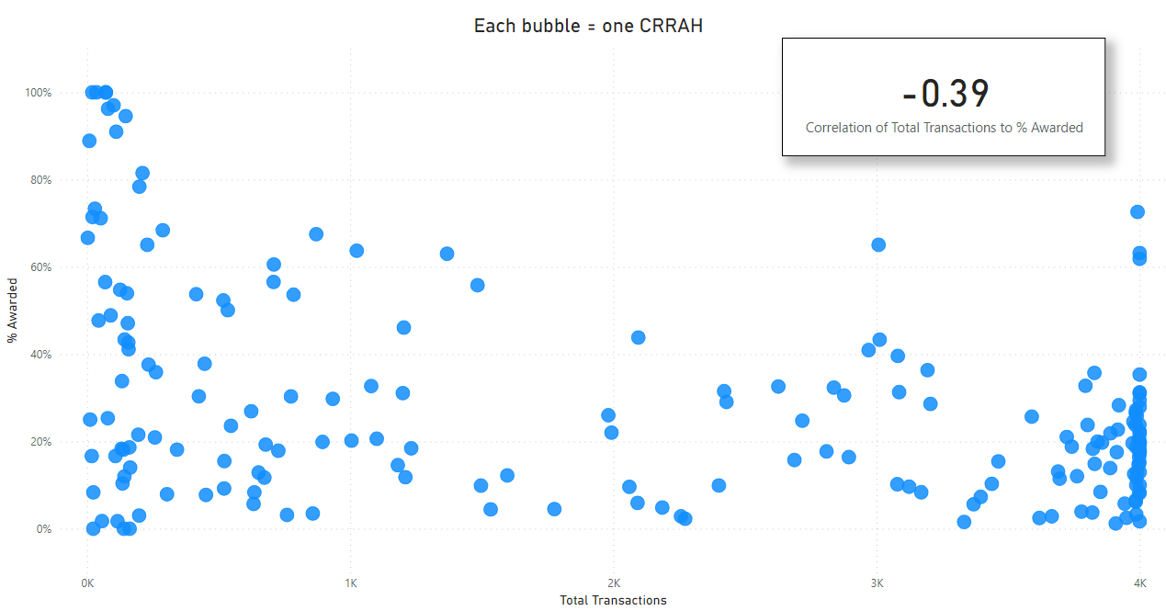
2024.1st6.Seq1: Transactions awarded/total transactions submitted by individual CRRAH

