Slide 1
ERCOT Frequency Control Report
December 2023
ERCOT
Operations Planning
PDCWG | January 25, 2024

Slide 2
Summary of December 2023
CPS1: 176.89%
Current CPS1 12-Month Rolling Average: 175.21%
0 BAAL Exceedance(s)
0 hourly CPS1 score below 100%
BAAL-003 Events have updated through 2022
2022 BAAL-003 FRM Performance: -1060.40
2023 RMS1 Statistics
  Mean: 14.88 mHz
  Min: 11.76 mHz
  Max 24.40 mHz
Energy Statistics
  Total Energy: 33,383,311 MWh
  Wind Energy: 9,330,245 MWh
  Percent Energy from Wind: 27.95%
  Solar Energy: 2,246,189 MWh
  Percent Energy from Solar: 6.73%
Minimum System Inertia
  Mean: 204,183 MW*s
  Max: 257,095 MW*s on December 28th
  Min: 154,946 MW*s on December 8th

Slide 3
Frequency Control
CPS1, BAAL, & RMS1

Slide 4
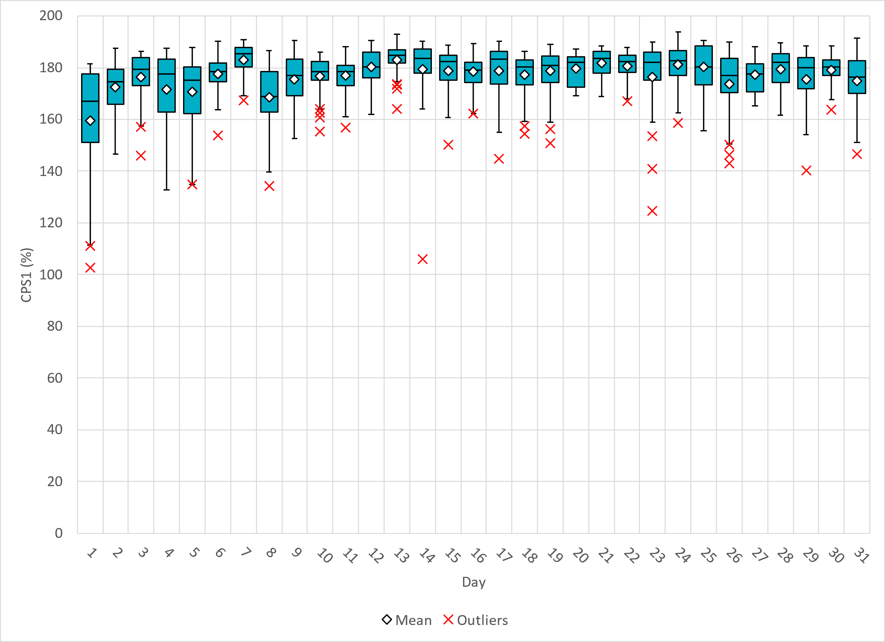
Hourly CPS1 by Day
Dec-23 CPS1 (%): 176.89
Notes:
Dec. CPS1 Score is 176.89%, there are no outliers below 100%.

Slide 5
BAAL Exceedances & Violations
There were 0 BAAL exceedance(s) in December.

Slide 6
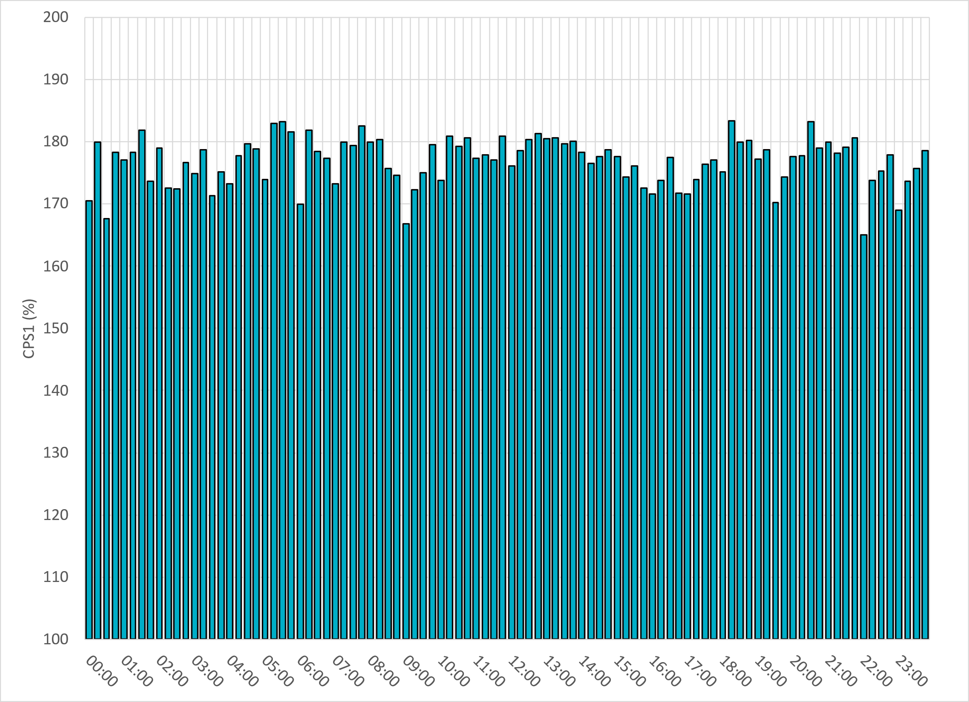
15-Minute Average CPS1%
Dec-23 CPS1 (%): 176.89
Notes:
CPS1 score is above 150% for 15-minute intervals.

Slide 7
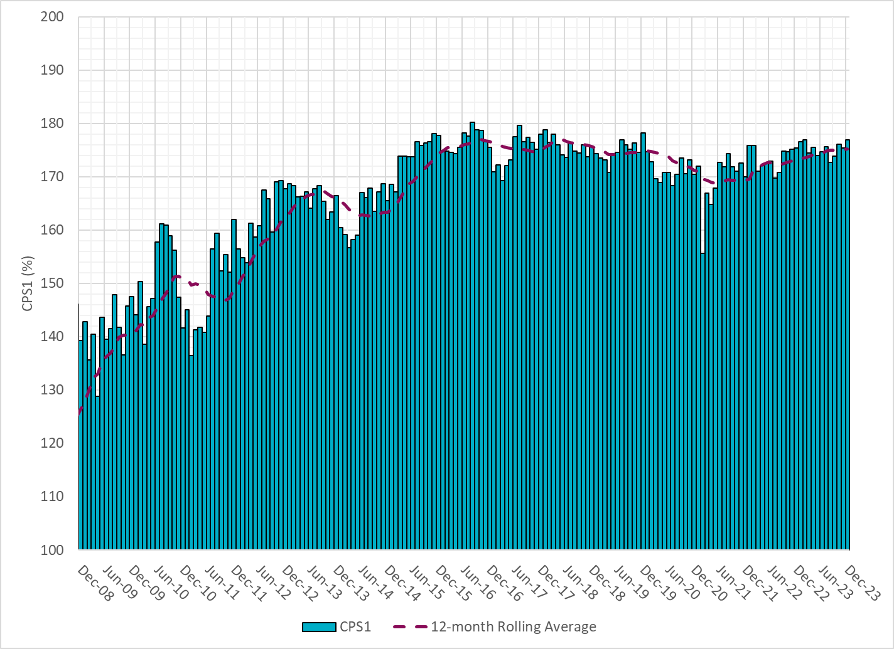
12-Month Rolling Average CPS1
Current 12-Month Rolling Average: 175.21%
Notes:
12 month rolling average CPS1 score is 175.21 which is in line with expectations, and the CPS1 score for December is slightly higher than the last month.

Slide 8
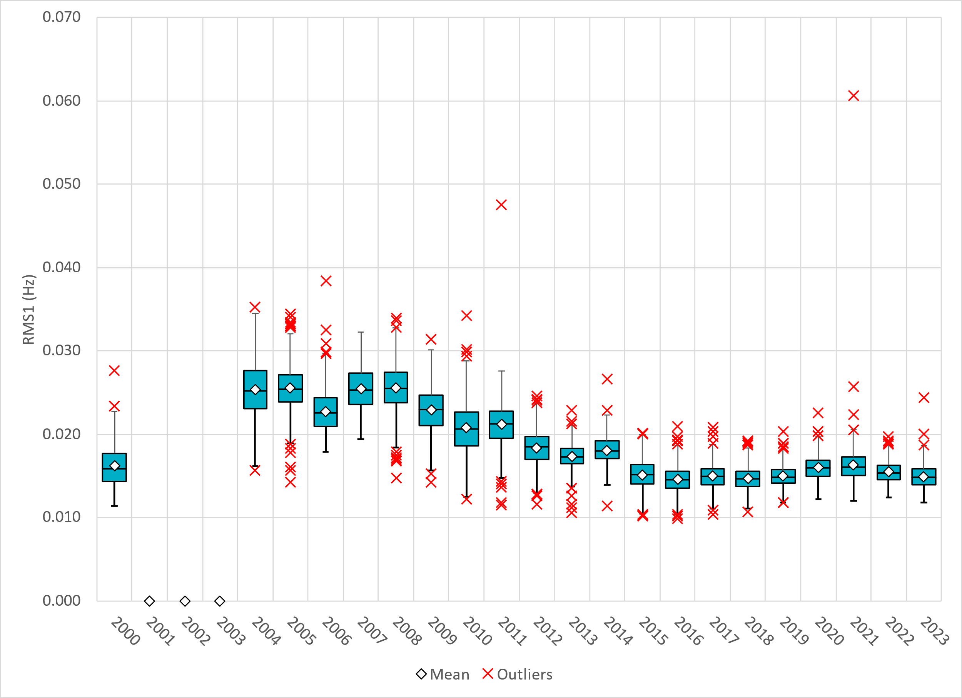
Daily RMS1 of ERCOT Frequency by Year
Notes:
Daily RMS1 frequency by year is slightly smaller overall compared with 2022.
Mean: 14.88 mHz
Min: 11.76 mHz
Max 24.40 mHz

Slide 9
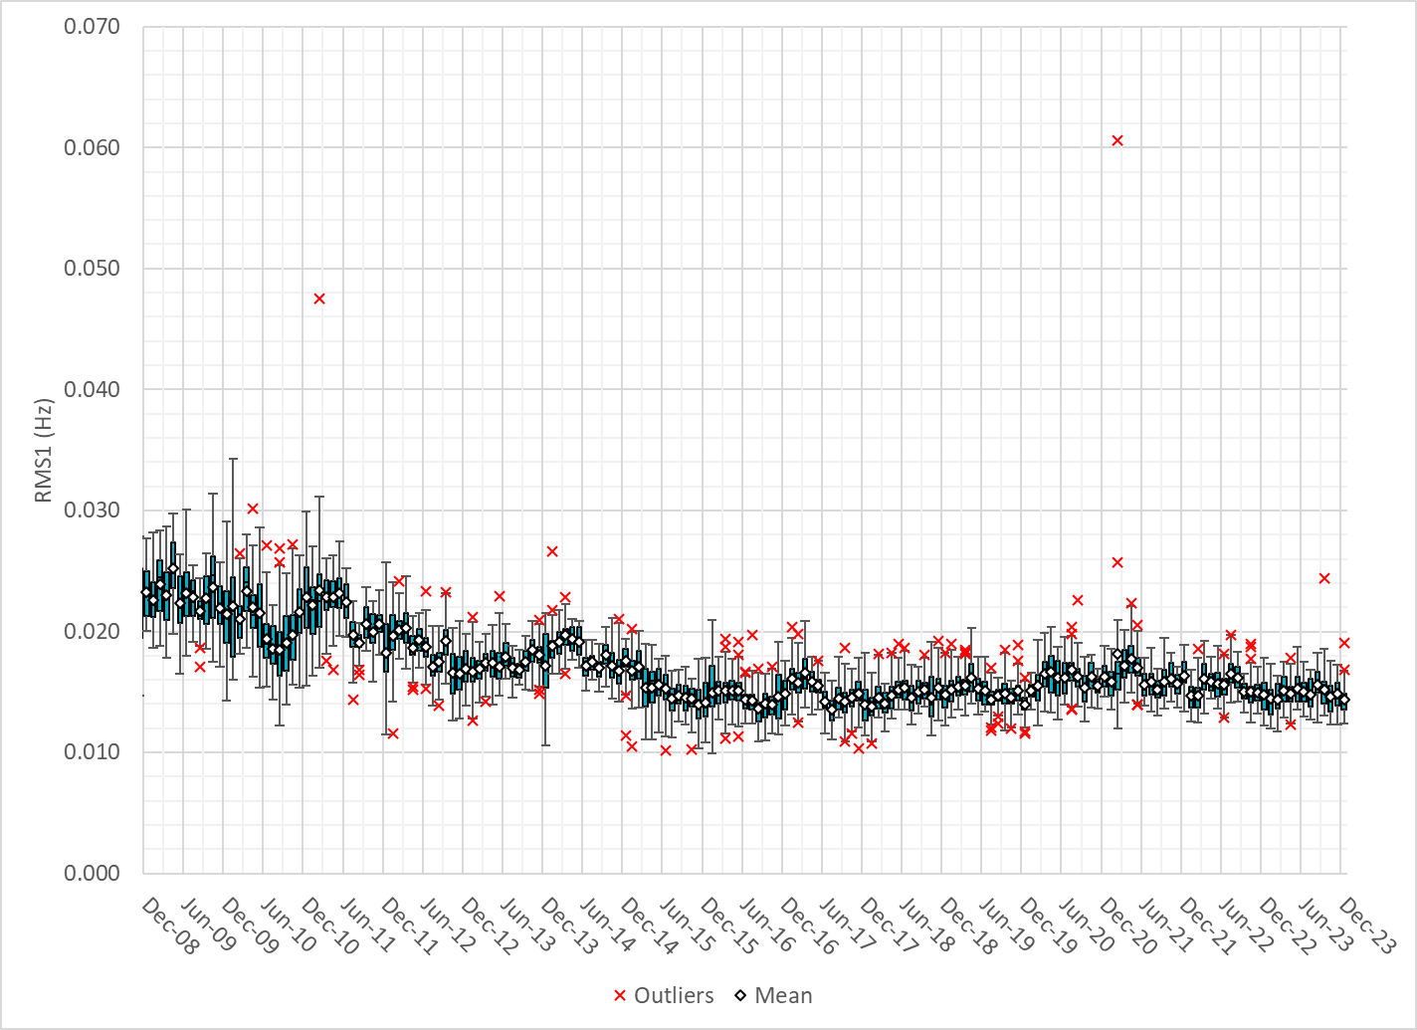
Daily RMS1 of ERCOT Frequency by Month
Notes:
A More granular look at last 15 years of RMS1 by month
14.36 mHz on avg for December 2023

Slide 10
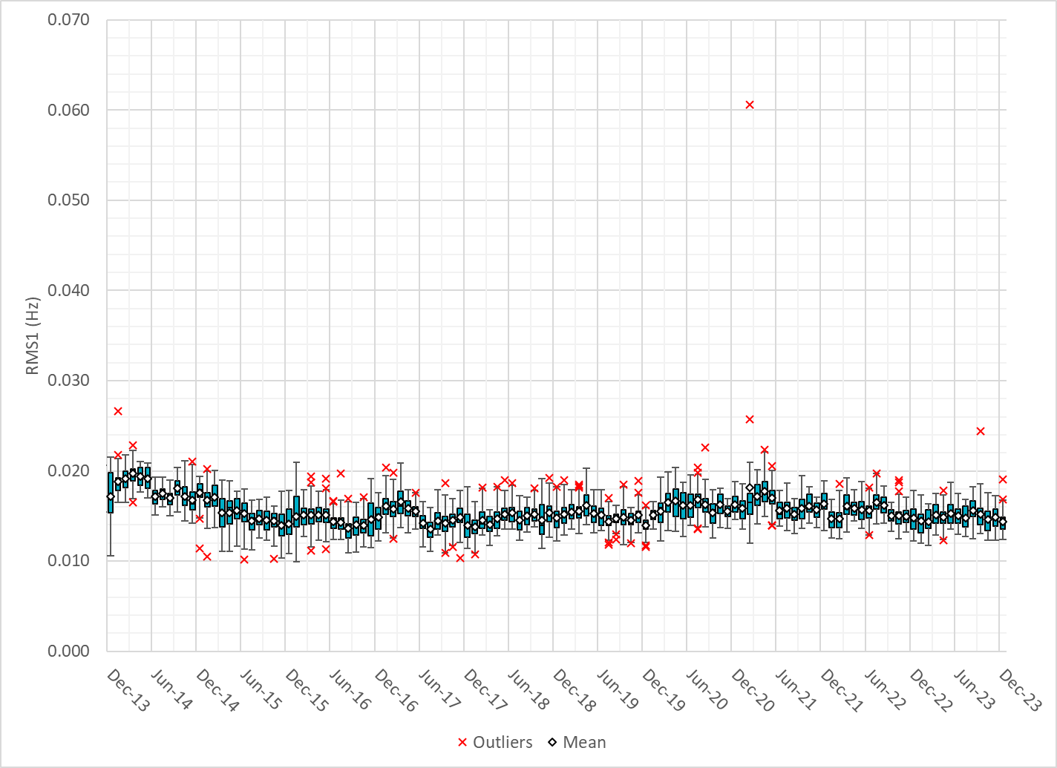
Daily RMS1 of ERCOT Frequency by Month
Notes:
Same data with 10 years shown instead of 15

Slide 11
Frequency Profile Comparison

Slide 12
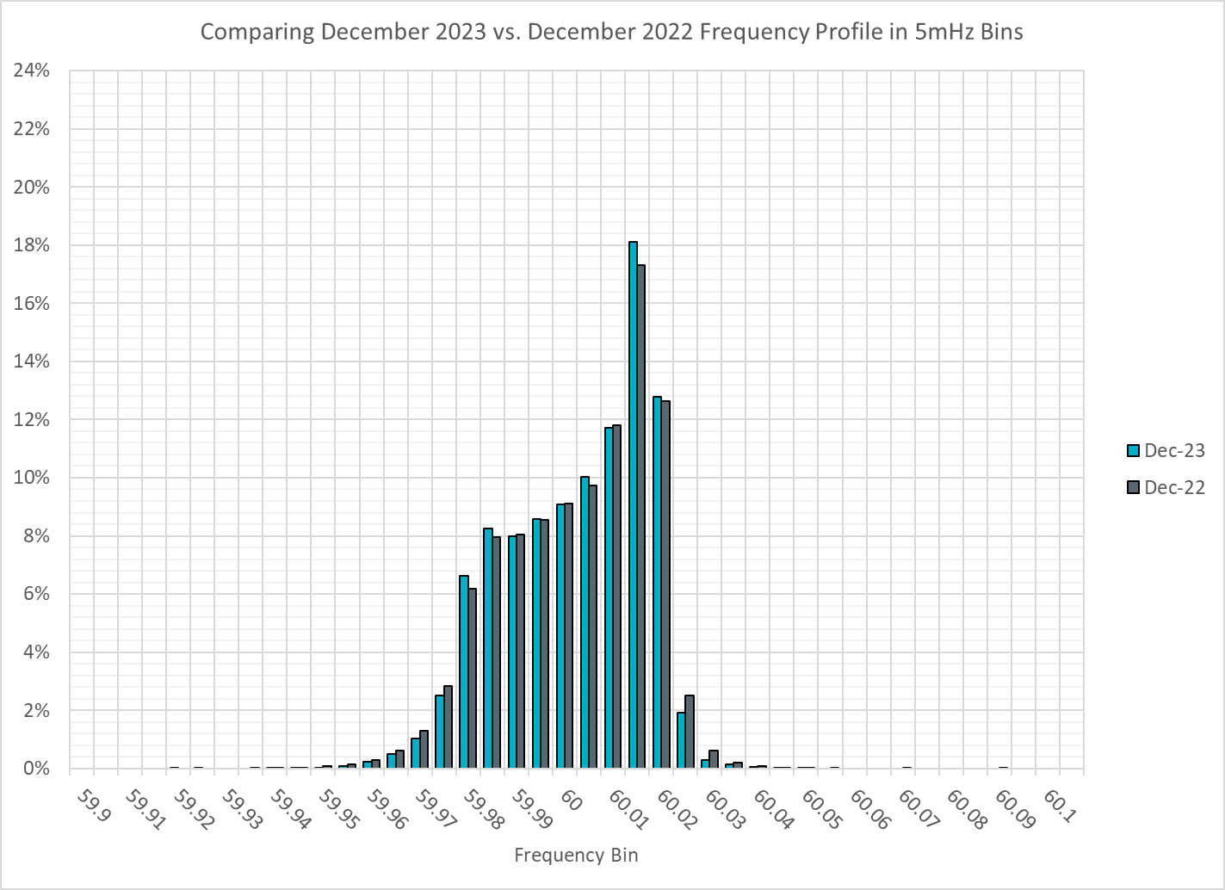
Frequency Profile Comparison
Notes:
Comparison of frequency profile between December 2022 and December 2023, overall the frequency profile is similar to the previous year.

Slide 13
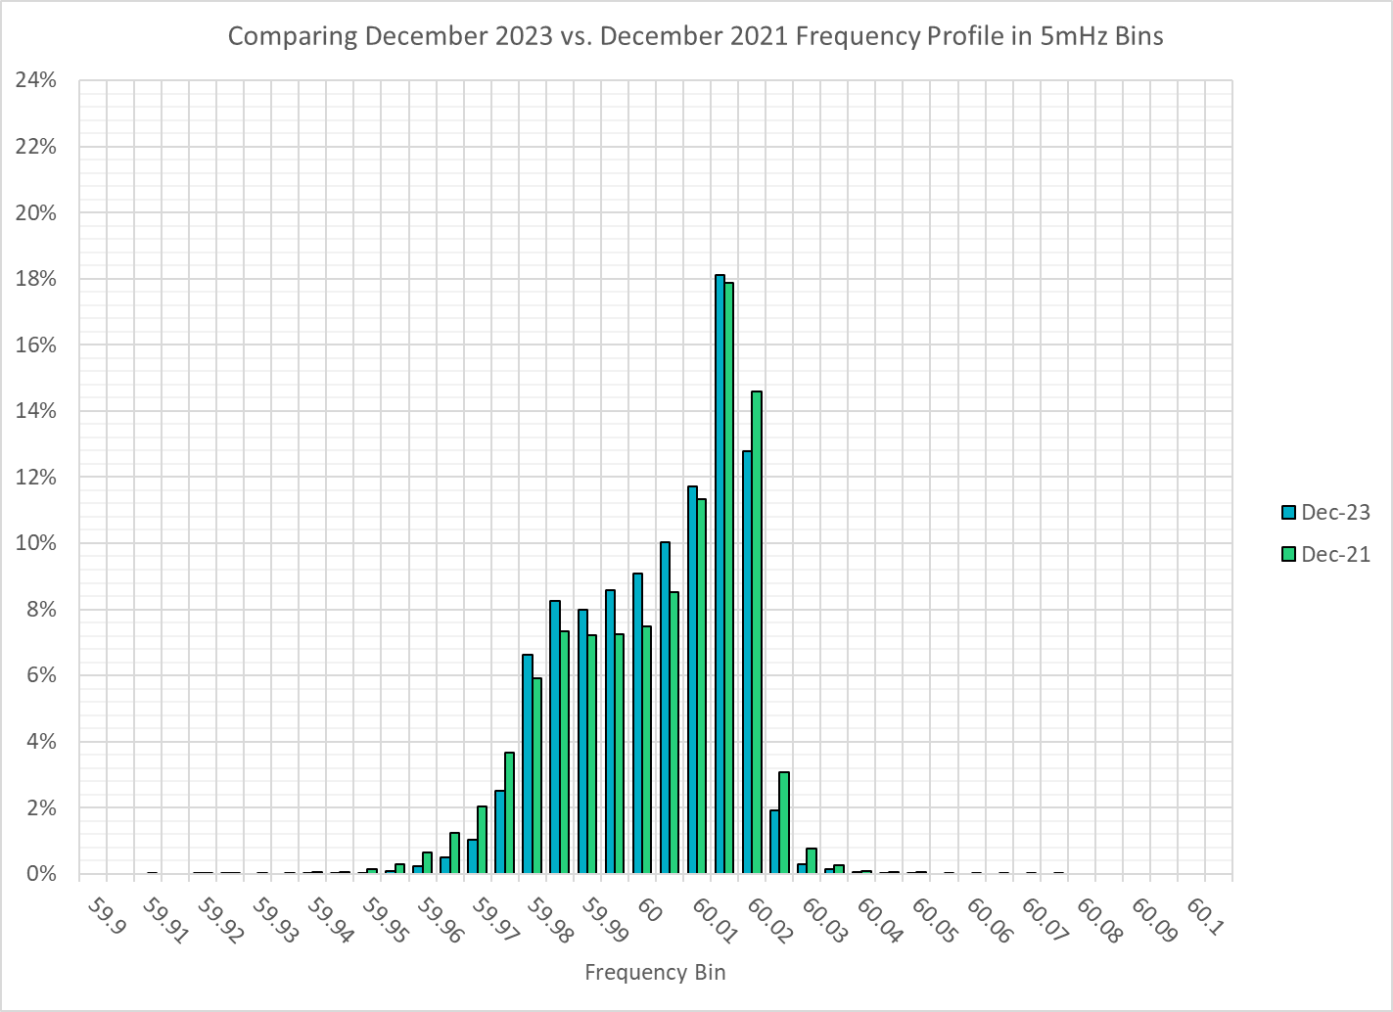
Frequency Profile Comparison
Notes:
Comparison of frequency profile between December 2021 and December 2023, we see more instances of frequency hovering at or below the low deadband in December 2023, when compared to 2021.

Slide 14
Time Error Correction

Slide 15
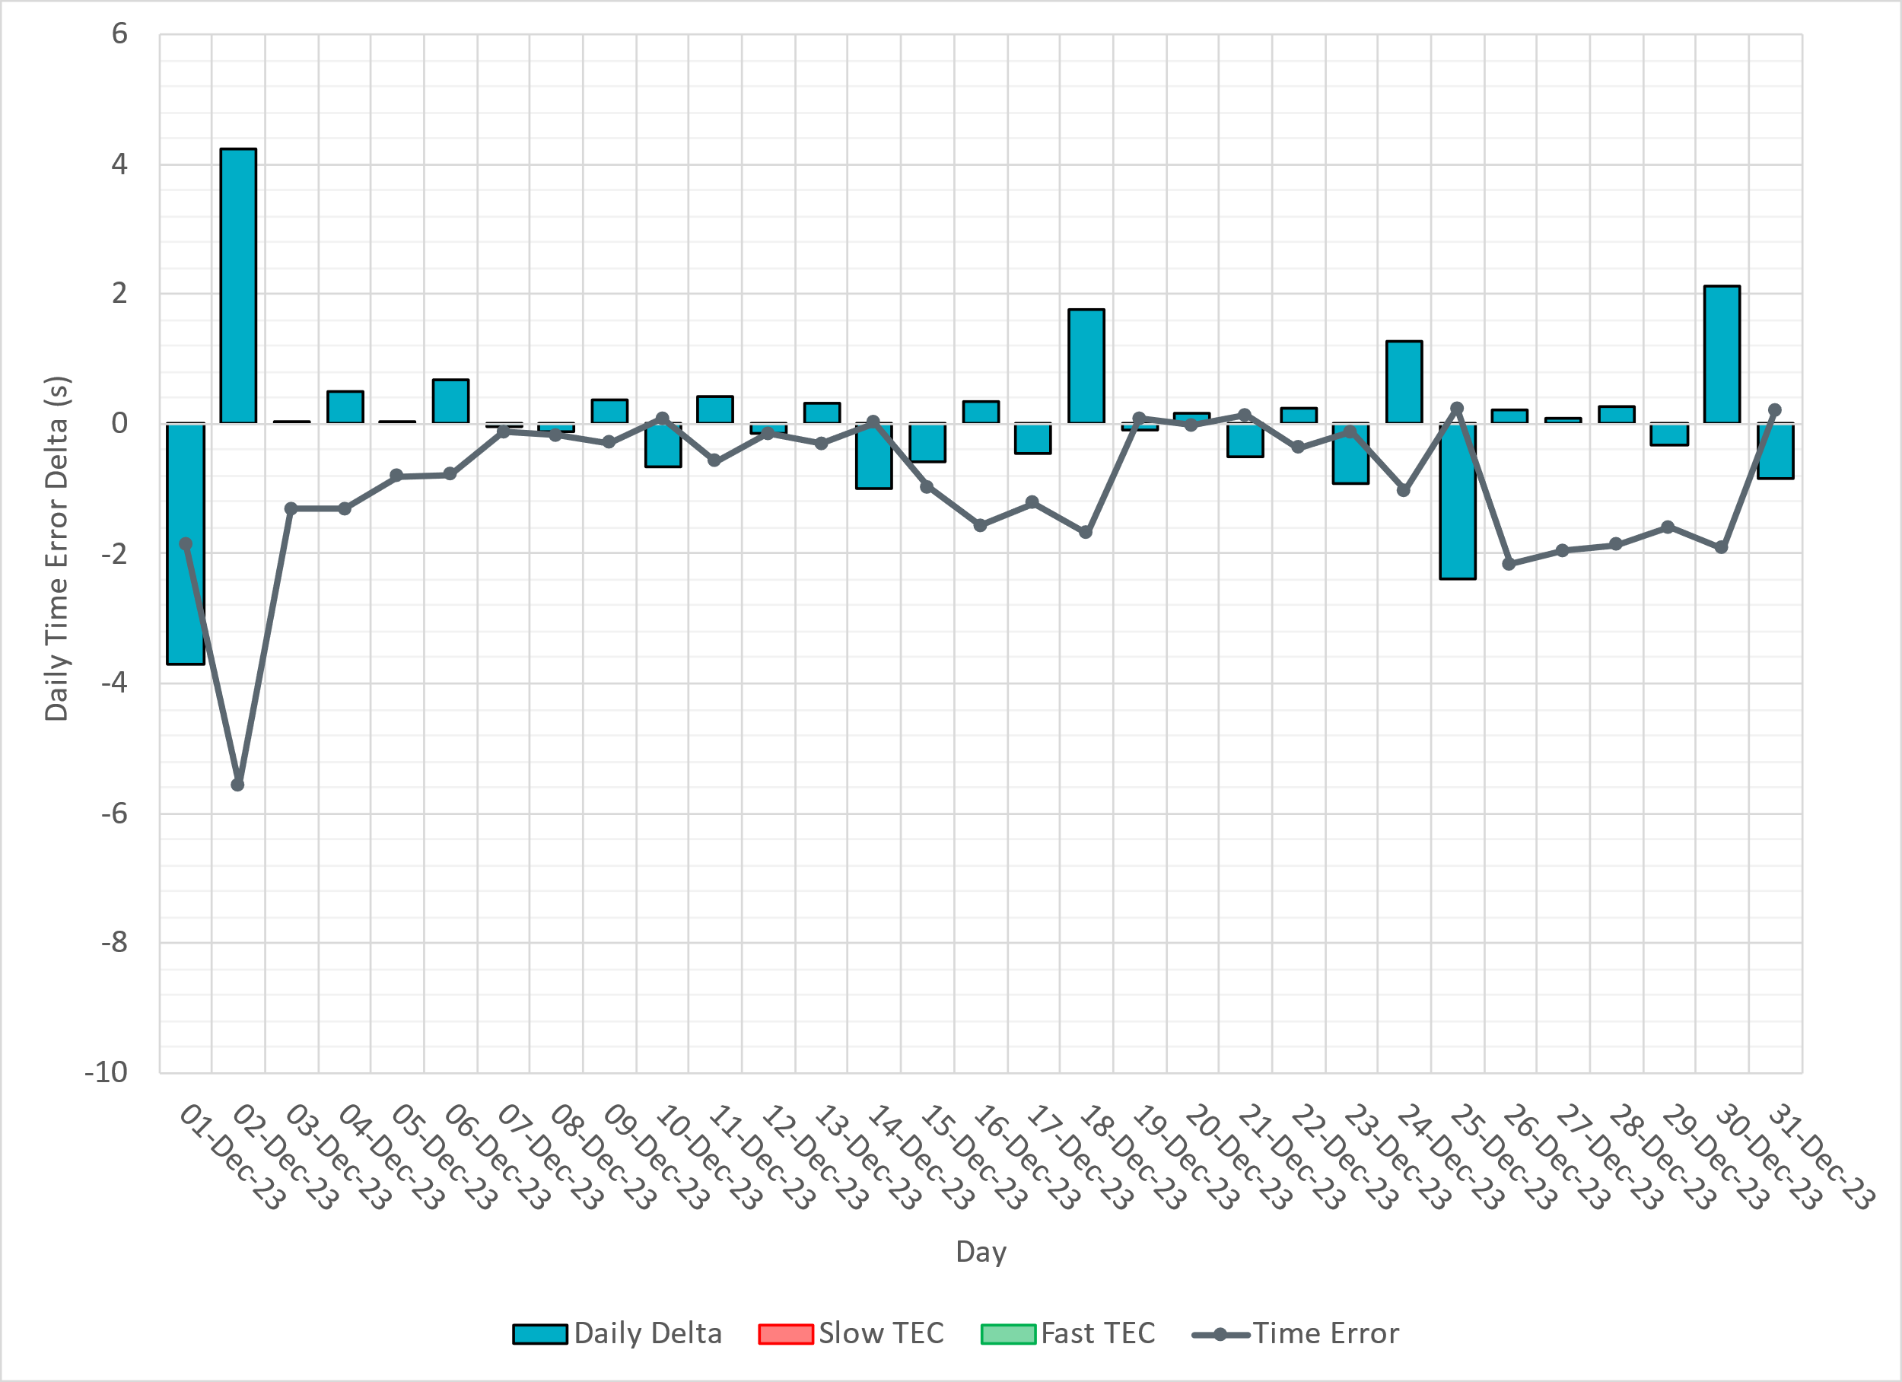
ERCOT Daily Time Error
Notes:
12/1/2023: Wind ramped down 5GW & load was over forecasted in the morning hours. Low frequency also occurred in the afternoon due to -900MW expected generation deviation.
12/2/2023: Over-frequency persisted for a few hours during an 8GW wind up ramp.

Slide 16
Time Error Corrections Log Summary
There have been no time error corrections since December 2016

Slide 17
BAL-003 Performance

Slide 18
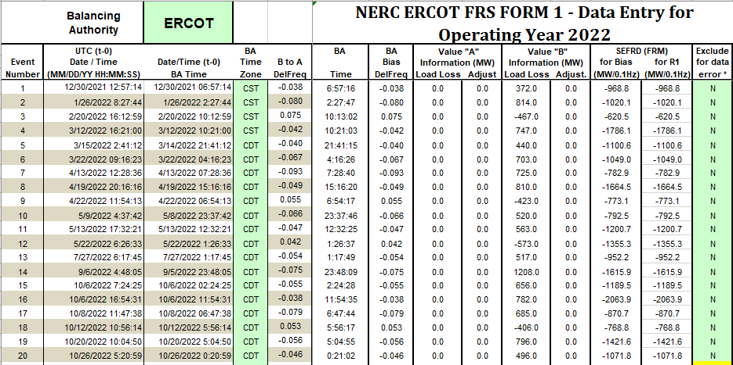
Op. Year 2022 BAL-003 Selected Events – Update
Notes:
BAL-003

Slide 19
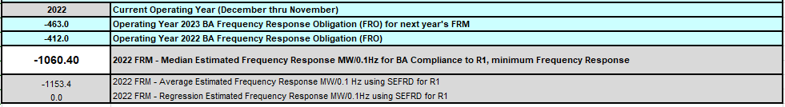
Op. Year 2022 BAL-003 FRM Performance - Update
Notes:
OP2018: FRO = -381.0, FRM_median = -843.17, FRM_average = -959.7
OP2019: FRO = -381.0, FRM_median = -811.14, FRM_average = -892.5
OP2020: FRO = -425.0, FRM median = -789.34, FRM average = -879.0
OP2021: FRO = -471.0, FRM median = -913.56, FRM average = -992.
OP2022: FRO = -463.0, FRM median = -1060.40, FRM average = -1153.4

Slide 20
ERCOT Energy Statistics

Slide 21
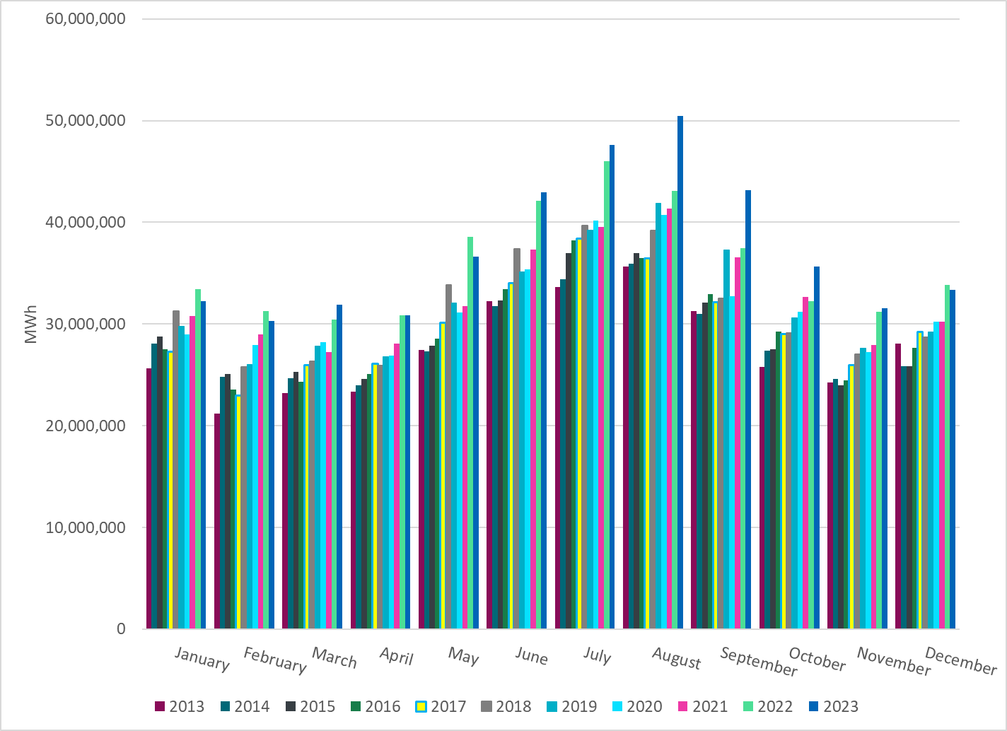
Total Energy
Notes:
33,383,311 MWh ~ slightly lower than last year.

Slide 22
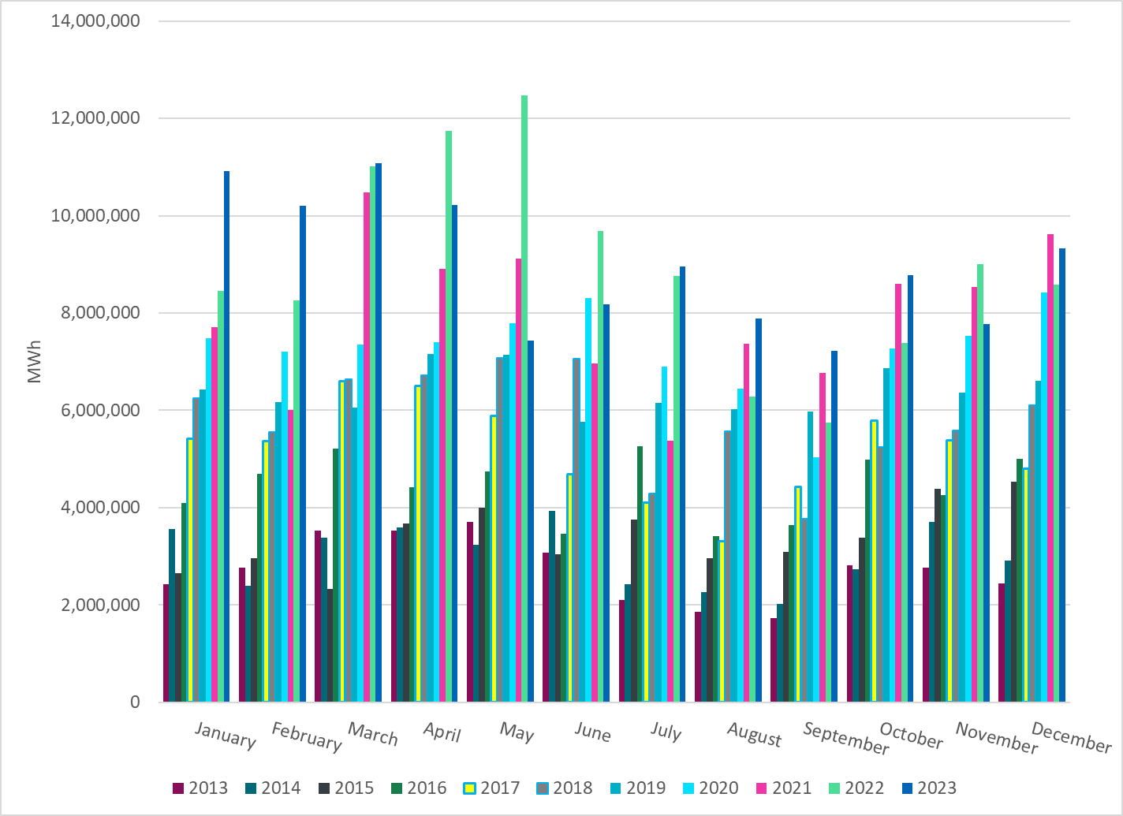
Total Energy from Wind Generation
Notes:
9,330,245 MWH ~

Slide 23
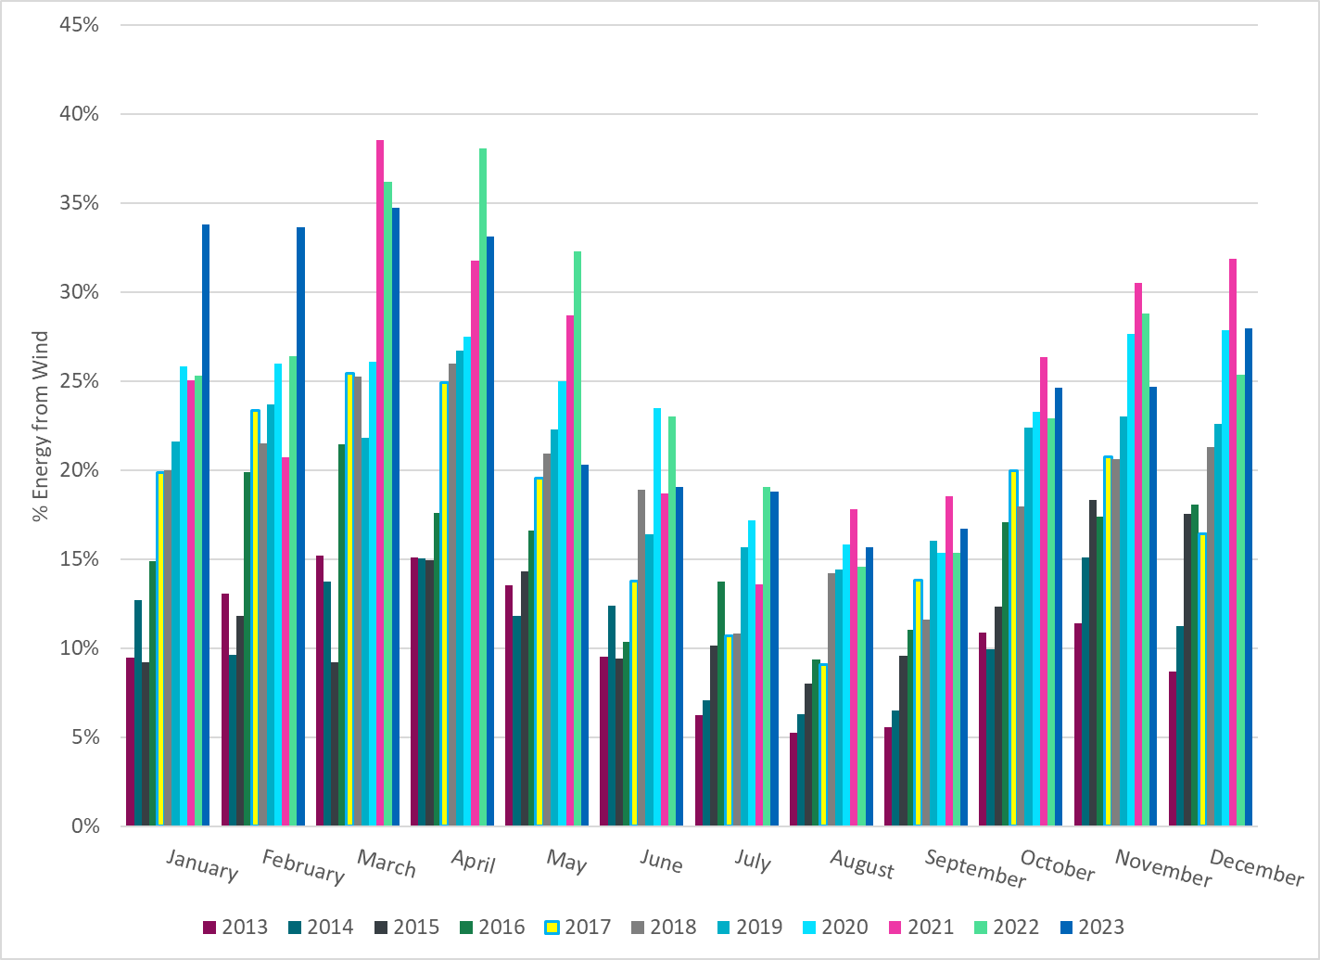
% Energy from Wind Generation
Notes:
27.95% of total energy was provided by wind generation

Slide 24
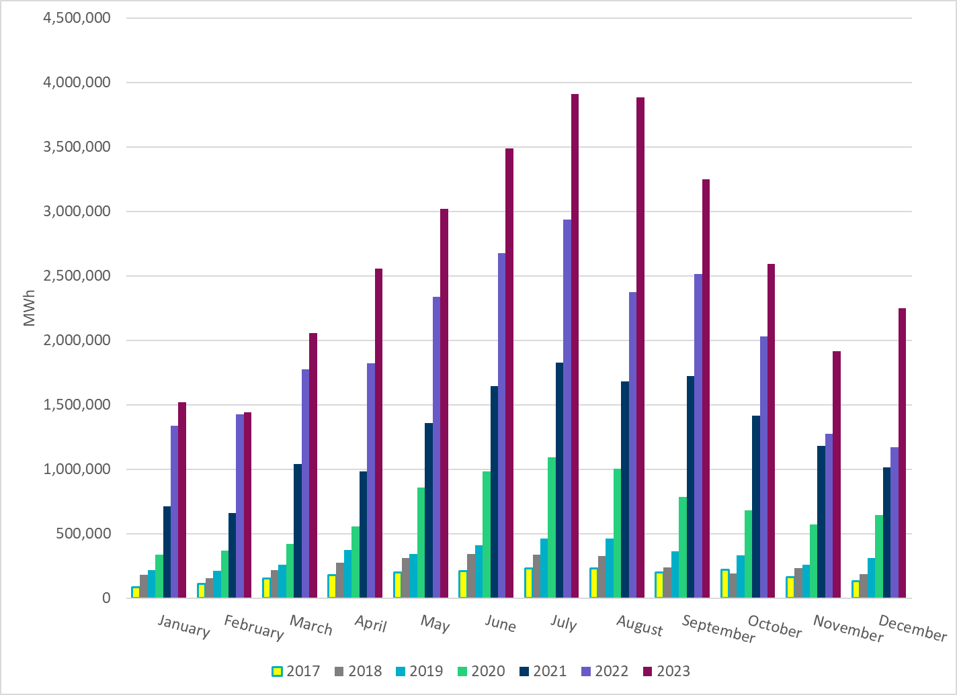
Total Energy From Solar Generation
Notes:
2,246,189 MWh ~ significant increase in solar from previous years.

Slide 25
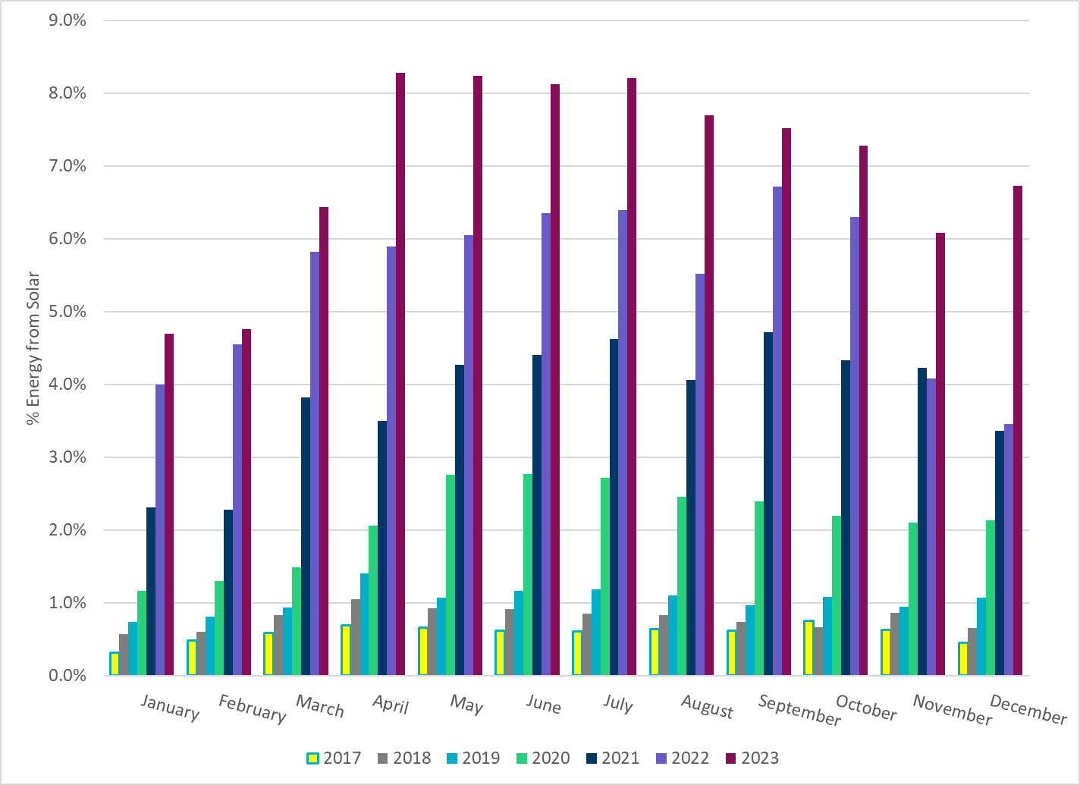
% Energy from Solar Generation
Notes:
6.73% of total
energy was provided by solar generation, which is highest solar penetration level so far for December.

Slide 26
ERCOT System Inertia

Slide 27
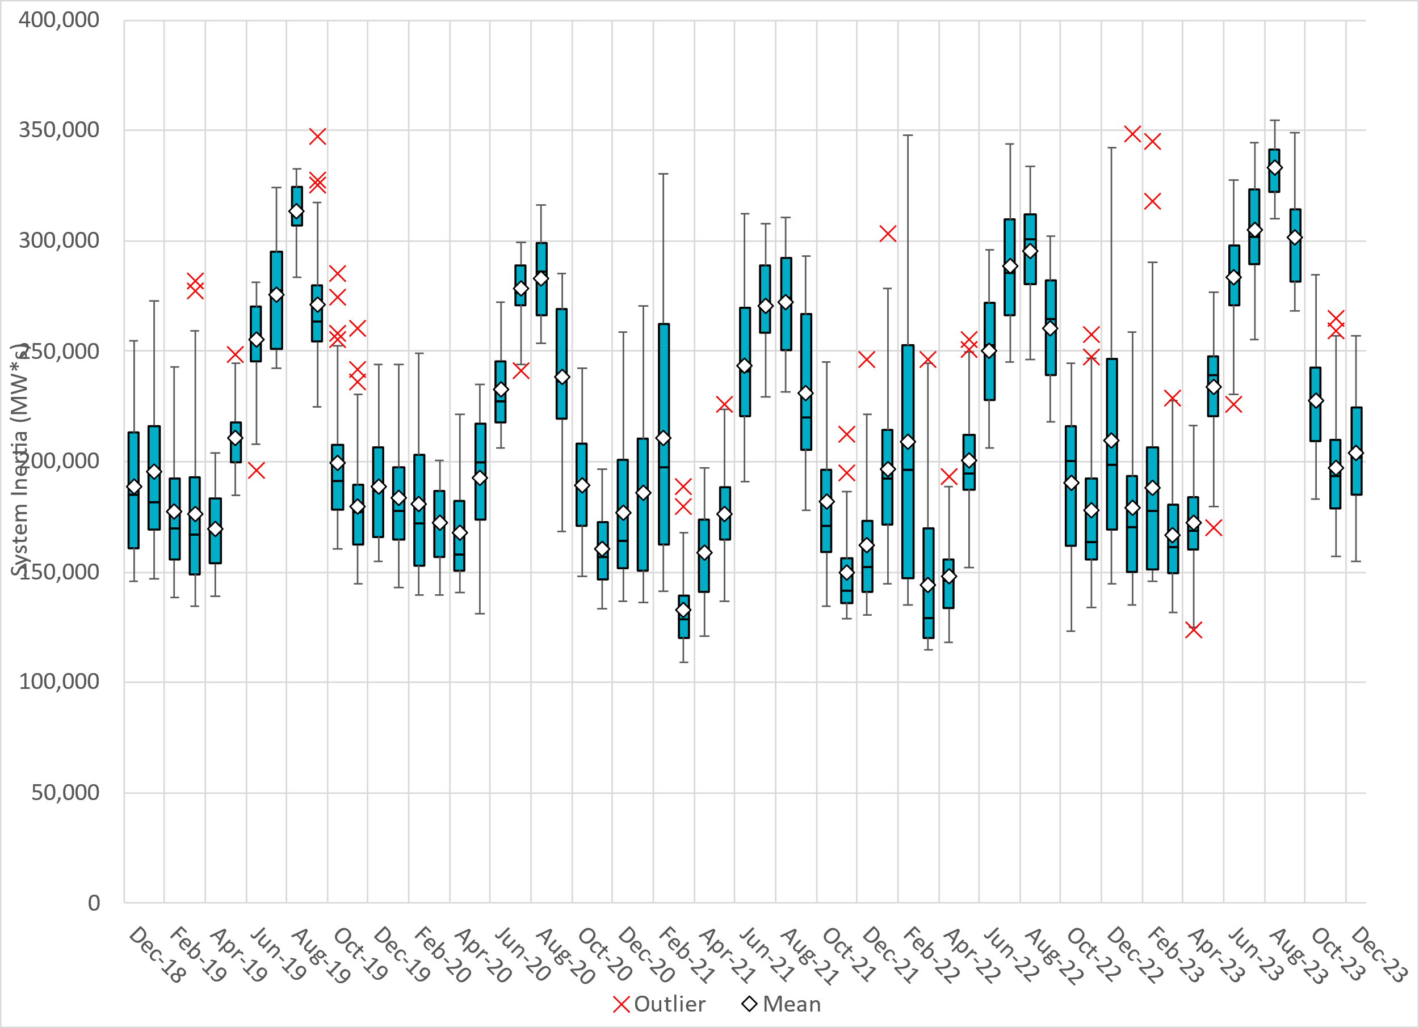
Daily Minimum System Inertia
Notes:
Minimum Inertia = 154,946 MW*s on 12/08/2023
Previous Overall Minimum was 109,029 MW*s on 3/22/2021
Data:
Mean: 204,183 MW*s
Max: 257,095 MW*s on December 28th
Min: 154,946 MW*s on December 8th

Slide 28
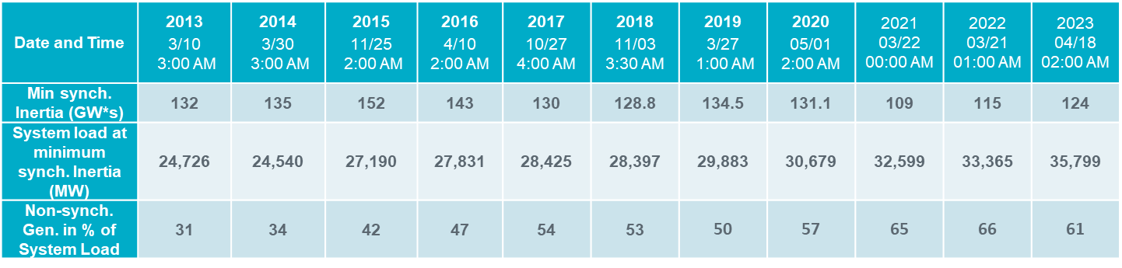
ERCOT Inertia 2013-2023
Notes:
Summary of ERCOT intertia for the previous 10 years. Lowest inertia this year was on April 18th.
For each box, the central mark (red line) is the median, the edges of the box (in blue) are the 25th and 75th percentiles, the whiskers correspond to +/- 2.7 sigma (i.e., represent 99.3% coverage, assuming the data are normally distributed. The corresponding lowest inertia in each year is given in the table.
The circle on each boxplot is showing inertia during time when highest portion of load was served by wind/solar generation in that year.

Slide 29
Questions?
Thank you!

