Slide 1
ERCOT Frequency Events
December 2023
ERCOT
Operations Planning
PDCWG |Jan 25th, 2024

Slide 2
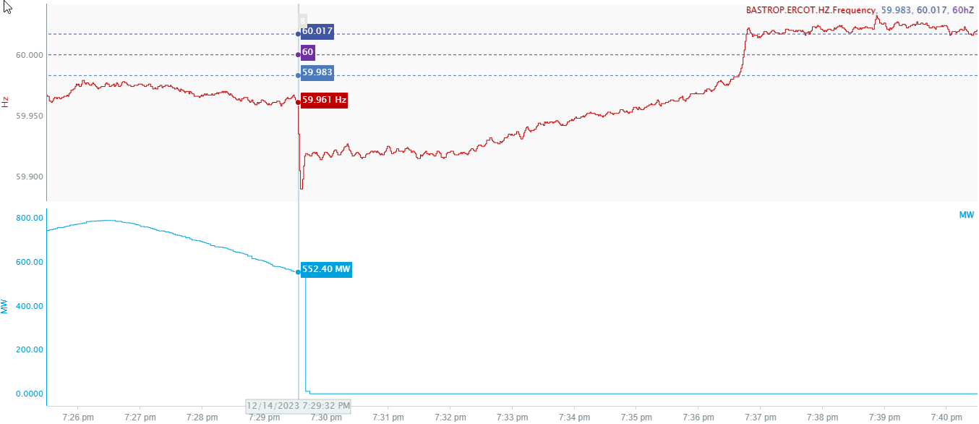
12/14/2023 19:29:32 (Non-FME)
Notes:
The unit experienced a runback and tripped offline while carrying approximately 552 MW
Starting Frequency: 59.961 Hz
Minimum Frequency: 59.890 Hz
A-C Time : 3 seconds
Recovery Time(back to deadband): 7 minutes 7 seconds
ECRS Released: 805 MW
Trip Reason: Loss of condensate feed pump
Contextual Information: 152 MW of Regulation Up was exhausted before the event. A manual offset of 450 MW was applied during this event.
Reason for no selection : Starting frequency was outside low deadband

Slide 3
Questions?
Thank you!

