Slide 1
Proposal to Modify the Methodology for Calculating Coal Fuel Adders
RCWG
ERCOT Staff
Jan 25, 2024

Slide 2
Verifiable Cost Manual, Appendix 11: Procedure for Determining the Fuel Adder for Coal and Lignite Resources with Approved Verifiable Costs
Fuel Adder for next period ($/MMBtu) = Max ($0.50, CF)
Where,
Coal Fuel Adder (CF) ($/MMBtu) = [∑ (weekly CFIP – average Fuel Index Price (FIP) for week)] / Number of weeks in period
Coal Fuel Index Price (CFIP) ($/MMBtu) = the price of Powder River Basin (PRB) 8,800 Btu/lb coal delivered to ERCOT or the Gulf Coast area, as derived from regularly published data selected by ERCOT. The CFIP for the current week shall be based on the most recent price data received by ERCOT from the publisher for PRB 8800 coal (i.e. prompt quarterly or monthly settled price) and the cost of rail transportation from the PRB.

Slide 3
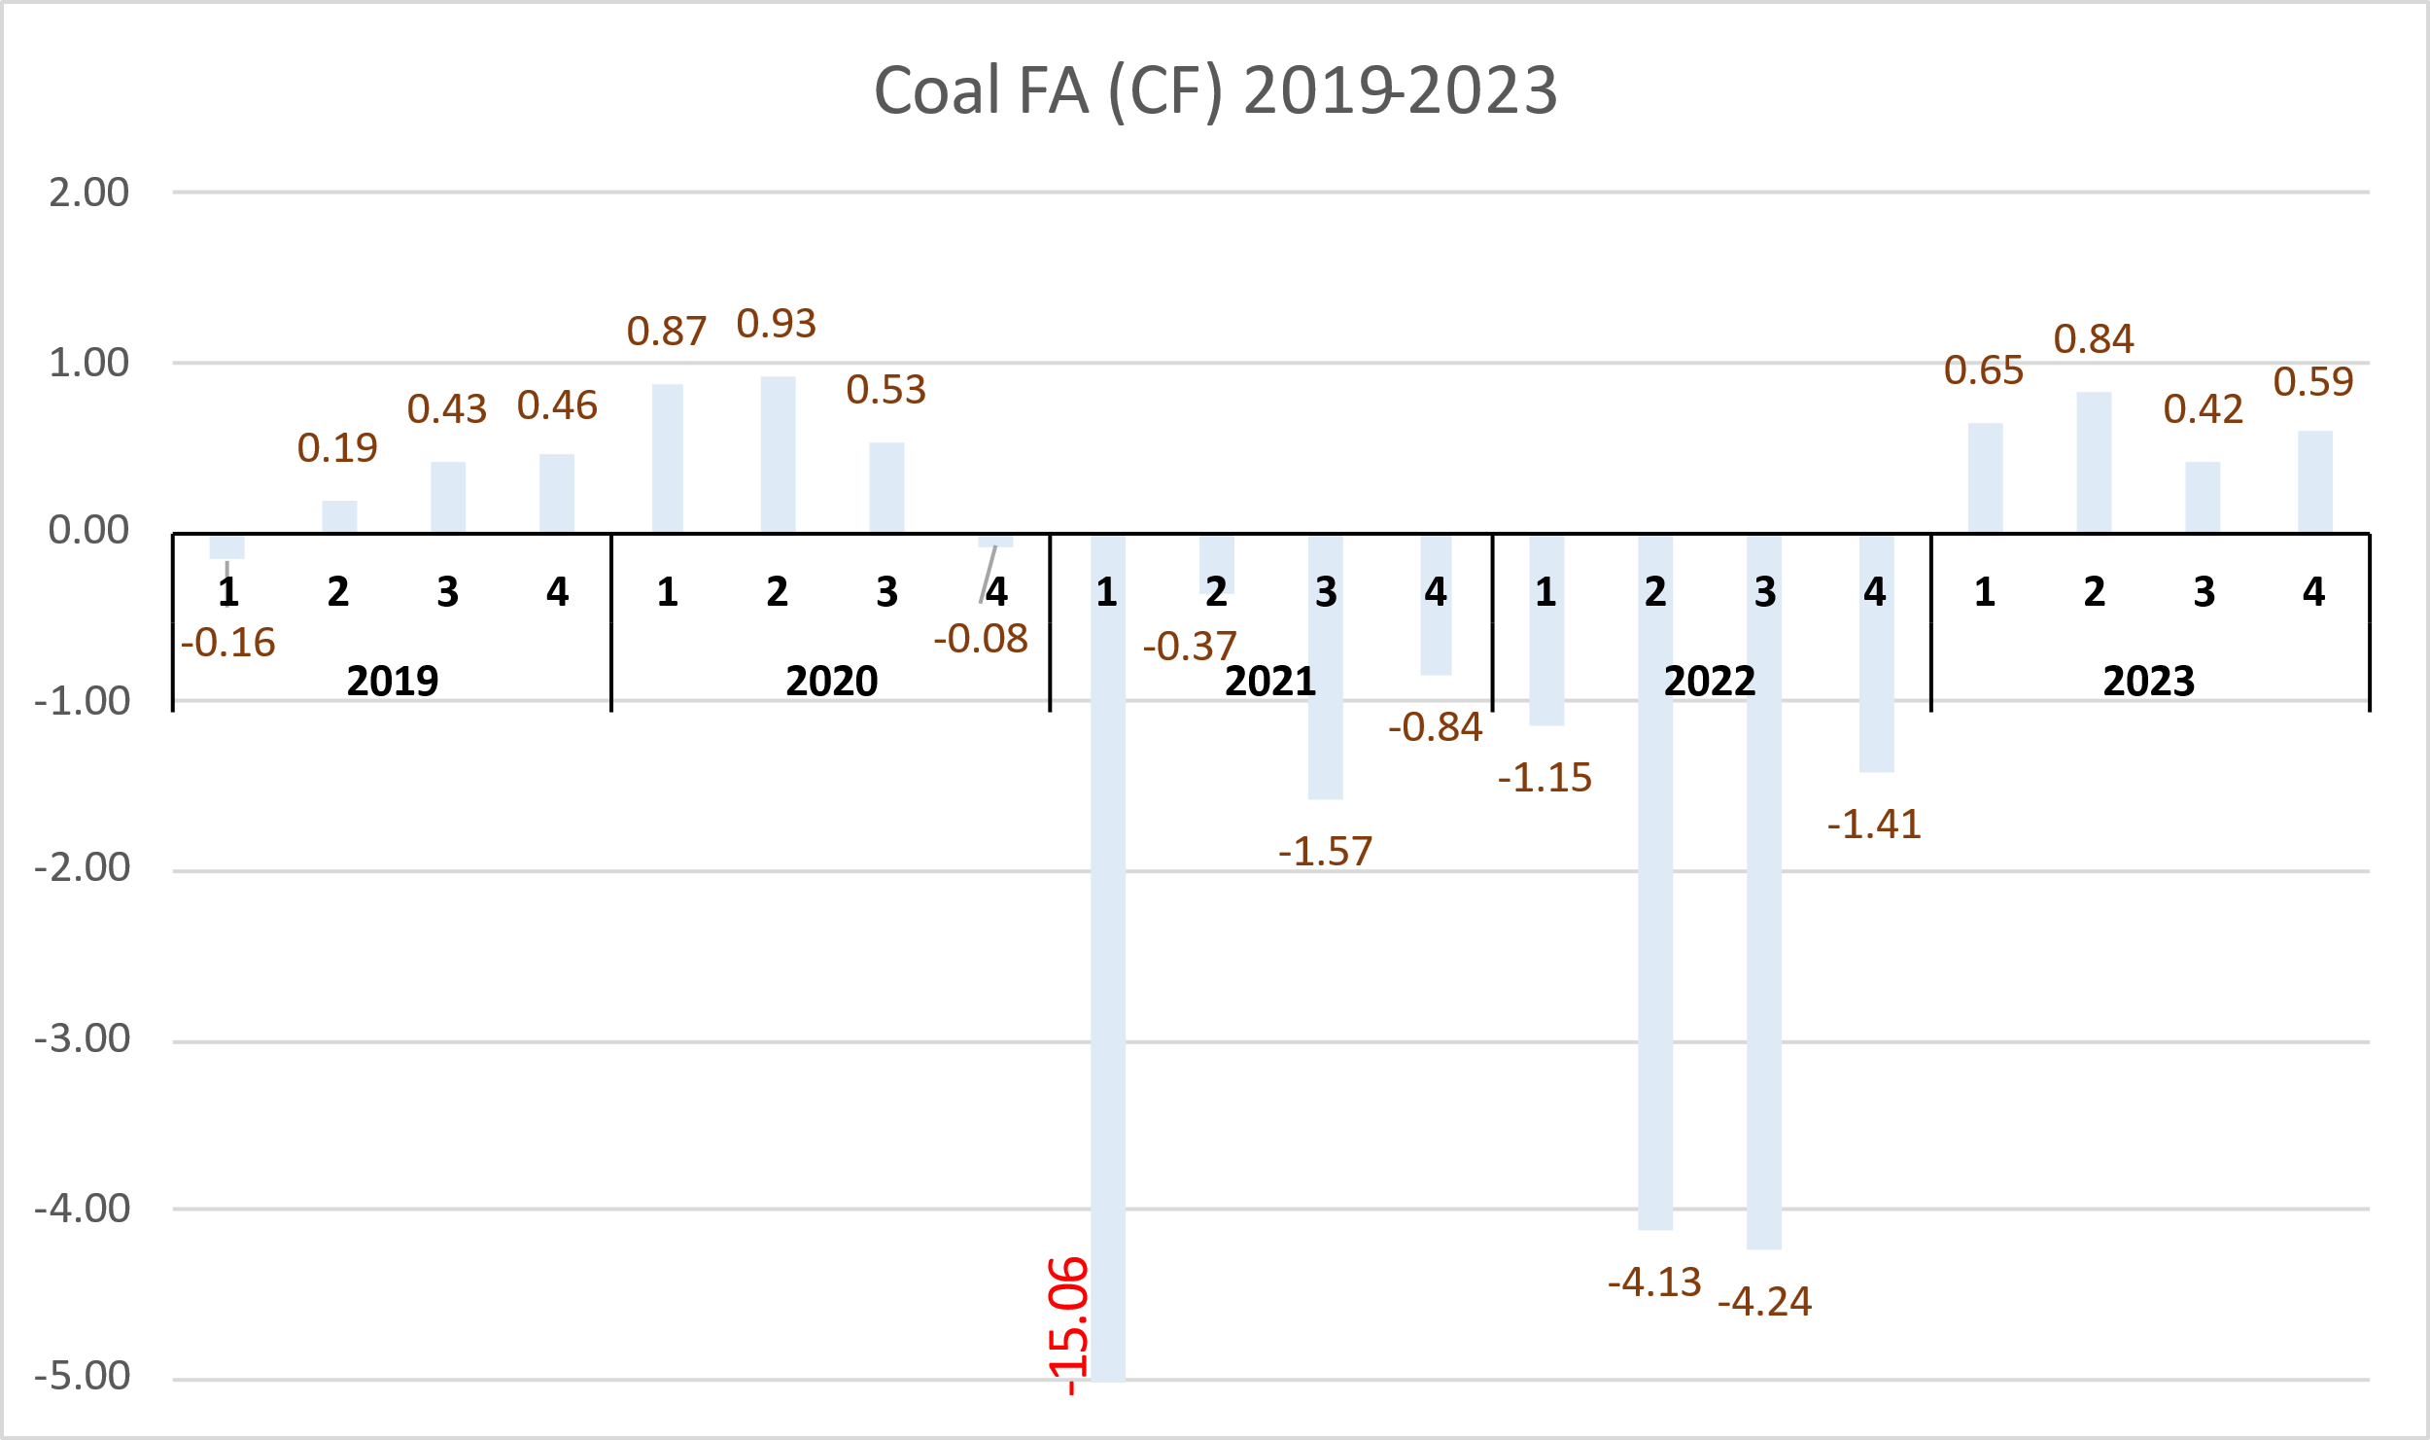
Actual Calculated Coal Fuel Adder (CF)

Slide 4
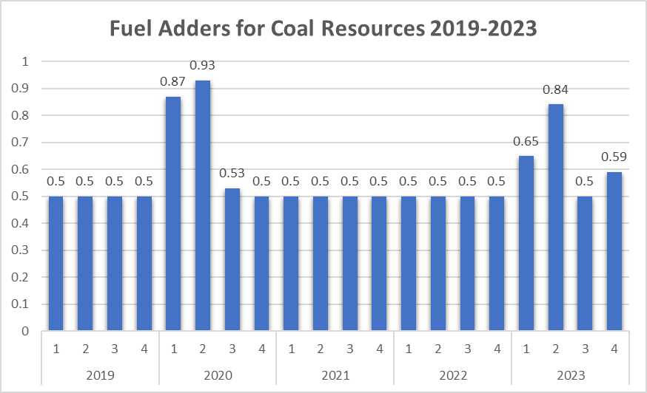
Approved Fuel Adders
Key Takeaway: Coal FA was $0.50/MMBtu 70% of the time over the last 5 years.

Slide 5
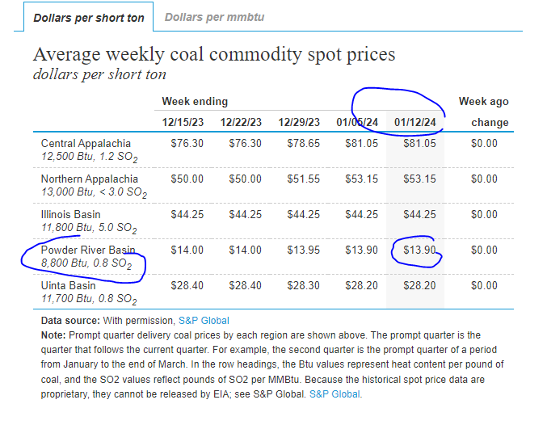
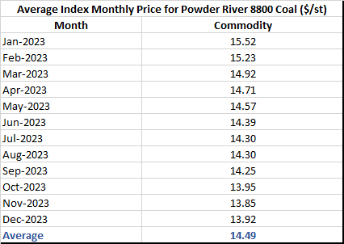
EIA Coal Commodity Spot Prices
Source: https://www.eia.gov/coal/markets/

Slide 6
ERCOT’s Recommended New Proposal
For Coal-Fired Resources
Resources with approved VC continue to receive $0.5/MMBtu.
Resources can file a fuel adder every 6 month, just like natural gas Resources, if CF is higher than $0.5/MMBtu.
The commodity price for coal can be based on one of the following¹:
Values published by the U.S. Energy Information Administration, or
Actual values provided by the QSE.
The commodity price provided by the U.S. Energy Information Administration (see next slide) matches very closely to the value shown by the ERCOT Index.
Calculating the weighted price of coal (commodity) is challenging given that coal is transported by multiple car trains, and it is difficult to establish the weighted average price of coal in the coal pile.
For the cost of transportation, the Resource can provide actual value(s) or value(s) from a published index recognized in the energy markets (or something similar).
¹ ERCOT will develop proposal for a new methodology.

Slide 7
Pros and Cons of Modifying the CF Methodolgy
Pros
Reduces costs of index subscription services for ERCOT.
Eliminates quarterly manual process.
Cons
Coal Resources that don’t file Fuel Adders may not be able to automatically recover costs if either/or:
Coal commodity and transportation costs increase significantly beyond FIP.
FIP is much lower than coal commodity and transportation for a sustained period.

Slide 8
Next Steps
Questions?

