Slide 1
EAL Change proposals: Proposal from REMC
Sanchir Dashnyam
ERCOT Market Credit Manager
ERCOT Public
January 19, 2024

Slide 2
Scenario #1: Proposal from REMC
Scenario 1: definitions
EAL q = Max [IEL during the first 40-day period only beginning on the date
that the Counter-Party commences activity in ERCOT markets, RFAF * Max
{RTNLE during the previous lrq days}, FAF*RTNLF] + DFAF * DALE + Max [RTLCNS NLCD, Max {ULERTA during the previous lrq days}] + OUT q + ILE q
OUT_{q} = OIA_{q} + UDAA_{q} + UFA_{q} + UTA_{q} + CARD
EAL t = Max [RFAF * Max { RTNLE during the previous lrt days}, FAF*RTNLF] + DFAF * DALE + Max [RTLCNS NLCD, Max {ULERTA during the previous lrq days}] + OUT t
OUT_{t} = OIA_{t} + UDAA _{t} + UFA_{t} + UTA_{t}
NLE = Total net liability extrapolated (Last 14 days RTM Initial Statement Average + Last 14 days DAM Initial Statement Average based on RTM Initial OD)*M1. Use same RTM ODs for DAM as well
NLF = net liability forward = 1.5 * (7 most recent Operating days Real time estimates + 7 most recent RTM ODs day-ahead) if settled data is available use settled else estimates – no price cap
FAF = 21 future / most recent days 7 RTM Prices
NLCD = (7 most recent Operating days Real time estimates + 7 most recent DAM ODs day-ahead) if settled data is available use settled else estimates – no price cap
ULE = unbilled liability extrapolated (Last 14 days RTM Initial Statement Average + Last 14 days DAM Initial Statement Average based on RTM Initial OD)*M2 - use same RTM ODs for DAM as well
OD Invoice Exposure: new proposal from RMC
Include:
RTM and DAM statements for the same Operating Day must be netted for every Operating Day considered in Invoice Exposure calculation (past 7 ODs and M1 forward ODs days).
For Finals and true-ups include (past 7 days as well as M1 forward days statements)
Exclude: M&N securitization invoices, CRR auction invoices, miscellaneous invoices relating to $2B distributed to market for Sec N on 6/21/22, and miscellaneous invoices related Uri short pay to market on 12/19/2022

Slide 3
Current EAL Formula vs. Scenarios #2 and #3
Current: EAL _{q} = Max [IEL during the first 40-day period only beginning on the date that the Counter-Party commences activity in ERCOT markets, RFAF * Max {RTLE during the previous lrq days}, RTLF] + DFAF * DALE + Max [RTLCNS, Max {URTA during the previous lrq days}] + OUT _{q} + ILE _{q}
Scenario #2: EAL q = Max [IEL during the first 40-day period only beginning on the date that the Counter-Party commences activity in ERCOT markets, Max{(RFAF * Max {RTLE) during the previous lrq days}, RTLF] + DFAF * DALE + Max [RTLCNS, Max {URTA during the previous lrq days}] + OUT q + ILE q
Scenario #3: EAL q = Max [IEL during the first 40-day period only beginning on the date that the Counter-Party commences activity in ERCOT markets, RFAF * Max {RTLE during the previous lrq days}, RTLF] + DFAF * DALE + Max [RTLCNS, Max {URTA during the previous lrq days}] + OUT q + ILE q
Two RFAF’s: CP specific RFAF and Global RFAF Max RTLE date
CP specific RFAF = Projected Real-Time ICE Forward Average Price / Historic Real-Time Settled Average Price
Global RFAF is calculated based on existing methodology. Global RFAF is used in MCE calculations.

Slide 4
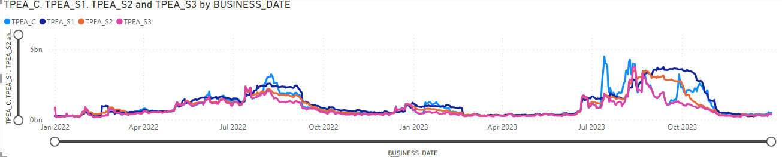
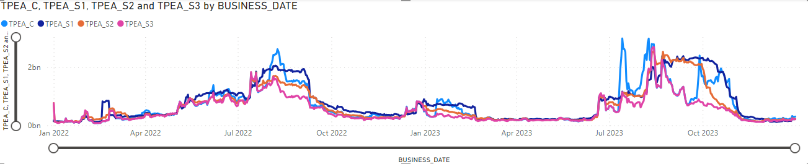
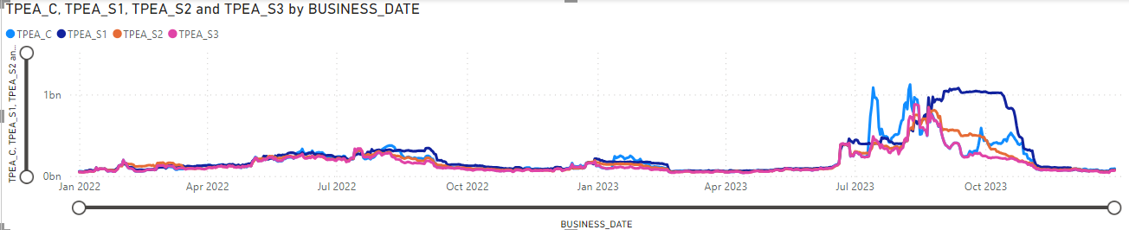
TPEA for Scenario#1,#2,#3 vs Current: Market, Load & Gen, Load

Slide 5
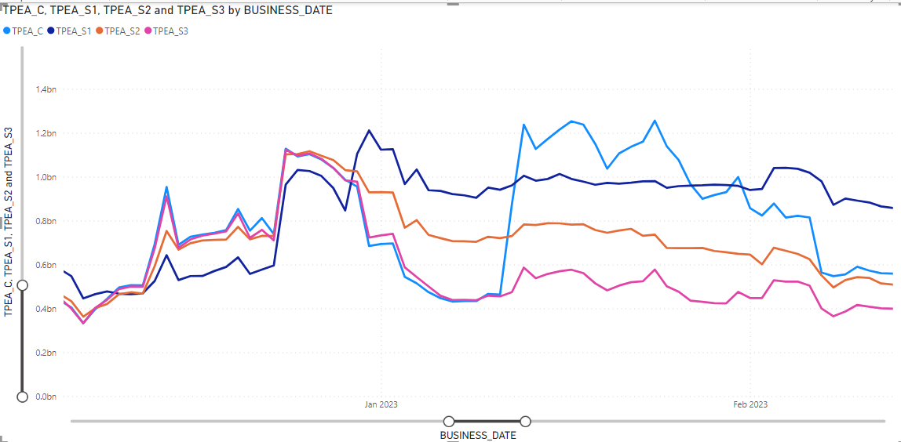
Market TPEA – Winter storm Elliott

Slide 6
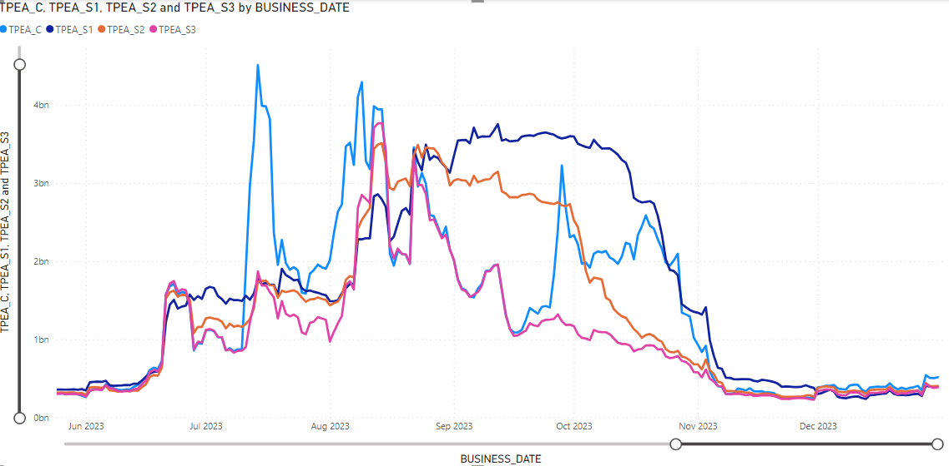
Market TPEA – Summer 2023

Slide 7
Scenario #1: (a) Netting, (b) FAF vs RFAF, (c) Application of FAF
EAL t = Max [RFAF * Max { RTNLE during the previous lrt days}, FAF*RTNLF] + DFAF * DALE + Max [RTLCNS NLCD, Max {ULERTA during the previous lrq days}] + OUT t
NLE = Total net liability extrapolated (Last 14 days RTM Initial Statement Average + Last 14 days DAM Initial Statement Average based on RTM Initial OD)*M1. Use same RTM ODs for DAM as well
NLF = net liability forward = 1.5 * NLCD
NLCD = (7 most recent Operating days Real time estimates + 7 most recent DAM ODs day-ahead) if settled data is available use settled else estimates – no price cap
FAF = 21 future / most recent days 7 RTM Prices
ULE = unbilled liability extrapolated (Last 14 days RTM Initial Statement Average + Last 14 days DAM Initial Statement Average based on RTM Initial OD)*M2 - use same RTM ODs for DAM as well
TPEA is driven mostly by Max NLE.
Scenario #1 avoids the “double top” and provides a gradual increase in TPE in both coming into the high volatility period as well as coming out. The shape of the TPE graph is more gradual and does not have “up & down” feature of the current TPE formula.
FAF is generally not as volatile as the existing RFAF. Thus, when applied against NLF it doesn’t overtake Max NLE.

Slide 8

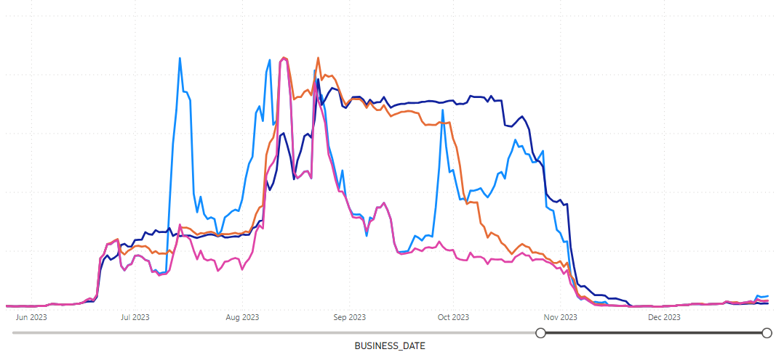
Example : Load & Gen MP - Summer 2023
Scenario #1 looks at Max NLE during the previous lrq days, thus, it does solve the problem of RFAF going below 1 and artificially depressing exposures.
On the other hand, the TPEA under Scenario #1 will tend to “sit” there until the Max rolls off.

Slide 9
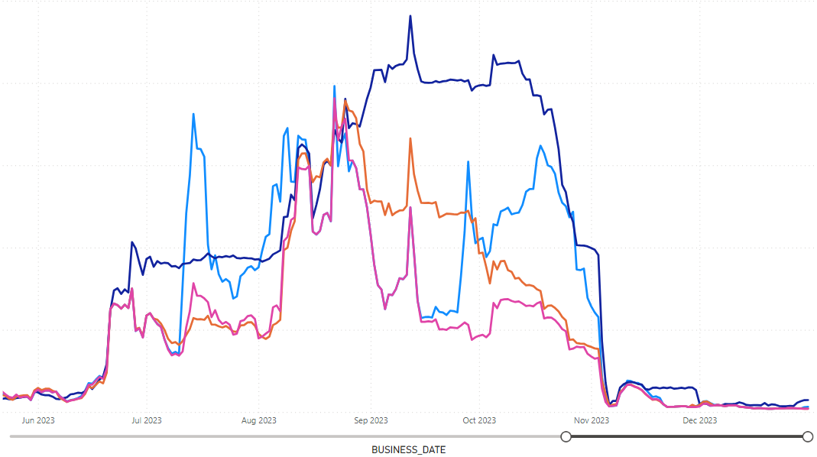
Example: Load MP - Summer 2023

Slide 10
RFAF
RFAF by its definition is very volatile: RFAF peaked during winter storm Uri at almost 11 then went to 0.01 on 2/24/21.
Most recently it hit 6 in July 2023, which was the highest since Feb 2021. Also, it went as low as 0.15 on 9/13/23, which was the lowest since Uri. The fact that, RFAF goes down below 1 means TPE is essentially mechanically lowered once historical settled prices roll off from the denominator.

Slide 11
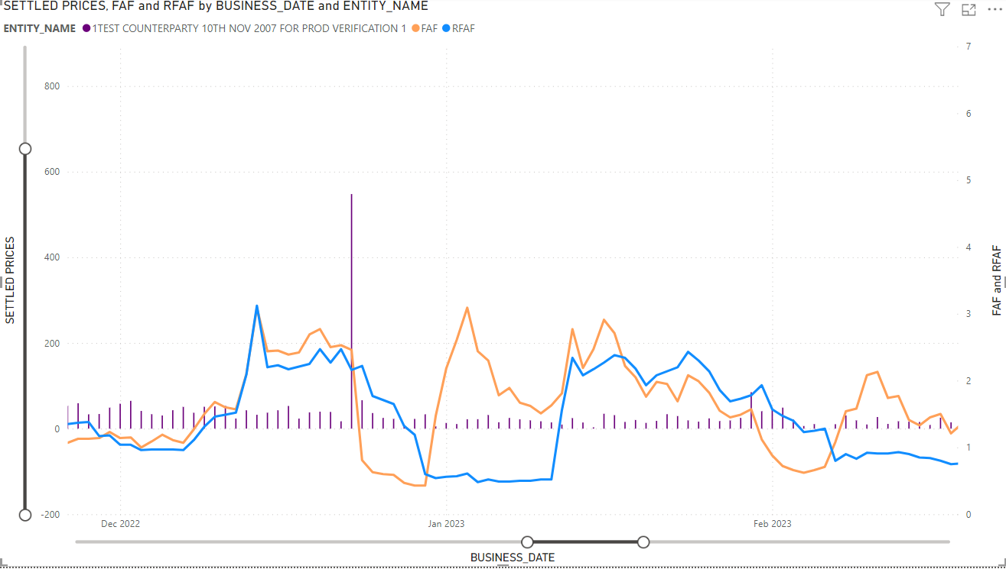
FAF vs RFAF vs Average Settled prices – Winter storm Elliott
Going into the event, both factors are about the same.
After the event, FAF normalizes faster since the denominator is based on the most recent 7 day prices vs. RFAF’s 14 days settled prices (5 day lag). Also, RFAF stays at the “bottom” longer than FAF, which recovers faster.
Overall, FAF seems to be more “sensitive”.

Slide 12
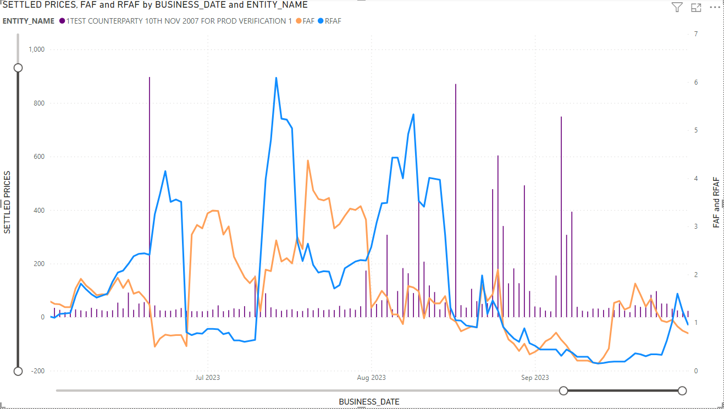
FAF vs RFAF vs Average Settled prices – Summer 2023
The spike in June was not captured by ICE futures.
FAF appears to be not as volatile as RFAF. The reason for the higher volatility for RFAF is due to the denominator using 14-day historical settled prices.
Due to shorter window for FAF’s denominator (last 7 days), it tends to be less volatile.

