Slide 1
Texas SET 5.0 Orientation
Kathryn Thurman & Tammy Stewart
June 25, 2024

Slide 2
Agenda
Acronyms
Texas SET V5.0 High Level Changes
Business Requirements for entering Flight Test – High Level
Testing Tracks and Testing Relationships
FlighTrak
Texas SET V5.0 Test Scripts
Implementation Plan
Supporting Documents location
MarkeTrak SCR817 Overview

Slide 3
Acronyms
CSA – Continuous Service Agreement
MCT – Market Coordination Team
PROD – Production Environment
RMG – Retail Market Guide
RMTE – Retail Market Test Environment (used for flight testing)
ROR – Rep of Record
Texas SET – Texas Standard Electronic Transaction

Slide 4
High Level Changes
Update CSA to include the use of Start and End Date
Move Outs to use the CSA Start and End Dates
Move Outs with the bypass flag
Switches rejected for NFI
New Values for County and Metered Service Type
Inadvertent Changes
New Reject Codes and Reject Reasons
Texas SET Change Controls

Slide 5
High Level Changes - CSA
Add CSA Start Date and CSA End Date to the Establish CSA transaction.
Add the ability to modify the CSA End Date through the CSA Change transaction (new ASI02 of 001).
CSA Start Date is required for all Establish CSA requests. CSA End Date is optional for all Establish CSA requests.
CSA End Date is required for all Change CSA requests. CSA Start Date should not be used for a CSA Change request, or the transaction will be rejected.

Slide 6
High Level Changes – CSA cont.
The use of CSA Start Date or CSA End Date on the Delete CSA will cause the transaction to be rejected at ERCOT.
CSAs with a requested Start Date in the future will be placed in a ‘Pending’ status until the morning of the requested Start Date.
CR’s wishing to cancel a CSA where the CSA start date is in the future should create a MarkeTrak Day-to-Day Market Rule issue subtype and enter “CSACAN” in the required Market Rule field.
On the morning of the requested Start Date, ERCOT will update the CSA status to Active and end any previous CSA Service Instances.

Slide 7
High Level Changes: CSA cont.
Add 2 new columns to the Siebel Service Order Extract for the CSA Start Date and CSA End Date.
CSA Adds, Changes and Deletes will be provided in the Siebel Service Order Extract
The Service Order Extract DDL can be found on the MCT page.
Find ESI updated to display both Active and Pending CSAs
Reference Change Controls:
TXSETCC828
TXSETCC830
TXSETCC833
TXSETCC838
TXSETCC840

Slide 8
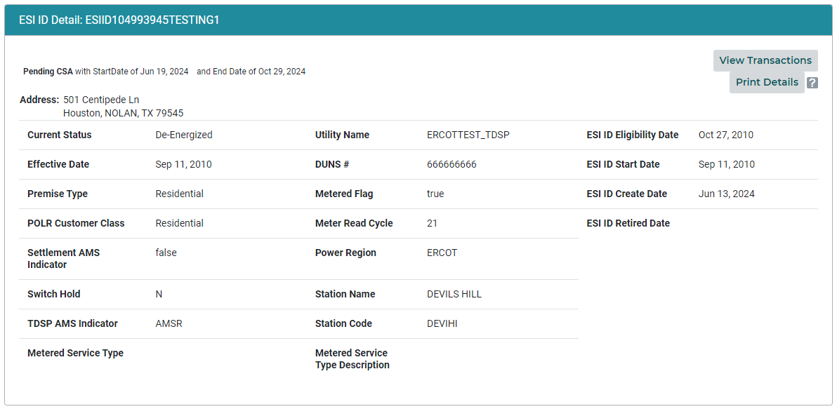
Find ESI – Display Pending CSAs

Slide 9
High Level Changes – Move Out evaluations against CSA relationships
On receipt of a Move Out request (814_24), ERCOT will use the Start Date and End Date of all Active and pending CSAs to determine if the Move Out will be a Move Out to CSA or a straight Move Out.
Example 1:
Today is 7/1
CR1 has a Pending CSA with a Start Date of 7/10
CR2 submits a Move Out for 7/15
ERCOT treats the Move Out as a Move Out to CSA and sends an 814_03 to the TDSP for 7/15 for CR1.
Example 2:
Today is 7/1
CR1 has an Active CSA with an End date of 7/5
CR 2 submits a Move Out for 7/10
ERCOT treats the Move Out as a straight Move Out and sends the 814_24 to the TDSP

Slide 10
High Level Changes – Bypass to CSA
After the implementation of Texas SET 5.0, the use of the REF~2W CSA Bypass code on an ESI ID where the CR is not the CSA, or scheduled to be the CSA, on the requested date of the Move Out, will result in ERCOT rejecting the Move Out.
Reference Change Controls:
TXSETCC798

Slide 11
High Level Changes – Switches rejected for NFI
ERCOT will begin rejecting switches based on the First Available Switch Date (FASD) of the Standard Switch.
In the event there is already a Switch Request (standard or Self-Selected) scheduled that does not have a Cancel Pending status and for which the Scheduled Meter Read Date (SMRD) is later than or equal to the FASD on the second standard Switch Request, the standard Switch request will be rejected for Not First In (NFI).
In the event ERCOT receives a standard switch on an ESI ID where there is a scheduled Move In with the SMRD equal to FASD of the standard Switch, the standard Switch will be rejected for NFI.
In the event ERCOT receives a standard switch on an ESI ID where there is a scheduled Move Out with the SMRD equal to FASD of the standard Switch, the standard Switch will be rejected for NFI.

Slide 12
High Level Changes - NFI
Scheduled | New Transaction | Rejected for Not First In
Move in | Move in | Yes
Move in | Self-selected switch | Yes
Move in | Move out | No
Move in | Standard switch | Yes
Move out | Move in | No
Move out | Self-selected switch | Yes
Move out | Move out | Yes
Move out | Standard switch | Yes
Switch | Move in | No
Switch | Self-selected switch | Yes
Switch | Move out | No
Switch | Standard switch | Yes
Mass Transition drop | Move in | No
Mass Transition drop | Self-selected switch | No
Mass Transition drop | Move out | No
Mass Transition drop | Standard switch | No
Acquisition Transfer | Move in | No
Acquisition Transfer | Self-selected switch | No
Acquisition Transfer | Move out | No
Acquisition Transfer | Standard switch | No
Items highlighted in yellow are the ones changing for Texas SET 5.0

Slide 13
High Level Changes - County
New data elements will be added to the following transactions to allow the TDSPs to communicate which County the ESI ID is in.
  814_04
  814_05
  814_14
  814_20
The addition of County Name allows for synchronization of REP’s databases with the TDSPs’ databases whenever heat advisories are activated per subsection (i)(2) of P.U.C. SUBST. R. 25.29, Disconnect of Service
During the Implementation weekend of Texas SET 5.0 each affected TDSPs will send a flat file to ERCOT that contains all the TDSPs ESI IDs (except for retired ESI IDs) and their respected County. Following the Texas SET 5.0 Implementation, REPs can obtain the TDSPs ESI ID extract from MIS.
After Implementation of Texas SET 5.0 County will be sent or update via normal processes using the 814_20 transaction.
Reference Change Control: TXSETCC821

Slide 14
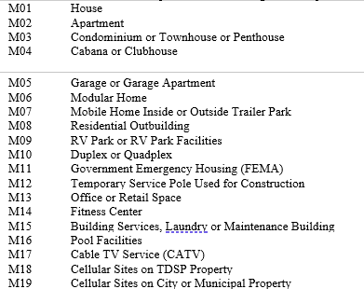
High Level Changes – Metered Service Type
A new optional REF segment (REF~MSL) will be added to the following transactions to communicate the Metered Service Type
  814_04
  814_05
  814_14
  814_20
  814_22
This new REF~MSL may be used by the TDSPs to provide additional information to the REP to better describe the ESI ID’s Service Type that is being metered.
Sample of the 44: Metered Service Type List
Reference Change Control: TXSETCC831

Slide 15
High Level Changes – County & Metered Service Type
County will be available on the TDSP ESIID Extract as well as Find ESIID lookup function in MIS.
Metered Service Type and Metered Service Type Description will be available on the TDSP ESIID Extract as well as Find ESIID lookup function in MIS.
The TDSP ESIID Extract DDL can be found on the MCT page.
Reference: Protocol 15:2 Database Queries

Slide 16
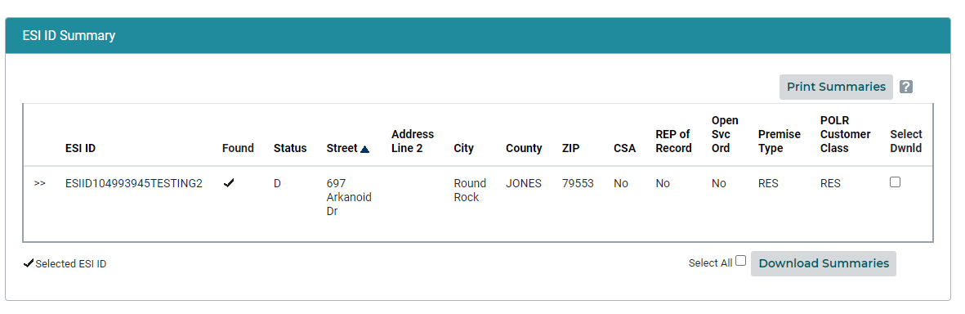
MIS Find ESI – ESIID Summary

Slide 17
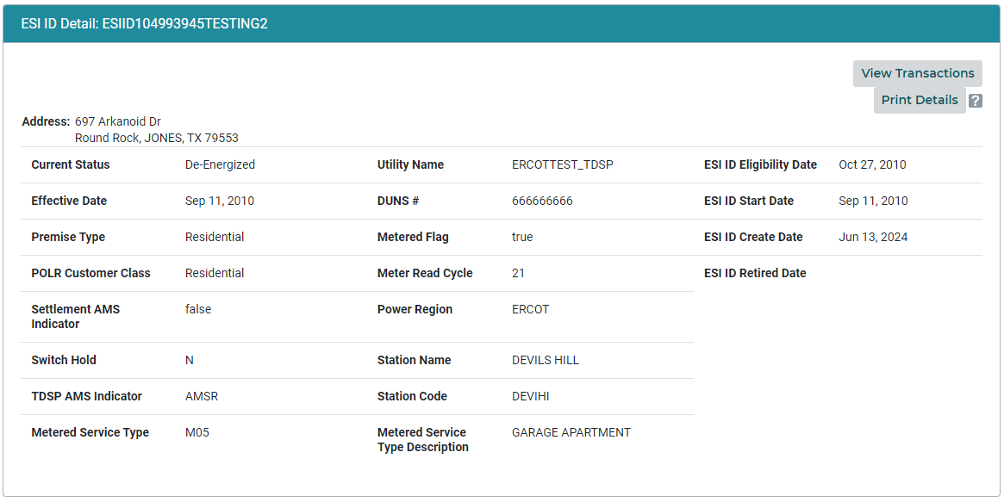
MIS Find ESI – ESIID Detail

Slide 18
High Level Changes – Customer Recission
A new indicator of “CR” has been added to the following transactions to communicate the ESI ID was involved in a Customer Recission.
  814_16
  814_03
  814_04
  814_05
The CR should use the “CR” code in the BGN07 on the Move In request to notify the TDSP the transaction is being used to reverse a Switch due to Customers Right of Recission.
With the implementation of SCR817, which will go live with the TXSET 5.0 changes, the Customer Rescission MarkeTrak workflow will be changing to support the automated transactional process.
Reference Change Controls:
TXSETCC829
TXSETCC832

Slide 19
High Level Changes – Inadvertent Gain or Loss
A new indicator of “IA” has been added to the following transactions to communicate the ESI ID has been involved in an Inadvertent Gain or Loss.
  814_16
  814_03
  814_04
  814_05
The CR should use the “IA” code in the BGN07 on the Move In request to notify the TDSP the transaction is being used to reverse a Switch or Move In due to Inadvertent Gain or Loss.
With the implementation of SCR817, which will go live with the TXSET 5.0 changes, the Inadvertent Gain and Inadvertent Loss MarkeTrak workflows will be changing to support the automated transactional process.
Reference Change Controls:
TXSETCC829
TXSETCC832

Slide 20
High Level Changes – Customer Rescission Workflows
With the implementation of the new “CR” indicator to the initiating transactions, the TDSPs will no longer have an active role in the resolution of Customer Rescission MarkeTrak issues. The TDSP involved transitions such as ’Send To TDSP’ and ‘Ready To Receive’ have been removed from the workflow since the TDSP will no longer have to prepare their systems in advance to receive a backdated MVI. The TDSP will continue to be an ‘MP Involved’ on the issue and will retain visibility to the issue details. They will also have the ability to add comments if needed. Below is a visual representation of the redesigned Customer Rescission workflow. This is an illustration of the ‘Happy Path’:
Reference:
TXSETCC829
TXSETCC832
SCR817

Slide 21
High Level Changes – Inadvertent Gain/Loss Workflows
As with Customer Rescission, the new “IA” indicator will also result in changes to the Inadvertent Gain/Inadvertent Loss workflows. The TDSP will no longer have an active role in the resolution of these MarkeTrak issues. The TDSP will continue to be an ‘MP Involved’ and will retain visibility to the issue details. They will also have the ability to add comments if needed. Below is a visual representation of the redesigned Inadvertent Gain and Inadvertent workflows. These are illustrations of the ‘Happy Path’ for each:
Inadvertent Gain Workflow:
Inadvertent Loss Workflow:
Reference:
TXSETCC829
TXSETCC832
SCR817

Slide 22
High Level Changes - Reject Codes and Reject Reasons
Add the reject code 090 “Greater than 90 in the future” to the REF~7G (Rejection Reason) in the 814_02, 814_04, 814_05, 814_11, 814_13, 814_17, 814_19, and 815_25. This reject code will be used by ERCOT or the TDSP to reject transactions requesting more than 90 days in the future. TXSETCC830
Add the reject code 270 “Greater than 270 in the past” to the REF~7G (Rejection Reason) in the 814_02, 814_04, 814_05, 814_11, 814_13, 814_17, 814_19, and 815_25. This reject code will be used by ERCOT or the TDSP to reject transactions requesting more than 270 days in the past. TXSETCC830
Add the reject code A78 “Item or Service Already Established” to the REF~7G (Rejection Reason) in the 814_04, 814_05, 814_11, and 814_25. This reject code will be used by the TDSPs to reject an order where the Item or Service is already established. TXSETCC830

Slide 23
High Level Changes - Reject Codes and Reject Reasons
Add the reject code CCL “Critical Care or Critical Load” to the REF~7G (Rejection Reason) in the 814_04, 814_05, 814_11, and 814_25. This reject code will be used by the TDSP’s to reject a Move Out where the premise has Critical care or Critical Load. TXSETCC830
Add the reject code DIP “Date In Past” to the REF~7G (Rejection Reason) in the 814_04, 814_05, 814_11, and 814_25. Remove ‘MIMO Rules, ERCOT 24’ from the DIP reject code in the 814_13 to allow the TDSP to reject a Date Change with a requested date in the past. This reject code will be used by the TDSPs to reject the 814_03, 814_12 or 814_24 with a requested date in the past. TXSETCC830
Add the reject code I2M “Invalid Second Move Out” to the REF~7G (Rejection Reason) in the 814_25. This reject code will be used by the TDSPs to reject Move Outs where a second Move Out request is received that is invalid. TXSETCC830, TXSETCC842, TXSETCC844

Slide 24
High Level Changes - Reject Codes and Reject Reasons
Add the reject code NFI “Not First In” to the REF~7G (Rejection Reason) in the 814_04 and 814_05. This reject code will be used by the TDSPs to reject orders where more than one Move In was received. TXSETCC830, TXSETCC837
Add the reject code NVS “No Valid Safety Net” to the REF~7G (Rejection Reason) in the 814_04, 814_05, 814_11, and 814_25. This reject code will be used by the TDSPs to reject orders where a valid safety net was not received. TXSETCC830
Add the reject code PCI “Priority Code Invalid” to the REF~7G (Rejection Reason) in the 814_04, 814_05 and 814_11. This reject code will be used by the TDSPs to reject orders where the priority code is invalid. TXSETCC830

Slide 25
High Level Changes - Reject Codes and Reject Reasons
Add the reject code SNP “Safety Net Pending” to be sent on Acquisition Transfers (BGN07=AQ). TXSETCC830
Add the reject code TMI “Invalid Move In on Temporary Service” to the REF~7G of the 814_04 and 814_05. This reject code will be used by the TDSPs to reject Move In’s due to temporary service. TXSETCC830
Add the reject code SOP “Subsequent Order Processed” to the REF~7G of the 814_09. This reject code will be used by the TDSPs to reject a request to cancel due to a subsequent order processed. TXSETCC830, TXSETCC843
Add the reject code DCI “Date Change Request Ineligible” to the REF~7G of the 814_13. This reject code will be used by the TDSPs to reject an invalid date change. TXSETCC830

Slide 26
High Level Changes - Reject Codes and Reject Reasons
Add the reject code DNS “Date Change Not available on Switch” to the REF~7G in the 814_13. This reject code will be used by ERCOT to reject a Date Change Request received on a Switch. TXSETCC830
Add the reject code RSD “Received Scheduled Date” to the REF~7G in the 814_13. This reject code will be used by the TDSPs to reject a Date Change Request that was received on the same business day as the requested change date. TXSETCC830
Add the reject code NCC “No Current CSA” to the REF~7G of the 814_19. This reject code will be used by ERCOT to reject a CSA Delete where there is no Active CSA. TXSETCC830
Add the reject code ERS “ESI ID already Exists in Registration System” to the REF~7G of the 814_21. This reject code will be used by ERCOT to reject an 814_20 Add where the ESI ID already exists in ERCOT’s registration system. TXSETCC830

Slide 27
High Level Changes - Reject Codes and Reject Reasons
Add the reject code IIC “Invalid Interconnection Point” to the REF~7G of the 814_21. This reject code will be used by ERCOT to reject an 814_20 Maintain with an invalid Standard Interconnection Point. TXSETCC830
Add the reject code RDF “Read Dates in Future” to the REF~7G of the 814_21. This reject code will be used by ERCOT to reject an 814_20 with an Effective Date of Change (DTM~152) or End Date (DTM~197) with a date in the future. TXSETCC830
Add the reject code SND “Status Not De-Energized” to the REF~7G of the 814_21. This reject code will be used by ERCOT to reject an 814_20 Delete where the ESI ID has open orders or the ESI ID status is not de-energized. TXSETCC830
Add the reject code A84 “Invalid Relationship” to the REF~7G of the 814_27. This reject code will be used by the TDSPs to reject a historical usage request where the CR does not have a valid relationship with the customer. TXSETCC830

Slide 28
High Level Changes - Reject Codes and Reject Reasons
Add the reject code TNR “Transaction Not In Review” to the REF~7G of the 814_29. This reject code will be used by ERCOT when an 814_28 (PT) is received on an order where the status is not In Review. TXSETCC830

Slide 29
High Level Changes – MIMO Rules Reference
Remove ‘MIMO Rules, ERCOT 1’ from the REF~7G of the NFI “Not First In” in the 814_02, 814_11, 814_17 and 814_25. This will allow the both the TDSP and ERCOT to send the NFI reject. TXSETCC830, TXSETCC837
Remove ‘MIMO Rules, ERCOT 3’ from the REF~7G of the SCP “Scheduling Conflict Priority” of the 814_02, 814_04, 814_05, 814_11, 814_13, and 814_25. This will allow both the TDSP and ERCOT to send the SCP reject code. TXSETCC830
Remove ‘MIMO Rules, ERCOT 4’ from the REF~7G of the SBD “Scheduled to be De-Energized” in the 814_02, 814_04, 814_05, 814_11, and 814_25. This will allow both the TDSP and ERCOT to use this reject code in the 814_04. The 814_25 will remain ERCOT use only. TXSETCC830

Slide 30
High Level Changes – MIMO Rules Reference
Remove the ‘MIMO Rules, ERCOT 24’ from the REF~7G of the IBO “Invalid Backdate Originator” of the 814_04, 814_05 and 814_25. This will allow both the TDSP and ERCOT to send this reject code. TXSETCC830
Remove ‘MIMO Rules, ERCOT 22’ from the REF~7G of the ICL “Iteration Count Lower” in the 814_13. This will allow both the TDSP and ERCOT to send the ICL reject code. TXSETCC830
Remove ‘Used by ERCOT Only’ to from the REF~7G of the CW1 “Cannot Cancel on the Day of Scheduled Meter Read Date or in the past” in the 814_09 and 814_13. This will allow both the TDSP and ERCOT to send the CW1 reject code. TXSETCC830

Slide 31
High Level Changes – MIMO Rules Reference
Remove MIMO rules reference from the following
  ‘MIMO Rules, ERCOT 1’ from the REF~7G of the UNS “Unable to Schedule” in the 814_02. TXSETCC830
  ‘MIMO Rules, ERCOT 4’ from the REF~7G of the MAR “Move In Already Received” in the 814_02. TXSETCC830
  ‘MIMO Rules, ERCOT 27’ from the REF~7G of the DOT “Duplicate Original Transaction ID” in the 814_02, 814_17, 814_19, 814_21, 814_25, and 814_27. TXSETCC830
  ‘MIMO Rules, ERCOT 27’ from the REF~7G of the DUP “Duplicate” in the 814_02, 814_09, 814_17, 814_19, 814_21, 814_25, 814_27 and 814_29. TXSETCC830

Slide 32
High Level Changes – Texas SET Change Controls
Add a new Optional PER segment PER~PO to the 814_01, 814_03 and 814_16 transactions to communicate Power Outage Contact Information. TXSETCC827
Add the Status Reason “CHP” (Construction Hold Pending) to the 814_04 and 814_05 of the REF~1P (Status Reason). TXSETCC809
Update the 650_02 to add 5 new codes to the REF~G7 (Complete Unexecutable Reason)
  J009 – Distributed Generation (DG) Premise requires ATS and signed Interconnection Agreement
  J010 – Auto Transfer Switch (ATS) Not Approved
  J011 – Distributed Generation (DG) Auto Transfer Switch (ATS) Disconnect Not Approved
  S004 – Service Standards Clearance Violation (Cut-Ins/Cut-Outs)
  U007 – Service Standards Clearance Violation (Unsafe Conditions)
  TXSETCC816, TXSETCC834

Slide 33
High Level Changes – Texas SET Change Controls
Update the 650_01 and 650_02 with graybox clarifications to 3 existing codes and adds 4 new codes to the REF~8X (Purpose Code)
  DC006 – Disconnected Premise Due to Safety, Weather Related or Emergency Condition(s)
  RC002 – To be used where applicable City Permit will be required before Premise can be reconnected by the TDSP
  RC003 – Reconnect Premise
  RC004 – Reconnect after Disconnect for Denial of Access
  RC006 – Reconnect Premise After Safety, Weather related or Emergency Conditions No Longer Exist
  RC007 – Reconnect Premise after Corrections made to Resolve Service Standards Clearance Violation(s)
  RC008 – Reconnect Premise after Correction(s) were completed to Customer’s Distributed Generation Equipment, which may include Auto Transfer Switch (ATS) corrections and/or Customer has signed Interconnection Agreement
  TXSETCC815, TXSETCC816, TXSETCC834

Slide 34
High Level Changes – Texas SET Change Controls
Update the 650_04 to add 8 new codes to the REF~5H (Suspension/Reactivation Code)
  DC006 – Disconnected Premise Due to Safety, Weather Related or Emergency Condition(s)
  DC007 – Disconnected Premise due to Service Standards Clearance Violation(s)
  DG001 – Disconnected Premise due to Distributed Generation (DG) Equipment requires Auto Transfer Switch (ATS) and signed Interconnection Agreement
  DG002 – Disconnected Premise due to Auto Transfer Switch (ATS) Not Approved
  DG003 – Disconnected Premise due to Distributed Generation (DG) Auto Transfer Switch (ATS) Disconnect Not Approved
  RC006 – Reconnected Premise after Safety, Weather Related or Emergency Conditions(s) No Longer Exist
  RC007 – Reconnected Premise after Service Standards Clearance Violation(s) was Resolved
  RC008 – Reconnected Premise after Correction(s) were completed to Distributed Generation Equipment, which may include Auto Transfer Switch Corrections and/or Customer signed Interconnection Agreement
  TXSETCC817, TXSETCC834

Slide 35
High Level Changes – Texas SET Change Controls
Update the 650_04 transaction to clarify the “R8” (Terminate) code located in the BGN08 of the BGN~13. TDSPs will use this code to indicate an ESI ID is permanently suspended and the CR will need to submit an 814_24 (Move Out) with the REF~1P=B44 so the TDSP can retire the ESI ID. TXSETCC817
Update the 650_04 gray box for the REF~MG (Meter Number) to remove incorrect information. TXSETCC817
Update the 650_02 for the YNQ to remove the RC003 (Reconnect for Customer Requested Clearance). TXSETCC816

Slide 36
High Level Changes – Texas SET Change Controls
Update the 650_04 to require the DTM~139 (Actual Completion or Estimated Restoration Date/Time) when the
  BGN08=79 (Reactive) and REF~5H=RC006 (Reconnected Premise after Safety, Weather Related or Emergency Conditions No Longer Exist). TDSP will provide actual Date/Time when restoration of service to Premise was completed.
  BGN08=79 (Suspended) and REF~5H=RC007 (Disconnected Premise due to Service Standards Clearance Violation(s)). TDSP will provide actual Date/Time when restoration of service to Premise was completed.
  BGN08=79 (Reactive) and REF~5H=RC008 (Reconnected Premise after Correction(s) were completed to Distributed Generation Equipment may include Auto Transfer Switch corrections and/or Customer Signed Interconnection Agreement. TDSP will provide actual Date/Time when restoration of service to Premise was completed.
  TXSETCC817, TXSETCC834

Slide 37
High Level Changes – Texas SET Change Controls
Update the 650_04 to require the MTX (Comments) when the BGN08=79 (Reactive) and REF~5H=RC007 (Reconnected Premise after Service Standards Clearance Violation(s) were Resolved.). TDSP will use “DEP” to provide Service Standards Clearance Violation(s) details in the “MTX02” data field. TXSETCC817
Update the 814_28 to add 3 new codes to the REF~G7
  J009 – Distributed Generation (DG) Premise Requires ATS and Signed Interconnection Agreement
  J010 – Auto Transfer Switch (ATS) Not Approved
  J011 – Distributed Generation (DG) Auto Transfer Switch (ATS) Disconnect Not Approved
  S004 – Service Standards Clearance Violation (Cut-Ins/Cut-Outs)
  U007 – Service Standards Clearance Violation (Unsafe Conditions)
  TXSETCC818, TXSETCC834

Slide 38
High Level Changes - Texas SET Change Controls
Update the BIG07 of the BIG (Beginning Segment for Invoice) for the 810_02 for the code “26” to match the name identified in the TX SET Guide as “Miscellaneous Service Invoice” TXSETCC835
ERCOT and TDSP to reject all name fields that contain only a comma or other one character punctuation in the following 814_01, 814_03, 814_04, 814_05, 814_08, 814_12, 814_14, 814_16, 814_18, 814_20, 814_22, 814_24, 814_26, 814_28, 814_PC, 650_01. The following will be validated on
  Period .
  Comma ,
  Semicolon ;
  Colon :
  Exclamation Mark !
  Question Mark ?
  Dash –
  TXSETCC836, TXSETCC837
  Hyphen -
  Parentheses ( or )
  Brackets [ or ]
  Curly Braces { or }
  Quotation Marks ” or “
  Apostrophe ‘
  Ellipses …

Slide 39
High Level Changes - Texas SET Change Controls
In the 814_20 Clarify the NM1 (Meter Level Information)
  When the NM108 Meter Number = NONE
  When the NM109 Meter Number = All and NONE
  TXSETCC819
Update the 814_20 for the REF~IX (Number of Dials) when the NM101 = MX (Meter Exchange)
  The REF~IX will not be provided in the NM1 loop if service type is ‘UNMETERED’ or Demand
  The REF~IX will not be provided when the NM108 = 93 and NM109 = ‘NONE’ or ‘UNMETERED’
  The REF~IX will not be provided in the NM1 loop for UNMETERED services.
  TXSETCC819
Update the 814_20 for the REF~IX (Number of Dials) when the NM101 = MQ (Meter Information).
  The REF~IX is required only if changing the number of dials
  TXSETCC819
Make the “Unmetered Service Type” found in the REF~PRT segment “Optional” for the TDSP when sending the 814_20 Create. TXSETCC794

Slide 40
High Level Changes - Texas SET Change Controls
Add clarification to the following Texas SET Implementation Guides that the State or Province Code(s) will only contain uppercase letters (A to Z) and if applicable digits (0 to 9).
  650_01
  814_01
  814_04
  814_05
  814_14
  814_28
  814_PC
  T1 Series
  T2 Series
  T3 Series
  T4 Series
  TXSETCC848

Slide 41
High Level Changes - Texas SET Change Controls
Update the 867_03 to add a new Unique Identifier of “M” (Mobile Generation) into the existing REF~JH (Meter Role) segment.
Mobile Generation “M” will be added to the following loops
  PTD~PL (Non-Interval Detail)
  PTD~BO (Interval Summary)
  PTD~PM (Interval Detail)
This code may be populated by the TDSP at the TDSP’s discretion to indicate the TDSP’s deployment of Mobile Generation Facility or TEEEF
If populated, the TDSP will provide total adjusted kWh usage resulting from this deployment.

Slide 42
Flight Testing
Business Requirements for Entering Test Flight

Slide 43
Entering Test Flight
How do I sign up to participate in Flight 0924, TX SET V5.0?
What are the business requirements I must fulfill before entering the test flight?

Slide 44
Signing up for Flight 0924: New LSEs
New LSEs that wish to sign up for Flight 0924 must complete ALL of the following by Flight Deadline
    Wednesday, July 3, 2024 – 5:00 CPT
Submit LSE Application
  Application can be found in Section 23 of the ERCOT Protocols:
  http://www.ercot.com/mktrules/nprotocols/current
  QSE Designation must be made prior to production
    Note – QSE must be Qualified/Certified by ERCOT
  Application requires a DUNS number (www.dnb.com).
    Note: ERCOT must be able to view and access the DUNS Number through www.dnb.com by the Application Processing Deadline; merely obtaining a DUNS Number from Dun and Bradstreet the day of the Application Processing Deadline is not sufficient, as it may take Dun and Bradstreet several days to enter the DUNS Number into their system
  Please note that proper registration of your company must be on file at the Texas Secretary of State office in order for your ERCOT LSE application to be accepted (http://www.sos.state.tx.us/) .
    Note: ERCOT must be able to view and access the TXSOS registration by the Application Processing Deadline
  Submit an Attestation Regarding Market Participant Citizenship, Ownership, or Headquarters form to ERCOT

Slide 45
Signing up for Flight 0924: New LSEs
Submit $500 LSE Application Fee
File for REP Certification with PUCT
  Send the PUCT docket number to: MPregistration@ercot.com
AR/BAR sends info to assign FlighTrak Admin
  Email sent to flighttesting@ercot.com by July 10, 2024
FlighTrak Admin creates user account for AR/BAR
  ERCOT confirms that the AR/BAR set up matches the contacts provided on the LSE application and assigns the AR/BAR roles to the appropriate users by July 17, 2024.
AR/BAR Submit Flight Registration in FlighTrak by July 31, 2024 @ 5:00 CPT
  Reference the FlighTrak Users Guide https://www.ercot.com/services/rq/lse/trt/index

Slide 46
Signing up for Flight 0924: DUNS + 4
Additional DUNS for Certified REP please note:
If a decision is made to add a DUNS for a Certified REP (DUNS or DUNS plus 4), this new entity is considered a new LSE from a business perspective
  The new LSE must follow the “New LSE” steps for signing up for Flight 0924
From a testing perspective, there are ad-hoc truncated testing tracks available under certain circumstances.

Slide 47
Signing up for Flight 0924: Existing LSEs
Existing LSEs will be required to test for the version upgrade to TX SET 5.0 and if they are entering new service territories, testing additional business functionality, changing banking information, changing their service provider, or adding another entity to their business umbrella.

Slide 48
Signing up for Flight 0924: Existing LSEs
Existing LSEs must sign up for Flight 0924 by submitting their Flight Registration in the FlighTrak application before 5:00 pm July 31, 2024
Only the AR/BAR for that LSE, as assigned in the FlighTrak application, can submit the Flight Registration form
Once the registration is approved by the Flight Administrator the LSE or applicable Service Provider can provide / update the Testing Specifications in FlighTrak
Testing Specifications must be submitted and approved in FlighTrak by August 5, 2024

Slide 49
Registration Requirements
ERCOT Registration requirements are defined in Protocol 16: Registration and Qualification of MPs
  http://www.ercot.com/mktrules/nprotocols/current
ERCOT Registration Requirements must be fulfilled prior to a Market Participant receiving their certification letter and migrating to production.

Slide 50
LSE Registration Requirements
New Load Service Entity (LSE) Registration Requirements:
LSE Application Completed
  Executed Standard Form Agreement
  QSE Designation
    Note – QSE must be qualified/certified by ERCOT
Apply for and receive a Data Universal Numbering System (DUNS) number that is accessible by ERCOT on www.dnb.com
  Note: ERCOT must be able to view and access the DUNS Number through www.dnb.com by the Application Processing Deadline; merely obtaining a DUNS Number from Dun and Bradstreet the day of the Application Processing Deadline is not sufficient, as it may take Dun and Bradstreet several days to enter the DUNS Number into their system
Registration with the Texas Secretary of State (TXSOS).
  Note: ERCOT must be able to view and access the TXSOS registration by the Application Processing Deadline
Submit an Attestation Regarding Market Participant Citizenship, Ownership, or Headquarters form to ERCOT
LSE Application Fee Received
PUCT Certification Issued

Slide 51
Flight 0924 Schedule
Market Notice for Flight 0924 will be sent on June 5, 2024. All existing MPs must sign up in order to continue in the ERCOT market.
Registration for 0924 is open now with a signup deadline of July 31, 2024
Testing specifications must be submitted and approved prior to August 5, 2024
Connectivity testing begins August 6, 2024
TDSPs upload test bed information to FlighTrak by September 16, 2024

Slide 52
Flight 0924 Schedule
Day 1 transactions flow September 23, 2024
Flight scheduled to conclude October 4, 2024. Contingency testing available until October 18, 2024 if needed.
MarkeTrak testing begins (TBD). Testing will be on a volunteer basis.
PROD implementation for TX SET V5.0 version upgrade scheduled to take place November 8th – 10th. The following weekend would be used as a contingency.

Slide 53
Flight Overview

Slide 54
Flight 0924 Test Participants
All Existing CRs currently in the Market
  Additional DUNS that utilize the same functionality as the Umbrella DUNS do not have to test
All Existing TDSPs
ERCOT
CRs new to the Market
  Testing full Flight using ‘All’ Track

Slide 55
How Do We Move Forward?
MPs and ERCOT are required to complete their daily activities as outlined in the testing scripts.
Timing – MPs are expected to have their transactions sent to Trading Partners as early as possible each day due to the number of transactions sent each day per script. This will allow the MP receiving the transactions to process them and send out responses or determine if the transactions contain errors. If you are unable to send your transactions by noon, please inform the appropriate testing contacts.
Critical Date – Some scripts have critical dates that must be met for specific Business Rules to be tested successfully.

Slide 56
How Do We Move Forward?
Check Points – Check Points will exist throughout the market test. These check points exist to allow:
  The Flight Administrator to gauge where the market test is in relation to the flight timeline
  Take necessary action to get the flight back on schedule
Weekends – The Flight Administrator may elect to use weekends for testing in the event testing has fallen behind schedule.

Slide 57
Testing
Testing Tracks
And
Testing Relationships

Slide 58
Testing Tracks for V5.0 End-to-End Scripts
Track Names
  TX SET 5.0
  Connectivity Testing Scripts
  All New IOU CRs
  All New MOU/EC CRs
  CSA CRs
  PUCT REP Certification Option 2 LSEs
  Existing CR – Changing Service Provider

Slide 59
Testing Tracks for V5.0 End-to-End Scripts
New IOU CR
  All New LSEs will execute all scripts in this track with at least one TDSP territory that the LSE is entering
New MOU/EC CR
  Any LSE who signed up to test with a MOU/EC TDSP will execute all scripts in this track with the MOU/EC TDSP
New CSA CR
  CSA LSEs and existing LSEs wanting to add CSA functionality will test IOU and MOU separately

Slide 60
Testing Tracks for V5.0 End-to-End Scripts
PUCT REP Certificate Option 2 LSEs
  LSEs who are PUCT REP Option 2 LSEs are only required to test this track.
Changing Service Provider
  LSEs who are changing Service Providers will execute all scripts in the track with all TDSP territories in which the LSE is certified.
Changing Bank
  LSEs who are changing Banks will execute all scripts in the track with all TDSP territories in which the LSE is certified.

Slide 61
NAESB Connectivity Testing
All testing participants must test connectivity using NAESB EDM v1.6, Testing with ERCOT requires TLS 1.2
Everyone participating in the Flight must test Connectivity with all trading partner relationships defined within your testing specifications and ERCOT
After connectivity is tested, any changes will require retesting before the start of the flight
Connectivity testing needs to be completed prior to Day 1

Slide 62
Testing Relationships
ERCOT has committed to provide the following information to the market:
  For all LSEs and TDSPs in the market, The Final Testing Matrixes to view Flight testing relationships and scripts will be available by 5:00pm CPT on August 2, 2024 in FlighTrak
  These lists will be available to all testing partners who have access to FlighTrak and are testing in the Flight.

Slide 63
Testing Relationships
If a Market Participant has issues with the testing relationships, issues must be communicated back to ERCOT by 5:00 P.M. on August 6, 2024
ERCOT will contact each party who has issues and work towards resolving the issue.

Slide 64
What Happens If I Don’t Meet Flight Checkpoints/Tasks?
Conference calls with the Flight Administrator as needed
Escalation procedures to executive management at the MP, ERCOT, and possibly the PUCT
MP may be requested to work overtime and/or weekends to catch up
MP may be asked to start the script over at a later time

Slide 65
Pre Testing Preparation
Review ERCOT Protocols, Retail Market Guide, Texas Market Test Plan, TDSP Tariffs, and the Terms and Conditions
Review the V5.0 Texas SET Implementation Guides
  These often contain additional information on the business process
Market Participants must establish banking relationships prior to Connectivity

Slide 66
Pre-Testing Preparation
Review all test scripts within your test track
Contact ERCOT and/or Texas SET working group if you have questions
If you have a service provider, coordinate your testing activities in advance
When utilizing a service provider for flight testing, the testing process between the MP and the service provider must be representative of the production environments

Slide 67
Testing Contacts
Market Participants must provide the following Testing Contacts in FlighTrak
  Primary & Secondary Testing Contact
  Primary & Secondary Business Contact MUST be an employee of the Market Participant company
  Treasury Contact

Slide 68
Testing Contacts
Market Participants must provide the following Testing Contacts in FlighTrak
  Primary & Secondary Connectivity Contacts
  Contacts should be updated by the MP FlighTrak Administrator as MP contact information changes.

Slide 69
Testing
FlighTrak
Your One Stop Shop for Retail Market Testing!
Please reference the FlighTrak Users Guide for information about FlighTrak
http://www.ercot.com/services/rq/lse/trt/index.html

Slide 70
Testing
FlighTrak
To obtain your own logon contact your company’s FlighTrak Admin or flighttesting@ercot.com if your company has not been set up

Slide 71
Testing Specifications
Testing Specifications provide valuable information to testing participants such as
  Company Information
  Contact Information
  Testing Information
  Connectivity Information
  EDI Specifications Information

Slide 72
Testing Specifications
Testing specifications will be provided in the FlighTrak application
This information can be provided / updated by a Service Provider, if applicable
All test specifications must be submitted and approved by August 5, 2024 @ 5:00 pm CPT

Slide 73
Commonly Used Testing Terms
Script – Individual tasks required for each scenario in a step-by-step layout
Actual Date – Current calendar date

Slide 74
Qualification Letters
New Market Participants will receive their ERCOT Retail Qualification letter when they have successfully completed testing and met all Registration requirements. Due to the large number of participants testing, please allow 2 – 3 weeks to receive your letter once flight concludes.
Existing Market Participants testing Texas SET V5.0 changes will receive their ERCOT Certification Letter upon completion of the Flight.
Market Participant business names should coincide between ERCOT registration, Public Utility Commission of Texas (PUCT), and Texas Secretary of State. Discrepancies in these names will delay ERCOT’s ability to generate certification letters after testing is complete.

Slide 75
Flight 0924 Test Scripts Overview

Slide 76
Texas SET V5.0 Test Scripts
Located in Key Documents of the MCT page on ercot.com
  https://www.ercot.com/committees/rms/mct

Slide 77

Texas SET V5.0 Production Implementation

Slide 78
Texas SET V5.0 PROD Implementation
Tuesday November 5th 2:00 pm – 1st Market Conference Call to confirm all MPs are ready to proceed with Texas SET V5.0 implementation
Wednesday November 6th 12:00 pm – CRs suspend sending 650_01 DNP transactions. Pending DNPs will continue to be worked according to DNP procedures.
Wednesday November 6th 5:00 pm – TDSPs will flush systems to cancel all pending 650 DNPs and send complete un-executables to CRs.
Thursday November 7th 4:00 pm – 2nd Market Conference Call to confirm DNPs are suspended. Roll call for TDSPs only.

Slide 79
Texas SET V5.0 PROD Implementation
Friday November 8th 12:00 pm – CRs suspend sending 814 transactions to ERCOT (EDI and MIS); CRs begin using Safety Net process as needed for submitting MVIs with a requested date of November 8th – 9th for emergency lights out only; Safety Net requests are for emergency lights out only. CRs suspend 814_PC and 650_01 transactions; TDSPs suspend 650_04 and 814_20 transactions.
Friday November 8th 1:00 pm – 814 responses, 814_PD, and 650_02 transactions; CRs suspend 824 transactions; TDSPs to log MarkeTrak Issue with ERCOT for Initial County Load file.
Friday November 8th 6:00 pm – 3rd Market Conference Call – MP Status; Confirm Market Readiness
NOTE: Friday November 8th will be treated as a TDSP Non-Business Day. Requested date for Move Ins, Move Outs and Switches must be for Monday, November 11, 2024 and beyond.

Slide 80
Texas SET V5.0 PROD Implementation
Saturday November 9th 5:00 am – TDSPs suspend 867s and 810_02 (810_03 MOU/EC) transactions; CRs suspend 820_02 (820_03 MOU/EC) transactions;
Saturday November 9th 6:00 am - All MPs suspend 997s;
Saturday November 9th 8:00 am - ERCOT shuts down inbound and outbound processing (including MarkeTrak) and sends System Shutdown email to the market.
Saturday November 9th 9:00 am – 4th Market Conference Call (MP migration status).
NOTE: Saturday November 9th will be treated as a TDSP Non-Business Day. Requested date for Move Ins, Move Outs and Switches must be for Monday, November 11, 2024 and beyond.

Slide 81
Texas SET V5.0 PROD Implementation
Saturday November 9th 6:00 pm – 5th Market Conference Call (MP migration status).
Sunday November 10th 10:00 am – 6th Market Conference Call (MP migration status).
Sunday November 10th 5:00 pm – 7th Market Conference Call (MP migration status).
Monday November 11th 10:00 am – 8th Market Conference Call (MP migration status).
NOTE: Refer to PROD Implementation schedule that is posted on ERCOT.com for final details

Slide 82
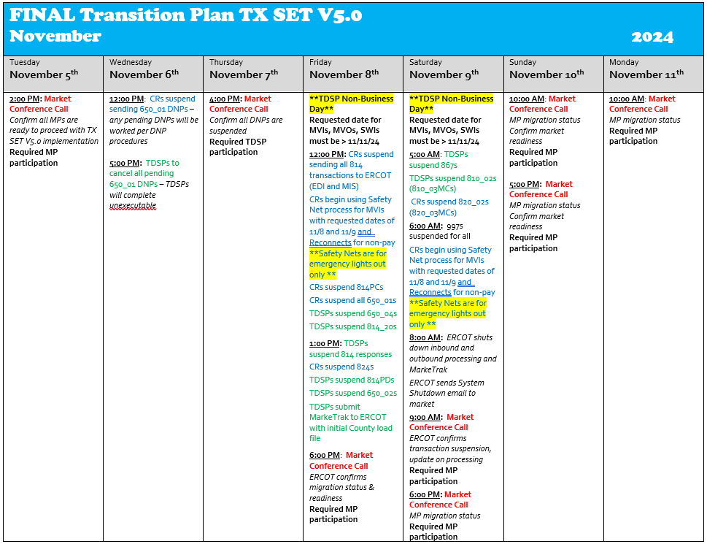
Texas SET V5.0 PROD Implementation

Slide 83
Texas SET V5.0 PROD Implementation
For Reconnects for Non-Payment during Version 5.0 conversion weekend, CRs shall use the appropriate Emergency Reconnect for Non-Payment Procedures as outlined for each TDSP in the Retail Market Guide (Emergency Reconnect Section 7.6.5.1). Link http://www.ercot.com/mkrules/guides/retail/current
If the TDSP’s Emergency Reconnect for Non-Payment Procedures instructs the CR to use the Emergency Reconnect Request Spreadsheet (Retail Market Guide Appendix C2) and the CR cannot include the actual BGN02 then the BGN02 must be provided in the following format (cannot exceed 30 characters):
  First 3 spaces = V50
  Next 3 spaces = Abbreviated CR name
  Then followed by a unique number for each transaction

Slide 84
Texas SET V5.0 PROD Implementation
As of Monday, November 11th at 8:00 am, or as soon as Version 5.0 transactions begin to flow, TDSPs will no longer support Emergency Reconnect for Non-Payment Spreadsheets in lieu of a 650_01 Reconnect for Non-Payment TX SET transaction.
Beginning Friday, November 8th at 12:00 pm, the CR will utilize the approved Safety Net process during implementation weekend with a default BGN02 value to request Move-Ins with a requested date during migration period (November 8th and 9th). If the REP cannot include the actual BGN02, the BGN02 must use the following format (cannot exceed 30 characters):
  First 3 spaces = V50
  Next 3 spaces = Abbreviated CR name
  Then followed by a unique number for each transaction

Slide 85
Texas SET V5.0 PROD Implementation
CRs will be required to follow up with the corrected BGN02 on a Safety Net correction to the TDSP once their actual BGN02 is available.
The TDSPs will no longer accept default BGN values on Monday, November 11th at 8:00 am or as soon as Version 5.0 transactions begin to flow.
Safety Net requests are for emergency lights out only.

Slide 86
Supporting Documents and Useful Links
MCT – https://www.ercot.com/committees/rms/mct
Texas SET – https://www.ercot.com/committees/rms/txset
SCR 817 - https://www.ercot.com/mktrules/issues/SCR817
Texas SET Change Controls - https://www.ercot.com/mktrules/issues/txsetcc

Slide 87
Testing to Production Transition
REMINDER:
  A Qualified Scheduling Entity (QSE) must be designated as part of the completion for your LSE Application.

Slide 88
SCR817 – MarkeTrak Enhancements Overview
SCR817 – MarkeTrak Changes Associated With TX Set 5.0 Release

Slide 89
SCR817 – High Level Requirements
Requirement # | Requirement | Description
1 | Revise Inadvertent Gain/Loss/Rescission workflows to remove Ready to Receive transition | Removing TDSP from workflows Adding “Provide Regaining BGN02” transition with “Proposed Regain Date” as a required field (excluding Rescission which will be prepopulated with DOL+1) Following validations on ‘proposed regain date’. If any are not met, appropriate hard stop error messages will populate calling for new proposed regain date to be submitted Regain Date is not < Date of Loss + 1 day Regain Date is not > MarkeTrak submit date + 10 days Regain Date is not > 150 days in the past
2 | Develop a unique set of Unexecutable Reasons for each applicable Subtype | Cancel w/Approval – “Unable to Cancel” reasons: Transaction is already Complete in the TDSP system Per ERCOT Protocols, a CR must send an 814_08 if systems permit Incorrect ESI ID Provided Transaction does not exist in TDSP system Incorrect Original Tran ID provided Switch Hold Removal – secondary drop down when “Documentation Invalid/Incomplete” is selected Incorrect or missing documents Illegible supporting documents Address not listed on documents Missing phone number on New Occupant Statement Signatures missing on the lease agreement Address on the lease does not match the service address The name on the lease does not match New Occupant Statement ESI ID invalid or not found ESI ID not listed on New Occupant Statement New customer is same as current tenant Other Comments Required

Slide 90
SCR817 – High Level Requirements Cont.
Requirement # | Requirement | Description
4 | Reduce 25 day validation on the Customer Rescission workflow to 15 days | Current hard stop 25-day validation will be reduced to 15 days. Updated error message to display: “Error: This issue is unable to proceed because the effective date of the originating transaction at this premise was more than 15 calendar days in the past. Please enter a different ESIID or consult the Retail Market Guide to determine the proper course of action.”
5 | Creation of a new Meter Cycle Change Request subtype | May only be submitted by the REP of Record Required fields: Assignee, ESI ID Required New fields: “Current Meter Read Cycle” – 2 digits (e.g. cycle 1 would be entered as 01) “Proposed Meter Read Cycle” - 2 digits Comments optional New transition: “Approved” Unexecutable transition with dropdown “Unexecutable Reason”: Only one meter cycle change per ESIID per Rep of Record for this Customer Causes cycle imbalance Unable to Accommodate Comments required if this value selected Surpasses TDSP cycle threshold Workflow to follow “Other” subtype
6 | Creation of a new 867 vs. Sum of LSE Intervals-Dispute subtype | Dispute requiring the 867 TRAN ID to be entered for reference and start date and end date should match the 867_03 transaction dates for validation Will follow “Usage & Billing – Dispute” workflow Required fields: Assignee, Assign to Pending, ESI ID, Comments Format of dates will remove the hh:mm:ss

Slide 91
SCR817 – High Level Requirements Cont.
Requirement # | Requirement | Description
7 | Redesign AMS LSE-Dispute subtype | Redesigning existing AMS LSE-Dispute subtype to support various reasons for submittal. New field “Reason to Dispute” dropdown: Disputing Peak Interval Requesting Estimation Methodology Utilized Disputing interval allocation of estimated consumption 4CP Verification Other Comments required if ‘Other’ selected
8 | Add drop down to Usage & Billing-Dispute subtype to clarify expected results | Adding a drop down field (YES/NO) if corrections are to be expected as a result of the dispute. New field: “Corrections Expected” with drop down
9 | Expand Siebel validations on the Submit transition for Missing Enrollment TXNs subtype | When submitting the Missing Enrollment TXN subtype, new validations will be performed: Checking status of transaction requested – if “Cancelled” – hard stop “The service order for the Global ID provided has been cancelled in ERCOT Registration System. Please update the ESIID/Original Tran ID provided and click OK or click Cancel to exit”. If 867_04 has been posted – hard stop “The 867_04 transaction has already been sent”” Review date parameter on 814_04/05 and consider date changes/cancels – if > 5 days, allow MT to proceed – warning “Please allow at least 5 days for the 867_04 to be sent by the TDSP”.
10 | Modify Switch Hold Removal subtype to all TDSPs to execute Time Limit Exceeded transition | Adding a new transition that will allow the TDSPs to release a Switch Hold and complete the MarkeTrak when REPs fail to respond. “Time Limit Exceeded” button added in TDSP workflow when issue in a state of “New (Assignee)” and “In Progress (Assignee)”

Slide 92
SCR817 – High Level Requirements Cont.
Requirement # | Requirement | Description
11 | Create additional validations on the Submit transition for Switch Hold Removal subtype | Two additional validations to be performed when a REP is submitting a Switch Hold: If no Switch Hold exists on the ESI – warning “ERCOT system indicates there is no Switch Hold currently in place on the ESIID provided. ” If the Submitting REP is the current REP of Record – warning “Switch Hold Removal issues should not be submitted by the current Rep of Record. Click OK to continue with the submit process or Cancel to exit.”
12 | Modify Switch Hold Removal subtype for ERCOT to auto populate the holding CR | ERCOT to auto-populate the holding CR prior to transitioning the MT to the TDSP If the ESI ID is de-energized (in ERCOT) and there is no current ROR, ERCOT will transition to TDSP with a null value in Assignee field Pre-populated Assignee value can be modified by TDSP
13 | Change the name of the Complete transition to Agree/Complete on Siebel Chg/Info subtype | Modify the “Complete” transition button to “Agree/Complete” providing clarity the market participant agrees to the proposed change
14 | Add a warning message on the Submit transition for Inadvertent Gain, Inadvertent Loss, Customer Rescission subtypes for third party transactions that are “Scheduled” or “In Review” | During the submittal of a IAG, IAL or Customer Rescission MT, a warning message will populate if any third-party or MVO transactions are “Scheduled” or “In Review” that would result in an unexecutable response and/or a rejected transaction. Warning message: “There is a third party or Move Out transaction in a status of “Scheduled” or “In Review” in the ERCOT Registration System for the ESIID provided. Please review prior to proceeding with Submit to avoid a potential Unexecutable situation.”
15 | Modify the Reject Code field on the Reject TXNs subtype – ERCOT requirement to support TX Set 5.0 | Modify the reject code field to eliminate the drop down reject codes due to the 36 new codes to be added to TXSET v5.0 and move to a freeform, optional field with Comments required if reject code = A13

Slide 93
SCR817 Training
Training Class:
In Depth SCR817 Training – A Deep Dive into the MarkeTrak enhancements being implemented with TX SET 5.0:
Date/Time: TBD (September/October timeframe)
Training/Reference Materials:
SCR817 Business Requirements Document: https://www.ercot.com/committees/rms/tdtms
*MarkeTrak User’s Guide/States and Transitions Documents/Bulk Insert Information: https://www.ercot.com/services/client_svcs/mktrk_info/index.html
*Cornerstone Learning Online MarkeTrak Classes: https://ercot.csod.com/login
* Updated versions with the changes associated with SCR817 will be available online closer to the actual November implementation.

Slide 94
SCR817 API WSDL Updates
Add New Subtypes:
Add New Required Elements:
Requirement 2 – Develop a unique set of Unexecutable Reasons for applicable subtypes
Requirement 7 – Redesign AMS LSE-Dispute subtype
Requirement 8 – Add a field to Billing-Dispute subtype to clarify expected results
Requirement 5 - Creation of a new Meter Cycle Change Request subtype
Requirement 6 – Creation of a new 867 vs. Sum of LSE - Dispute
Add New Validation Flags:
Requirement 9 – Expand Siebel validations on the Submit transition for Missing Enrollment TXNs subtype
Requirement 14 - Add a warning message on the Submit transition for Inadvertent Gain, Inadvertent Loss, Customer Rescission subtypes for third party transactions that are “Scheduled” or “In Review”
Add New Transition Labels and Field Formats:
Requirement 13 – Change the name of the Complete transition to Agree/Complete on Siebel Chg/Info subtype
Requirement 15 – Modify the Reject Code field on the Reject TXNs subtype
A draft WSDL with the SCR817 changes is scheduled to be posted to the MarkeTrak Information page (https://www.ercot.com/services/client_svcs/mktrk_info/index.html) in early July, 2024.
94

Slide 95
SCR817 Implementation Plan

Slide 96
THANK YOU!

