Slide 1
PDCWG Report to ROS
Chair: Jimmy Jackson, CPS
Vice Chair: Chad Mulholland, NRG
ROS
January 8th, 2024

Slide 2
Meeting Minutes
PDCWG Meeting 12/20/2023
2024 Leadership PDCWG
2024 PDCWG Calendar Review
High Level Review of September 6, 2023 Frequency Event
ERCOT Analysis of Disturbances/Frequency Events
ERCOT Frequency Control Metrics and Regulation Reports
TRE Report

Slide 3
Frequency Measurable Events Performance

Slide 4
Frequency Measurable Events
There was 1 FME in November
11/9/2023 12:37:36
Loss of 512 MW of Generation
Interconnection Frequency Response: 1422 MW/0.1 Hz
102 Resources were evaluated. These includes,
30 Generation Resources
3 Controllable Load Resources
69 Energy Storage Resources
14 of 102 Evaluated Resources had less than 75% of their expected Initial Primary Frequency Response.
11 of 102 Evaluated Resources had less than 75% of their expected Sustained Primary Frequency Response.

Slide 5
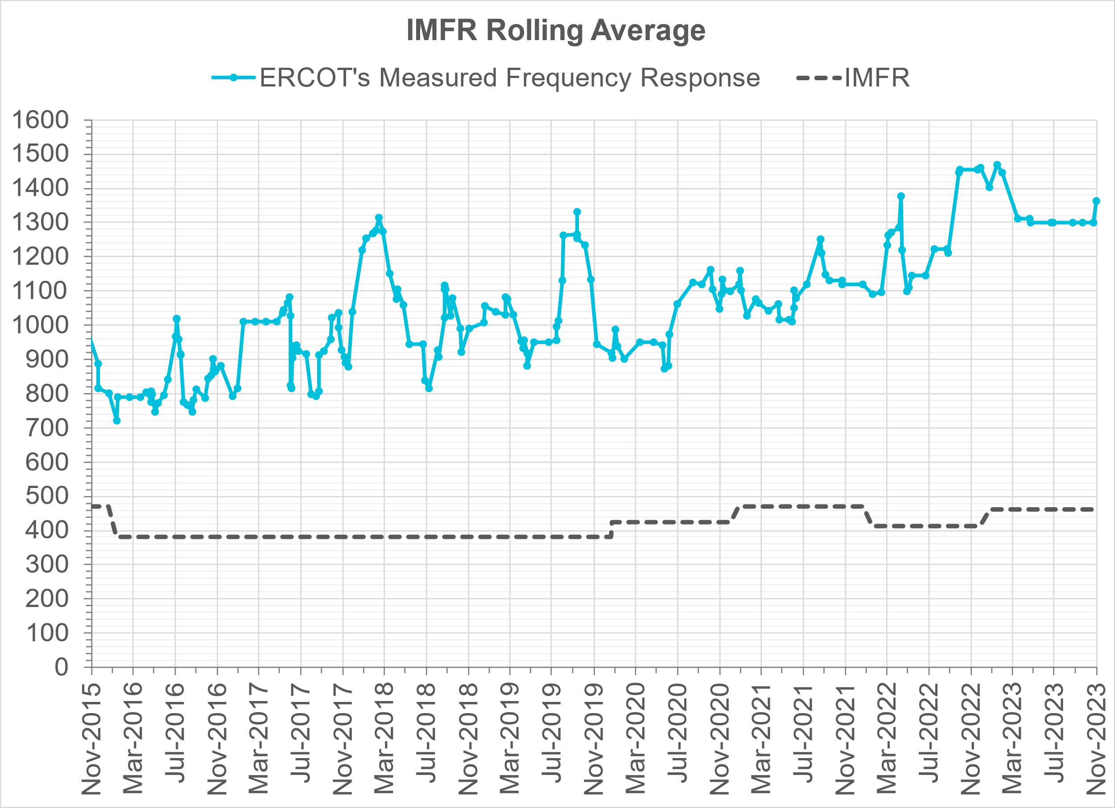
Interconnection Minimum Frequency Response (IMFR) Performance
IMFR Performance currently
1362.18 MW/0.1HZ
Frequency Response Obligation (FRO): 463 MW/0.1 Hz

Slide 6
Questions?

Slide 7
Frequency Control Report
October 2023

Slide 8
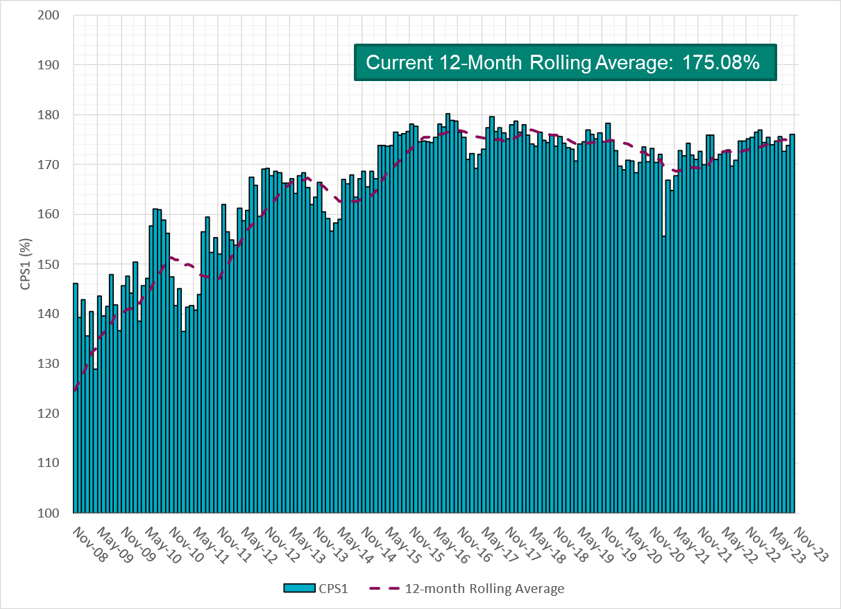
CPS1 Performance

Slide 9
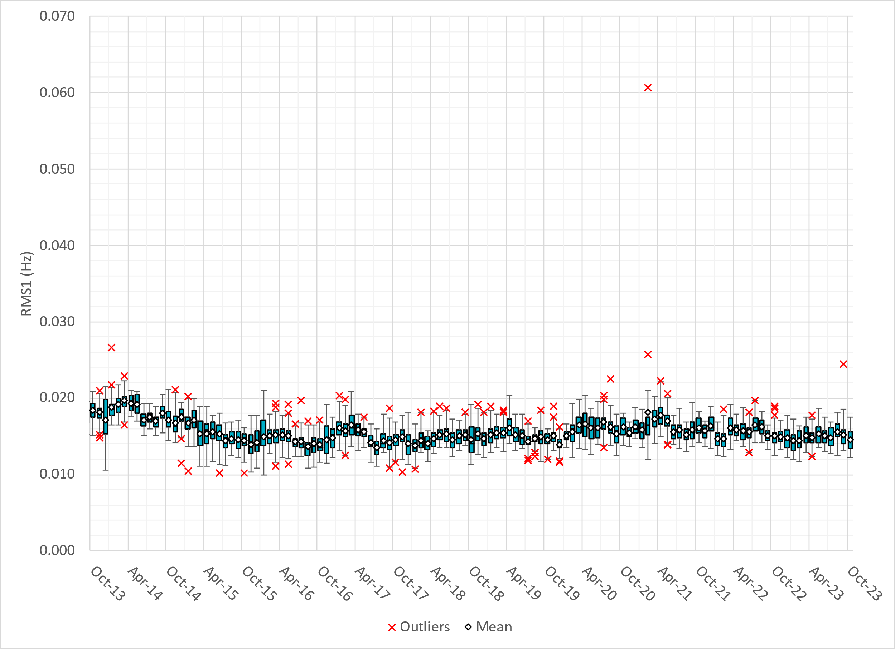
RMS1 Performance of ERCOT Frequency
Notes:
14.82 mHz on avg for November 2023

Slide 10
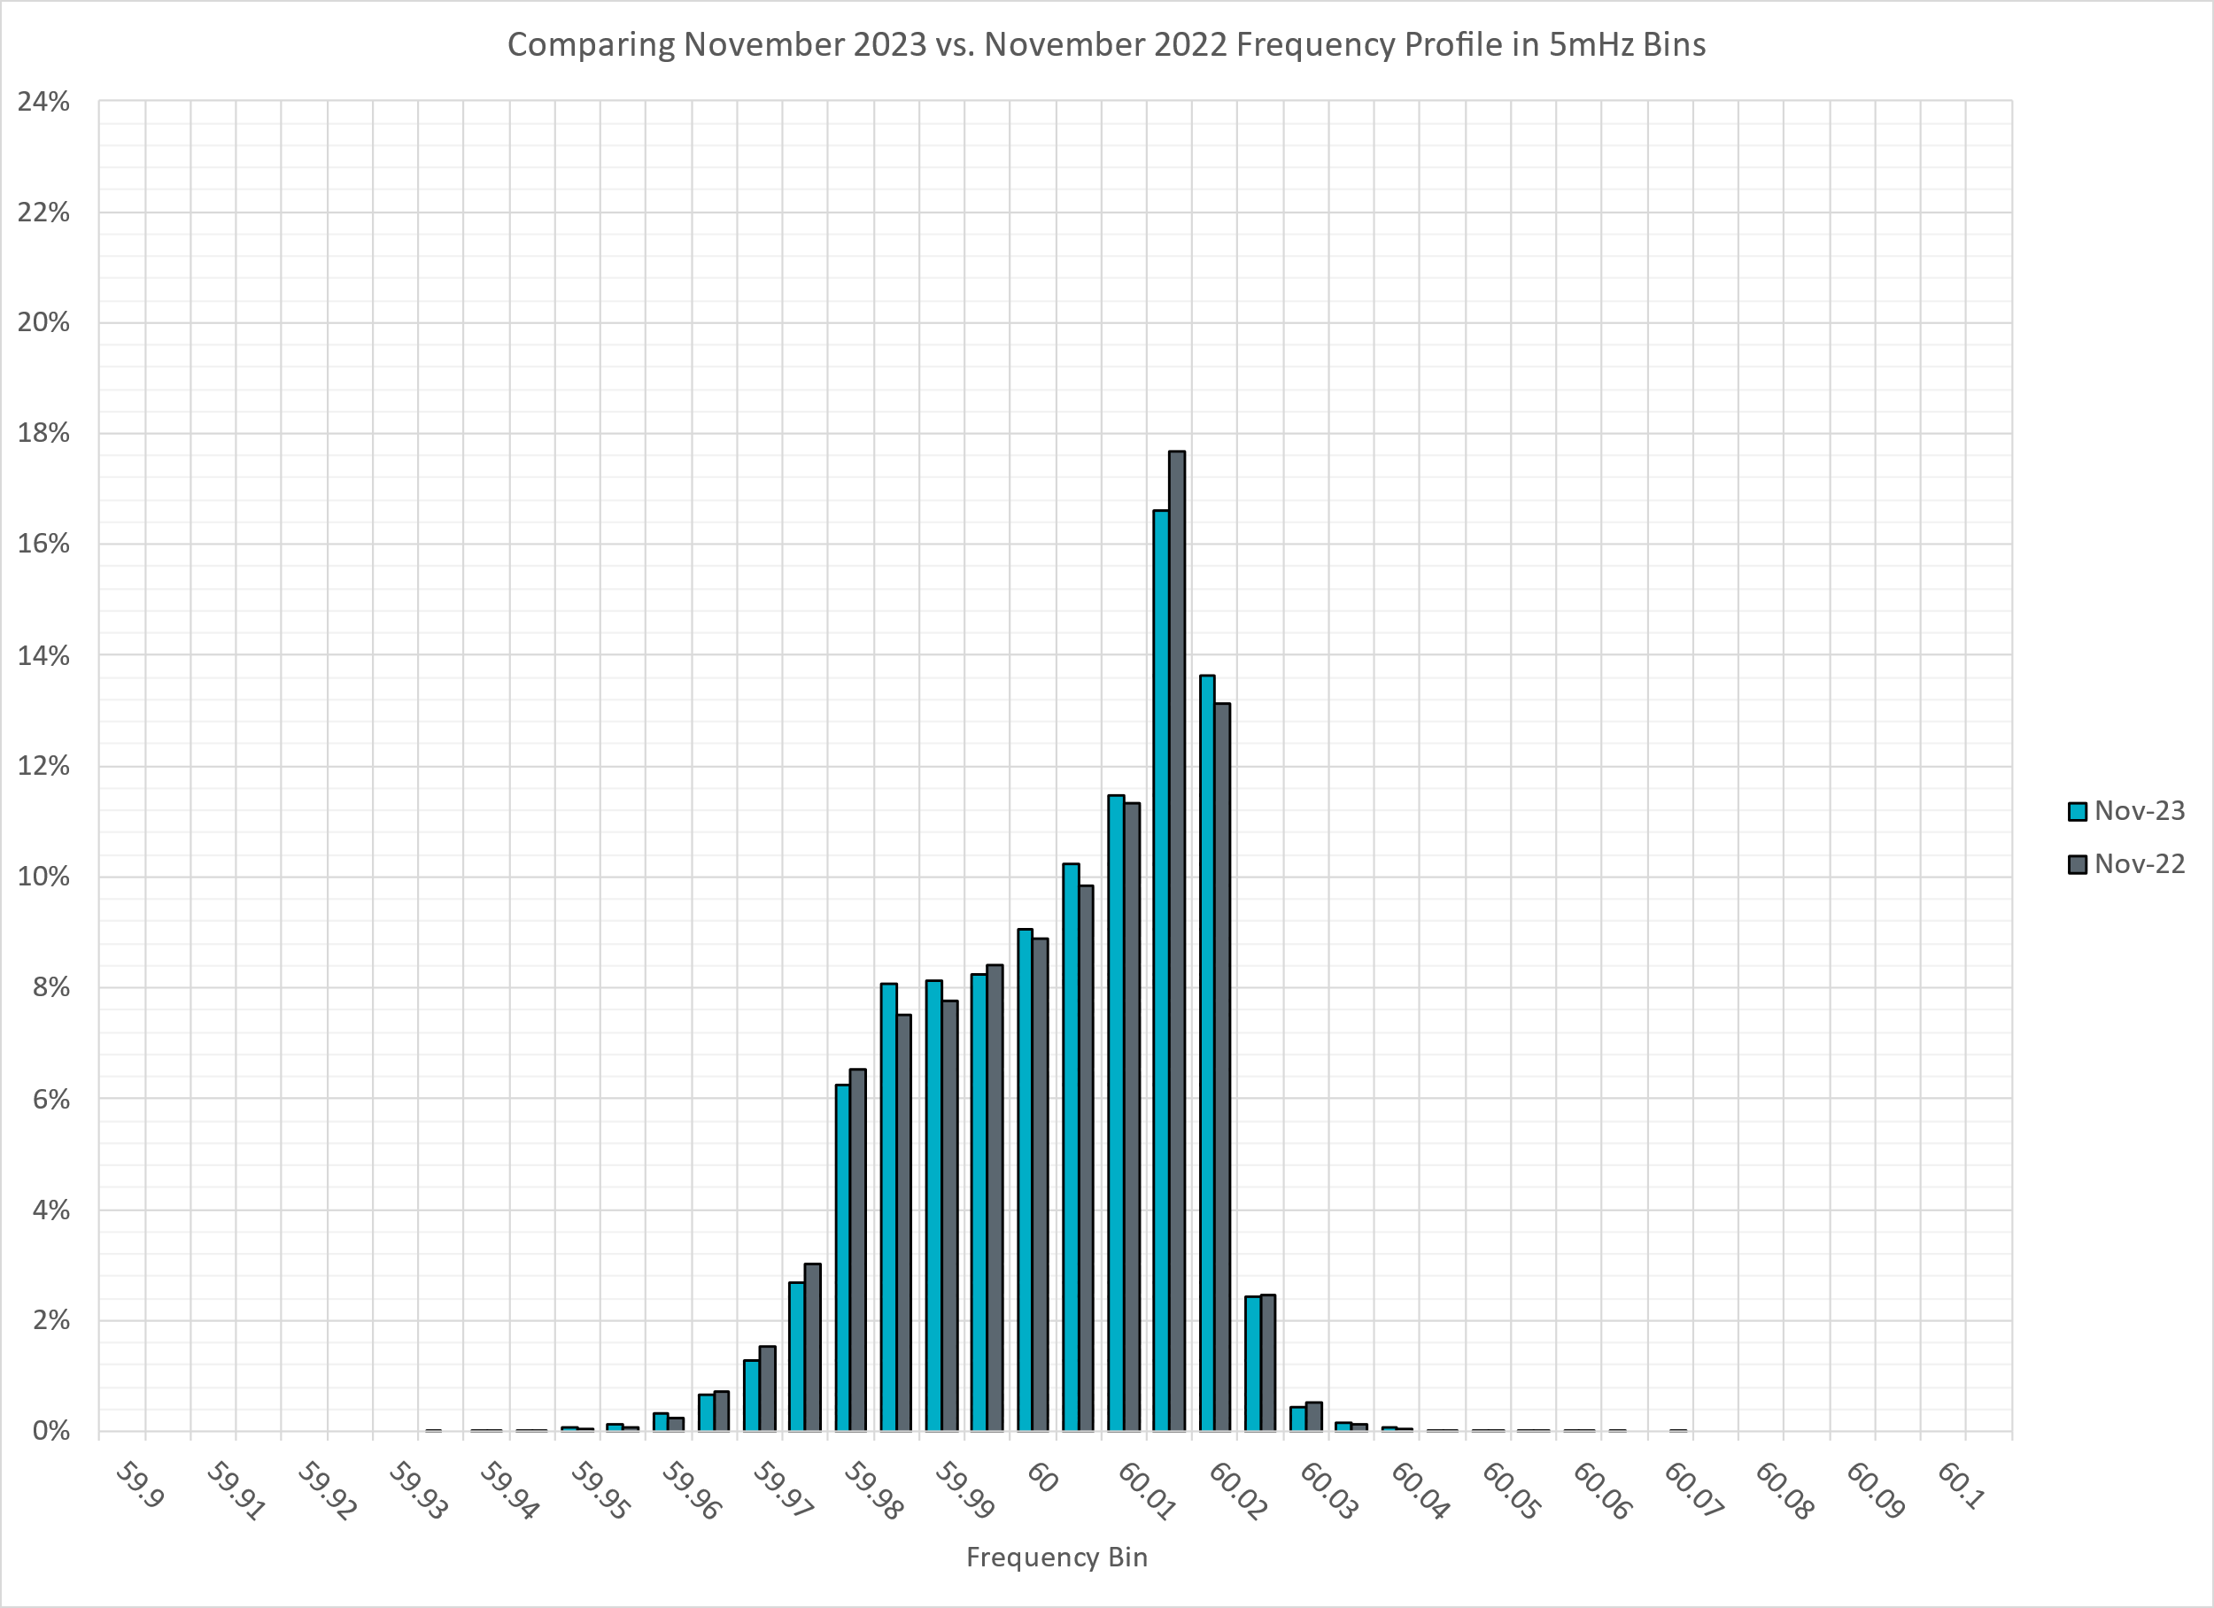
Frequency Profile Analysis

Slide 11
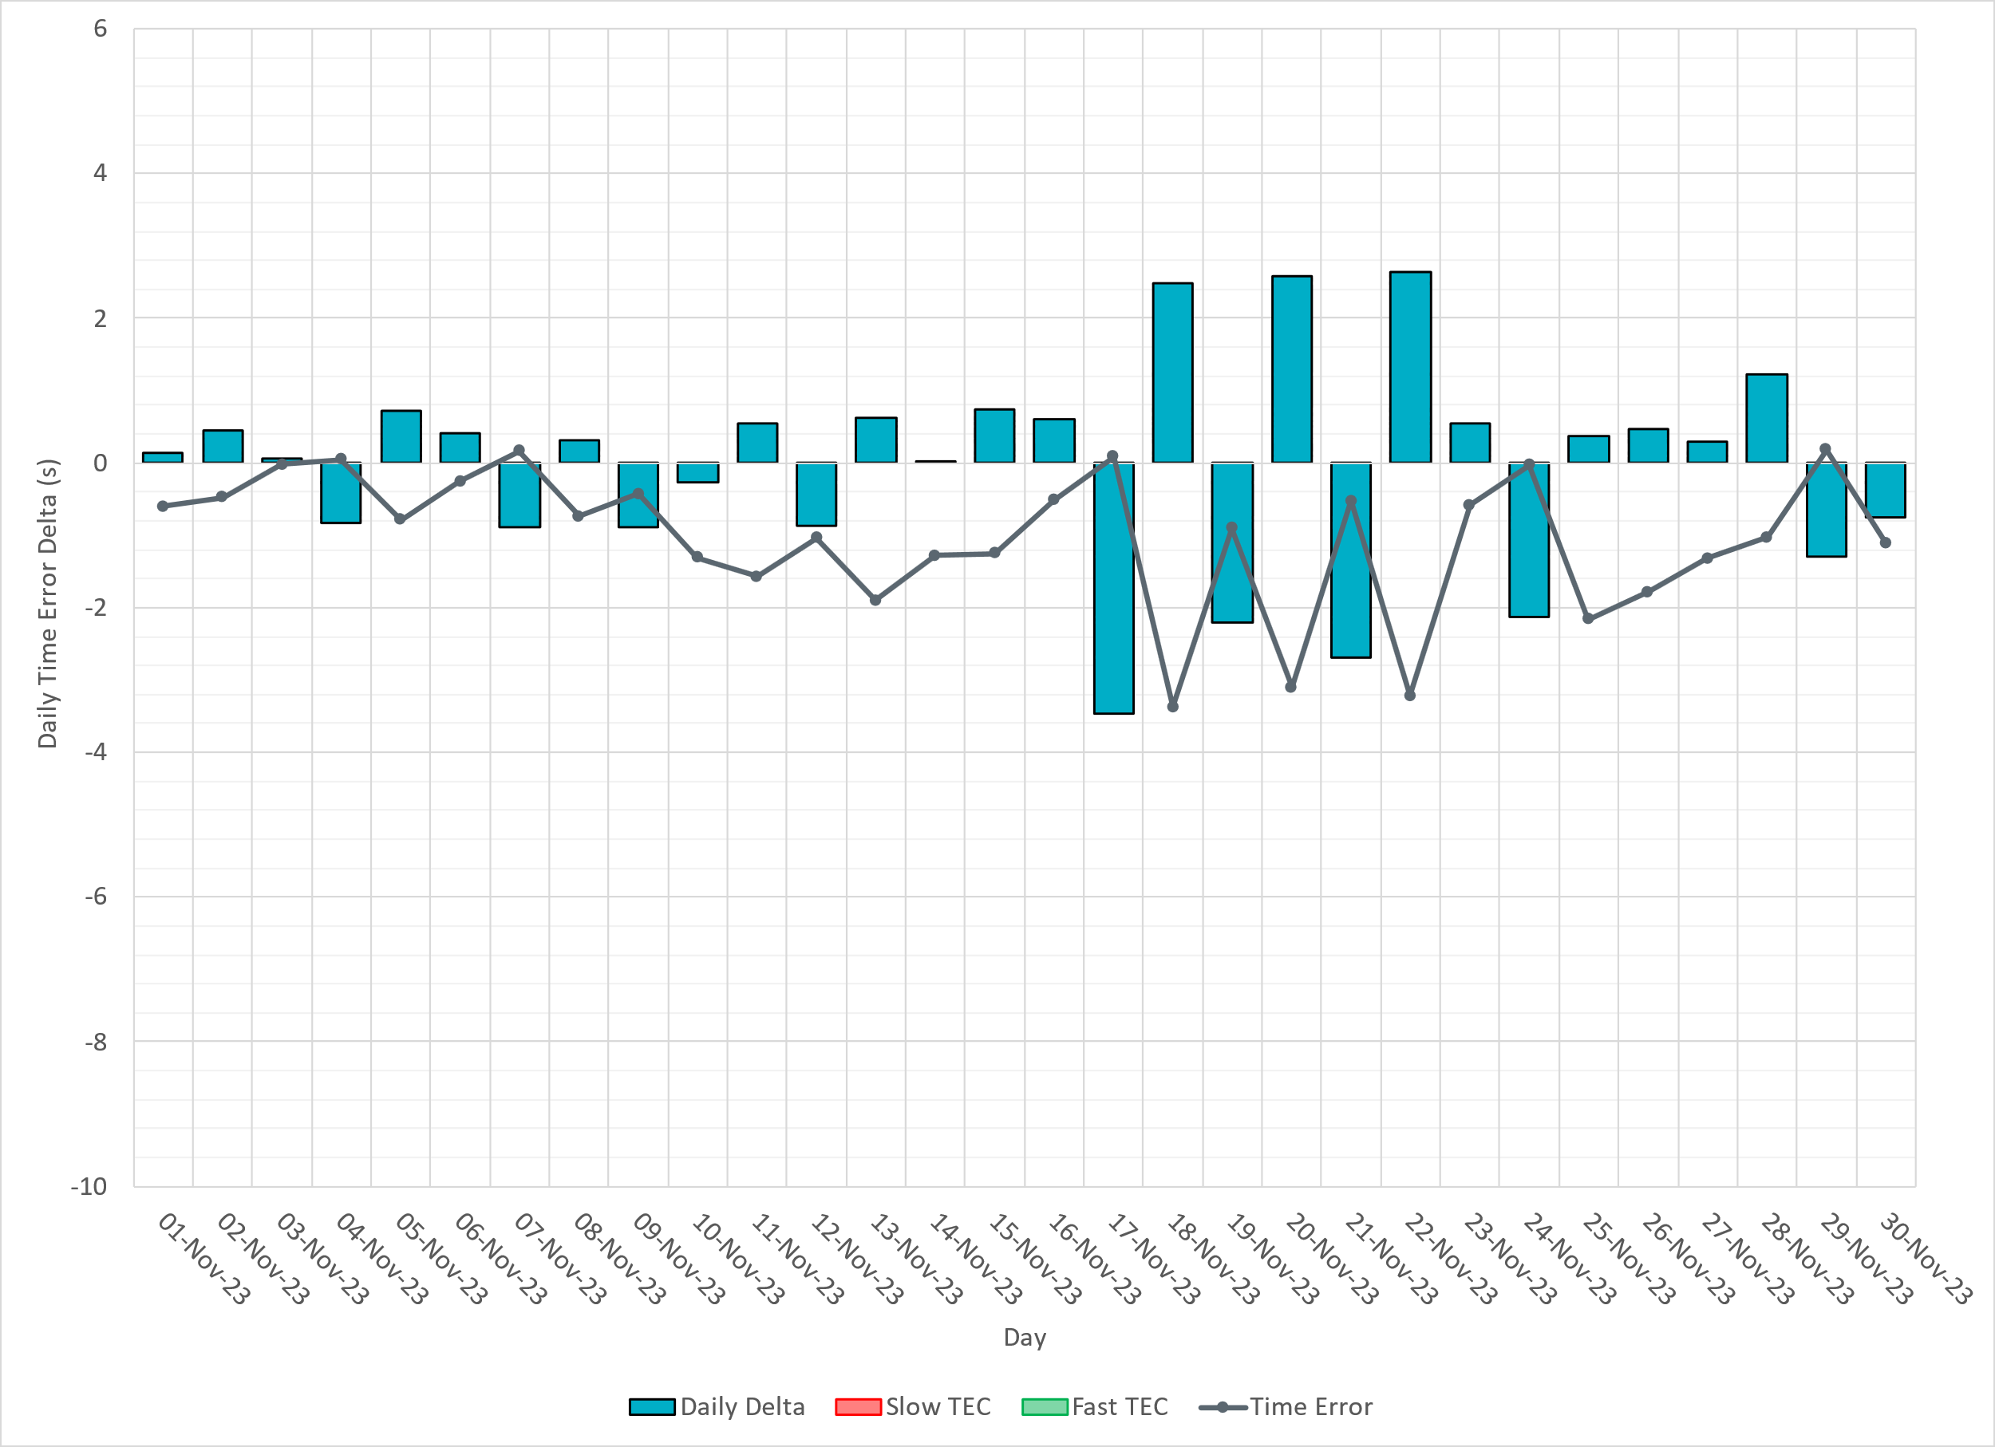
Time Error Corrections

Slide 12
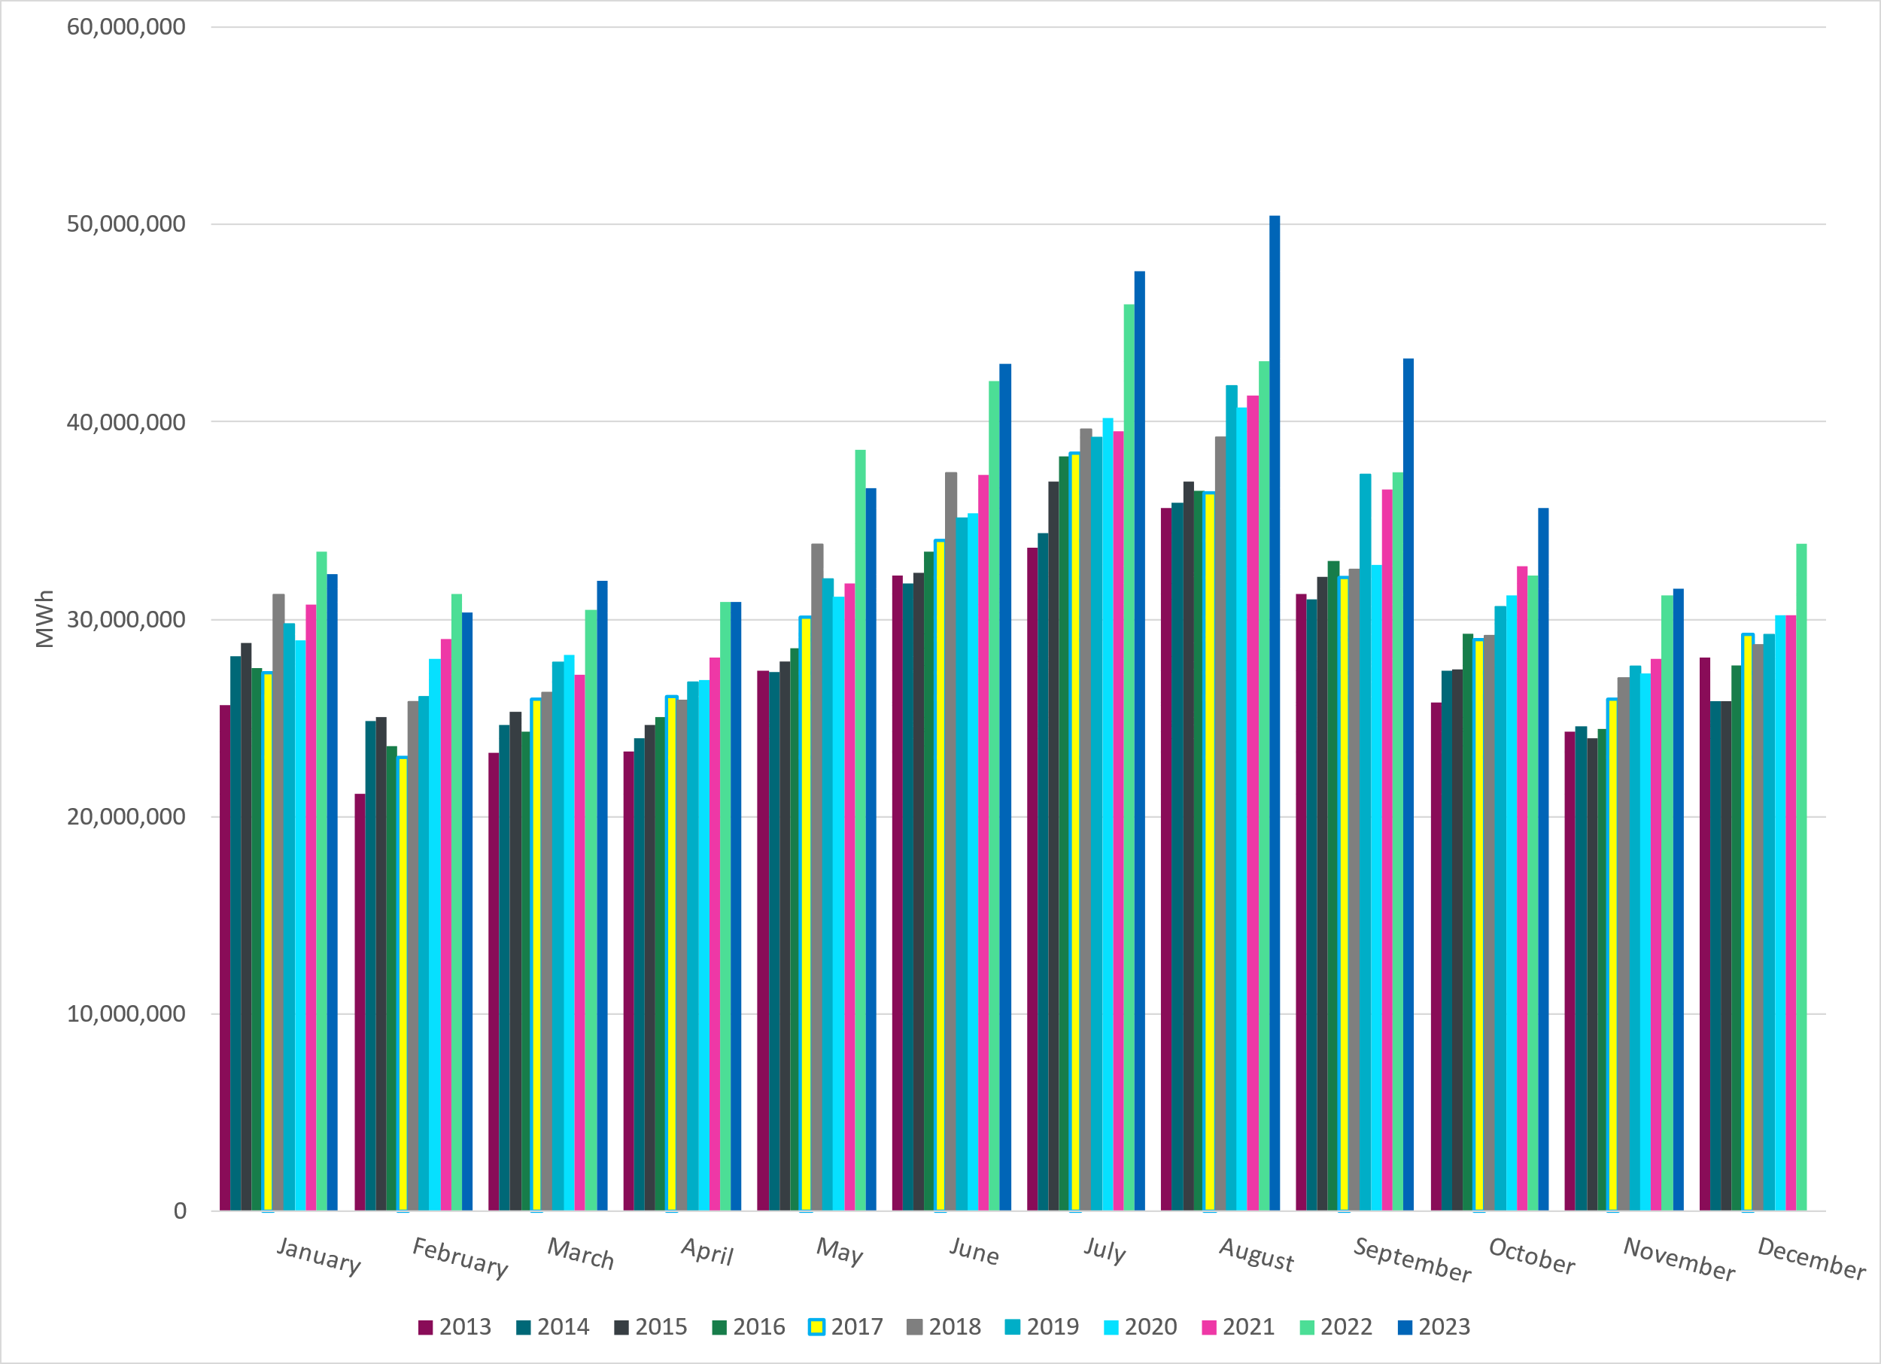
ERCOT Total Energy
Notes:
31,531,973 MWh

Slide 13
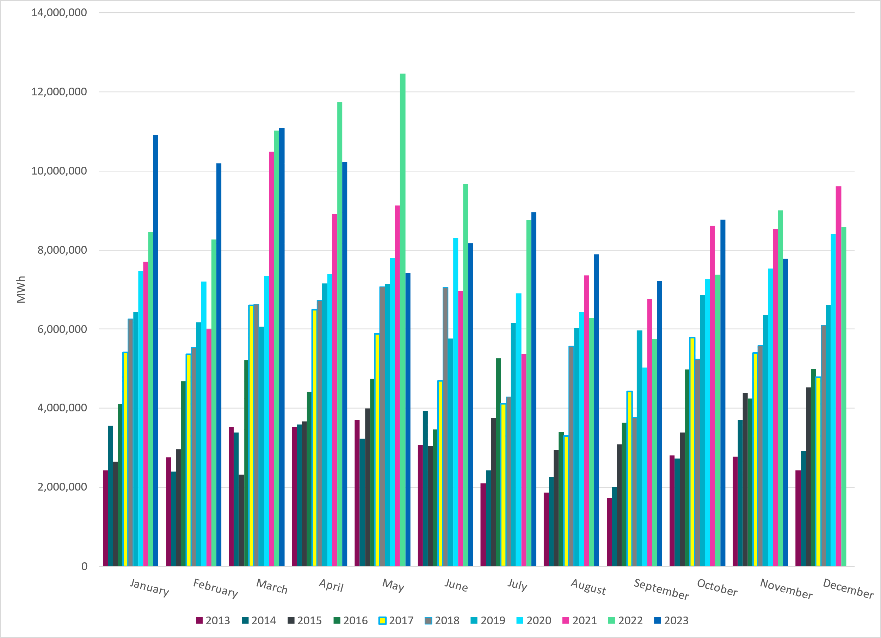
ERCOT Total Energy from Wind Generation
Notes:
7,779,271 MWH

Slide 14
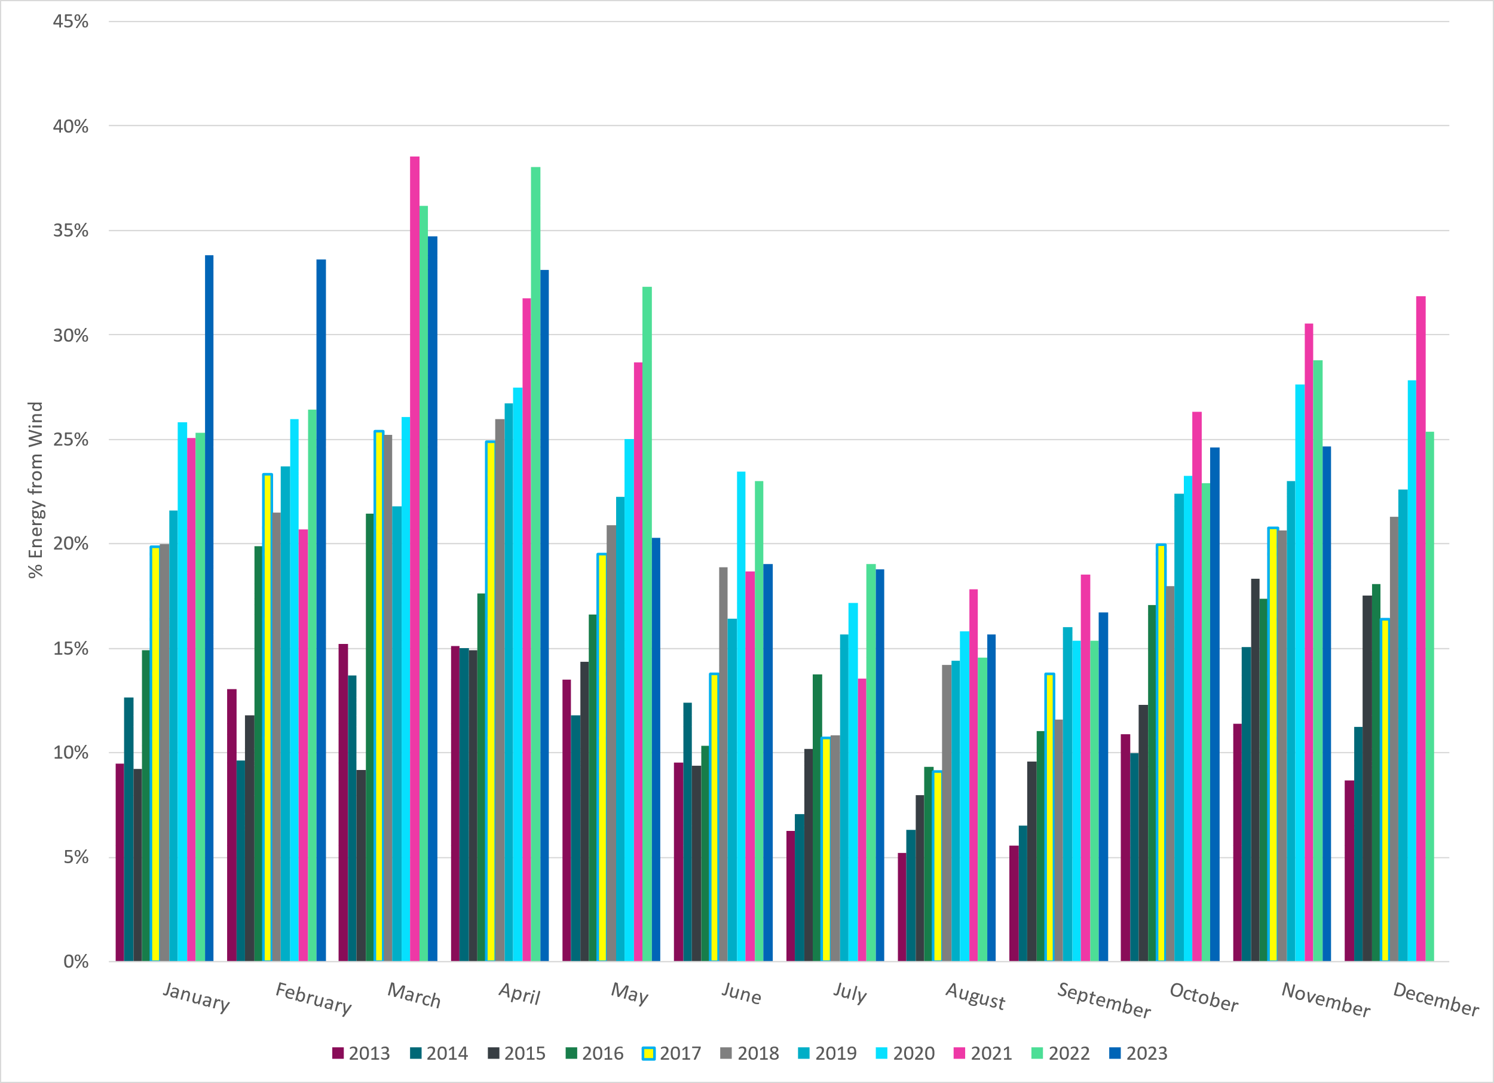
ERCOT % Energy from Wind Generation
Notes:
24.67%
of total energy was provided by wind generation

Slide 15
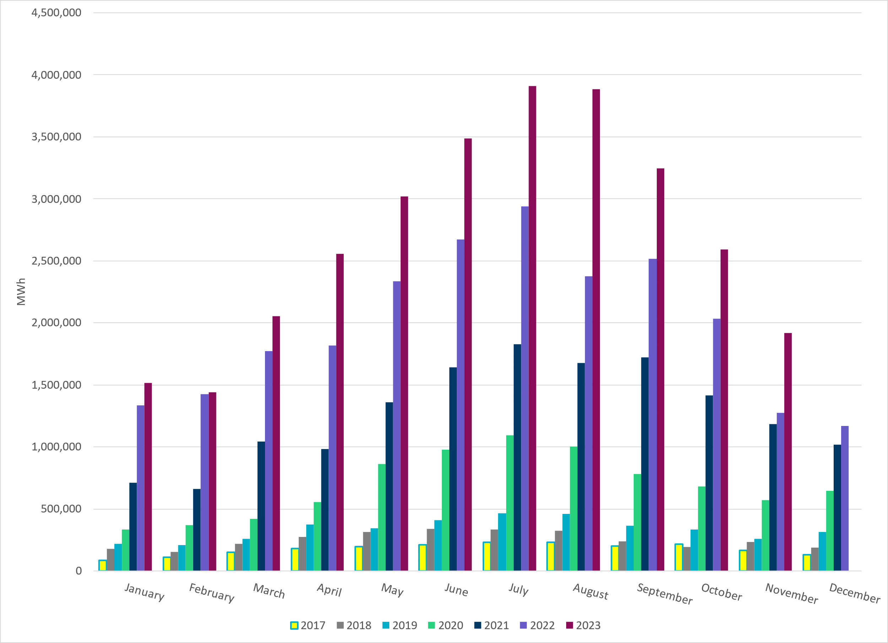
ERCOT Total Energy from Solar Generation
Notes:
1,916,520 MWh

Slide 16
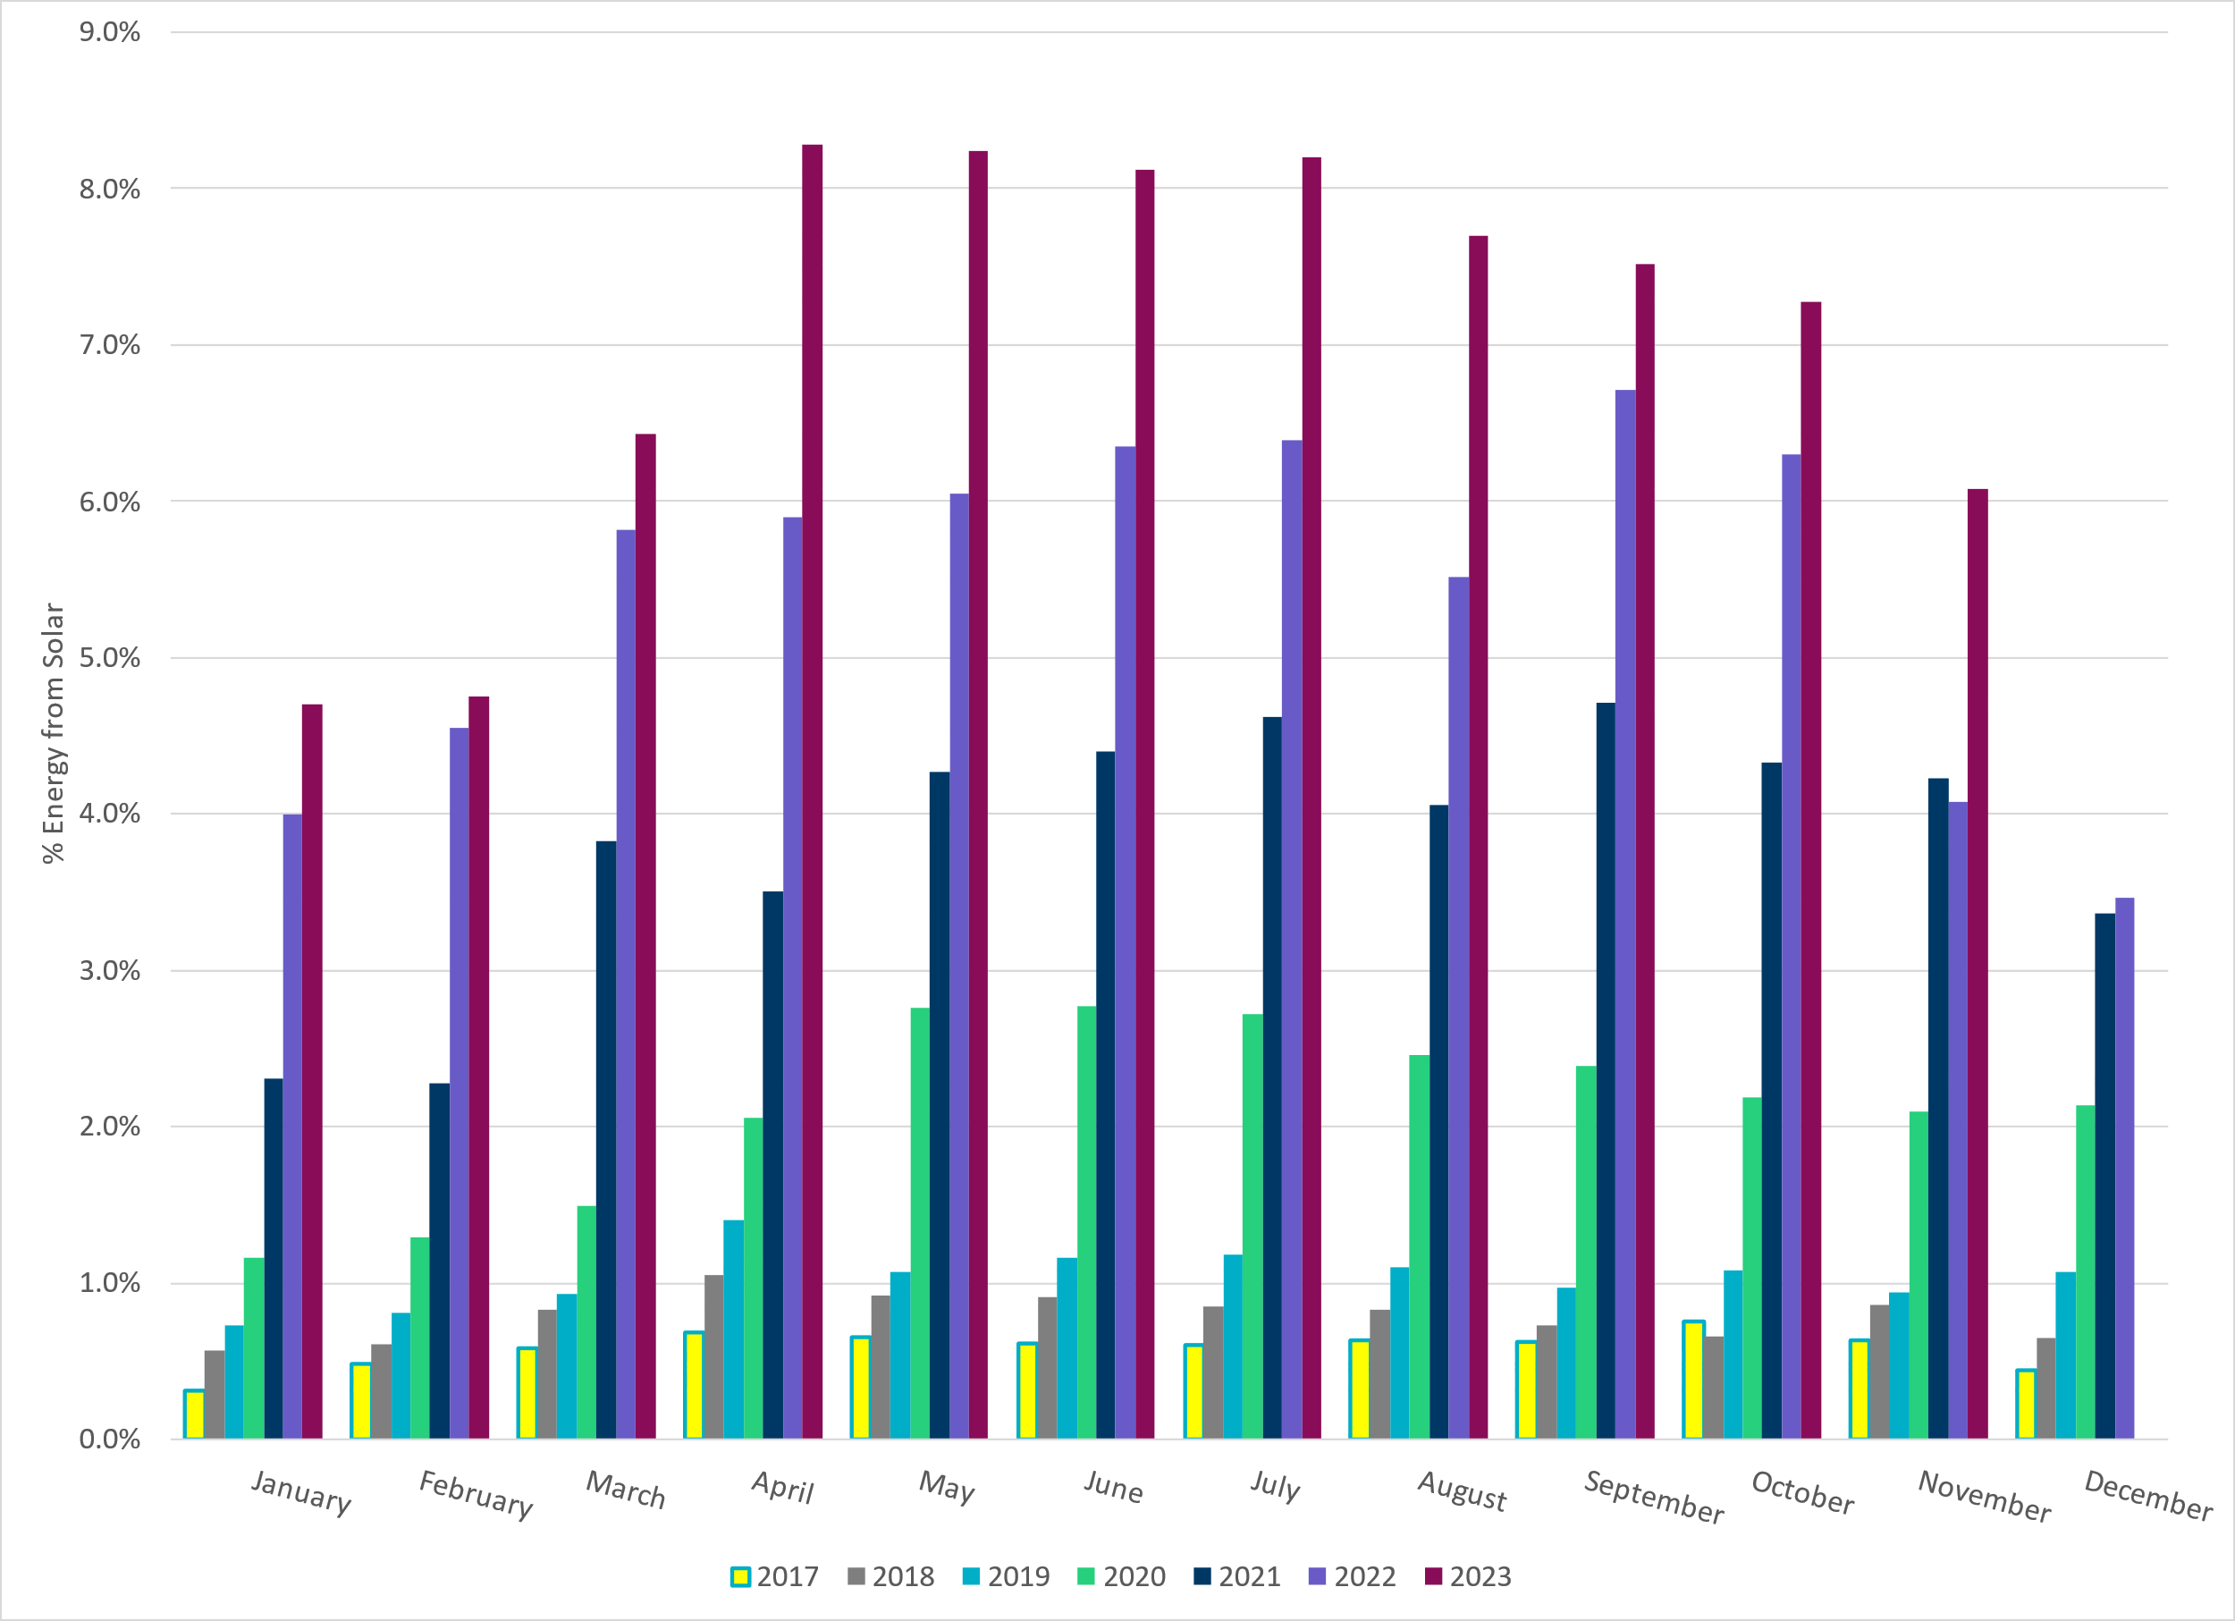
ERCOT % Energy from Solar Generation
Notes:
6.08% of total energy was provided by solar generation.

Slide 17
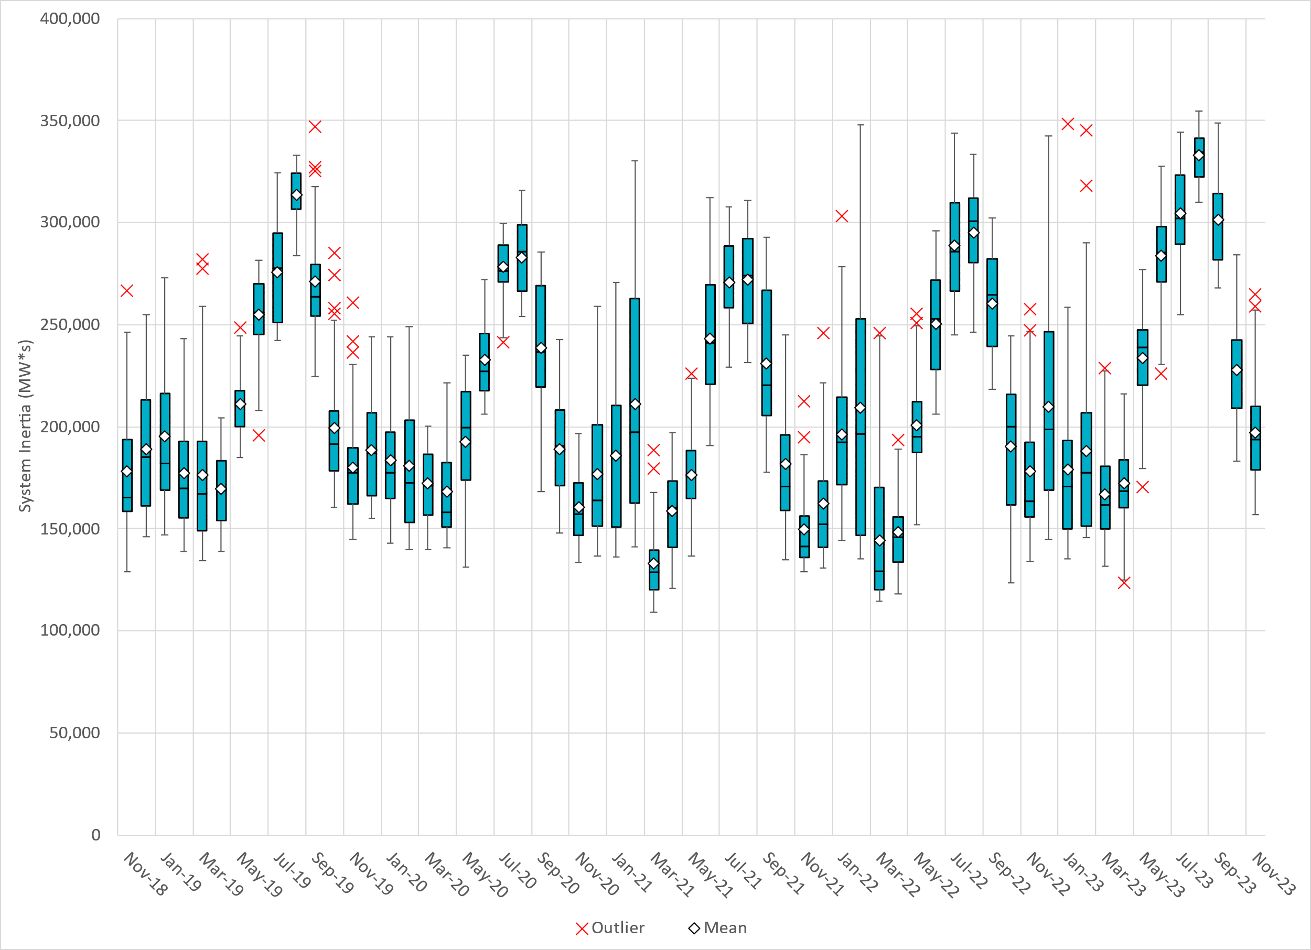
ERCOT Daily Minimum System Inertia
Notes:
Minimum Inertia = 157,095 MW*s on 11/21/2023
Previous Minimum was 109,029 MW*s on 3/22/2021
Data:
Mean: 197,289 MW*s
Max: 264,808 MW*s on November 28th
Min: 157,095 MW*s on November 21st

Slide 18
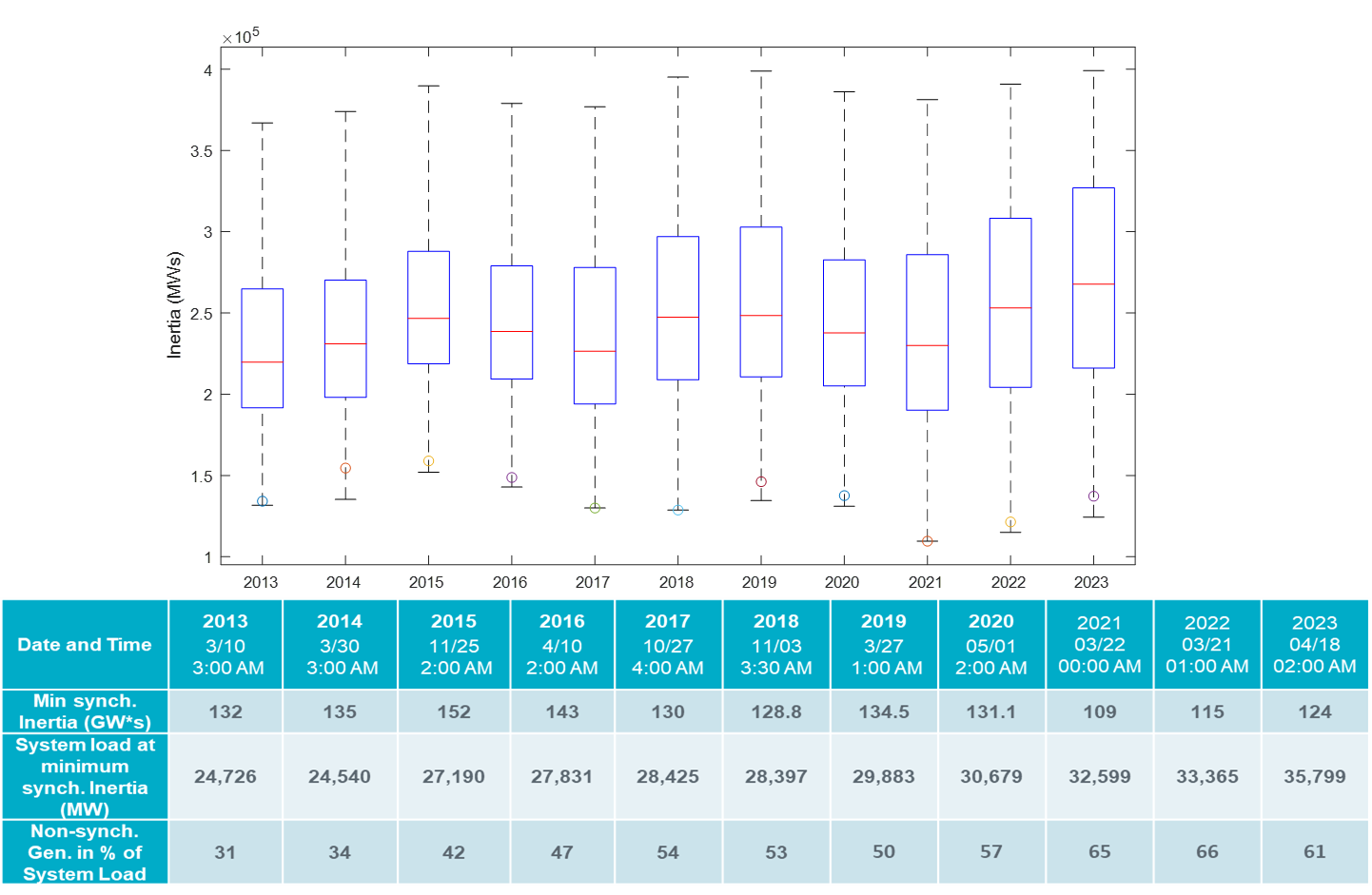
ERCOT Inertia Trend
Notes:
For each box, the central mark (red line) is the median, the edges of the box (in blue) are the 25th and 75th percentiles, the whiskers correspond to +/- 2.7 sigma (i.e., represent 99.3% coverage, assuming the data are normally distributed. The corresponding lowest inertia in each year is given in the table.
The circle on each boxplot is showing inertia during time when highest portion of load was served by wind/solar generation in that year.

