Slide 1

TEXAS SET UPDATE
RMS: January 9, 2024

Slide 2
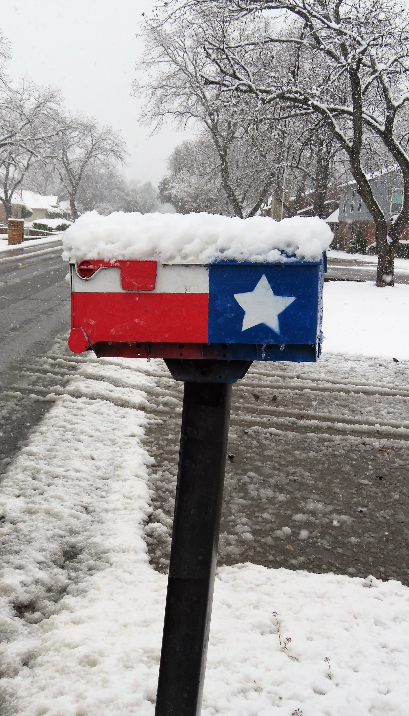
Meeting
  Joint meeting with MCT
  Announcement: TEXAS SET 5.0 Orientation has been rescheduled to coincide with first MCT meeting of January to be held on January 16th
  TEXAS SET Change Control Call
    TXSETCC 846: Update the 814_04 to clarify the use of PCI and TMI reject codes
  Mobile Generation Discussion
    RMGRR179, TDSP Temporary Emergency Electric Energy Facility (TEEEF) Deployment Transactional Processing

Slide 3

LUBBOCK
  TEXAS SET reaffirmed LPLs participation in Flight 0224 is limited to bank changes and third-party service providers.

Slide 4
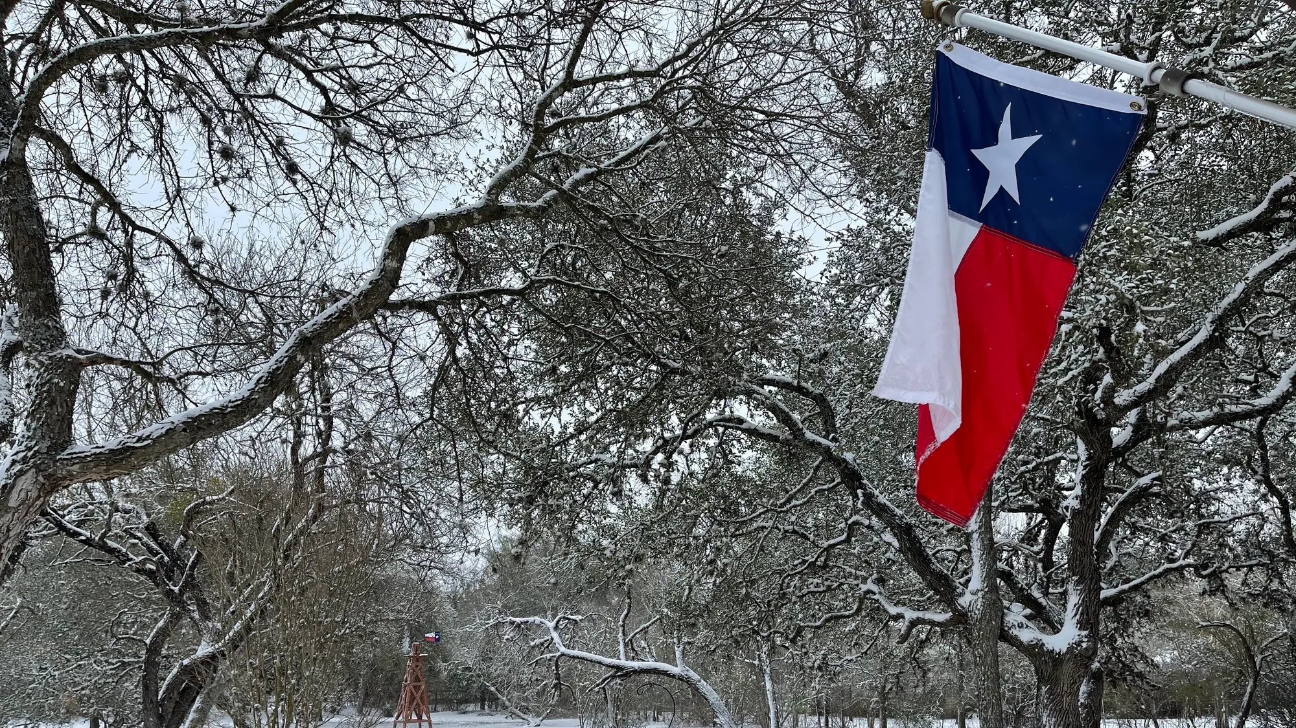
NEXT MEETING
  January 16th, 2024 @ 1pm
  Goals and Accomplishments
  Elections
  WebEx Only

