Slide 1
Lubbock
Retail Integration Task Force – LRITF
January 9th, 2023
Chris Rowley Michael Winegeart Sheri Wiegand

Slide 2
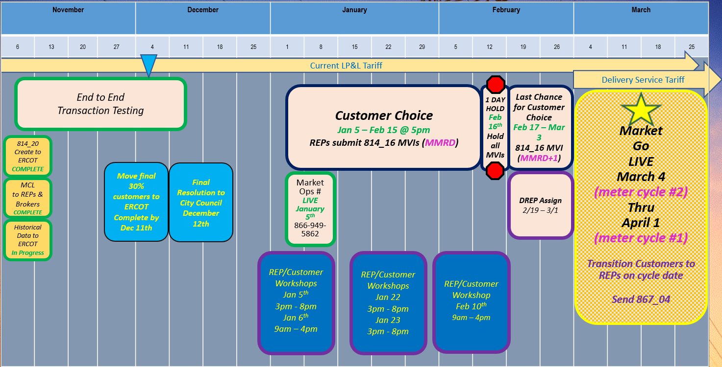
Final Transition Timeline

Slide 3
LRITF meetings
12/05/23
12/20/23
1/3/24
The Task Force reviewed the following:
Customer Choice Transaction Window – review of MVI timeline matrix based on March/early April Monthly Meter Read Date (MMRD)
Winter Storm Uri Securitization: discussion regarding the applicability of securitization charges for transitioned LP&L customers and ERCOT’s operationalizing LP&L exceptions.
Distribution Loss Factors: Lubbock’s plan to revise DLFs to only three codes: one for secondary voltages, one for primary, and one for transmission voltages. Revised DLFs submitted to ERCOT for review.
Various Updates: Shopping Fairs, Smart Meter Texas, Tariff revisions, transitioning de-energized ESIs (clearance requests), historical LP&L rates, Aggregate # of ESIs per load profile

Slide 4
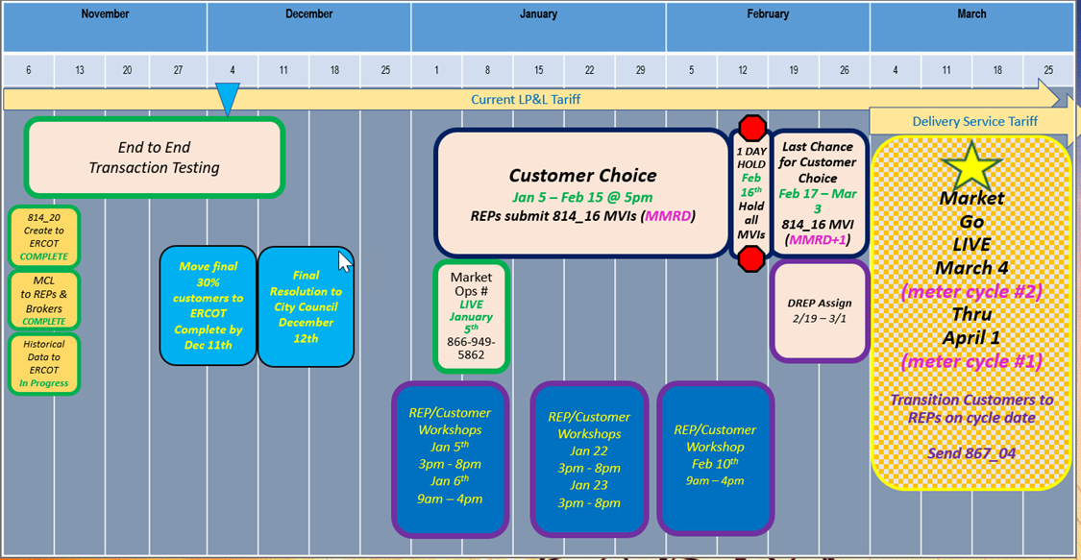
Completed Action Items
Q&A
Transition to Competition
Q: When will LP&L accept EDI transactions for transition to competition? A:
ERCOT/LP&L will begin accepting transactions 1/5/24 – 2/15/24 @ 5PM. . On 1/5/24, transactions will be accepted at any time, however, LP&L will not begin processing transactions until after 5PM on 1/5/24.
With the throttling of transactions to LP&L on 1/5 @ 5PM (by ESG), Not First In transactions (NFI) on 1/5 will be reviewed by LP&L and NFIs will be unexecuted if necessary with T025 codes “Competing Transaction Scheduled for the Same Date”.
IMPORTANT: LP&L has asked REPs to hold transactions from 2/15/24 @ 5PM until Saturday, 2/17 @ 7AM to allow time for LP&L to perform queries for DREP assignments and modify systems to no longer automate the MVI date for the appropriate meter read cycle.
DREP Assignment Period to commence 2/19/24 – 3/1/24
Transitioning of LP&L customers on March/early April meter read cycles (starting 3/4/24 – 4/1/24)

Slide 5
Completed Action Items
Q&A
Transition to Competition - continued
Q: When does LP&L plan to cease disconnections for non-pay prior to the transition? A: LP&L will continue disconnections through the end of February regardless of the meter cycle. A customer will remain disconnected (unless payment is received) and will be energized with the MVI transition transaction on the March/early April meter read cycle.
Customer Education
Q: Will payment history information be available for LP&L customers? A: LP&L customers may self-serve using their current customer portal to request a print of payment history form/utility letter of credit. A sample is posted on the main LRITF page.

Slide 6
Completed Action Items
Q&A
Customer Education - continued
Q: Will Lubbock host Town Halls/Community Meetings informing Lubbock residents about the transition to competition? A: Lubbock will be hosting “Shopping Fairs” where REPs may engage customers (no peddler’s license required). Registration, times, and additional information to follow. The Shopping Fairs will be held at the Civic Center on: January 5th, Friday, 3 PM – 8 PM January 6th , Saturday, 10 AM – 4 PM January 22nd , Monday, 3 PM – 8 PM January 23rd , Tuesday 3 PM – 8 PM February 10th , Saturday 10 AM – 4 PM Interested REPs and brokers may contact marketops@mylubbock.us to register for any of the Shopping Fairs. An official invite/RSVP will be sent out via Market Ops team. Lubbock plans to advertise for the shopping fairs via website, billboards, TV ads, and static ads prior to the fairs. Lubbock has also partnered with local station KCBD for a live telecast during the first shopping fairs. Lubbock plans to distribute a ‘one-pager’ with “questions to ask your provider” at each fair to educate residents about the transition. Wifi will be available for REPs. REPs may request two booths (one for residential, one for commercial). Booths will be 10x12 in size and equipped with table and chairs. REPs are encouraged to bring a Spanish speaking representative. Set up and tear down times will be one hour before and one hour after each fair.

Slide 7
Completed Action Items
Q&A
PUCT Requirements
Q: Will the Winter Storm Uri securitizations apply to LP&L customers post-transition? A: LP&L’s position is that HB4492 and PUCT Dockets 52321 and 52322 (Securitizations M & N) excluded LP&L customers (post-transition) from securitization charges and REPs should not be charging customers for such charges. LP&L met with PUCT Staff and Executive Director to review. ERCOT agrees with LPL’s interpretation and intends to file two petitions (one for each subchapter of PURA 39.151 (j-1) addressing Securitizations M and N) for a clear written record of the PUCT’s interpretation of the above applicability. The goal of the procedural schedule is for the Commission to hear no later than the Feb 15th Open Meeting. Concurrently, ERCOT is working to operationalize excluding LP&L load from the calculations and expect the exclusions to be in place for the first initial settlement invoices (in March).
ERCOT Market Requirements
Q: How will LP&L respond transactionally for same day requests submitted after operational hours? Will the order be unexecuted or “skootched” to the next operational day? A: LP&L plans to “skootch” the key date on the response 814_04/05 transaction. For example, if an order was submitted on Saturday at 5PM for Saturday, will the response be unexecuted for Invalid Backdated Order (IBO) or skootched to Monday. LP&L would respond to the order with a date of Monday. Q: When will NAESB URL information be exchanged with registered REPs? A: LP&L will work with ESG to coordinate connectivity with each registered REP.

Slide 8
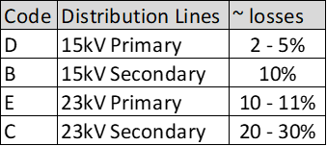
Completed Action Items
Q&A
TDSP Specific Activities
Q: What are LP&L’s Distribution Loss Factors? A: Additional information is posted https://www.ercot.com/files/docs/2023/08/01/LPL-Distribution-Loss-Factor-and-Methodology.docx. LP&L Distribution Loss Factors were calculated based on 70% of the load in ERCOT with remaining 30% in SPP and acknowledging some inefficient 23kV circuits. LP&L plans to review DLFs in Q2-3 2024 timeframe to update.at the end of 2023 when the final 30% of Lubbock’s load has moved to ERCOT. The revised DLFs will include one value for secondary voltage, one for primary voltage, and one for transmission. New codes will be provided early January 2024. The new DLF codes are expected to be: A – Primary voltage B – Secondary voltage T – Transmission voltage (LP&L currently has no transmission level customers) LP&L does not plan to review any efficiencies gained with moving to ERCOT for at least a couple of months. Q: What format should be expected on an 867_03 for an ESI with a BUSLRG load profile? IDR or summary? A: LP&L will provide an 867_03IDR format where interval data will be received on the monthly 867_03 transaction. Q: Pre-transition, for new construction projects, when will an ESI be created? A: Similar to above, once an inspection is received an ESI will automatically be created in a batch process overnight. Once the ESI is created, the REP can then send an MVI for the March/early April MMRD.

Slide 9
Completed Action Items
Q&A
TDSP Specific Activities - continued
Q: What is the aggregated number of ESIs by load profile? A: Based on information as of mid-December, Lubbock as classified the following load profiles:

Slide 10
Completed Action Items
Q&A
TDSP Specific Activities - continued
Q: Will historical usage information be available for transitioning customers? Will an LOA process be available and when? A: Monthly summary historical usage information will be available via the Mass Customer List (MCL) for entering REPs. Historical interval data will be available for REPs by emailing marketops@mylubbock.us with a signed copy of the approved LOA which is posted on the LP&L website. Brokers may also request monthly and interval data via the LOA process noted above. The LOA process may commence at the time the MCL is available for distribution (late April/early May). LOAs are required to be notarized. Out of state LOAs are accepted with a valid Commission ID. Modifications to the LOA will not be accepted. Upon effectuation of RMGRR176, the LOA found in Appendix B1/B2 may be utilized for LOA requests. LP&L has agreed to provide the following information when responding to a valid LOA: DLF code, load profile, LP&L Rate Class, LP&L Meter Read Cycle, and address.
LP&L Rates
Q: What is the expected cadence of LP&L rate revisions? Will REPs be provided a 45 day notice of approved rates? A: LP&L expect their rates to be reviewed once per year aligning with Lubbock’s fiscal calendar thus the expected effective date is 10/1. LP&L acknowledged REP’s expected 45 day notice of approved rates and intend to honor.

Slide 11
Completed Action Items
Q&A
LP&L Rates - continued
Q: Can LP&L provide mapping of existing LP&L rate classes to the new rate classes post transition? A:

Slide 12
TIMELINE of Actions
Pro Forma Tariff
Access Agreement
POLR Process
Safety Net Process
Q4 2022
ERCOT Activities: SAC04s, Load Profiles
TSDP Activities: Critical Care, DLFs, Solar/DG, Switch Hold Files, BUSIDDRQ, Call Center, OGFLT, Weather Moratoriums, Proration
LP&L Rates
Customer Enrollment Process – Detailed Timeline
PUCT Complaint Process / Application of PUCT Rules
Transaction Timelines / TXSET Timelines
CSA Process
Q1 2023
Q2 2023
ESI IDs in TDSP Extract
RMG Chapter 8 Revisions
Historical Usage Requests
TDSP AMS Data Practices
Mass Customer Lists
Power to Choose website
Customer Forums/Town Halls
Flight Testing / Bank Testing
Q3 2023
CBCI files
Default REP Selection Process
DNP Blackout Period
Market Operations Group Established
Tampering Information Process
Smart Meter Texas
Q4 2023
March 2024
GO LIVE – Transition to Competition
Completed
Q3 2023
Q4 2023
Q1 2024
Q2 2024

Slide 13
Lritf meeting
1/9/2024 @ 1:00PM following RMS
AGENDA ITEMS:
Customer Choice Window –
  update on transaction count
  Issues/observations
Shopping Fairs update
Recalculation of DLFs update
RMGRR174 / RMGRR176 Updates
Sample 867s/810s: cancel /rebills, solar example, BUSLRG – IDR format
Zip code update
Transitioning De-Energized ESIs (clearance requests)
Historical LP&L Rates
Winter Storm Uri Securitization Applicability Status
Open Discussion

