Slide 1
Supply Analysis Working Group Update January 2024 Update to WMS
January 10, 2024
Kevin Hanson (National Grid) Chair
Greg Lackey (CPS Energy) Co-Vice Chair
Pete Warnken (ERCOT) Co-Vice Chair

Slide 2
Overview
2024 SAWG Leadership remains the same as 2023
2024 Long Term Load Forecast Overview (Kate Lamb and Sam Morris)
Reliability Standard, VOLL and CONE Study Updates (Pete Warnken)
Status of CDR NPRR (Pete Warnken)
December CDR / February 2024 MORA Overview and Q&A (Pete Warnken)

Slide 3
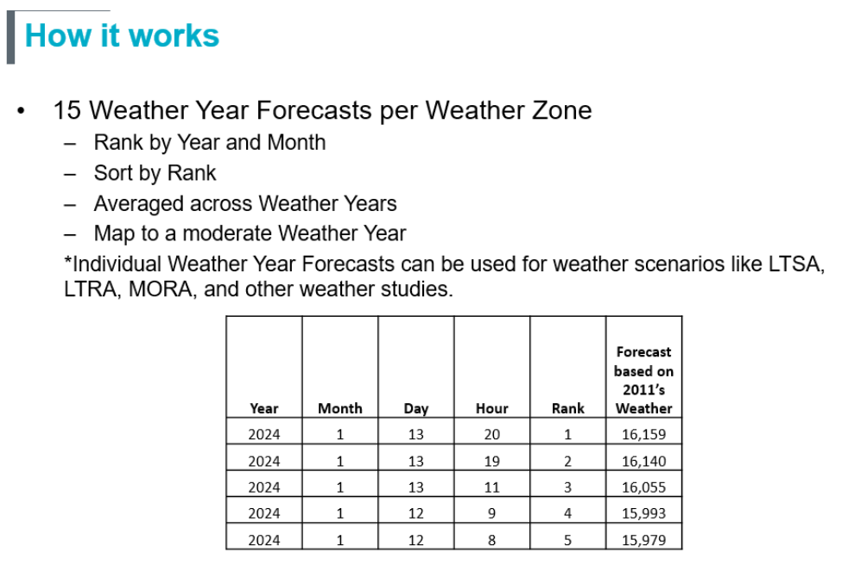
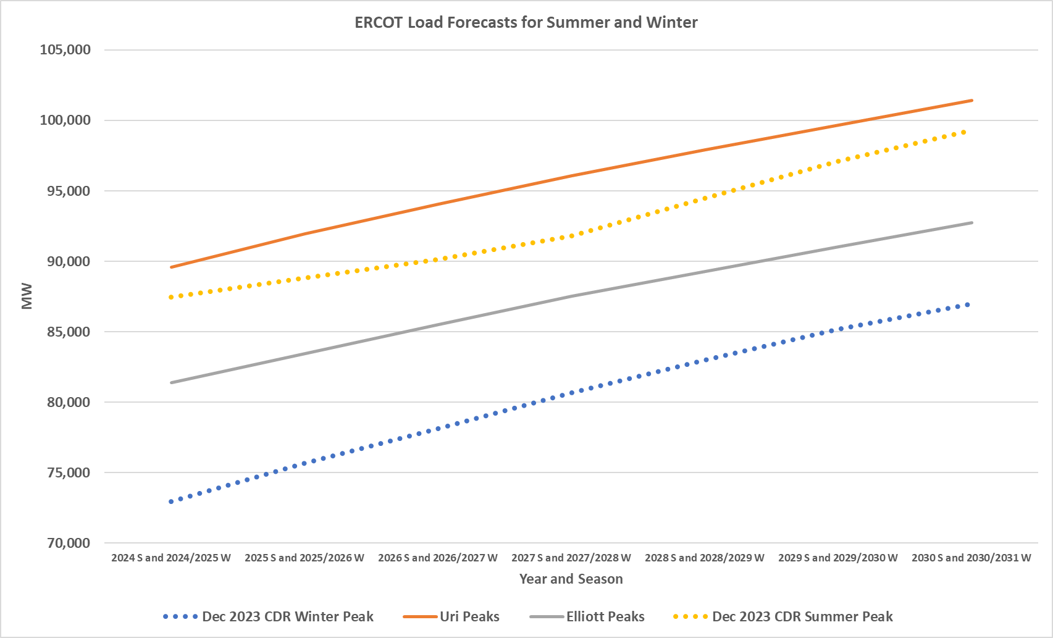
2024 Long Term Load Forecast Overview
WATERFALL METHODOLOGY
Net Forecast = Gross Forecast + EV Forecast + LFL Forecast – PV Forecast
Base year changed from 2013 to 2008
Large Flexible Loads contribution changed from 10% to 15%

Slide 4
Reliability Standard, VOLL and CONE Study Updates
Reliability Standard Scenario Study
Completed third modeling phase
Replaced 1 in 5 year (0.2 LOLE) with 1 in 8 year (0.125 LOLE)
CDR Mix portfolio with more inverter-based resources
Discussing strategy with PUCT staff for analyzing LOLE impact of $1 billion PCM net cost cap
Results are expected to be filed for the January 2024 PUCT Open Meeting
VOLL
PUCT VOLL review project opened in November, #55837
Brattle Group recently completed VOLL literature review and estimated interim VOLL values based on Lawrence Berkeley National Lab methodology and Texas public economic/energy use data
Brattle submitted a VOLL survey work plan on December 7 with implementation timeline January to July 2024
Cost of New Entry (CONE) Study
Consultant selected and contract will be awarded by end of December
Brattle Group has been identified as the consultant since the SAWG meeting

Slide 5
December CDR / February 2024 MORA Overview and Q&A
December 2023 to May 2023
~5,000 MW COD delay for storage resources
February MORA Overview
Under normal weather: Riskiest hour for experiencing emergency conditions are at 8 am which is the same for January 2024, but February risk at 8 am drops from 7.6% to 3.2%
Under WS Elliott weather: Riskiest hour for experiencing emergency conditions are at 8 am which is the same for January 2024, but February risk at 8 am drops from 20.6% to 18.3%

