Slide 1
Resource Integration Topics
Jay Teixeira
ERCOT
Resource Integration Working Group
December 20, 2023

Slide 2
Quarterly Stability Assessment (QSA)
Planning Guide 5.9
Next Deadline for QSA
If a GINR is not included in QSA, its Initial Synchronization date will be automatically delayed to the next quarter
All-Inclusive Generation Resource Initial Synchronization Date | Last Day for an IE to meet prerequisites as listed in paragraph (4) below | Completion of Quarterly Stability Assessment
Upcoming January, February, March | Prior August 1 | End of October
Upcoming April, May, June | Prior November 1 | End of January
Upcoming July, August, September | Prior February 1 | End of April
Upcoming October, November, December | Prior May 1 | End of July

Slide 3
Quarterly Stability Assessment (QSA)
Planning Guide 5.9, Quarterly Stability Assessment
Issue’s seen in previous QSA’s
  10 day comment period for FIS
    Needs to be complete before QSA deadline
    TSPs need to plan for it
  Dynamic/PSCAD Model Review
    Dependent on FIS Stability study
    Need to meet PG 6.9 15 to 30 days prior to QSA deadline
PSSE Model Quality Test Required
PSCAD Model Quality Test and Unit Model Validation required
TSAT Model Required – If PSSE model is UDM, then TSAT model should be UDM and should include MQT

Slide 4
RIOO-IS and RARF
Those with an PLD in 2023 may continue to use RARF forms
PLD dates beyond 2023 (even those that slip) will have to re-enter data into RIOO-IS
RARF forms will no longer be used starting in 2024
November 2023 Changes to RIOO-IS – Self Limiting Facilities and POIB - screenshots posted on Services->Resource Integration
New release on 12/19 for NPRR1153 (Fee Changes) and SCR824 (File Size Increase)

Slide 5
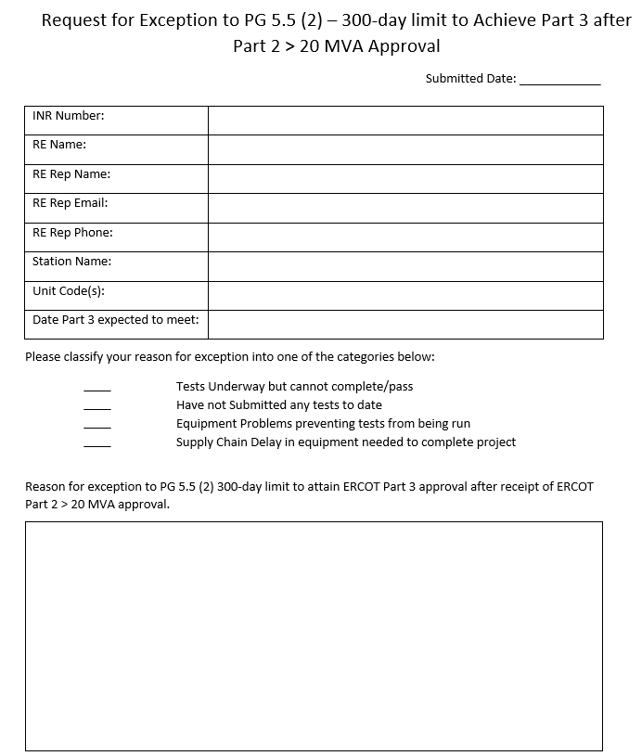
PGRR103 Good Cause exception request form – latest version
Language added by PGRR103
to Planning Guide 5.5
(2) Within 300 days of receiving ERCOT’s approval for Initial Synchronization above 20 MVA of a new or repowered Generation Resource or ESR, a Resource Entity shall ensure the Resource meets the conditions established by ERCOT for commercial operations and shall submit a request to ERCOT to commission the Resource.
In the event a Generation Resource or ESR will be unable to complete all necessary construction and required testing to commence commercial operations and connect reliably to the ERCOT System within the 300 days, the Generation Resource or ESR may request a good cause exception with sufficient detail, and shall notify ERCOT prior to the planned commercial operation date and provide ERCOT with an updated commercial operation date that the Generation Resource or ESR can reasonably expect to commence operations in a reliable manner.

Slide 6
PGRR103 Good Cause exception request form
Submitted forms are reviewed, then approved and signed and posted to RIOO-IS in the appropriate project
10 exception requests submitted
File name must contain the words “Exception Request” as in the original file name to be found
Template posted on Services->Resource Integration https://www.ercot.com/files/docs/2023/10/17/Exception_Request_10242023.docx
First set of 43 projects submitted to ERCOT Reliability Monitor (ERM)

Slide 7
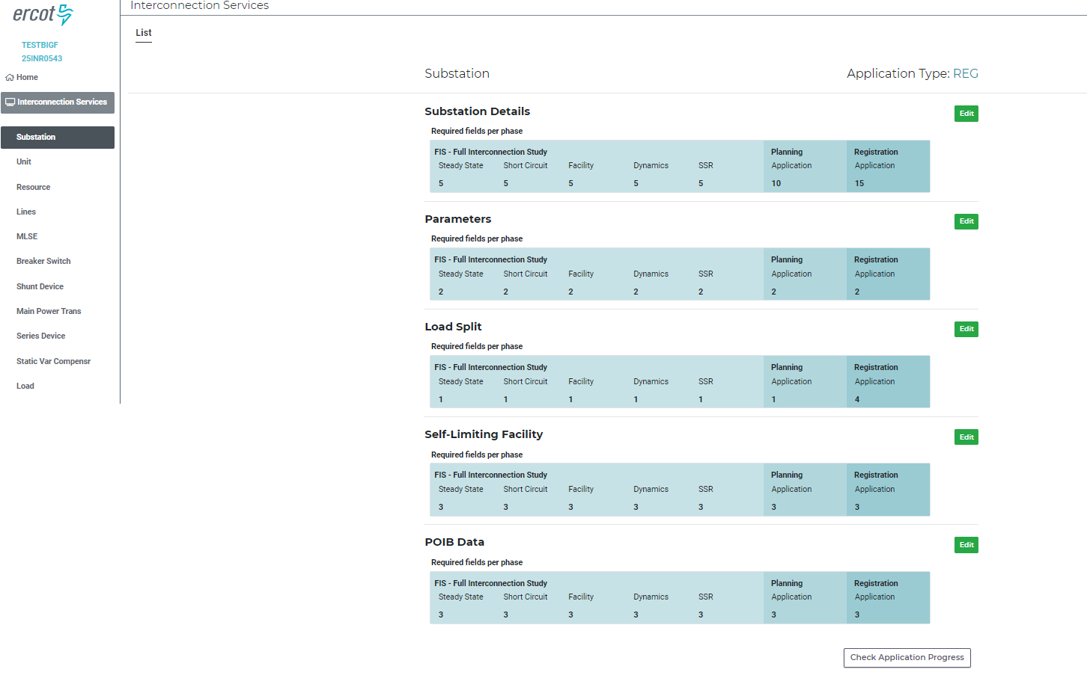
RIOO-IS November 2023 Changes to RIOO - SLF

Slide 8
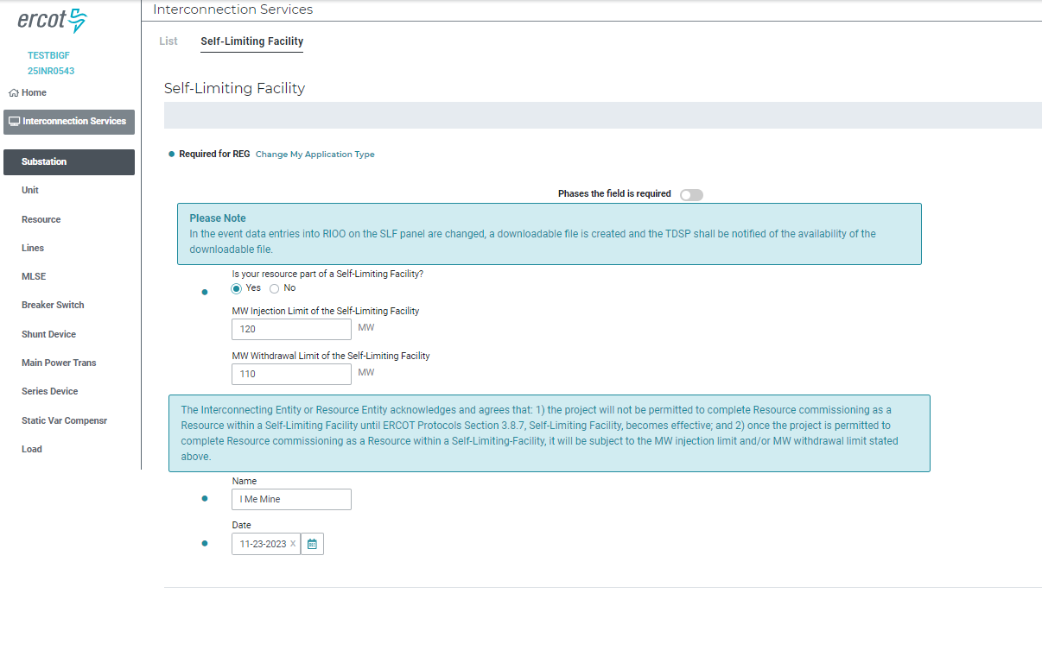
RIOO-IS November 2023 Changes to RIOO SLF
Must put name and date even if “No” chosen above

Slide 9
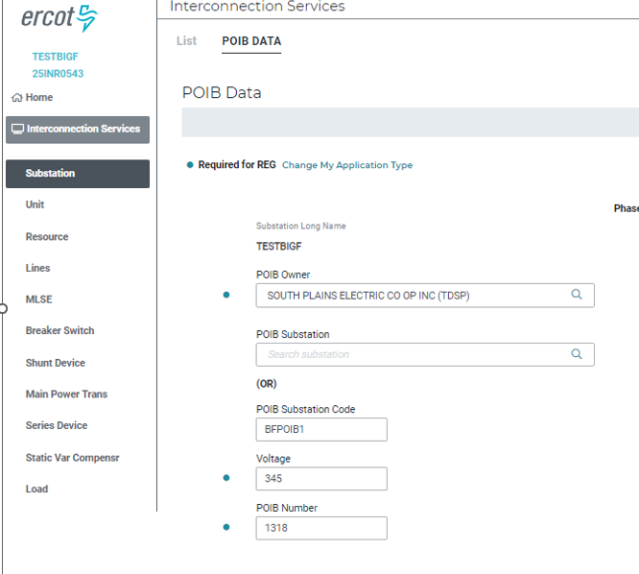
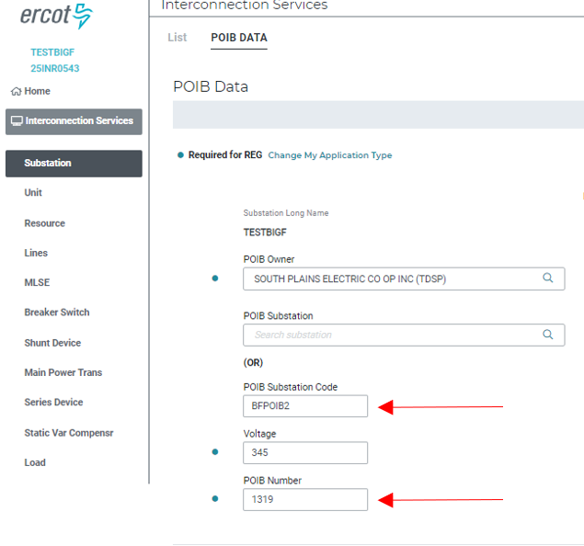
RIOO-IS November 2023 Changes to RIOO POIB
existing
new
Must be
Different
Multiple POIB’s can be created – use if parts of RE station not connected

Slide 10
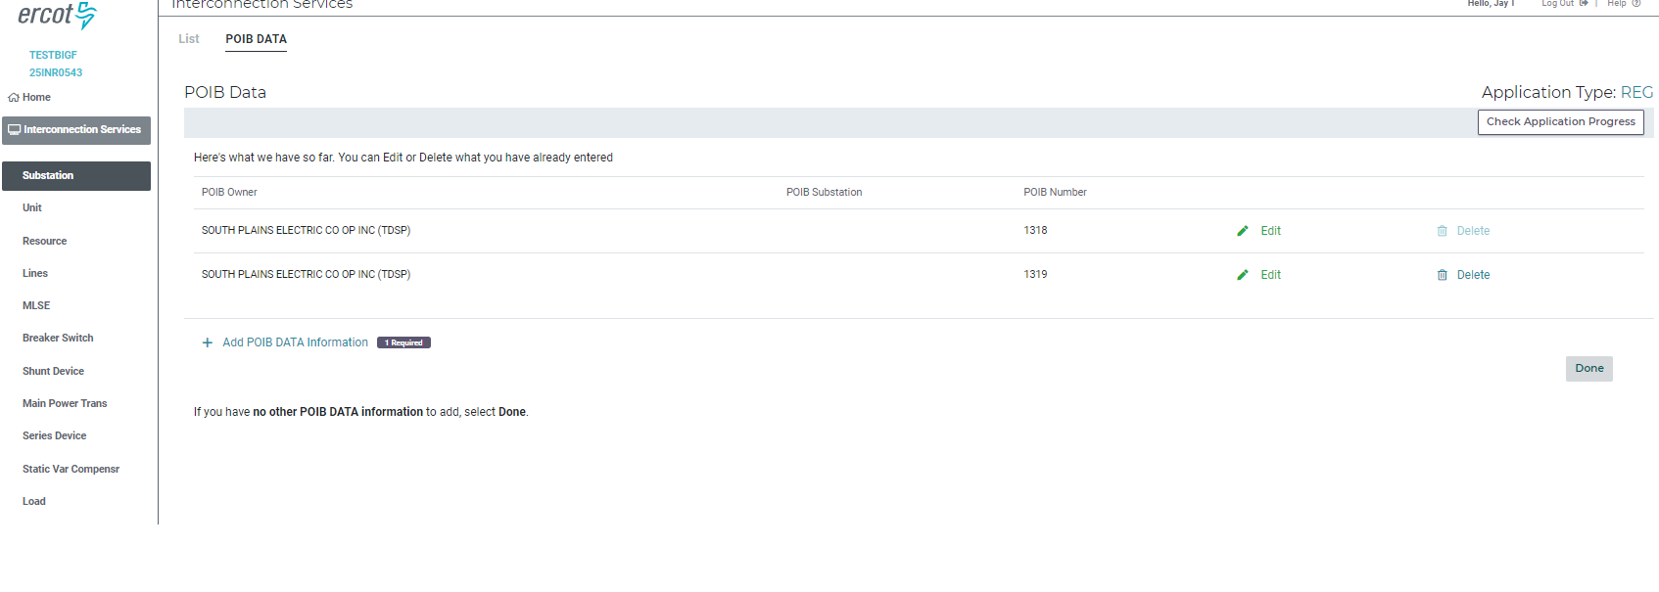
RIOO-IS November 2023 Changes to RIOO POIB
Multiple POIB’s can be created – use if parts of RE station not connected

Slide 11
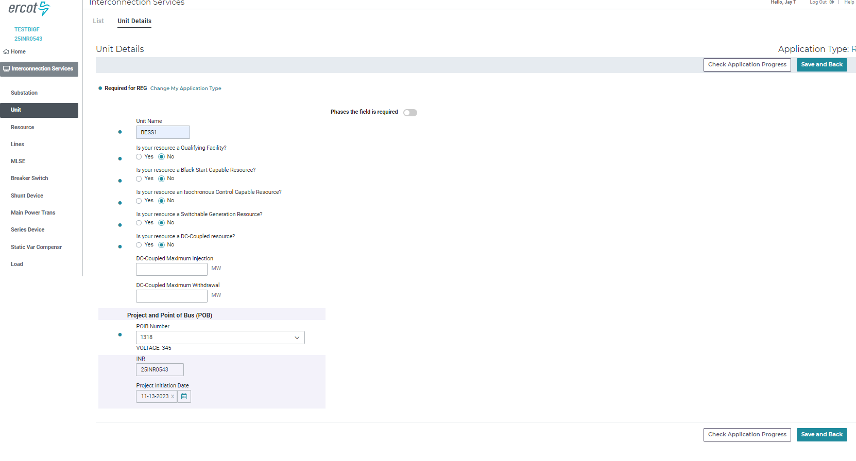
RIOO-IS November 2023 Changes to RIOO POIB
On Unit Details panel – POIB Dropdown contains the two entered in POIB panel

Slide 12
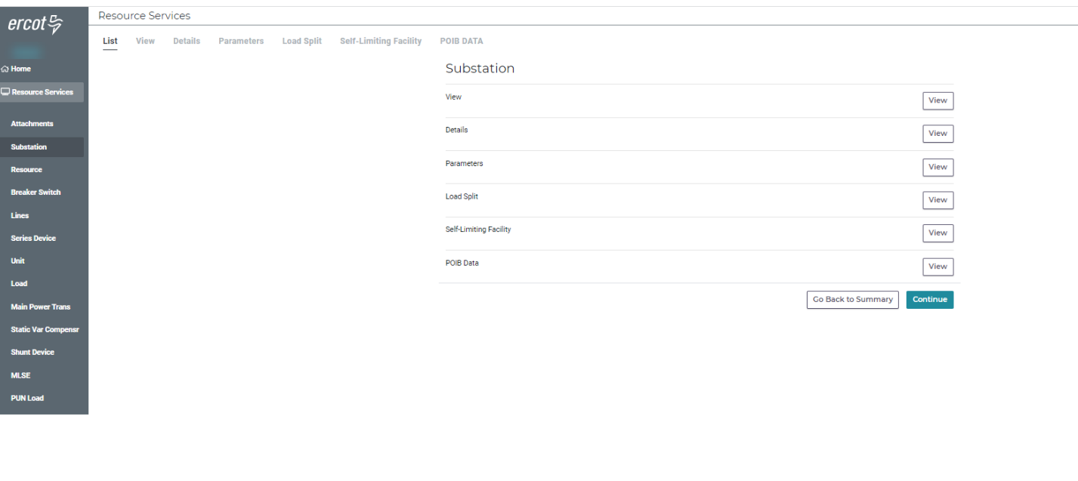
RIOO-RS November 2023 Changes to RIOO POIB
To enter or change POIB, go to Substation->POIB Data – similar to RIOO-IS panel.

Slide 13
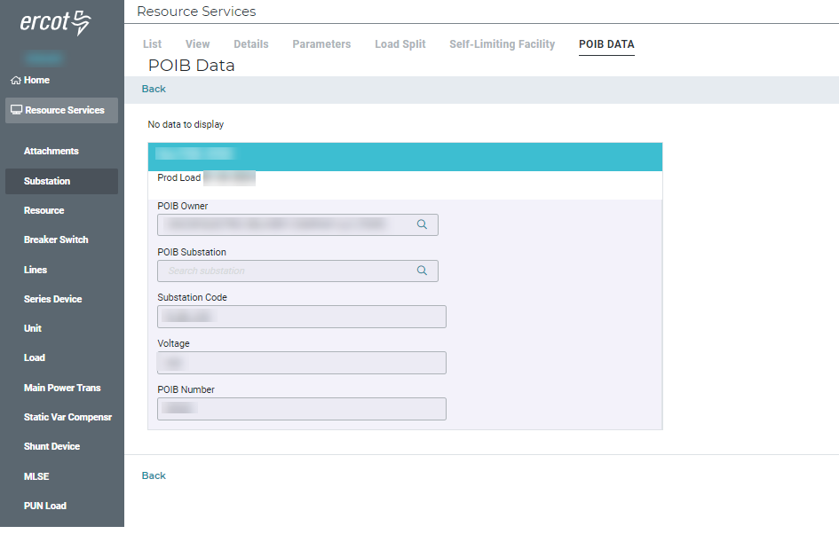
RIOO-RS November 2023 Changes to RIOO POIB
Existing station, start typing, matches will appear
New, 8 characters
Enter the POIB voltage level here
Enter the POIB bus number here
Substation->POIB Data – similar to RIOO-IS panel.

Slide 14
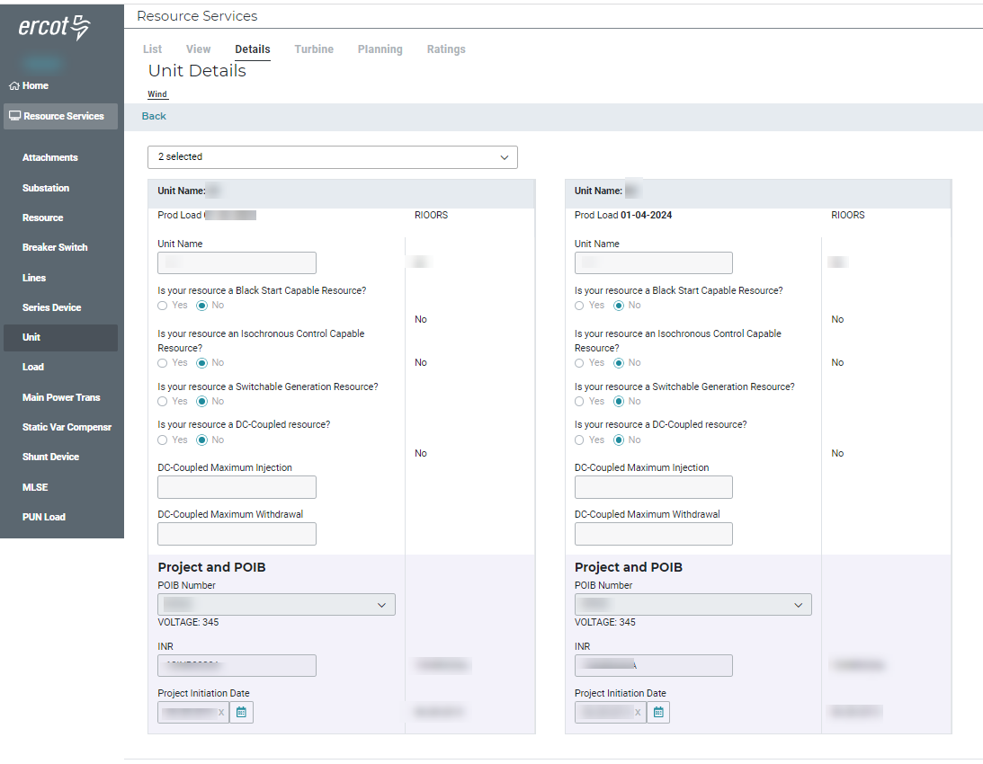
RIOO-RS November 2023 Changes to RIOO POIB
POIB bus number entered
Above should appear in dropdown
Substation->POIB Data – similar to RIOO-IS panel.

Slide 15
RIOO-RS December 2023 Changes to RIOO NPRR1153 - New Fee Schedule
Description | Amount
New Generation Interconnection
Projects greater than or equal to10 MW | $14,000
Projects less than 10 MW | $8,000
Full Interconnection Study (FIS) Application fee | $3,000
New Settlement Only Distribution Generators | $2,300
Update Settlement Only Distribution Generators (increase >= 1MW) | $2,300
Change existing SODG to DGR | $8,000
New Load Resource | $500 per LR
Update Load Resource (MW increase > 20%) or change registration NCLR<>CLR | $500 per LR
Repower
New Generation greater than or equal to10 MW | $14,000
New Generation less than 10 MW | $2,300
Full Interconnection Study Application fee | $2,700

Slide 16
RIOO-RS December 2023 Changes to RIOO NPRR1153 - New Fee Schedule
RIOO-IS
User will be able to select a “Repower” option on the RIOO-IS start page. This selection will affect how fees are calculated on the schedule above. User must log in as “RE” to see this option.
Fees will be collected based on the fee schedule provided. If a project < 10 MW submit a CR to go to 10 MW or greater, they will have to pay the difference ($14,000 - $8,000 = $6,000)
Fees will now be collected for Load Resources; Previously the system did not collect fees for Load Resources. Once the INR is submitted a user will have to create a new INR to add additional load resources.
RIOO-RS
RIOO-RS will require a fee in the following situations when submitting a change request:
  A Load Resource is updated and the HRL is modified where the increase is greater than or equal to 20%.
  A Settlement Only Distribution Generator is updated where the Name Plate Rating MW is increased by 1 MW or more. The maximum MW value is 10MW. If greater than 10MW a new INR must be started in RIOO-IS as a Distribution Connected generator.
  Changes will be aggregated over a 12-month period leading up to the production load date. For example, a user may submit one change request for 0.5 MW and not be charged. If there is a 2nd MW increase in the same period for another 0.5 MW, then the user will be charged a fee.
  Once the change request is submitted, ERCOT will have the option to return the change request. User will not be allowed to edit MW values after the payment was done; A new Change request must be submitted.

Slide 17
RIOO-RS December 2023 Changes to RIOO SCR 824
Issue:
The current limitations within RIOO on file size and quantities are preventing the addition of more documents to 24INR0459. There are files that need to be uploaded to complete the interconnection and move to the engineering scope for the Full Interconnection Study (FIS).
Current RIOO Limits:
1. Max file upload limit = 25 files per INR
2. Max file size = 60 MB
Resolution:
The SCR requests an increase in file upload space to add critical engineering, kmz, and studies to complete the interconnection request and prevent this issue for other developers in the future.
Specifically, the limits should be increased to, at least:
Max file upload limit = 35 files per INR
Max file size = 70 MB (files up to 100 MB tested)

Slide 18
Active RR’s
PGRR112 - Dynamic Data Model and Full Interconnection Study (FIS) Deadline for Quarterly Stability Assessment – in review at PLWG.

Slide 19
Other contact information
ResourceIntegrationDepartment@ercot.com is distribution list for Resource Integration department
Mailing List
  RESOURCE_INTEGRATION@LISTS.ERCOT.COM

Slide 20
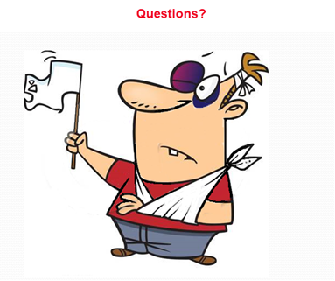
Questions?
Thank you!

Slide 24
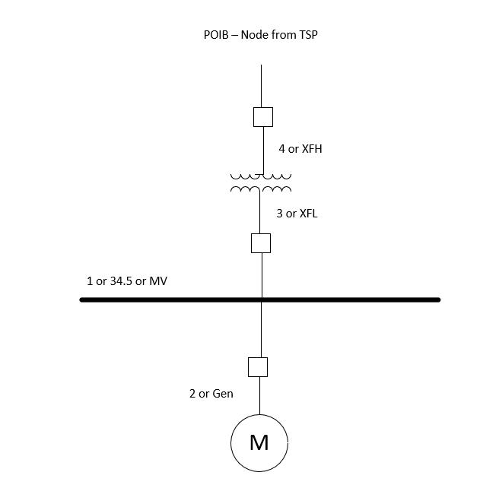
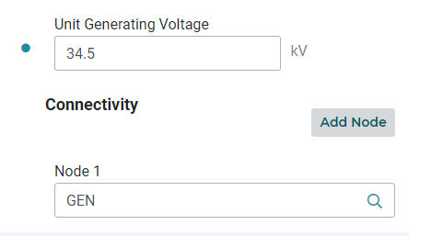
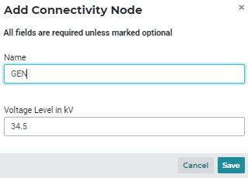
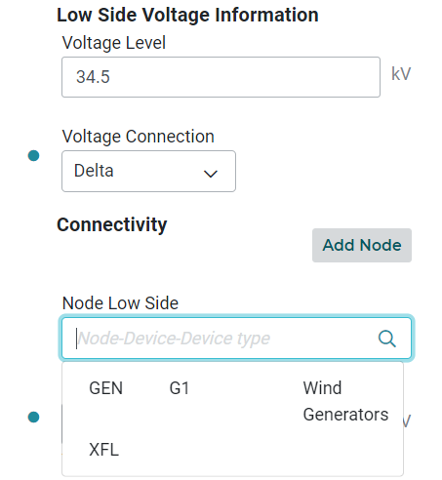
Node creation and use
August Update: Please use 4 numeric digits for node names
Must be entered
To create Node
Must be entered
To create Node
0004
0003
Click to create
node
0001
0002
Nodes
Created at
34.5 kV

Slide 25
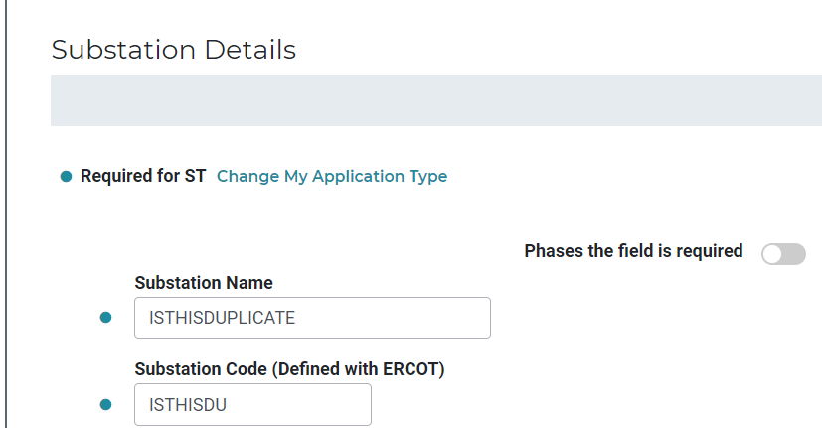
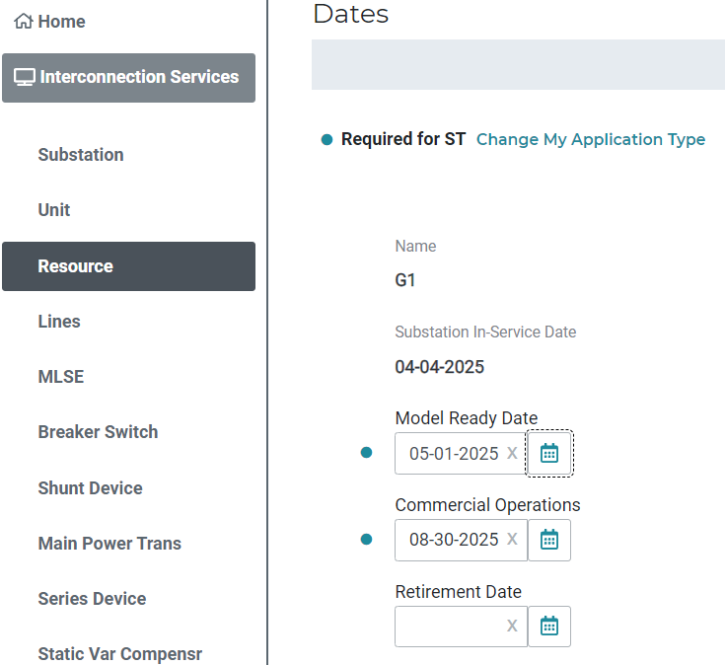
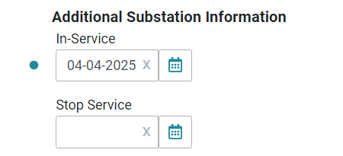
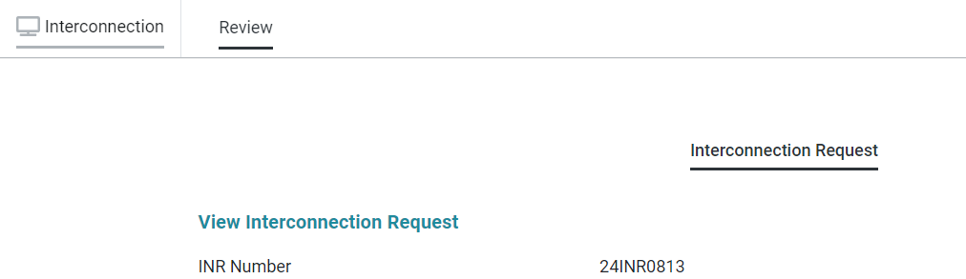
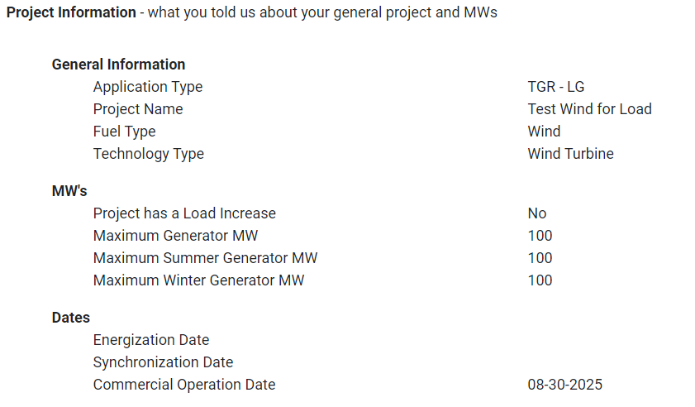
Date Relationships and how to change them
Change on Substation Details
Use Basic Project Information
Add a Change Request
To Change
Notes:
24INR0813 on ITEST

Slide 26
Changing Contacts
RE Contact Scheme
Primary Contact
Full Name: I Me Mine
Company: ERCOT RE LLC (RE)
An.emailaddress@att.net
DUNS: 012345673000
P: 5125551234
Ext:
To Change from RE Contact Scheme to IE Contact Scheme
IE Contact Scheme
Primary Contact
Full Name: For You Blue
An.emailaddress@att.net
P: 5125551234
Ext:
Backup Contact
Full Name: I Me Mine
An.emailaddress@att.net
P: 512-5551234
Ext:

Slide 27
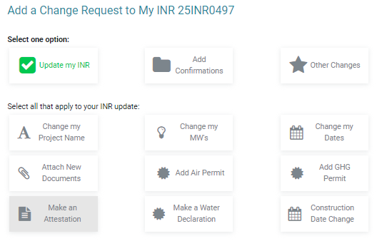
RARF Attestation – Coming Up in September
Most entities could not click “Make an Attestation” button
Cause undetermined at the time
Should be fixed
ERCOT instructed entities to complete Planning Guide Section 8, Attachment A: Declaration of Resource Data Accuracy and attach to RIOO as type “Other”

Slide 28
Attachments for embedded documents
Renewable Form Tab Name | Files to be include from that tab | Proposed RIOO Attachment Type
Collector System - RENEWABLE | Collection System One Line Diagram – Collector Workbook, One-Line | CollectorSystem
 | Collection System Detailed Model – RAW, SEQ | CollectorSystemModel
Dynamic Data | PSSE Model and MQT VSAT Model and MQT | PSSE MMQT,VSAT MMQT
PSCAD Model | PSCAD Model and MQT | PSCAD MMQT
Inverter Efficiency Curve | Inverter Efficiency Curve | Inverter Curve
Transmission Form Tab Name | Files to be include from that tab | RIOO Attachment Type
One Line | PDF or CAD One Line Diagram | One-Line (existing type)
Transformer Test Data | Transformer Test Data | Test Data
Attach these documents using Basic CR with type “Other” until attachment types are available

Slide 29
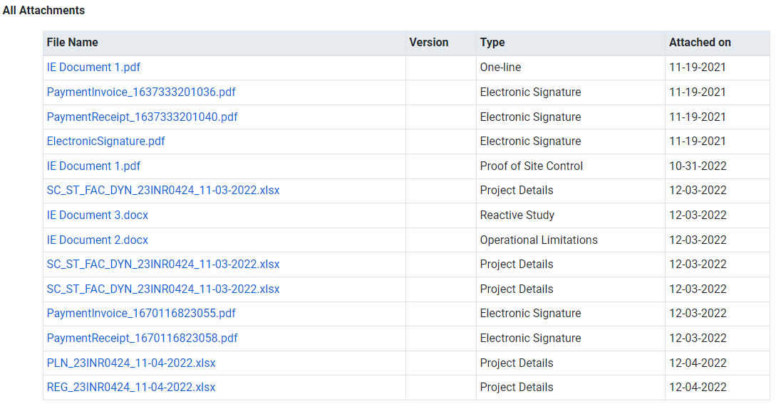
Modifying the Project Details to make corrections that cannot be made in RIOO

Slide 30
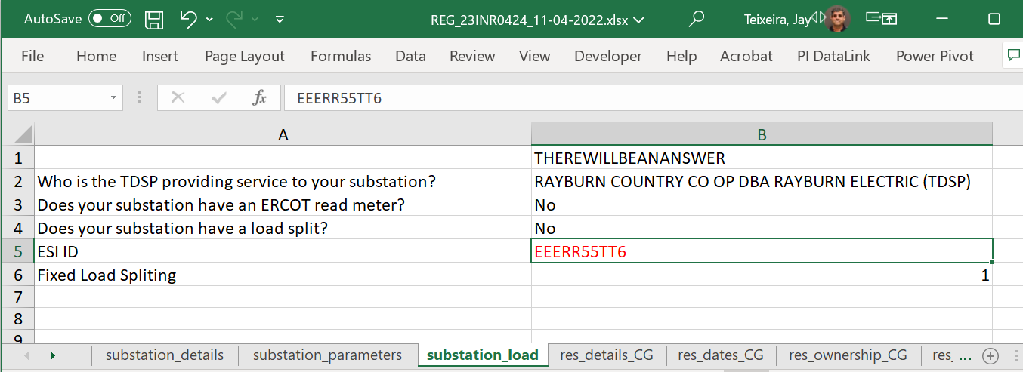
Modifying the Project Details to make corrections that cannot be made in RIOO
Take latest Project Details file, which is an excel spreadsheet and modify the data that cannot be modified in RIOO. Find the tab and modify the data. Re-attach to RIOO as file “Other” and put “_modified” at the end of the filename. “REG_23INR0424_11-04-2022_modified.xlsx”

Slide 31
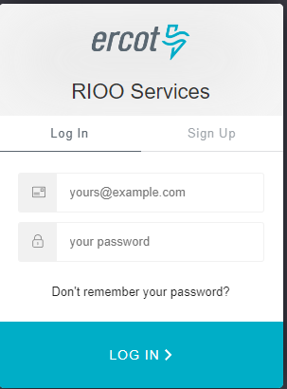
TSPs not Creating RIOO Accounts Correctly
Use this document
  https://www.ercot.com/files/docs/2022/01/14/TSP-Sign-Up-for-RIOO-Services.pdf.
Too many TSP employees create IE account because they didn’t use the above document
Takes several days for ERCOT to fix this issue in the database and in auth0
TSP’s and RE’s – never click this tab!
TSP’s and RE’s – start here after USA adds role

Slide 32
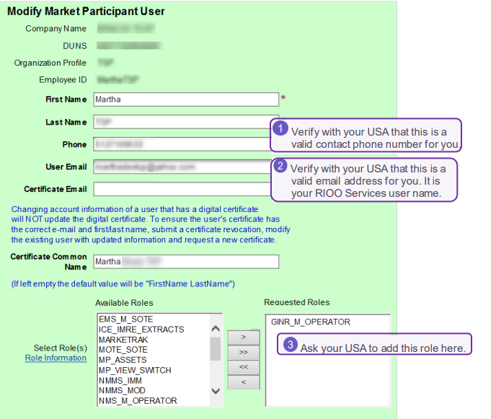
TSPs not Creating RIOO Accounts Correctly
TSP’s – GINR_M_OPERATOR only
RE’s – RIOORS_M_OPERATOR only
Do not do anything until you receive an email from ERCOT. This may take 20 minutes after the role is added.
Then click the verify email link in the email.
This gives you the RIOO Services log in page. Do not enter an email address or any other username. Click the “Don’t remember your password” link.
The next screen enter your email and another email will be sent to you. Click the “Change my Password” link.
You should get a message that your password has been reset successfully.

Slide 33
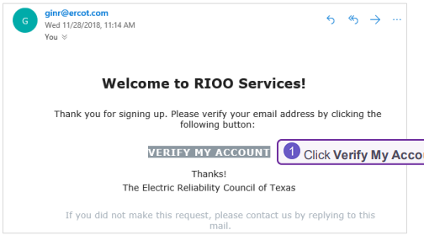
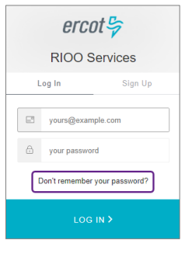
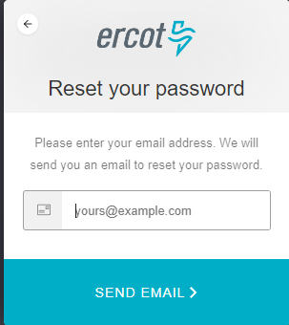
TSPs not Creating RIOO Accounts Correctly
Do not do anything until you receive an email from ERCOT. This may take 20 minutes after the role is added.
Then click the verify email link in the email.
This gives you the RIOO Services log in page. Do not enter an email address or any other username. Click the “Don’t remember your password” link.
The next screen enter your email and another email will be sent to you. Click the “Send Email” link.
You should get a message that your password has been reset successfully.
Click the “Don’t remember your password? link

Slide 34
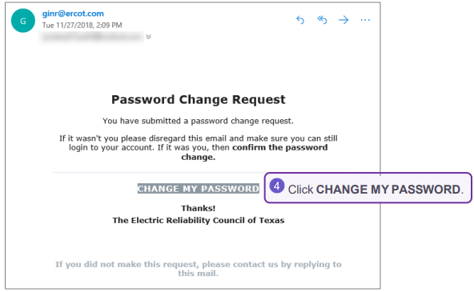
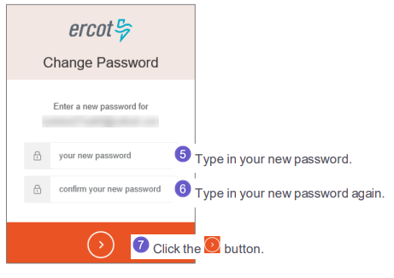
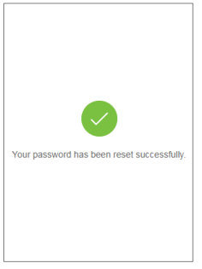

TSPs not Creating RIOO Accounts Correctly
Do not do anything until you receive an email from ERCOT. This may take 20 minutes after the role is added.
Then click the verify email link in the email.
This gives you the RIOO Services log in page. Do not enter an email address or any other username. Click the “Don’t remember your password” link.
The next screen enter your email and another email will be sent to you. Click the “Send Email” link.
If you do not get the “Password Change Request” email, contact your USA to make sure the email address is correct. Click the “Change my Password” link.
Change your password by entering your new password twice and click the button.
You should get a message that your password has been reset successfully.

Slide 35
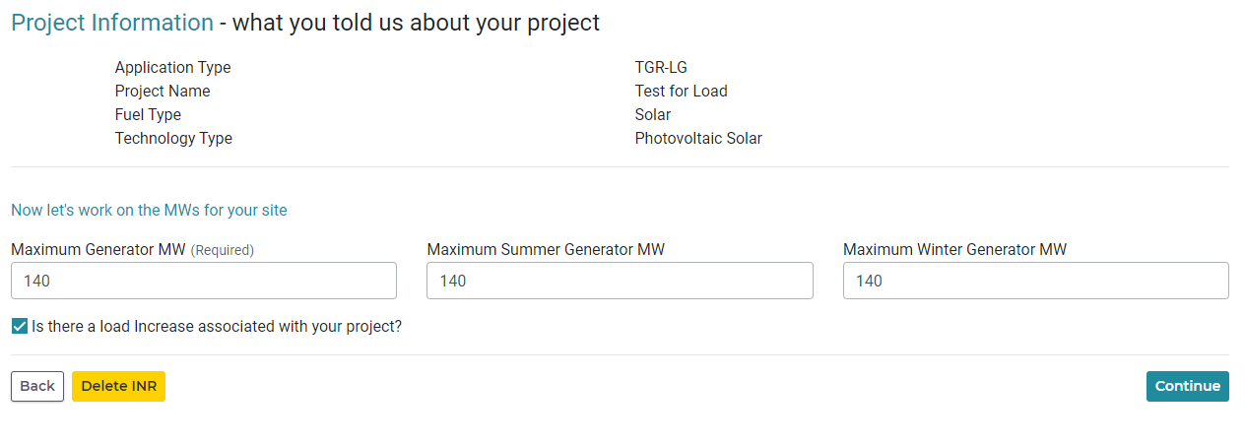
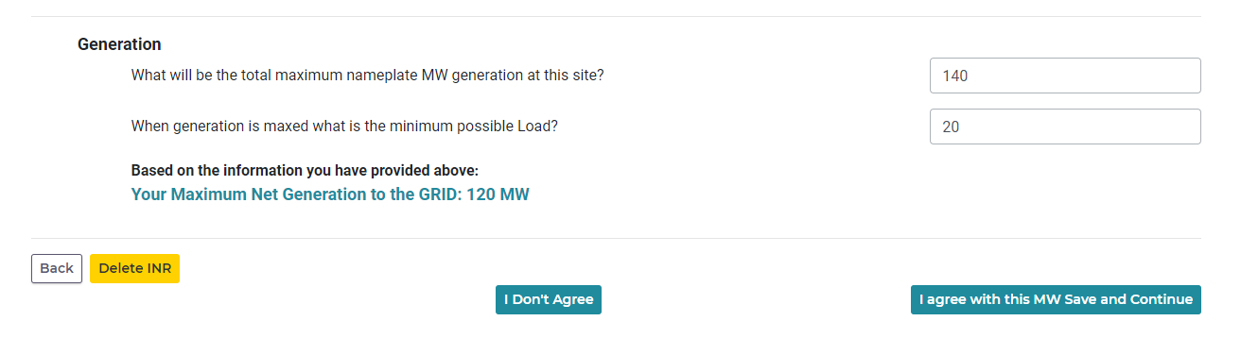
Is Load associated with INR

Slide 36
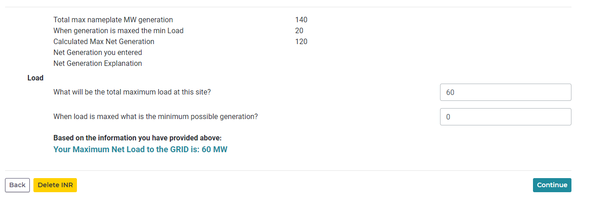
Is Load associated with INR
            Not to be checked for
                Aux Load
              Battery charging load

Slide 37
Load Names for BESS and non-BESS
For non-BESS, one load is required per MPT
Name = “LOAD1”, “LOAD2”, etc.
For each BESS, two loads are required
Name for WSL load = “CHARGE1”, “CHARGE2”, etc.
Name for Aux load, like chillers, = “BESS_AUX1”, “BESS_AUX2”, etc.

Slide 38
Changes to COD and FIS Restudy
If the COD is changed and the case that would be used to do FIS study based on new COD is 2 case years or more different than original FIS study case year
prior to meeting QSA prerequisites
  Restudy is Needed
  TSP to determine FIS study elements that need to be restudied
  TSP and ERCOT agree
after meeting QSA prerequisites
  Check with TDSP and ERCOT Planning to see if project included in annual planning studies
  Check that no changes to dynamic model has occurred
  If Yes to both then no FIS restudies are required
    Recheck in 1 year OR if COD is delayed further
  If No to either check than FIS restudy needed
    TSP to determine FIS study elements that need to be restudied
    TSP and ERCOT agree
What if subsequent COD changes occur?

Slide 39
COD Change Example
If the original study had a COD date of 2/2023, the original FIS would use the SSWG 23 Summer Peak case (July 1 is the flip date between 23SUM and 24SUM). If the COD then gets delayed to 2/2024, the 24 Summer Peak case would be used if a study was done. But this is only a difference of 1 SSWG case year, so no restudy would be necessary.
But if the COD gets further delayed until 8/2024, the 25 Summer Peak case would be used. This is a 2 year SSWG case difference (2025 -2023) so a restudy would be necessary.
We use the SSWG cases because they are built for every year for 5 years. I believe the DWG cases are built for 2 year increments, right? If we used the DWG case year difference, the case difference would either be 0 or 2 and possibly trigger too many restudies.

Slide 40
Small Gen Clarifications
For Small Generation projects, the TDSP should log in to RIOO-IS and enter dates for IA signed date, financial commitment and notice to proceed. This is based on planning guide section 5.4 where this information is provided from the TDSP to ERCOT.
Small Generation System Impact Study (SIS) scope is a determination of the TDSP.
  The SIS scope and necessity of the SIS is a determination of the TDSP.
  ERCOT recommends that, at a minimum, a thermal, voltage, short circuit and flicker analysis are performed.
  ERCOT may inquire as to the reasoning why a TDSP states that a SIS may not be required.
If an affiliated IE or RE submits a less than 10 MW GIM that is behind the same TDSP station as another planned and affiliated GIM then the new less than 10 MW GIM will need to go through the large gen process.
Small generation projects require PSS/E models, PSCAD models, their associated Model Quality Tests and a PSCAD Unit Model Validation.

Slide 41
Miscellaneous Reminders
Prior to Full Registration, ERCOT requests that the RE reach out to ERCOT at least 30 days prior to the deadline for the desired PLD to allow for calls and edits prior to submittal in RIOO-IS for review. For Full Registration, the desired Production Load Date deadlines can be found in https://www.ercot.com/gridinfo/transmission/opsys-change-schedule. Resource data submitted after 15 days prior to the PLD deadline may not get processed in time to be included in the desired PLD!
Load Resource request must be submitted in RIOO-IS at the same time as the Resource (BESS) full registration data submittal. Resource data will not be processed if the Load Resource Request is missing by the PLD deadline.

