Slide 1
Regulation Bias Analysis Post SCR-773
November 2023
ERCOT
Operations Planning
PDCWG | December 20, 2023

Slide 2
Discussion Points
Current GTBD Parameters & References
Metric to measure Regulation bias and performance
Regulation Deployed comparison for last three months.
Total Regulation (net) Deployed Comparison
Regulation Deployed 15-minute interval comparison by each hour for 2021, 2022, and 2023 months
Regulation Exhaustion Rate
Regulation bias for consecutive 5-min SCED intervals
Time Error & Contributing Factors
Summary

Slide 3
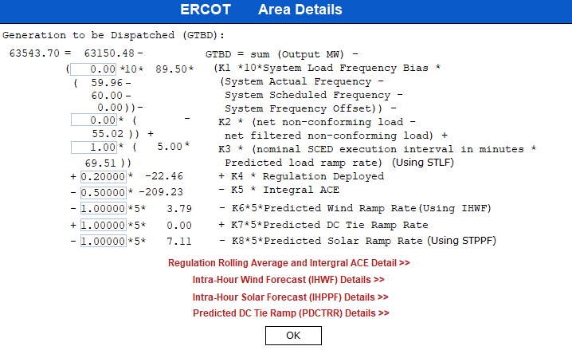
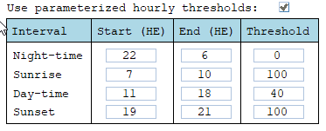
Current GTBD Parameters
Notes:
3/12/18 – Integral ACE Time Constant Changed from 60 min to 45 min
5/17/18 – K4 Changed from 0.3 to 0.2 and K5 Changed from 0.4 to 0.5
12/4/18 – 10:05 AM – K6 Changed from 0 to 0.5
2/12/19 – 2:15 PM – K6 changed from 0.5 to 1.0
3/12/19 – 2:10 PM – PWRR Threshold from 10 to 15 MW/min
3/19/19 – 2:15 PM – PWRR Threshold from 15 to 20 MW/min
4/01/19 – 10:00 AM – K5 changed from 0.5 to 0.4 and Max. Integral ACE Feedback changed from 250 to 150
4/24/19 – 1:15 PM – Max. Integral ACE Feedback changed from 150 to 160. PWRR Threshold changed from 20 to 25.
5/22/19 – 1:10 PM – K5 changed from 0.4 to 0.5, Max Integral ACE feedback changed from 160 to 200, PWRR Threshold changed from 25 to 30
6/17/20 – 10 AM - PWRR Calculation method changed from Direct to Interpolated
9/1/20 – 11 AM - Max Integral ACE Feedback changed from 200 to 250
9/3/20 – 3 PM - Max Integral ACE Feedback changed from 250 to 300
9/4/20 – 3 PM - Max Integral ACE Feedback changed from 300 to 250
6/1/21 – 10:00 AM – K8 Changed from 0 to 0.5, PSRR Threshold changed to 10
6/2/21 – 10:00 AM – PSRR Threshold changed from 10 to 20
6/3/21 – 10:00 AM – K8 Changed from 0.5 to 0.75
6/4/21 – 10:00 AM – K8 Changed from 0.75 to 1
9/2/21 – 10:00 AM – PSRR Threshold changed to 30
6/7/22 – 10:30 AM – K7 Changed from 0 to 0.5, PDCTRR Min/Max Threshold changed to 10 MW/min
6/8/22 – 10:30 AM – PDCTRR Min/Max Threshold changed from 10 to 20 MW/min
6/9/22 – 10:30 AM – K7 Changed from 0.5 to 0.75
6/10/22 – 10:30 AM – K7 Changed from 0.07 to 1.0
7/21/22 – 10:00 AM–Max Integral ACE Feedback changed from 250 to 350
7/21/22 – 05:10 PM – K5 Changed from 0.5 to 1
7/22/22 – 09:40 PM – K5 Changed from 1 to 0.5
7/27/22 – 08:40 AM – PSRR Threshold changed to 40 MW/min
6/12/23 - PSRR dynamic threshold enabled. The Max PSSR started at 80 MW/min for sunrise and sunset hours
6/15/23 – The Max PSRR threshold increased to 100 MW/min for sunrise and sunset hours

Slide 4
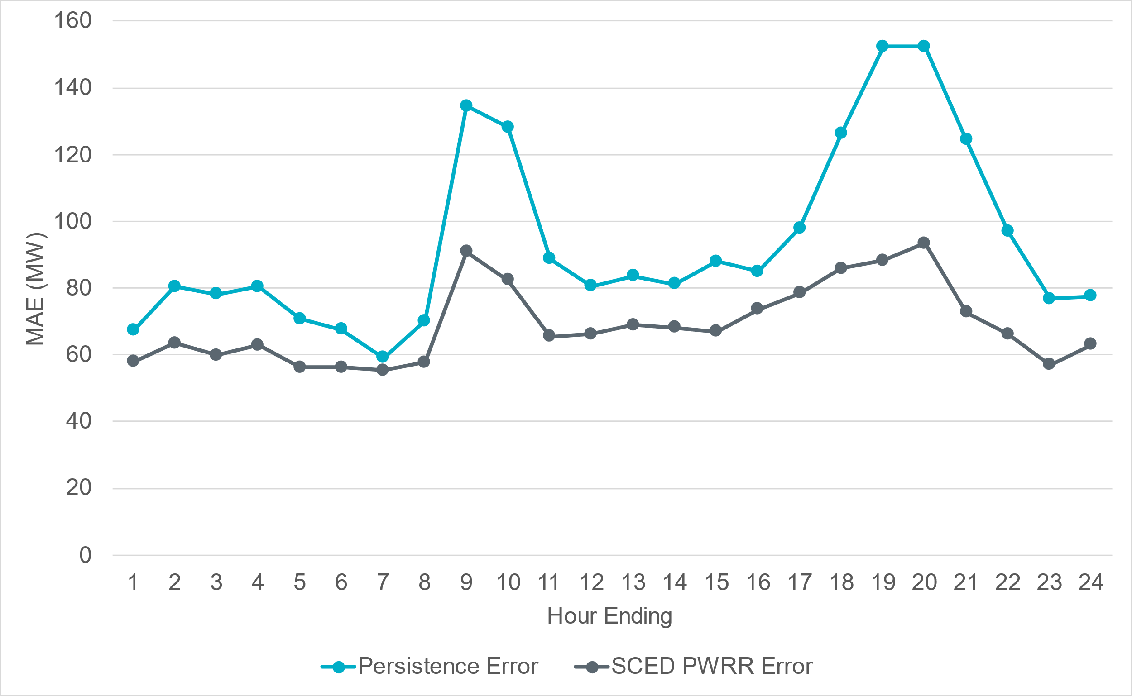
Projected Wind Ramp Rate MAE
Notes:
For intra-hour wind ramp forecast, SCED PWRR MAE is consistent and persistently smaller than the persistence forecast across the board.

Slide 5
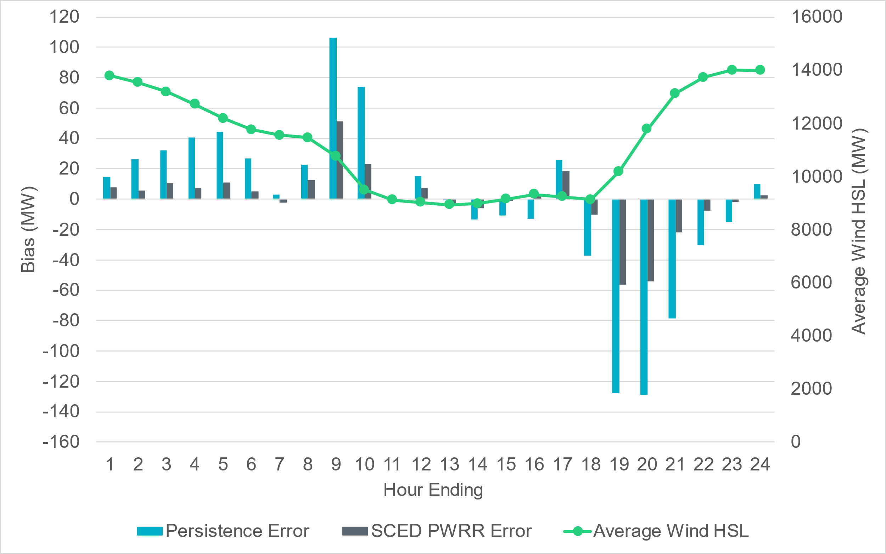
Projected Wind Ramp Rate Error
Notes:
SCED PWRR is consistent and performing significantly better than the persistence forecast

Slide 6
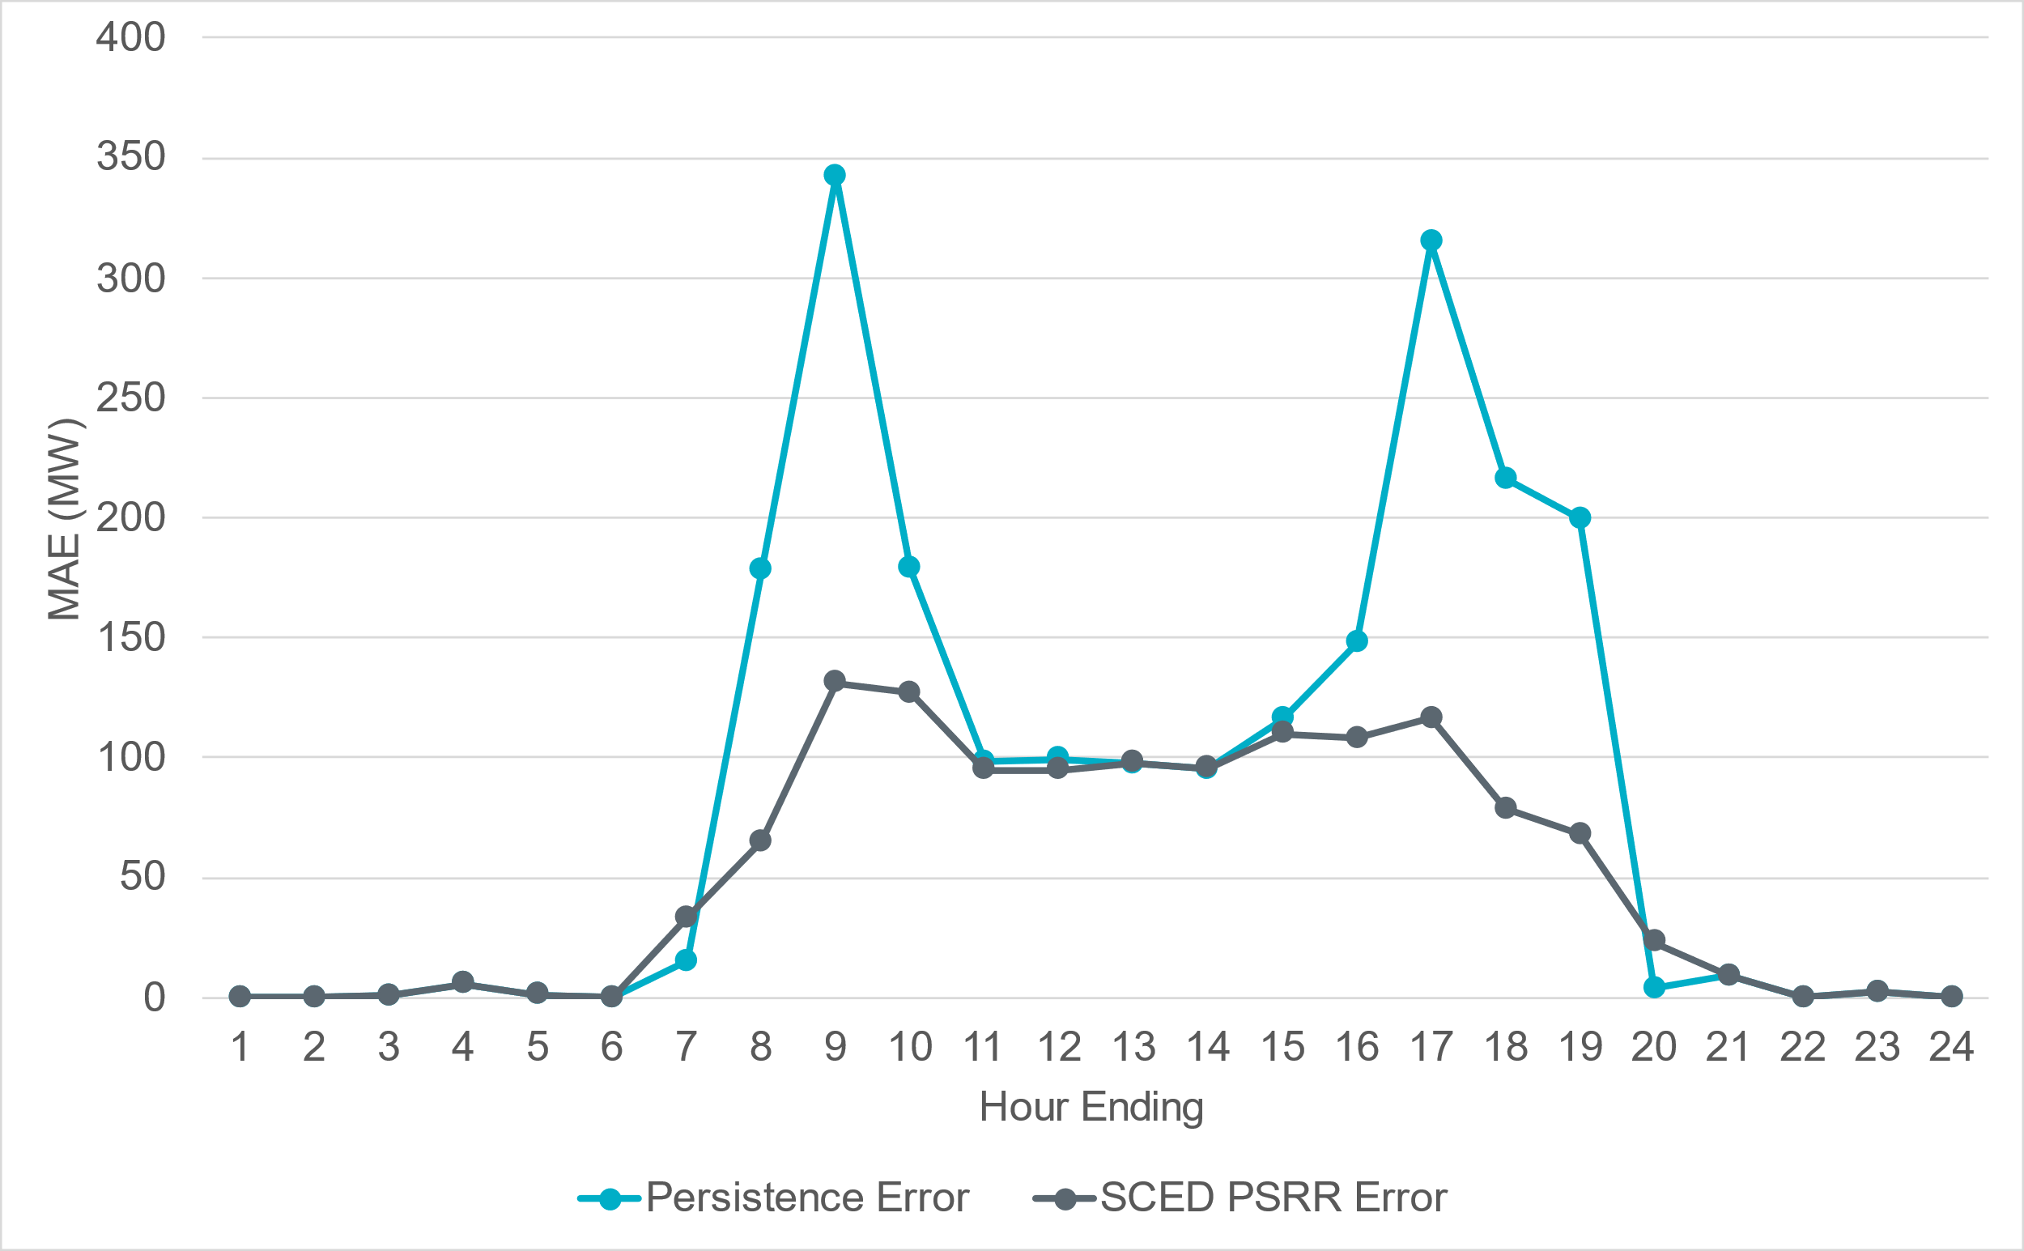
Projected Solar Ramp Rate MAE
Notes:
For intra-hour solar ramp forecast, SCED PSRR is generally performing significantly better when compared to the persistence forecast, particularly during the most significant solar ramp hours.

Slide 7
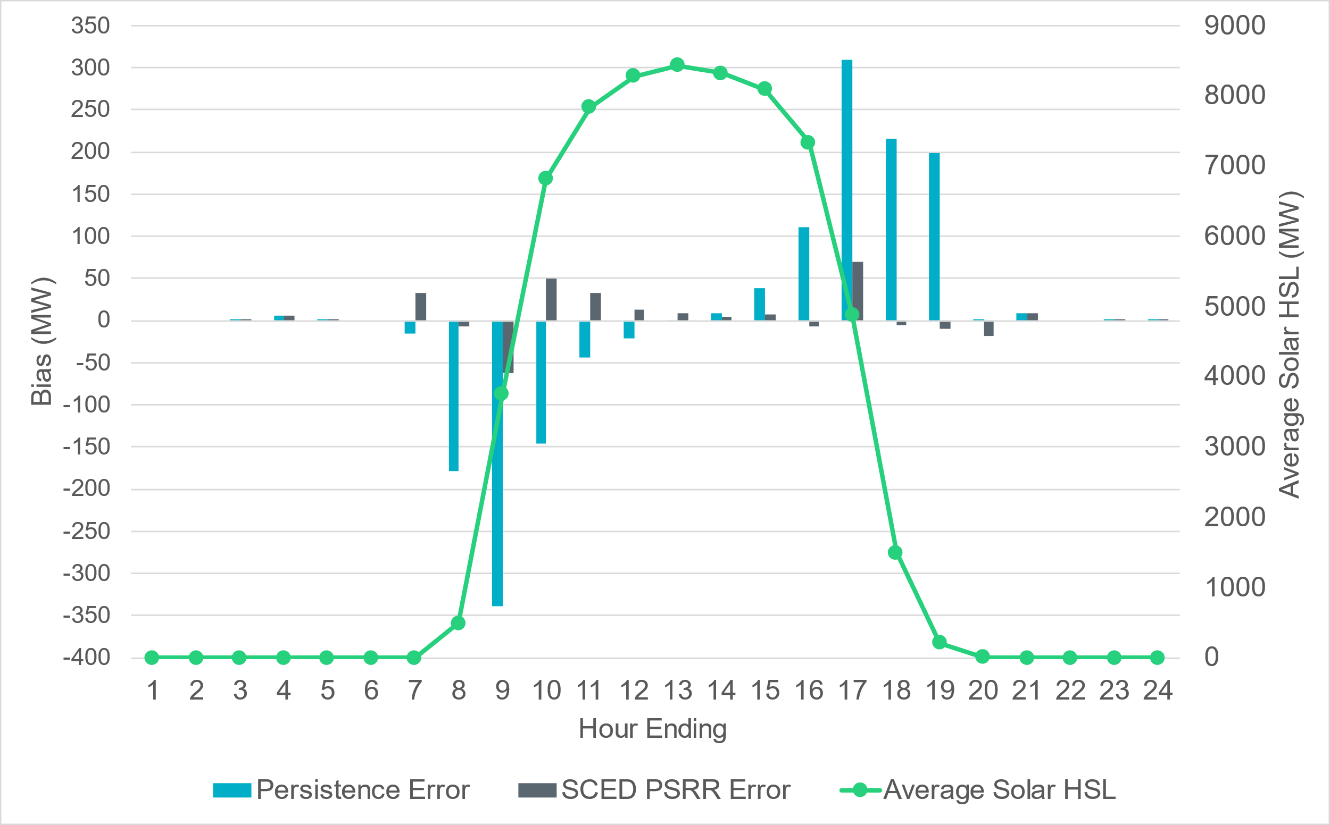
Projected Solar Ramp Rate Error
Notes:
Similar to wind, generally we see bigger forecast errors during ramping periods.

Slide 8
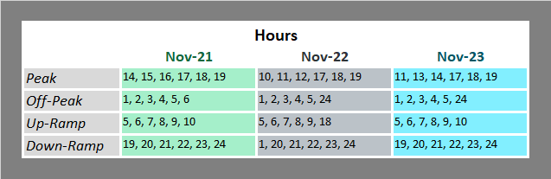
References

Slide 9
Metrics to Measure SCR-773 Performance
Trend and monitor the regulation deployed by hour.
Set target of 50 MW for total regulation deployed by hour for peak hours.
Set target of 85% for the number of intervals where regulation deployment was both up and down for peak hours.
Track the Regulation exhaustion rate for all hours (not to exceed 5%).
Using a 50MW filter, target 15 occurrences or less per month for regulation bias of six or more consecutive 5 minute intervals for peak hours.

Slide 10
Total Regulation Deployed Comparison
Total regulation deployed for the last three months.

Slide 11
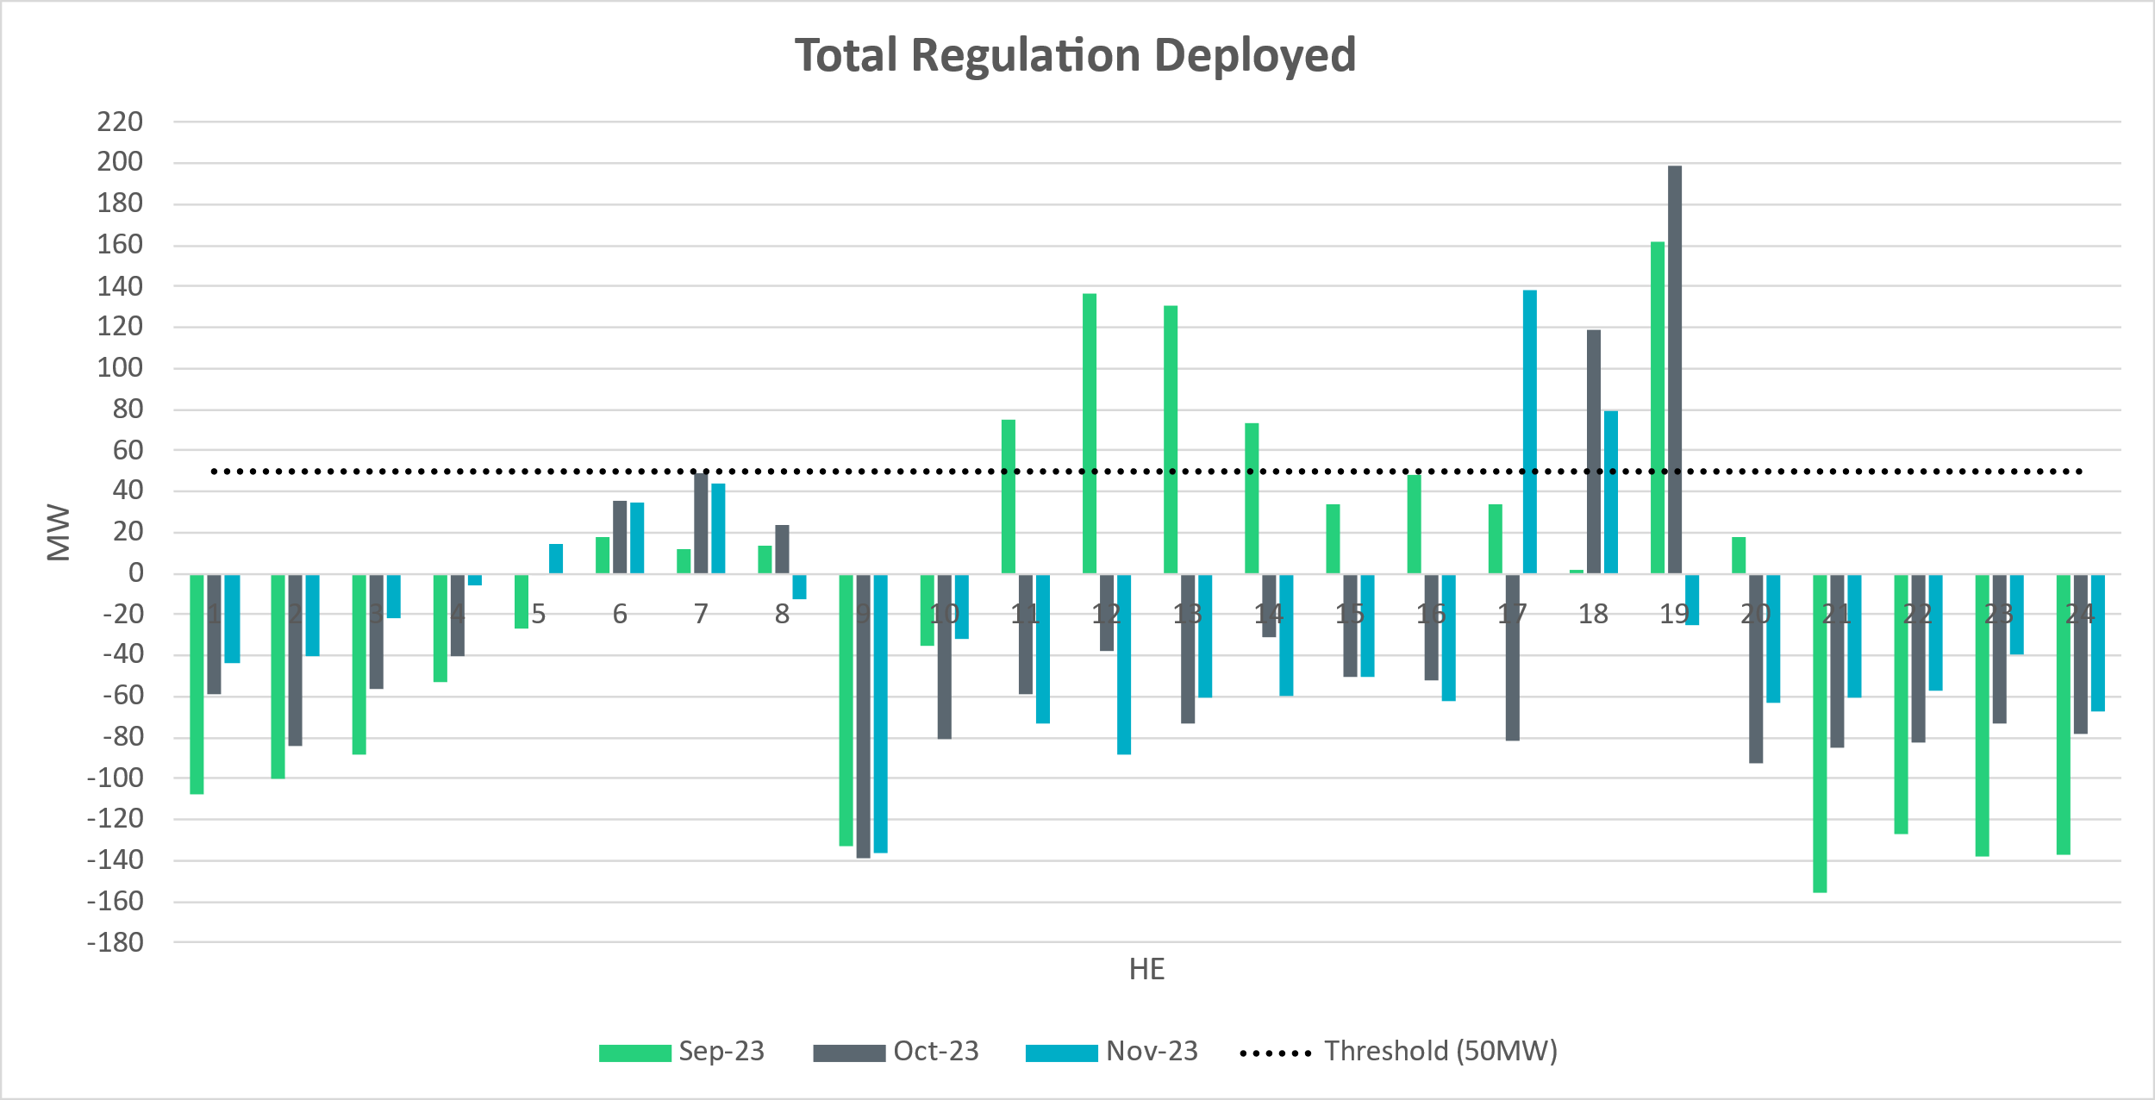
Total Regulation Deployed Comparison - Monthly
Notes:
Total regulation deployed comparison in the last 3 months: Overall we see more bias towards Regulation Down deployment

Slide 12
Metric 1: Regulation Deployed Comparisons
Trend and monitor the regulation deployed by hour.

Slide 13
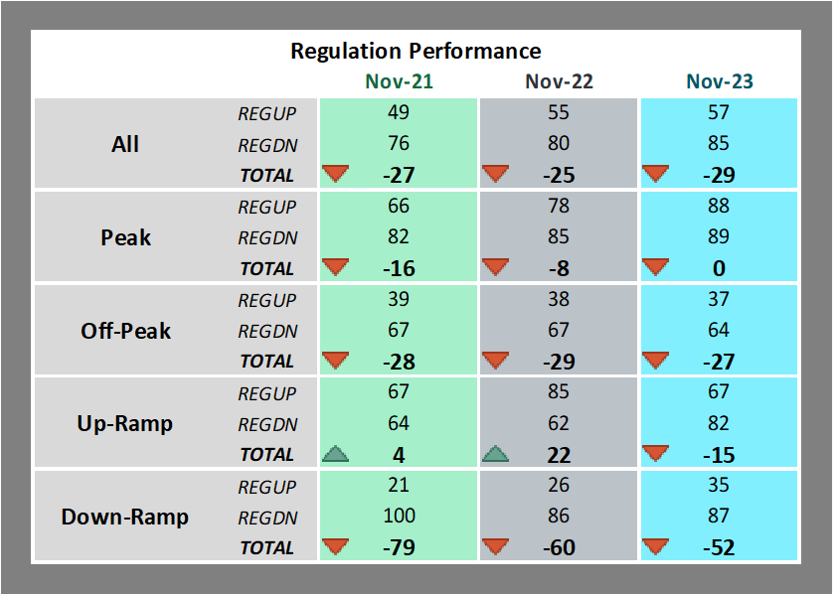
Regulation Deployed Comparison
Notes:
Regulation deployed comparison for November 23 is consistent with last year. We see more bias towards regulation down deployment during all hour

Slide 14
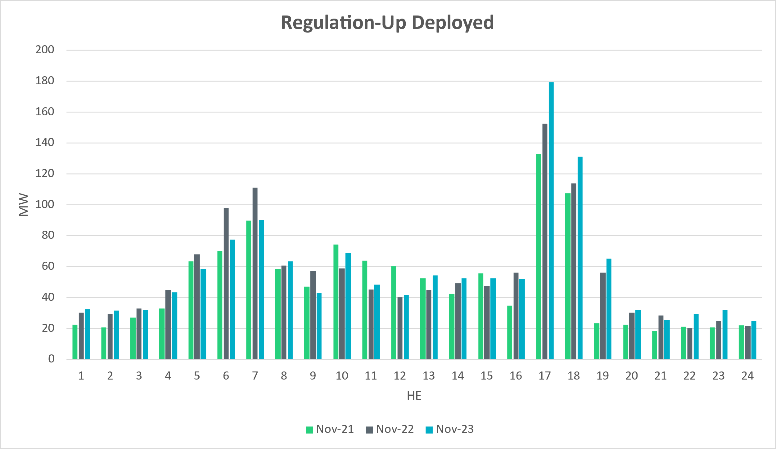
Regulation Deployed Comparison
Notes:
Similar levels of reg up deployment overall.

Slide 15
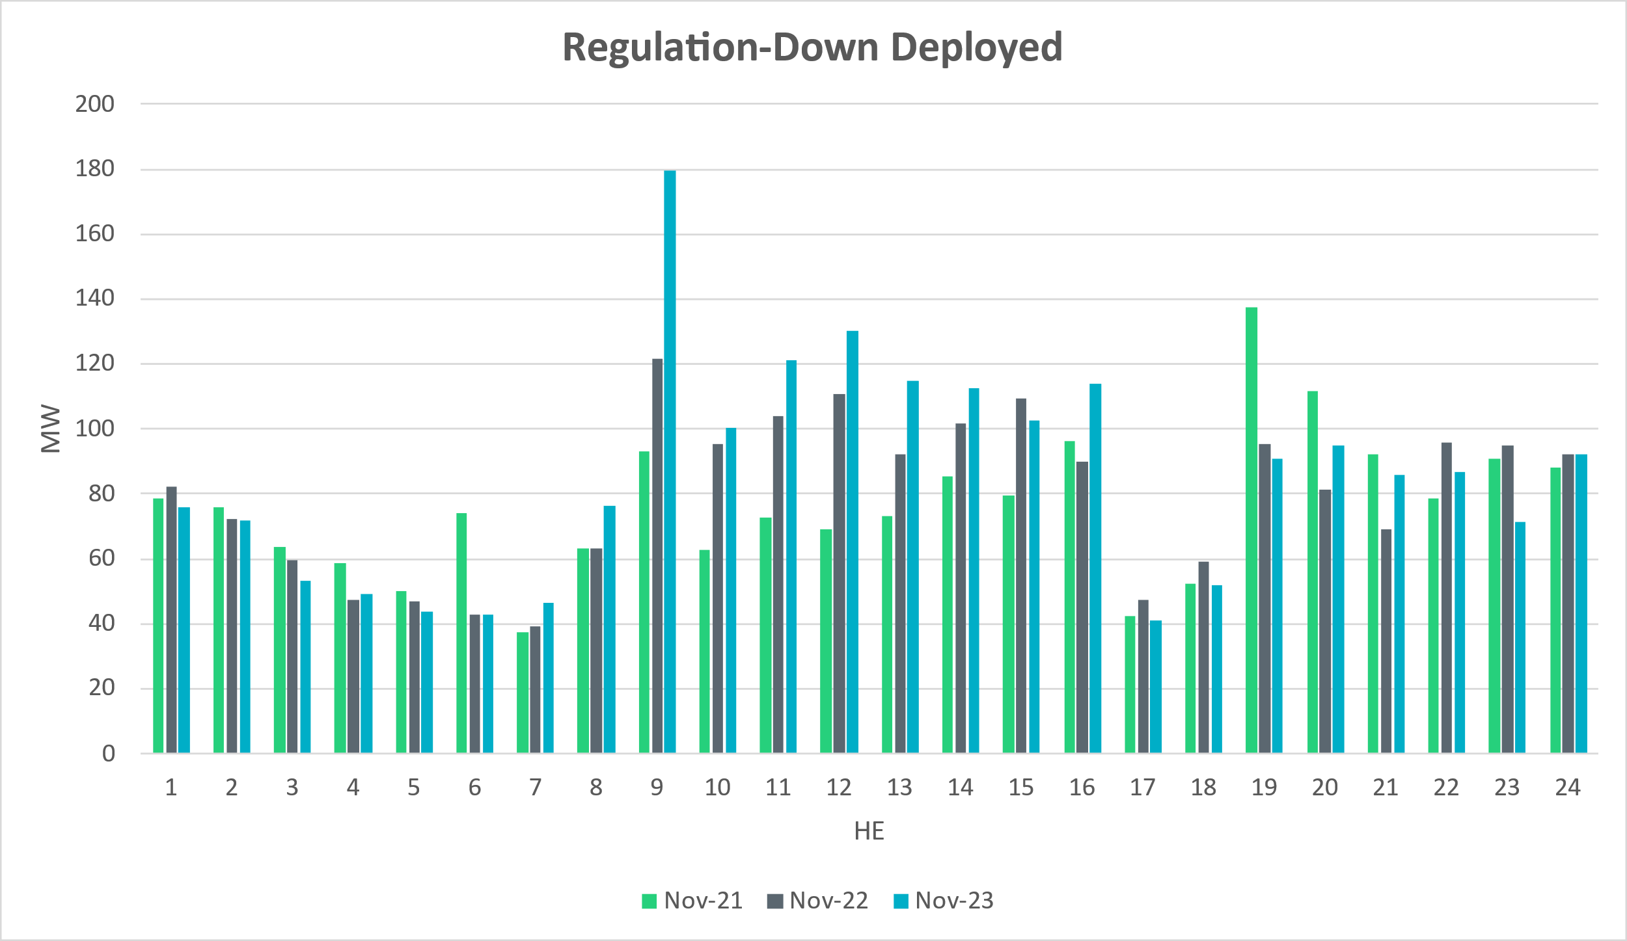
Regulation Deployed Comparison
Notes:
Overall Regulation down deployment in November 23 is consistent with that of the previous two years. Spike in HE9 due to high gen dev

Slide 16
Metric 2: Total Regulation Deployed Comparisons
Set target of 50MW for total regulation deployed by hour for peak hours.

Slide 17
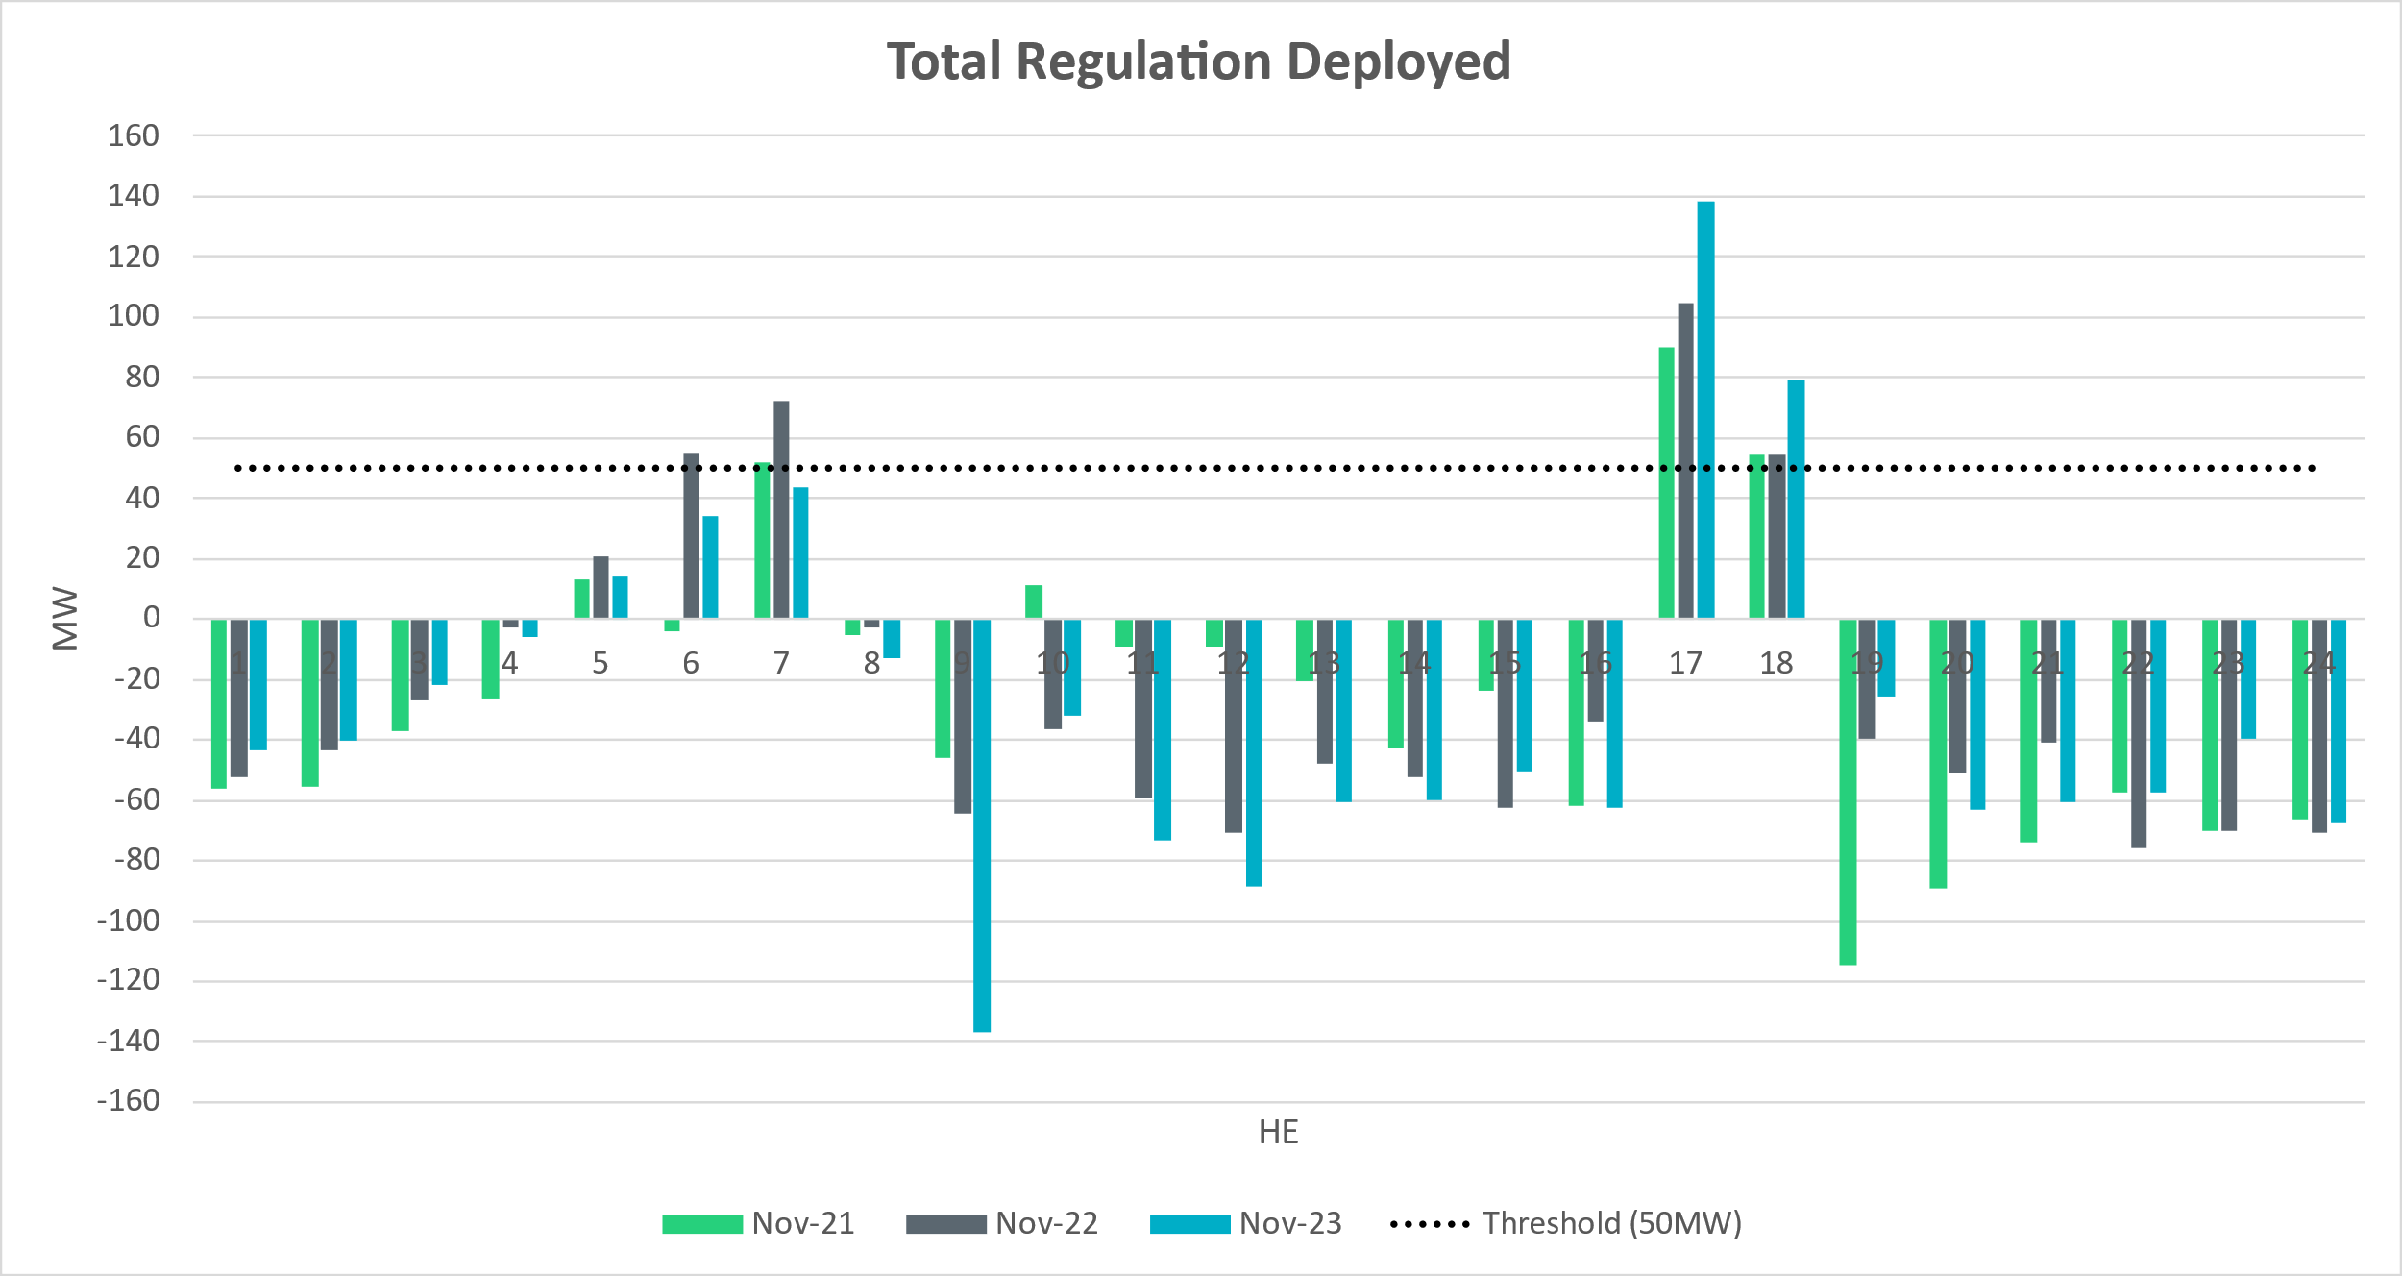
Total Regulation Deployed Comparison
Notes:
Total regulation deployed compared with the previous two years. Overall, trends are very similar. Again, we see more regulation down for HE9 due to high gen dev.

Slide 18
Metric 3: 15-min Intervals Where Both REGUP/REGDN Were Deployed
Set target of 85% for the number of intervals where regulation deployment was both up and down.

Slide 19
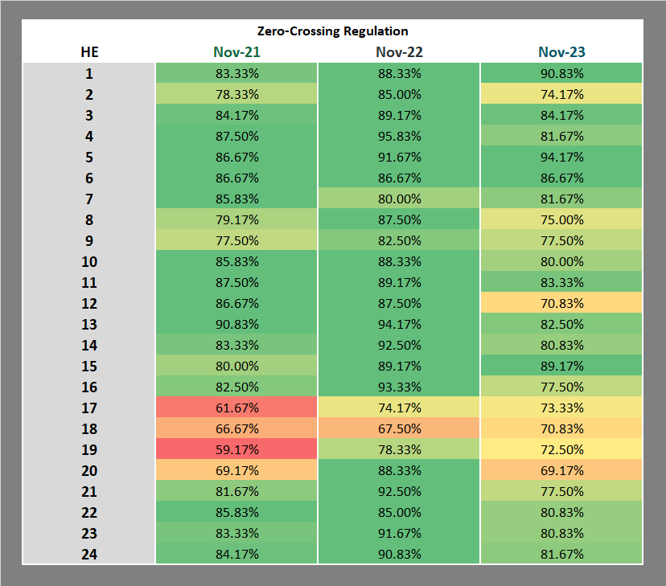
“Zero” Crossing Regulation
Notes:
Zero crossing regulation is lower than last two years. On average the zero crossing regulation is above 70%. The lower zero crossing percentage is seen during the sunset hours where there is bias for regulation up deployment.

Slide 20
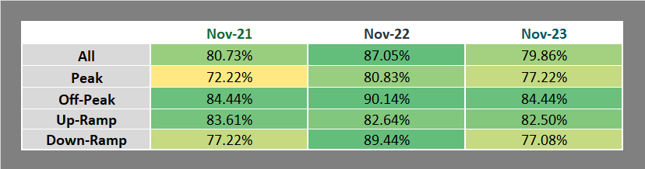
“Zero” Crossing Regulation
Notes:
Overall, we see that it is above 70% for all hours

Slide 21
Metric 4: Regulation Exhaustion Rate
Track the regulation exhaustion rate for all hours (not to exceed 5%.)

Slide 22
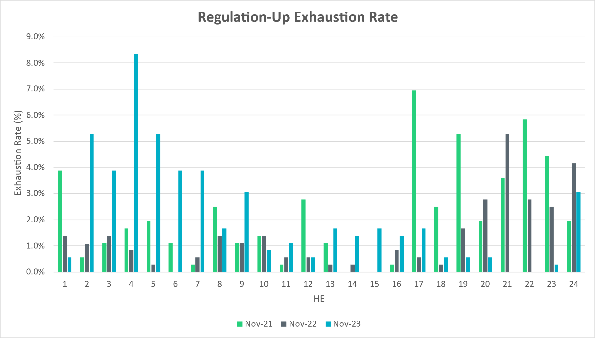
Regulation Exhaustion Rate
Notes:
Average regulation up exhaustion rate for all hours is 2.13% which is higher than previous year.

Slide 23
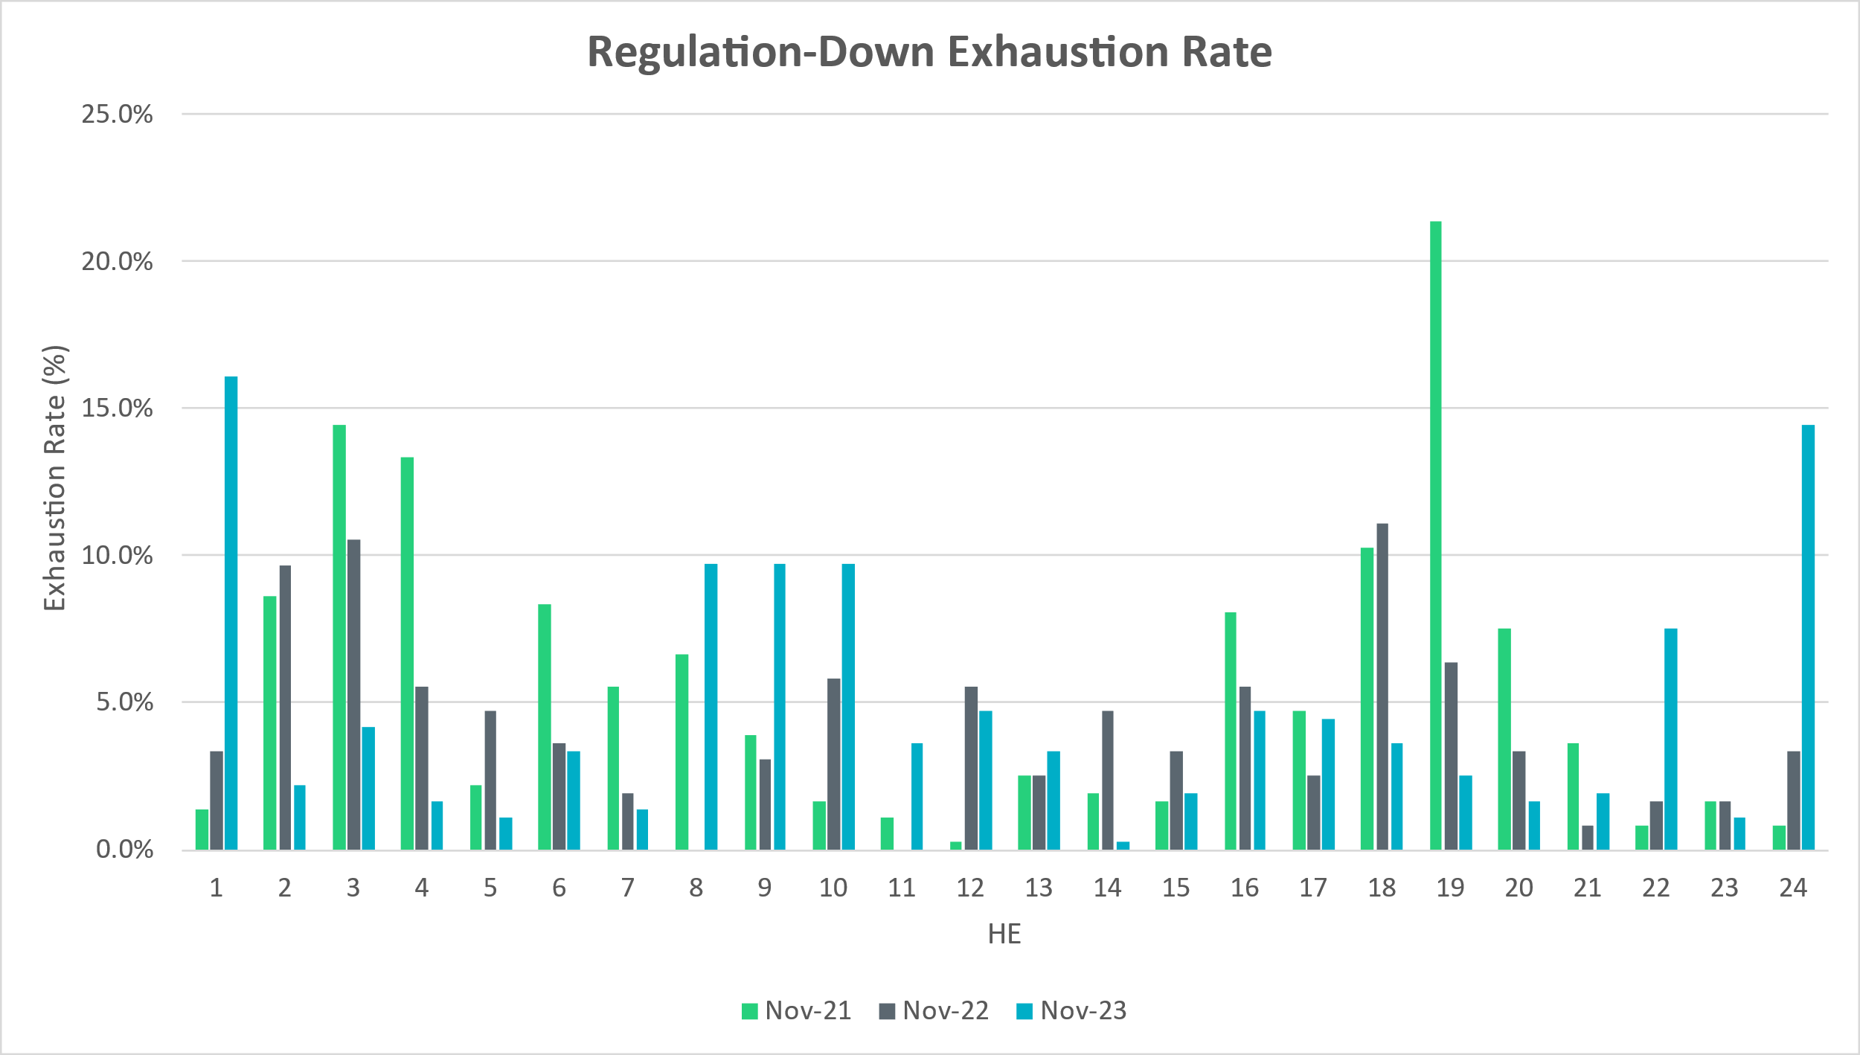
Regulation Exhaustion Rate
Notes:
Average regulation down exhaustion rate for all hours is 4.79%, higher than previous year.

Slide 24
Metric 5: Stats on REGUP Bias for Consecutive 5-min Intervals
Using a 50MW filter, target 15 occurrences or less per month for regulation bias of six or more consecutive 5-minute intervals for peak hours.

Slide 25
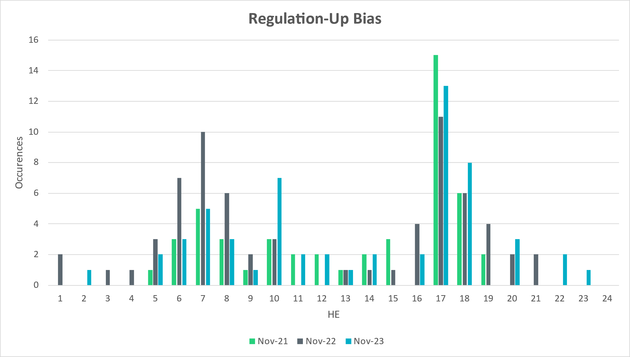
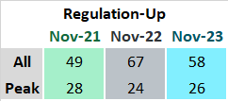
Regulation Bias for Consecutive SCED Intervals
Notes:
Regulation up bias occurrence for consecutive SCED intervals for all hours is 58 and peak hours is 26.

Slide 26
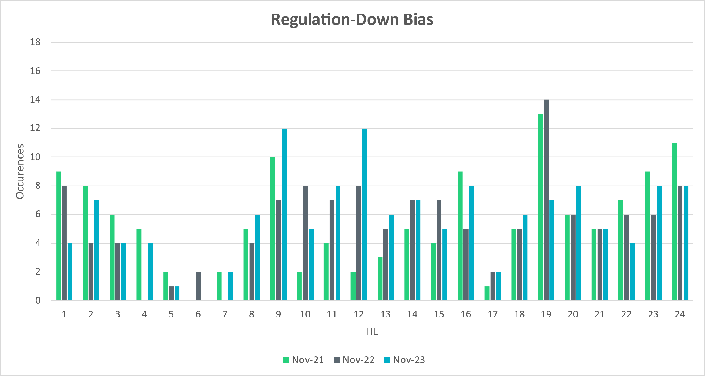
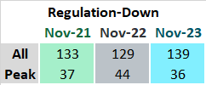
Regulation Bias for Consecutive SCED Intervals
Notes:
Regulation down bias occurrence for consecutive SCED intervals for all hours is 139 and peak hours is 36.

Slide 27
Time Error and Contributing Factors
Accumulated Time Error, Load and Wind Ramp, PWRR Error, Start-Up/Shut-Down Hours, STLF Error, and Expected Generation Deviation.

Slide 28
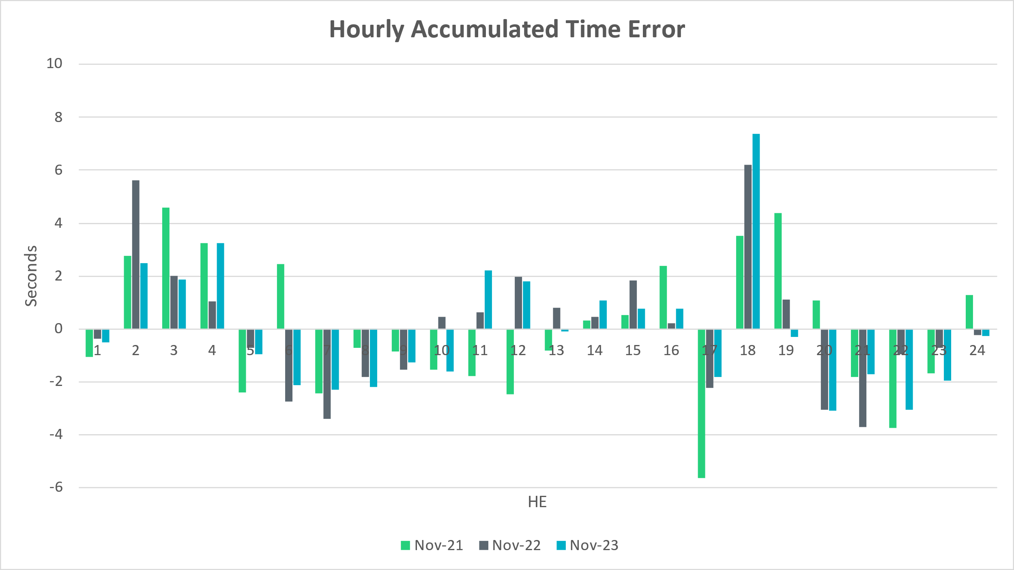
Time Error Accumulation
Notes:
Hourly time error accumulation is generally minimal

Slide 29
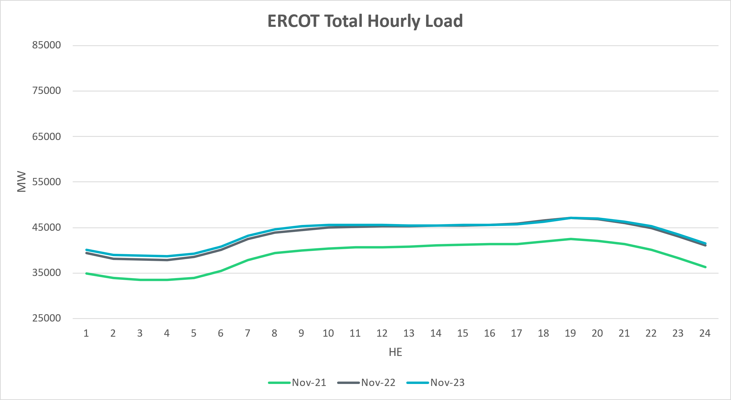
Load Profile
Notes:
The load for November 23 is slightly higher than last year.

Slide 30
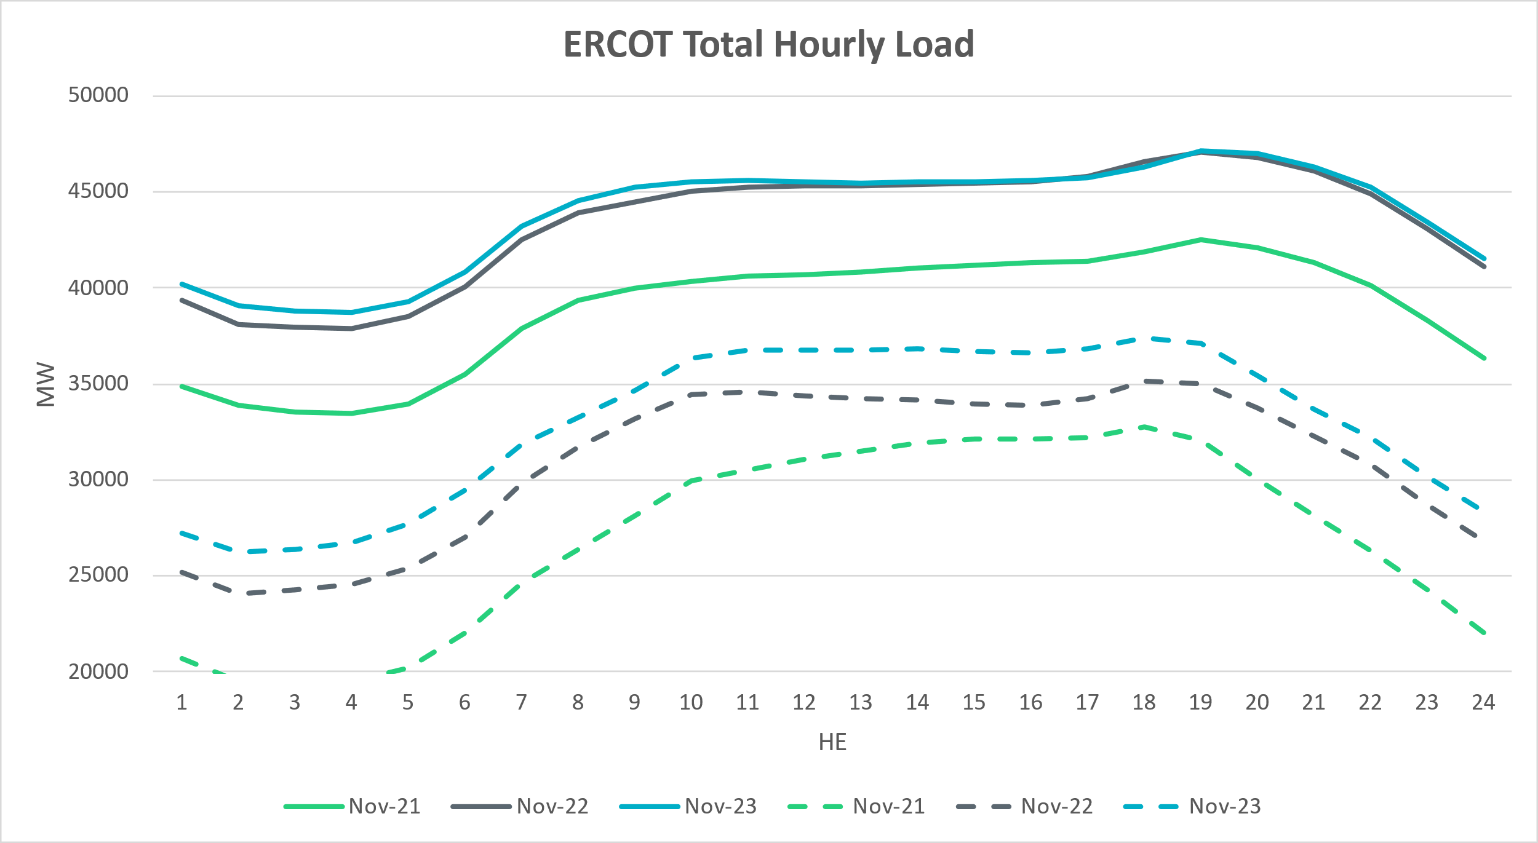
Net Load Profile
Notes:
The net load is higher than last two years.

Slide 31
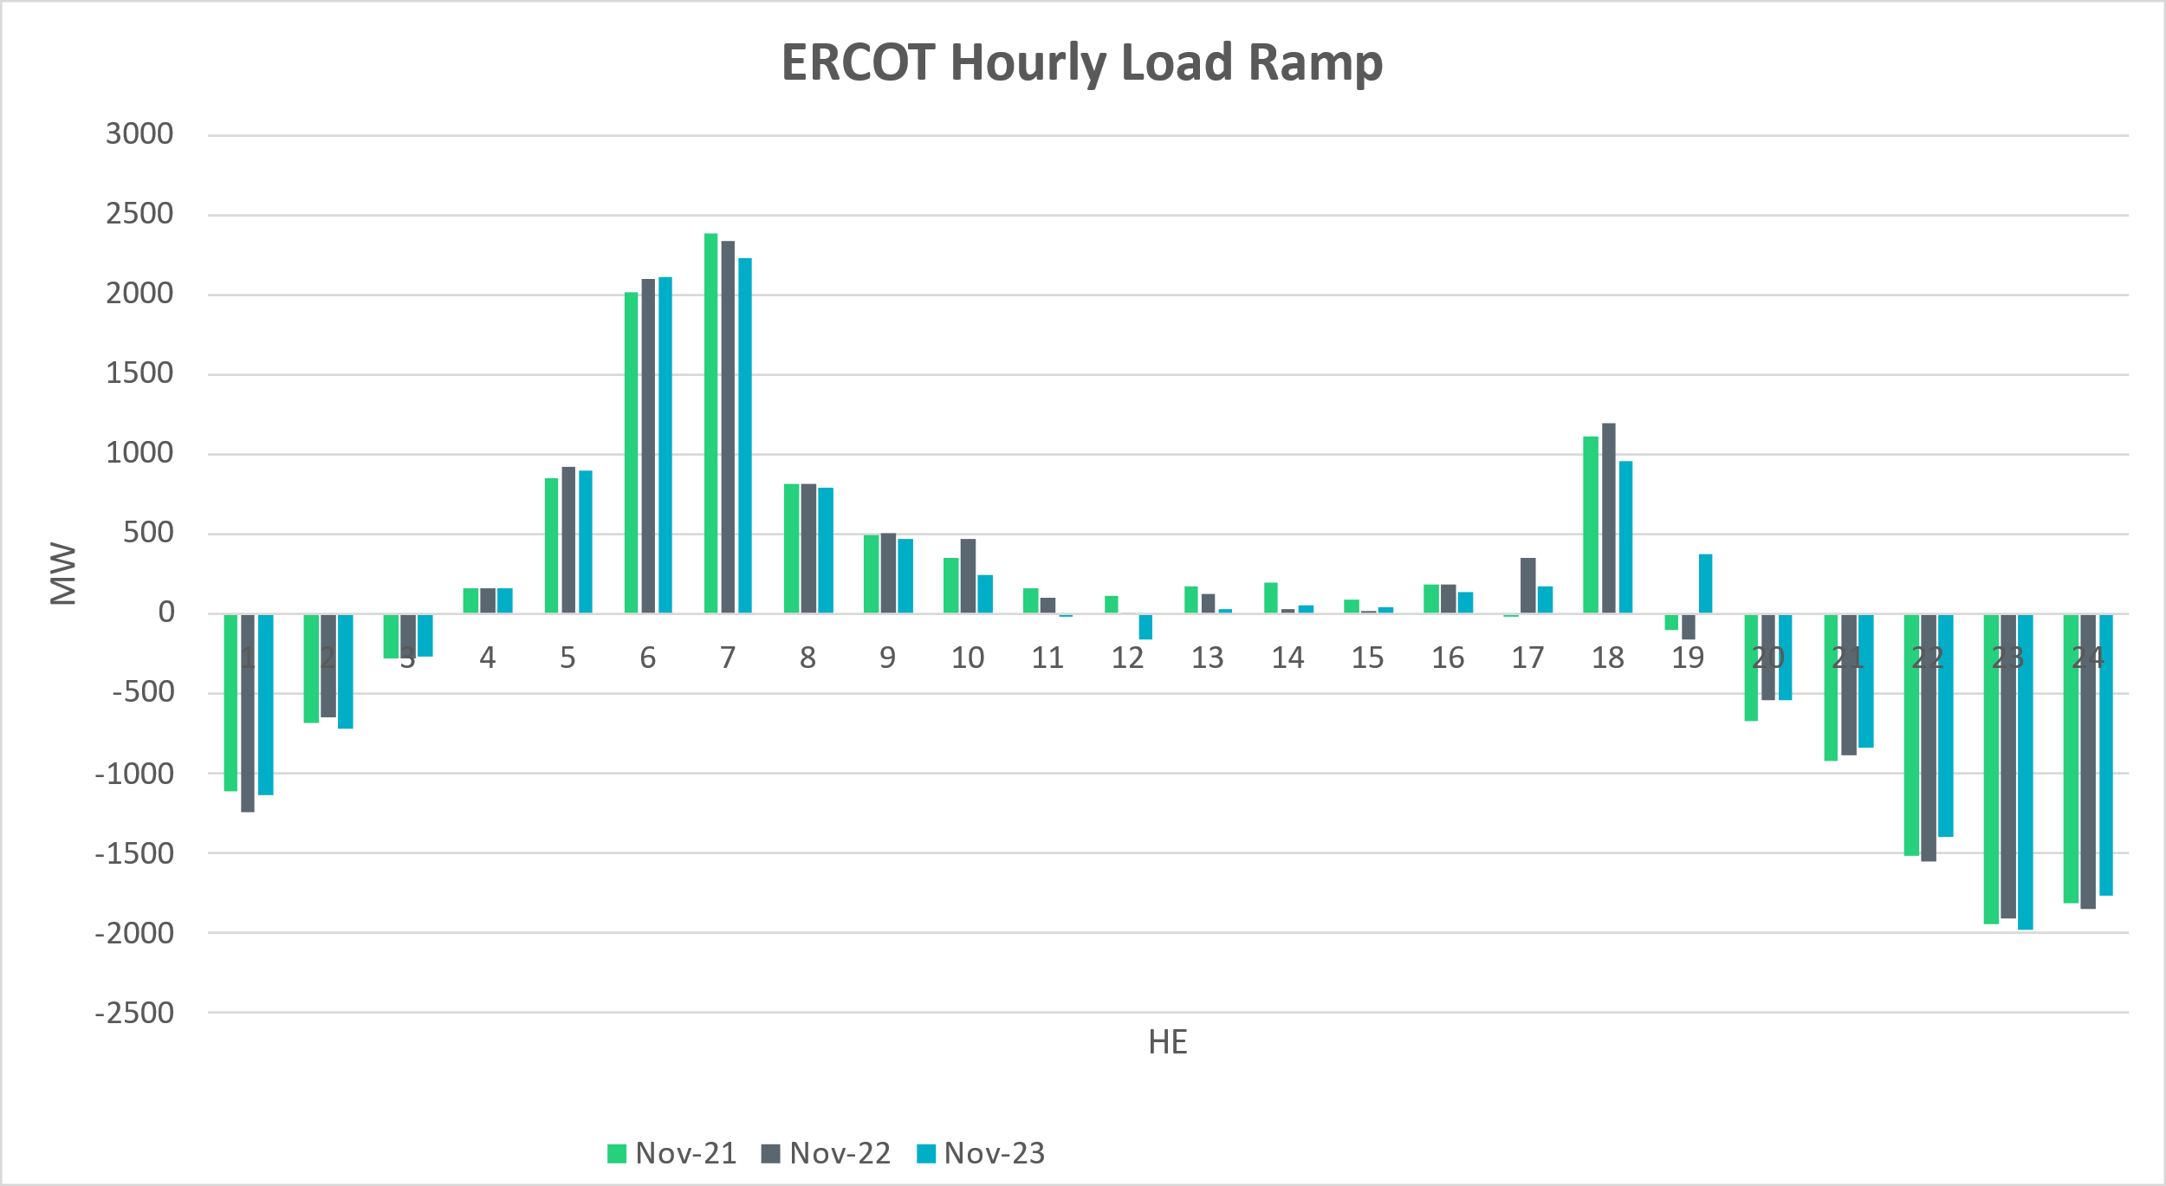
Load Ramp
Notes:
Overall hourly load ramp trend is consistent with last two years.

Slide 32
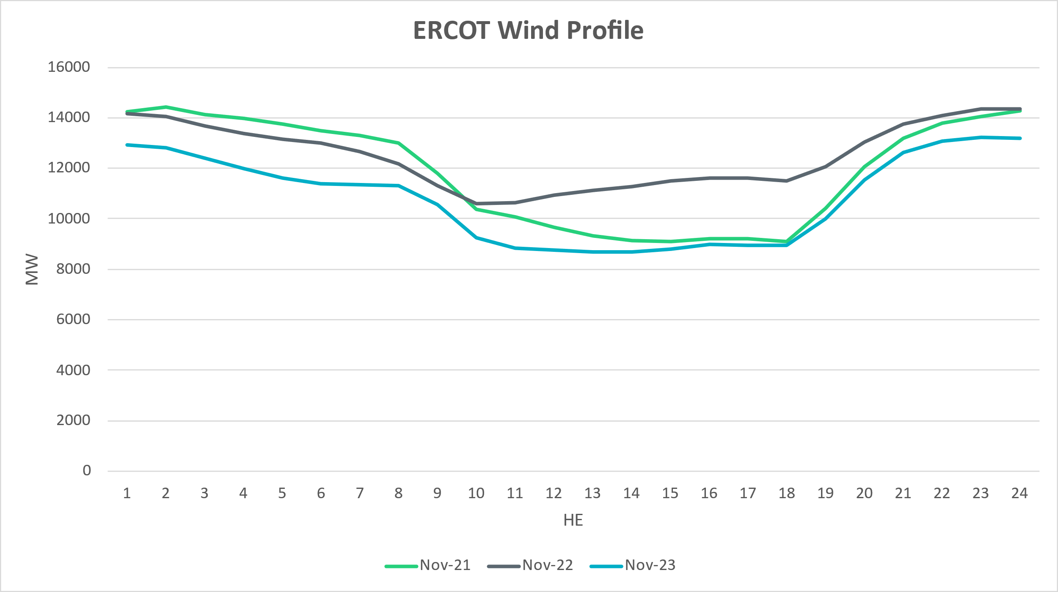
Wind Profile
Notes:
Wind generation is lower compared to last two years

Slide 33
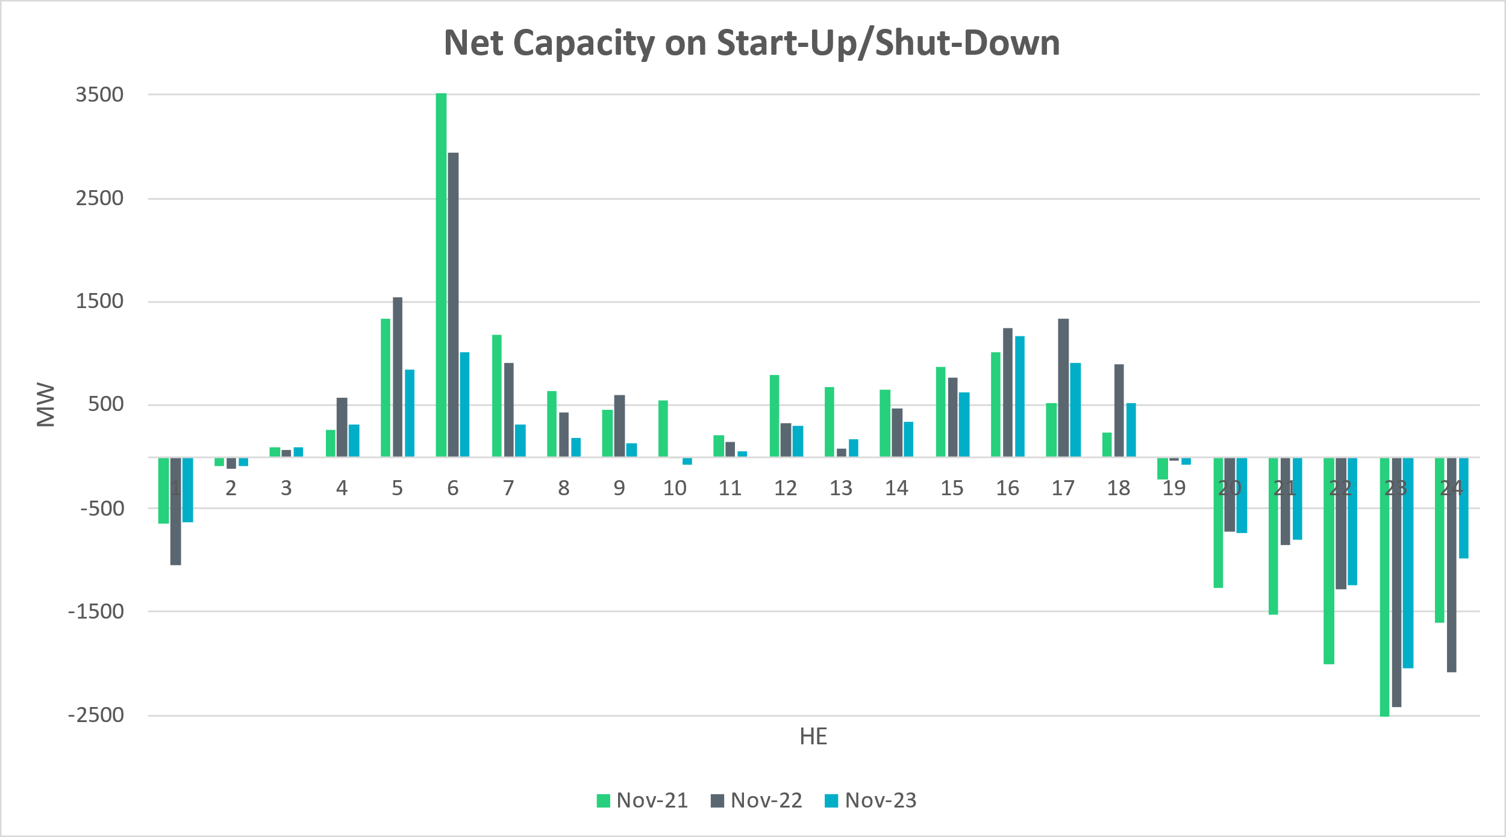
Start-Up & Shut-Down Hours
Notes:
Net capacity on start up and shut down is fairly consistent with the last two years.

Slide 34
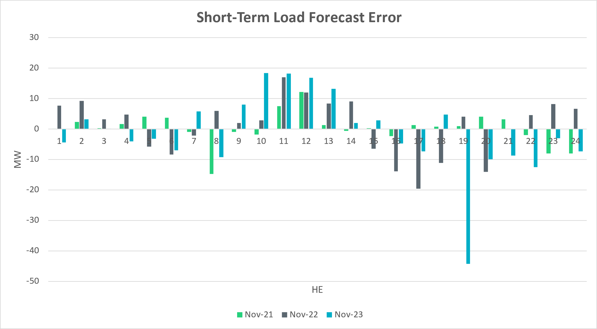
Short-Term Load Forecast Error
Notes:
Forecast – Actual
+ve Error => Over forecasted load
-ve Error +> Under forecasted load
For STLF, we have seen over forecast during peak hours and under forecast during down ramp hours.

Slide 35
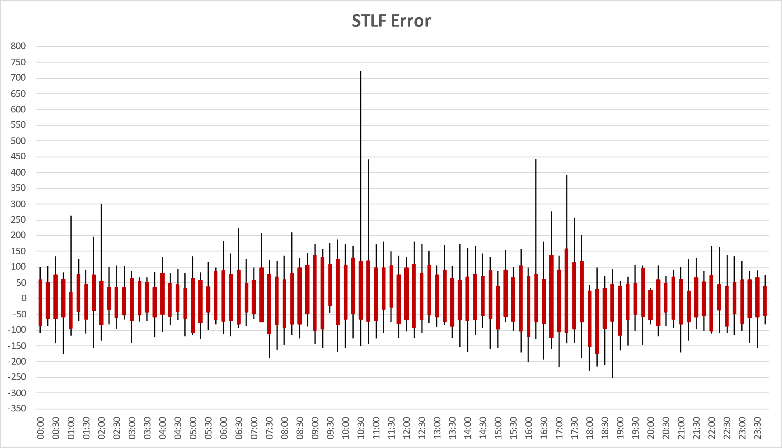
STLF Error Chart
Notes:
Error = Forecast – Actual
Min,Max, 10th, 90th percentile
15 minute intervals
Max Positive Forecast Error:
11/2/2023 10:30 -> 721.797 MW
Max Negative Forecast Error:
11/1/2023 18:45 -> -251.358 MW

Slide 36
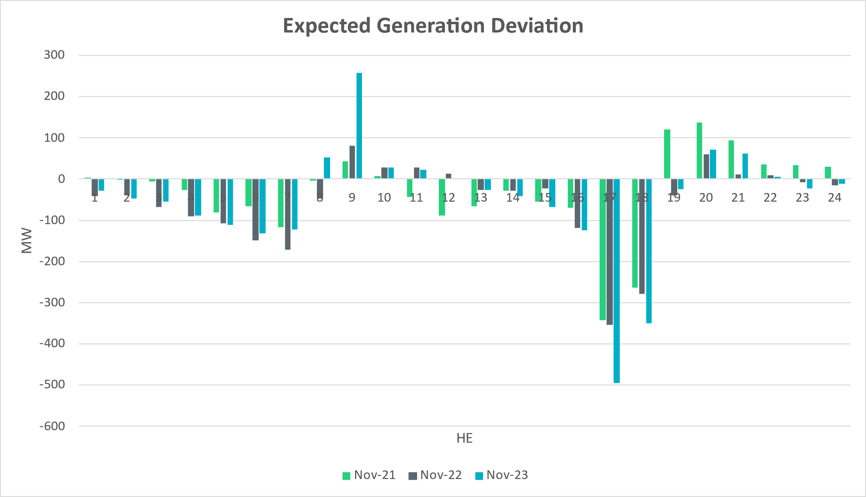

Expected Generation Deviation
Notes:
There was a spike in expected gen dev for HE 9.

Slide 37
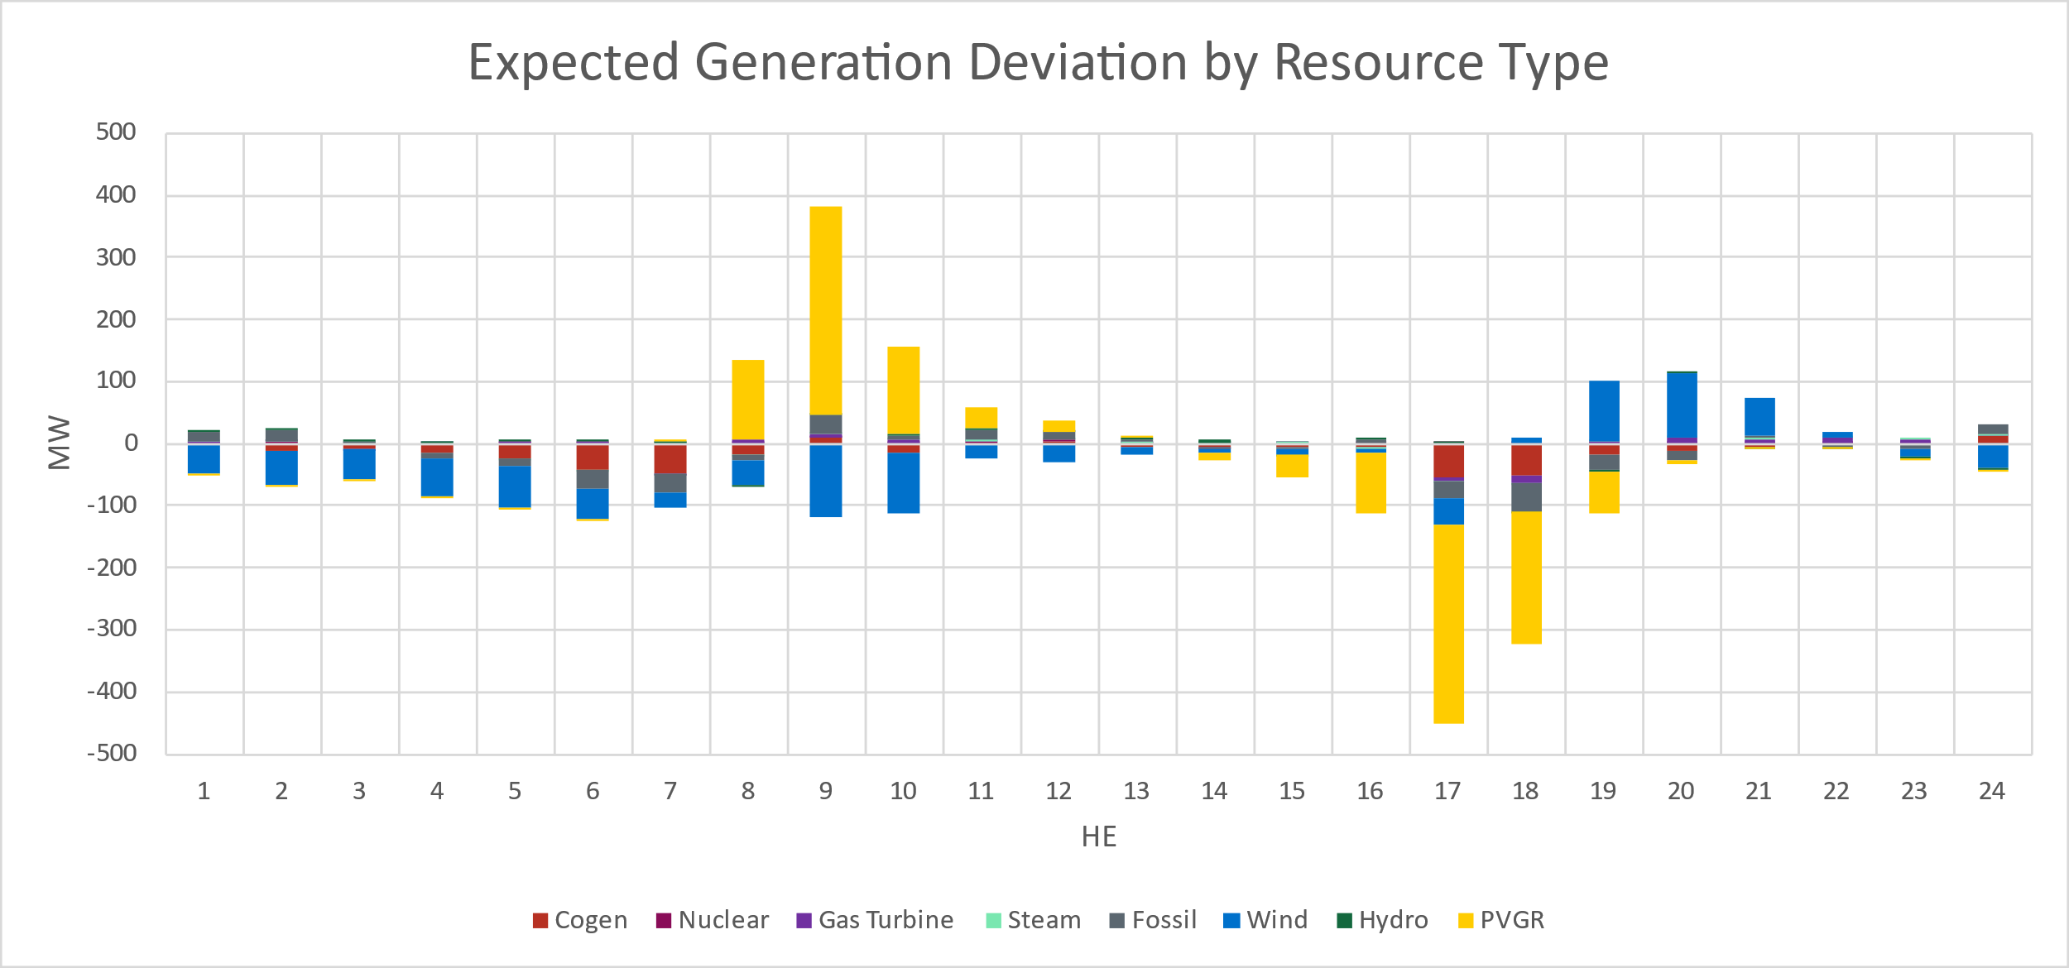
Expected Generation Deviation
Notes:
Breakdown by resource type and we see significant contribution from wind and solar during the ramping hours

Slide 38
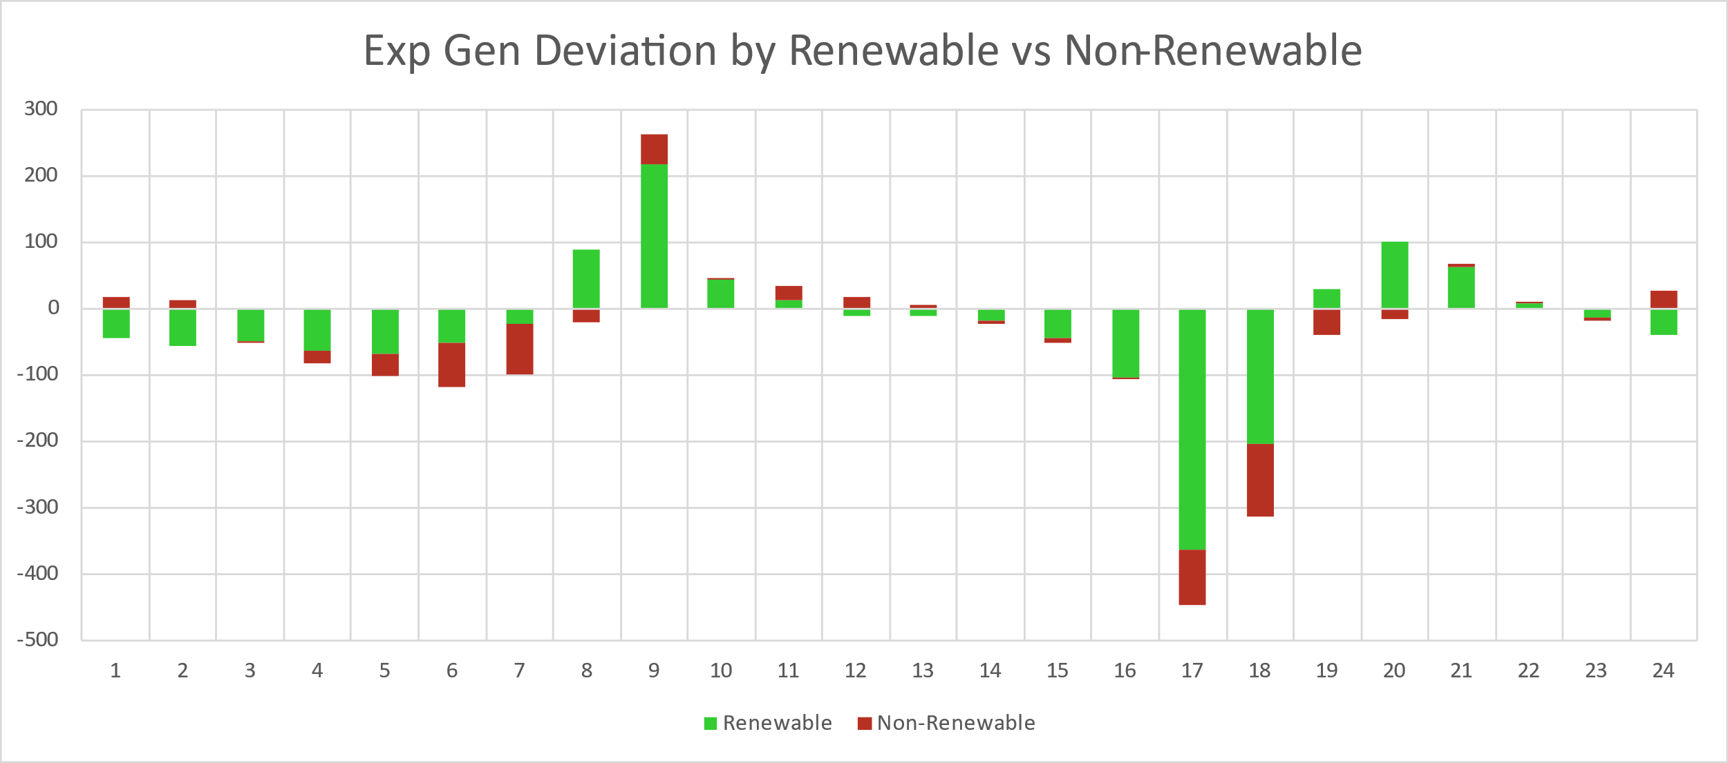
Expected Generation Deviation
Notes:
Comparing renewables vs non-renewables. IRR resources are the main contributor for most part of the day.

Slide 39
Questions?
Thank you!

