Slide 1
ERCOT Frequency Events
November 2023
ERCOT
Operations Planning
PDCWG |Dec 20th, 2023

Slide 2
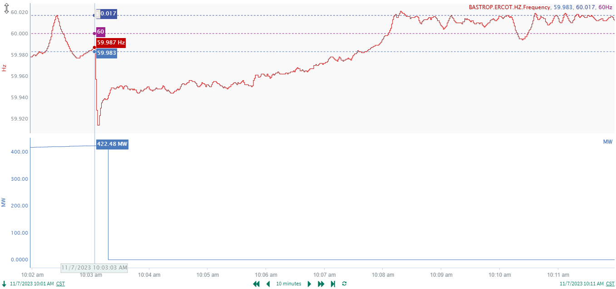
11/7/2023 10:03:04(Non-FME)
Notes:
The unit tripped offline while carrying approximately 422 MW
Starting Frequency: 59.987 Hz
Minimum Frequency: 59.914 Hz
A-C Time : 4 seconds
Recovery Time(back to deadband): 4 minutes 31 seconds
ECRS Released: 0 MW
Trip Reason: Unknown
Contextual Information: A total of 315 MW of regulation Up was deployed and manual offset of 250 MW was applied during the event.
Reason for no selection : MW loss is small

Slide 3
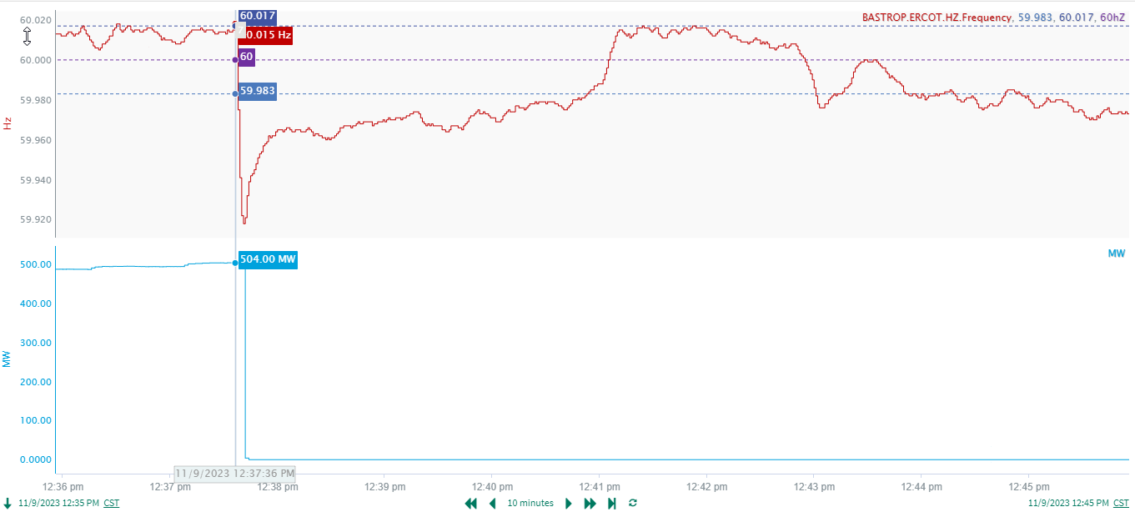
11/9/2023 12:37:36(FME)
Notes:
Unit tripped offline while carrying approximately 504 MW
Starting Frequency: 60.015 Hz
Minimum Frequency: 59.918 Hz
A-C Time : 5 seconds
Recovery Time(back to deadband): 3 minutes 17 seconds
ECRS Released: 0 MW
Trip Reason: Boiler control issue
Contextual Information: A total of 290 MW of regulation Up was deployed during the event.

Slide 4
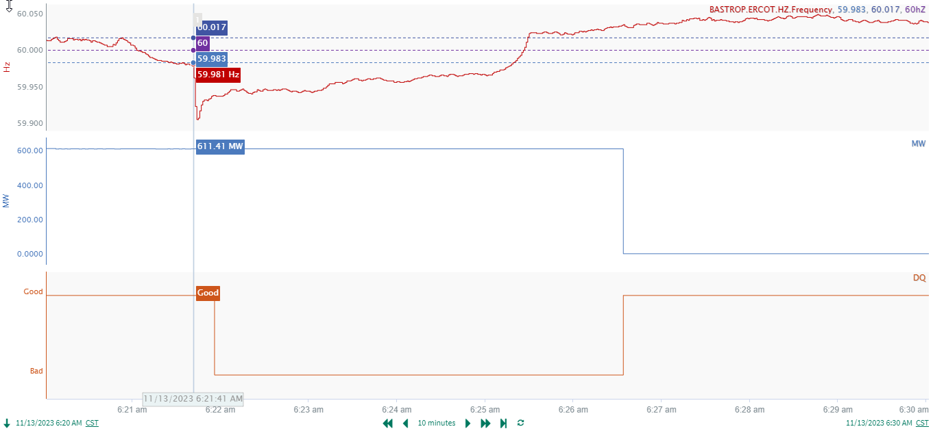
11/13/2023 6:21:41 (Non-FME)
Notes:
A unit tripped offline while carrying approximately 611 MW
Starting Frequency: 59.981 Hz
Minimum Frequency: 59.905 Hz
A-C Time : 4 seconds
Recovery Time(back to deadband): 3 minutes 38 seconds
ECRS Released: 148.66 MW
Trip Reason: Unknown.
Contextual Information: A total of 414 MW of regulation Up was deployed and 200 MW of SCED offset was applied during the event.
Reason for no selection : Starting frequency was outside the low deadband

Slide 5
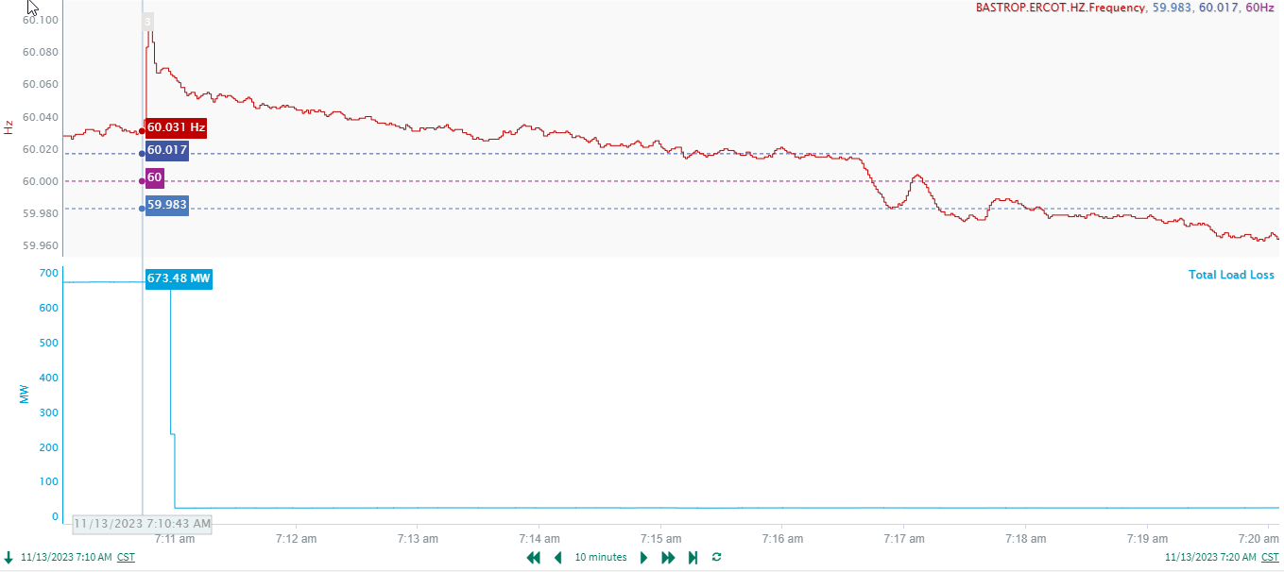
11/13/23 7:10:44(Non-FME)
Notes:
Load loss of approximately 649 MW
Starting Frequency: 60.031 Hz
Minimum Frequency: 60.103 Hz
A-C Time : 3 seconds
Recovery Time(back to deadband): 4 minutes 28 seconds
ECRS Released: 0 MW
Trip Reason: Unknown
Contextual Information: A total of 430 MW of Regulation Down was deployed during this event.
Reason for no selection : Starting frequency was outside the high deadband
Wind was ramping up during frequency recovery

Slide 6
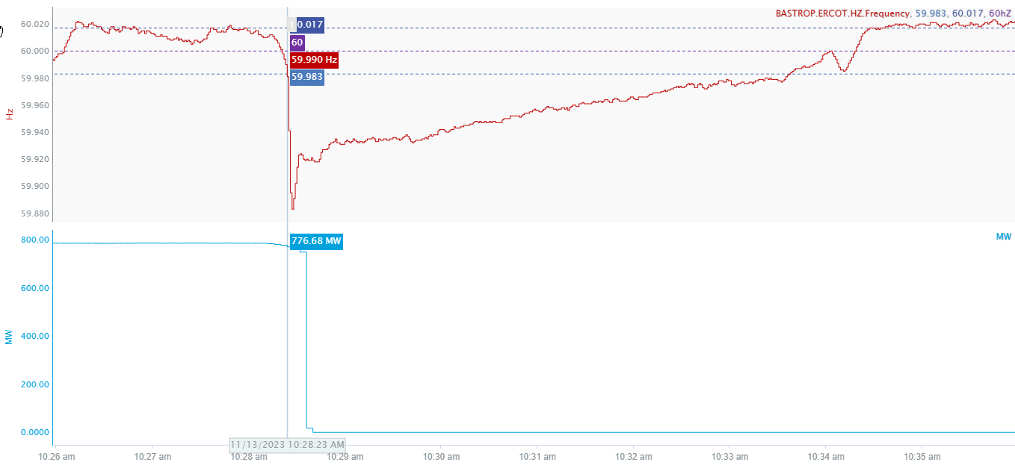
11/13/2023 10:28:23 (Non-FME)
Notes:
The unit experienced a runback and tripped offline while carrying 748 MW
Starting Frequency: 59.990 Hz
Minimum Frequency: 59.883 Hz
A-C Time : 4 seconds
Recovery Time(back to deadband): 5 minutes 9 seconds
ECRS Released: 546 MW
Trip Reason: Unknown.
Contextual Information: A total of 322 MW of regulation Up was deployed and 150 MW of SCED offset was applied during the event.
Reason for no selection : The unit trip is not clean, experienced run back

Slide 7
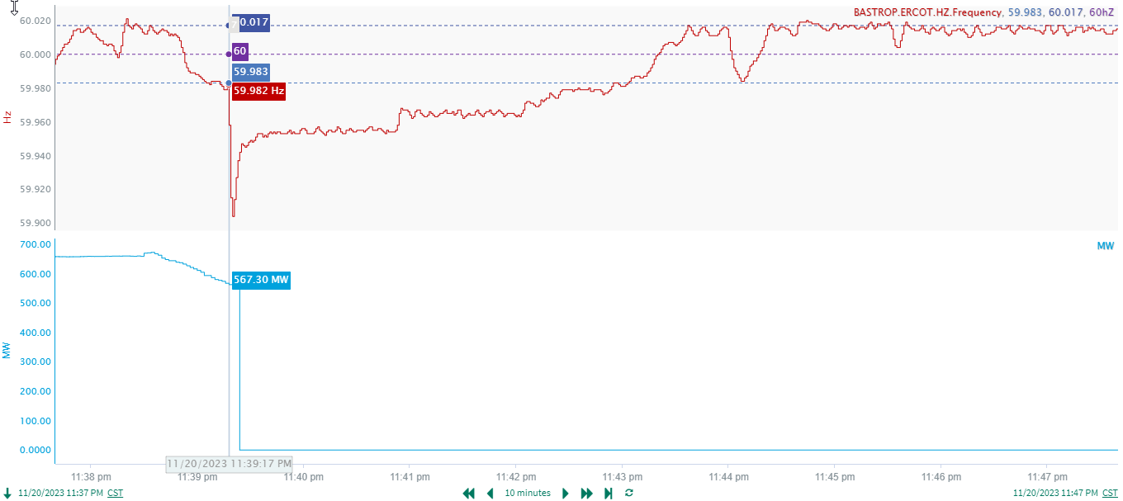
11/20/2023 23:39:17 (Non-FME)
Notes:
The unit experienced a runback and tripped offline while carrying 554 MW
Starting Frequency: 59.82 Hz
Minimum Frequency: 59.904 Hz
A-C Time : 3 seconds
Recovery Time(back to deadband): 3 minutes 47 seconds
ECRS Released: 0 MW
Trip Reason: Unknown.
Contextual Information: A total of 94 MW of regulation Up was deployed during the event.
Reason for no selection : The unit experienced a runback and starting frequency is outside the low deadband.

Slide 8
Questions?
Thank you!

