Slide 1
September 6th PRC Analysis
PDCWG
Operations Analysis and Ancillary Services
12/20/2023

Slide 2
Introduction
Following EEA2 operations on September 6th, the Operations Analysis and Ancillary Services team conducted analysis to identify Generation Resources and Energy Storage Resource operations that differed from ERCOT expectations and issued RFIs to gain better understanding of the underlying challenges that the resources were experiencing. This analysis primarily focused on 7:25pm when frequency reached its minimum.
ERCOT sent RFIs to 30 QSEs representing 83 resources. The selected resources met one or more of the following criteria
Output differed from expected output by 3% of telemetered HSL or
Had a non-zero PRC i.e., frequency responsive headroom but inadequate/suspect PFR response during the lowest frequency timeframe (including curtailed wind) or
Were carrying FFR.
The following slides will present findings and expectations of generation operations.

Slide 3
Physical Responsive Capability (PRC) on September 6 at 7:25pm
PRC totaled 2,594 MW when frequency reached a minimum of 59.77 Hz at 7:25pm on September 6th.
Note that Other PRC includes Hydro, Thermal, and Combined Cycle Resources

Slide 4
Summary of 83 RFI Responses
Incorrect HSL due to HSL Estimation Errors: (30 resources)
30 Thermal and Combined Cycle resources.
Improper Equipment (Controller) Settings: (29 resources)
18 curtailed Wind resources did not provide PFR or pause curtailment in line with UDBP.
11 FFR resources triggered before 59.85 Hz or deployed less than their responsibility.
Incorrect HSL due to Equipment Unavailability: (6 resources)
4 ESRs experienced inverter derates/faults but did not update HSL.
2 ESRs depleted SOC but did not update HSL.
Resources Experiencing Equipment Failure: (4 resources)
3 Thermal resources with mechanical issues. Of these, 1 resource switched to ONHOLD status.
1 ESR with SCADA errors at their site.
Incorrect PRC due to Suspect HRL in RARF: (4 resources)
LFC flagged 4 ESRs telemetry when it exceeded the corresponding reasonability limit set by HRL.
Unknown (4 resources)
Wind resources that did not provide PFR. Cause unknown due to a communication disruption at the QSEs data center.
6 resources were able to demonstrate acceptable performance and are not categorized.

Slide 5
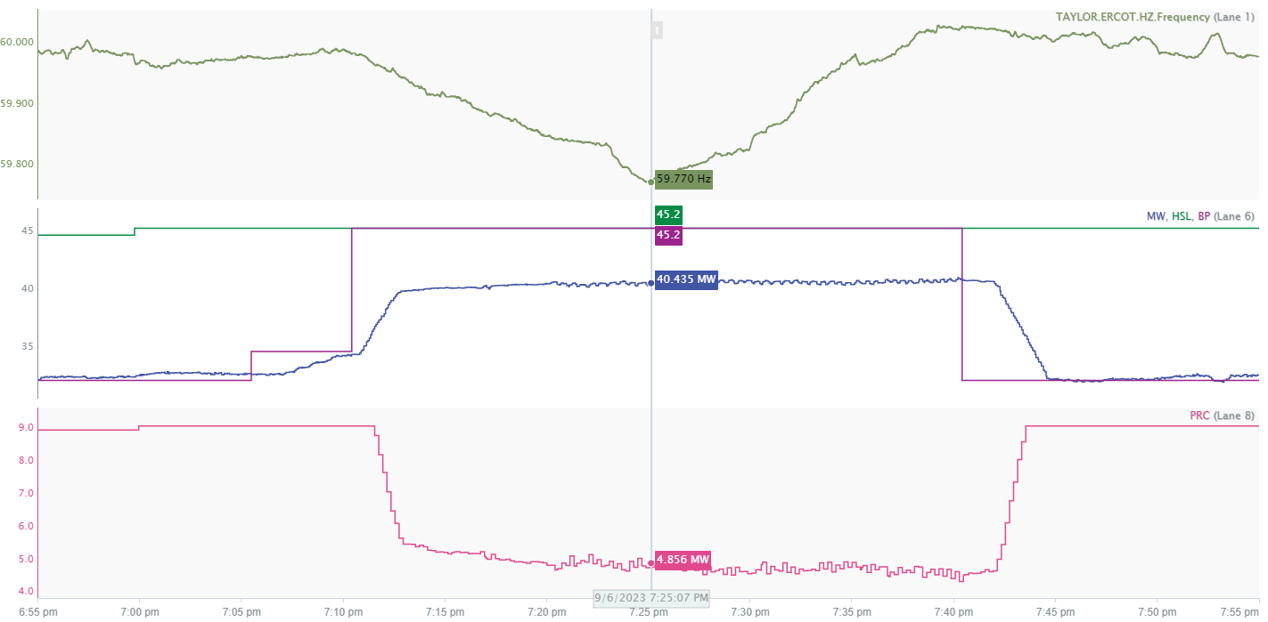
Incorrect HSL due to HSL Estimation
Issue:
During EEA operations, ERCOT observed some thermal and combined cycle resources generating below their basepoints when dispatched up to their HSL.
HSL telemetry is critical for ERCOT dispatch and estimating available headroom.
Separation between MW and HSL leads to inaccurate PRC calculation
Key Takeaway: The resource was already generating at its maximum capability. Telemetered HSL was erroneous, but within the bounds of margins established in Protocols.
5

Slide 6
Incorrect HSL due to HSL Estimation
Expectation:
ERCOT recognizes that there are compliance rules for HSL. Knowing this, ERCOT recommends QSEs develop mechanisms to determine if there are any further changes that can be made to improve the accuracy of telemetered HSL beyond the threshold specified.
Reference:
Nodal Protocol Section 3.1.4.7, Reporting of Forced Derates, Paragraph (4) states “The QSE must appropriately update the telemetered High Sustained Limit (HSL) and any applicable telemetry as specified in paragraph (2) of Section 6.5.5.2, Operational Data Requirements, based on the Forced Derate, as soon as practicable but no longer than 15 minutes after the beginning of a Forced Derate, if the Forced Derate is greater than ten MW and more than 5% of the Seasonal net maximum sustainable rating of the Resource and its expected or actual duration is greater than 30 minutes. Alternatively for a Forced Derate, a QSE may use the ONHOLD process described in paragraph (2) of Section 6.5.5.1, Changes in Resource Status.”
6

Slide 7
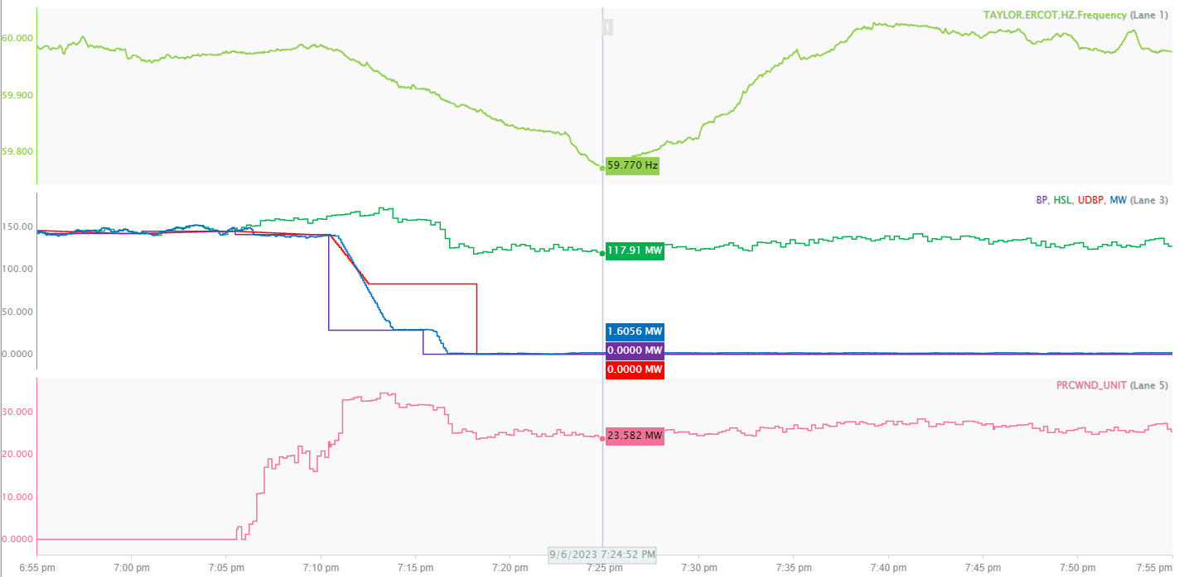
Improper Controller Settings
Issues: Wind resources with one or more of the following improper controller settings.
Curtailed wind resources did not temporarily suspend ramping when ramping directionally opposite to ACE.
Telemetered HSL reduced when curtailed.
PFR not provided when curtailed.
No ramping pause
PFR not provided
Key Takeaway: Improper controller settings impacted frequency response from 18 Wind resources.
7

Slide 8
Improper Controller Settings
Expectation:
Wind resources should follow UDBP like logic, pausing ramping when negatively impacting frequency.
IRR resource HSL should represent real time power potential when curtailed.
PFR should always be enabled and provided in response to changes in system frequency, independent of UDBP ramping pause.
Reference:
Nodal Protocols Section 8.5 Primary Frequency Response Requirements and Monitoring
Nodal Protocols Section 6.5.7.6.1 LFC Process Description Paragraph (9)
Business Practice Manual – ERCOT and QSE Operations Practice During the Operating Hour Section 3.10
8

Slide 9
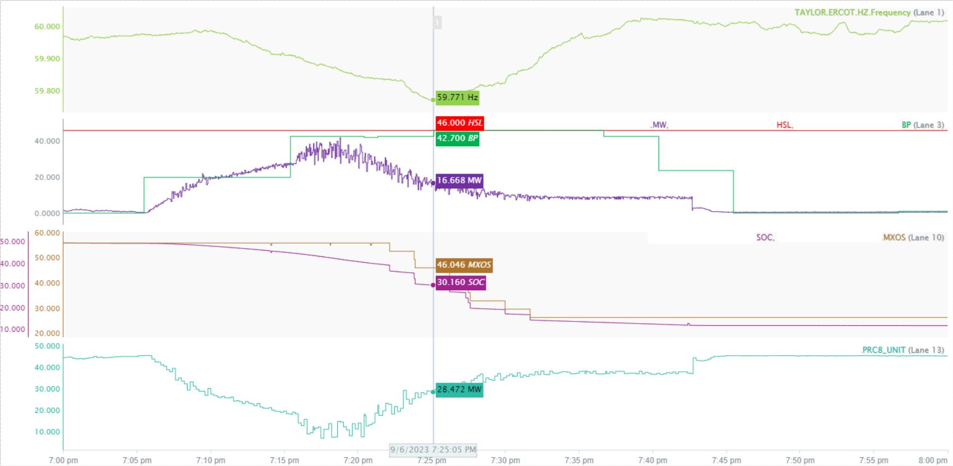
Incorrect HSL Due to Equipment Unavailability
Issue:
ESRs telemetering static HSLs that may not represent real time dispatchable capability
MW output reduced due to inverter faults/derates.
Large PRC calculated due to static HSL
Key Takeaway: This ESR was generating at its maximum capability, Telemetered HSL did not correctly account for faults/derates and should have been updated.

Slide 10
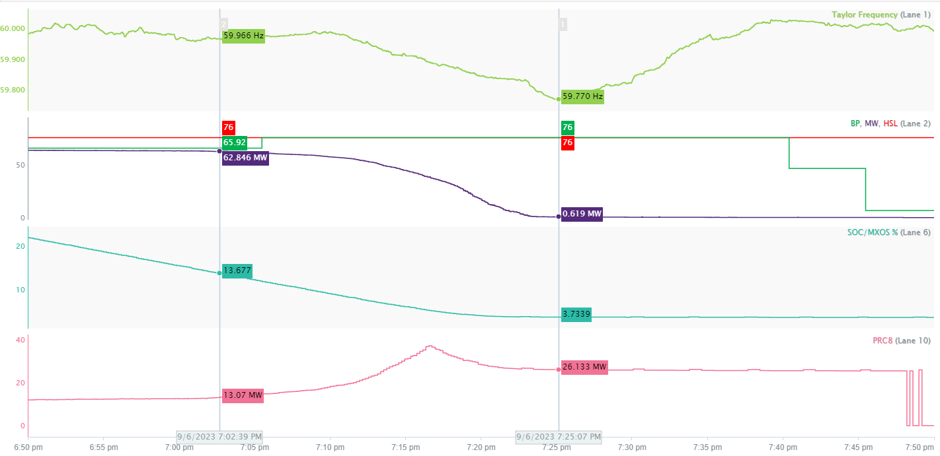
Incorrect HSL Due to Diminishing SOC
Issue:
ESRs telemetering static HSLs that may not represent real time dispatchable capability.
MW output reduces when SOC falls below 13%
Resource cannot meet HSL or BP due to low SOC
Large PRC calculated due to static HSL
Key Takeaway: This ESR was operating at maximum capability. Incorrect telemetered HSL resulted in inaccurate PRC accounting for this resource.
10

Slide 11
Incorrect HSL Due to Equipment Unavailability
Expectation:
ESRs should use a dynamic calculation to determine telemetered dispatchable HSL to improve ERCOT dispatch and PRC accounting.
Telemetered HSL should consider:
State of Charge
Available SOC, considering MXOS/MNOS and any nonlinearities when fully charged or nearing depletion.
Equipment availability
Availability of all equipment (inverters, battery cells/strings, etc.)
Ensure procedures include conducting regularly scheduled maintenance for equipment.
Reference:
Nodal Protocols Section 3.8.5 Energy Storage Resources
Business Practice Manual – ERCOT and QSE Operations Practice During the Operating Hour Section 3.13
11

Slide 12
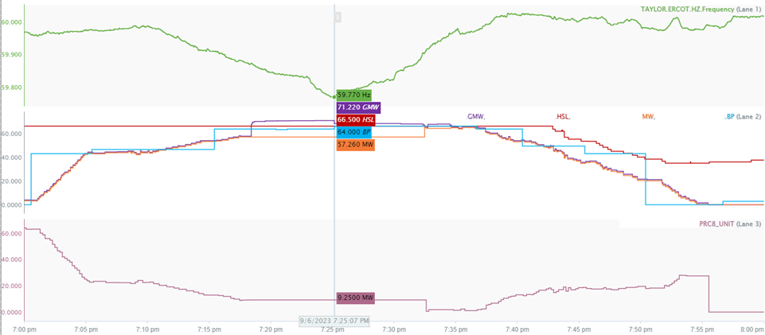
Incorrect PRC due to Suspect HRL in RIOO/RARF
Issue:
ESRs telemetering a net MW output greater than their High Reasonability Limit (HRL) modeled in RIOO/RARF. ERCOT systems use HRL to validate telemetry to prevent EMS from consuming erroneous data, flagging telemetered generation values as suspect if the resource output exceeds the modeled HRL, leading to inaccurate PRC accounting.
LFC flagged as suspect, retains last good value of 57.26 MW
PRC calculated although resource had no headroom
Key Takeaway: This resource was operating at maximum capability. Incorrect PRC accounting was due to incorrect reasonability limits.
12

Slide 13
Incorrect PRC due to Suspect HRL in RIOO/RARF
Expectation:
High Reasonability Limits should reflect true maximum capability of resources.
This update can be made via RIOO.
Reference:
ERCOT Resource Registration Glossary
13

Slide 14
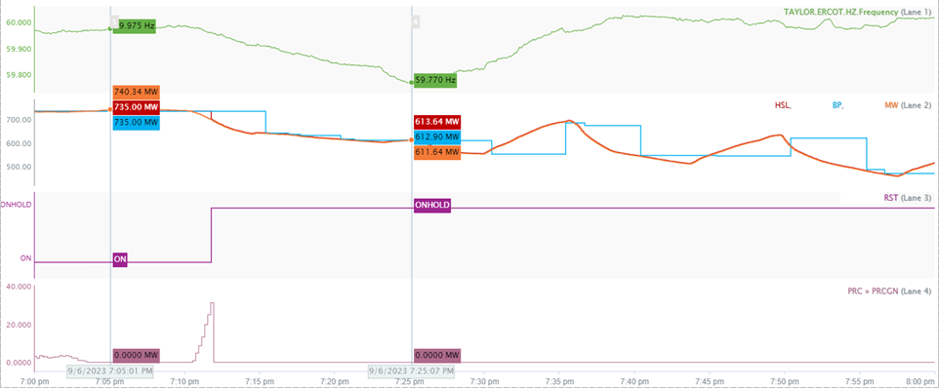
Resources Experiencing Equipment Failure
Issue:
Some resources experienced operational issues leading up to or during the event and did not enter ONHOLD status, leading to inaccurate PRC accounting.
PRC = 0 when resource enters ONHOLD status.
Key Takeaway: This resource experienced an equipment failure but used ONHOLD status correctly to improve dispatch and PRC accounting.

Slide 15
Resources Experiencing Equipment Failure
Expectation:
Resources should use the ONHOLD resource status when experiencing operational issues to help improve ERCOT dispatch and PRC accounting.
Reference:
Nodal Protocols Section 6.5.5.1 Changes in Resource Status Paragraph (2)

Slide 16
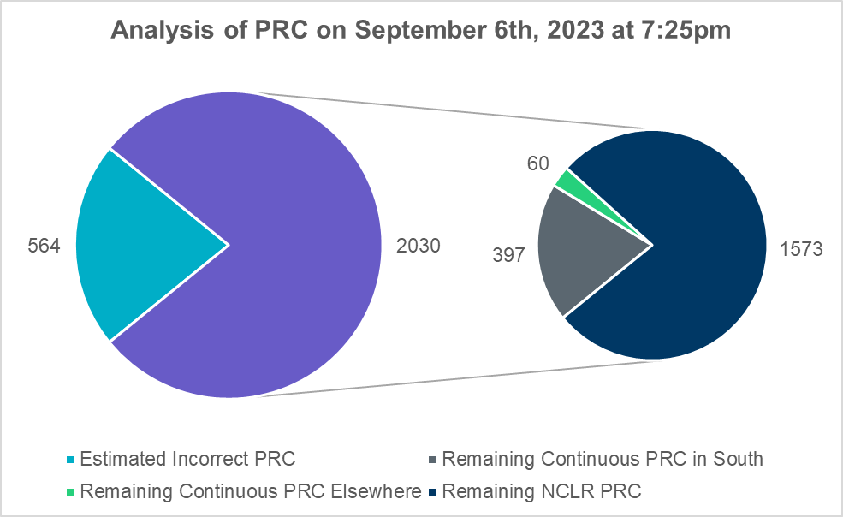
PRC Review
Based on the analysis and RFI responses ERCOT estimates, ~22% of the PRC at 7:25pm to be incorrect. PRC from load was not reviewed in this analysis.
Note that Other PRC includes Hydro, Thermal, and Combined Cycle Resources.
Total Actual PRC = 2030 MW
Remaining Continuous PRC Elsewhere
Resource Type | Count | PRC
ESR | 13 | 38
ESR-CLR | 3 | 5
Thermal | 18 | 17
16

Slide 17
Takeaways and Next Steps
ERCOT is actively collaborating with QSEs to identify corrective actions where applicable to improve operations during such situations.
30 resources with incorrect HSL due to HSL estimation errors: Working with QSE/RE to identify if any improvements can be made to the methodology used to estimate HSL.
18 Wind and 11 FFR-ESRs that had incorrect operations due Improper Equipment (Controller) Settings: Have implemented or are working with OEM to implement corrective actions.
6 ESRs experienced inverter derates/faults or had low SOC but did not update HSL: Working with QSEs to identify and implement methods to improve quality of telemetered HSL and operations during these scenarios.
4 resources with incorrect HRL: ERCOT has requested QSEs to submit updated registration data.
3 resources with equipment failures that did not enter ONHOLD status: Informed QSEs to enter ONHOLD when experiencing equipment failures.

Slide 18
Questions?

Slide 19
Appendix

Slide 20
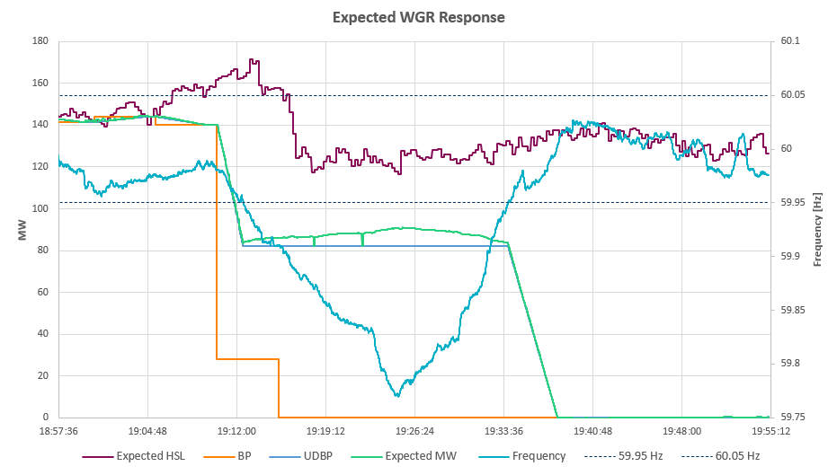
Expected Curtailed WGR Operations
Provide PFR in addition to ramping pause.
HSL remains at power potential when curtailed.
Pause ramping when negatively impacting frequency and frequency is outside of the dead band.
Resume ramping to BP once frequency recovers.

Slide 21
6.5.5.1 (2) Changes in Resource Status
When an On-Line Resource is experiencing an event that may affect its availability and/or capability and that requires further actions to stabilize the Resource and/or determine the impact of the event, the QSE may change the Resource Status to ONHOLD within 15 minutes of experiencing an event. Following this Resource Status change, the telemetered HSL and any other applicable telemetry of the Resource as specified in paragraph (2) of Section 6.5.5.2, Operational Data Requirements, shall be updated as soon as practicable but no longer than 15 minutes after the change in Resource Status to ONHOLD. After the QSE has determined the impact of the event, the QSE shall change the Resource Status to its updated status as soon as practicable but no longer than 60 consecutive minutes of being in the ONHOLD status.

