Slide 1
Review of December 2023 Capacity, Demand and Reserves and February Monthly Outlook for Resource Adequacy Reports
Pete Warnken
Resource Adequacy
Supply Analysis Working Group
December 20, 2023

Slide 2
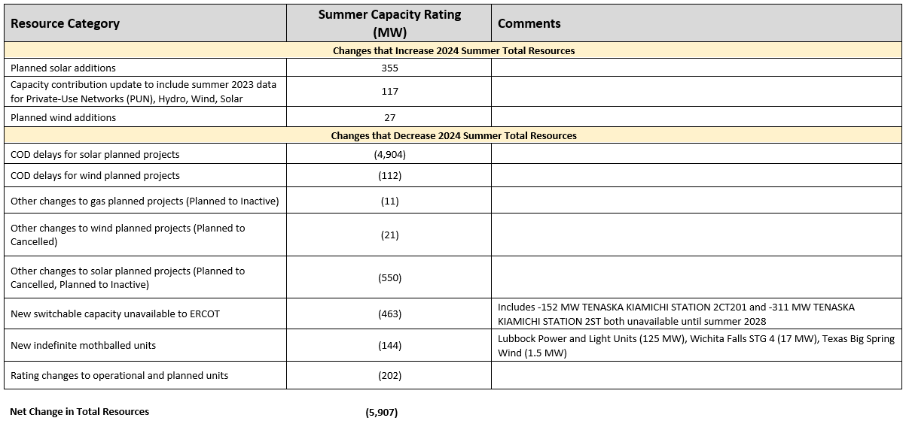
Resource Changes Relative to the May 2023 CDR

Slide 3
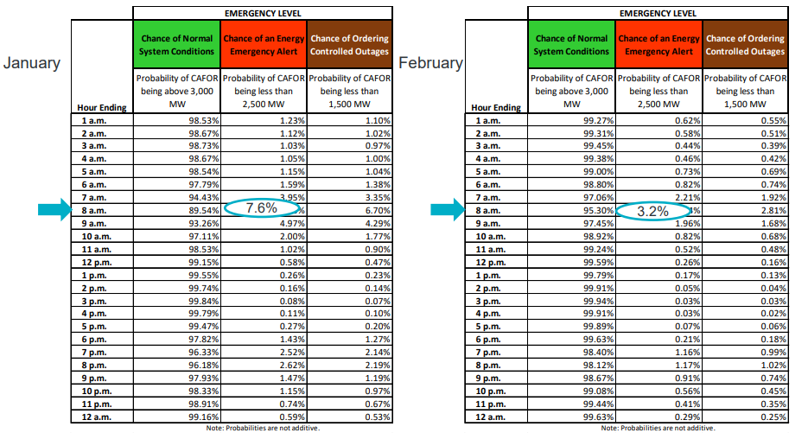
Monthly Outlook for Resource Adequacy (MORA)
Riskiest hour for experiencing emergency conditions remains at 8 a.m., with February expected to have lower risk than January

Slide 4
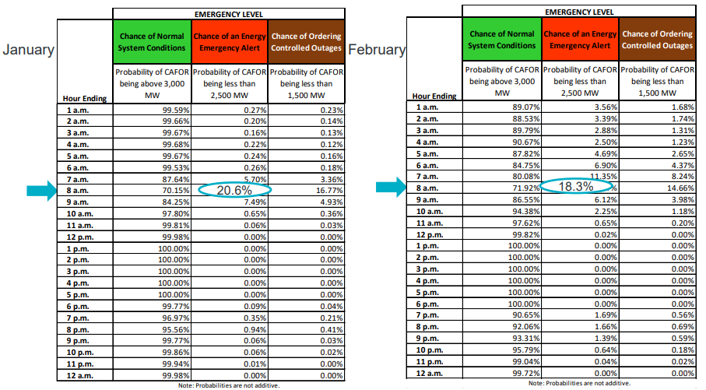
Monthly Outlook for Resource Adequacy (MORA)
A WS Elliott scenario fixes peak load to a value reflecting weather comparable to that experienced during the storm; risk for emergency conditions increases

Slide 5
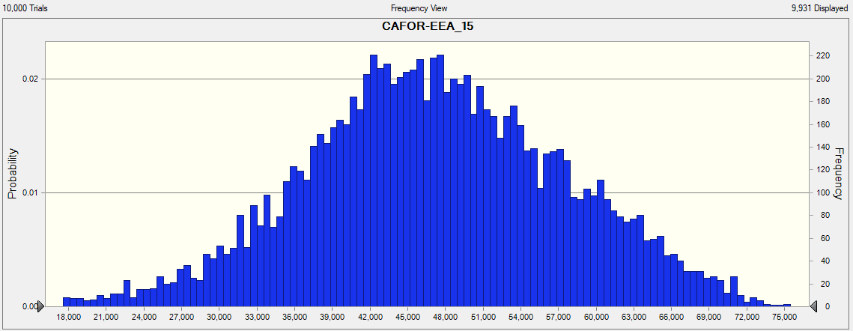
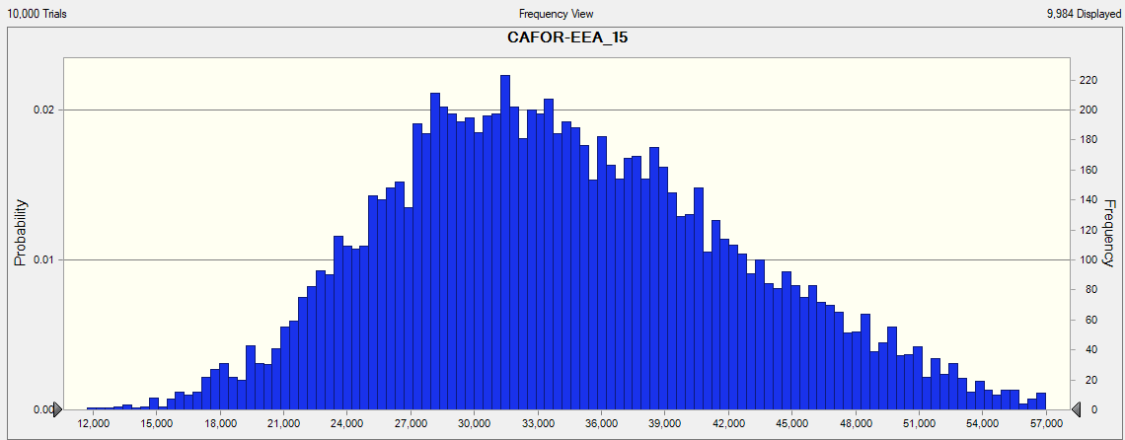
Monthly Outlook for Resource Adequacy (MORA)
Base Simulation (Hour-ending 1500)
The fixing of loads to WS Elliott levels results in many more CAFOR outcomes that are near or below the 2,500 MW risk threshold; however, it also reduces the severity and number of extremely low CAFOR outcomes; if load is not fixed, the model can select load values higher than the Elliott amount.
Number of CAFOR outcomes less than 2,500 MW = 3
50th Percentile CAFOR = 46,806 MW
Min CAFOR value =
-3,209 MW
Elliott Scenario Simulation (Hour-ending 1500)
Number of CAFOR outcomes less than 2,500 MW = 0
50th Percentile CAFOR = 27,781 MW
Min CAFOR value =
7,979 MW

Slide 6
Monthly Outlook for Resource Adequacy (MORA)
Why do certain hours show slightly less EEA risk under the WS Elliott scenario?
The availability of ~3,500 MW of “pre-EEA resources” eliminates the already small number of low-CAFOR outcomes that would otherwise arise during the lowest-risk hours (mid-afternoon load dip along with maximum solar generation).

