Slide 1
Intra-Hour IRR Forecast Accuracy Updates
(November 2023)
WMWG
Operations Analysis
December 01, 2023

Slide 2
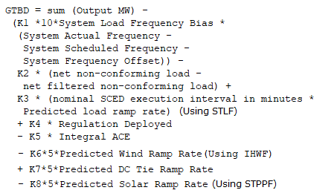
Current GTBD Parameters
GTBD Component Tuning events:
  None
K1 | 0.00
K2 | 0.00
K3 | 1.00
K4 | 0.20
K5 | 0.50
K6 | 1.00
K7 | 1.00
K8 | 1.00
Integral ACE Cap | 250.00
PWRR Cap | 30.00
PSRR Cap | 40.00/ 100.00
PDCTRR Cap | 20.00
Notes:
3/12/18 – Integral ACE Time Constant Changed from 60 min to 45 min
5/17/18 – K4 Changed from 0.3 to 0.2 and K5 Changed from 0.4 to 0.5
12/4/18 – 10:05 AM – K6 Changed from 0 to 0.5
2/12/19 – 2:15 PM – K6 changed from 0.5 to 1.0
3/12/19 – 2:10 PM – PWRR Threshold from 10 to 15 MW/min
3/19/19 – 2:15 PM – PWRR Threshold from 15 to 20 MW/min
4/01/19 – 10:00 AM – K5 changed from 0.5 to 0.4 and Max. Integral ACE Feedback changed from 250 to 150
4/24/19 – 1:15 PM – Max. Integral ACE Feedback changed from 150 to 160. PWRR Threshold changed from 20 to 25.
5/22/19 – 1:10 PM – K5 changed from 0.4 to 0.5, Max Integral ACE feedback changed from 160 to 200, PWRR Threshold changed from 25 to 30
6/17/20 – 10 AM - PWRR Calculation method changed from Direct to Interpolated
9/1/20 – 11 AM - Max Integral ACE Feedback changed from 200 to 250
9/3/20 – 3 PM - Max Integral ACE Feedback changed from 250 to 300
9/4/20 – 3 PM - Max Integral ACE Feedback changed from 300 to 250
6/1/21 – 10:00 AM – K8 Changed from 0 to 0.5, PSRR Threshold changed to 10
6/2/21 – 10:00 AM – PSRR Threshold changed from 10 to 20
6/3/21 – 10:00 AM – K8 Changed from 0.5 to 0.75
6/4/21 – 10:00 AM – K8 Changed from 0.75 to 1
9/2/21 – 10:00 AM – PSRR Threshold changed from 20 to 30
7/21/22 – Integral ACE Cap Changed from 250 to 350
7/21/22 – K5 changed from 0.5 to 1
7/22/22 – K5 changed from 1 to 0.5
6/12/23 - PSRR dynamic threshold enabled. The Max PSSR started at 80 MW/min for sunrise and sunset hours
6/15/23 – The Max PSRR threshold increased to 100 MW/min for sunrise and sunset hours
10/26/23- Integral ACE Cap Changed from 350 to 250

Slide 3
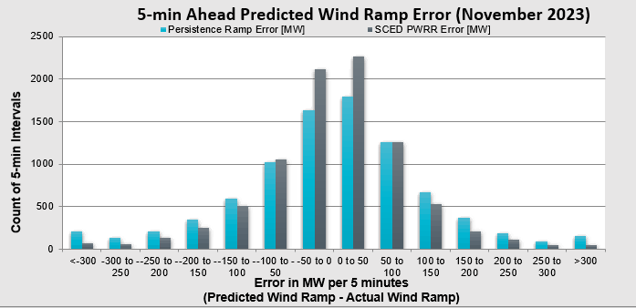
Predicted Wind Ramp Rate (PWRR) Error
Performance Metric | Persistence Ramp* | SCED PWRR
Monthly MAE (MW per 5 minutes) | 94 | 69
Monthly MAE when 5-Min. Wind Ramp > 100 MW | 191 | 112
* Persistence Ramp assumes a 0 MW wind ramp

Slide 4
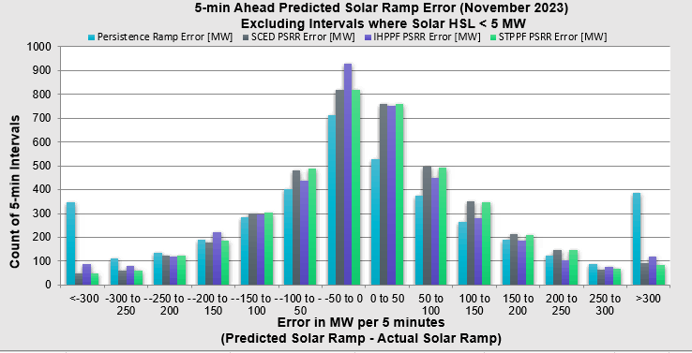
Predicted Solar Ramp Rate (PSRR) Error
Performance Metric | Persistence Ramp* | SCED PSRR | PSRR, IHPPF | PSRR, STPPF
Monthly MAE (MW per 5 minutes) | 163 | 97 | 100 | 97
Monthly MAE when 5-Min. Solar Ramp > 100 MW | 279 | 135 | 133 | 134
* Persistence Ramp assumes a 0 MW solar ramp

