Slide 1
Public API Beta
Presented by: Omar Soberanis and Michael Ackermann
Date: 12/14/2023

Slide 2
ERCOT Public API Updates
Beta Release Functionality
Important Notices
Upcoming Release
Demo

Slide 3
Beta Release Functionality
Data Portal http://data.ercot.com | API Gateway http://api.ercot.com | API Explorer http://apiexplorer.ercot.com
List of Data Reports | Access to all data reports through the APIs | API documentation/specs
Near real-time current reports | API versioning | API testing
Historical report downloads | RESTFUL API using OpenAPI specification | Scripting suggestions
Report Search | Stateless client-server communication
Data Navigation | Secure – TLS encryption as data is transfer
 | Rate Limiting

Slide 4
Important Notices
Reports
There approximately 10 million archival public reports, only about 5% have been transferred to the data lake. Every day we are moving thousands of files. Expect completion date around February/March timeframe.
Near-real time repots were activated on December 11^{th.}
Currently there no data filter in the Data Portal.
There no real-time download features in the Data Portal.
Defect: Data Portal display duplicate data in some reports.
Data Portal
Timeout after 10 to 15 minutes, just refresh.
No authentication
API Gateway/API Explorer
No Authentication

Slide 5
Upcoming Features
Data Portal http://data.ercot.com | API Gateway http://api.ercot.com | API Explorer http://apiexplorer.ercot.com
Authentication | Token Authentication | Authentication
Data filter on real-time: Date time picker Data Type
Sorting
Data Downloads
More historical files

Slide 6
Public API Timenline
Dec 2023
Beta Release
January 2024
Some Data Filters
Authentication
February 2024
Data Filter
Data Downloads
March 2023
GA Release

Slide 7
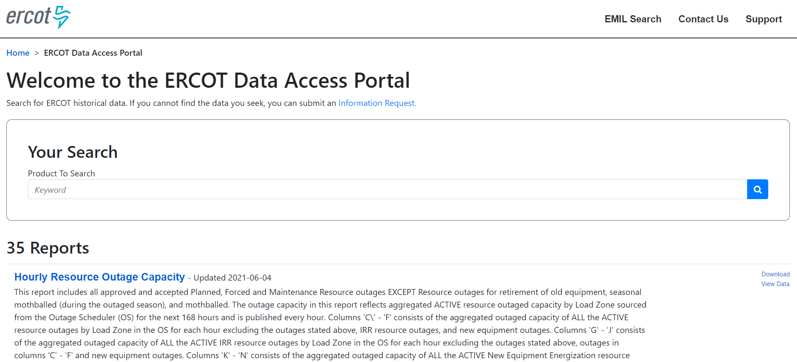
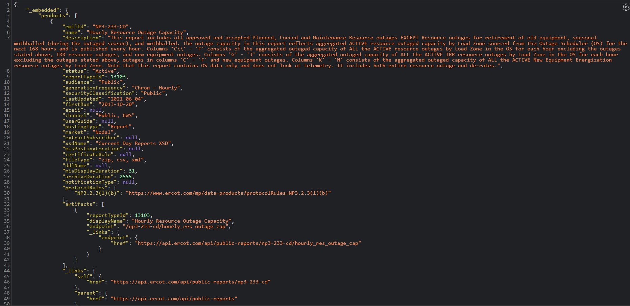
Demo

Slide 8
Q&A

