Slide 1
NERC EMSWG Update
Wei Qiu, NERC EA
ERCOT TWG Conference Call
December 14, 2023

Slide 2
NERC EMSWG Officers Update
Phil Hoffer, AEP, stepped down as the NERC EMSWG chair position but remains a part of the group.
Rob Adams, FPL, stepped down as the NERC EMSWG vice chair position.
New officers
Chair: Rob Adams, FPL
Vice Chair: Dwayne Fewless, ReliabilityFirst
Approved by the NERC EAS
Effective January 01, 2024

Slide 3
2023 Monitoring and Situational Awareness Technical Conference
Location: WECC, Salt Lake City, UT
Date and Time:
Tuesday, October 3, 2023, 9am – 5pm MT
Wednesday, October 4, 2023, 9 am – 12pm MT
Presentations – Clicking the link below or scan the QR code
https://www.nerc.com/pa/rrm/Resources/Documents/MSA_Presentations_2023.pdf

Slide 4
EMS Lessons Learned Published
Abnormal Area Control Error due to a Model Translation Error
After a scheduled quarterly model update, the entity experienced an abnormal Area Control Error (ACE) deviation from expected ranges. It was identified that the Automatic Generation Control (AGC) application sent invalid set point instructions to the generation fleet due to a model translation error. LL20230901_Abnormal_ACE_due_to_Model_Translation_Error.pdf (nerc.com)
Loss of Communication to Transmission Substations
A TO experienced an unplanned interruption on its “Path A” (fiber optic) that impacted several communication circuits due to previously rerouted circuits during an ongoing planned outage on “Path B”(microwave). As a result, select relay communications were affected in addition to the monitoring and control to several remote substations. As a result of this break, both analog communications and digital SCADA communications were interrupted for 11 hours and 30 minutes
LL20231101_Loss_of_Communication_to_Transmission_Substations.pdf (nerc.com)

Slide 5
EMS Lessons Learned In-process
Loss of Visibility from Lack of Contractor Oversight
During scheduled work, DC power was lost to both telecommunication racks (A and B) at the BES substation interrupting all telecommunications equipment fed from both “A” and “B” racks which resulted in the loss of visibility to 135 Remote Terminal Units (RTUs).

Slide 6
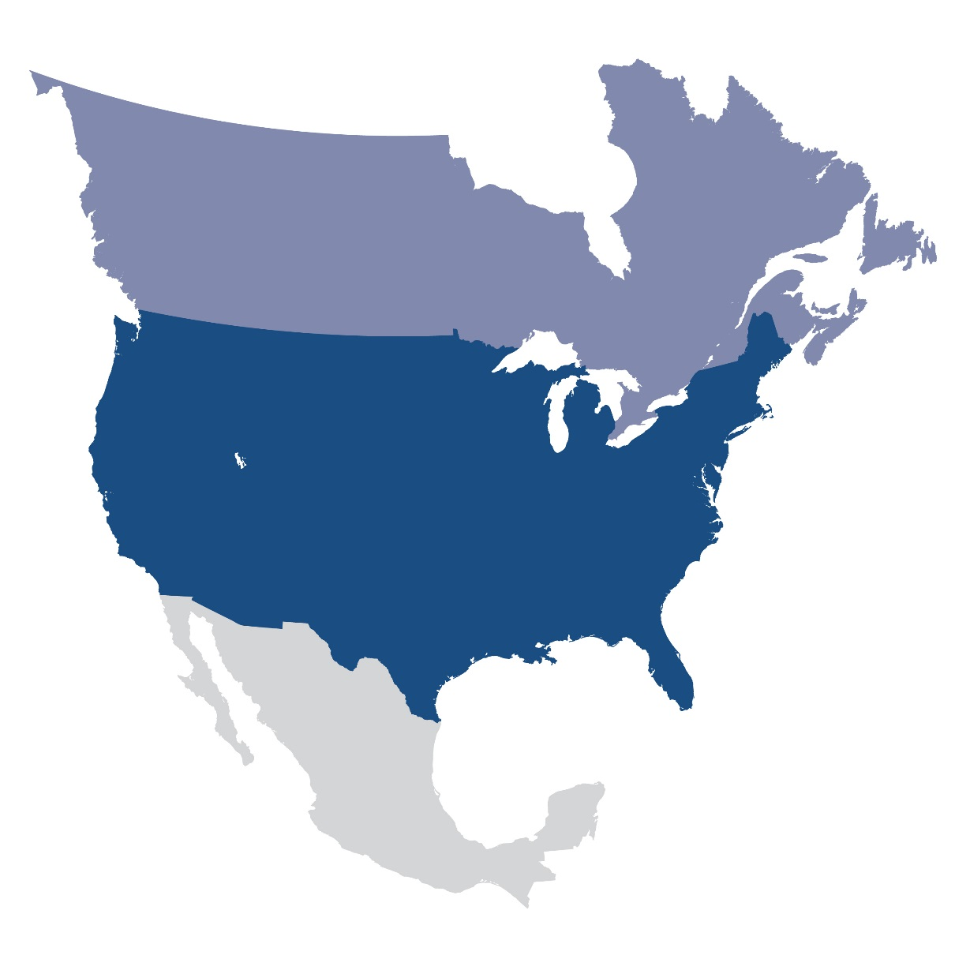
Questions and Answers
Contact Information:
wei.qiu@nerc.net

