Slide 1


FERC Order 901 and NERC IBR Alert Summary
IBRWG Meeting
December 8, 2023

Slide 2
NERC IBR Key Findings
  Many GOs did not have the requested facility data readily available
  About 5,200 MW of bulk electric system (BES) IBRs have voltage and frequency protection settings within the NERC PRC-024 “no trip zone.”
  About one-quarter of the reported facilities use phase lock loop (PLL) loss of synchronism protection with a trip threshold that results in an increased likelihood of inadvertent tripping during normally cleared grid faults.
  About one-quarter of the reported facilities use a fault ride-through mode that does not adequately support BPS reliability.
  About one-third of the reported facilities use a “triangle-shaped” facility reactive power capability curve, indicating a significant amount of underused reactive power capability

Slide 3
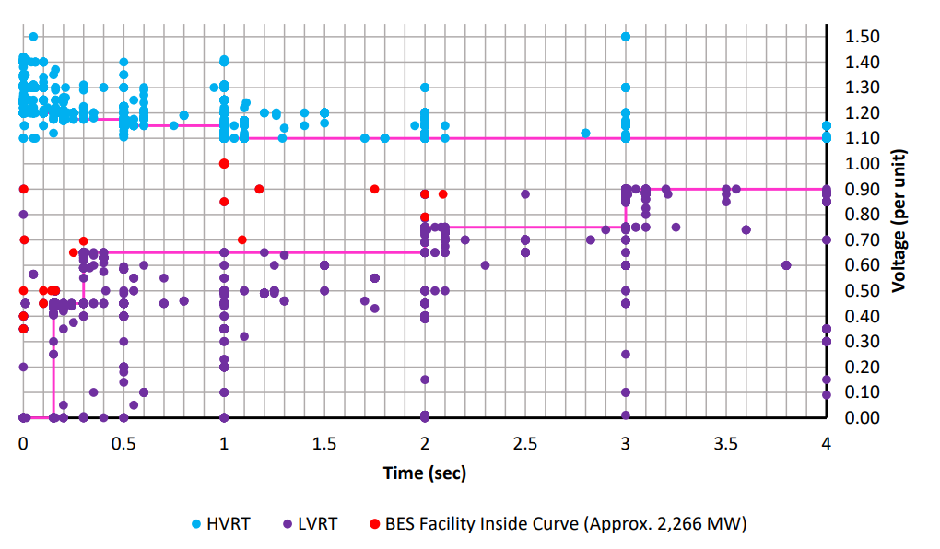
NERC IBR Key Findings
Key Takeaways
2260 MW of BES solar facilities set inside of the “no trip zone”
Voltage protection settings set directly on the PRC0-24 curve, indicating that these settings are not optimizing their ride-through capability
Voltage protection settings set at inverter terminals and not compensated for voltage at POI

Slide 4
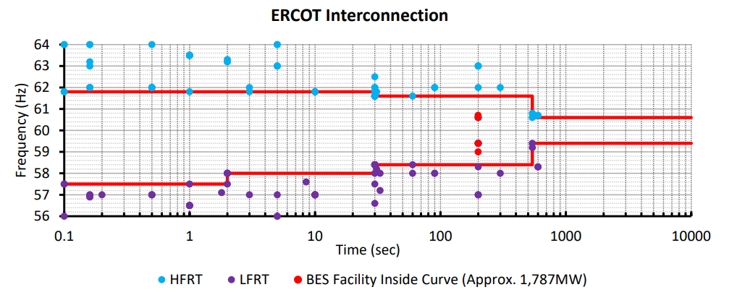
NERC IBR Key Findings
Key Takeaways
1787 MW of BES solar facilities set inside of the “no trip zone”
Frequency protection settings set directly on the PRC0-24 curve, indicating that these settings are not optimizing their ride-through capability

Slide 5
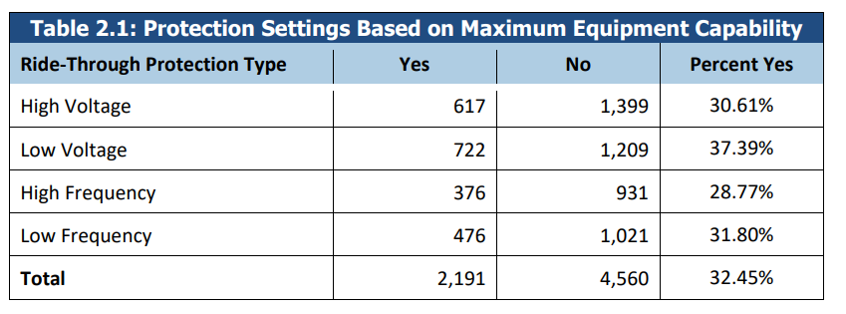
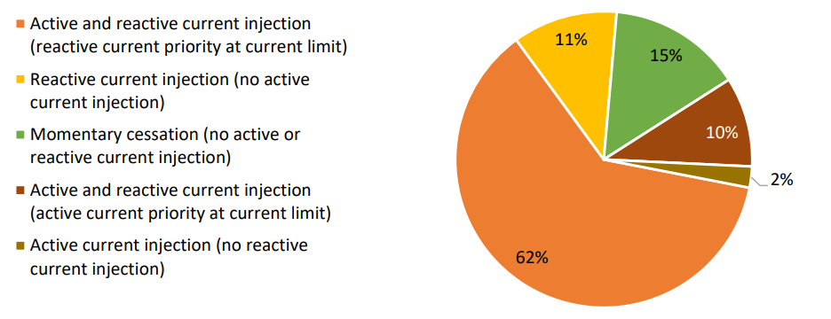
NERC IBR Key Findings
Key Takeaways
Use of instantaneous unfiltered measurements which are prone to inadvertent tripping
Settings not based on maximum equipment capabilities
Key Takeaways
Combined active and reactive current injection is preferred (~ 73% of units)
Momentary cessation, reactive injection only, and active injection only do not align with NERC disturbance findings

Slide 6
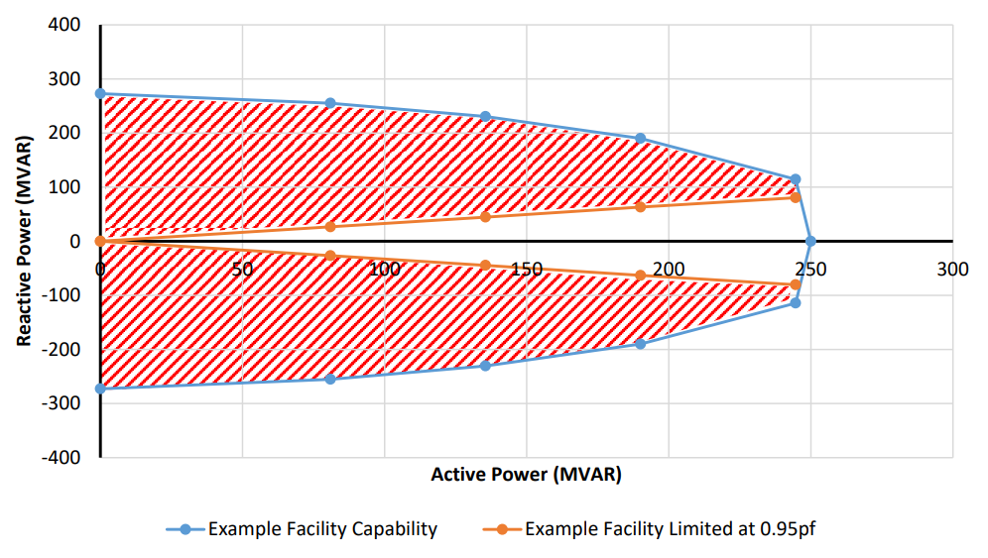
NERC IBR Key Findings
Key Takeaways
~35% of resources have the “triangle” shaped capability curve, potential leaving significant reactive power capability unused
Reactive capability artificially limited by plant controller settings
Steady-state and dynamic reactive capability should be at least 0.95 power factor at maximum power output

Slide 7
FERC Order 901 Summary
  Issued October 19, 2023
  Directs NERC to submit a detailed standards development plan to address inverter-based resource reliability gaps in four areas
    Data sharing
    Model validation
    Planning and operational studies
    Performance requirements
  Informational filing due within 90 days (by January 17, 2024)
  New or modified standards to be submitted by November 2026

Slide 8
FERC Order 901 Need for Reform
  Multiple events have demonstrated gaps in the Reliability Standards specific to IBRs
  Current actions are insufficient to address IBR reliability risks
  Existing Reliability Standards do not adequately address IBR reliability risks

Slide 9
IBR Reliability Gaps – Data Sharing
  The Reliability Standards must require that generator owners, transmission owners, and distribution providers share validated modeling, planning, operations, and disturbance monitoring data for all IBRs with planning coordinators, transmission planners, reliability coordinators, transmission operators, and balancing authorities so that the latter group has the necessary data to predict the behavior of registered and unregistered IBRs individually and in the aggregate, as well as IBR-DERs in the aggregate, and their impact on the reliable operation of the Bulk-Power System.
    Registered IBRs data sharing
    Disturbance monitoring data
    Unregistered IBR and IBR-DER data sharing

Slide 10
IBR Reliability Gaps – Model Validation
The Reliability Standards must require that all IBR models are comprehensive, validated, and updated in a timely manner, so that planning coordinators, transmission planners, reliability coordinators, transmission operators, and balancing authorities can adequately predict the behavior of registered and unregistered IBRs individually and in the aggregate, as well as IBR-DERs in the aggregate, and their impacts on the reliable operation of the Bulk-Power System.
  Industry-approved generic component models
  Verification of IBR plant dynamic model performance
  Validating and updating system models
  Coordination to create and update planning, operational, and interconnection-wide data and models

Slide 11
IBR Reliability Gaps – Planning and Operational Studies
The Reliability Standards must require that planning and operational studies include validated IBR models to assess the reliability impacts of registered and unregistered IBRs individually and in the aggregate, as well as IBR-DERs in the aggregate, on the reliable operation of the Bulk-Power System, and must require that planning and operational studies assess the impacts of all IBRs within and across planning and operational boundaries for normal operations and contingency event conditions.

Slide 12
IBR Reliability Gaps – Performance Requirements
  The Reliability Standards must ensure that registered IBRs
  Provide frequency and voltage support during frequency and voltage excursions in a manner necessary to contribute toward the overall system needs for essential reliability services
  Establish clear and reliable technical limits and capabilities for registered IBRs to ensure that all registered IBRs are operated in a predictable and reliable manner during normal operations and contingency event conditions
  Require that the operational aspects of registered IBRs contribute towards meeting the overall system needs for essential reliability services.
    Registered IBR frequency and voltage ride-through requirements
    Bulk power system planner and operator voltage ride-through mitigation activities
    Post-disturbance IBR ramp rate interactions and phase-lock-loop synchronization

Slide 13
NERC Standards Strategy for 2024
  NERC must file standards by November 2024
  2020-06 IBR definitions
  2021-04 Modifications to PRC-002 (PRC-028)
  2020-02 Modifications to PRC-024
  2023-02 Performance of IBRs (modifications to PRC-004)
  New projects and SARS (2024 stretch target)
  Data sharing
  Data and model validation
  Planning and operational studies
  Data sharing for unregistered IBRs and DERs
  Data and model validation for unregistered IBRs and DERs

Slide 14
NERC Standards Strategy for 2025
  NERC must file standards by November 2025
  2023-05 FAC-001 and FAC-002
  2023-01 EOP-004
  2020-06 MOD-026
  2023-08 MOD-031
  2022-04 EMT models in MOD, TPL, and FAC
  Complete new projects to address
    Data sharing for registered IBRs, unregistered IBRs, and DERs
    Data and model validation for registered IBRs, unregistered IBRs, and DERs

Slide 15
NERC Standards Strategy for 2026
  NERC must file standards by November 2026
  2022-02 MOD-032 and TPL-001
  Complete new projects to address
    Planning and operational studies for registered IBRs, unregistered IBRs, and DERs

