Slide 1
Current AS Cost Allocation
Day Ahead AS costs allocated to QSEs based on most recently available initial settlement load ratio share data for same day and hour through the calculation of hourly Day-Ahead AS obligations.
RT AS costs are adjusted using the final, settled hourly load ratio share for the operating day (HLRS).

Slide 2
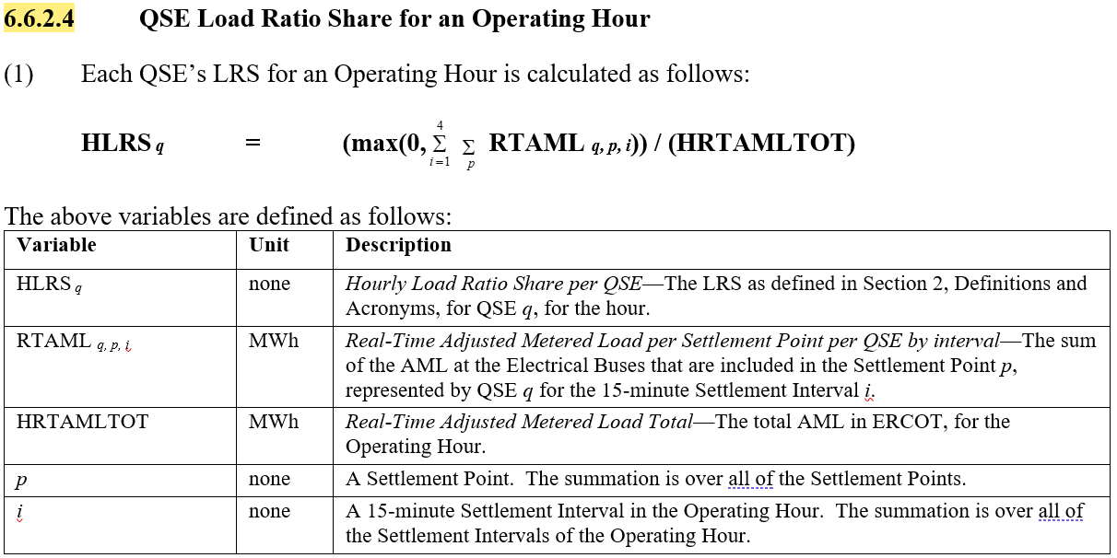
Current AS Cost Allocation

Slide 3
RCL AS Cost Allocation – Option 1
Calculate separate hourly RCL and Non-RCL Load Ratio Share (LRS) and AS cost allocation. Reliant proposal is to apply to ECRS and NSRS only.
RCL Load per QSE per Hour
RCLRTAML q
Non-RCL Load per QSE per Hour
NRCLRTAML q = RTAML q – RCLRTAML q
RCLHLRS q = (max(0, RCLRTAML q)) / (NRCLRTAMLTOT + RCLRTAMLTOT)
NRCLHLRS q = (max(0, NRCLRTAML q)) / (NRCLRTAMLTOT + RCLRTAMLTOT)
RCL AS Cost q = RCLHLRS q * AS Cost
Non-RCL AS Cost q = NRCLHLRS q * AS Cost

Slide 4
RCL AS Cost Allocation – Option 2
Change AS cost allocation to be a daily cost calculation with allocation based on the load ratio share during the peak net load hour. Reliant proposal is to apply to ECRS and NSRS only.
Uncovered AS obligations (net of self-arrangement and trades) multiplied by MCPCs and summed for each hour of the day to calculate daily total AS cost
Daily total AS cost multiplied by each QSE’s peak net load ratio share in the same way as below except applied to the peak net load hour only
RCLPNLLRS q = (max(0, RCLPNLAML q)) / (NRCLPNLAMLTOT + RCLPNLAMLTOT)
NRCLPNLLRS q = (max(0, NRCLPNLAML q)) / (NRCLPNLAMLTOT + RCLPNLAMLTOT)
RCL AS Cost q = RCLPNLLRS q * AS Cost
Non-RCL AS Cost q = NRCLPNLLRS q * AS Cost

Slide 5
Other considerations
Aligning DR incentives with peak net load reduction establishes more accurate cost causation and will help flatten peak net load ramps and reduce peak net loads.
Reducing peak net load ramps and lowering peak net load should, over time, reduce the amount of ECRS and NSRS that ERCOT needs to procure.
Reduces peak net load forecast error and variability

