Slide 1
Credit Finance Sub Group update to the Technical Advisory Committee
Brenden Sager, Austin Energy, Chair
Loretto Martin, NRG, Vice Chair
15 November 2023

Slide 2
General Update
15 November CFSG meeting
Voting matters
Operational NPRR’s without credit impacts
Discussion items
new invoice report, and NPRR on bank qualifications
EAL Change Proposals
Letter of Credit Concentration limits
Regular credit exposure updates

Slide 3
NPRR Reviewed
NPRR1204, Considerations of State of Charge with Real-Time Co-Optimization Implementation – URGENT NPRR1181, Submission of Seasonal Coal and Lignite Inventory Declaration
ERCOT Credit Staff and CFSG have reviewed NPRR1204 and do not believe that it requires changes to credit monitoring activity or the calculation of liability

Slide 4
Update on Invoice Report from NRG
This Nodal Protocol Revision Request (NPRR) creates a new daily report which lists the ERCOT Invoices issued for the current day and day prior at a Counter-Party level.
The Credit Finance Sub Group (CFSG) provided feedback to ERCOT that it is cumbersome for Counter-Parties to monitor the posting of Invoices that are posted at infrequent intervals (e.g. quarterly).
ERCOT has observed this difficulty, noticing Qualified Scheduling Entities (QSEs) with a history of timely paying Settlement Invoices missing payment timelines for Wide Area Network (WAN) and Electric Reliability Organization (ERO) Invoices.
This NPRR creates a daily report that lists the Invoices issued to all the QSEs and Congestion Revenue Right (CRR) Account Holders represented by the Counter-Party for the current day and the prior day.
This report can be used by Counter-Parties to ensure they are aware of all Invoices posted, which helps assure timely payment. This also has the benefit of decreased administrative burden on ERCOT to manage late payments.
Next step: to PRS for December meeting

Slide 5
EAL Changes and Analysis
DC and Rainbow requested changes to the Estimated Aggregate Liability report that represents parameters defining the CP’s collateral obligation to ERCOT
Members expressed desire to have settlement from RT and DA combined in the calculation
Current forward adjustment factors apply separately to DA and RT
Evaluating lookback period designed to protect against default mass transition
Varies but can reflect up to 40 days of invoices and financial market activity
Evaluating Forward Adjustment Factors (FAFs), ratios of future and past prices scaling invoices
CFSG will continue to review EAL calculation methodology
ERCOT Credit team is evaluating four scenarios and presenting these to CFSG in detail.
Scenario 2 involves applying Forward Adjustment Factors against Real Time Liability and removing the “Max” function from the 40 day lookback period
Scenario 3 involves CP-level customized Forward Adjustment Factors based on a ratio of forward and settled prices
Waiting for scenarios 1 and 4

Slide 6
Letter of Credit Discussion
ERCOT has issuer LC max limits of $750 million per issuer with sublimits based on ratings
Once limit breached, no more new LC’s or increases from that issuer
Credit Agricole and BBVA have breached, six other issuers in the "danger zone" at > 60% capacity
ERCOT staff discussed with the group the possibility of raising limits
No CFSG action taken but group will continue to monitor and staff will include a consolidated view of LC amounts at monthly meetings in the future

Slide 7
Letter of Credit Discussion

Slide 8
Monthly Highlights September 2023 – October 2023
Market-wide average Total Potential Exposure (TPE) increased from $2.50 billion in September 2023 to $2.88 billion in October 2023
TPE increased due to the higher forward adjustment factors in October
Discretionary Collateral is defined as Secured Collateral in excess of TPE,CRR Locked ACL and DAM Exposure
Average Discretionary Collateral decreased from $5.04 billion in September 2023 to $4.33 billion in October 2023
No unusual collateral call activity

Slide 9
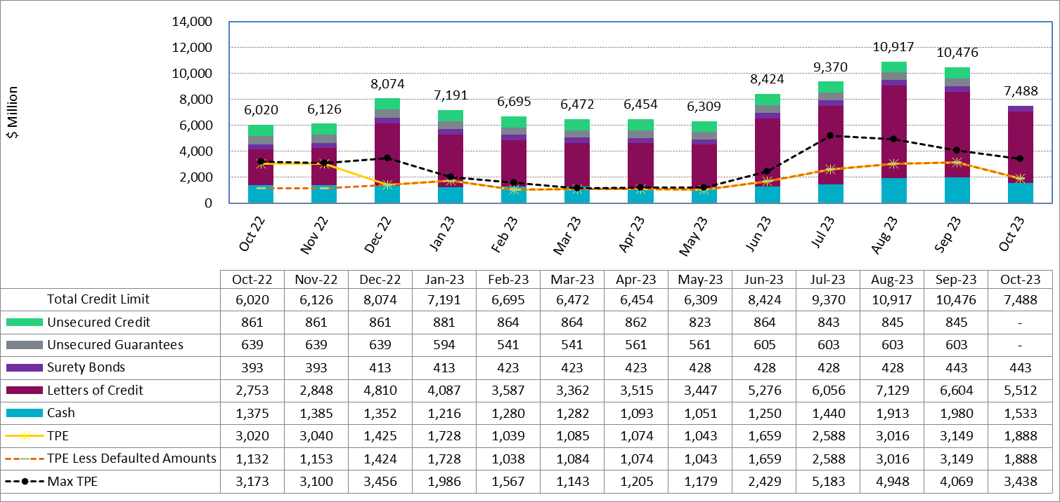
Available Credit by Type Compared to Total Potential Exposure (TPE) YTD Oct 2023

Slide 10
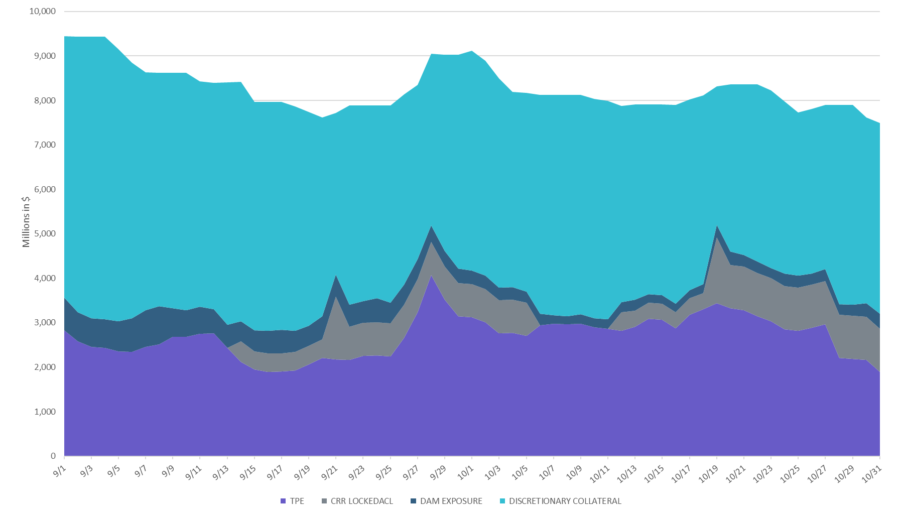
Discretionary Collateral Sept-Oct 2023

Slide 11
Questions?

