Slide 1
Lubbock Retail Integration Task Force – LRITF December 5th, 2023
Chris Rowley Michael Winegeart Sheri Wiegand

Slide 2
Final Transition Timeline

Slide 3
LRITF meeting 11/07/23
The Task Force reviewed the following:
Various updates: FERC, Flight Testing, ESI creation, MCL, REP registration, new LP&L rates effective 10/1/23, Peddler’s Licenses, Smart Meter Texas, testing 867s/810s, city inspections, master-metered accounts, electric bill timing, meter read & holiday calendars, etc.
LP& Communications: bill onserts, direct mailers, “media kit”, website listing, Shopping Fairs
Reviewed differences in Chapters 7 and 8 in RMGRR176 of the Retail Market Guide outlining market processes to be adopted by LP&L: safety net processing and historical usage requests.
Transition Monitoring: market calls and development of a plan for meetings/communications pre and post transition.
Stacking Logic Scenarios: application of ERCOT stacking rules and the differences with MMRD and MMRD(Monthly Meter Read Date) + 1 (day) – who wins the customer?

Slide 4
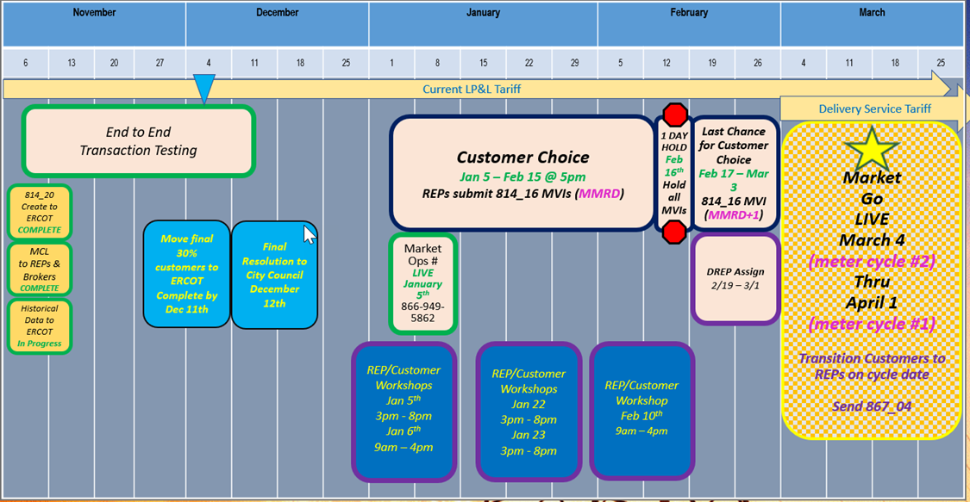
Completed Action Items Q&A
Transition to Competition
Q: Does LP&L plan to transition customers / ESIs on meter cycle reads or a ‘flash cut’ date? A: LP&L plans for an on-cycle transition. ESIs will transition commencing with March Meter Read Cycle 2 on 3/4/24 and conclude with April Meter Read Cycle 1 on 4/1/24. Q: When will LP&L accept EDI transactions for transition to competition? A:
ERCOT/LP&L will begin accepting transactions 1/5/24 – 2/15/24 @ 5PM
IMPORTANT: LP&L has asked REPs to hold transactions from 2/15/24 @ 5PM until Saturday, 2/17 @ 7AM to allow time for LP&L to perform queries for DREP assignments and modify systems to no longer automate the MVI date for the appropriate meter read cycle.
DREP Assignment Period to commence 2/19/24 – 3/1/24
Transitioning of LP&L customers on March/early April meter read cycles (starting 3/4/24 – 4/1/24)

Slide 5
Completed Action Items Q&A
Transition to Competition - continued
Q: Has LP&L selected Default Service REPs, POLR Voluntary REPs and a POLR REP? A: Lubbock’s Electric Utility Board and City Council have approved the following REPs: Default Service REPs: Reliant, Octopus, TXUE (Octopus will only serve residential customers) POLR Voluntary REPs: Reliant, Octopus, TXUE POLR REP: Reliant Q: Does Lubbock have any requirements/regulations pertaining to door-to-door solicitations? A: Below is a summary of the Peddler’s License requirements for any solicitations within the City of Lubbock. The Lubbock Police Department administers the licensing. REPs granted Peddler’s permits will be noted on the LP&L website. Q: Will email addresses be provided in the Mass Customer List? A: No, LP&L does not collect or store email addresses. Q: Will registered brokers/aggregators have access to the Mass Customer List? A: YES, LP&L has a parallel process for brokers/aggregators to obtain a copy of the MCL with an authorized agreement. Brokers/Aggregators should email marketops@mylubbock.us for additional information. Q: Will additional updated Mass Customer Lists be provided to registered REPs/brokers? A: NO, only one Mass Customer List will be provided.

Slide 6
Completed Action Items Q&A
Customer Education
Q: Will Lubbock host Town Halls/Community Meetings informing Lubbock residents about the transition to competition? A: Lubbock will be hosting “Shopping Fairs” where REPs may engage customers (no peddler’s license required). Registration, times, and additional information to follow. The Shopping Fairs will be held on: January 5th & 6th – Friday and Saturday January 22nd & 23rd – Monday and Tuesday February 10th - Saturday Q: Where can information be found on Lubbock’s communications to its residents about the transition? A: Any materials used for community meetings and bill onserts is posted on the LP&L website as well as information about the transition.

Slide 7
Completed Action Items Q&A
ERCOT Market Requirements
Q: When will flight testing occur for LP&L and REPs planning to operate in LP&L’s territory? A: LP&L has agreed to accept ‘round robin’ results of the other TDSPs and will perform penny and connectivity testing themselves in the 0224 Flight Test. Q: How will LP&L monitor safety-nets? Will LP&L accept safety nets on Saturdays? A: LP&L’s SFTP site will be monitored Mon-Fri 8AM through 5PM. Safety nets files will be automatically run during these times. LP&L is also asking REPs to send an email (with the spreadsheet attached) to marketops@mylubbock.us notifying of the SN submission. The mailbox will be monitored Mon-Fri 7AM – 7PM and Saturdays 7AM-12PM (noon). Q: Which transaction will be sent by LP&L to cancel/unexecute a default MVI or a competitive MVI with an MMRD date as the requested date? When will the cancel/unexecutable transaction be sent? A: The 814_28 with a reject code of T025 “Competing Transaction Scheduled for the Same Date” will be used during Customer Choice, DREP Assignment, and Transition phases. When multiple transactions are submitted with both MMRD and MMRD+1, the MMRD MVI will be cancelled the day prior to the MMRD.

Slide 8
Completed Action Items Q&A
TDSP Specific Activities
Q: Will historical usage information be available for transitioning customers? Will an LOA process be available and when? A: Monthly summary historical usage information will be available via the Mass Customer List (MCL) for entering REPs. Historical interval data will be available for REPs by emailing marketops@mylubbock.us with a signed copy of the approved LOA which is posted on the LP&L website. Brokers may also request monthly and interval data via the LOA process noted above. The LOA process may commence at the time the MCL is available for distribution (late April/early May). LOAs are required to be notarized. Out of state LOAs are accepted with a valid Commission ID. Modifications to the LOA will not be accepted. Upon effectuation of RMGRR176, the LOA found in Appendix B1/B2 may be utilized for LOA requests. Q: Will the meter read and holiday calendars be posted on LP&L’s website by October 31st each year? A: YES, schedules will be posted on LP&L website and 2023/2024 schedules will be posted on LRITF main page. Meter Cycle # is listed as “Bill Cycle”; ALOP stands for ‘always open’ and is indicative of an internal LP&L process. The cycles show a “1” in front of the true meter read cycle, e.g. 121 is listed, however the cycle noted in ERCOT is 21. Q: What are Lubbock’s requirements for city inspections? A: All new meter boxes require a standard inspection by one of the city’s inspectors – both residential and commercial premises. Green tags or red tags will be issued. If a customer is performing electrical work, an inspection may be required (residential customers are expempt). Typically, it is the customer’s electrician providing the notification an inspection is required. Q: For clearance requests, how should the customer/customer’s electrician notify LP&L? A: Typically, an Option 1 REP will notify LP&L of a clearance request by sending the appropriate transactions and informing customers of any associated costs. Option 3 REPs would allow customers/electricians to make the request directly with LP&L. With LP&L not charging for a clearance requests, having the customer contact LP&L directly to make the arrangements should be preferred.

Slide 9
Completed Action Items Q&A
TDSP Specific Activities - continued
Q: Does LP&L have any master metered apartments? A: LP&L does not currently have any master metered apartments, however, if in the future a REP needs to make arrangements for a DNP/RNP, REPs should email marketops@mylubbock.us to confirm and coordinate as noted in Chapter 8 of the RMG. Q: What is the current timing for a Lubbock resident to receive their utility bill after their meter has been read? A: Today, Lubbock residents typically receive their utility bills within 48 hours of their read date.

Slide 10
TIMELINE of Actions
Pro Forma Tariff
Access Agreement
POLR Process
Safety Net Process
Q4 2022
ERCOT Activities: SAC04s, Load Profiles
TSDP Activities: Critical Care, DLFs, Solar/DG, Switch Hold Files, BUSIDDRQ, Call Center, OGFLT, Weather Moratoriums, Proration
LP&L Rates
Customer Enrollment Process – Detailed Timeline
PUCT Complaint Process / Application of PUCT Rules
Transaction Timelines / TXSET Timelines
CSA Process
Q1 2023
Q2 2023
ESI IDs in TDSP Extract
RMG Chapter 8 Revisions
Historical Usage Requests
TDSP AMS Data Practices
Mass Customer Lists
Power to Choose website
Customer Forums/Town Halls
Flight Testing / Bank Testing
Q3 2023
CBCI files
Default REP Selection Process
DNP Blackout Period
Market Operations Group Established
Tampering Information Process
Smart Meter Texas
Q4 2023
March 2024
GO LIVE – Transition to Competition
Completed
Q3 2023
Q4 2023
Q1 2024

Slide 11
Lritf meeting 12/5/2023 @ 1:00PM following RMS
AGENDA ITEMS DISCUSSED :
Transition Timeline
Transitioning remaining load
Review Transition MVI Matrix
REP Registration Update
Smart Meter Texas Portal Update – LSE files/samples
Sample 867s/810s: cancel /rebills, solar example, BUSLRG – IDR format?
Historical Usage request format
Shopping Fairs – logistics/registration
Lubbock Rate Revisions - cadence
Tariff Update
DNP Blackout Period
Transitioning De-Energized ESIs (clearance requests)
AMS Operational Hours – transaction responses
NAESB URL – Production
Open Discussion

