Slide 1



TDTMS Update
RMS
December 5th, 2023

Slide 2

TDTMS
Update
ERCOT Updates –
ERCOT Retail Release Calendar – Changes to 2024 calendar have been completed/corrected. 11 retail releases are planned (more frequent, yet shorter in duration) RMS Vote
Listserv Activity – no incidents to report
SCR817 – testing continues to progress well. OPEN ACTION ITEM: Will TDSPs want to retain the ability to place a comment in an IAG/IAL MarkeTrak without any impacts to proposed workflow.
MIS API project update – Testing was underway. All results are appearing as expected. The new SOAP architecture will be in place in December’s 12/10 release. Market notices will be forthcoming.

Slide 3

TDTMS
SCR817 Implementation – Training Plan
Orientation – aligning with MCT/TXSET 5.0 rollout slated for January timeframe (3rd week) – high level introduction on IAG workflow changes.
TXSET/MCL/MarkeTrak Transition Plan - expected around late April/early May which will review the transition plan for transactions and MarkeTraks “in play” at the time of go live/transition to 5.0.
SCR817 Detailed Training – planned for pre-rollout and RMTE availability, likely September 2024 and will focus on all the changes to MarkeTrak associated with the SCR.

Slide 4
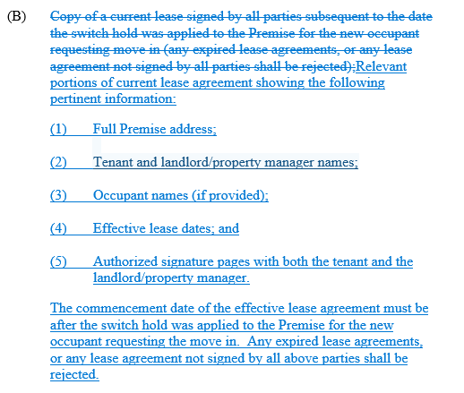

TDTMS
RMGRR177 – Switch Hold Removal Clarification
Switch Hold Removal – “copy of lease” was clarified with the following language
VOTE in December

Slide 5

TDTMS
Inadvertent Gain Analysis – July 2021 – Dec 2022 – timing to complete

Slide 6

TDTMS
Inadvertent Gain Analysis – July 2021 – Dec 2022 – timing to complete

Slide 7
TDTMS
Inadvertent Gain Analysis – July 2021 – Dec 2022 – timing to complete

Slide 8
TDTMS
Inadvertent Gain Analysis – July 2021 – Dec 2022 – timing to complete
MarkeTrak analysis files are posted to the main TDTMS page for your review.

Slide 9

TDTMS
Next Meeting –
December’s TDTMS has been cancelled
On the Agenda:
System Instances & MT Performance
Listserv
ERCOT Updates
RMGRR Switch Hold Removal Clarification
MIS API update
Digital Certificates
SCR817 Business Requirements
Data/Talking Points for Client Services on MT Analysis
Elections
preparation for implementation – orientation
Review of User’s Guide drafts
Goals/Accomplishments
Wednesday, January 17th, 9:30 AM WebEx only

