Slide 1
NPRR 1209 Illustration with Examples
PRS Special Meeting
ERCOT staff
November 30, 2023

Slide 2
Purpose and Context
Purpose: to provide greater clarity on how adjustments to Ancillary Service (AS) Resource Responsibility due to insufficient State of Charge (SOC) under NPRR 1209 will be calculated and applied using different examples.

Slide 3
NPRR 1209: Recap
Provides for consideration of SOC insufficiency in the determination of Systematic AS Failed Quantity Calculations under NPRR 1149
SOC insufficiency will be reflected in adjustments to telemetered AS Resource Responsibilities (in a priority order)
Adjusted values will then be used in adjustments to AS failed quantity calculations for a Qualified Scheduling Entity’s (QSE’s) portfolio

Slide 4
SOC Insufficiency Calculation
Security-Constrained Economic Dispatch (SCED) level data snapshots used to calculate values.
Energy Management System (EMS) will calculate the insufficient Up Ancillary Service MW amount by dividing the insufficient State of Charge (SOC) MWh amount by the remaining time in the current Operating Hour.
A similar process will be used to calculate the insufficient Down Ancillary Service MW amount by dividing the insufficient SOC headroom MWh by the remaining time in the Operating Hour.

Slide 5
Examples
The list of examples outlined below are meant to help illustrate whether/how AS insufficiency values are calculated and applied under different scenarios:
Sufficient SOC
Insufficient SOC
Insufficient SOC with carrying multiple AS
An example showing an intra-hour obligation change
Each example includes:
A slide which illustrates how adjustments to AS Resource Responsibility are applied with a calculated SOC insufficiency value
A detailed calculation slide which illustrates how the average SOC insufficiency value is calculated using SCED-level

Slide 6
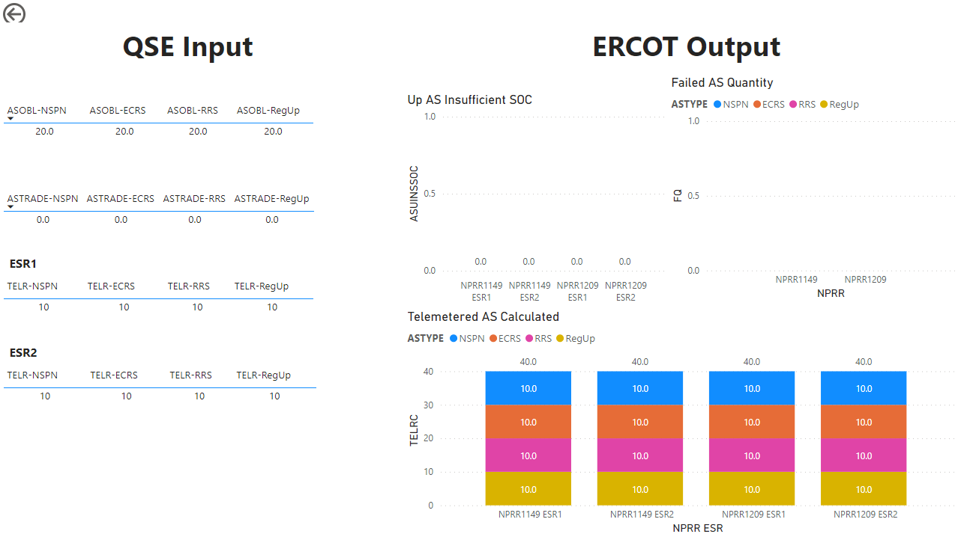
Example 1: Sufficient SOC

Slide 7
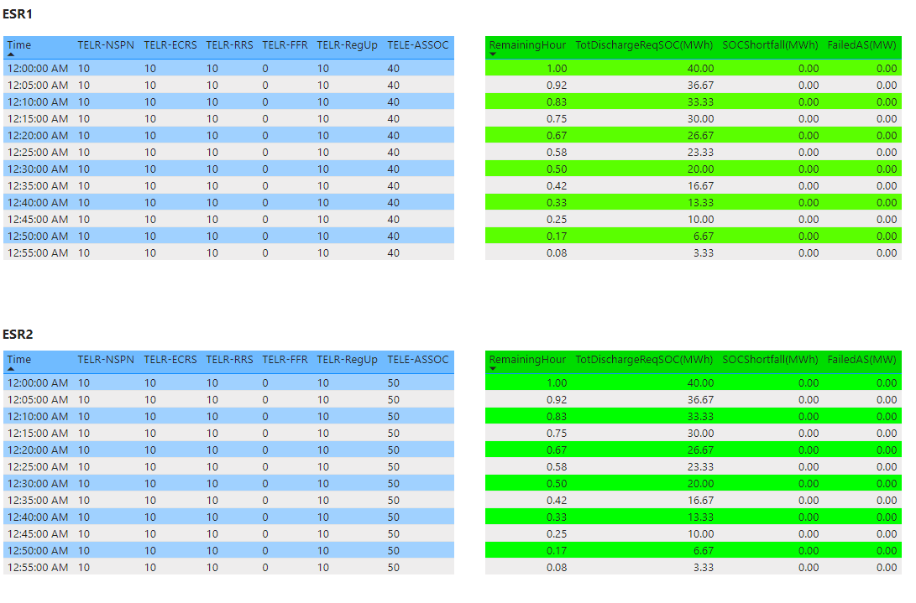
Example 1: Sufficient SOC

Slide 8
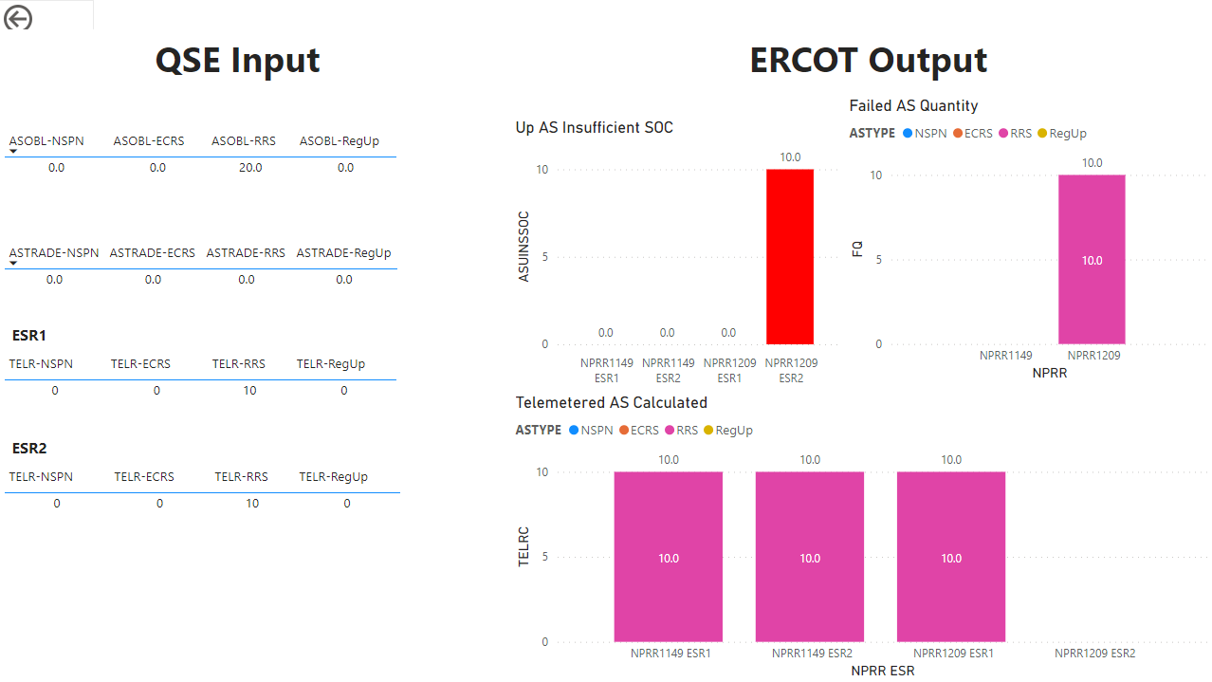
Example 2: Insufficient SOC

Slide 9
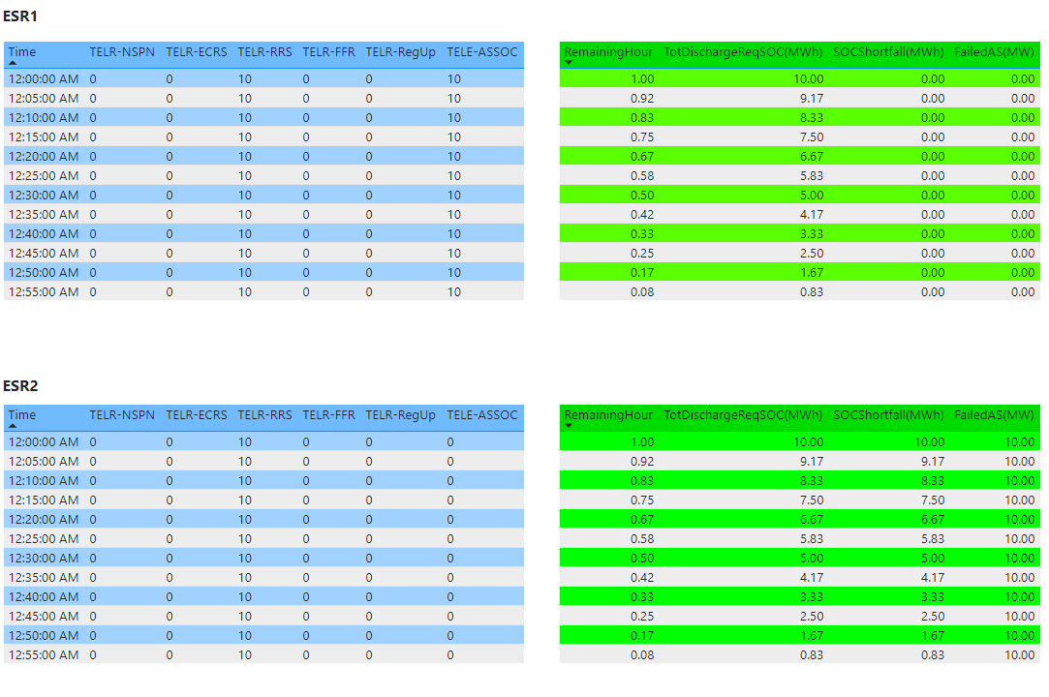
Example 2: Insufficient SOC

Slide 10
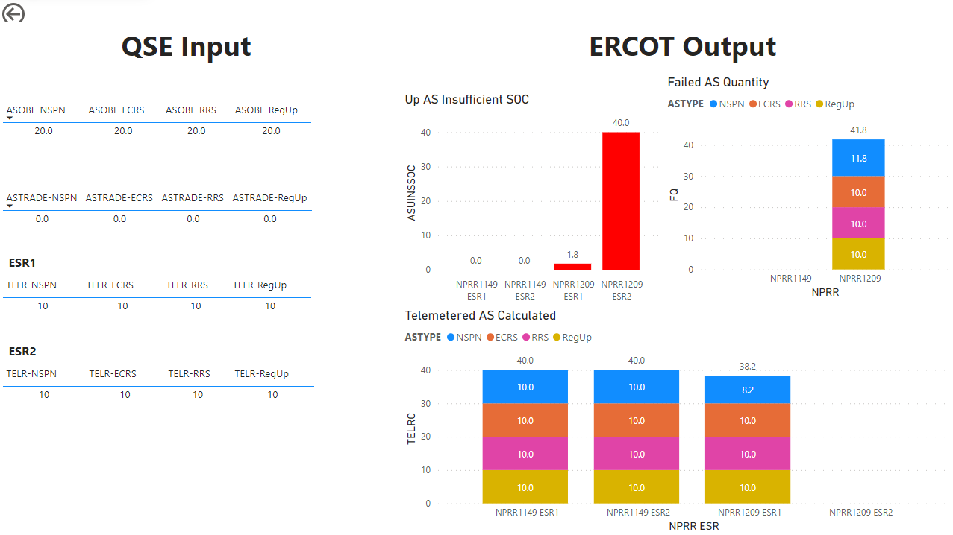
Example 3: Insufficient SOC With Carrying Multiple AS

Slide 11
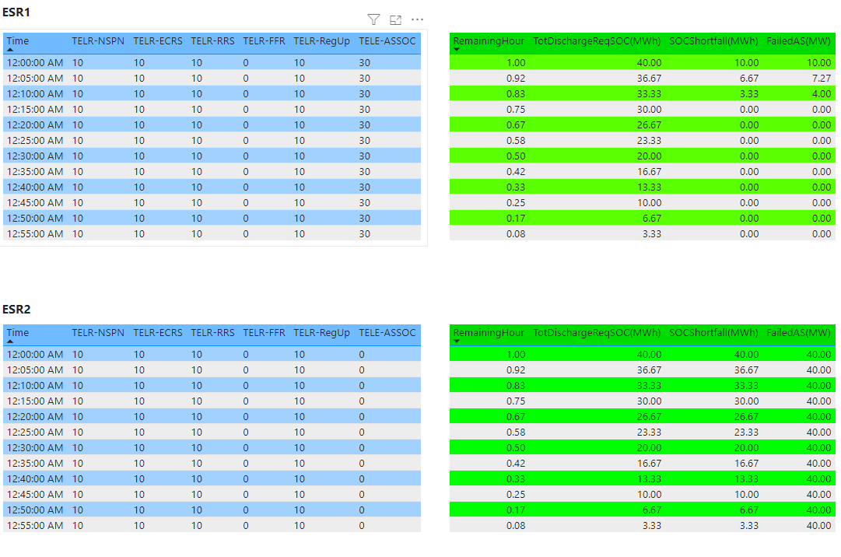
Example 3: Insufficient SOC With Carrying Multiple AS

Slide 12
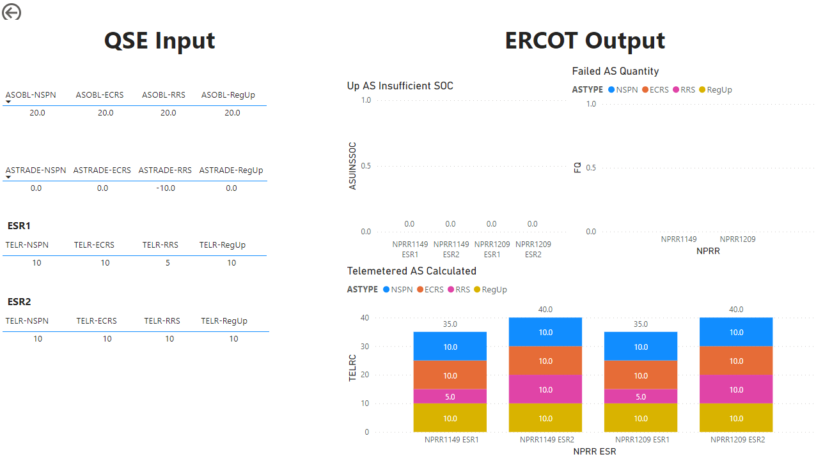
Example 4: Intra-hour obligation change

Slide 13
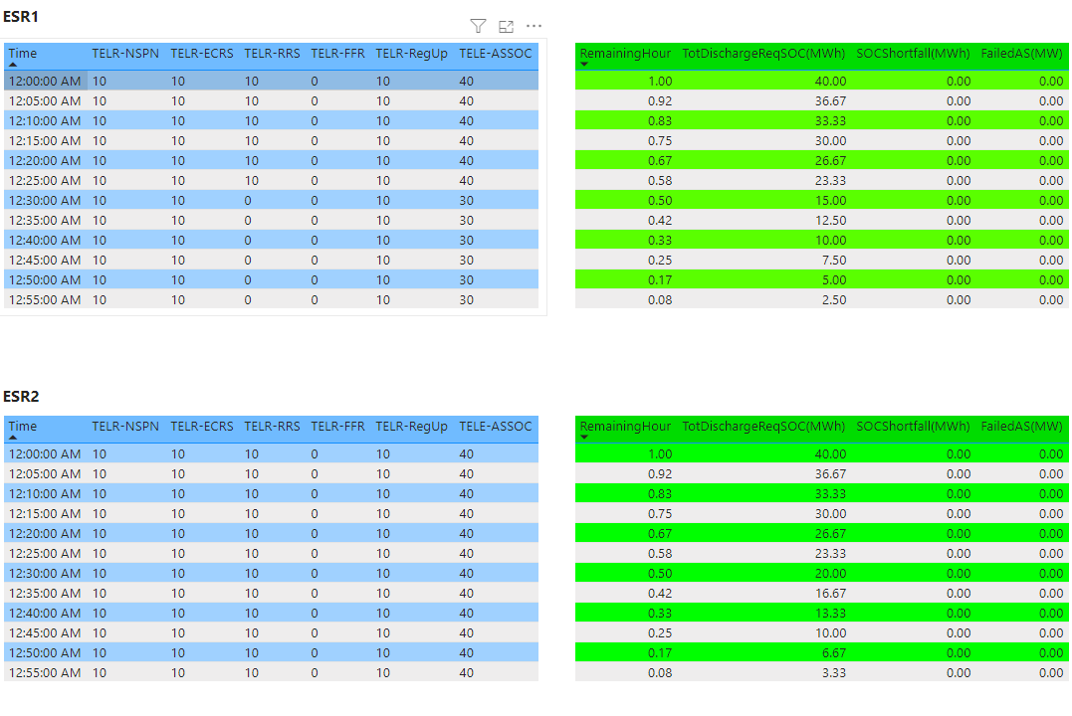
Example 4: Intra-hour obligation change

