Slide 1
ERCOT Frequency Control Report
October 2023
ERCOT
Operations Planning
PDCWG | November 15, 2023

Slide 2
Summary of October 2023
CPS1: 176.12%
Current CPS1 12-Month Rolling Average: 175.06%
0 BAAL Exceedance(s)
0 hourly CPS1 score below 100%
BAAL-003 Events have updated through 2022
2022 BAAL-003 FRM Performance: -1060.40
2023 RMS1 Statistics
  Mean: 14.94 mHz
  Min: 11.76 mHz
  Max 24.40 mHz
Energy Statistics
  Total Energy: 35,628,256 MWh
  Wind Energy: 8,770,987 MWh
  Percent Energy from Wind: 24.62%
  Solar Energy: 2,592,963 MWh
  Percent Energy from Solar: 7.28%
Minimum System Inertia
  Mean: 227,814 MW*s
  Max: 284,485 MW*s on October 5th
  Min: 183,022 MW*s on October 18th

Slide 3
Frequency Control
CPS1, BAAL, & RMS1

Slide 4
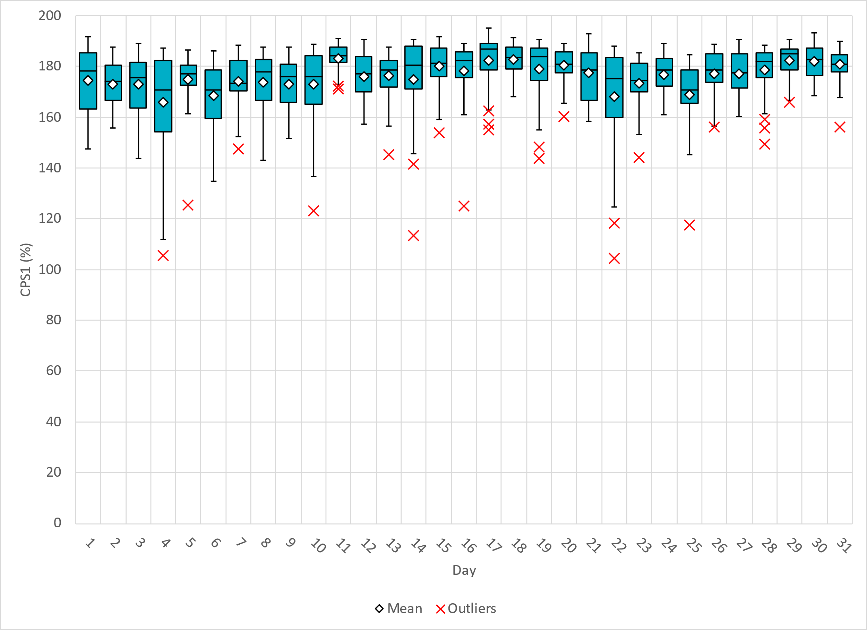
Hourly CPS1 by Day
Oct-23 CPS1 (%): 176.12

Slide 5
BAAL Exceedances & Violations
There were 0 BAAL exceedance(s) in October.

Slide 6
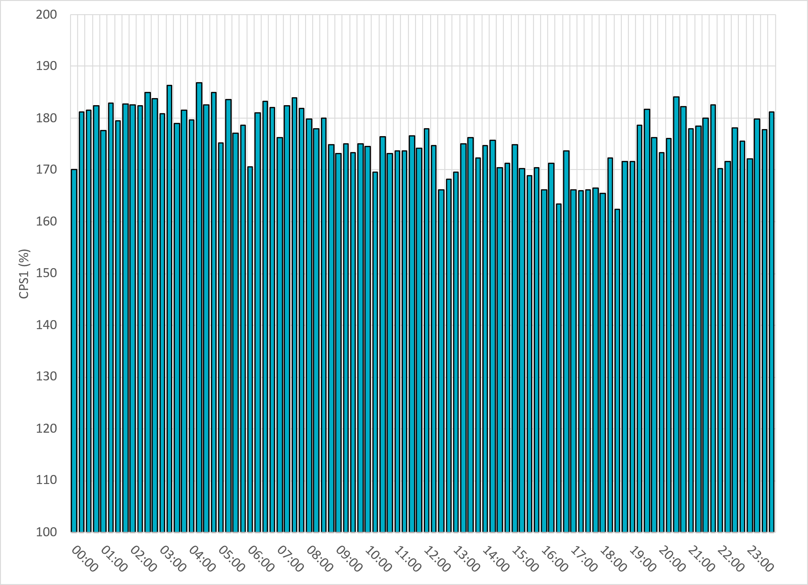
15-Minute Average CPS1%
Oct-23 CPS1 (%): 176.12

Slide 7
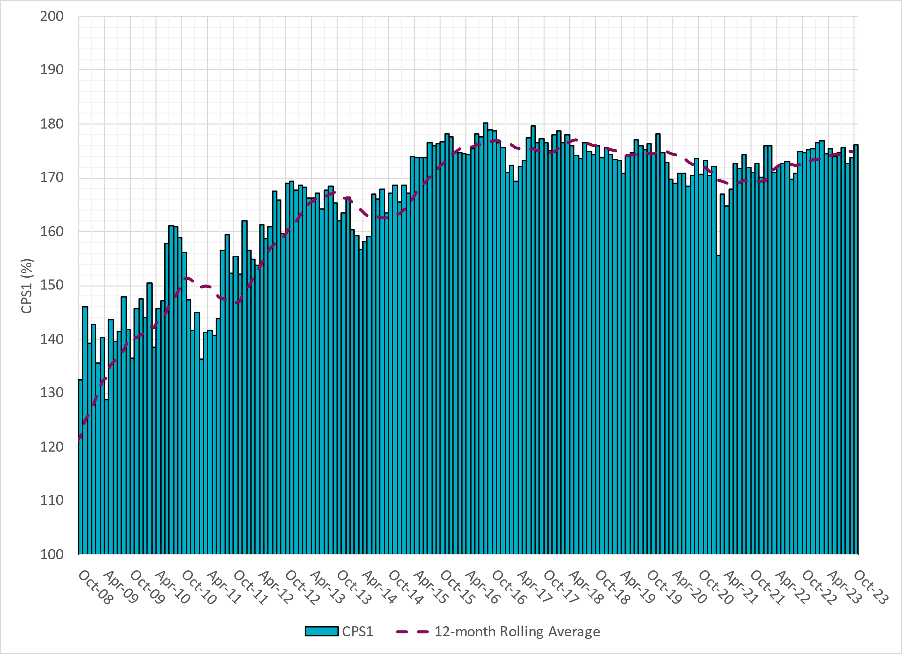
12-Month Rolling Average CPS1
Current 12-Month Rolling Average: 175.06%
Notes:
12 month rolling average CPS1 score is 175.06 which is in line with expectations, and the CPS1 score for October is slightly higher than the last month.

Slide 8
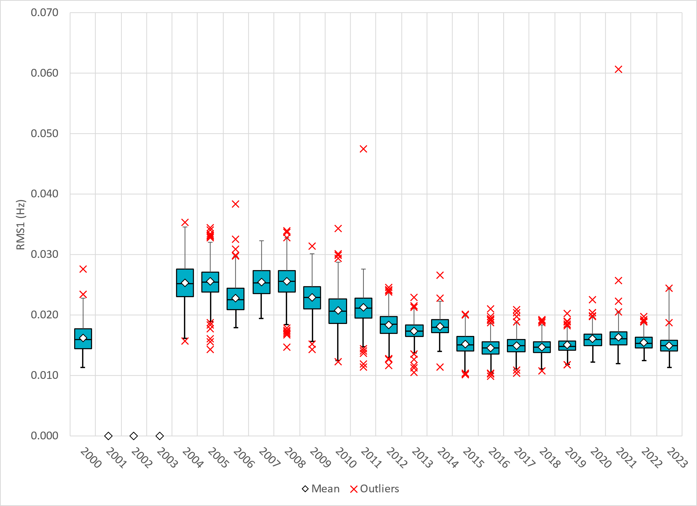
Daily RMS1 of ERCOT Frequency by Year
Notes:
Daily RMS1 frequency by year is so far slightly larger overall compared with 2022.
Mean: 14.94 mHz
Min: 11.76 mHz
Max 24.40 mHz

Slide 9
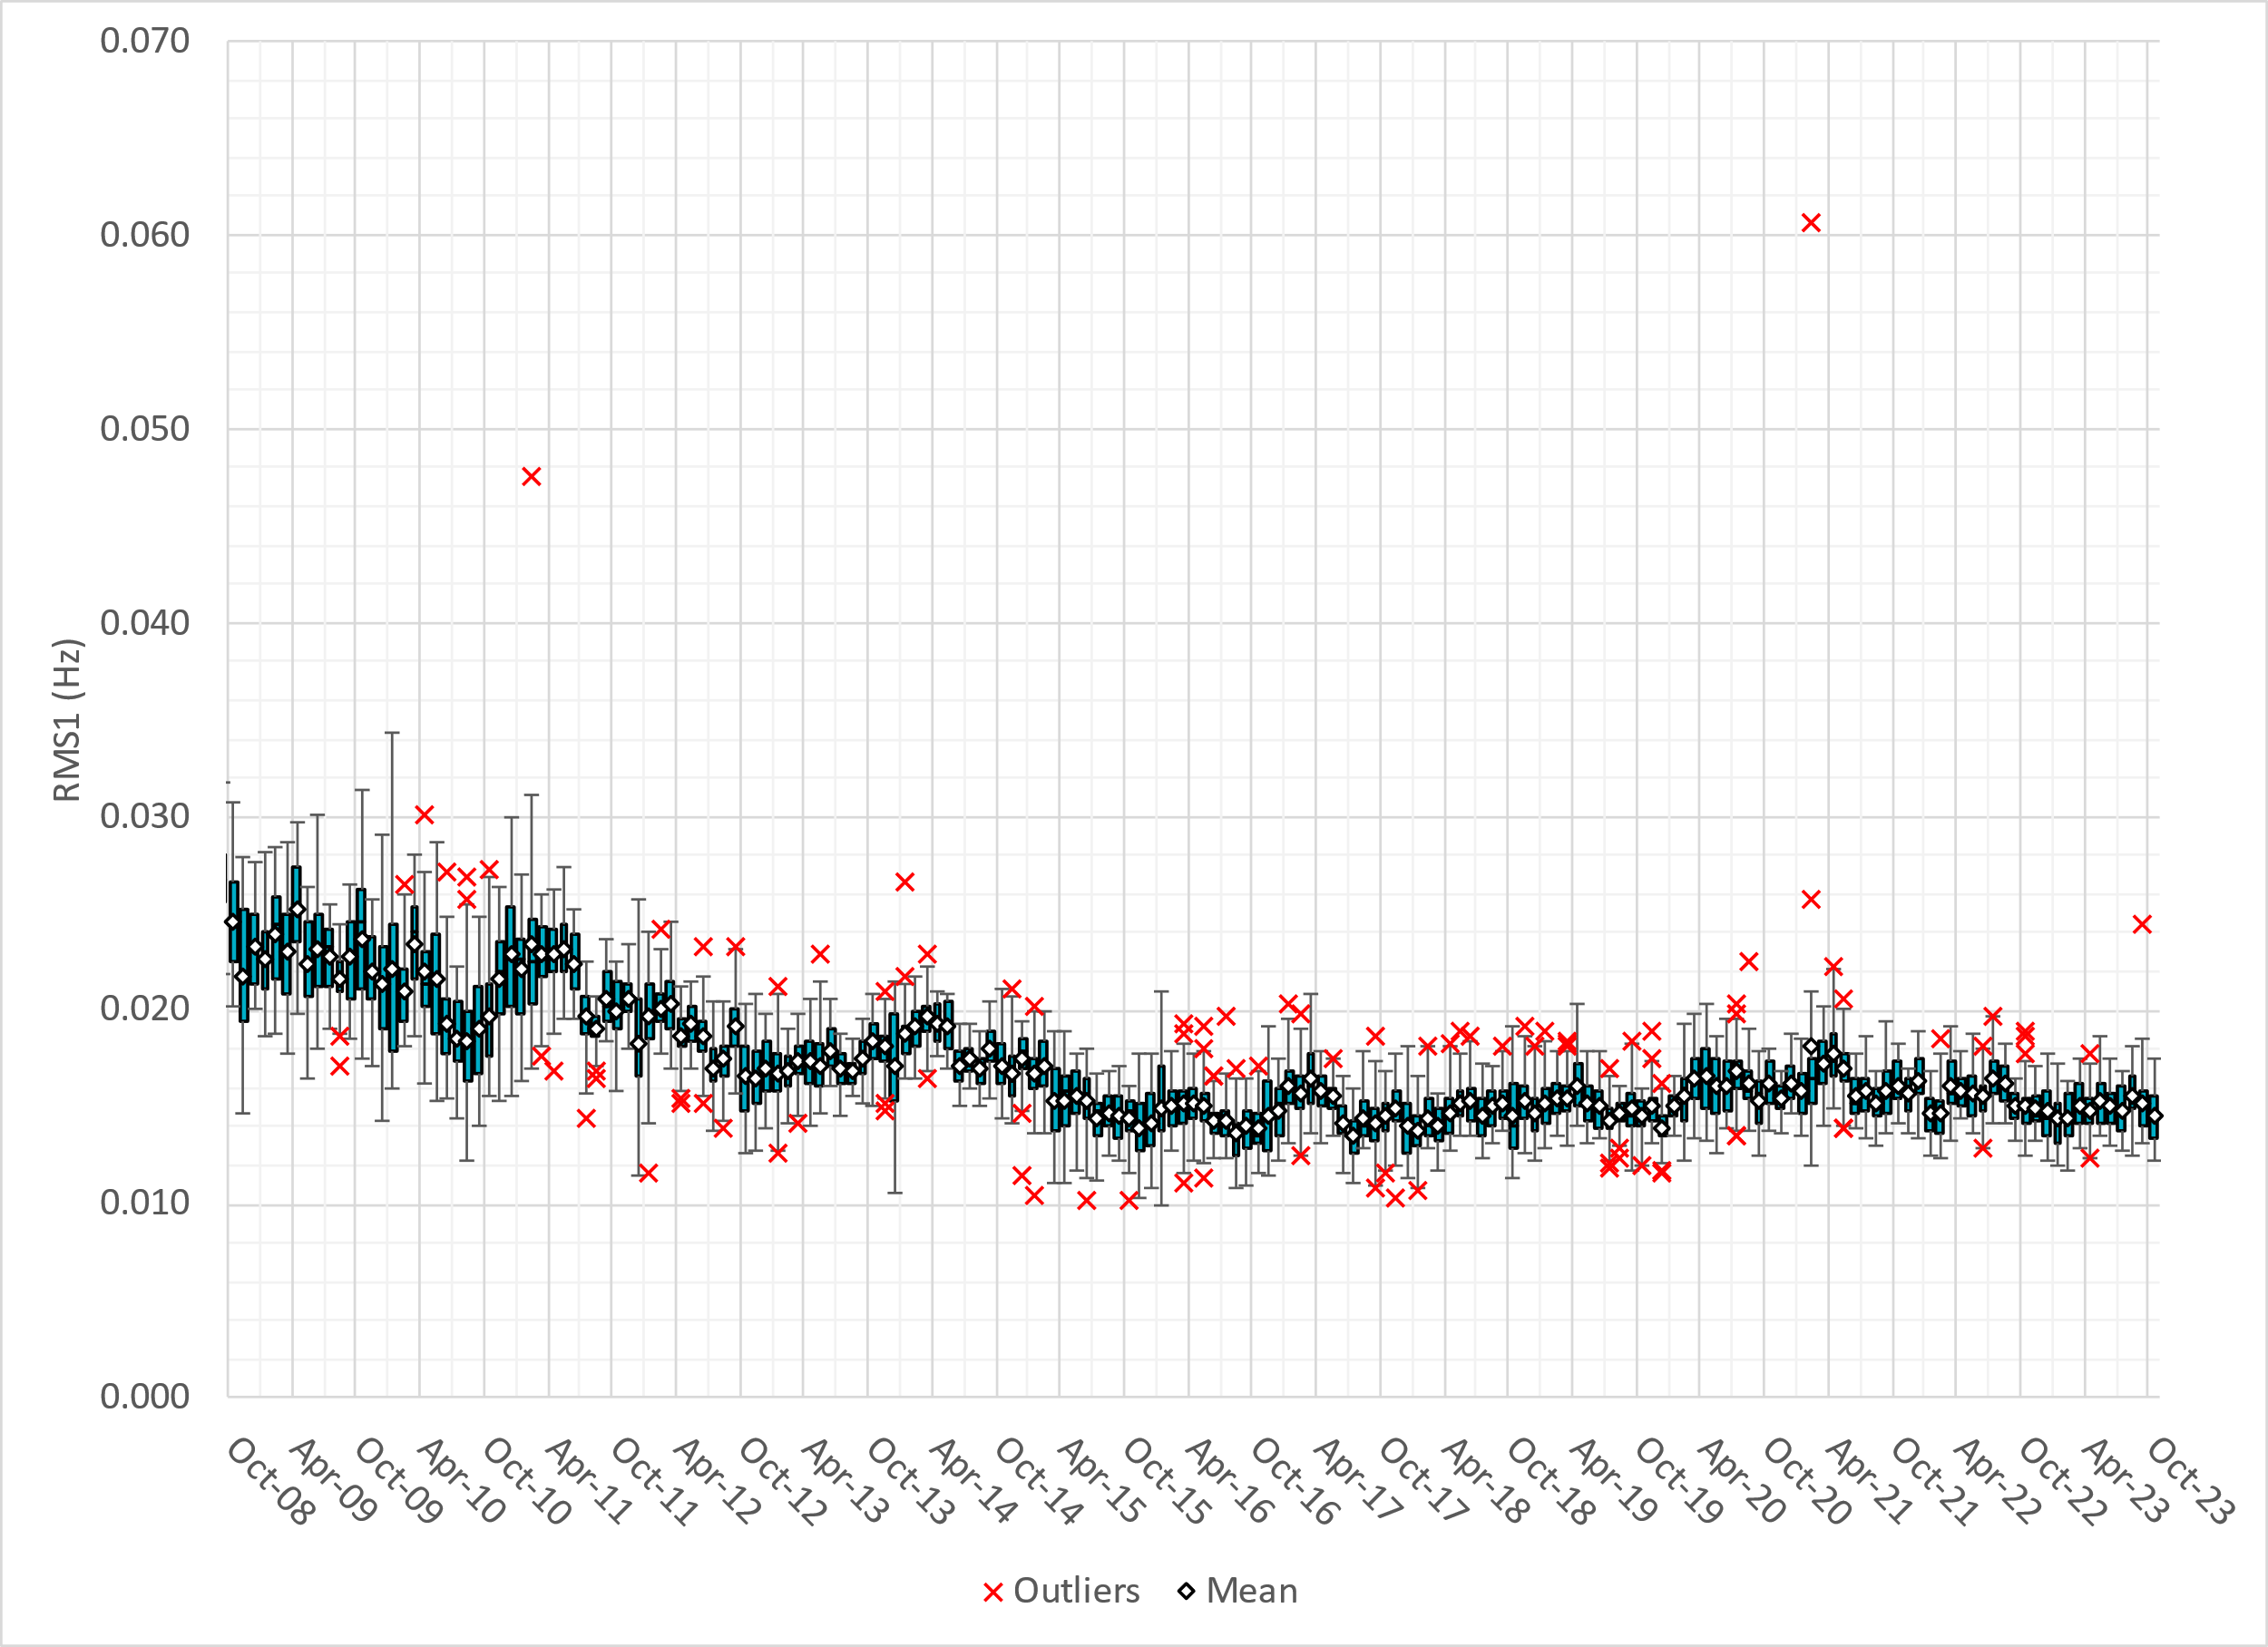
Daily RMS1 of ERCOT Frequency by Month
Notes:
A More granular look at last 15 years of RMS1 by month
14.60 mHz on avg for October 2023

Slide 10
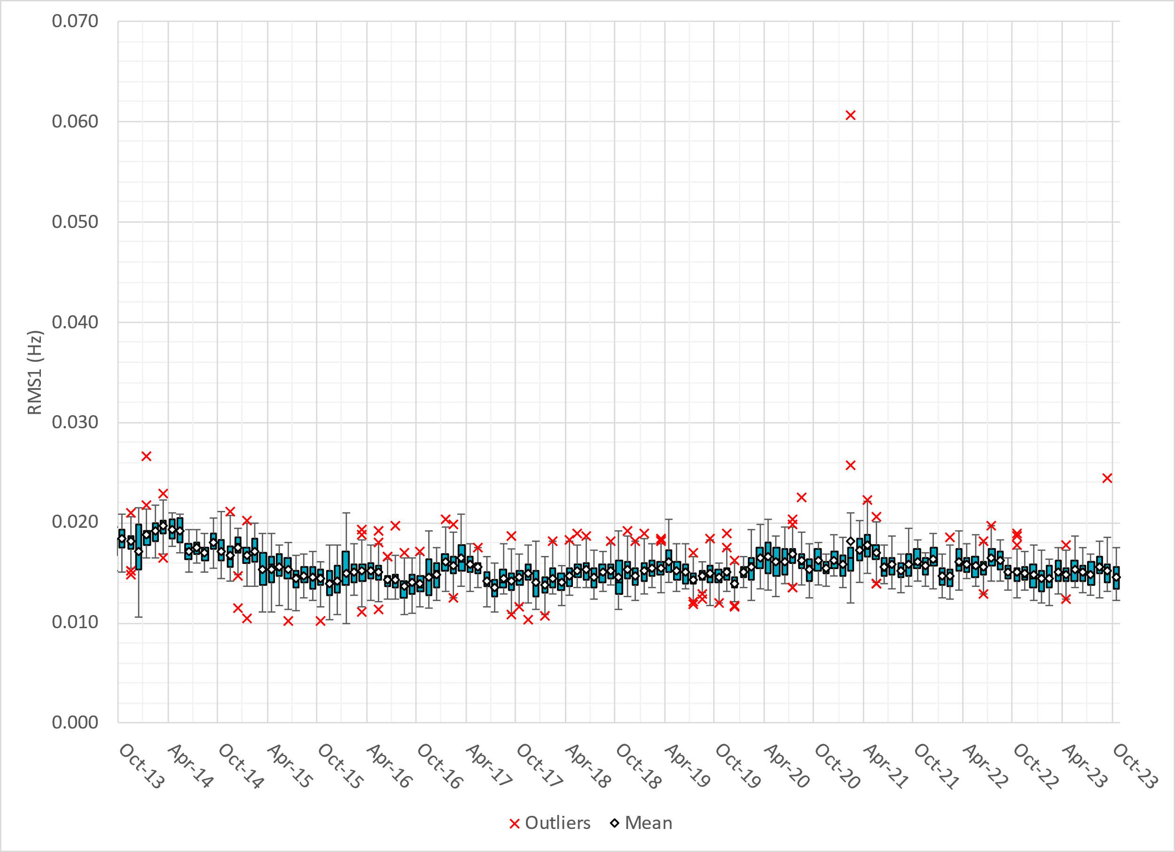
Daily RMS1 of ERCOT Frequency by Month
Notes:
Same data with 10 years shown instead of 15

Slide 11
Frequency Profile Comparison

Slide 12
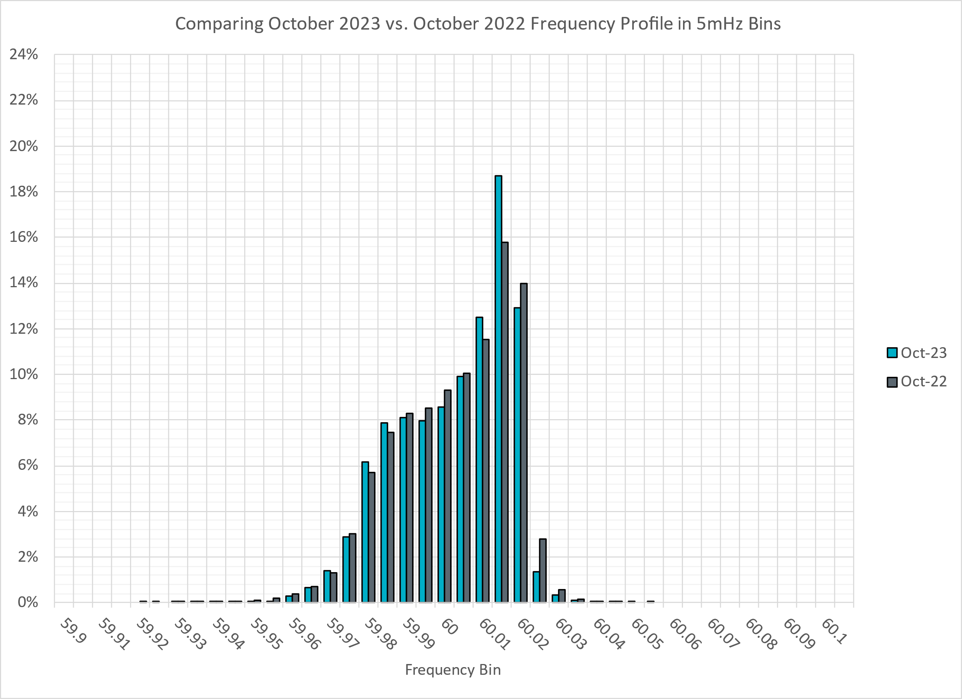
Frequency Profile Comparison
Notes:
Comparison of frequency profile between October 2022 and October 2023, we see slightly more instances of frequency hovering at or below the lower deadband in September 2023.

Slide 13
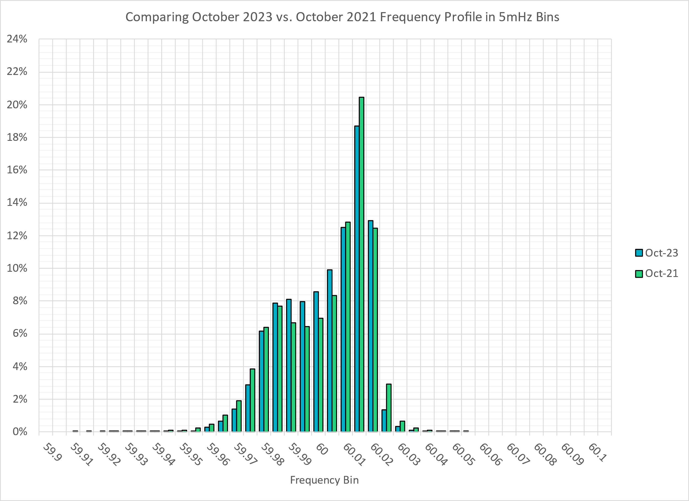
Frequency Profile Comparison
Notes:
Comparison of frequency profile between October 2021 and October 2023, we see fewer instances of frequency hovering well below the lower deadband in October 2023, and significantly fewer instances of frequency crossing the higher deadband in October 2023.

Slide 14
Time Error Correction

Slide 15
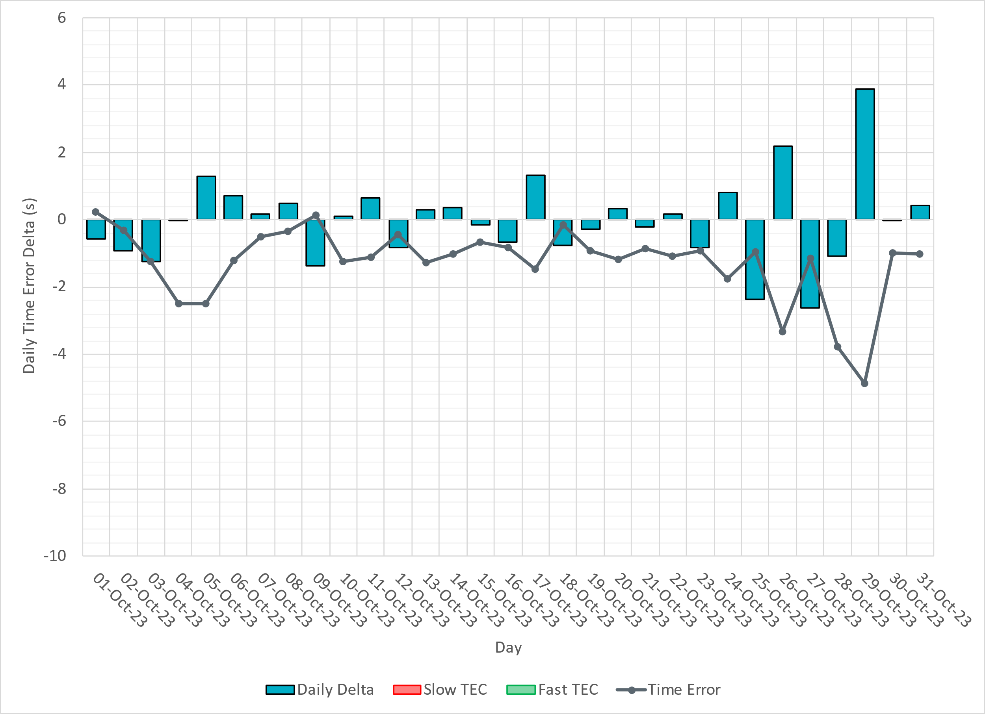
ERCOT Daily Time Error

Slide 16
Time Error Corrections Log Summary
There have been no time error corrections since December 2016

Slide 17
BAL-003 Performance

Slide 18
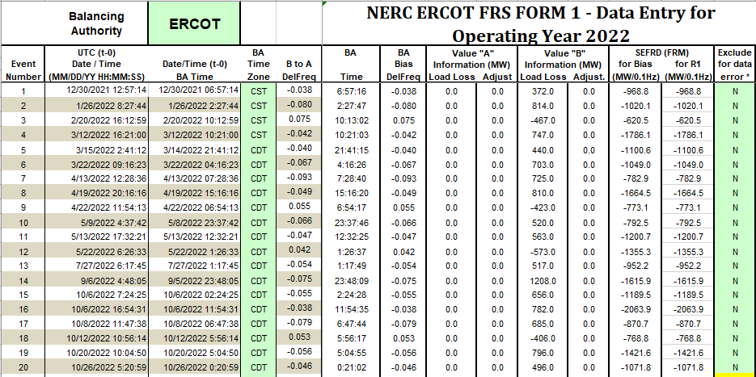
Op. Year 2022 BAL-003 Selected Events – Update
Notes:
BAL-003

Slide 19
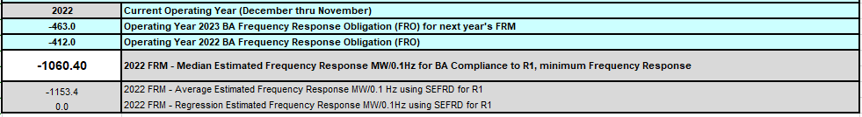
Op. Year 2022 BAL-003 FRM Performance - Update
Notes:
OP2018: FRO = -381.0, FRM_median = -843.17, FRM_average = -959.7
OP2019: FRO = -381.0, FRM_median = -811.14, FRM_average = -892.5
OP2020: FRO = -425.0, FRM median = -789.34, FRM average = -879.0
OP2021: FRO = -471.0, FRM median = -913.56, FRM average = -992.
OP2022: FRO = -463.0, FRM median = -1060.40, FRM average = -1153.4

Slide 20
ERCOT Energy Statistics

Slide 21
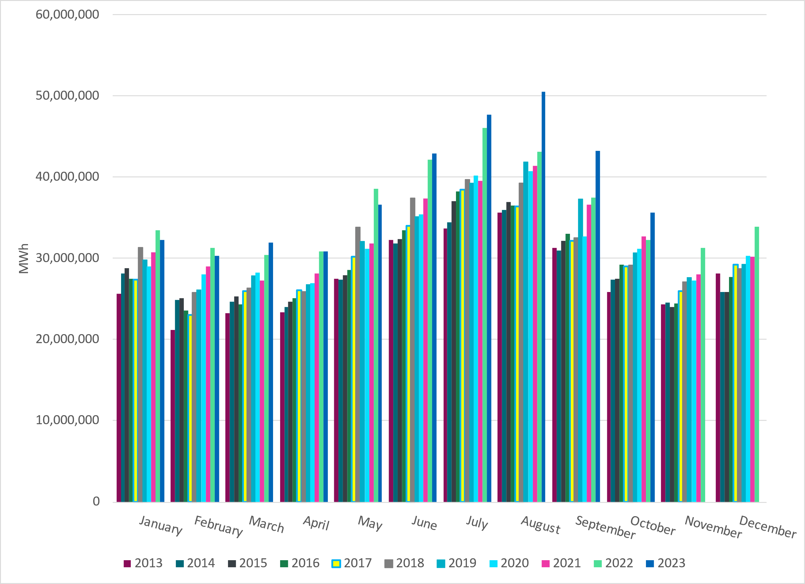
Total Energy
Notes:
35,628,256 MWh

Slide 22
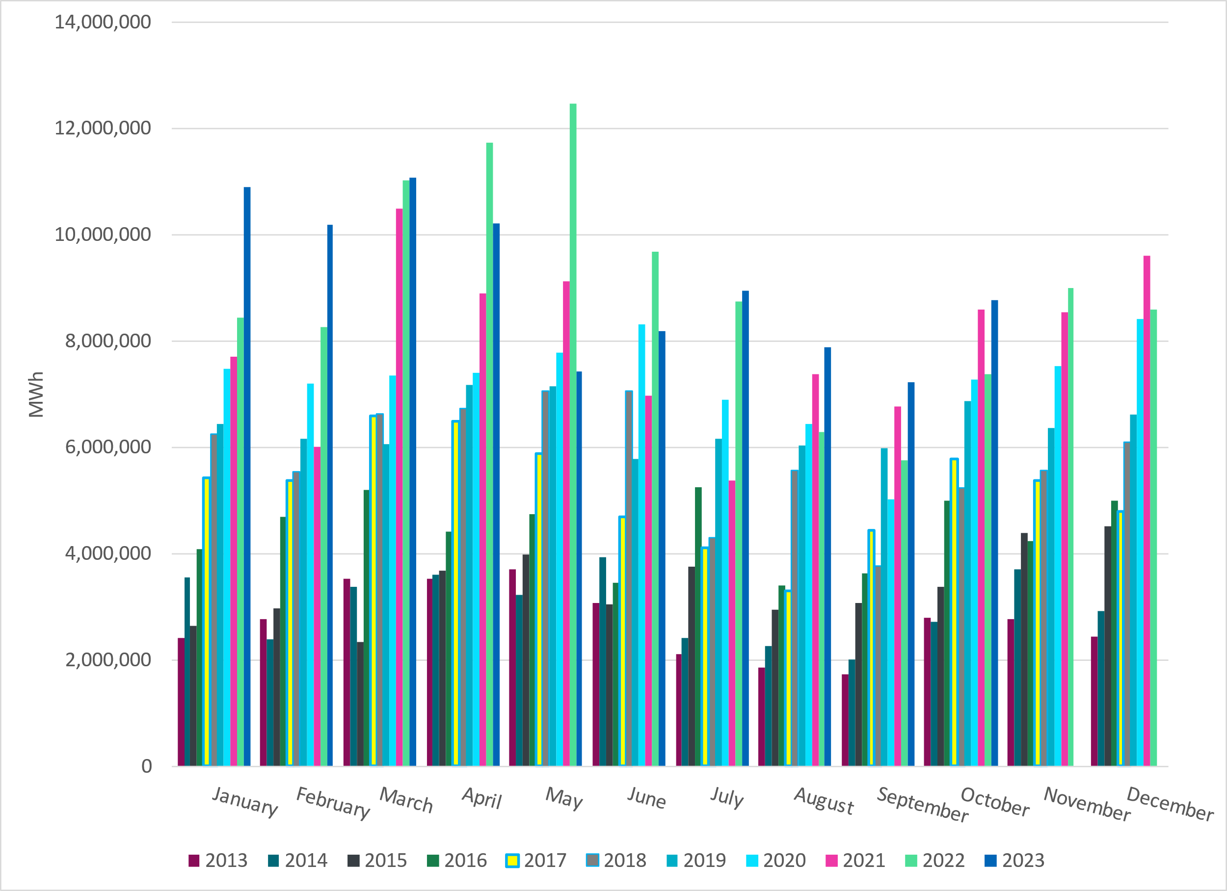
Total Energy from Wind Generation
Notes:
8,770,987 MWH

Slide 23
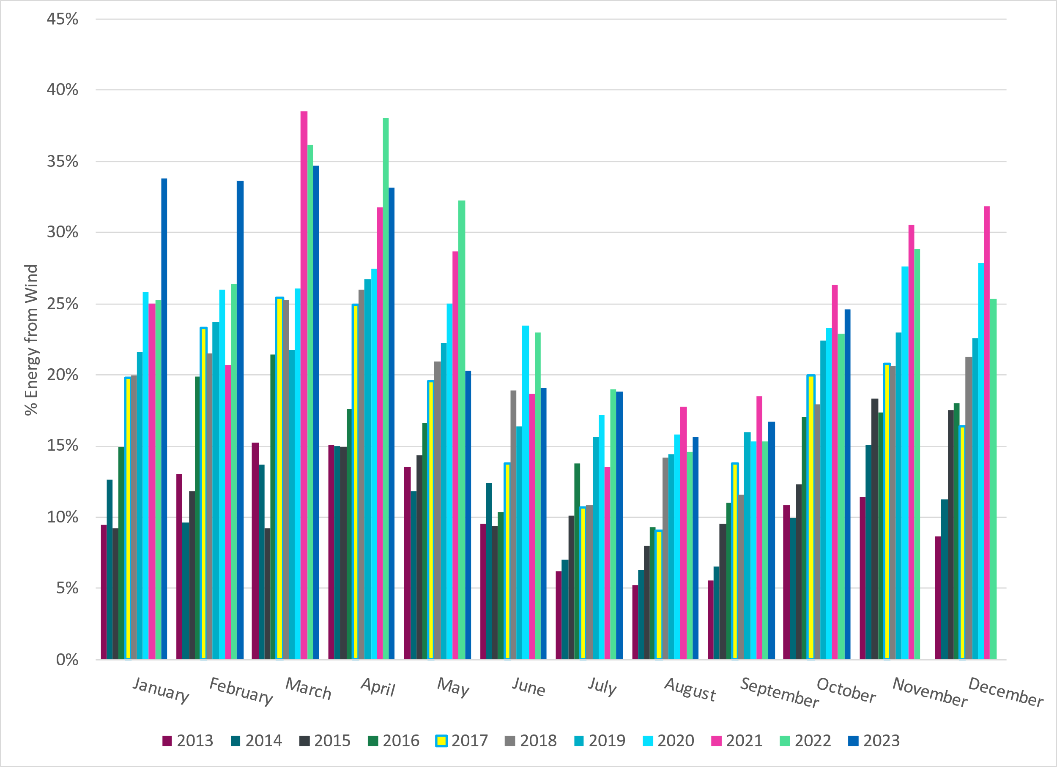
% Energy from Wind Generation
Notes:
24.62%
of total energy was provided by wind generation

Slide 24
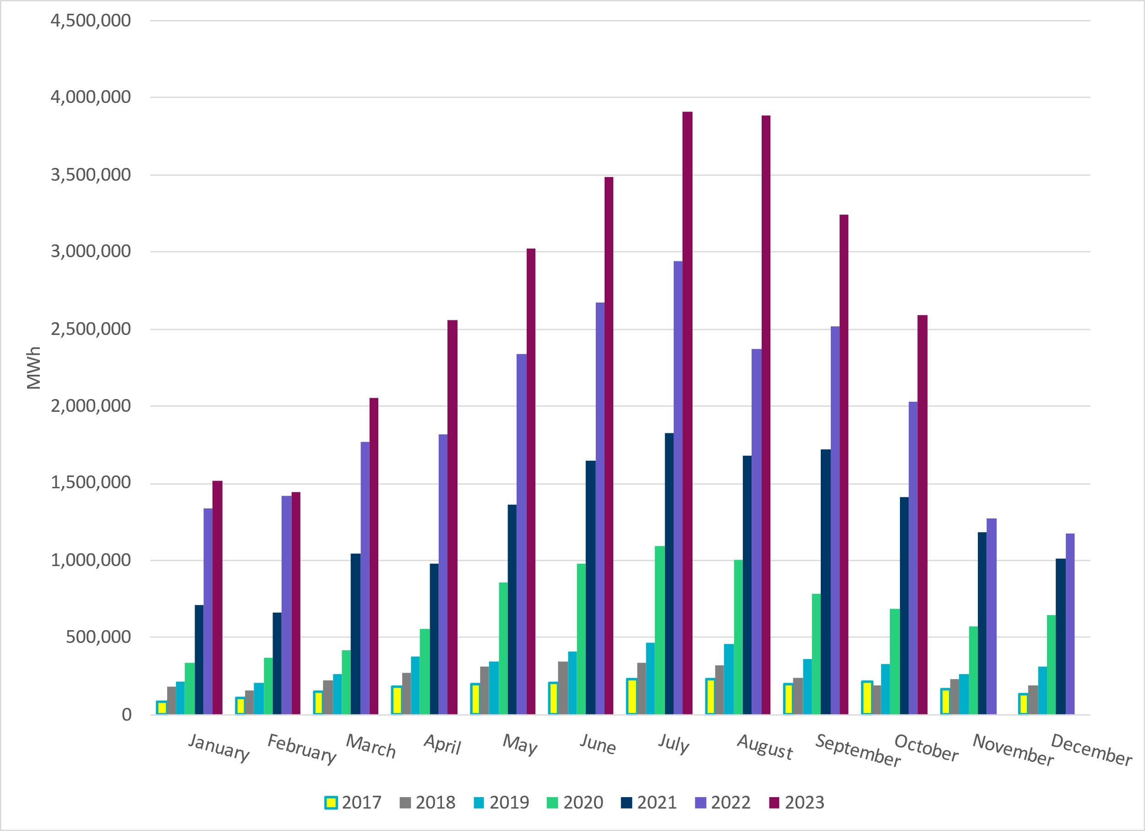
Total Energy From Solar Generation
Notes:
2,592,963 MWh

Slide 25
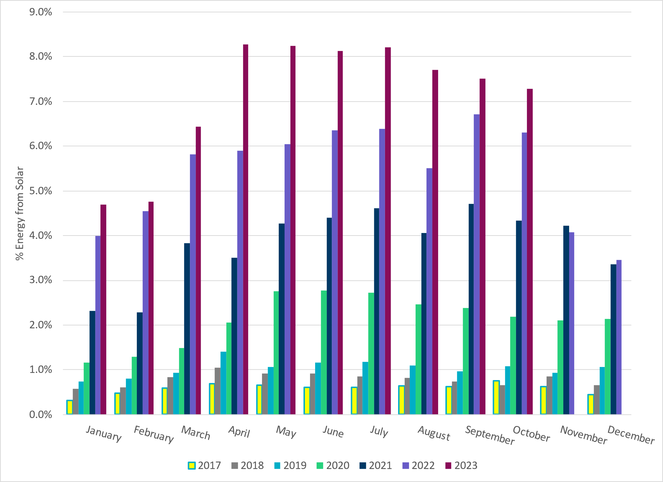
% Energy from Solar Generation
Notes:
7.28% of total
energy was provided by solar generation, which is highest solar penetration level so far.

Slide 26
ERCOT System Inertia

Slide 27
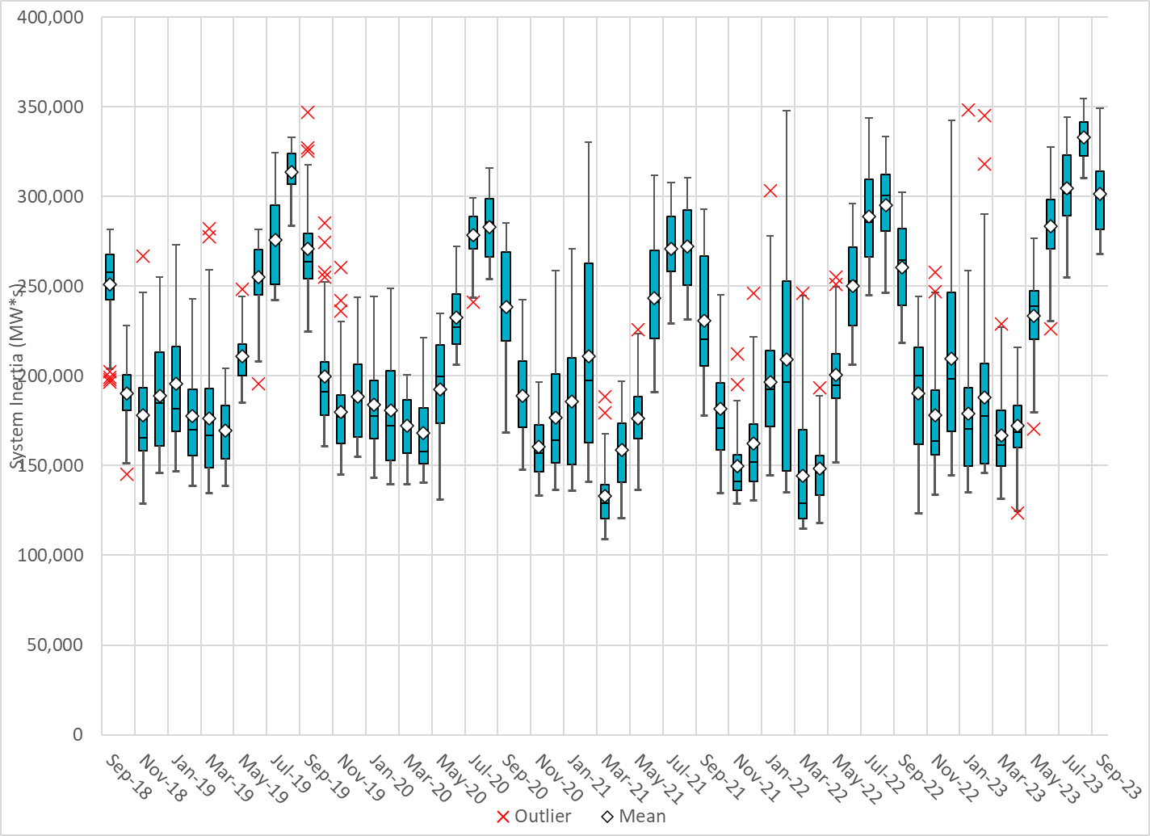
Daily Minimum System Inertia
Notes:
Minimum Inertia = 183,022 MW*s on 10/18/2023
Previous Minimum was 109,029 MW*s on 3/22/2021
Data:
Mean: 227,814 MW*s
Max: 284,485 MW*s on October 5th
Min: 183,022 MW*s on October 18th

Slide 28
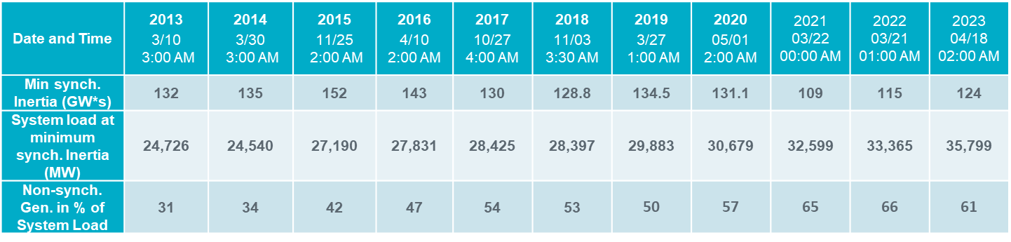
ERCOT Inertia 2013-2023
Notes:
For each box, the central mark (red line) is the median, the edges of the box (in blue) are the 25th and 75th percentiles, the whiskers correspond to +/- 2.7 sigma (i.e., represent 99.3% coverage, assuming the data are normally distributed. The corresponding lowest inertia in each year is given in the table.
The circle on each boxplot is showing inertia during time when highest portion of load was served by wind/solar generation in that year.

Slide 29
Questions?
Thank you!

