Slide 1
ERCOT Frequency Events
October 2023
ERCOT
Operations Planning
PDCWG |Nov 15th, 2023

Slide 2
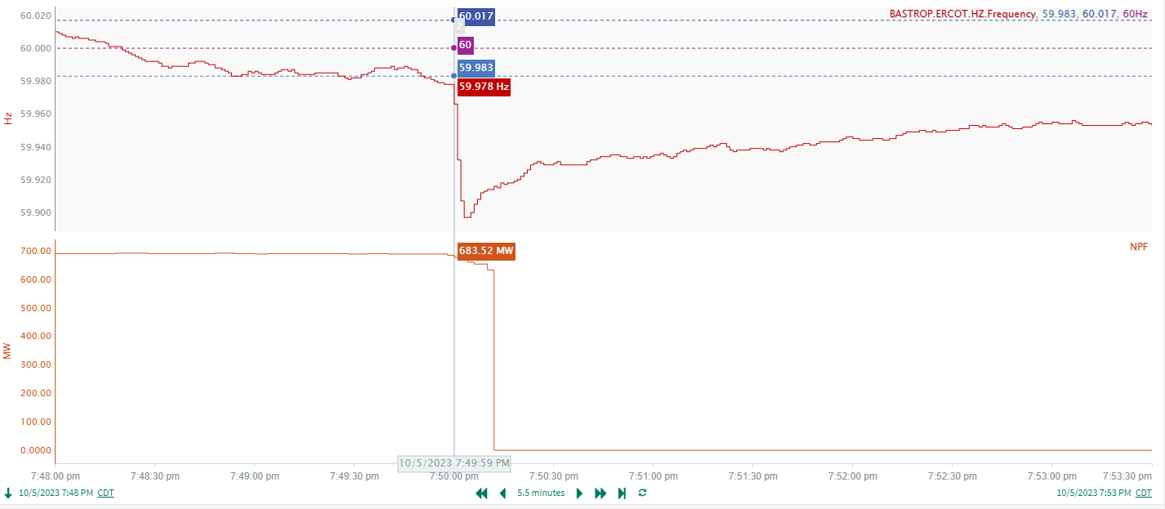
10/5/2023 19:49:59(Non-FME)
Notes:
The unit ran back for 55MW and then tripped offline while carrying approximately 632MW
Starting Frequency: 59.978 Hz
Minimum Frequency: 59.897 Hz
A-C Time : 4 seconds
Recovery Time(back to deadband): 6 minutes 18 seconds
ECRS Released: 498 MW
Trip Reason: Momentary Fuel Loss
Contextual Information: A total of 245 MW of regulation Up was deployed and manual offset of 400 MW was applied during the event.
Reason for no selection : Frequency is outside the low deadband before the event

Slide 3
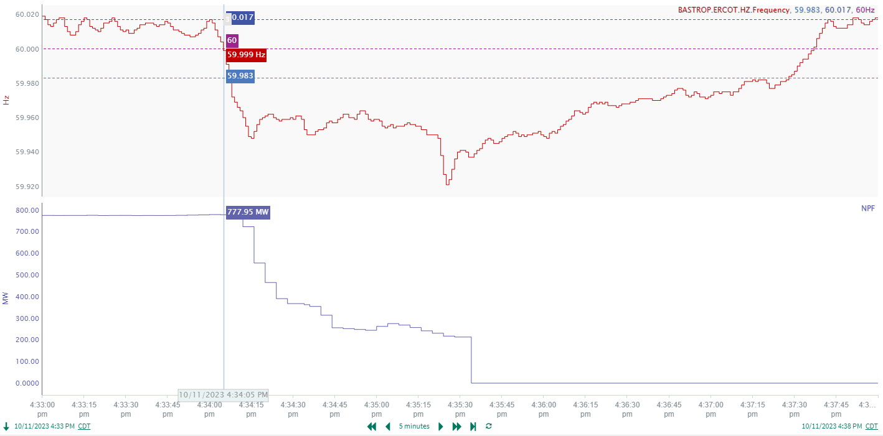
10/11/2023 16:34:05 (Non-FME)
Notes:
Several units of a combine cycle plant ran back and tripped offline in sequence which resulted in approximately 778 MW gen loss
Starting Frequency: 59.999 Hz
Minimum Frequency: 59.921 Hz
A-C Time : 1 minute 20 seconds
Recovery Time(back to deadband): 3 minutes 23 seconds
ECRS Released: 0 MW
Trip Reason: Unknown.
Contextual Information: A total of 332 MW of regulation Up was deployed and a manual offset of 300 MW was applied during the event.

Slide 4
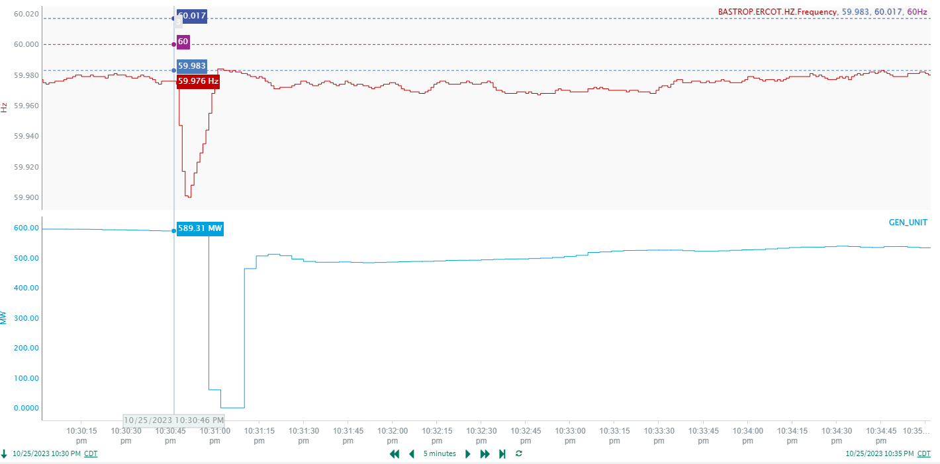
10/25/2023 22:30:46(Non-FME)
Notes:
A unit tripped offline while carrying approximately 589 MW and came back immediately
Starting Frequency: 59.976 Hz
Minimum Frequency: 59.900 Hz
A-C Time : 5 seconds
Recovery Time(back to deadband): 15 seconds
ECRS Released: 0 MW ( Released and recalled within 10 seconds)
Trip Reason: Unknown.
Contextual Information: A total of 92 MW of regulation Up was deployed during the event.

Slide 5
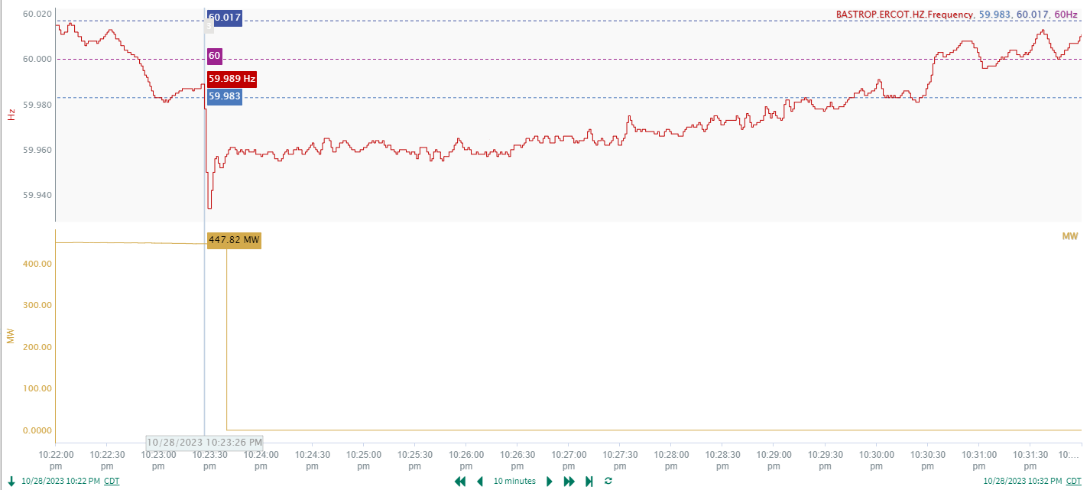
10/28/2023 22:23:26(Non-FME)
Notes:
A unit tripped offline while carrying approximately 448 MW
Starting Frequency: 59.989 Hz
Minimum Frequency: 59.934 Hz
A-C Time : 3 seconds
Recovery Time(back to deadband): 5 minutes 52 seconds
ECRS Released: 0 MW
Trip Reason: Unknown
Contextual Information: A total of 92 MW of regulation Up was deployed.

Slide 6
Questions?
Thank you!

