Slide 1
EAL Change proposals: Sep 2023 data and RFAF dynamics
Sanchir Dashnyam
ERCOT Market Credit Manager
ERCOT Public
November 15, 2023

Slide 2
Invoice exposures – definition
Invoice exposures – Old
Invoice exposure is defined as “Invoices * M1 days + RTLCNS + UDAA”. Invoices include charges only.
Invoice exposures – New
M1 days forward invoices + 7 days look back actual invoices
M1 days could range from 10 to 21 days depending on weekends/holidays, MP activity
Invoices exclude M&N securitization invoices, CRR auction invoices and miscellaneous invoices relating to $2B distributed to market for Sec N on 6/21/22
Data is for a period covering 1/1/22 through 8/30/23
TPEA excludes Uri invoices and PUL uplift
TPEA – Invoice exposures = Gap
Negative gap is when invoice exposures exceed TPEA (less than -$10,000)
Positive gap is when TPEA exceeds invoice exposures (more than $10,000)

Slide 3
Current EAL Formula vs. Scenarios #2 and #3
Current: EAL _{q} = Max [IEL during the first 40-day period only beginning on the date that the Counter-Party commences activity in ERCOT markets, RFAF * Max {RTLE during the previous lrq days}, RTLF] + DFAF * DALE + Max [RTLCNS, Max {URTA during the previous lrq days}] + OUT _{q} + ILE _{q}
Scenario #2: EAL q = Max [IEL during the first 40-day period only beginning on the date that the Counter-Party commences activity in ERCOT markets, Max{(RFAF * Max {RTLE) during the previous lrq days}, RTLF] + DFAF * DALE + Max [RTLCNS, Max {URTA during the previous lrq days}] + OUT q + ILE q
Scenario #3: EAL q = Max [IEL during the first 40-day period only beginning on the date that the Counter-Party commences activity in ERCOT markets, RFAF * Max {RTLE during the previous lrq days}, RTLF] + DFAF * DALE + Max [RTLCNS, Max {URTA during the previous lrq days}] + OUT q + ILE q
Two RFAF’s: CP specific RFAF and Global RFAF
CP specific RFAF = Projected Real-Time ICE Forward Average Price / Max RTLE date Historic Real-Time Settled Average Price
Global RFAF is calculated based on existing methodology. Global RFAF is used in MCE calculations.

Slide 4
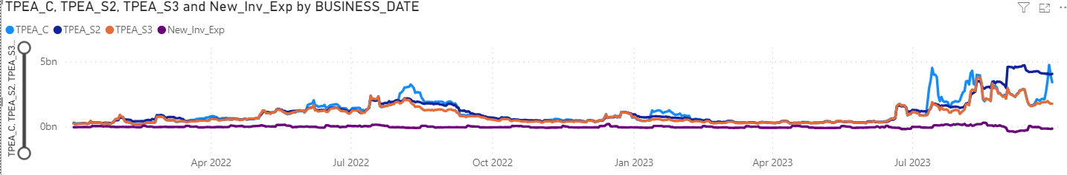
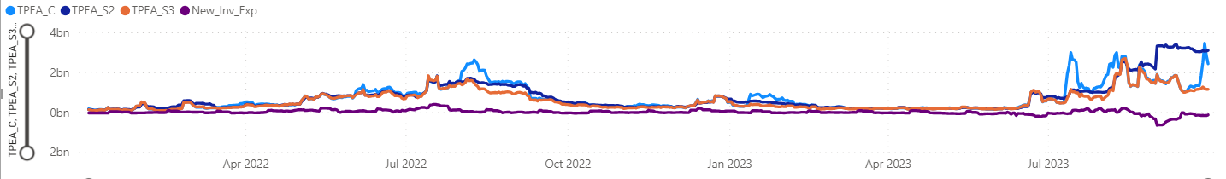
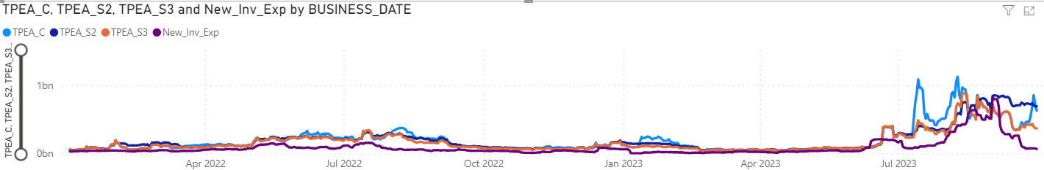
TPEA vs Invoice Exposures incl. Sep: market, load & gen, load

Slide 5
RFAF
RFAF by its definition is very volatile: RFAF peaked during winter storm Uri at almost 11 then went to 0.01 on 2/24/21.
Most recently it hit 6 in July 2023, which was the highest since Feb 2021. Also, it went as low as 0.15 on 9/13/23, which was the lowest since Uri. The fact that, RFAF goes down below 1 means TPE is essentially mechanically lowered once historical settled prices roll off from the denominator.

Slide 6
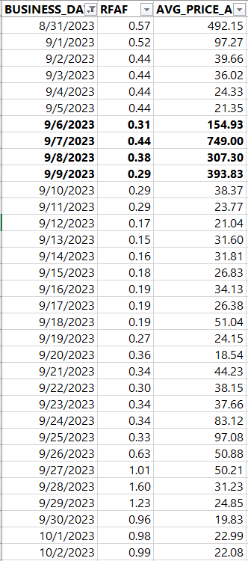
RFAF vs Avg settled prices
RFAF does not always predict the magnitude or extent of price volatility.
In 2023 prices were sustained at high levels throughout the summer, whereas in 2022 there was a relatively short period of high prices at the end of July. On the other hand, RFAF before July 22 price spike peaked at roughly 2.5, while it hit 6 in July 23 with relatively low prices. Spike in July 23 was rather a “mechanical” increase compared to the second spike in August 23, which was more on “point”.
RFAF was essentially below 1 for the entire month of September 2023. After August 9th peak of 5.3 RFAF has declined steadily and bottomed in mid September despite prices being relatively high during 9/6-9/10.
A market participant would have been exposed to higher prices, while TPEA would have been artificially lowered due to the RFAF going below 1. Also, it is noted that in cases of MCE driving TPEA, RFAF going below 1 could also artificially depress TPEA.

Slide 7
Example, a load & gen MP during September 2023
Scenario #2 looks at Max (RFAF *RTLE during the previous lrq days), thus, it does solve the problem of RFAF going below 1 and artificially depressing exposures.
On the other hand, the TPEA under Scenario #2 will tend to “sit” there until the Max rolls off.
Current methodology and Scenario #3, could result in negative gap events, especially, when RFAF goes below 1.

Slide 8
June through Sep 2023: Negative and positive gaps
Negative gaps – Scenario #2 lowers negative gaps while Scenario #3 increases negative gaps
Scenario #2 reduces negative gap occurrences by 9%, aggregate total negative gap amounts by 18.6% with the average negative gap amounts decreasing 10.5%.
Scenario #3 increases negative gap occurrences by 7%, aggregate total negative gap amounts by 23.5% with the average negative gap amount increasing by 15%.
Positive gaps – Scenario #3 will lower positive gaps while Scenario #2 will increase them
Scenario #2 increases positive gap occurrences by 0.8%, increases aggregate total positive gap amounts by7.4% with the average positive gap amount staying about the same.
Scenario #3 reduces positive gap occurrences by 0.8%, aggregate total positive gap amounts by 18.7% with the average positive gap amount decreasing 18.1.

Slide 9
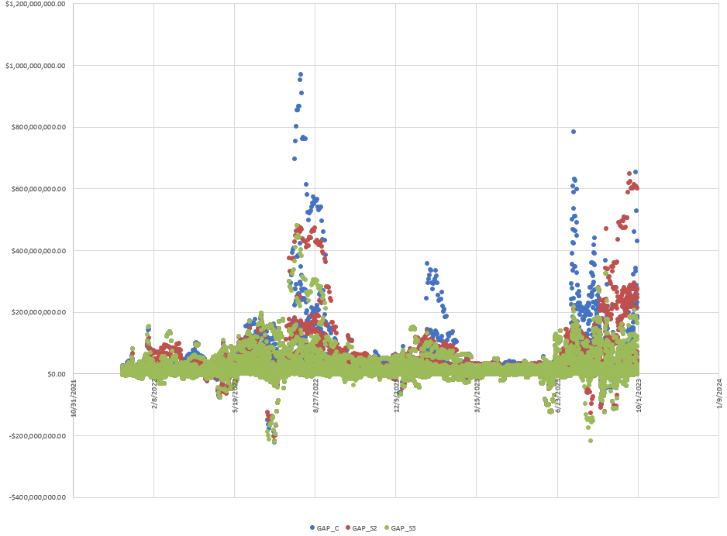
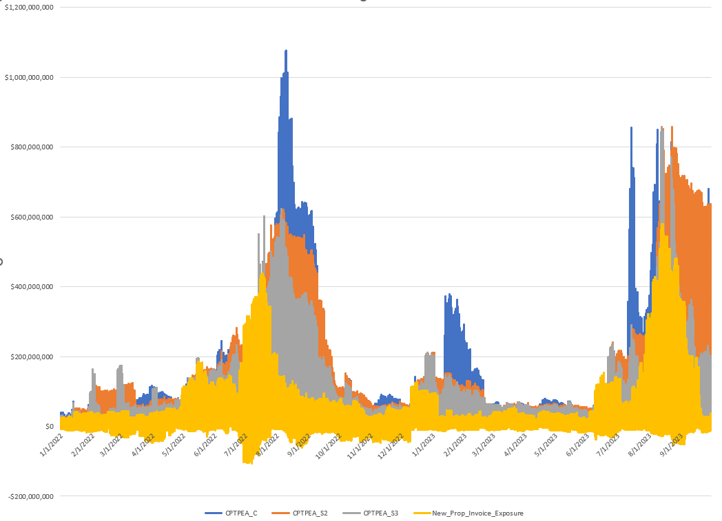
Top 20 negative gap counterparties, current

Slide 10
Correlation: Invoice exposures vs Current, Scenario #2 and Scenario #3
Both scenarios appear to have higher correlation with invoice exposures compared to the existing methodology.
Scenario #3 appears to have a highest correlation with invoice exposures, though the marginal difference compared to Scenario #2 appears to not that significant.
Scenario #2 lowers negative gaps while Scenario #3 increases negative gaps. Scenario #3 lowers the positive gaps the most.

