Slide 1
LC Issuing Bank Credit Limit Breaches
Sanchir Dashnyam
ERCOT Market Credit Manager
ERCOT Public
November 15, 2023

Slide 2
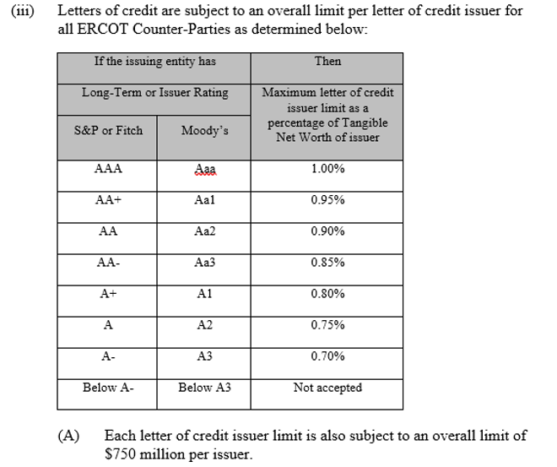
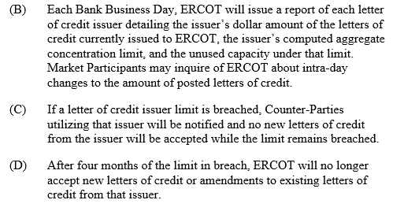
Overall limit per letter of credit issuer: ERCOT Protocol Section 16.11.3 (1) (a)

Slide 3
Issuer credit limits vs LC amounts issued
ERCOT LC concentration limit report is published daily https://www.ercot.com/services/rq/credit
As of 11/7/23, ERCOT has two banks currently in breach of Bank Issuer Credit Limits.
CICB hit 120 day mark on 11/10/23 and BBVA will hit 120 day on 11/17/23.
Issuer limits are usually breached during summer and resolved by the fall, when prices come down and market TPE is reduced.
2023 is the first year when ERCOT is observing issuer limit breaches hit the 120 day mark, i.e., this never happened before.
Overall, there are 38 banks with $13.2B total issuer limit, of which ERCOT received 313 LC’s with aggregate total amount of $4.5B. This leaves 65% of aggregate issuer limit available.

Slide 4
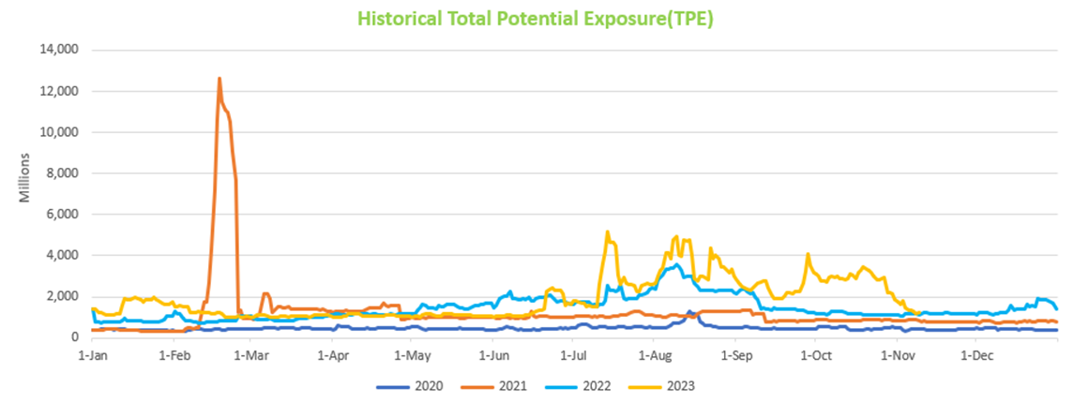
Historical TPE

Slide 5
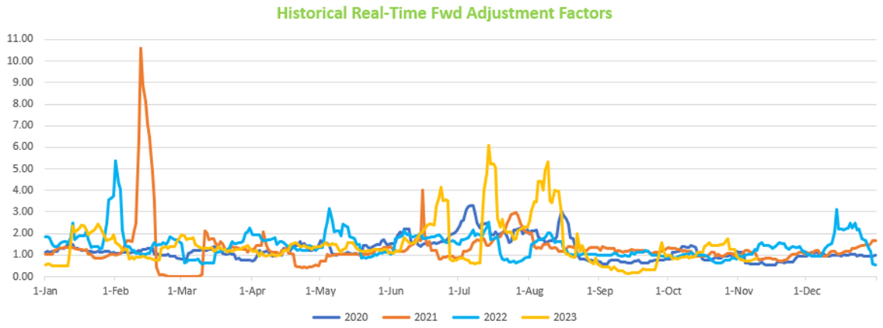
Historical RFAF and Average settled prices
* For 2021, the $9K high prices in Feb 2021 were kept at less than $400 to avoid having a huge spike in the graph.

