Slide 1

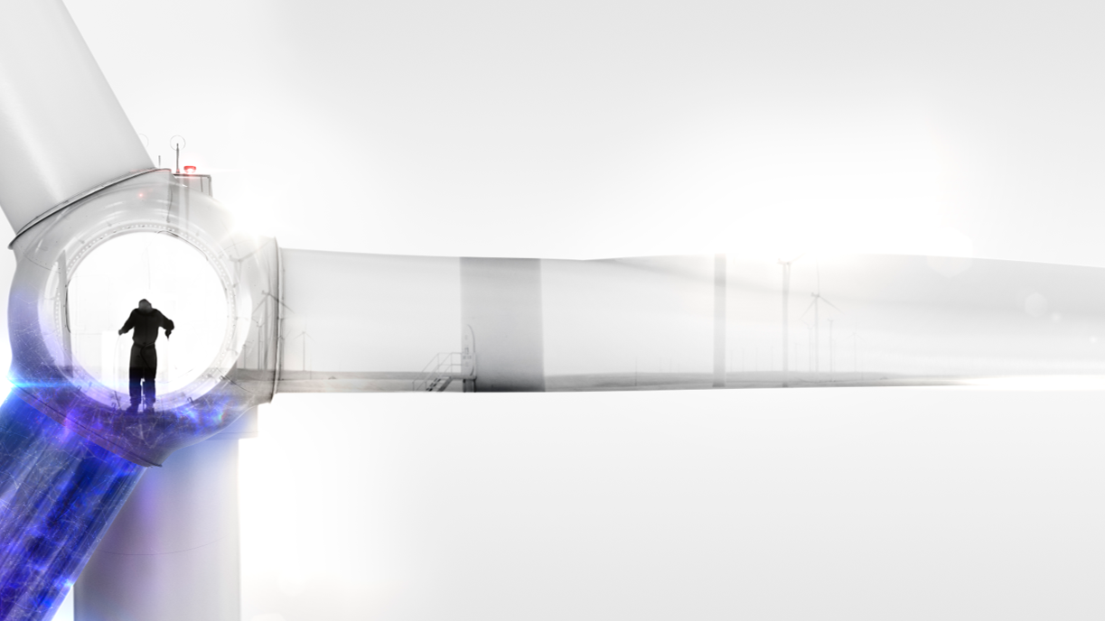
Vestas Perspective on NOGRR-245
Miguel A. Cova Acosta
Power Plant Solutions

Slide 2

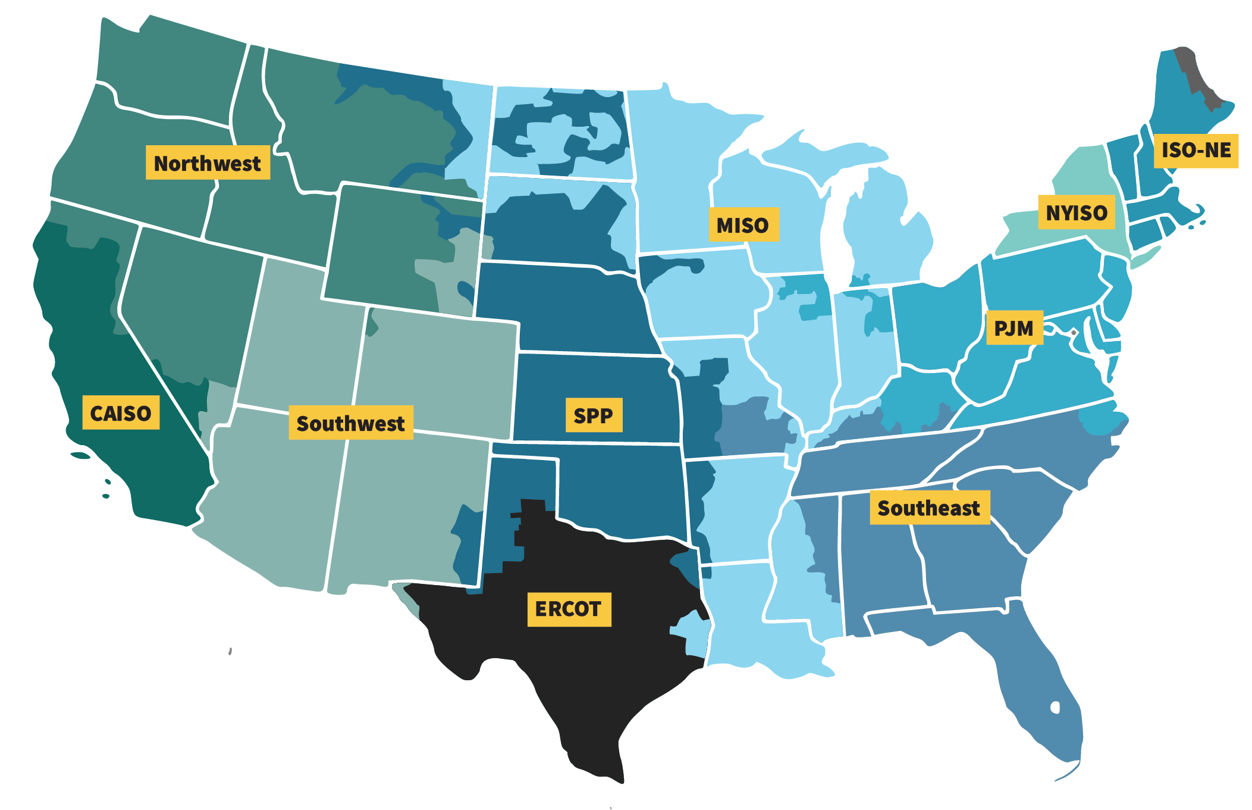
Overview
IEEE – 2800 US Context
IEEE 2800
Guidance on test and verification procedures for IBR

Slide 3
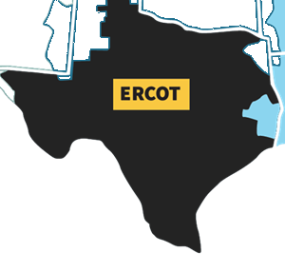
Overview
NOGRR - 245
IEEE 2800
ERCOT Implementation and interpretation of requirements
IEEE 2800
Guidance on test and verification procedures for IBR
NOGRR-245 represents a “short” section of IEEE-2800 requirements based on ERCOT interpretation.
NOGRR-245

Slide 4
Overview
IEEE – 2800 US Future?
IEEE 2800
ERCOT Implementation and interpretation of requirements
IEEE 2800
MISO Implementation and interpretation of requirements
IEEE 2800
NYISO Implementation and interpretation of requirements
IEEE 2800
NOGRR-245

Slide 5

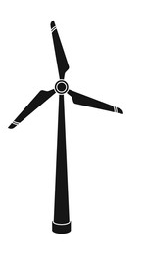


IEEE 2800/ NOGR-245
Requirement Interpolation – PoI vs WTG
The following criteria are not defined at this stage by ERCOT / IEEE:
Evaluation Criteria
Operational Points
Loading Factor
Project specific control tuning
Project Specific Conditions that will affect the compliance outcome:
Grid Stiffness
Single Line Diagram/Reactive Compensation devices
PPC Configuration (Control strategy)
Nearby IBR plants
Others
Isn't straightforward to translate requirements from PoI to WTG_
NOGRR-245 / IEEE 2800
OEM - RFI
PoI
Project Specific Power Plant
Turbines
Grid

Slide 6
Vestas Presence in ERCOT
Turbine Variants Installed
Type I - Direct-Connected Induction (Asynchronous) Generator: These are fixed-speed turbines with stall-regulated blades. They're directly connected to the grid and often include capacitors for reactive power compensation. They're robust but less efficient in energy capture.
Type II - Wound-Rotor Induction Generator with External Resistance Control: These turbines have a variable slip enabled by external resistors and pitch-regulated blades, allowing for a wider speed range.
Type III - Doubly-Fed Asynchronous Generator (DFAG): Also known as DFIG, these have a wound rotor induction generator with a power converter for vector control of the rotor circuit current, enhancing operational speed range and efficiency.
Type IV - Variable Speed Turbine with Full-Rated Power Converter: These employ a full-rated power converter for decoupling generator dynamics from the grid, enabling independent real and reactive power control, with either synchronous or induction generators.

Slide 7
Vestas assessment of Installed fleet in ERCOT
 | Type 3 | Type 4 | Discontinued Type 3 & 4 | Type 1 and 2
2.6.2.1 (1) Frequency Ride Through curve
2.6.2.1(3) Protection System Coordination
2.6.2.1(3) Rate of Change of Frequency (RoCoF)
2.6.2.1 (4) Current injection settings
2.6.2.1 (5) Controls system coordination
2.6.2 (3) Filtered quantities/ time delay use
2.9.1.2 (1) Table A VRT Curves
2.9.1.2 (3) Protection System Coordination
2.9.1.2 (4) Current injection settings
2.9.1.2 (5) Controls system coordination
2.9.1.2 (6) Filtered quantities/ time delay use
2.9.1.2 (7) Multiple excursion FRT
2.9.1.2 (8) Phase Angle Jump
2.9.1.1 (1) Table A and C VRT Curves*
NOGRR-245
Vestas's evaluation of the requirements at turbine terminals indicates that the capabilities of most of our current installed fleet meets the specified requirements, as detailed in the accompanying table with no hardware changes required.
Pass
Not Assessed
Fail

Slide 8
NOGRR-245 – Voltage Requirement
Global Comparison

Slide 9
NOGRR-245 – Frequency Requirement
Global Comparison

Slide 10
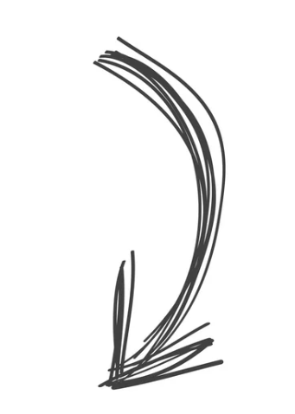
Plant Lifecycle
Active and Reactive Current Profile
LVRT Recovery timings
Control Bandwidths
PLL PI Control Constants
Reactive Controller Constants
Negative Sequence Support
Grid Harmonic Damping
Post Fault Support
Features
Plant Lifecycle
Bug Fixes
Plant is recurrently reconfigured to mitigate potential grid connection issues
Models are updated based on bug fixes or new features for real product
Constant monitoring of performance and usability for Grid Code Compliance
Commissioning
Updated Models
Compliant?
Updated Models
New Project
Operational Project
Beginning of model cycle release for a new potential sales project
Due
Diligence
Ending of lifecycle when project is energized and delivering full power to grid
Bug Fixes
Compliant?
GI Studies
Plant Connection
PreliminaryModels
Mature Models
GI Studies

Slide 11
Multiple FRT
Power Recovery for Weak Grid Conditions
Multiple Fault Ride-Through (FRT) is essential for maintaining grid stability. However, requirements should consider exemptions for energy dissipation, depending on the specific configuration of the project.
Weak Grid with 2pu/s recovery of Active Power
Multiple FRT Requirement
Voltage Stability
50% More Energy Dissipated in the Chopper for same fault
Strong Grid with 10pu/s recovery of Active Power

Slide 12
Phase Jump
PLL Tuning for Weak Grid Conditions
Phase Jump Ride Through is beneficial for maintaining grid stability. However, requirements should consider exemptions for site specific PLL tuning to maintain control stability under very weak grid conditions.
Control Stability
Phase Jump Requirement

Slide 13
NOGRR-245 – Full Picture
Known
LVRT Requirements
OVRT Requirements
Multiple FRT
Phase Jump
ROCOF Requirements
Unknown
Compliance Evaluation and Evidence
Modeling vs HiL vs Field Test vs Plant Commissioning
Operational Scenarios
Tolerances
Type Tests
Exemption Process
NOGRR-245
13

Slide 14
Suggestions and Reflections
Wrap up
Will each Independent System Operator (ISO) interpret the IEEE-2800 standard on an individual basis, potentially resulting in multiple variants of 'IEEE-2800' within the United States?
Do ISOs have a definitive understanding of the evidence required by Generation Owners (GO) and Original Equipment Manufacturers (OEM) to demonstrate compliance with the IEEE-2800 requirements as of today?
Could site-specific parameters, which are designed to enhance the grid's stability, supersede NOGRR-245 or the IEEE-2800 standards?
…
Vestas requires clarification on the test conditions and deliverables for evaluating various requested features, such as attestations, simulation reports, and plant or turbine-level simulations.
While Vestas recognizes the importance of NOGRR-245 within the industry and its alignment with IEEE 2800 standards. However, its verification processes should also be in accordance with IEEE 2800.2.

Slide 15
Thank you

