Slide 1
October IBRWG Slido poll results
IBRWG
Stephen Solis – Principal, System Operations Improvement
November 10th, 2023

Slide 2
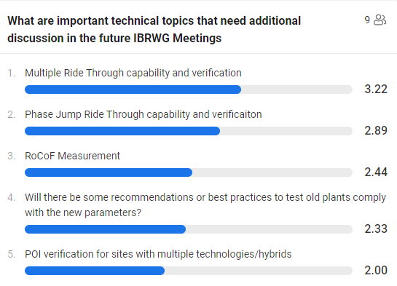
Slido Poll results
Observation: These topics seem to all be focused on testing and verification.

Slide 3
Questions?

