Slide 1
Samantha Findley
CRR Market Operations
CMWG
November 13, 2023

Slide 2
Agenda
KML file issue: feedback requested from users
Increases in auction transactions and risk of transaction adjustment period

Slide 3
Recap: KML file issue
Issue: The tool that generates the KML files has not been updated to include new substations containing new RNs since Sept 2017.
273 RNs have been added to the model since Sept 2017.
107 of those are located within substations that existed prior to Sept 2017, so they are included in KML files.
166 RNs are located at new substations, and those substations are not captured by the KML generating tool.

Slide 4
Recap: KML file issue
Options:
Discontinue the KML files (ERCOT’s preference)
If discontinued, a market notice will go out to notify market participants.
Continue publishing outdated KML files until the KML generating tool can be updated (eta pending cost/prioritization)
Risk that outdated KMLs may be relied upon for market participant analysis
ERCOT is requesting feedback from KML file users specifically about how the KML files are used, as well as any concerns about discontinuing the KML files.

Slide 5
Increases in registered CRRAHs, CPs, Settlement Points and auction transactions
*Date column corresponds to the month that the Seq1 bid window closed and the month of the monthly auction.
The 2020.1st6.AnnualAuction.Seq1 was the first auction that exceeded 300K transactions and triggered a transaction adjustment period. The transaction adjustment period had 98,880 transactions submitted by 130 CRRAHs.
After the transaction adjustment period auction, NPRR 972 Enhancing Existing CRR Transaction Limit Process allowed ERCOT discretion to not hold a transaction adjustment period auction if the number of transactions does not exceed what the system can process.

Slide 6
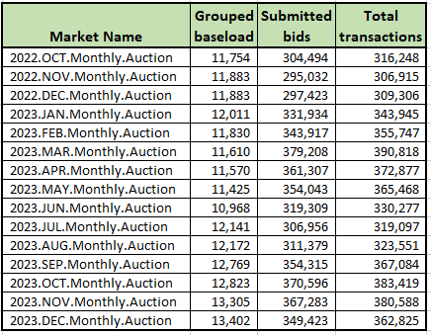
Risk of upcoming transaction adjustment period
Every monthly auction since 2022.OCT has exceeded 300K transactions
Any auction that exceeds 500K total transactions will trigger a transaction adjustment period.
If a transaction adjustment period is triggered, the CRR market operator will notify CRRAHs with a message to the MUI within an hour of the auction close and a market notice will be sent.

Slide 7
Transaction clearing ratios in auctions since Jan 2022 (awarded transactions/total submitted transactions)
Monthly auctions since 2022.JAN:
Avg: 16.73%, Range: 15.11 – 18.71%
LTAS auctions since Jan 2022:
Overall avg: 16.41%, Range: 11.24 – 21.33%
Seq1 avg: 20.75%, Range: 20.13 - 21.33%
Seq2 avg: 19.7%, Range: 18.54 - 21.14%
Seq3 avg: 16.72%, Range: 14.6 – 18.27%
Seq4 avg: 15.08%, Range: 12.86 – 16.68%
Seq5 avg: 14.31%, Range: 12.37 – 16.0%
Seq6 avg: 12.8%, Range: 11.24 – 13.86%
*These values do include offer transactions.

Slide 8
Possible options for avoiding a Transaction Adjustment Period (TAP) and alternative TAP process
Bid fee on uncleared bids (NPRR and system change)
Bid fee on only uncleared OPT bids (NPRR and system change)
Add a new Protocol definition for Participating CRRAH for TAPs to include only CRRAHs who submitted bids in initial bid window. Participating CRRAH currently defined as either owning baseload or whose CP submitted credit for the auction. (NPRR and system change)
Enable TAPs as follows:
CRRAHs who did not submit bids in the initial bid window are not Participating CRRAH for TAPs and would have portfolios retracted at close of any TAP.
First TAP allows 2500 bids per Participating CRRAH for TAPs
If first TAP exceeds the number of transactions that can be processed by the CRR system, second TAP with (available transactions / # Participating CRRAHs for TAPs)
(NPRR and system change)

