Slide 1
Monthly Review of Reliability Unit Commitment Market Impacts – October 2023
Wholesale Market Working Group
ERCOT Staff

Slide 2
RUC Resource-Hours
October 2023 | Total | Opt-Out | Non-Opt-Out
Instructed Resource-Hours
Total Count | 56 | 12 | 44
Effective Resource-Hours*
Total Count | 44.9 | 12 | 32.9
Average LSL | 99.6 | 60 | 114.1
Average LDL | 100.5 | 62.3 | 114.6
Average BP | 101.5 | 64.1 | 115.3
Average HSL | 326.8 | 223.4 | 364.8
* The difference between “Instructed” and “Effective” values is a result of Resources starting up, shutting down, receiving partial hour instructions, or otherwise not being dispatchable by SCED.

Slide 3
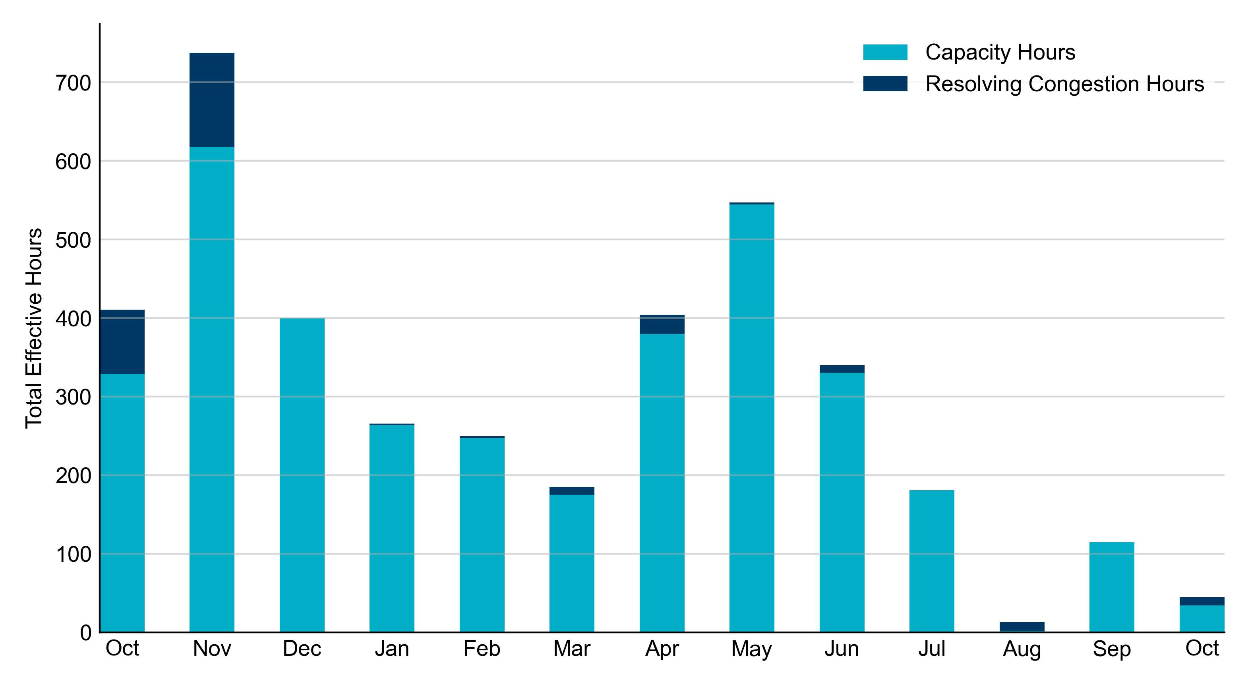
RUC Instruction Reasons: Last 13 Months RUCs in October 2023 were primarily driven by system-wide capacity and congestion concerns.

Slide 4
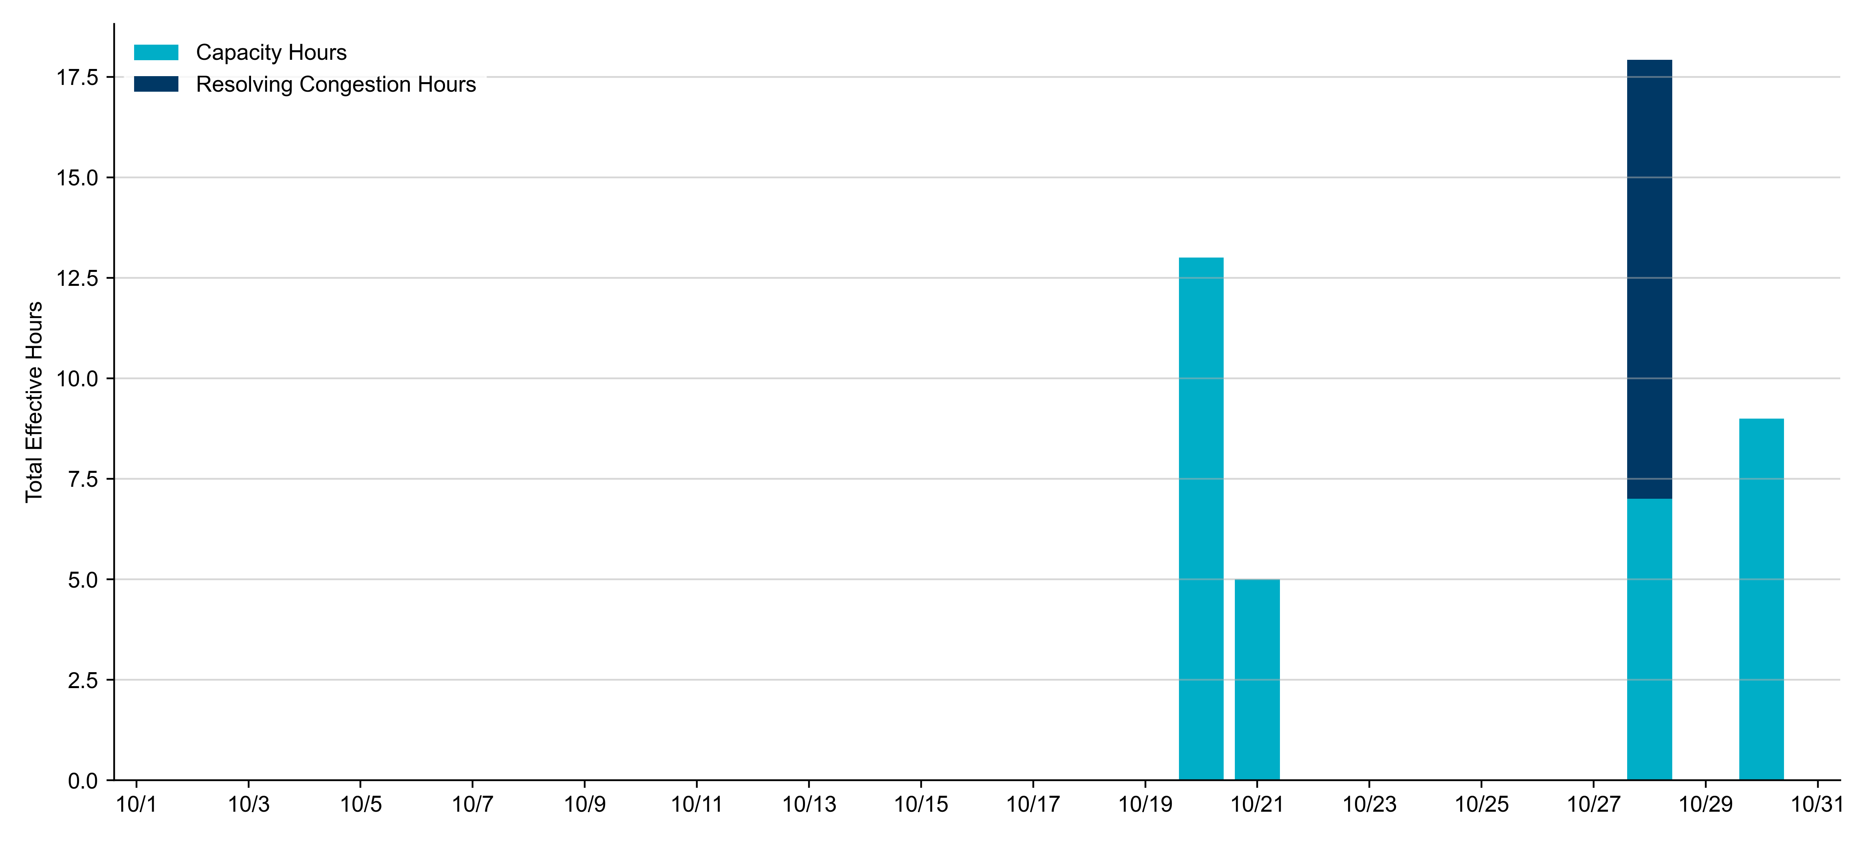
RUC Instruction Reasons in October 2023
44.9 effective RUC Resource-hours.
34.0 hours (75.69%) for capacity concerns.
10.9 hours (24.31%) for congestion concerns.

Slide 5
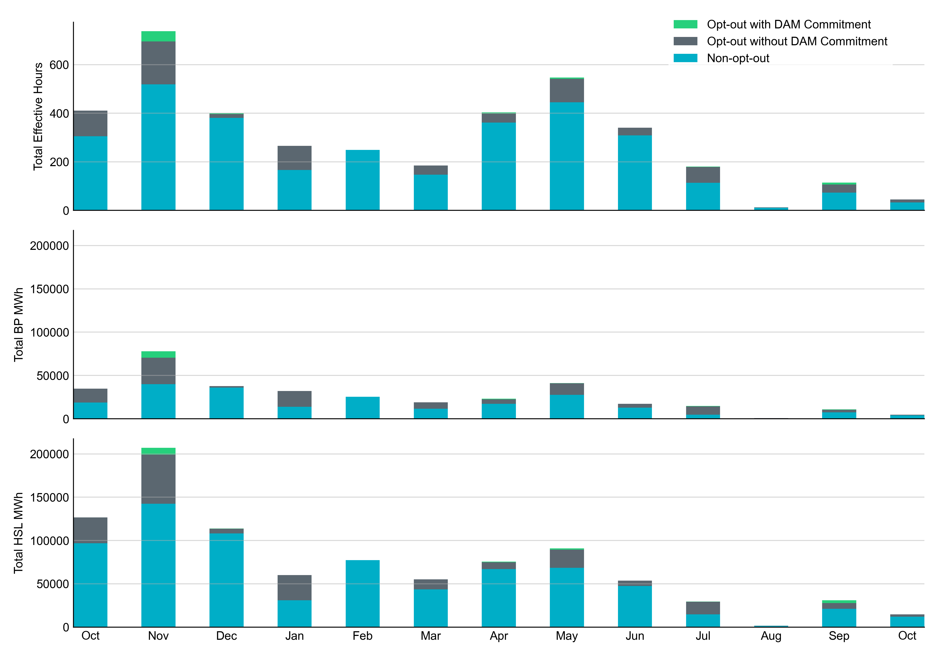
Non-opt-out and Opt-out Totals: Last 13 Months October 2023 had a total of 32.9 non-opt-out effective Resource-hours (73.28%) and 12.0 opt-out effective Resource-hours (26.72%).

Slide 6
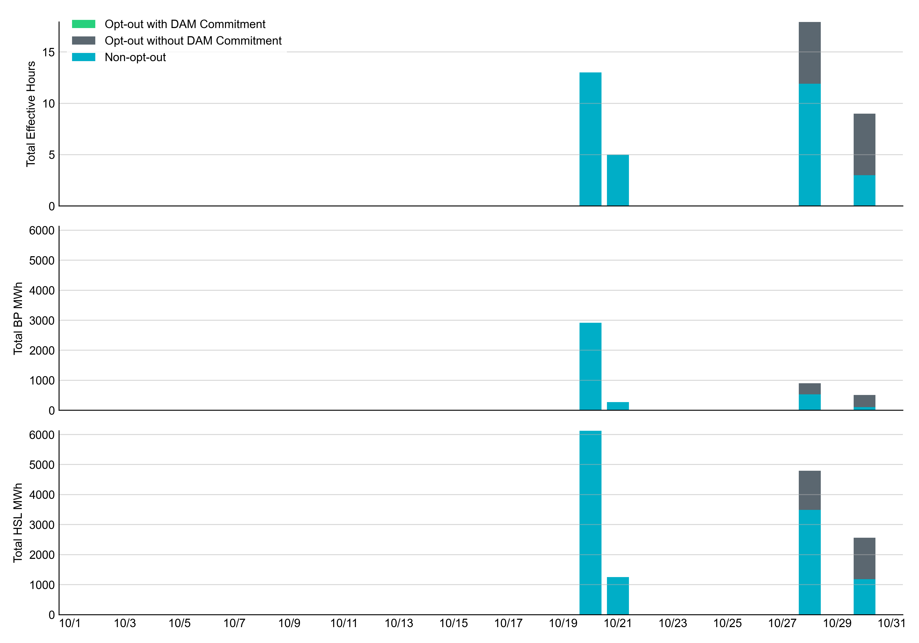
Non-opt-out and Opt-out Totals: October 2023

Slide 7
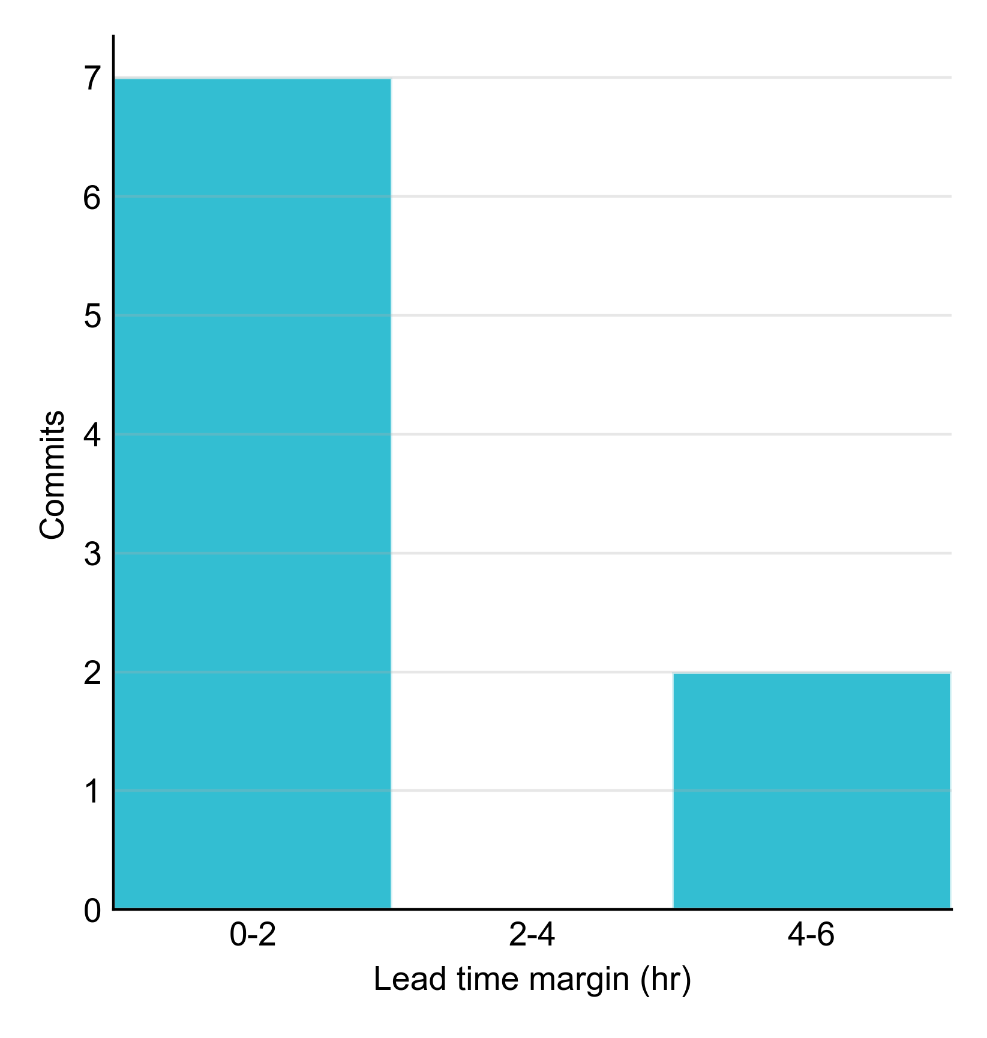
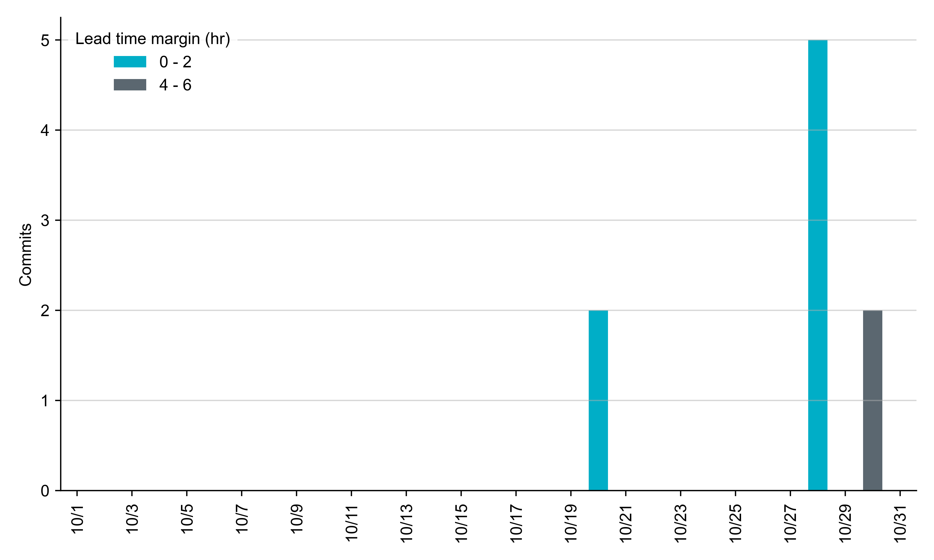
RUC Lead Time Margin: October 2023
Most RUC commit windows had lead time margin at or below 2 hours.
Lead time refers to the length of time between a RUC instruction and the start of the commitment window.
Lead time margin is the difference between lead time and the Resource’s startup time.
In cases where a Resource is committed for multiple back-to-back time blocks, lead time margin is calculated from the first instruction.
Notes:
The first bin is both-inclusive (i.e. [0, 2] ), while subsequent bins are left-inclusive (i.e. [2, 3), [3, 4), etc.).

Slide 8
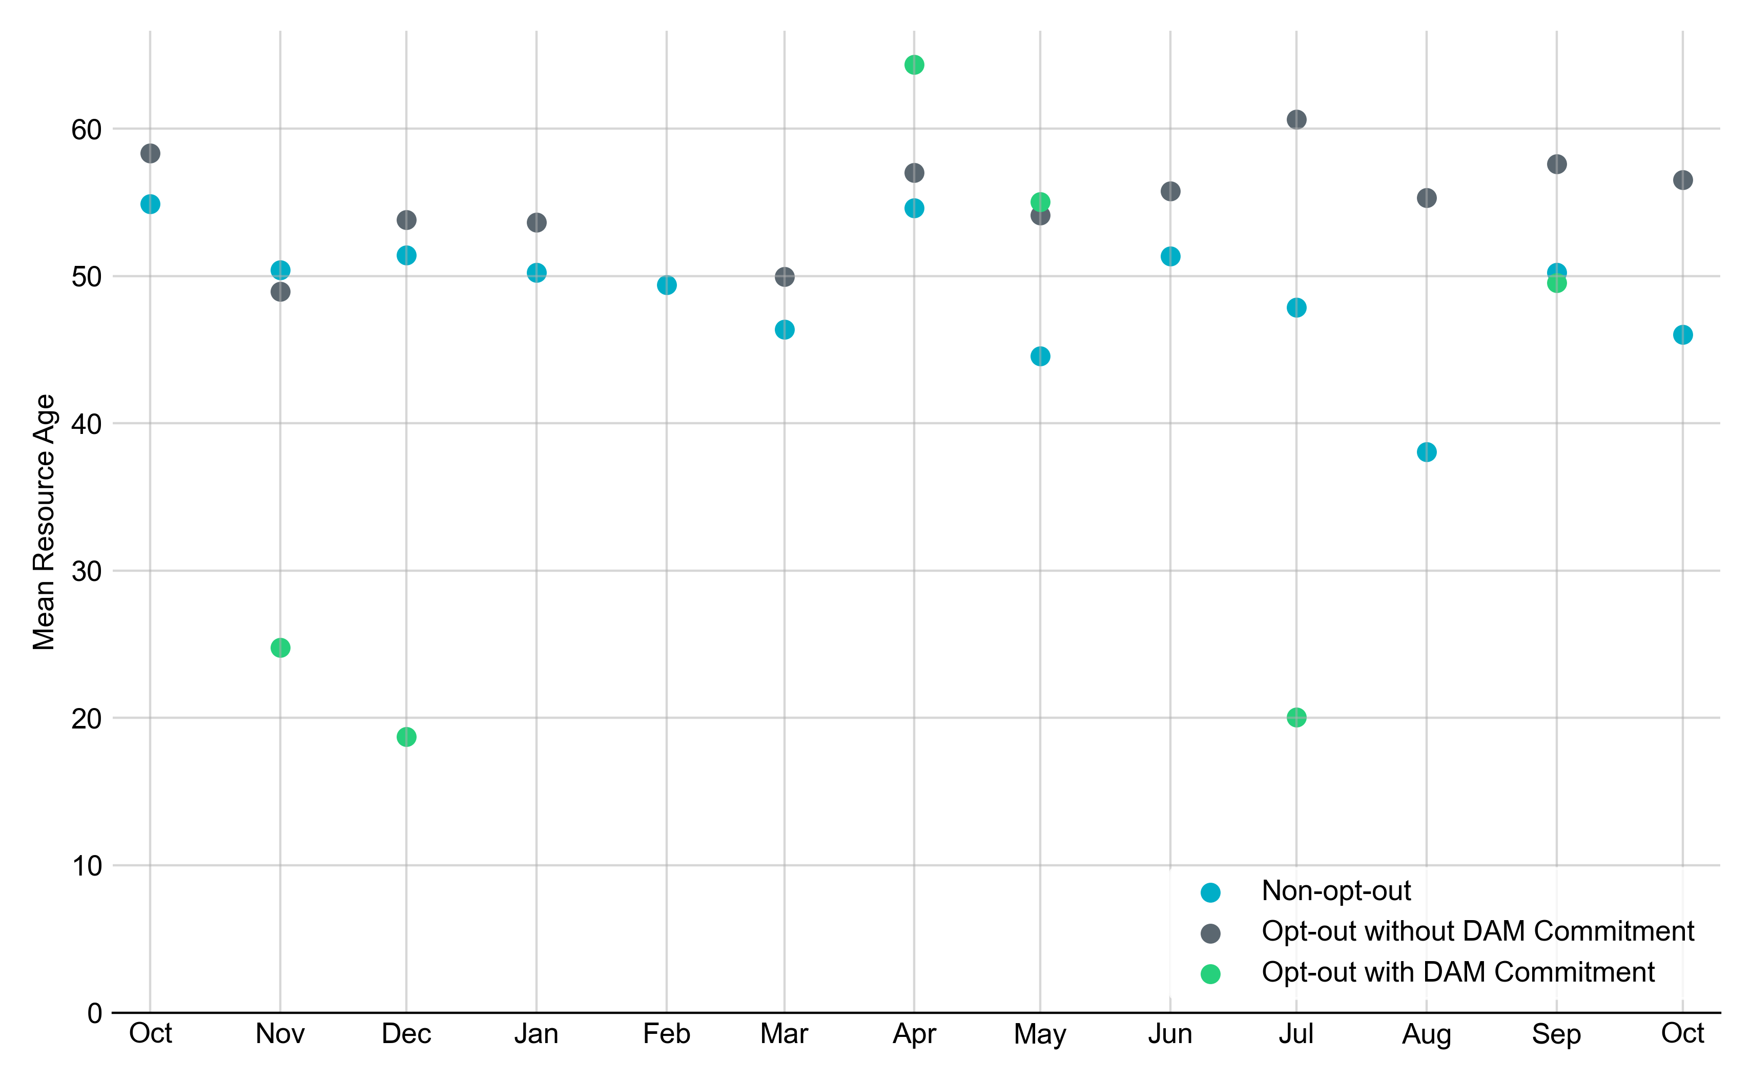
Average Resource Age: Last 13 Months In October 2023, the mean age of RUC-committed Resources was 46.0 years for Non-Opt-Out Resource-hours and 56.5 years for Opt-Out Resource-hours without DAM Commitments.
Note: For Resource configurations with multiple physical generators, the age of the oldest generator is used.

Slide 9
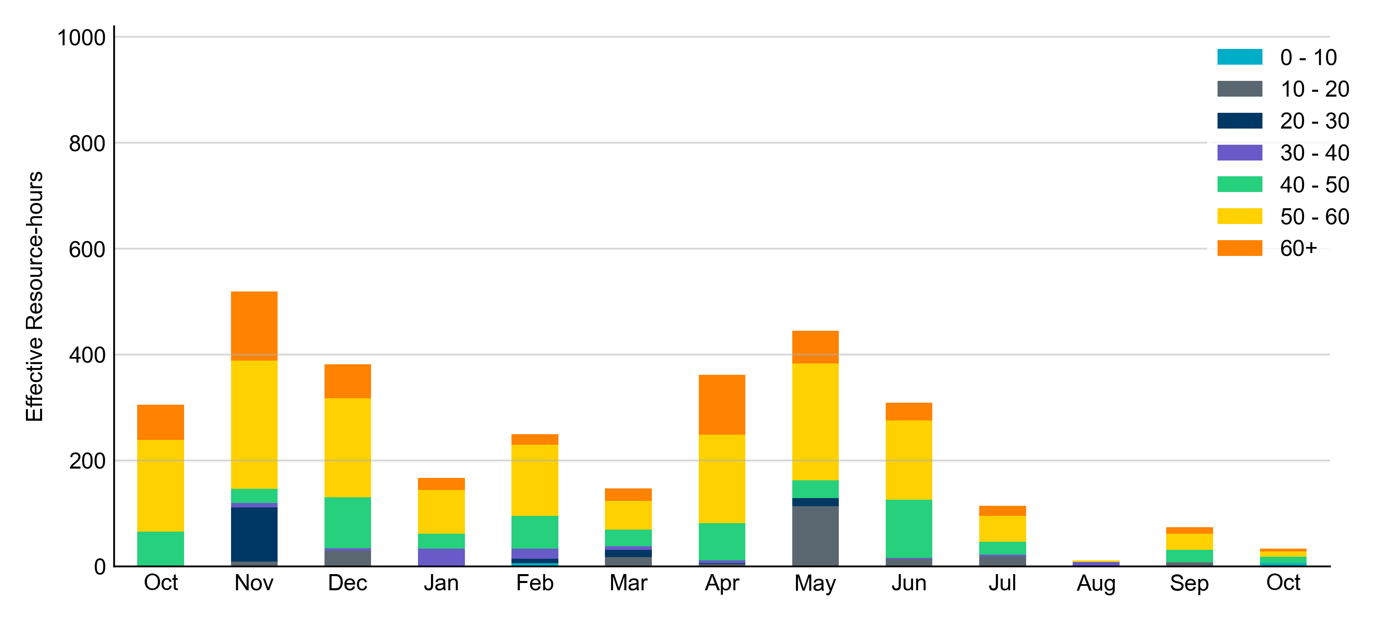
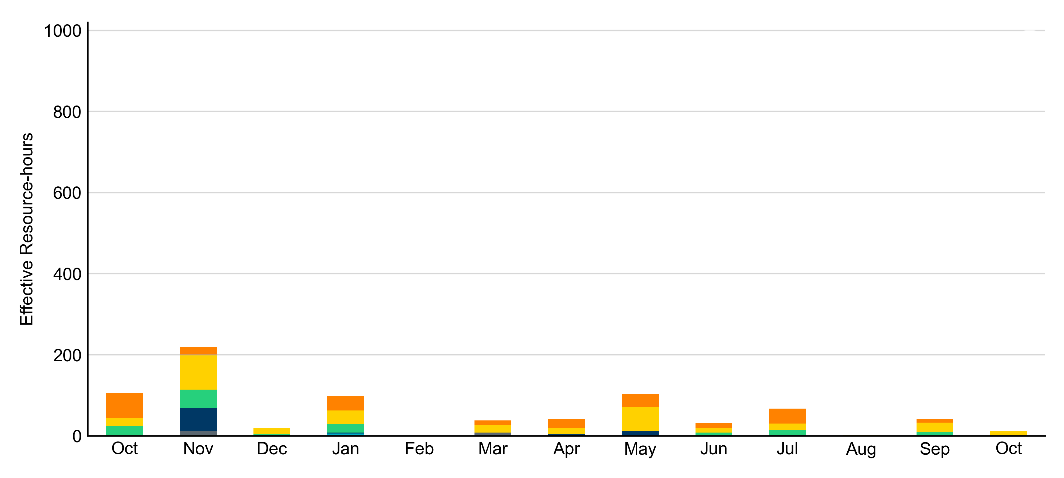
Age Category: Last 13 Months Most RUC-Committed Resources in October 2023 were older than 40 years.
Non-opt-out
Opt-out

Slide 10
RUC-Instructed Resource Dispatch above LDL
October 2023
When Resources did not successfully opt out, there were 0.7 effective Resource-hours for which the Resource was dispatched above its LDL.
For 0.2 of these Resource-hours, the LMP for the RUC-instructed Resource was above the RUC offer floor.
For 0.5 of these Resource-hours, the LMP for the RUC-instructed Resource was below the RUC offer floor.
For all these Resource-hours, the RUC-instructed Resource was mitigated.
There were no Exceptional Fuel Cost submissions for any RUC-Committed Resources in October 2023.

Slide 11
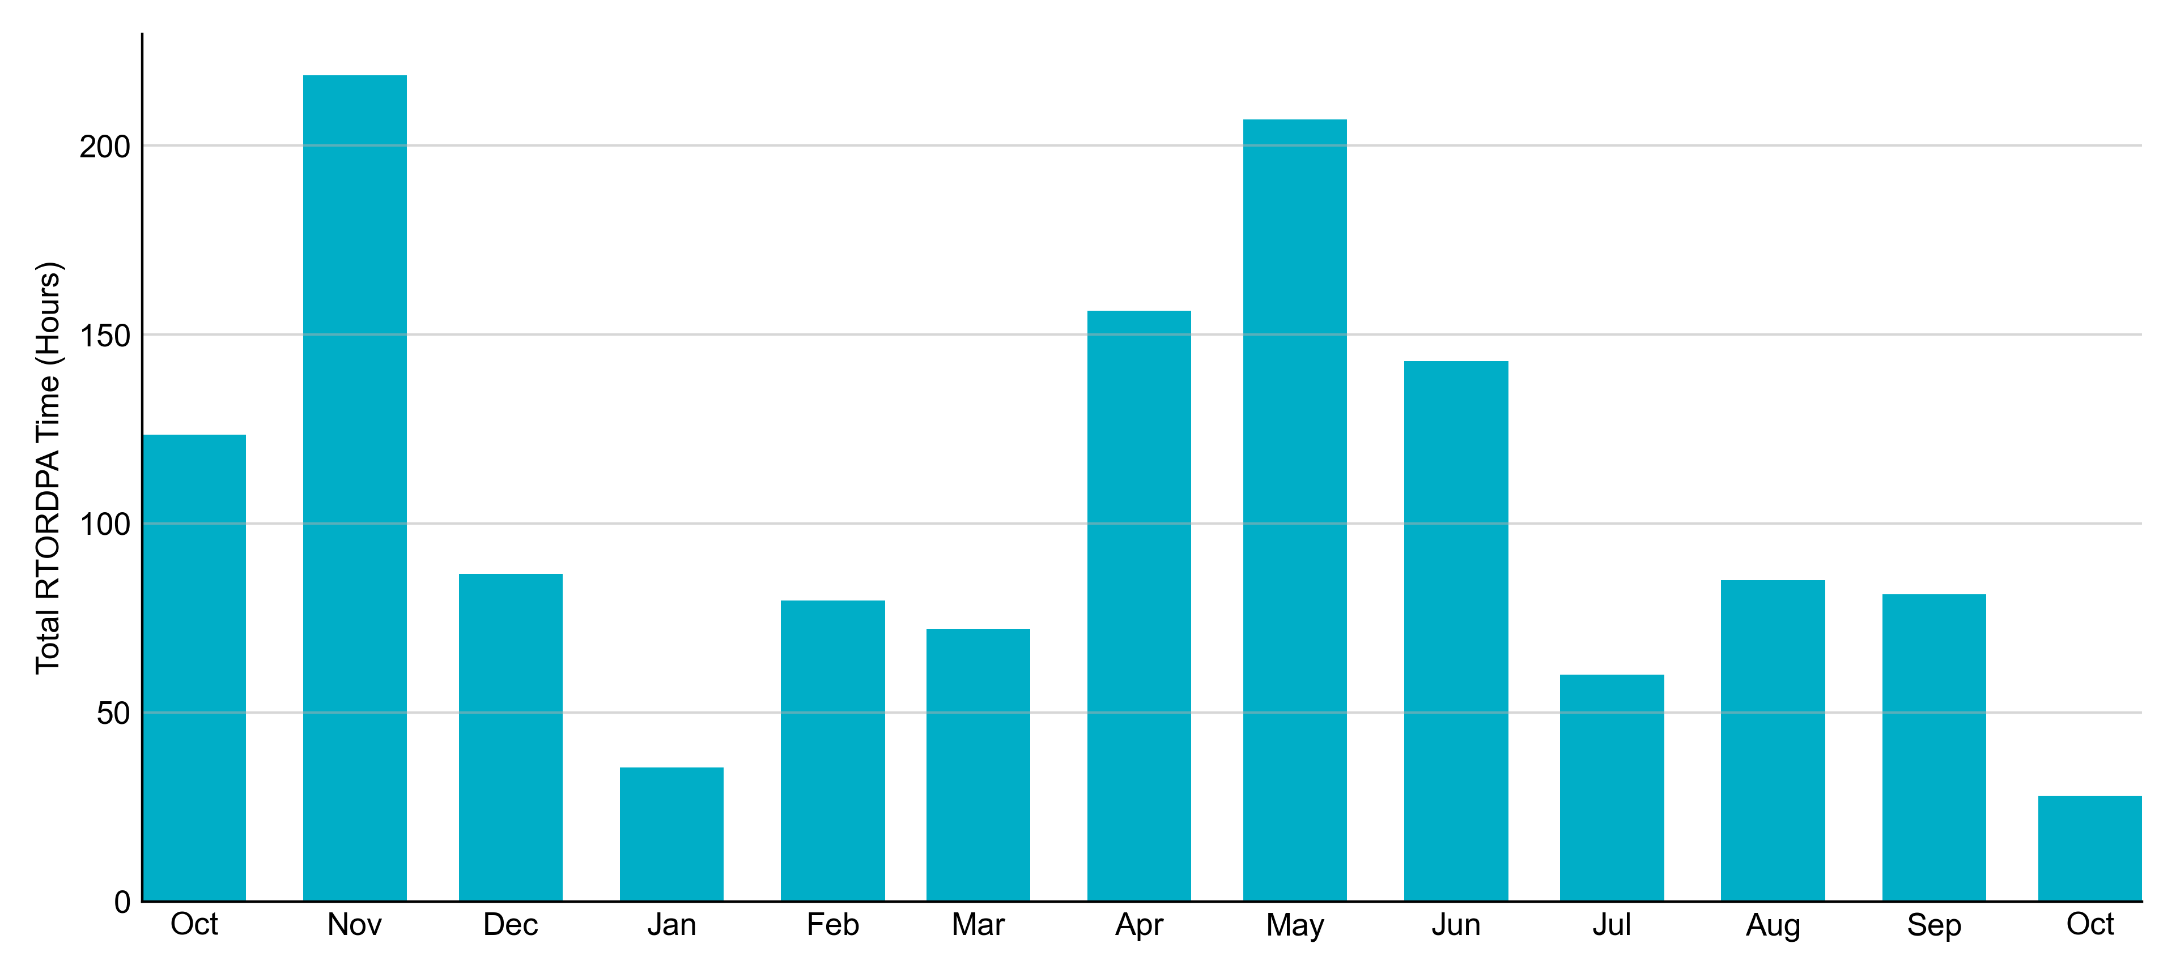
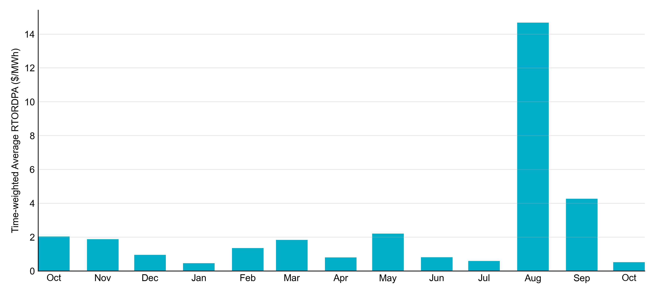
Reliability Deployment Price Adder: Last 13 Months October 2023 had a total of 27.92 RTORDPA hours with an average value of $0.52/MWh.
These graphs include all non-zero RTORDPA triggered by reliability action taken by ERCOT including RUC, Deployed Non-Controllable Load Resources, Deployed ERS, etc. The full list and detailed methodology can be found in protocol section 6.5.7.3.1, Determination of Real-Time Reliability Deployment Price Adders.

Slide 12
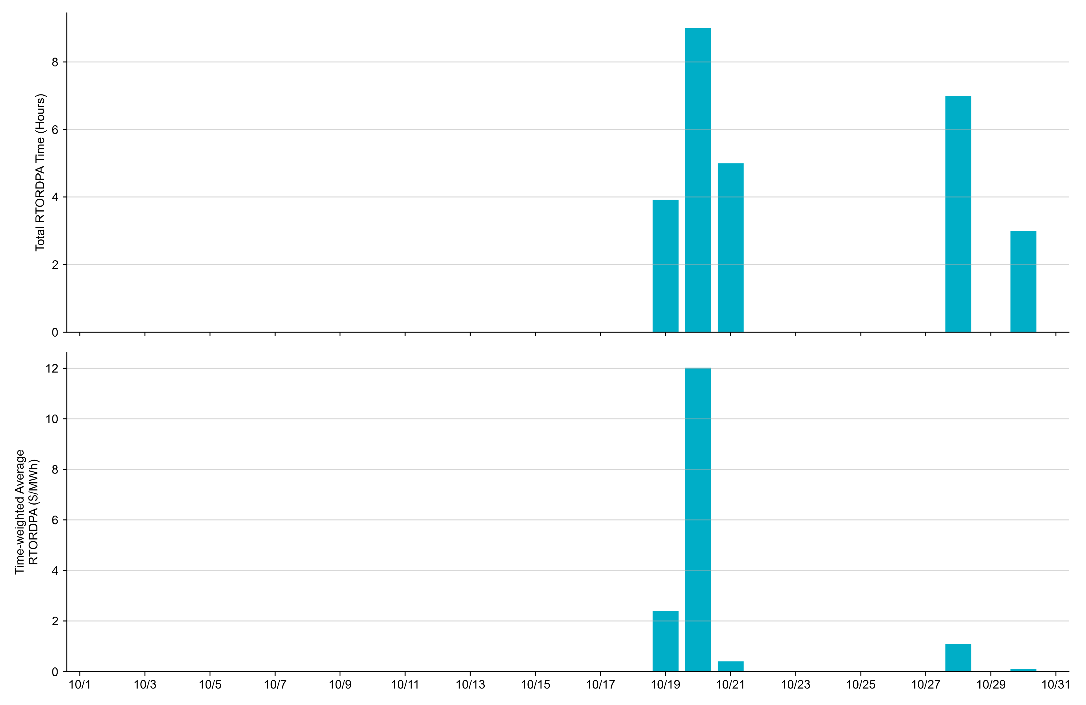
Reliability Deployment Price Adder: October 2023 OD 10/20 had the highest daily time-weighted average RTORDPA: $12.02/MWh.
These graphs include all non-zero RTORDPA triggered by reliability action taken by ERCOT including RUC, Deployed Non-Controllable Load Resources, Deployed ERS, etc. The full list and detailed methodology can be found in protocol section 6.5.7.3.1, Determination of Real-Time Reliability Deployment Price Adders.

Slide 13
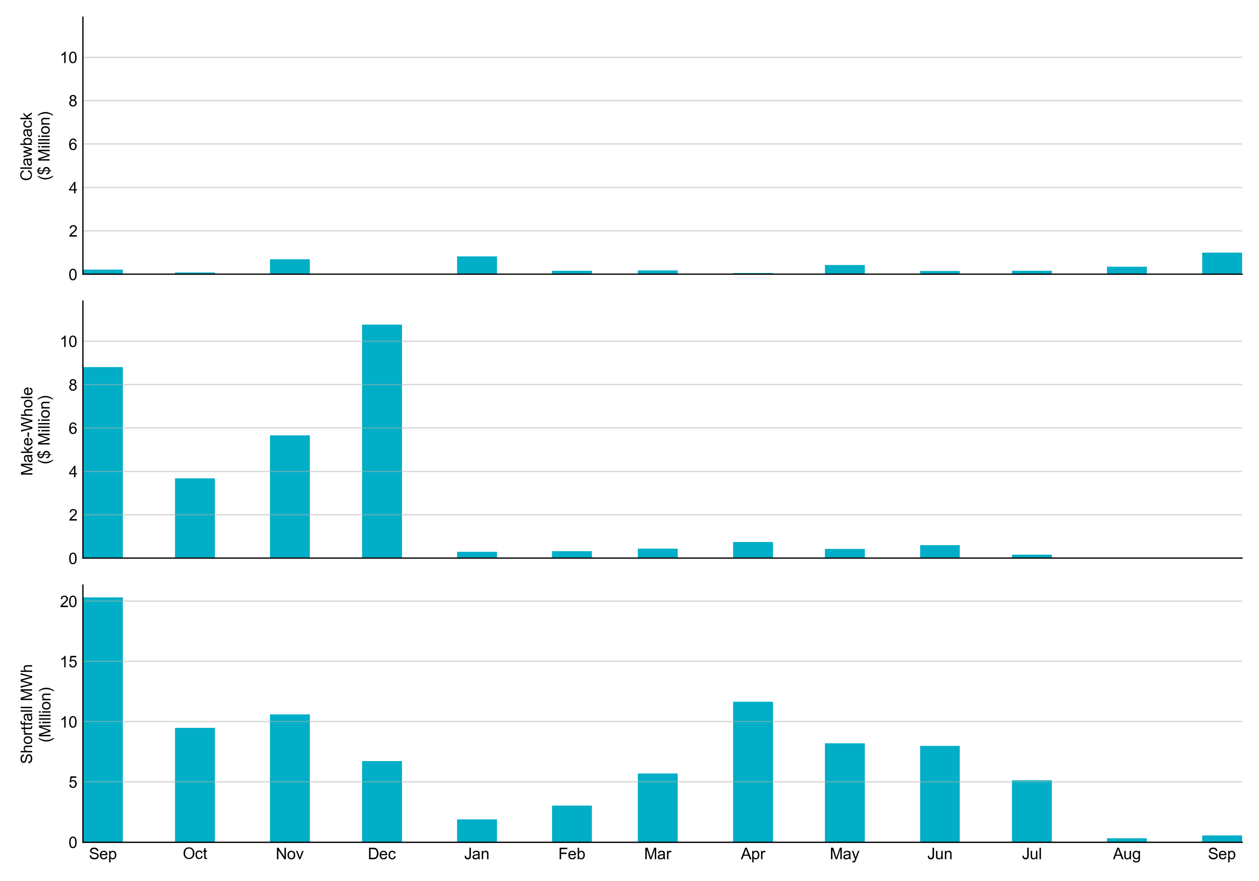
RUC Clawback, Make-Whole, and Shortfall For October 2023, the total Clawback charge was $0.191M. The total Make-Whole payment was $0.072M, which was almost entirely covered through capacity-short charges.
Of the $0.072M in Make-Whole paid out in October 2023, -$0.07 was uplifted to load due to rounding.
The remaining amount was collected through Capacity Short Charges.
Data as of November 7^{h}, 2023

Slide 14
RUC Make-Whole by Settlement Type
Month | Initial Settlement ($) | Final Settlement Change ($) | True-up Settlement Change ($) | Net as of November 7, 2023 ($)
Oct '22 | -851,291 | -37,747 | -2,785,833 | -3,674,871
Nov '22 | -809,352 | 0 | -4,855,881 | -5,665,233
Dec '22 | -1,479,207 | 0 | -9,288,953 | -10,768,159
Jan '23 | -141,639 | -59,381 | -100,426 | -301,446
Feb ‘23 | -295,131 | 0 | -31,972 | -327,103
Mar ‘23 | -343,491 | 0 | -97,889 | -441,379
Apr ‘23 | -687,506 | 0 | -226,976 | -914,482
May ‘23 | -426,974 | 0 | - | -426,974
Jun ‘23 | -600,652 | 0 | - | -600,652
Jul ‘23 | -161,994 | -4,996 | - | -156,998
Aug ‘23 | -12,090 | 0 | - | -12,090
Sep ‘23 | -35,168 | - | - | -35,168
Oct ‘23 | -72,477 | - | - | -72,477
Negative dollars represent a payment from ERCOT to a market participant
“-” indicates settlement has yet to be completed.

Slide 15
RUC Clawback by Settlement Type
Month | Initial Settlement ($) | Final Settlement Change ($) | True-up Settlement Change ($) | Net as of November 7, 2023 ($)
Oct '22 | 544,601 | -16,449 | -448,264 | 79,887
Nov '22 | 951,568 | 0 | -262,845 | 688,723
Dec '22 | 148,277 | 0 | -148,277 | 0
Jan '23 | 835,738 | -6,526 | -6,864 | 822,349
Feb ‘23 | 158,319 | 0 | -1,348 | 156,971
Mar ‘23 | 179,783 | 0 | 0 | 179,783
Apr ‘23 | 53,643 | 0 | -3,557 | 50,087
May ‘23 | 426,519 | 0 | - | 426,519
Jun ’23 | 149,347 | 0 | - | 149,347
Jul ‘23 | 218,907 | -60,841 | - | 158,066
Aug ‘23 | 352,002 | 0 | - | 352,002
Sep ‘23 | 997,843 | - | - | 997,843
Oct ‘23 | 190,721 | - | - | 190,721
Negative dollars represent a payment from ERCOT to a market participant
“-” indicates settlement has yet to be completed.

